Slide 1
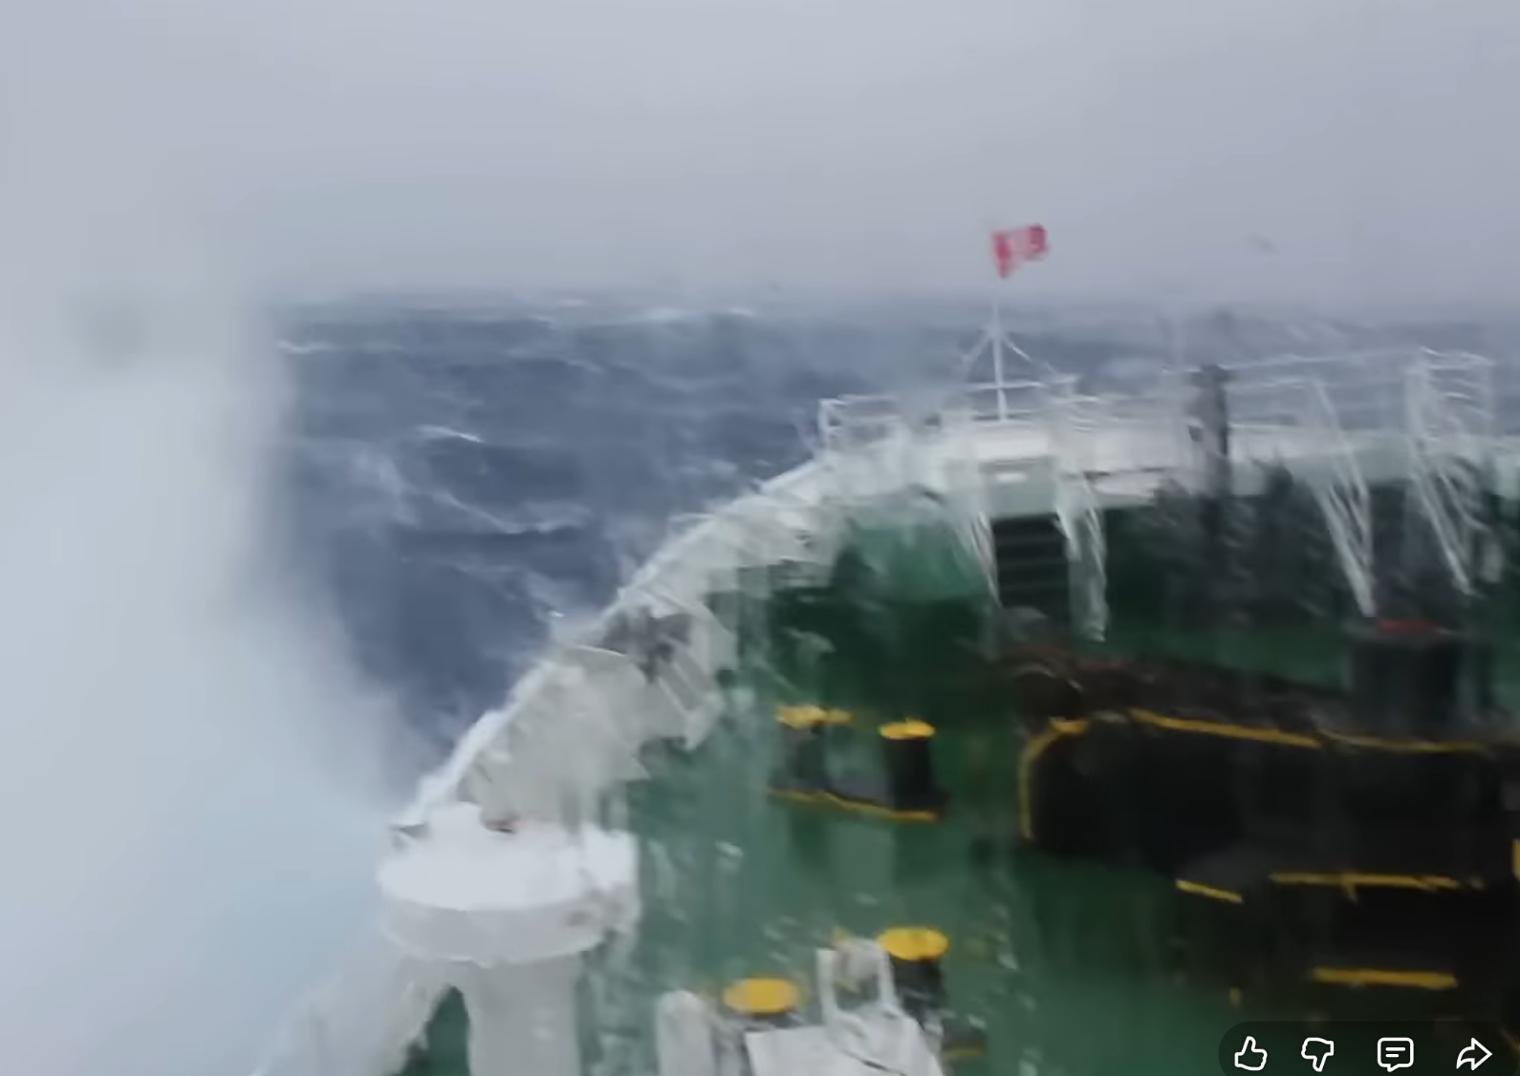
Drake’s Passage

Slide 2
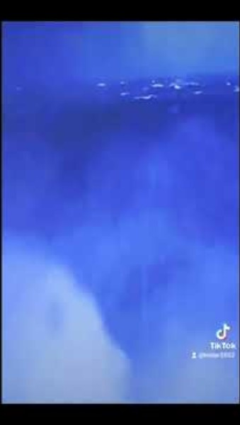

Slide 3
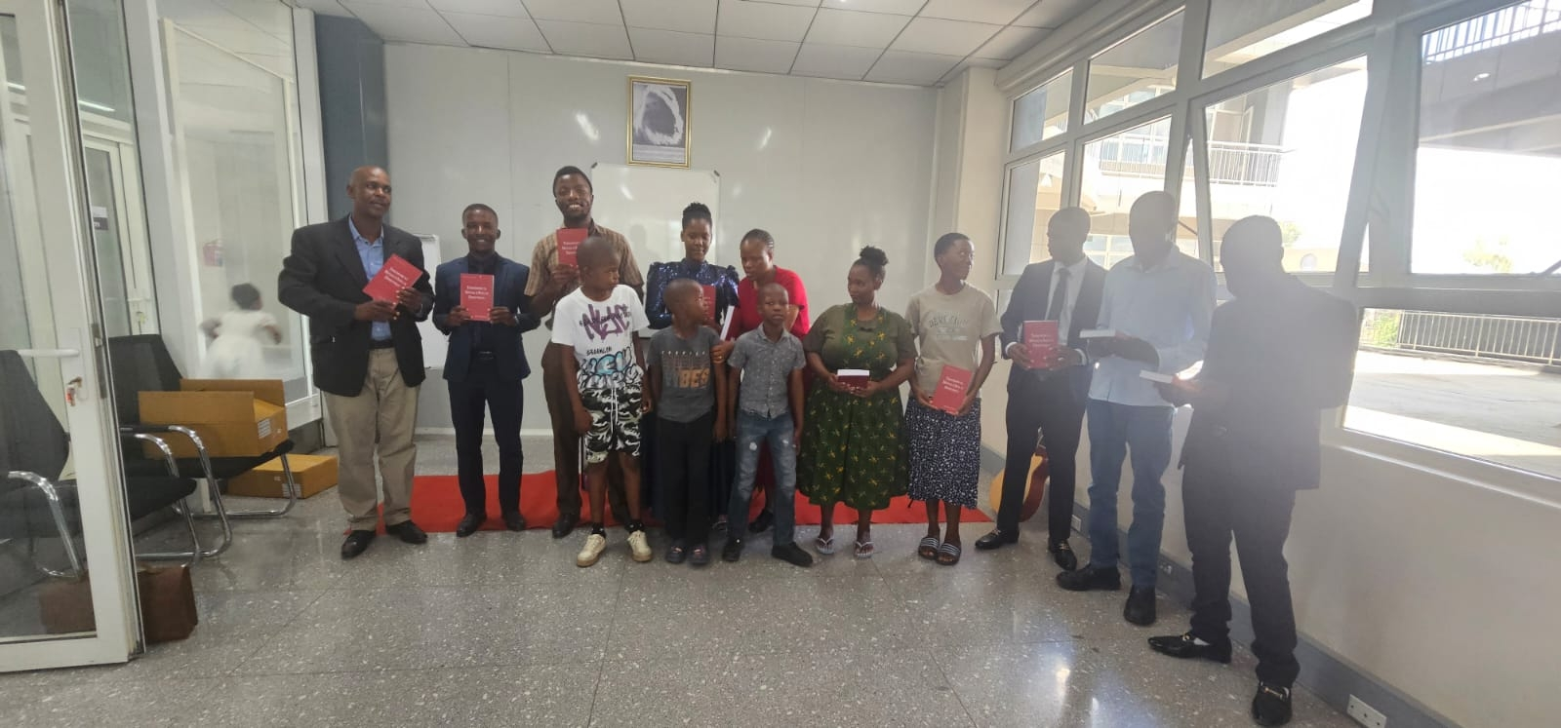
Botswana: First Church Age Books have arrived.

Slide 4
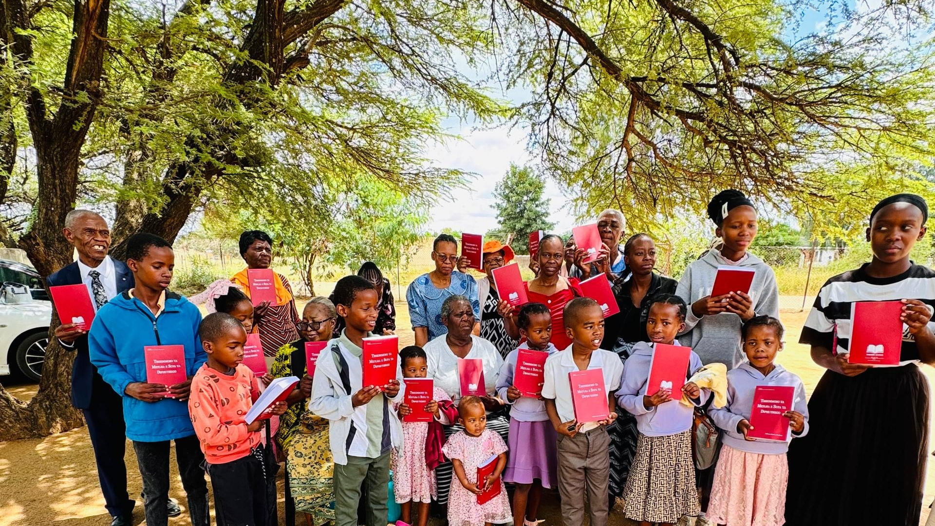

Slide 5
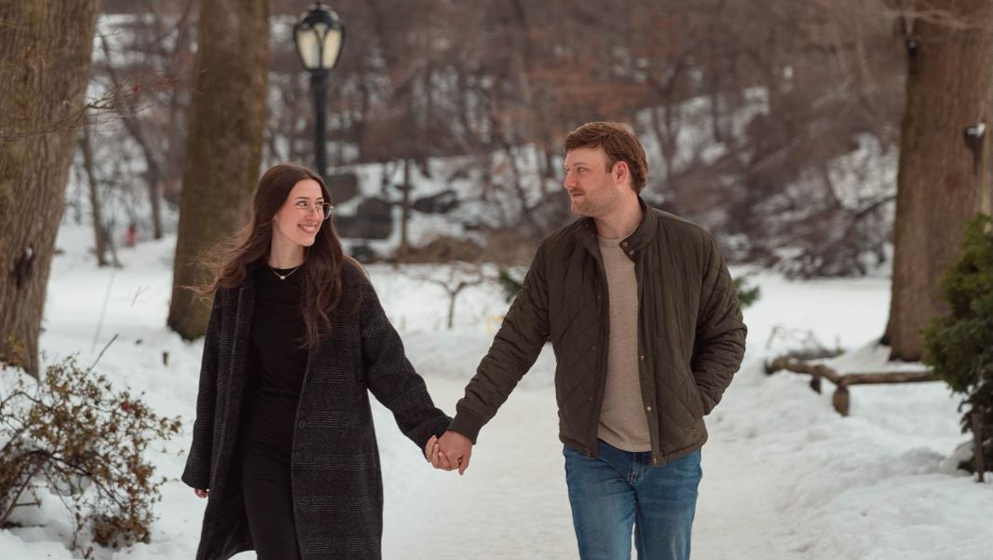
Emma & Harrison

Slide 6
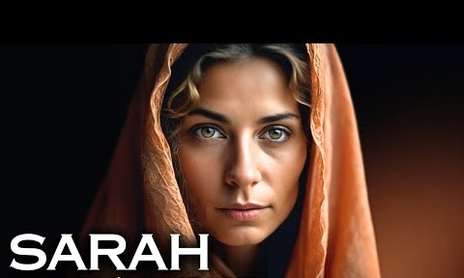
Sarah Also Received Strength
Hebrews 11:8-11

Slide 7
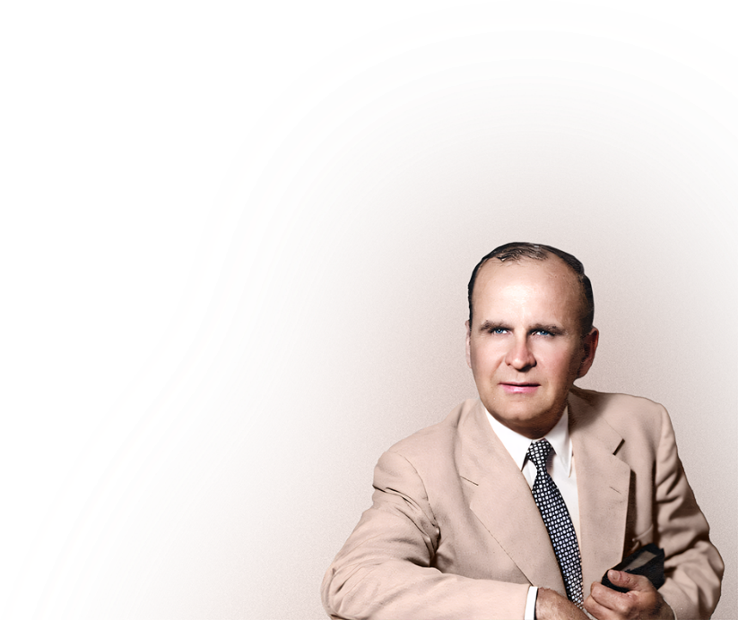
61-0318 - Abraham's Covenant Confirmed
Now listen, church, I want to drop this in here, ’cause I believe the Holy Spirit told me to do it, you may be setting there, which some of you are, I know you are, disagreeing with me, right now, now I can call your name if you want me to, so, I know that, but I also can see
farther than that, that you’re going to
believe it one of these days.

Slide 8
Abraham's Covenant Confirmed
So I’m just going to put this in, so you’ll understand, so I can give you a little spot of grace here, when ain’t going to be too long, till you’re going to change your mind, some of you, some of you won’t. But remember, when Sarah first heard that Man, which she is a type
of the Church, when she heard that, see
that sign take place to Abraham, she
actually laughed about it in her heart,

Slide 9
Abraham's Covenant Confirmed
and she disbelieved and doubted it ever being so. Is that right? At that time, God would have rubbed her name off. That right? But He couldn’t, she’s part of Abraham, they are one. And if you’ve really not been excited, not worked up in emotion, not got some church creed, but really received the Holy Ghost,

Slide 10
Abraham's Covenant Confirmed
and you’re really part of Christ, and still a little skeptic in your mind, God will not shove you off from that, because He can’t, you’re a part of Christ, He’ll bring you to the truth.

Slide 11
A Testimony Upon The Sea
That’s the reason when Sarah laughed at the Angel, said she couldn’t be like that, God would have slew that woman right there, but He couldn’t hurt her, because she’s part of Abraham; He would hurt Abraham if He took Sarah. That’s the reason our sins today, we’d be every one condemned,

Slide 12
A Testimony Upon The Sea
but God can’t take us because, He does, He hurts Christ, we are part of Him, we are the Bride, don’t you see? So there it is. So, grace holds us in our mistakes until we can see better. So thankful for that.

Slide 13
62-0620 - Be Not Afraid
You know what? God would have took her life right then, that’s right, for disbelieving Him, but He couldn’t do it. Why? She was a part of Abraham, He would have to take Abraham with her. Oh, that’s where grace comes in, all our mistakes and our errors, God holds us
because we are part of Christ, the grace
of God holding us. “Oh, amazing grace!
How sweet the sound.”

Slide 14
Be Not Afraid
140 He could not take Sarah, because He did, He would have to strike Abraham with it. He cannot take the Church, in all of Its mistakes It is still His Church. Right. He can’t take It because He would take Christ, see, part of Christ, She becomes flesh of His flesh,
and bone ofHis bone.

Slide 15
Be Not Afraid
All of our ins and outs, and unbeliefs, and so forth, and scruples, as long as She is into that Body, and her ups and downs, the grace of God still holds Her.

