Slide 1

Safe & Secure 2
Deut. 6:6-9 And these words, which I command thee this day, shall be in thine heart: 7 And thou shalt teach them diligently unto thy children, and shalt talk of them when thou sittest in thine house, and when thou walkest by the way, and when thou liest down, and when thou risest up.

Slide 2
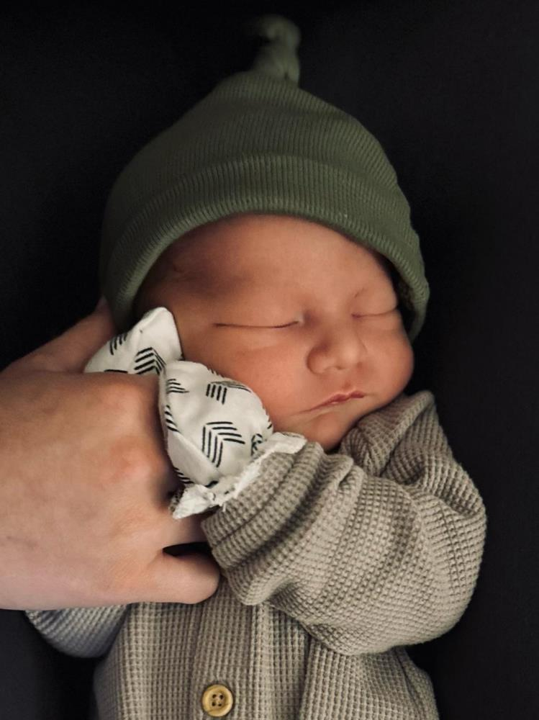
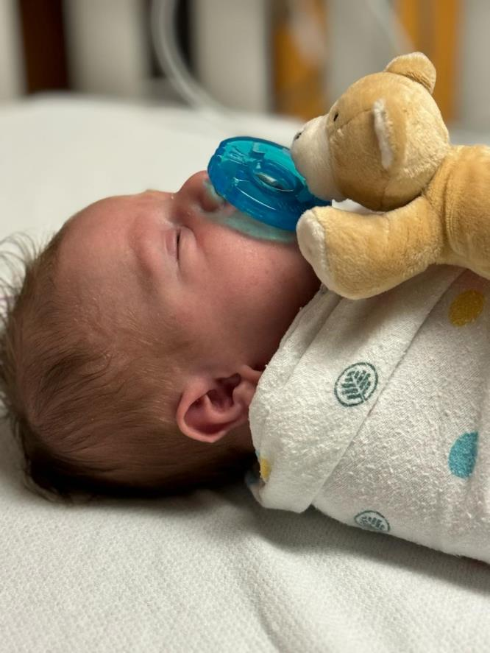
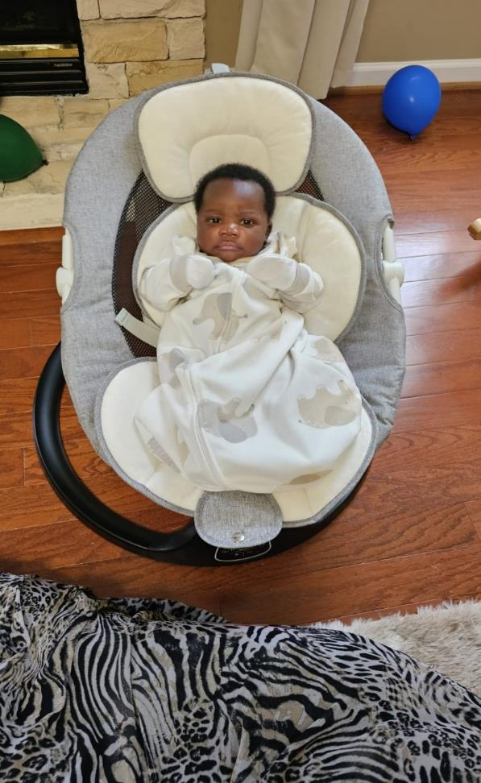
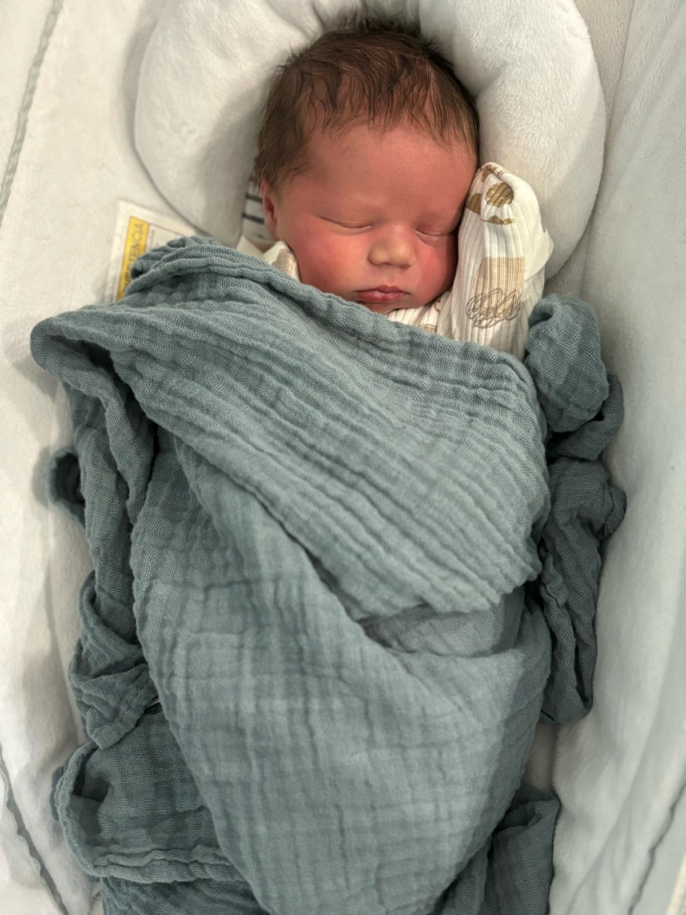
Babies R’ Us
Liam
Jedediah
Wells
Cody

Slide 3
CONTEND.FOR.THE.FAITH
16 I love you. And I'm here with all my heart to try to help you, try to help you to make your home a better place to live, to make the community you live in a horrible place to do evil and an easier place to do right. That's the idea. 55-0220

Slide 4
Agenda
  Growing towards Independence
  Letting Go
  What Happens Next?

Slide 5
CONFERENCES
20 That's what's the matter with the nations today. Each one's trying to get smarter than the other.
That's what's the matter with the people today. We're trying to outsmart something… But it'll never work. It never did work, and it never will work. God's way is always right. Got to be His way, is the only way. 60-0228

Slide 6
We Are Family
What the Research Shows
Gene Edward Veith · WORLD · May 20, 2000
Notes:
Theme statement from Gene Edward Veith, WORLD magazine, May 20, 2000. The following slides set verified research beside each part of his claim.

Slide 7
The Claim
“
The family is God’s invention. He protects it in the Ten Commandments. Although the family is the basis of culture, today parents often find themselves having to protect their children from their own culture.
Gene Edward Veith, “We Are Family,” WORLD, May 20, 2000
Notes:
Quoted as supplied. Verify wording against your printed copy of WORLD, May 20, 2000; the article was not found online.

Slide 8
The Claim (continued)
“
Instead of helping parents teach their children to control themselves, to act morally, and to mature into adults, our society — in its entertainment industry, its schools, and its government — often seems to undermine parents and to be at war against children.
Gene Edward Veith, “We Are Family,” WORLD, May 20, 2000
Notes:
Quoted as supplied. Verify wording against your printed copy of WORLD, May 20, 2000; the article was not found online.

Slide 9
PART 1 · THE EVIDENCE
What Our Children Face
“Lo, children are an heritage of the LORD: and the fruit of the womb is his reward.”
Psalm 127:3
Notes:
Section divider. Key verse Psalm 127:3 KJV.

Slide 10
Teens Online “Almost
Constantly”
46%
24%
2014–15
2024
Pew Research Center, Teens, Social Media and Technology 2024 (1,391 teens ages 13–17)
Notes:
Pew Research Center, Dec. 2024. 46% of teens say they are online almost constantly, up from 24% a decade earlier. 96% use the internet daily.

Slide 11
Hours a Day on Screens for Entertainment
Tweens (8–12)
Teens (13–18)
8:39
7:22
6:40
5:33
4:36
4:44
2015
2019
2021
Common Sense Census: Media Use by Tweens and Teens, 2021 · excludes school and homework
Notes:
Common Sense Media, 2021 Census. Teens: 6:40 (2015), 7:22 (2019), 8:39 (2021). Tweens: 4:36, 4:44, 5:33. Excludes screen time for school or homework. Pandemic years inflated the 2021 jump.

Slide 12
Teens and Online Pornography (2023)
73%
54%
15%
Have seen it
(13–17)
First saw
by 13
First saw it at 10 or younger
Common Sense Media, “Teens and Pornography,” January 2023 (1,358 teens ages 13–17)
Notes:
Common Sense Media, Jan. 2023. Average age of first exposure: 12. 52% of those who had seen it saw violent material. 30% were exposed during the school day.

Slide 13
What Parents of Teens Fear from Social Media
Wasting time on social media
42%
Homework distraction
38%
Oversharing personal life
34%
Pressure to act a certain way
32%
Harassment / bullying
29%
Anxiety / depression
28%
Lower self-esteem
27%
Pew Research Center, survey of 1,316 parents of teens, 2022 · share “extremely” or “very” worried
Notes:
Pew Research Center, Dec. 2022. Explicit content ranked near the top of the list; its exact percentage was not verified and is not shown.

Slide 14
High Schoolers Persistently Sad or Hopeless
53%
53%
40%
39%
30%
28%
28%
21%
2013
All 2023
Girls 2013
Girls 2023
Boys 2013
Boys 2023
CDC Youth Risk Behavior Survey, Data Summary & Trends 2013–2023 (20,000+ students)
Notes:
CDC YRBS. 2023: 40% of high schoolers, down from 42% in 2021, up from 30% in 2013. Girls 39% to 53%; boys 21% to 28% (2013 to 2023). Correlation with media is not proof of cause.

Slide 15
Sources
Veith, Gene Edward. “We Are Family.” WORLD, May 20, 2000.
Common Sense Media. The Common Sense Census: Media Use by Tweens and Teens, 2021.
Common Sense Media. Teens and Pornography, January 2023.
Pew Research Center. Teens, Social Media and Technology 2024 (Dec. 2024).
Pew Research Center. Parents of teens and social media worries (Dec. 2022).
Pew Research Center. Parents Differ Sharply by Party Over What Their K-12 Children Should Learn in School (Oct. 2022).
Pew Research Center. Children living with two married parents, 1970–2024 (2026).
Centers for Disease Control and Prevention. YRBS Data Summary & Trends Report, 2013–2023.
U.S. Surgeon General. Social Media and Youth Mental Health Advisory (May 2023).
University of Virginia IASC. Culture of American Families (2012).
Institute for Family Studies & Communio. Passing the Torch (June 2026).
Notes:
Full source list.

Slide 16
(Example) LOVE
18 And if you'll learn to love and to be kind to everybody, and to be gentle, have patience, it'll even make your home life different. It'll make your associations different. God will honor you.
57-0519
(Ephesians 6:1-4; Deuteronomy 6:6-7 Romans 12:2 - Proverbs 22:6)

Slide 17
Every aspect of culture is not evil, but parents cannot assume culture will reinforce Biblical values. Scripture places the primary responsibility for forming children's character and faith on parents, requiring discernment about the messages children receive from entertainment, peers, schools, government, and the broader culture.
DEUTERONOMY 6:6 And these words, which I command thee this day, shall be in thine heart: 7 And thou shalt teach them diligently unto thy children, and shalt talk of them when thou sittest in thine house, and when thou walkest by the way, and when thou liest down, and when thou risest up. 8 And thou shalt bind them for a sign upon thine hand, and they shall be as frontlets between thine eyes. 9 And thou shalt write them upon the posts of thy house, and on thy gates.

Slide 18
Definition:
A Christian family is a man and a woman joined in marriage, together with the children God gives them, who order their home under the lordship of Jesus Christ. They love one another, worship together, and pass the faith down to the next generation.
“…but as for me and my house, we will serve the LORD.”
JOSHUA 24:15

Slide 19
What Do We Allow Our Kids to Participate in by Establishing Appropriate Boundaries:
    Good Friendships;
    Dress; Music; Media;
    Choices in Relationships

Slide 20
“No”

Slide 21
QUESTIONS.AND.ANSWERS.4
390. What activities should our preteen children participate in. Also, how should we go about helping them select their associates?
Keep them in Christian company as long as you possibly can. If it's a girl, keep her with Christian girls; Christian boys, vice versa. If she's old enough to go with a boy, see that she keeps with the right kind of boy. Discourage her to any boy otherwise, or boy to a girl. If she's going with an unbeliever, try to encourage her to go with a believer, and vice versa. Make your home nice. Make your home a place where your daughter or son will not be ashamed to bring their company before their father and mother, and into their house; and make home so happy that they'll be pleased in their home to stay there. 64-0830

Slide 22
C.S. LEWIS:
“God is not so much offended that we want too much as by the fact that we are satisfied with so little. For parents, they actually want too little for their children - they settle for success in this world's terms. But God would have us aim higher, not like an ambitious stage mother pushing her mildly talented children into the spotlight, but like a fine jeweler making the best possible use of each bit of gold, silver, and precious stone he has.
My children are priceless treasures, and I want God's highest and best for them.”

Slide 23

Summary:
The same four high-stakes tests shape the destiny of every adolescent on planet Earth… How to be safe,
How to navigate social norms,
How to connect romantically, How to live independently.

Slide 24

Mt. Everest
The “Death Zone”
Starting altitude: about 8,000 m/ 26,000–26,250 ft. Air pressure at 8,000m: about 36% of sea level. Air pressure on the summit of Everest: about 33% of sea level.

Slide 25
Key Principles for Navigating the Teen "Death Zone"
Stay Present Without Hovering: A high-altitude guide stays close by without carrying the climber's pack every step of the way, so parents shift from managing every detail of a teen's life to coaching and asking guiding questions;
Build Heart Connection: The goal of teenage years is not emotional detachment, but forging a relationship that bridges the gap between childhood and adulthood.
When teens face a problem, replacing immediate lectures with open-ended questions helps them learn how to evaluate risk and make sound decisions independently.

Slide 26
LOVE (Atmosphere)
23 Now, you have to change the situation. If that can be done in the home, it can be done in a church; it can be done in a nation, it could be done in the whole world. It's the atmosphere that counts. The natural way to hatch an egg is put it under a hen, because she keeps it warm. But put it under the same kind of a heat, and it'll hatch anyhow. It's the atmosphere that counts… And you make up that atmosphere with what you are inside of you. 57-0519

Slide 27
TAKING.SIDES.WITH.JESUS
We got to think of young people. So we've got to think of the others that's coming on behind us, these young people, and a place for our children. Our daughters, we don't want them out in the world like that, we want them girls raised like their mothers. We've got to make arrangements for that.
62-0601

Slide 28

Age Integration Contributes to Maturity
Everyone is Reaching for Higher levels of Maturity & Liberty.
Kingdom
Elders
Parents
Young
Adults
The Power of Influence:
He that walketh with wise men shall be wise: but a companion of fools
shall be destroyed.
PROVERBS 13:20
Children

Slide 29
Gregg Harris:
“Walking with the wise is a lifestyle, not a program. God placed the responsibility for child training and education here, and it works in aiming children at God's highest and best targets in life.
That is what I want for my children - God's highest and best. I don't want my children to be merely counted among the Reformed. I want them to stand with the Reformers.”
http://greggharrisblog.blogspot.com/2005/11/priceless-treasure-why-i-choose-to.html

Slide 30
A Jewish Lesson in Raising Responsible Children:
“Jewish tradition requires that children be educated to independence. The rabbis of the Talmud instructed every father to teach his son a trade, but some said he also must teach his son to swim. Swimming involves being out of one’s element.
The job of the parent is to give the child the necessary skills to survive in a foreign, protentially dangerous environment to learn coping and survival skills.”
www..Haaretz.com/jeiwsh/premium-a-lesson-in-raising-teenagers

Slide 31
Example: Titus 2:3-5
The aged women likewise, that they be in behaviour as becometh holiness, not false accusers, not given to much wine, teachers of good things; That they may teach the young women to be sober, to love their husbands, to love their children, To be discreet, chaste, keepers at home, good, obedient to their own husbands, that the word of God be not blasphemed.

Slide 32
Example: PROVERBS 11:14
Where no counsel is, the people fall: but in the multitude of counsellors there is safety.
[They that have no guidance shall fall like leaves.”]
II TIMOTHY 2:1-2
Thou therefore, my son, be strong in the grace that is in Christ Jesus. And the things that thou hast heard of me among many witnesses, the same commit thou to faithful men, who shall be able to teach others also.

Slide 33
1 Corinthians 12:28 “And God hath set some in the church, first apostles, secondarily prophets, thirdly teachers, after that miracles, then gifts of healings, helps, governments, diversities of tongues.” So the steering that Proverbs says a people needs is something God sets in the church itself.
Timothy: a young man surrounded by counsellors
[Before Paul ever met him, Timothy had two counsellors at home:] “When I call to remembrance the unfeigned faith that is in thee, which dwelt first in thy grandmother Lois, and thy mother Eunice; and I am persuaded that in thee also.” (2 Tim.1:5)
“And that from a child thou hast known the holy scriptures…
(2 Timothy 3:15)

Slide 34
Tools for Parents of Teenagers
  You are the chief counsellor, but you can’t be the only one. Timothy had Lois, Eunice, Paul, elders. (Choose 3-5 faithful);
  Choose Wisely: Each one should be faithful and able to teach, not just friendly.
  Watch for Rehoboam’s Error. A teenager’s peers will always be close by. Older counsellors have to be put there on purpose. (I Kings 12)
  Make confession safe. Confession should not be punishment.
  Raise counsellors, not just listeners. 2 Tim. 2:2 ends with “teach others also.” The goal is a teenager who will one day steer someone else correctly.

Slide 35
IS.THERE.ANYTHING.TOO.HARD.FOR.THE.LORD
22 (Abram & Sarah) "I wonder how many fanatics my husband can entertain?" Well, the Angel… leans His back toward the tent. And Sarah listening through the tent, you know, she was kind of in an awful mood that morning.
You don't see things when you come to church in that kind of a mood. You just no need of trying; you just might as well have stayed home; you won't get nothing out of it. When you come to church, come prayed up, come in the atmosphere, come expecting.
60-0328

Slide 36
PSALM 128:1-4
Blessed is every one that feareth the LORD; that walketh in his ways. 2 For thou shalt eat the labour of thine hands: happy shalt thou be, and it shall be well with thee.
3 Thy wife shall be as a fruitful vine by the sides of thine house: thy children like olive plants round about thy table. 4 Behold, that thus shall the man be blessed that feareth the LORD.

Slide 37
Example: A.SECONDHANDED.ROBE
14 (Elijah/Elisha) …Elijah the prophet, who had the mantle of God on his shoulders, he came down and laid it across Elisha, the farmer, to see if it would fit him. And it taken about ten years to get altered to fit that mantle. You know, God usually puts us in the shop and trims us up. Now, He didn't alter His robe to fit Elisha; He altered Elisha to fit the robe. And that's what He does today. He alters us to fit the robe, not the robe to fit us. Sometimes we want to make the robe fit us. But we can't do that. You've got to be altered yourself for the robe. It's God's robe and He made it perfect. And He's got to bring us into that realm to make the robe fit us. 56-1125

Slide 38
QUESTIONS.AND.ANSWERS.1 64-0823
243. Dear, Brother Branham, will all the sons and daughters of true, borned again believers be saved?
No, brother; no, they sure won't. See, they'll have to be born just exactly like their father and mother was born of the Spirit. That's what makes a man a new person, is because he's born again… "Believe on the Lord Jesus Christ, thou and thy house shall be saved." You pray and commit your children to God and hold onto God, believing that they will be saved.

Slide 39
117 I've just went through the experience with my Rebekah. Just commit it to God. When she got to be a little "teeannie," and she was going with some girl, run over to some girl's house taking music lessons. I come by one day, and this girl was setting there at the piano playing rock-and-roll. Well, that was just enough for me. So I told her stay away from over there. "Well, it's the only place I got to go to take music." Every kid has to go through that. Practically everyone goes through that age. You did; I did. And we got to think their thoughts.
119 So then, a few days after that her mother got after her for something, and she sassed her. Now, that's not Rebekah at all. Took off and slammed the door, knocked the things off the wall, went to school.

Slide 40
But I thought, "Wait a minute; I got to think 18 year old thoughts.” Meda started crying, "I know you done all you can do; I done all I can do. Now, if it's out of our hands, we have to take the next step. Well look, honey, now, you've got to listen to me. It's hard for you to do this; I'm your husband.“
123 Now, Becky never did do that to me. And when her mother said something, she slammed the door, "You expect me to set here and be a wallflower all my life?" And slammed the door and went out. That was the devil. And I took Meda about a hour. I said, "Meda, take your hands off." "Me? That's my kid." I said, "Isn't it mine too?

Slide 41
If she was dying this morning, you'd have to commit her to God for her eternal destination. Why can't we commit her to God now for her earthly journey?"
"Me not say nothing to her?" I said, "I never said that… She needs a buddy, and you're the one to be her buddy, you and I. We're her parents."
128 These kids today needs a buddy…So we there got down on our knees and committed it to God. I said, "I know she's eighteen years old, and she and a girl that age will think about boyfriends, and we've kept her in." I never wanted to see her get married. I want to put her in the office here, do the work. I want to see her filled with the Spirit and live like that. " Well, we all wanted that. We've raised her all we can, now put her in the hands of God: commit her."

Slide 42
And I said, "Then when she does anything say, 'Becky, darling, mother don't want you to do that, but I'm your pal; I'll stick by you.' Let her know that you love her. She's going to get somebody to love her, and it might be the wrong woman. You be the woman does the loving. Honey, I'm so common; we're common to one another, because we're husband and wife… You must remember, this is the Name of the Lord.“
Said, "All right." We got down and committed it to God. Said we'd take our hands off it. That afternoon she come in; she said, "Well, I guess you're still saying I ain't going over there."

Slide 43
Meda said, "No, I never said nothing about it. You know mother don't want you to do that; and you know it liked to killed your daddy when he heard you up there playing that boogie-woogie music with that girl. Now, he didn't want you to do that, and we don't want you to do that, Becky, but we just committed it to the Lord. I want you to know we love you. Whatever you do, we still love you."
She hollered, "I'm going anyhow." Said, "All right, I'll have supper ready when you get back." She never did go. No, she's never went since. Not long after that she met George; George is a Christian…

Slide 44
Example: Boundaries
The Lord’s instruction for parents is that they teach a child boundaries (Chasten thy son while there is hope, and let not thy soul spare for his crying. Prov. 19:18 )
Boundaries help a child see that life is not about pursuing what he wants but surrendering to the Lord and following Him.
Boundaries set with unconditional love will teach children to surrender to the Lord because they trust that God knows what is best and will bring true contentment.

Slide 45
Example: DEUT. 6:4-9
Hear, O Israel: The LORD our God is one LORD: 5 And thou shalt love the LORD thy God with all thine heart, and with all thy soul, and with all thy might. 6 And these words, which I command thee this day, shall be in thine heart: 7 And thou shalt teach them diligently unto thy children, and shalt talk of them when thou sittest in thine house, and when thou walkest by the way, and when thou liest down, and when thou risest up. 8 And thou shalt bind them for a sign upon thine hand, and they shall be as frontlets between thine eyes. 9 And thou shalt write them upon the posts of thy house, and on thy gates.

Slide 46
Taking the Promised Land
DEUTERONOMY 6:20
And when thy son asketh thee in time to come, saying, What mean the testimonies, and the statutes, and the judgments, which the LORD our God hath commanded you? 21 Then thou shalt say unto thy son, We were Pharaoh's bondmen in Egypt; and the LORD brought us out of Egypt with a mighty hand:
DEUTERONOMY 7:3
Neither shalt thou make marriages with them; thy daughter thou shalt not give unto his son, nor his daughter shalt thou take unto thy son. 4 For they will turn away thy son from following me, that they may serve other gods: so will the anger of the LORD be kindled against you, and destroy thee suddenly.

Slide 47
ONENESS
15 Any man and his family, a correct, good, noble, obedient family is one with another, any family. And if there's something in the family that moves them apart, then it's not right, the family's broken somewhere.
They should all be one, father with mother, mother with father, children with parent, parent with children, all in agreement. And, when you see that, you'll see one lovely picture.
62-0211

Slide 48
The Empty Nesty nest
“…all those years of meals, school clothes, and then a peck on the cheek and farewell—until you realize it’s just the way it is, and even biblical: “Therefore a man shall leave his father and mother …” (Eph. 5:31).
I have seen a photo of a mother bird pushing her baby out of a nest so it will learn to fly. When it stopped raining, Noah sent the dove out until it never returned…”
It makes me sad each time I hear that part. But the thing about loving someone is that it always changes you. That is part of the bargain. No one’s ever loved and not been wounded.

Slide 49
Priorities
Christ
Marriage Covenant
Children

Slide 50
GENESIS 2:23-24
And Adam said, This is now bone of my bones, and flesh of my flesh: she shall be called Woman, because she was taken out of Man. 24 Therefore shall a man leave his father and his mother, and shall cleave unto his wife: and they shall be one flesh.

