Slide 1
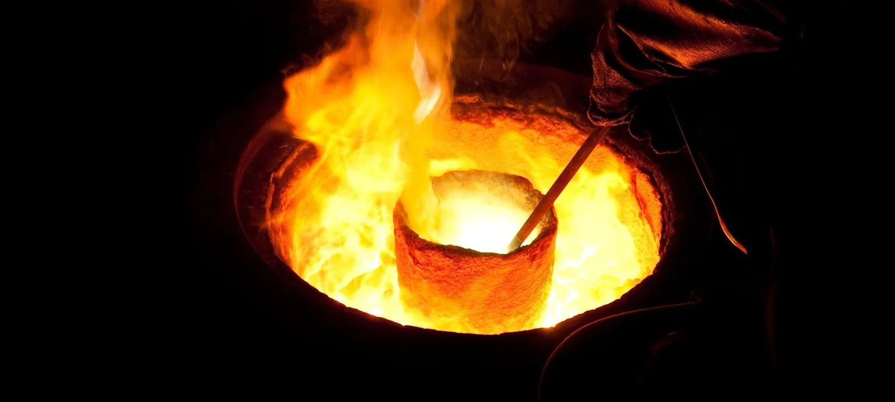
The Crucible
The Press
Around Us
Mal. 3:2-3; I Peter 4:12-13
Beloved, think it not strange concerning the fiery trial which is to try you, as though some strange thing happened unto you:

Slide 2

Birthdays & Anniversaries & Events
Nov. 1st Hunter & Caroline McIntosh
Nov. 2nd Jonah Cross
Nov. 5th Ben Pritchard, Pierce Jackson
Nov. 7th Amber McCall,
  David & Karen Mourglea
Dec. 19th Annual Dinner
Notes:
[Sources]
AI-generated celebration image, created for this slide.
[/Sources]

Slide 3
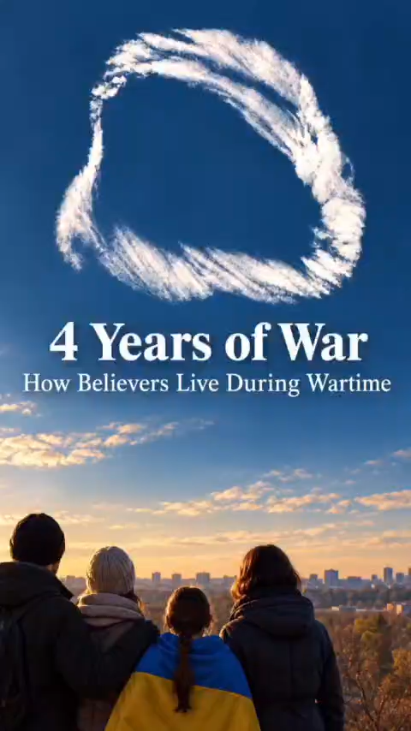

Slide 4
The Crucible
The Press
Around Us
Mal. 3:2-3; I Peter 4:12-13
Beloved, think it not strange concerning the fiery trial which is to try you, as though some strange thing happened unto you:

Slide 5
LETTING.OFF.THE.PRESSURE
17 I want to take a text tonight that comes to my mind on the subject of "Letting Off The Pressure." I thought that would be very appropriate.
There's so much pressure everywhere. Everybody seems to be under a pressure. What's the matter? Everything... it's a day of pressure.
62-0518

Slide 6
At the End of the Ages:
Rev. 2 & 3, (Candlesticks)
A Distinct Change that takes place.
The Church goes into Apostasy (Laodicean Darkness). A judgment cycle begins;
The Bride enters into what is identified as the “Bride Age.” (Rapture Cycle Begins);
The Cycle of Restoration of Israel Begins;
The Antichrist Begins to Rise.

Slide 7
PRESENT.STAGE.OF.MY.MINISTRY
138 See, you couldn't go up There with this kind of a body. Neither could you go up like these astronauts, you have to be in a pressurized tank. You're not pressurized for it. But when God changes you, you're pressurized then, you're going in the Rapture then. When these old earthly senses has been lost, and you're gone on in that glorious way of the cross, going Home with Jesus. 62-0908

Slide 8
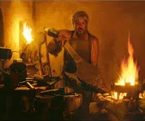
ISAIAH 48:9
For my name's sake will I defer mine anger, and for my praise will I refrain for thee, that I cut thee not off. 10 Behold, I have refined thee, but not with silver; I have chosen thee in the furnace of affliction. 11 For mine own sake, even for mine own sake, will I do it: for how should my name be polluted? and I will not give my glory unto another.

Slide 9
THE.REACTION.TO.AN.ACTION
22 A chemist will always test something. I used to work for a gas company. And they'd test those pipes by putting a plug in the end and a valve, they’d put [pressure] on them pipes to see if there's a little sand hole that would blow. If they could not stand the test, then it was throwed into the scrap heap.
And when you're put under a test, when you're fixing to be used for God for a testimony... Like the lady here in the wheelchair, the man, the little boy, some of you people out

Slide 10
there, maybe you're Christians and wonder why you're put under this test. God's fixing to use your testimony, but He wants to see how you'll react, so He puts the pressure on. If you blow up, well then, He can't do nothing with you. But if you'll hold on, stand the test...
59-0810

Slide 11

The Crucible
Extreme
Heat
Rapid
Quench
Cooling
1400- 1750 Deg.
Intent: Change the molecular structure
Freezes molecules
into “martinsite”
The steel is hardest but extremely
brittle

Slide 12

The Crucible
Scalpels
Razor blades
Carving Knives
300-450
Releasing
Stress
Pocket Knives
Hammers
Axes
450-650
“Relaxes” internal
Structure and
allows trapped carbon to escape.
Springs
Swords
Structural Beams
650-1100

Slide 13
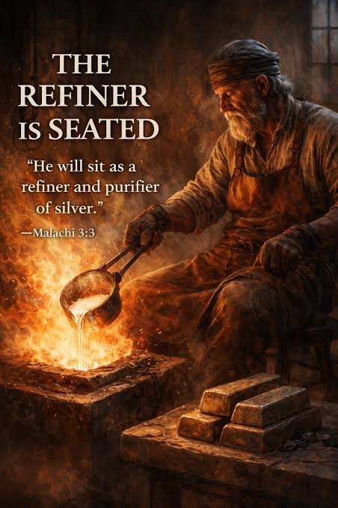
MALACHI 3:2
But who may abide the day of his coming? and who shall stand when he appeareth? for he is like a refiner's fire, and like fullers' soap: 3 And he shall sit as a refiner and purifier of silver: and he shall purify the sons of Levi, and purge them as gold and silver, that they may offer unto the LORD an offering in righteousness.
PSALM 119:71
It is good for me that I have been afflicted; that I might learn thy statutes.

Slide 14
GO.WAKE.JESUS
130 That refiner's fire, a hundred percent, all the dross melted out, all the unbelief, an experience that you know! What the Hebrew children could testify, after they went through the fire, "God is a Saviour, from fire.“ Daniel knew, after the lions' den experience. Lazarus knew…
132 After you went through these tests and trials, they're glorious to you. This is done to test their faith. Maybe some here has got sickness, and it's a test of faith, to see what you'll do about it. 63-1103

Slide 15
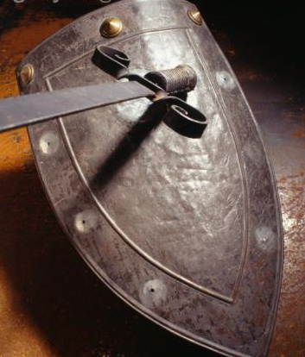
II SAMUEL 22:31
As for God, his way is perfect; the word of the LORD is tried: he is a buckler to all them that trust in him.

Slide 16
WE.HAVE.SEEN.HIS.STAR
46 [Forging bells] God is our great Cupola. He is the great Refiner's Furnace, that where He has to put these things upon us, trials, and persecutions to mold it together, to make our testimony ring for a certain time, and a certain note that He wants rang out in a certain day.
47 We're all made different. We see different. But we all see one thing, that's Jesus Christ. 63-1216

Slide 17
THE.EVENING.MESSENGER
11 God's jewels are brought up from the dust. We're so happy that He gives us the privilege of going into His great refinery, and all the dross taken out. Before they had the smelter, the old Indians used to beat it and beat it until they got all the dross beat out of it. And the way they knew that all of it was out (all the pyrite) when they knowed it [was] out, the beater seen his reflection he could see himself. Then he knew it was coming clear, when it reflect his own image.
13 And I think God wants to do His Church that way, just beat all the world out until the reflection of Jesus Christ lives in each one of us and we reflect His Life. 63-0116

Slide 18
ROMANS 11:33
O the depth of the riches both of the wisdom and knowledge of God! how unsearchable are his judgments, and his ways past finding out!
FAITH.IN.THE.SON.OF.GOD
12 Don't ask me; I can't explain it. And there's nobody else can explain it. God’s ways is past finding out… there's no need of trying to figure it. You just believe it... And you see the results, you see what God does. 52-0715
PSALM 128:1
Blessed is every one that feareth the LORD; that walketh in his ways.

Slide 19
PSALMS 119:71
It is good for me that I have been afflicted; that I might learn thy statutes.
Afflicted: oppress, humble, bowed down.
JOHN 16:33
These things I have spoken unto you, that in me ye might have peace. In the world ye shall have tribulation: but be of good cheer; I have overcome the world.

Slide 20
2 Corinthians 1:7-9
And our hope of you is stedfast, knowing, that as ye are partakers of the sufferings, so shall ye be also of the consolation. ⁸ For we would not, brethren, have you ignorant of our trouble which came to us in Asia, that we were pressed out of measure, above strength, insomuch that we despaired even of life:
⁹ But we had the sentence of death in ourselves, that we should not trust in ourselves, but in God which raiseth the dead:

Slide 21
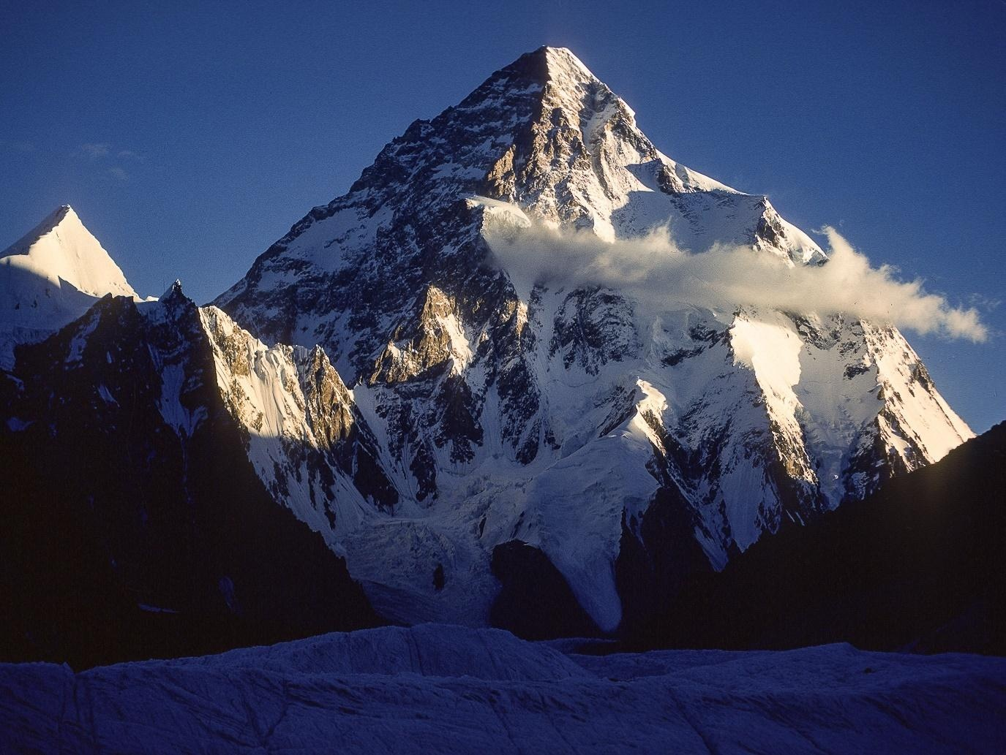
“We are pressurized for the place we live.”
PRESENT.STAGE.
OF.MY.MINISTRY

Slide 22
COUNTDOWN
92 Now, astronauts is really no new thing. What about Elijah? He went where John Glenn never did think about going. One took off in slow motion one time, Enoch. He just walked up, he was an astronaut. He was pressurized, he didn't have to be changed, nothing. No, he was already pressurized when he started walking. Just walked right on out of all the dimensions and walked out in the Presence of God.
62-0909

Slide 23
Philippians 3:13-15
Brethren, I count not myself to have apprehended: but this one thing I do, forgetting those things which are behind, and reaching forth unto those things which are before,
¹⁴ I press toward the mark for the prize of the high calling of God in Christ Jesus. ¹⁵ Let us therefore, as many as be perfect, be thus minded: and if in any thing ye be otherwise minded, God shall reveal even this unto you.

Slide 24
I.WAS.NOT.DISOBEDIENT.
7 I was just thinking upon the subject of science… and what he has done. And how little the spiritual man has progressed in the Kingdom of God.
If [the natural man] could do that [split the atom] in the natural realm, what ought the man of God to be doing? Friends the church is so far behind. Let's pray that God will move His church up. The natural man with the natural resource is getting greater results than people are that calls themself Christian. Let's press into the unseen.
49-0718

Slide 25
I.HAVE.HEARD.BUT.NOW.I.SEE
110 He said, "I'll give them a sign, an everlasting sign, 'A virgin shall conceive,' an everlasting sign."
111 Now, we find that in those hours of real stress, that's usually when the Spirit of God moves in. He let the Hebrew children walk right into the fiery furnace, before He ever moved a hand. But when He moves, He moves.
65-1127

Slide 26
LIFE
39 That's the way it is with some of this "shake-hands" religion. I believe in being born again: go back to the beginning, and die out, and be re-molded. If you don't, there's going to be a blowup somewhere down along the road.
It'll blow up on you when the pressure comes. So let's hold the pressure.
62-0719

Slide 27
CHURCH.AGE.BOOK
224-1 …Now faithfulness and patience go together. In fact patience is the outcome of faithfulness, for it says in James 1:3, "The trying of your faith worketh patience."
There is absolutely no other way in which to gain patience. It has to come by the trial of our faith. Rom. 5:3, "Tribulation worketh patience."

Slide 28
CHURCH.AGE.BOOK
224 How highly God regards this out-working of our patience is seen in James 1:4, "But let patience have her perfect work, that ye may be perfect and entire lacking nothing." God's will for us is Perfection. And that perfection is patience-waiting on God and waiting for God. This is the process of character development.

Slide 29
GOD.CALLED.MAN
100 Look what He's doing right here now… It's crossing Jordan. Get alone with God. Lay in His own furnace of refinery. Get on the big Master Potter's wheel and let Him mold you.
58-1005

