Slide 1

Safe & Sound
Genesis 18:17-19

Slide 2
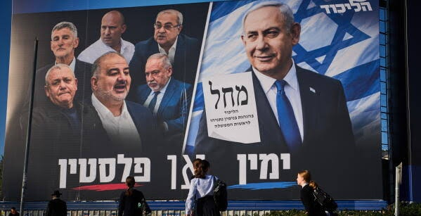

Slide 3
THE.IDENTIFIED.MASTERPIECE.OF.GOD
147 You've got to stay with that Word, to be the Bride. If you're in the Bride, you're in the Word, and the Word is in you. And the Word that reflected God through Christ, reflects the same God through you... 64-1205

Slide 4
27 Jesus is the only safe and secure Foundation that anything could be built on. It's the only foundation that can be built upon; all other foundations is sinking sand. "On Christ the solid Rock I stand; all other grounds is sinking sand."A lot of people build upon riches. They try to work, see how much money they can make. They say, "If I can't spend it, my children can behind me." What does it do? It leads to a slavery; you become a slave to your money.
1960-0604
TO.WHOM.SHALL.WE.GO

Slide 5
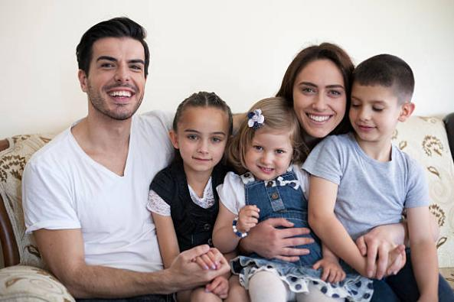
Meet the Carter family
(They are a composite, not a real family: a suburban household built from the national averages below.)
Every weekend from March through July, and again in the fall, their life is organized around one child's baseball schedule.

Slide 6
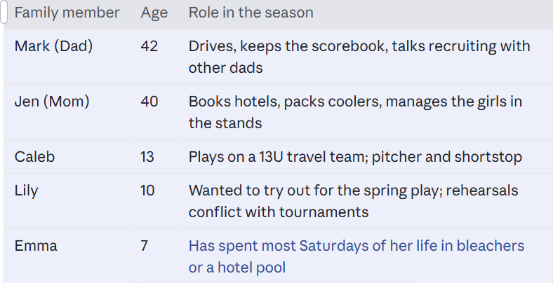

Slide 7
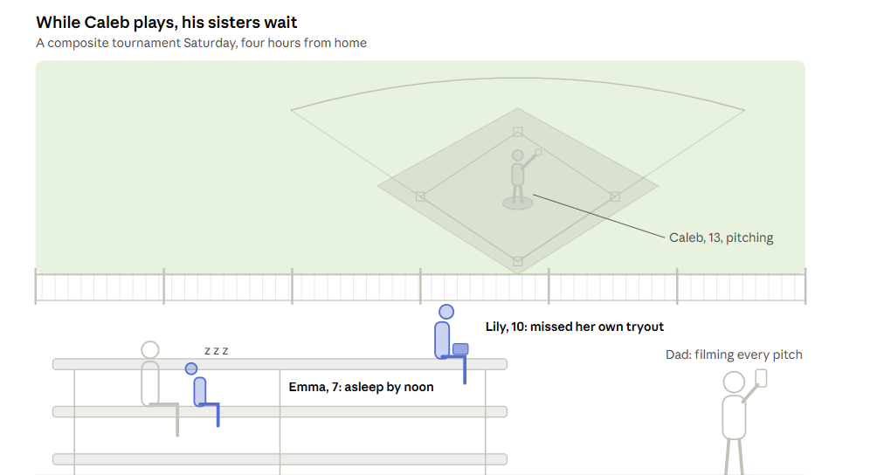

Slide 8
A Season In The Life
For Lily and Emma, a tournament weekend is roughly 40 hours away from home, and most of it is spent waiting.
Friday, 3:30 p.m. Picked up early from school. Three to four hours in the car to a sports complex in another state.
Friday night. Team hotel. Fast food in the room. The girls share a bed; homework goes undone.
Saturday, 7:00 a.m. First game. Two to three games a day, each about two hours, with dead time between. The girls sit on bleachers, in folding chairs, or in the car with a tablet.
Sunday. Bracket play. If Caleb's team keeps winning, the family stays until dark. Church, friends' birthday parties and Sunday dinner with grandparents are missed again.
Sunday night. Drive home late. School Monday morning.

Slide 9
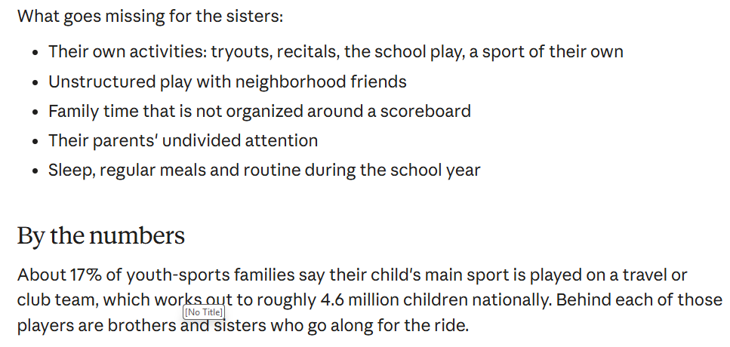

Slide 10
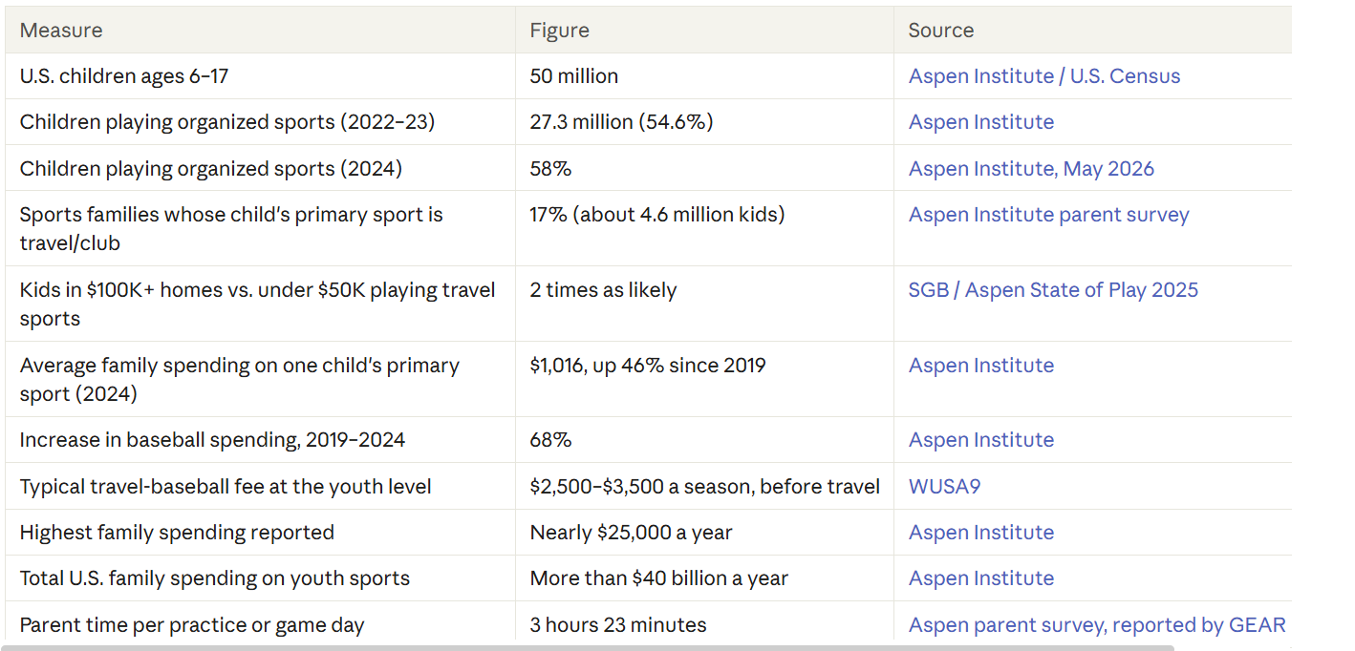

Slide 11
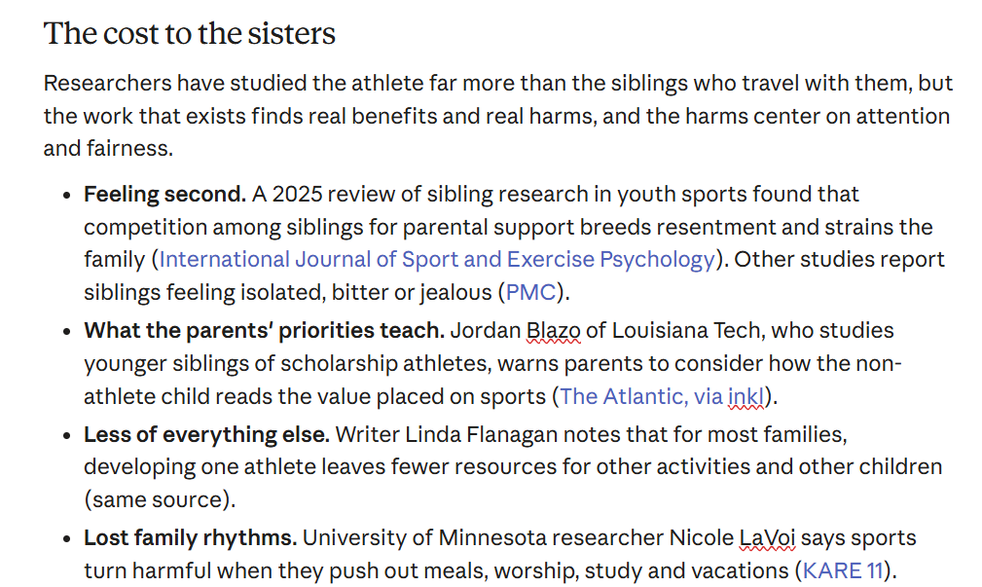

Slide 12
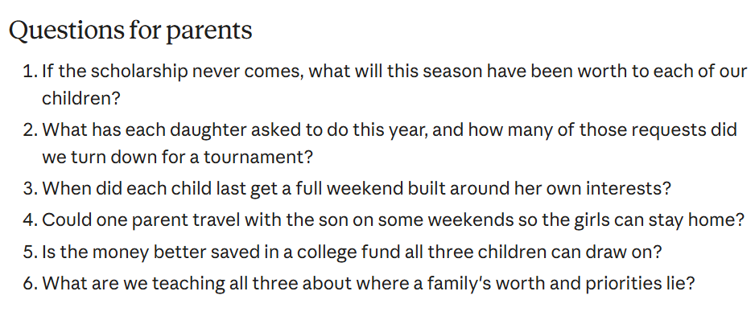

Slide 13
QUESTIONS.AND.ANSWERS
This is a little token that's been sent into the Wood's family... Little William David Jr. And he sure is a fine, little boy. Yes, his trigger finger is doubled up. Squirrel hunter. He's just looking out of one eye at me.
But we know that these are little things that God sends into our home that we appreciate, in giving us the responsibility of raising these up. And I'm quite sure if the grace of God continues in this family, that this baby will be raised in admonition of God. 61-1015

Slide 14
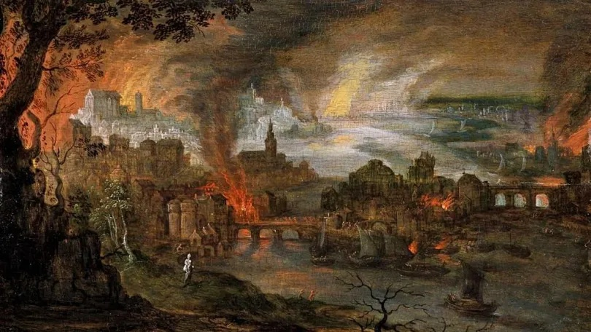
Moses & Children
of Israel Exodus 12
Rahab & Her Family
Joshua 2:12
Josh
Token
Lot
& Family
Abraham
& Family

Slide 15
GENESIS 18:19
For I know him, that he will command his children and his household after him, and they shall keep the way of the LORD, to do justice and judgment; that the LORD may bring upon Abraham that which he hath spoken of him.
Token
Abraham & His Family
Lot
& Family

Slide 16
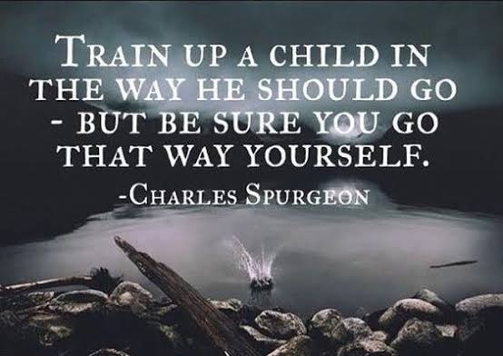
PROVERBS 22:6
Train up a child in the way he should go: and when he is old, he will not depart from it.

Slide 17
TOKEN
295 They must have believed that their own big denomination of Jericho was able to resist the wrath of God... That's what many of them are thinking today. But there must have been some tape boys slipped in some-where, for the predestinated seed.
300 They still got them. The Message got to the predestinated Seed anyhow. We don't know how It got there, but It got there, so that the Just will not perish with the unjust. God is seeing to that, today… 63-0901

Slide 18
TOKEN
362 You believe for your safety, and then apply the Token for the whole family. "How can I do that?" Claim It! You and the Word are one, then apply It to your children, apply It to your loved ones. Like Rahab did, she applied the token to her father, her mother, her brothers and sisters, and got them all in.
364 Say, "Lord, I'm going after my son. I'm going after my daughter. I claim her! 'Satan, you turn her loose!' O Holy Spirit, that lives within me, catch my daughter there. I'm going to her now, with Your anointing upon me." He'll do it.

Slide 19
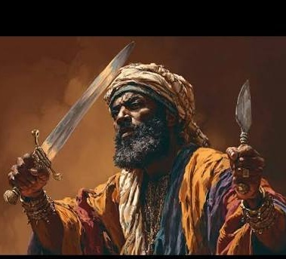
NEHEMIAH 4:13 (7-14)
Therefore set I in the lower places behind the wall, and on the higher places, I even set the people after their families with their swords, their spears, and their bows. 14 And I looked, and rose up, and said unto the nobles, and to the rulers, and to the rest of the people, Be not ye afraid of them: remember the Lord, which is great and terrible, and fight for your brethren, your sons, and your daughters, your wives, and your houses.

Slide 20
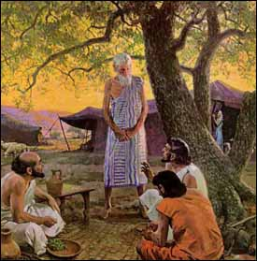
GENESIS 18:17-19
And the LORD said, Shall I hide from Abraham that thing which I do; 18 Seeing that Abraham shall surely become a great and mighty nation, and all the nations of the earth shall be blessed in him? 19 For I know him, that he will command his children and his household after him, and they shall keep the way of the LORD, to do justice and judgment; that the LORD may bring upon Abraham that which he hath spoken of him.
CJB For I have made myself known to him, so that he will give orders to his children and to his household after him to keep the way of Adonai and to do what is right and just, so that Adonai may bring about for Avraham what he has promised him.
CEV I have chosen him to teach his family to obey me forever and to do what is right and fair. If they do, I will give Abraham many descendants, just as I promised.

Slide 21
MATTHEW 22:35-40
Then one of them, which was a lawyer, asked him a question, tempting him, and saying, 36 Master, which is the great commandment in the law? 37 Jesus said unto him, Thou shalt love the Lord thy God with all thy heart, and with all thy soul, and with all thy mind. 38 This is the first and great commandment. 39 And the second is like unto it, Thou shalt love thy neighbour as thyself. 40 On these two commandments hang all the law and the prophets.

Slide 22
Way: (Heb.) “derek”
Road, distance, journey, manner, direction, course of life, moral character.
DEUTERONOMY 5:33
Ye shall walk in all the ways which the LORD your God hath commanded you, that ye may live, and that it may be well with you, and that ye may prolong your days in the land which ye shall possess.
DEUTERONOMY 6:7
And thou shalt teach them diligently unto thy children, and shalt talk of them when thou sittest in thine house, and when thou walkest by the way, and when thou liest down, and when thou risest up.

Slide 23
GENESIS 24:27 (Eliezer)
And he said, Blessed be the LORD God of my master Abraham, who hath not left destitute my master of his mercy and his truth: I being in the way, the LORD led me to the house of my master's brethren.
40 And he said unto me, The LORD, before whom I walk, will send his angel with thee, and prosper thy way; and thou shalt take a wife for my son of my kindred, and of my father's house:
42 And I came this day unto the well, and said, O LORD God of my master Abraham, if now thou do prosper my way which I go:
48 And I bowed down my head, and worshipped the LORD, and blessed the LORD God of my master Abraham, which had led me in the right way to take my master's brother's daughter unto his son.

Slide 24
TOKEN
277 Not responsible for one person, no matter who you are, He is not responsible, out from under It. And remember, all the family was got, brought together. Oh, my!
279 You say, "Well, my daddy is a preacher. My brother! My pastor!" That might be true, too, but what about you? Remember, only safe when the token was displayed!
63-0901

Slide 25
AS.THE.EAGLE.STIRS.HER.NEST
28 We're thankful to our Lord God for His goodness to His children, aren't we? How He deals with us in mysterious ways, His wonders to perform. How easy He makes it for us to walk on. How bright He makes the path before us. We're sheltered by His blessed Presence.
Remember, when the little eagle is born, the mother's over him with her wings spread. She's ready to protect him. When he's a young one, how she sets right there with that eye watching him in the nest, wherever he goes. 58-0316

