Slide 1

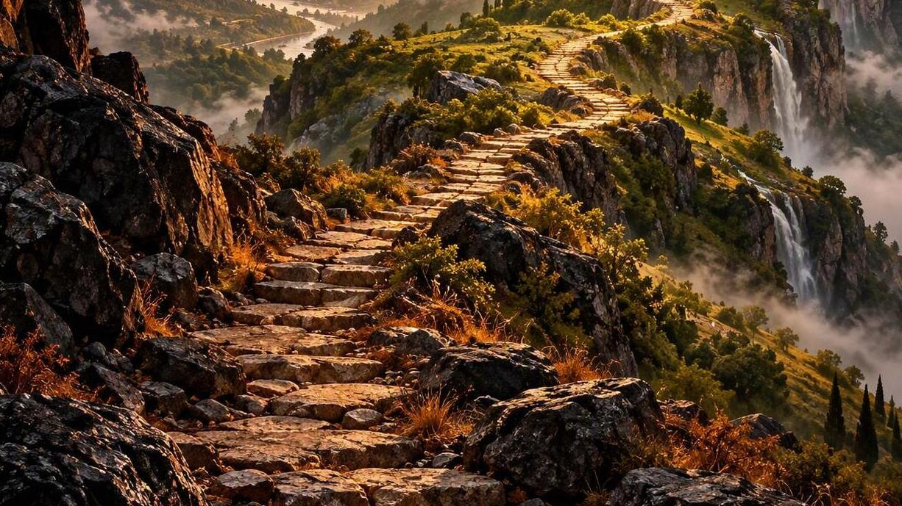


The ascending order of our journey 3
MATTHEW 24:32-35 (34)
Verily I say unto you, This generation shall not pass, till all these things be fulfilled.
Notes:
[Sources]
AI-generated conceptual illustration: ascending path toward a sunlit landscape.
[/Sources]

Slide 2

Birthdays & Anniversaries & Events
Oct. 28th Matt & Melody Cross
      Suzanne Doucette
Oct. 29th Titus Clayville
Oct. 30th David Stevens
Nov. 1st Communion Service
Dec. 19th Annual Dinner
Notes:
[Sources]
AI-generated celebration image, created for this slide.
[/Sources]

Slide 3
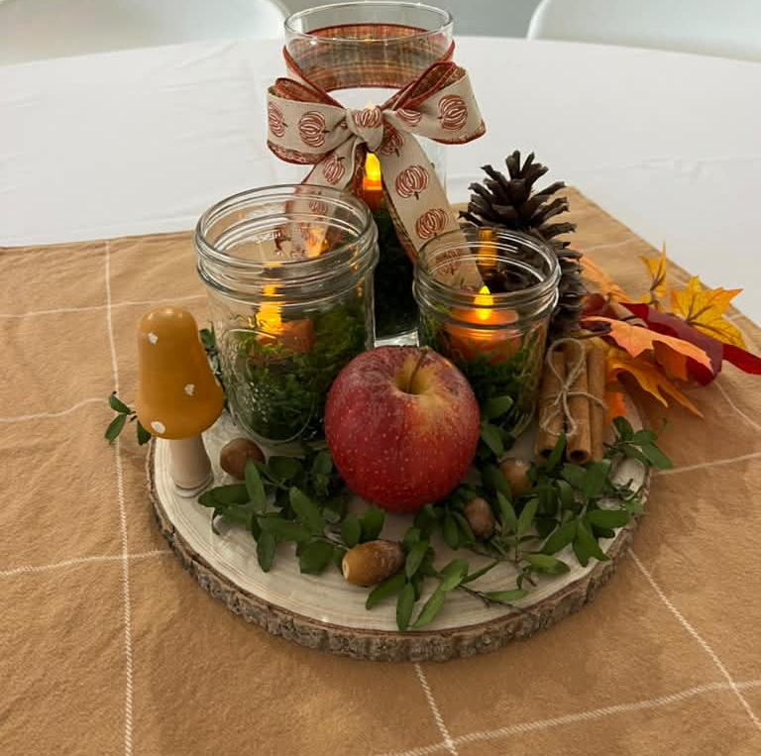

Fall Fellowship
OCTOBER 24TH 2026

Slide 4
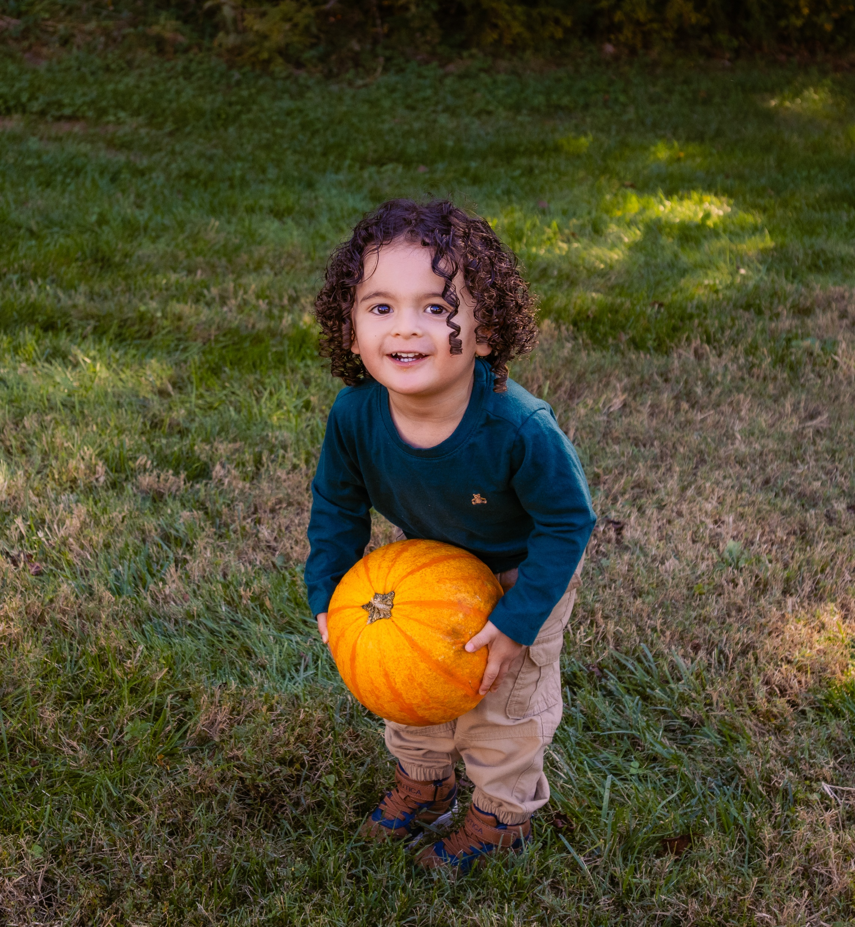
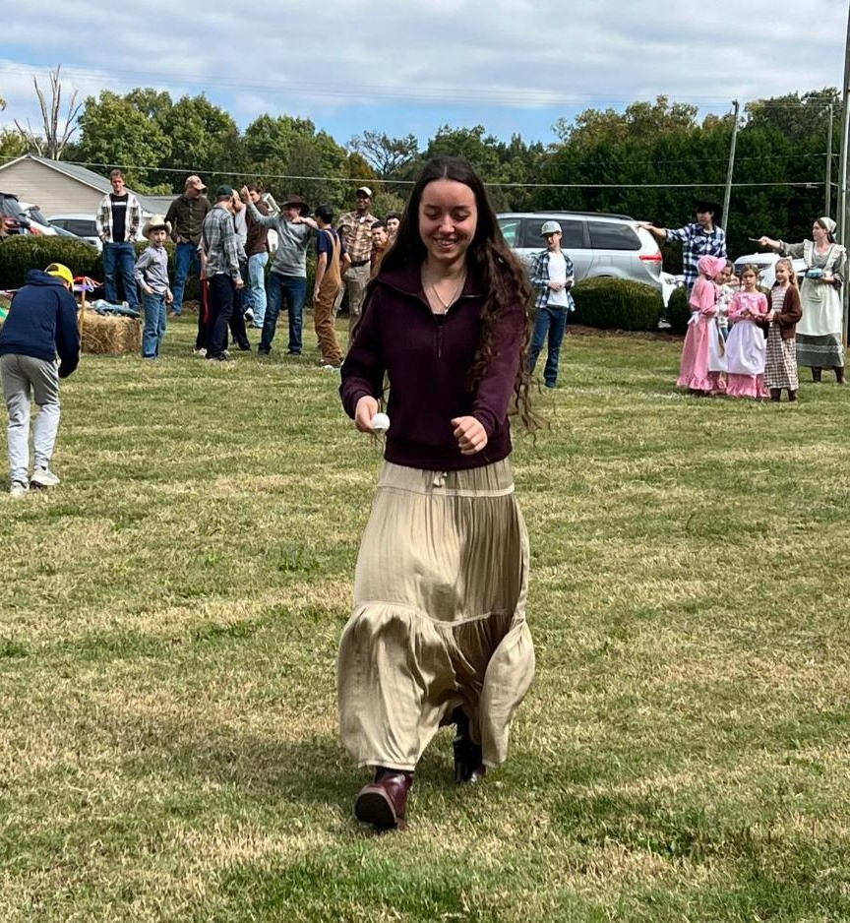

Slide 5

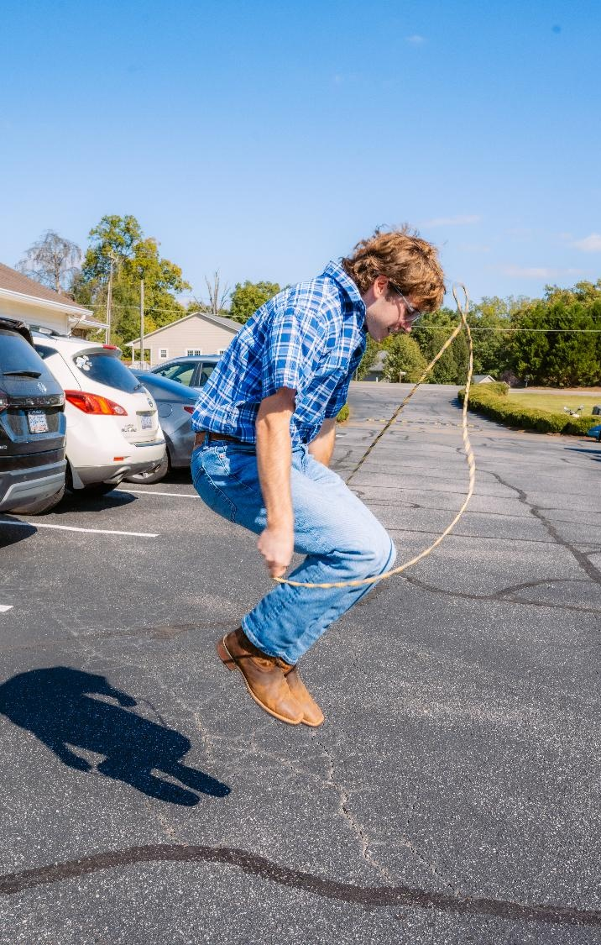

Slide 6
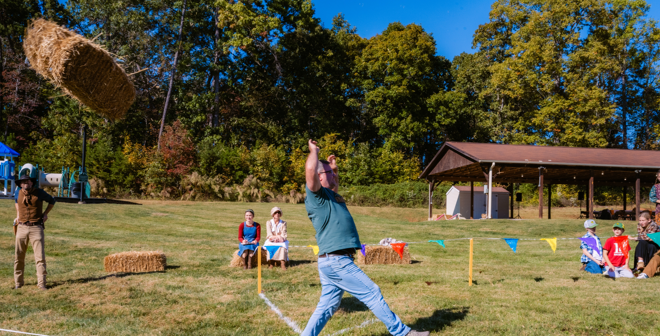

Slide 7
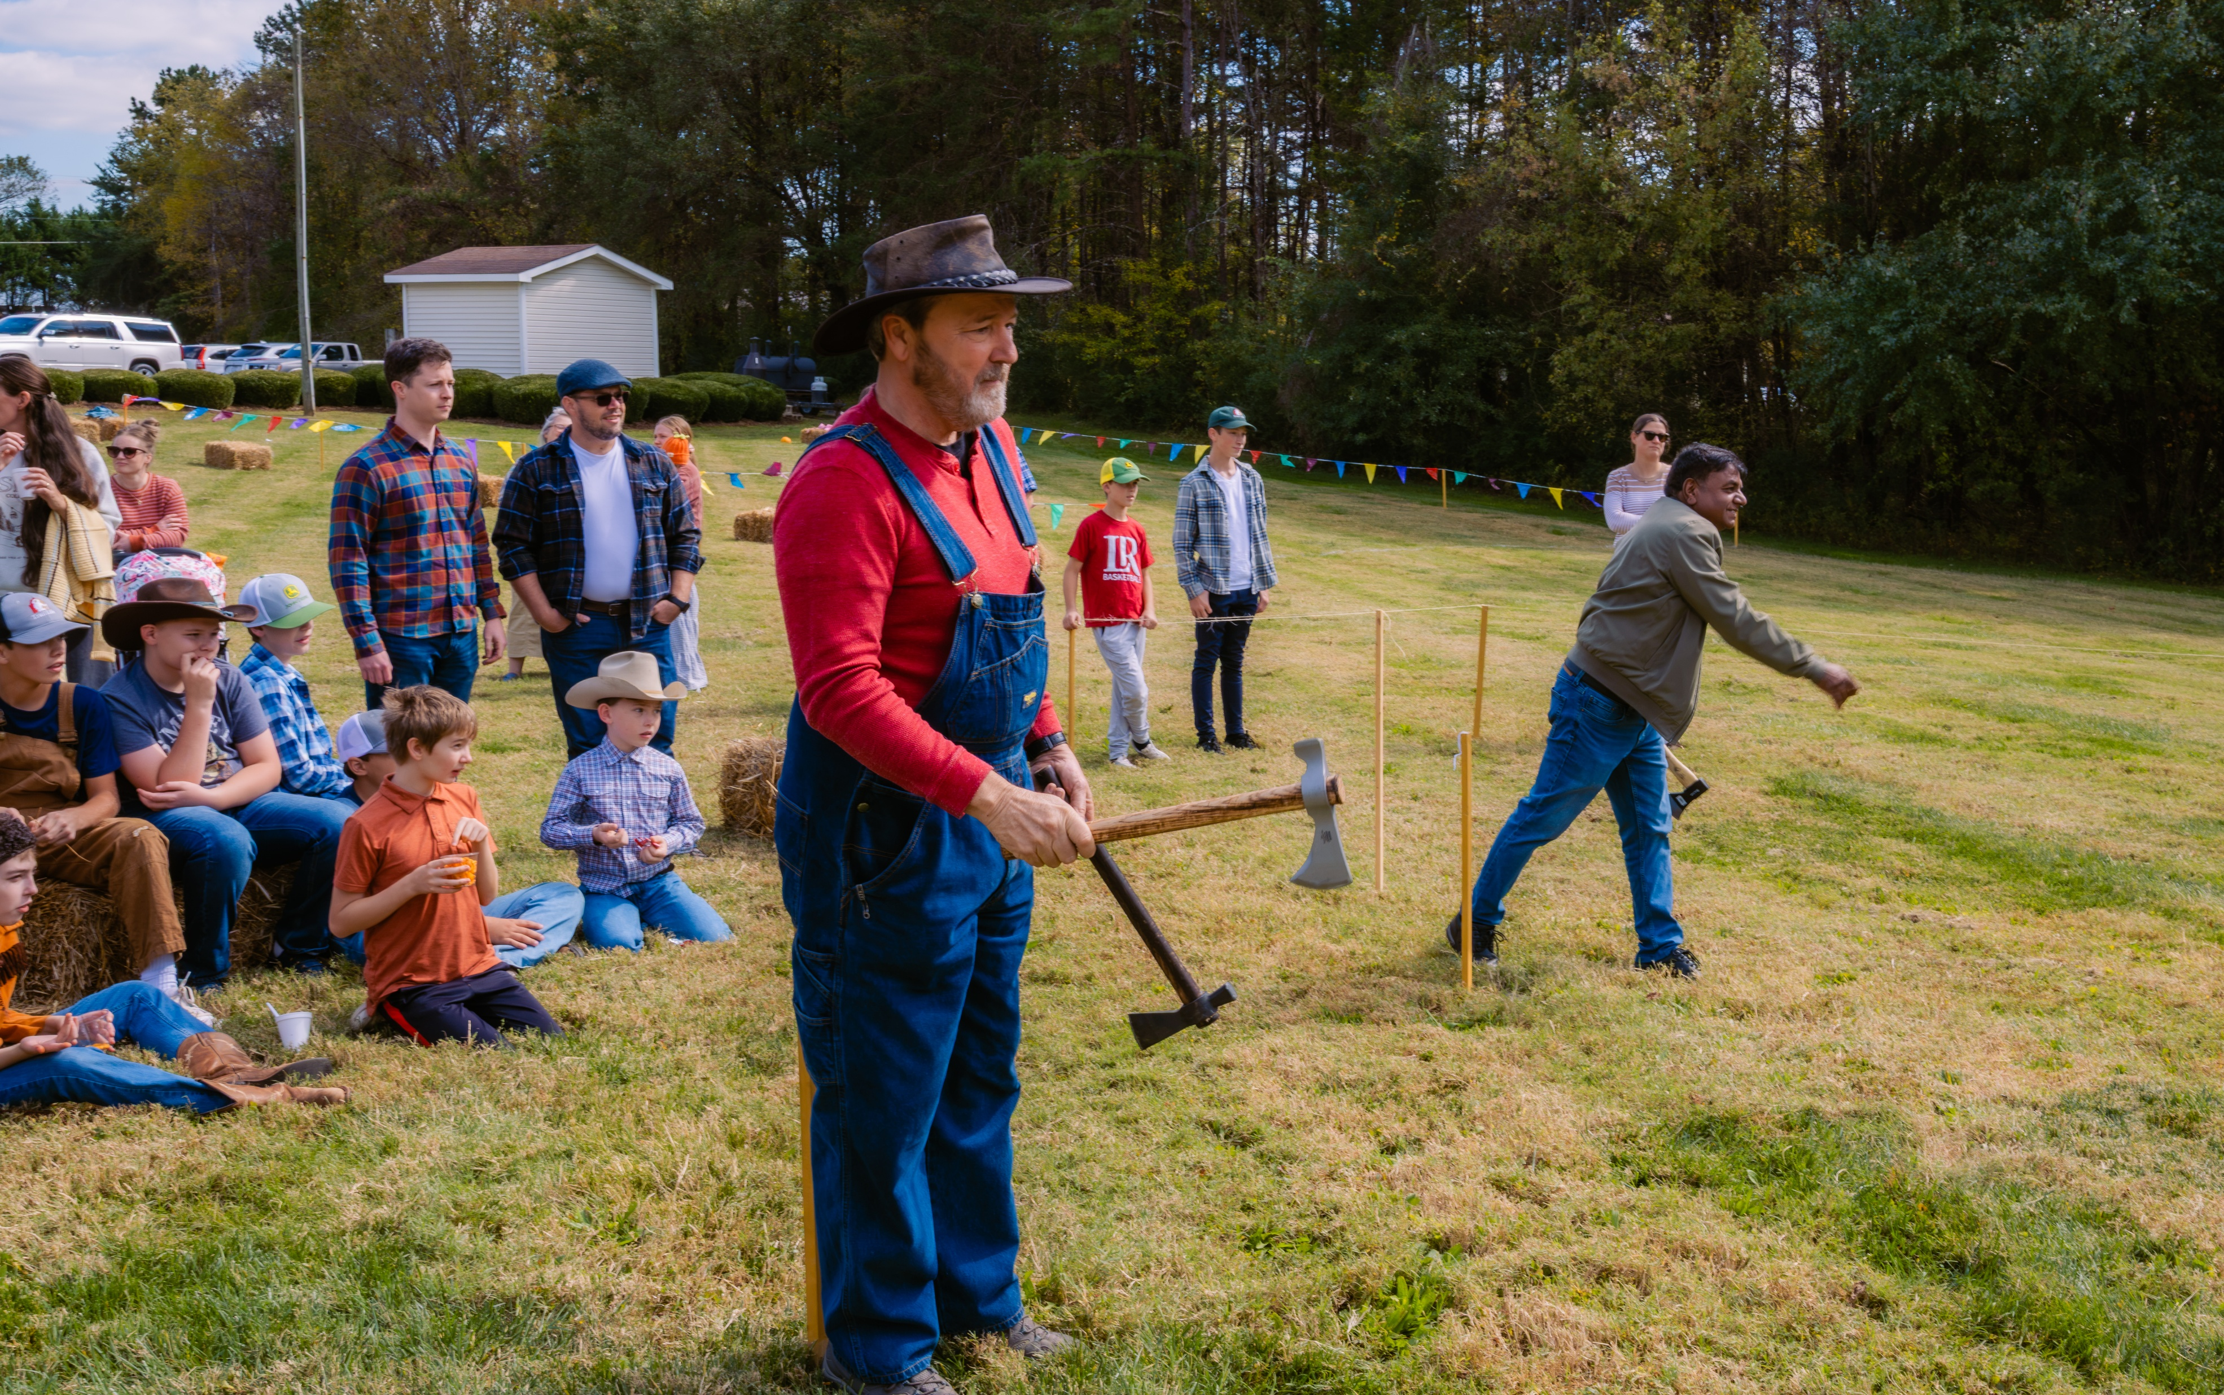


Slide 8
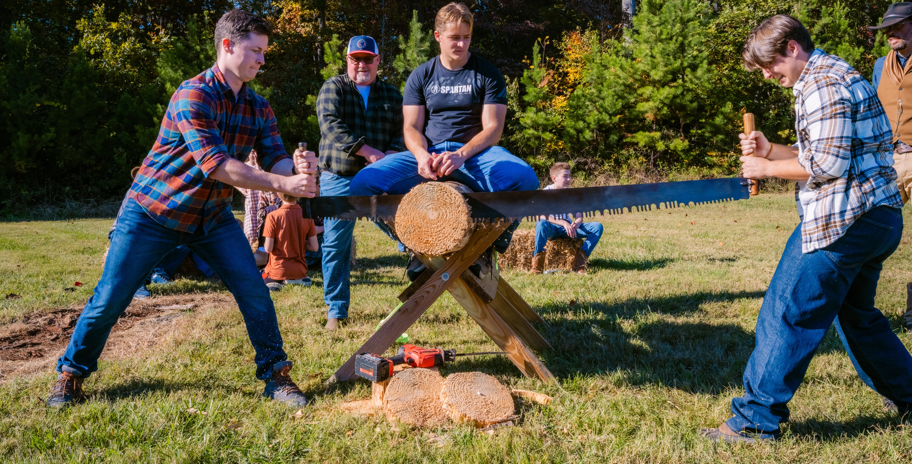

Slide 9
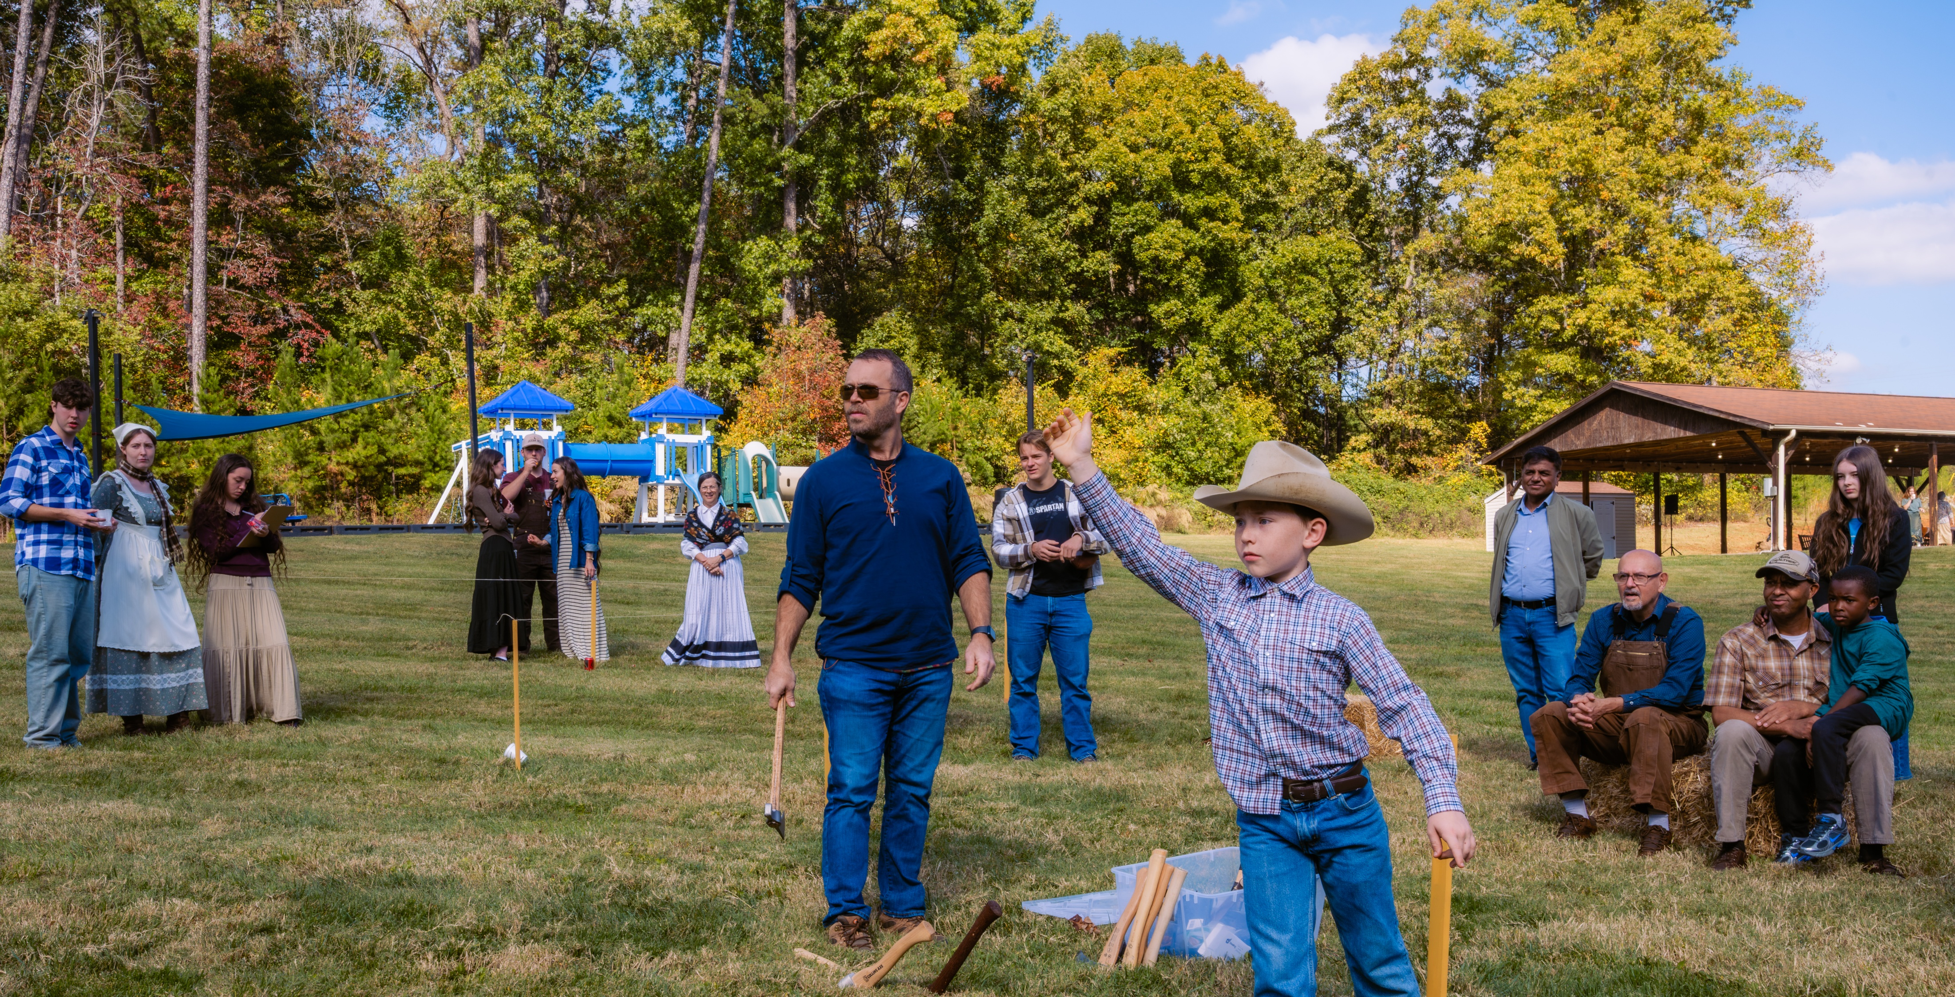

Slide 10
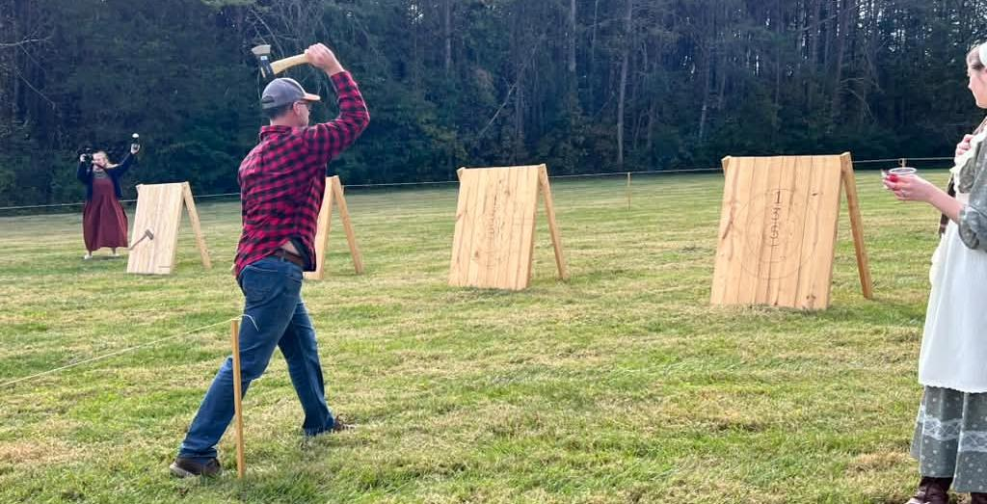

Slide 11
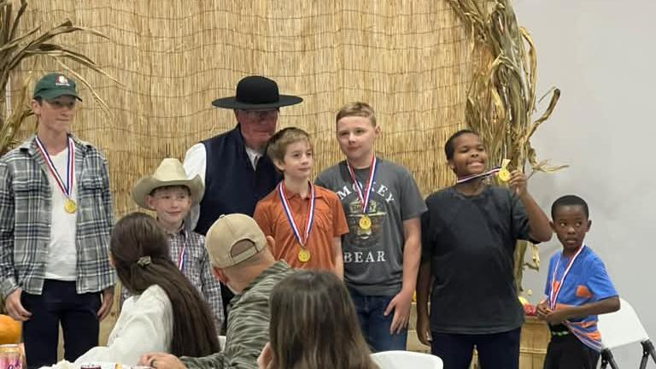

Slide 12
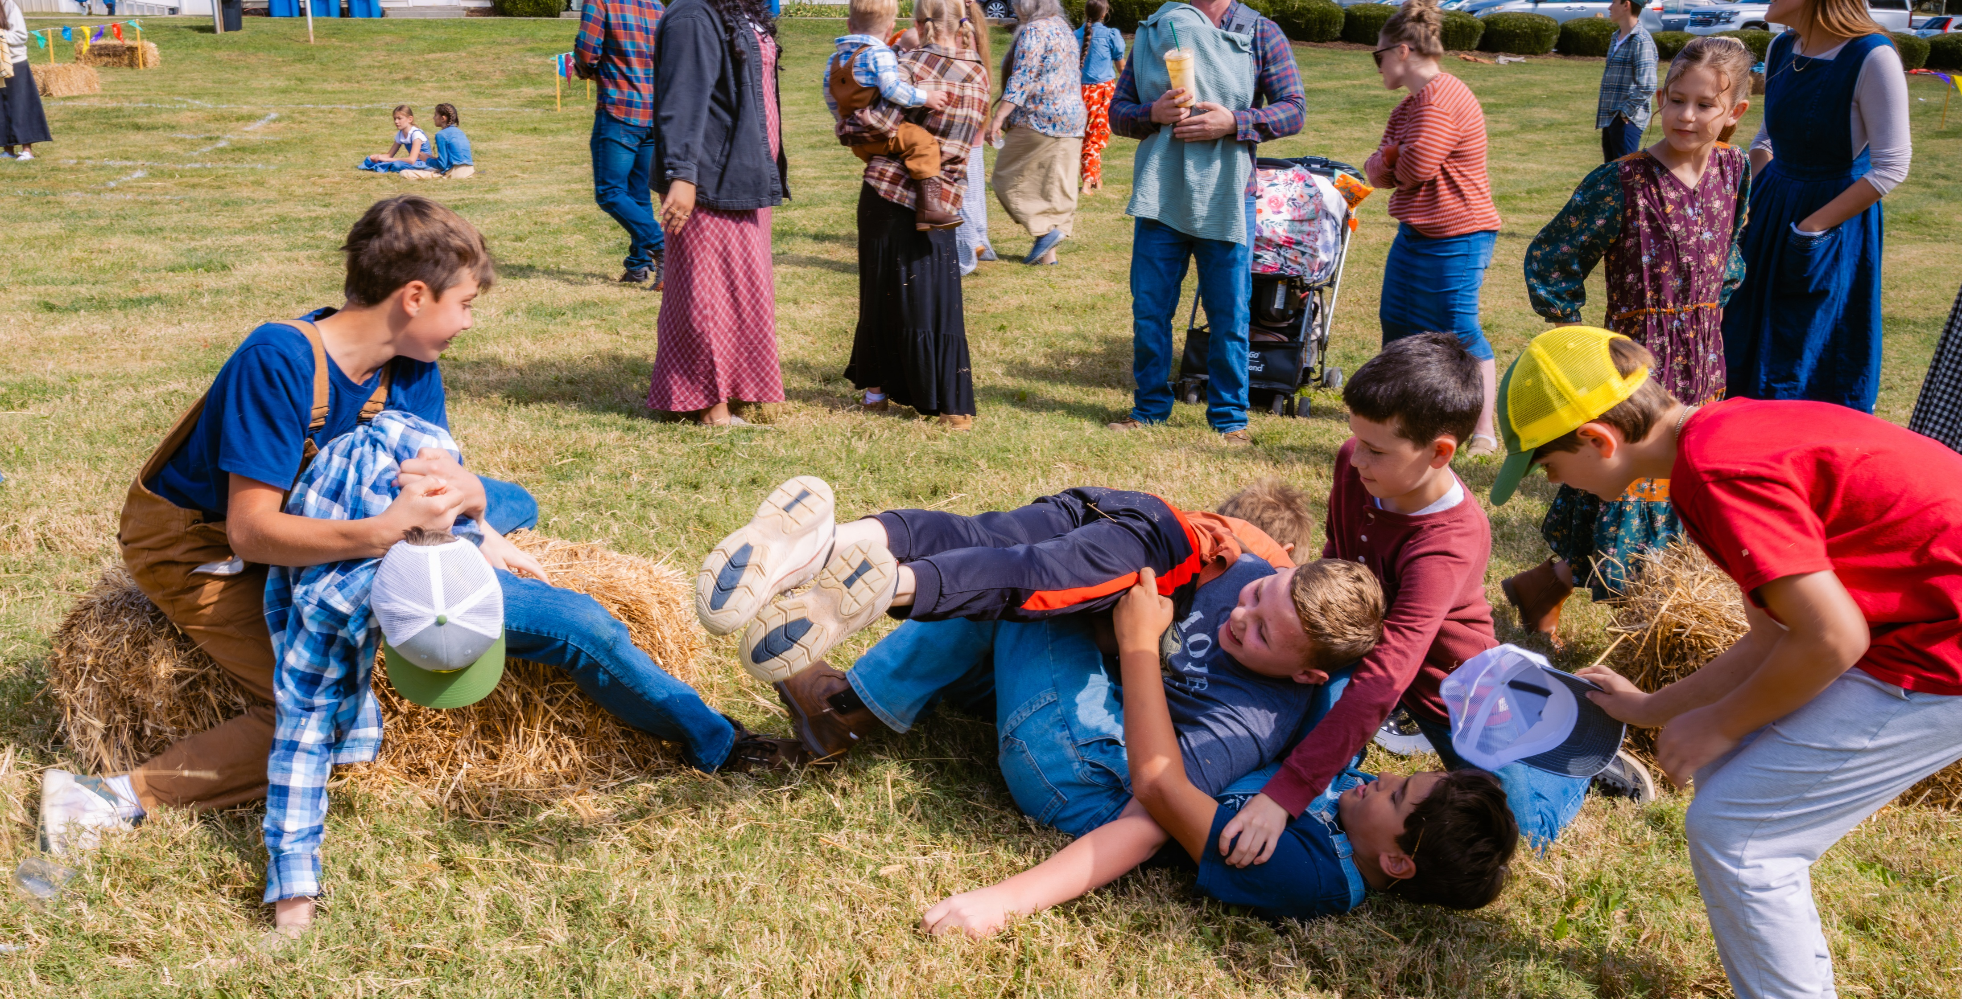

Slide 13
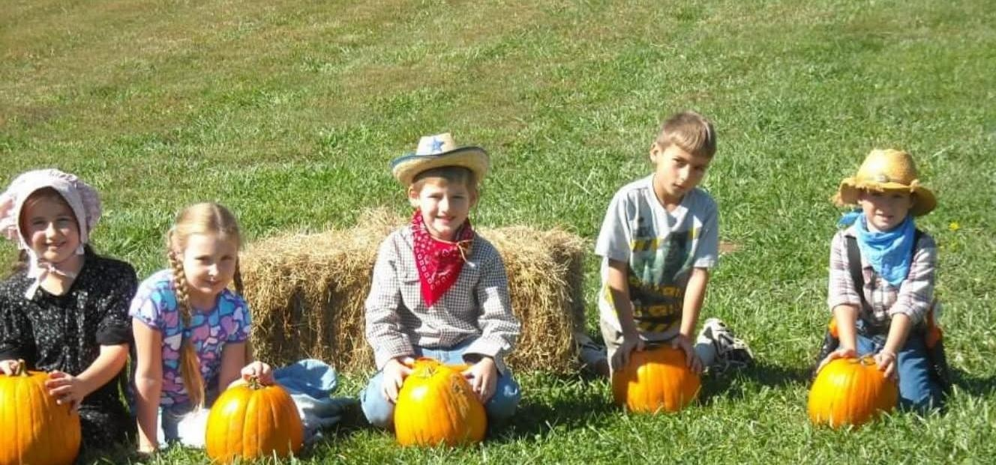
Fall Fellowship

Slide 14
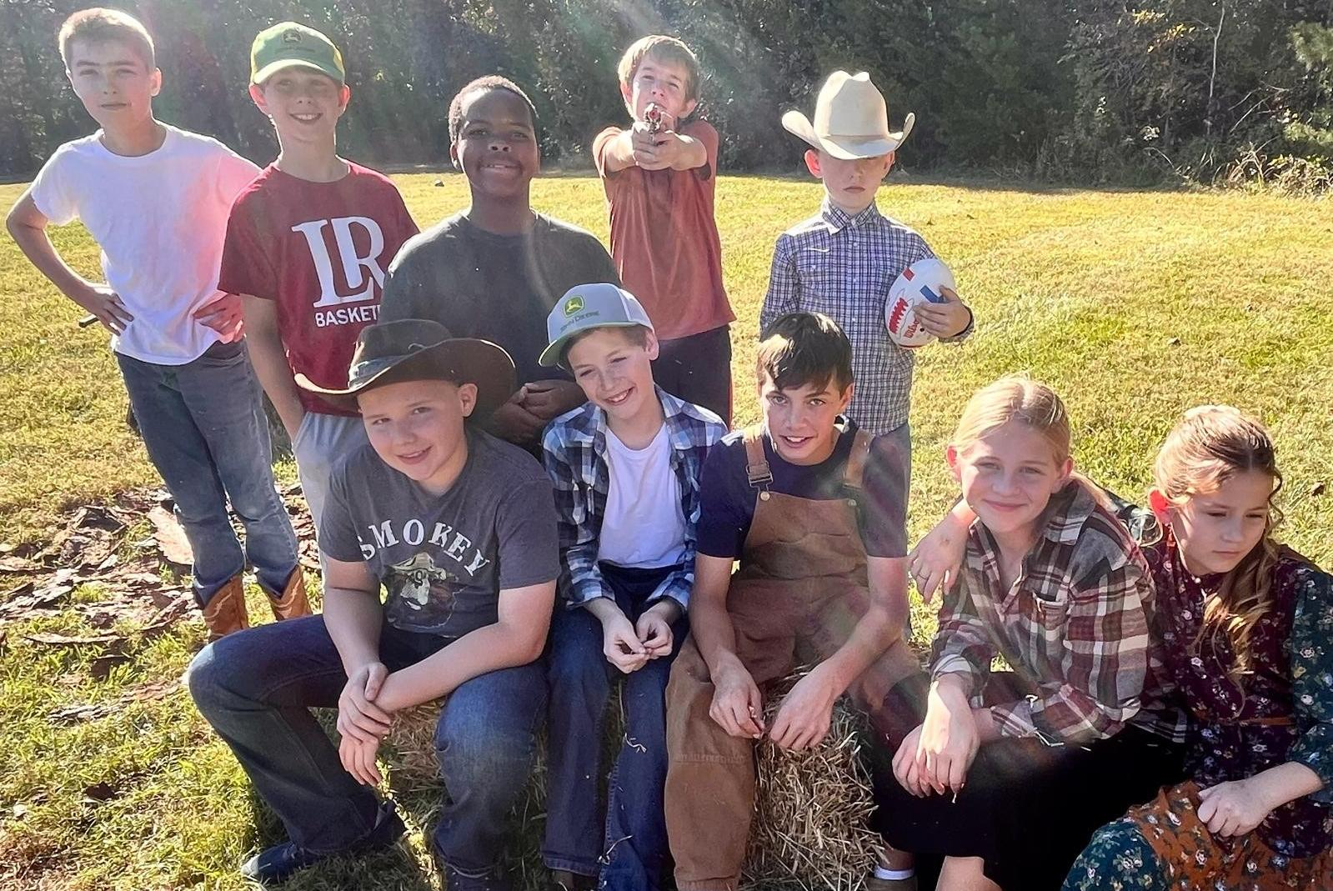

Slide 15
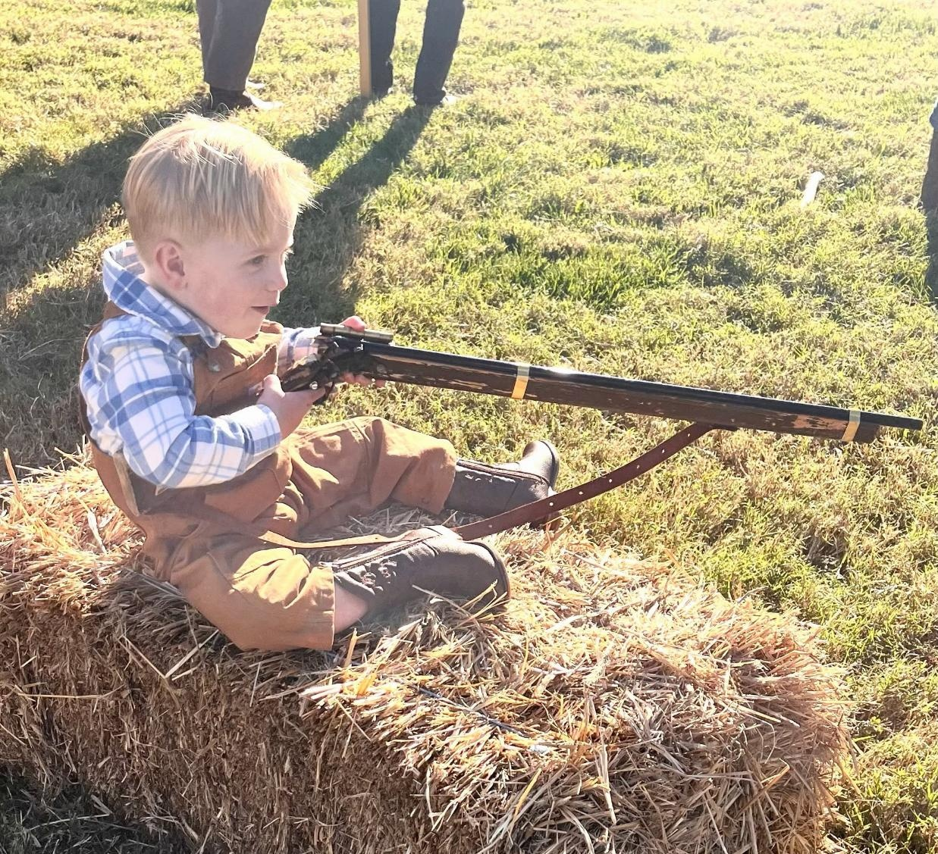
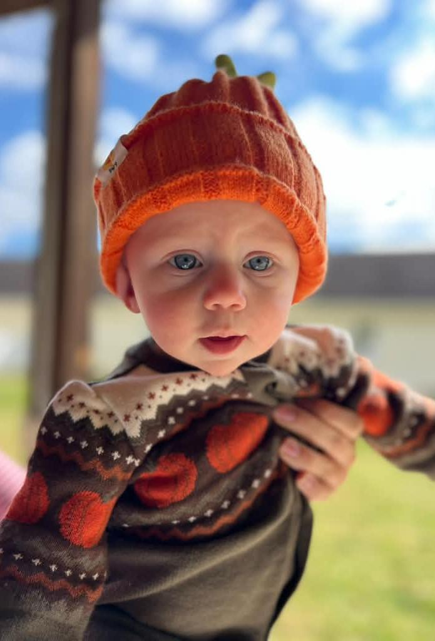

Slide 16
The ascending order of our journey 3
MATTHEW 24:32-35 (34)
Verily I say unto you, This generation shall not pass, till all these things be fulfilled.
Notes:
[Sources]
AI-generated conceptual illustration: ascending path toward a sunlit landscape.
[/Sources]

Slide 17

The Junction Of Time
The junction, God always, before these great junctions comes or ending off time where He starts something new with the old to the new, with one dispensation to another He always shows forth His power. 56-0115
Notes:
[Sources]
AI-generated symbolic hourglass illustration, inspired by the quotation on this slide.
[/Sources]

Slide 18
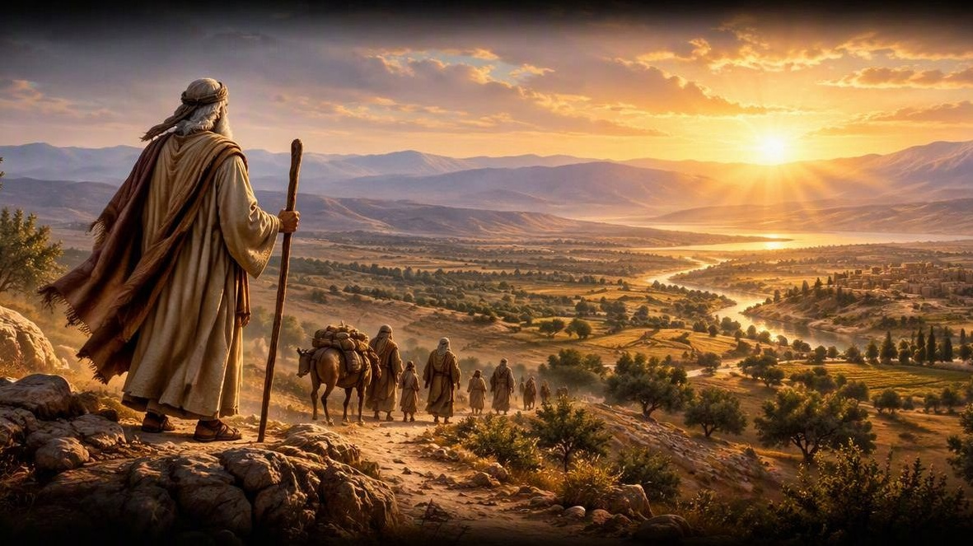
Genesis 12:1-3
12 Now the Lord had said unto Abram, Get thee out of thy country, and from thy kindred, and from thy father's house, unto a land that I will shew thee: 2 And I will make of thee a great nation, and I will bless thee, and make thy name great; and thou shalt be a blessing: 3 And I will bless them that bless thee, and curse him that curseth thee: and in thee shall all families of the earth be blessed.
Notes:
[Sources]
AI-generated artistic interpretation of Abram setting out toward a new land, inspired by the Genesis 12:1-3 passage on this slide.
[/Sources]

Slide 19
*Transition Between Numbers 14 & 15
NUMBERS 14:40-42
And they rose up early in the morning, and gat them up into the top of the mountain, saying, Lo, we be here, and will go up unto the place which the LORD hath promised: for we have sinned. 41 And Moses said, Wherefore now do ye transgress the commandment of the LORD? but it shall not prosper. 42 Go not up, for the LORD is not among you; that ye be not smitten before your enemies.
NUMBERS 15:1
And the LORD spake unto Moses, saying, 2 Speak unto the children of Israel, and say unto them, When ye be come into the land of your habitations, which I give unto you…

Slide 20
A.TRIAL (A New Generation)
146 You Presbyterians… Pentecostals, fifty years ago* we'd have got the promised Land, but you got to fussing, making organizations… a new revelation, instead of following the Word. Now we been fifty years this side the full Promise.
147 But, Joshua wants you all to know God kept His Word, with a brand new generation. He took the promised land just as it was promised, 'cause he stilled the people on the Word of God, to let them know that God made the promise, that this prophet they were following was not a false prophet, because the things that he was doing was exactly with the Scripture. No matter how falsely Pharaoh said it was… 64-0427

Slide 21
QUESTIONS.AND.ANSWERS.4
159 "He will turn the hearts of the fathers to the children." That was John's first coming. He turned the hearts of the old patriarch fathers to the Message of the children, which was the new generation then. Then tying together the hearts of the children back to the fathers, which mean the Message of today will turn the hearts of the children in the church age back to the original Pentecostal faith of the beginning. So it will be two different messenger[s], but it differentiates there the first coming and the second of… Elijah. 64-0830

Slide 22
CHURCH.AGE.BOOK (Pg. 279)
1. It was God's purpose to bring forth a people like unto Himself that would be a Word Bride. She was chosen before the foundation of the world IN HIM. She was redeemed by His blood and can NEVER come into condemnation.
2. Secondly, another class. Their names are also in the Book of Life and they will come up in the second resurrection. (Foolish virgins and the righteous of Matt. 25). [They] do not worship the beast or become involved in the antichrist system but die for their faith (not in the Bride, not having been born again.) Come up in the 2nd resurrection and go into eternal life.

Slide 23
3. Thirdly, the borderline Christians such as we saw in Israel coming out of Egypt. These had their names in the Book of Life and their works written in the books. These having failed to obey God and being void of the Spirit… will have their names removed from the Book of Life. (Eg. Judas, Balaam, etc.)
4. Fourth and finally are the ones whose names have never been or will ever be written on the books.

Slide 24
ANOINTED.ONES.AT.THE.END.TIME
196 Look at those people who come out under Moses' prophecy, out of that organization, out of everything, under the prophecy, saw the great works and wonders, come up to the borderline of going in.
Lee, there comes your "name on the Book."
65-0725

Slide 25
RECOGNIZING.YOUR.DAY.AND.ITS.MESSAGE
82 I was reading one of the outstanding papers comes here, very fine paper… Herald of His Coming. But they hardly print anything unless it's, "Fast, pray! Fast, pray! Sound a trumpet!"
83 Why do they do that? They're crying, believing that there will be awakening. They're good people. They have not recognized the awakening of the Bride. Being a Christian, they feel the pull of the hour... they're looking for it way off in the future, to come, when it's already happened right by you. 64-0726

Slide 26
INVASION.OF.THE.UNITED.STATES
40 [Ahab] was riding on the reputation of other Israelite kings [and he] was kind of a borderline believer. I've often referred to him that way, because he was part time on this side of the fence, part of the time on that side of the fence.
A person that professes to be a Christian, and unstable, you don't know what to do about the person. Today they're a Christian; tomorrow you don't know where they're at. In church today, rejoicing, singing, praising God, and tomorrow, out drinking, carousing, running around. Then that type of a person is hard to do anything with. 54-0509

Slide 27
The Vindication of Moses: 70 Elders
1. Numbers 11:16–30
And the LORD said unto Moses, Gather unto me seventy men of the elders of Israel, whom thou knowest to be the elders of the people, and officers over them; and bring them unto the tabernacle of the congregation, that they may stand there with thee. 17 And I will come down and talk with thee there: and I will take of the spirit which is upon thee, and will put it upon them; and they shall bear the burden of the people with thee, that thou bear it not thyself alone.
25 And the LORD came down in a cloud, and spake unto him, and took of the spirit that was upon him, and gave it unto the seventy elders: and it came to pass, that, when the spirit rested upon them, they prophesied, and did not cease.

Slide 28
2. Miriam & Aaron
NUMBERS 12:1-7
And Miriam and Aaron spake against Moses because of the Ethiopian woman whom he had married: for he had married an Ethiopian woman. 2 And they said, Hath the LORD indeed spoken only by Moses? hath he not spoken also by us? And the LORD heard it.
7 My servant Moses is not so, who is faithful in all mine house. 8 With him will I speak mouth to mouth, even apparently, and not in dark speeches; and the similitude of the LORD shall he behold: wherefore then were ye not afraid to speak against my servant Moses?

Slide 29
3. The Report of the Spies
NUMBERS 14:8-10
If the LORD delight in us, then he will bring us into this land, and give it us; a land which floweth with milk and honey. 9 Only rebel not ye against the LORD, neither fear ye the people of the land; for they are bread for us: their defence is departed from them, and the LORD is with us: fear them not. 10 But all the congregation bade stone them with stones. And the glory of the LORD appeared in the tabernacle of the congregation before all the children of Israel.

Slide 30
4. Korah, Dathan & Abiram.
NUMBERS 16:2
And they rose up before Moses, with certain of the children of Israel, two hundred and fifty princes of the assembly, famous in the congregation, men of renown: 3 And they gathered themselves together against Moses and against Aaron, and said unto them, Ye take too much upon you, seeing all the congregation are holy, every one of them, and the LORD is among them: wherefore then lift ye up yourselves above the congregation of the LORD?

Slide 31
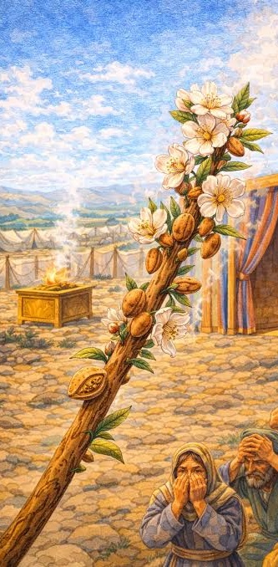
5. Aaron’s Rod
NUMBERS 17:8 And it came to pass, that on the morrow Moses went into the tabernacle of witness; and, behold, the rod of Aaron for the house of Levi was budded, and brought forth buds, and bloomed blossoms, and yielded almonds. 9 And Moses brought out all the rods from before the LORD unto all the children of Israel: and they looked, and took every man his rod. 10 And the LORD said unto Moses, Bring Aaron's rod again before the testimony, to be kept for a token against the rebels; and thou shalt quite take away their murmurings from me, that they die not.

Slide 32
THE.MARK.OF.THE.BEAST
114 When the darkest age was on of the Jews was when Ahab, in the bloom after the great king before him; and before that, had Israel all in a beautiful condition. And Ahab come in as a borderline believer, a lukewarm condition, and went over and married this little princess, Jezebel, which was an idolater, and brought her in, and brought idolatry into Israel. 54-0513

Slide 33
THE.TOKEN
95 Moses chose twelve man to spy out the land; and bring back a token... When they got there, ten of them was scared to death. "Why, them Amalekites, we look like grasshoppers to them..." That's borderline believers.
They come through these different elements, joining church, and forms. But when it comes right up to crossing over to get the Token... Jesus Christ is not dead. It's another dimension. He lives in it… He is now in us. They couldn't believe that. And everyone, died in the wilderness, not one of them went over. 64-0308

Slide 34
QUESTIONS.AND.ANSWERS.1
93 As that supernatural brought in the Gentile kingdom, so the supernatural is taking out this [age] of the Gentiles. The kingdom was ushered in by the supernatural; it's going out by the supernatural. The walls of Jerusalem shall be trod: "Gentiles will possess it until the Gentile dispen-sation be finished." Then God turns to the Jew. 54-0103

Slide 35
Usher: (w)
An usher is a person who helps others find their way, manages seating, and maintains order during an event, service, or performance.
Essentially, their role is to act as the primary point of hospitality and logistical coordinator for the comfort of the audience or guests.

Slide 36
USHERING IN OF THE BRIDE
CHURCH.AGE.BOOK
322-4 Based on these seven visions, along with the rapid changes which have swept the world in the last fifty years, I PREDICT (I do not prophesy) that these visions will have all come to pass by 1977…I sincerely believe and maintain as a private student of the Word, along with Divine inspiration that 1977 ought to terminate the world systems and usher in the millennium.

Slide 37
Rapid Changes
The Last 100 Years · 1926–2026

Slide 38
Communication and Media
Radio in most homes (1920–30s)
Television (common by 1950s)
Satellites: live worldwide TV (1962)
Personal computers (1970s–80s)
The Internet (early 1990s)
Email & World Wide Web
Smartphones (2007)
Social media (2004–2006)
Artificial intelligence (2022)

Slide 39
Travel and Transportation
Commercial air travel (1950s)
The jet age (1958)
Interstate highways (1956)
Sputnik (1957)
First man in space (1961)
Moon landing (1969)
Space shuttle and space station
Electric & self-driving cars

Slide 40
War and World Events
Great Depression (1929)
World War II (1939–1945)
The Atomic bomb (1945)
The Holocaust
Cold War & Arms race
Korea, Vietnam, Gulf, Iraq, Afghanistan
Fall of the Berlin Wall (1989)
September 11 attacks (2001)
COVID-19 pandemic (2020)

Slide 41
Israel and the Middle East
Israel became a nation — May 14, 1948
The Six-Day War — Jerusalem taken (1967)
Jews returning from all over the world
Massacre October 7, 2023

Slide 42
Medicine and Science
Penicillin and antibiotics (1928, 1940s)
Polio vaccine (1955)
DNA discovered (1953)
First heart transplant (1967)
Test-tube babies (1978)
Cloning: Dolly the sheep (1996)
Human genome mapped (2003)
1987-2012 CRISPR Technology

Slide 43
Money and Business
Credit cards (1950s)
Global trade and outsourcing
Online shopping (1994)
Cryptocurrency — Bitcoin (2009)
Cashless payments by phone
National Debt

Slide 44
Society and Morals
Women entering the workforce (WWII on)
Birth control pill (1960)
Sexual revolution (1960s)
Prayer and Bible removed from schools (1962–63)
Roe v. Wade (1973; overturned 2022)
No-fault divorce (1970s)
Same-sex marriage legal (2015)
Gender identity debates (2010s–20s)

Slide 45
Young Couple in Burlington, Vermont
THE.EXPECTATIONS
64 You people believe that God is here. Now, to you that's sick, bow your heads just a moment for prayer… Now, eternal God, be merciful and grant tonight, that as the enemy sent this young couple in, that You'll forgive their sins, that they will not be harmed, but You will forgive them. You've come to spare the life of men, but the Holy Spirit has sent His blessings to heal the people just the same. Your grace has overrode it.
But now, the people will know, and the young couple knows that I had nothing to do with them coming here, but told the night before of their being here. 58-0508

Slide 46
Daniel 12:4
But thou, O Daniel, shut up the words, and seal the book, even to the time of the end: many shall run to and fro, and knowledge shall be increased.

Slide 47
CHURCH.AGE.BOOK
128-2 Now you might desire to scold me right here for what I have said. They call themselves Pentecostal and Full Gospel. Let them prove it. At Pentecost the fire came in a cloud and separated over each of them like a tongue and fell on each one. Where is the fire? Tongues today is ringing down the curtain on the Gentile church ages and the Gospel is going back to the Jews. People are talking about tongues heralding in a great Spiritual move. They have missed the boat. The truth is that it is writing the finish to all of man's ideas, programs and kingdoms, and the kingdom of God is being ushered in. Wake up people of God.

Slide 48
THE.SEVENTH.SEAL
233 It's the end of the church age, the end of the Seven Seals, the trumpets, the vials, even ends the ushering in of the Millennium... The Seventh Seal just ends the time for the world. Everything ended up on that Seventh Seal.
It's even the time for all these things, and the ushering in of the Millennium. The breaking of this Seal was so great that heaven was hushed by it in silence for the space of a half hour. There wasn't a thing moved for a half hour… John couldn't even write of it… 63-0324

