Slide 1
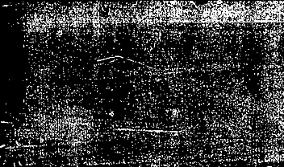
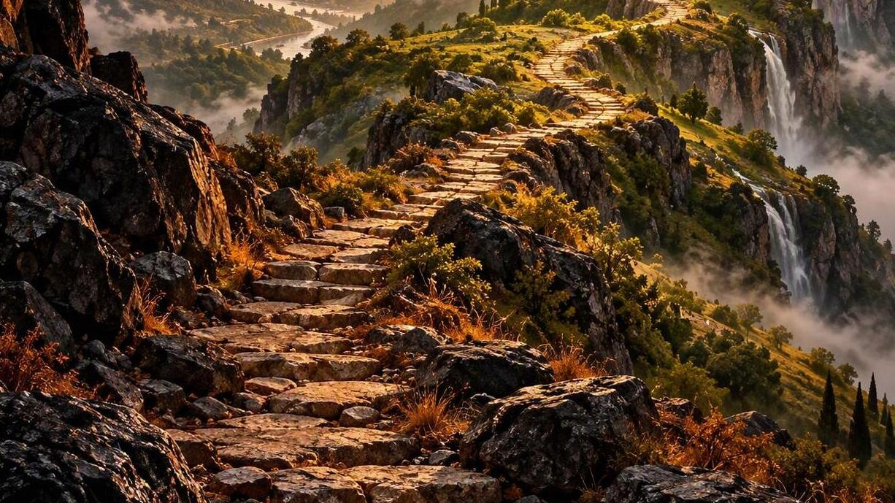
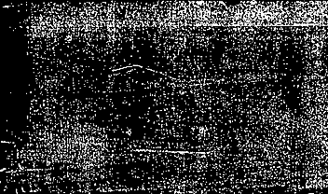

The ascending order of our journey 2
EXODUS 3:8
And I am come down to deliver them out of the hand of the Egyptians, and to bring them up out of that land unto a good land and a large, unto a land flowing with milk and honey; unto the place of the Canaanites, and the Hittites, and the Amorites, and the Perizzites, and the Hivites, and the Jebusites.
Notes:
[Sources]
AI-generated conceptual illustration: ascending path toward a sunlit landscape.
[/Sources]

Slide 2

Birthdays & Anniversaries & Events
Oct. 12th Tafara Nengomazha, Tom Ward
Oct. 13th Samuel Pugh
Oct. 15th Alora Clayville
Oct. 17th Dennis Sheppard
Oct. 18th Joseph Drum
Oct. 23rd Ethan McCafferty
Oct. 24th Fall Festival
Nov. 1st Communion Service
Dec. 19th Annual Dinner
Notes:
[Sources]
AI-generated celebration image, created for this slide.
[/Sources]

Slide 3
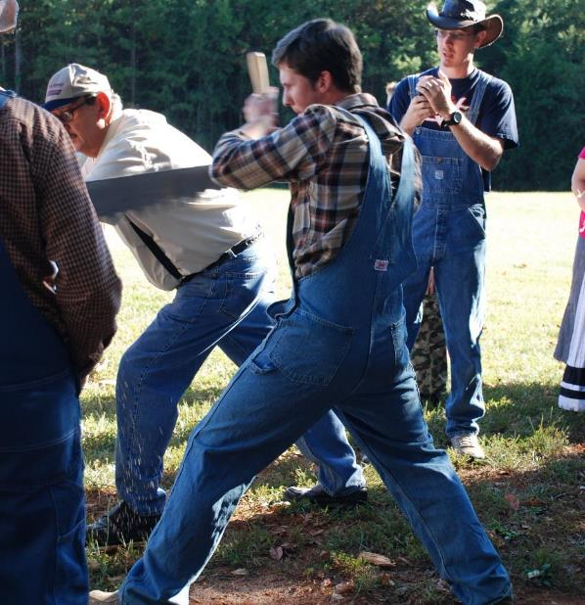
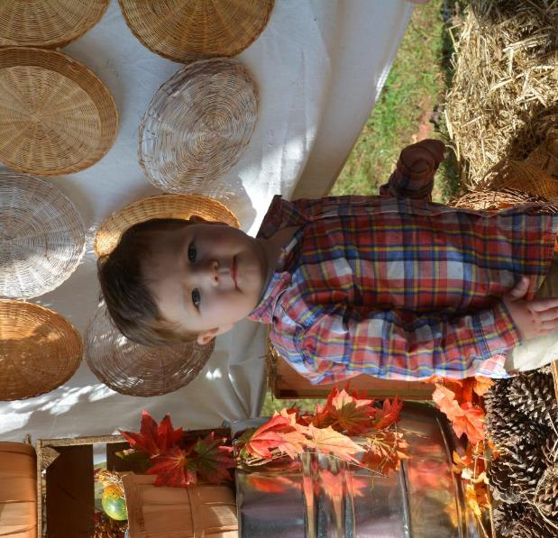

Slide 4
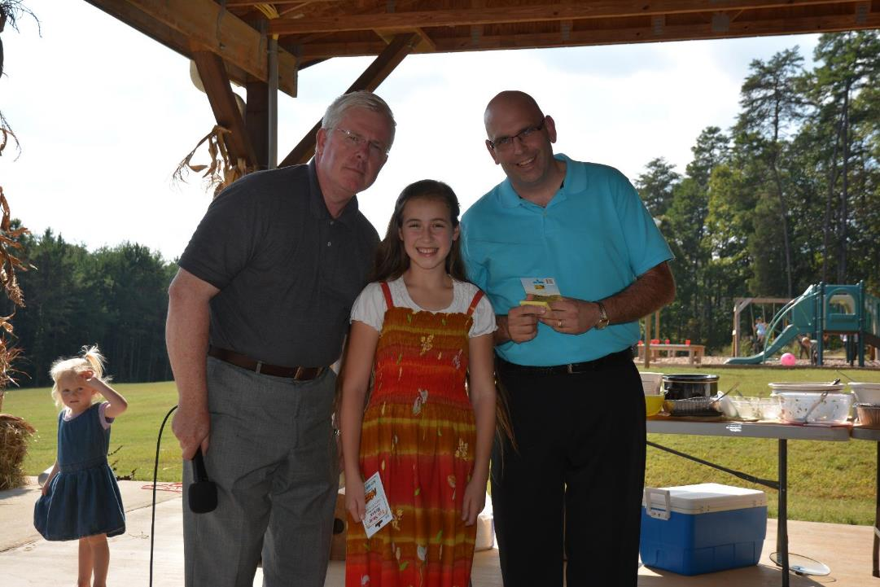

Slide 5
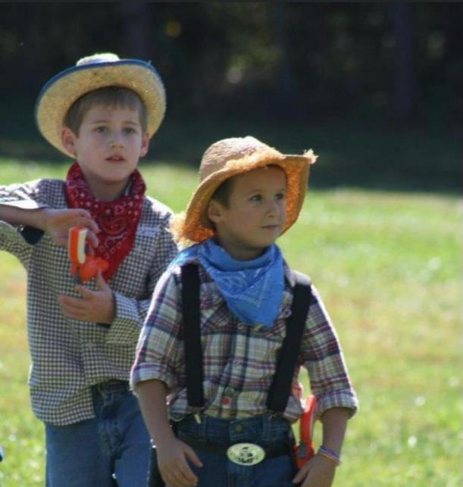
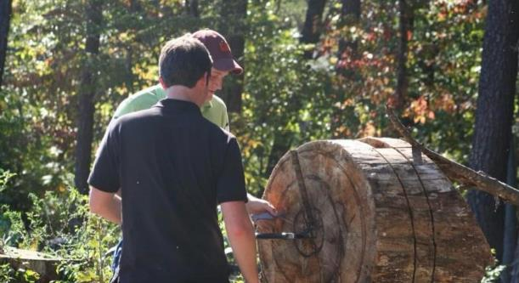
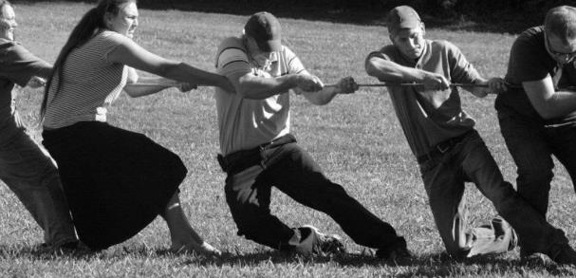

Slide 6
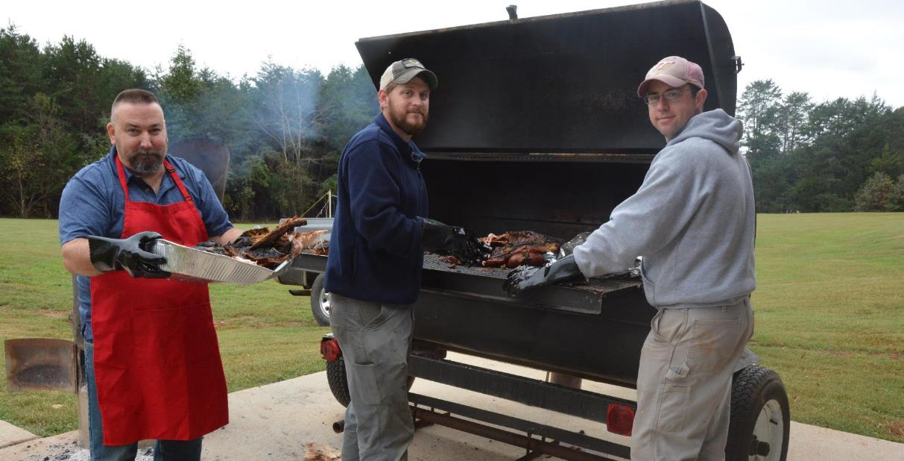

Slide 7

^{October 24th}
12:00 pm to 6:00 pm
Dress Up Encouraged

Slide 8

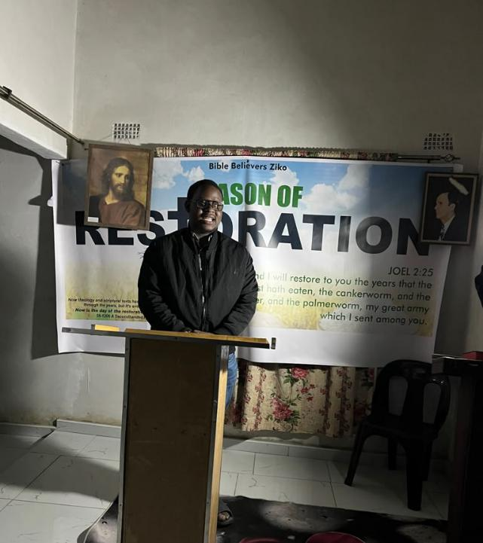
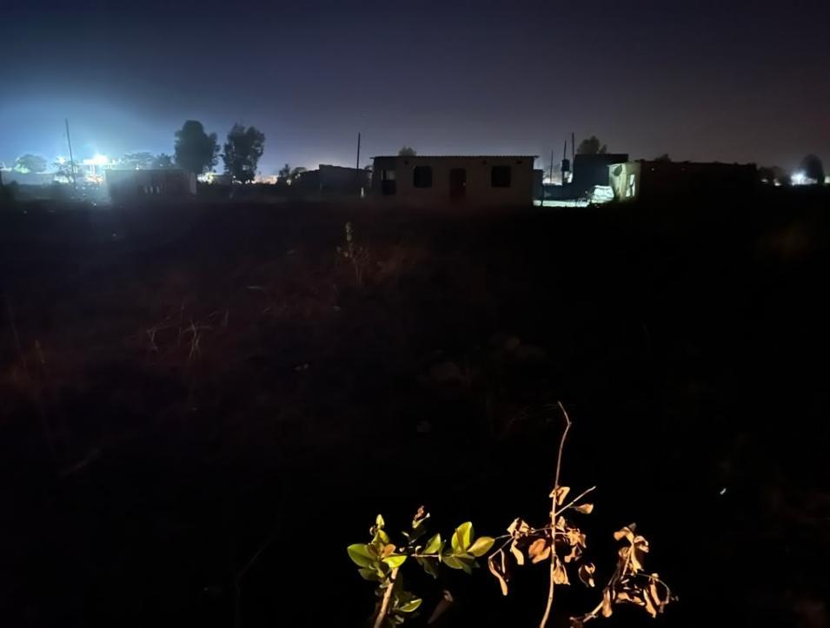
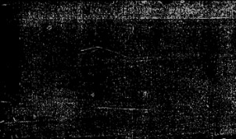
Project ZIM01 Zimbabwe
“When i visited them a few years ago, they were worshipping inside a believer’s home. Saw the church land at night and prayed over it.”

Slide 9
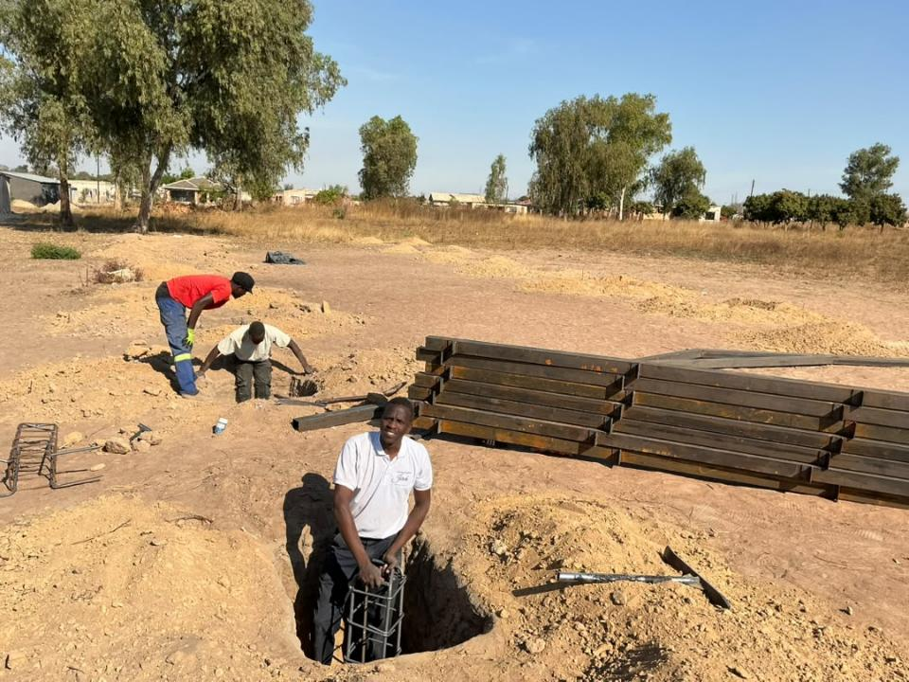

Slide 10
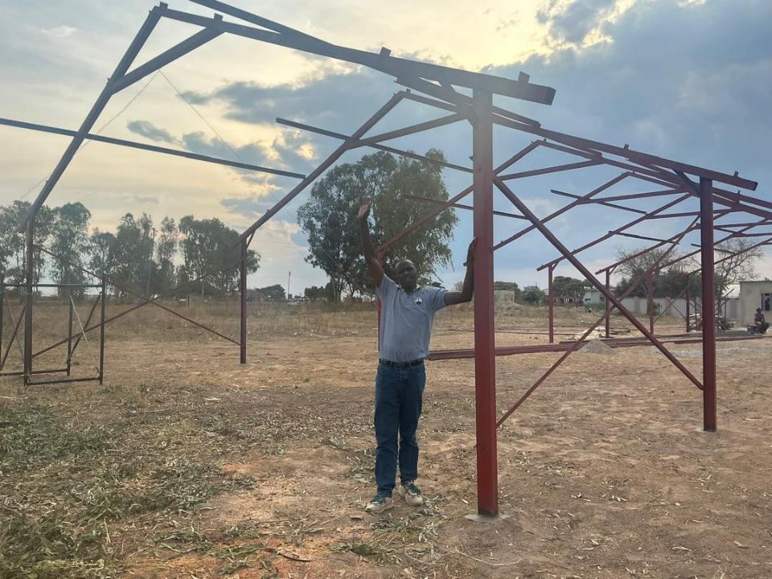

Slide 11
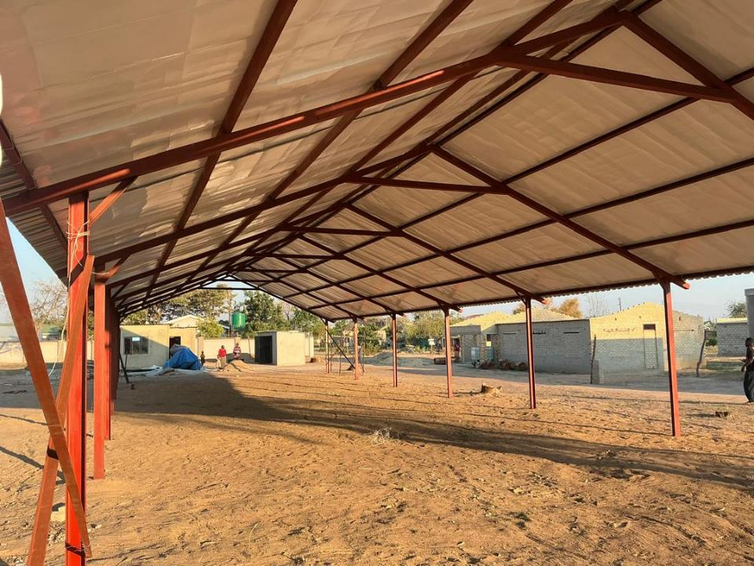

Slide 12
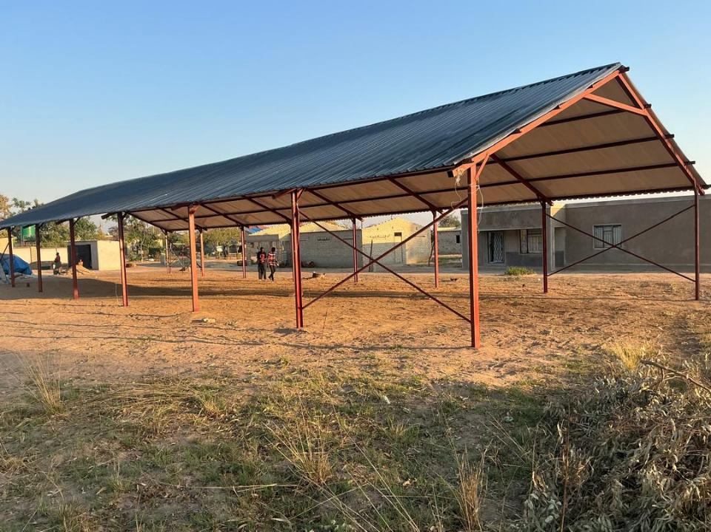

Slide 13
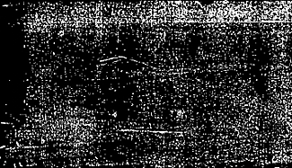
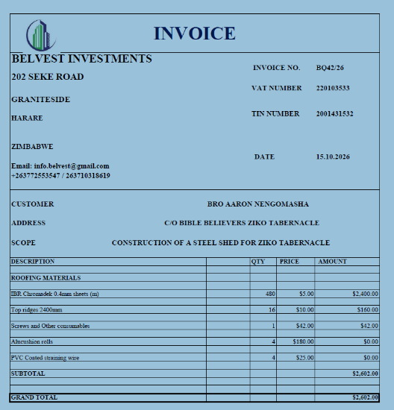

Slide 14
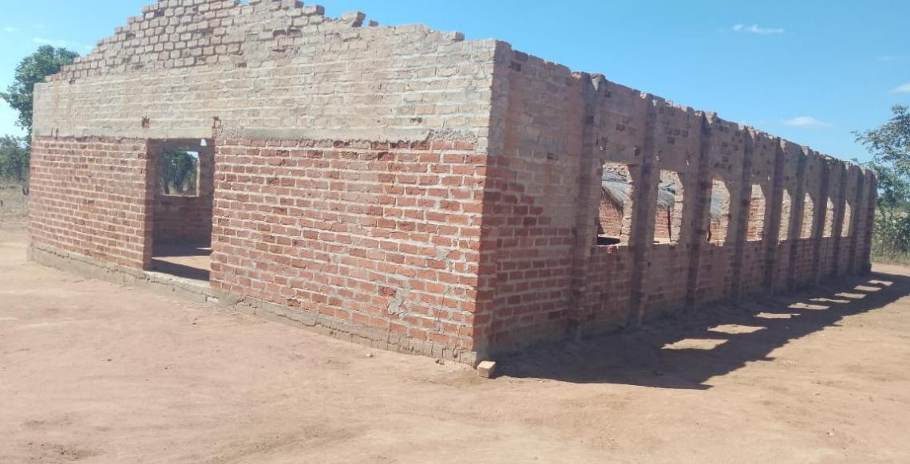
Zambia
Shalom servant of our Lord Pastor Barry.
Attached are pictures of a church building in Chinsali District, they humbly request if possible to help them with roofing materials. They built this building 2 years now. Nearly all the believers are peasant farmers.

Slide 15
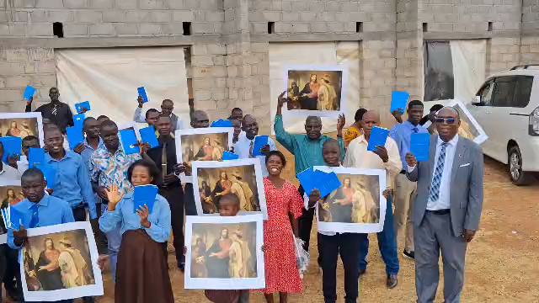

Slide 16
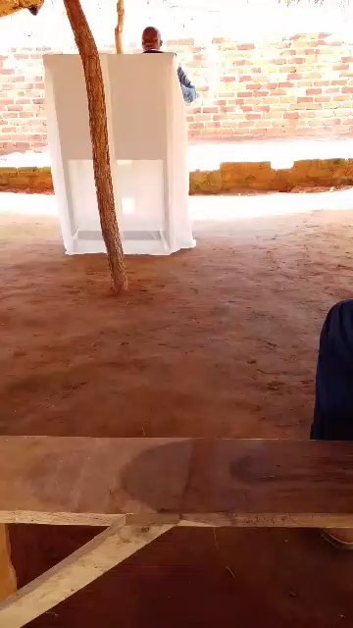

ZAM01
$2,431.39
This need is completed and
Funds are being sent to supplier.

Slide 17
The ascending order of our journey 2
EXODUS 3:8
And I am come down to deliver them out of the hand of the Egyptians, and to bring them up out of that land unto a good land and a large, unto a land flowing with milk and honey; unto the place of the Canaanites, and the Hittites, and the Amorites, and the Perizzites, and the Hivites, and the Jebusites.
Notes:
[Sources]
AI-generated conceptual illustration: ascending path toward a sunlit landscape.
[/Sources]

Slide 18
THE.THIRD.EXODUS
299 The first exodus, what did He do? He brought them out of a natural land, to a natural land.
300 The second exodus, He brought them out from a spiritual condition, into a spiritual baptism of the Holy Ghost.
301 Now [Third Exodus] He is bringing them from the spiritual baptism of the Holy Ghost, right back into the Eternal Land of the Millennium and the great Hereafter.
Same Pillar of Fire, by the same anointed system, the same God doing the same things!

Slide 19
And the same Word, declared the first one, declared the second one. The same Word… has declared the third one, and here we see It among us.
302 Come out. Oh! Come out of this chaos. Come to the living God. Come to the Word. "And the Word was made flesh and dwelt among us." And now He's in our flesh, dwelling among us. Come out and serve the living God. 63-0630

Slide 20
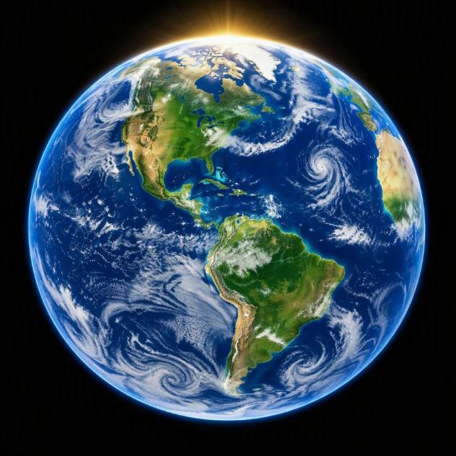
Isaiah 65:17
For, behold, I create new heavens and a new earth: and the former shall not be remembered, nor come into mind.
The Seven Church Ages
The truth is that it is writing the finish to all of man's ideas, programs and kingdoms, and the kingdom of God is being ushered in. Wake up people of God. Wake up.
Notes:
[Sources]
AI-generated conceptual globe illustration for new heavens and new earth.
[/Sources]

Slide 21
CHURCH.AGE.BOOK
128-2 Now you might desire to scold me right here for what I have said… Tongues isn't the evidence of revival. It is the evidence of death. Tongues proclaimed the evidence that the ceremonial religion of the Jews was over, that a new era had begun. Tongues today is ringing down the curtain on the Gentile church ages and the Gospel is going back to the Jews. People are talking about tongues heralding in a great Spiritual move. They have missed the boat…

Slide 22
Isaiah 65:17
For, behold, I create new heavens and a new earth: and the former shall not be remembered, nor come into mind.
The Seven Church Ages
The truth is that it is writing the finish to all of man's ideas, programs and kingdoms, and the kingdom of God is being ushered in. Wake up people of God. Wake up.
Notes:
[Sources]
AI-generated conceptual globe illustration for new heavens and new earth.
[/Sources]

Slide 23
Seed Not Heir With Shuck
Now, if we're to have a new earth, the new world and the old world cannot exist at the same time. There can't be two world orders together at the same time.
Now, in order to get the new earth, the old one has to die. 65-0218

Slide 24
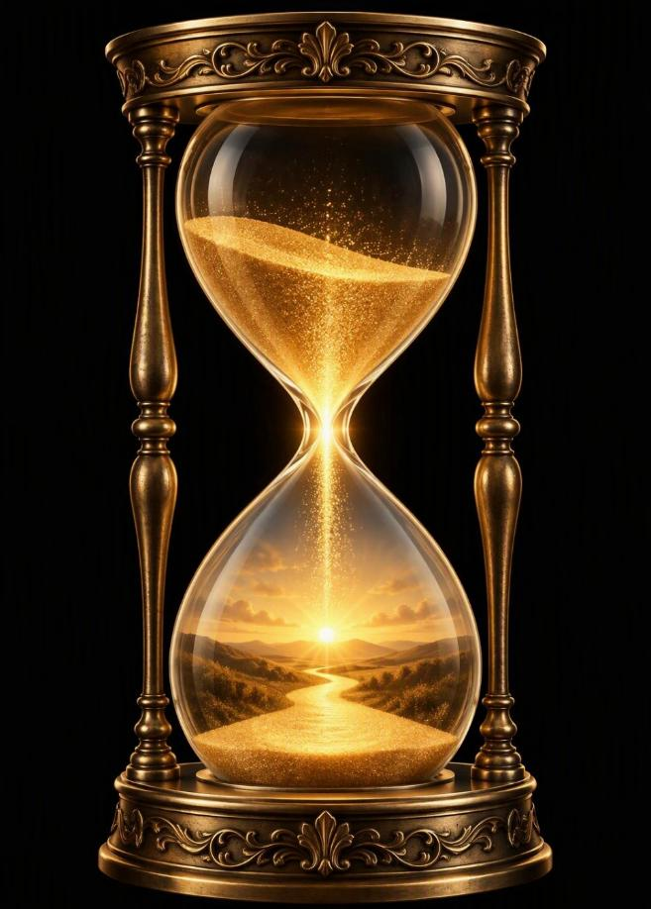
The Junction Of Time
The junction, God always, before these great junctions comes or ending off time where He starts something new with the old to the new, with one dispensation to another He always shows forth His power. 56-0115
Notes:
[Sources]
AI-generated symbolic hourglass illustration, inspired by the quotation on this slide.
[/Sources]

Slide 25
ISAIAH 61:1-4
The Spirit of the Lord GOD is upon me; because the LORD hath anointed me to preach good tidings unto the meek; he hath sent me to bind up the brokenhearted, to proclaim liberty to the captives, and the opening of the prison to them that are bound; 2 To proclaim the acceptable year of the LORD, and the day of vengeance of our God; to comfort all that mourn; 3 To appoint unto them that mourn in Zion, to give unto them beauty for ashes, the oil of joy for mourning, the garment of praise for the spirit of heaviness; that they might be called trees of righteousness, the planting of the LORD, that he might be glorified. 4 And they shall build the old wastes, they shall raise up the former desolations, and they shall repair the waste cities, the desolations of many generations.

Slide 26
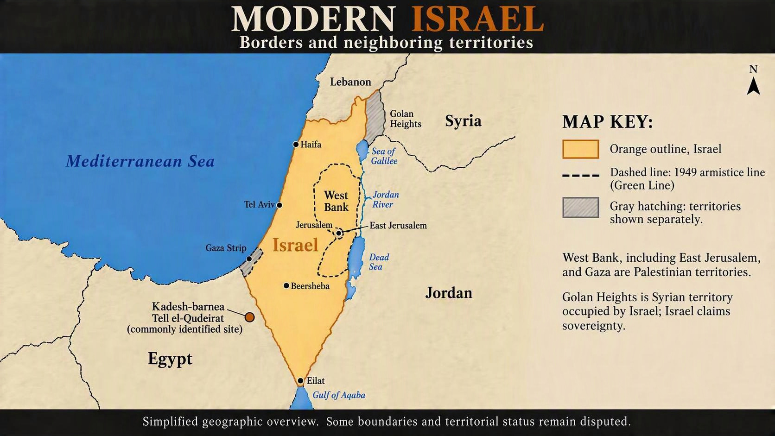
GENESIS 20:1
And Abraham journeyed from thence toward the south country, and dwelled between Kadesh and Shur, and sojourned in Gerar.
Notes:
[Sources]
Restored AI-generated schematic map with requested uniform West Bank fill. Fill is a visual styling choice, not a sovereignty claim. Labels and Green Line retained. Not a legal boundary survey or current military control map.
https://www.britannica.com/place/Israel
https://en.wikipedia.org/wiki/Borders_of_Israel
https://en.wikipedia.org/wiki/Green_Line_%28Israel%29
Kadesh-barnea: Tell el-Qudeirat, commonly identified site in northeastern Sinai, Egypt.
https://www.biblicalarchaeology.org/daily/biblical-sites-places/biblical-archaeology-places/wilderness-wanderings-where-is-kadesh/
[/Sources]

Slide 27
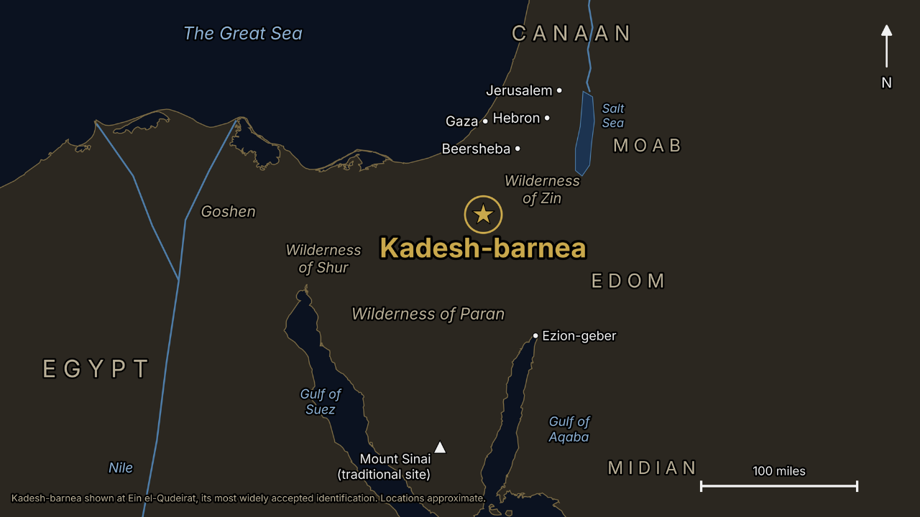

Slide 28
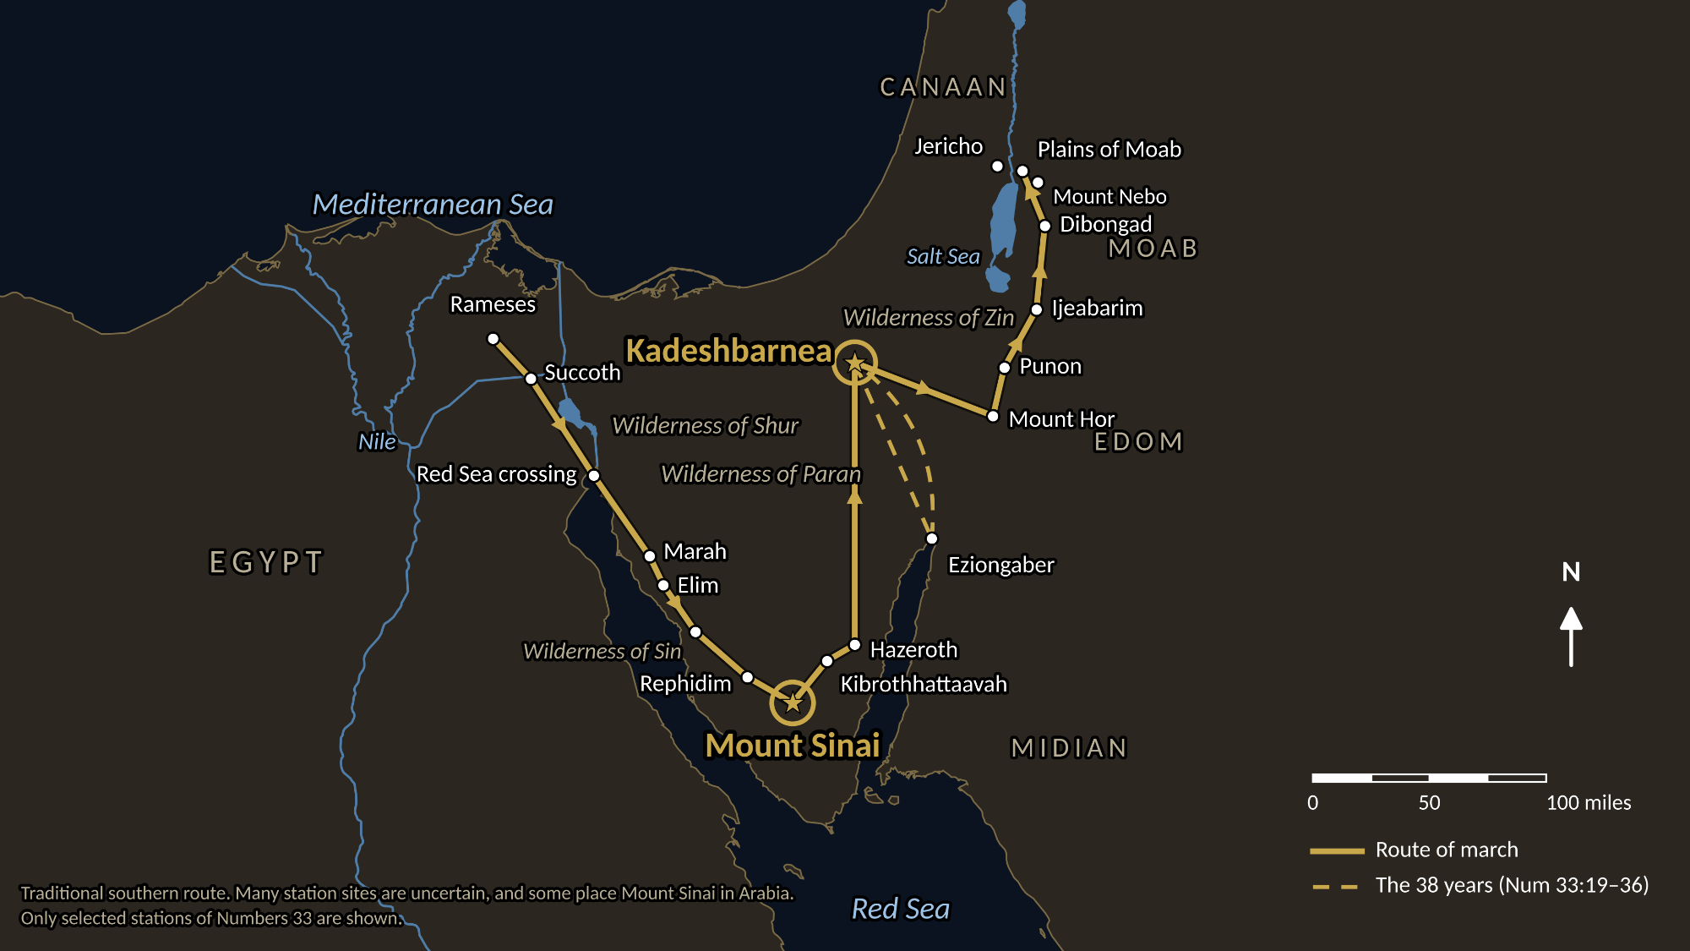

Slide 29
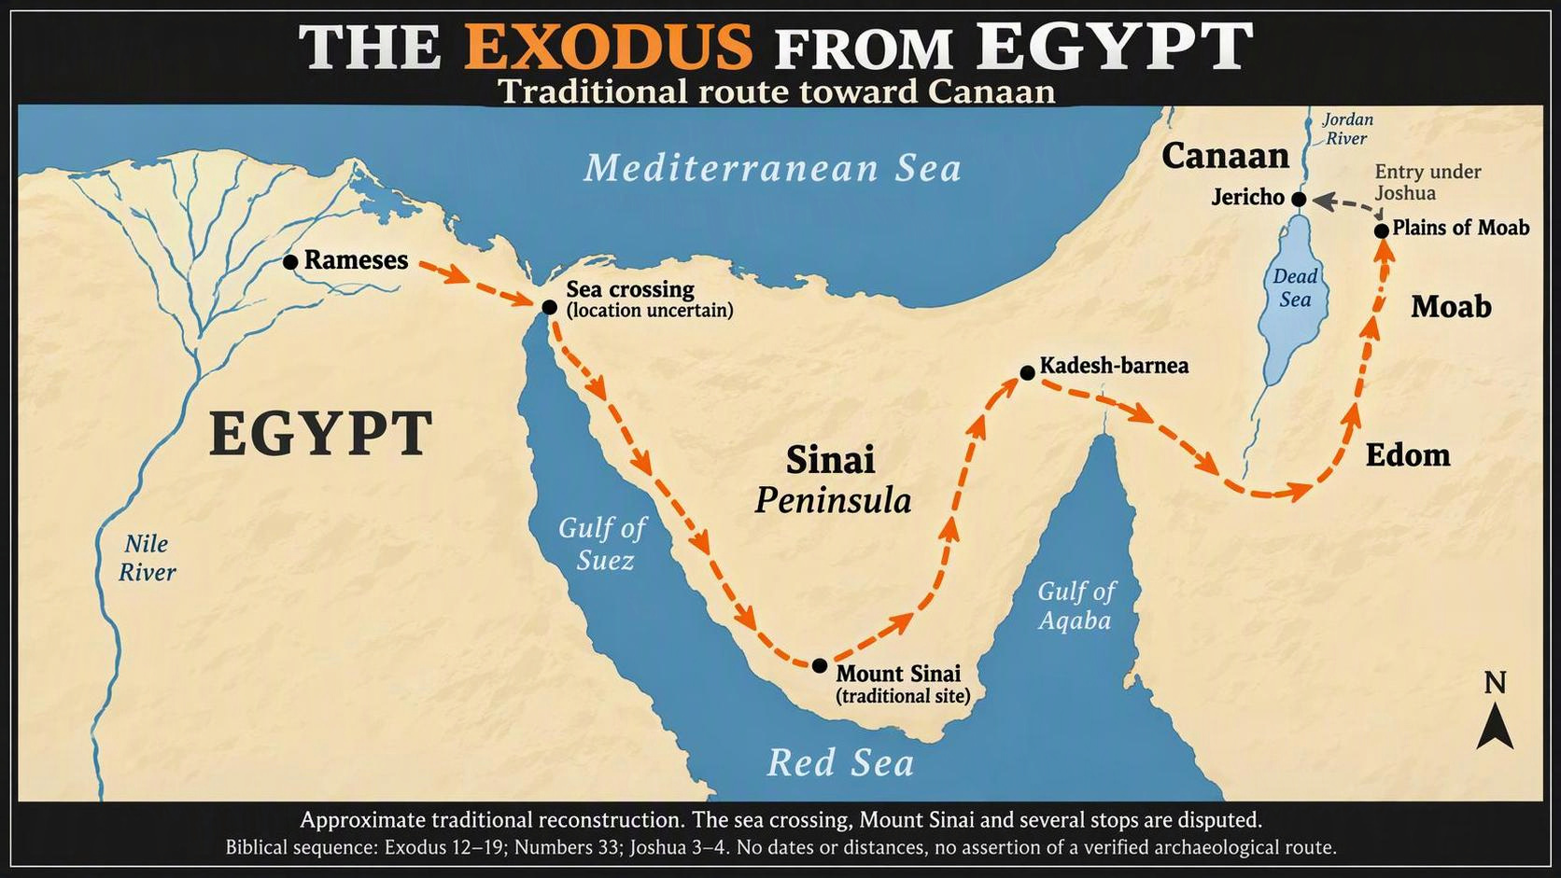

Slide 30
Numbers 13:30
And Caleb stilled the people before Moses, and said, Let us go up at once, and possess it; for we are well able to overcome it.
Numbers 14:6–9
And Joshua the son of Nun, and Caleb the son of Jephunneh, which were of them that searched the land, rent their clothes: And they spake unto all the company of the children of Israel, saying, The land, which we passed through to search it, is an exceeding good land. If the LORD delight in us, then he will bring us into this land, and give it us; a land which floweth with milk and honey. Only rebel not ye against the LORD, neither fear ye the people of the land; for they are bread for us: their defence is departed from them, and the LORD is with us: fear them not.

Slide 31
A Total Separation From Unbelief
When they come to the borderland, Kadesh-barnea, the great mistake they made... When they got to the land and looked over into the promised land, they said, 'We can't take it.’ They looked at the circumstances, the prestige they would lose. But Joshua and Caleb… went back to the Word, 'I give you this land. It's a good land flowing with milk and honey.' They didn't count what they looked like...
God's Word said, 'I give it to you. Go get it.' And they were the only ones that went in. 64-0121

Slide 32

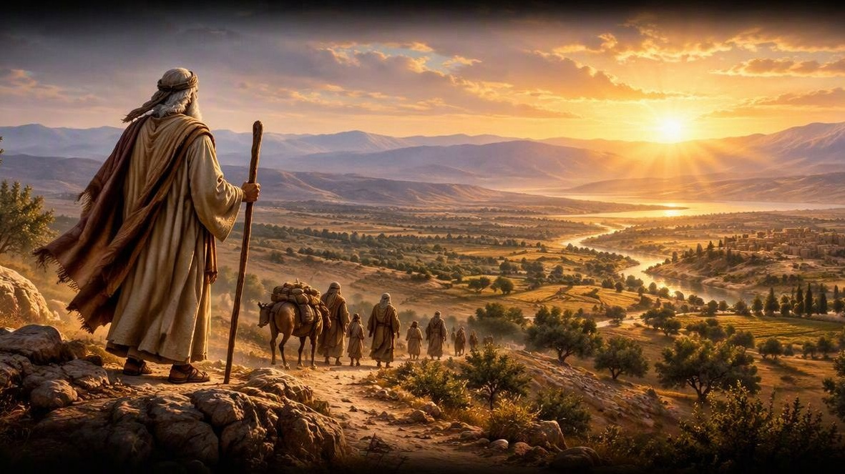
Genesis 12:1-3
12 Now the Lord had said unto Abram, Get thee out of thy country, and from thy kindred, and from thy father's house, unto a land that I will shew thee: 2 And I will make of thee a great nation, and I will bless thee, and make thy name great; and thou shalt be a blessing: 3 And I will bless them that bless thee, and curse him that curseth thee: and in thee shall all families of the earth be blessed.
Notes:
[Sources]
AI-generated artistic interpretation of Abram setting out toward a new land, inspired by the Genesis 12:1-3 passage on this slide.
[/Sources]

Slide 33
*Transition Between Numbers 14 & 15
NUMBERS 14:40-42
And they rose up early in the morning, and gat them up into the top of the mountain, saying, Lo, we be here, and will go up unto the place which the LORD hath promised: for we have sinned. 41 And Moses said, Wherefore now do ye transgress the commandment of the LORD? but it shall not prosper. 42 Go not up, for the LORD is not among you; that ye be not smitten before your enemies.
NUMBERS 15:1
And the LORD spake unto Moses, saying, 2 Speak unto the children of Israel, and say unto them, When ye be come into the land of your habitations, which I give unto you…

Slide 34
Numbers 14:22–23
Because all those men which have seen my glory, and my miracles, which I did in Egypt and in the wilderness, and have tempted me now these ten times, and have not hearkened to my voice; Surely they shall not see the land which I sware unto their fathers, neither shall any of them that provoked me see it:

Slide 35
CHURCH.AGE.BOOK (Pg. 279)
1. It was God's purpose to bring forth a people like unto Himself that would be a Word Bride. She was chosen before the foundation of the world IN HIM. She was redeemed by His blood and can NEVER come into condemnation.
2. Secondly, another class. Their names are also in the Book of Life and they will come up in the second resurrection. (Foolish virgins and the righteous of Matt. 25). [They] do not worship the beast or become involved in the antichrist system but die for their faith (not in the Bride, not having been born again.) Come up in the 2nd resurrection and go into eternal life.

Slide 36
3. Thirdly, the borderline Christians such as we saw in Israel coming out of Egypt. These had their names in the Book of Life and their works written in the books. These having failed to obey God and being void of the Spirit… will have their names removed from the Book of Life. (Eg. Judas, Balaam, etc.)
4. Fourth and finally are the ones whose names have never been or will ever be written on the books.

Slide 37
ANOINTED.ONES.AT.THE.END.TIME
196 Look at those people who come out under Moses' prophecy, out of that organization, out of everything, under the prophecy, saw the great works and wonders, come up to the borderline of going in.
Lee, there comes your "name on the Book."
65-0725

Slide 38
RECOGNIZING.YOUR.DAY.AND.ITS.MESSAGE
82 I was reading one of the outstanding papers comes here, very fine paper… Herald of His Coming. But they hardly print anything unless it's, "Fast, pray! Fast, pray! Sound a trumpet!"
83 Why do they do that? They're crying, believing that there will be awakening. They're good people. They have not recognized the awakening of the Bride. Being a Christian, they feel the pull of the hour... they're looking for it way off in the future, to come, when it's already happened right by you. 64-0726

Slide 39
INVASION.OF.THE.UNITED.STATES
40 [Ahab] was riding on the reputation of other Israelite kings [and he] was kind of a borderline believer. I've often referred to him that way, because he was part time on this side of the fence, part of the time on that side of the fence.
A person that professes to be a Christian, and unstable, you don't know what to do about the person. Today they're a Christian; tomorrow you don't know where they're at. In church today, rejoicing, singing, praising God, and tomorrow, out drinking, carousing, running around. Then that type of a person is hard to do anything with. 54-0509

Slide 40
The Vindication of Moses: 70 Elders
1. Numbers 11:16–30
And the LORD said unto Moses, Gather unto me seventy men of the elders of Israel, whom thou knowest to be the elders of the people, and officers over them; and bring them unto the tabernacle of the congregation, that they may stand there with thee. 17 And I will come down and talk with thee there: and I will take of the spirit which is upon thee, and will put it upon them; and they shall bear the burden of the people with thee, that thou bear it not thyself alone.
25 And the LORD came down in a cloud, and spake unto him, and took of the spirit that was upon him, and gave it unto the seventy elders: and it came to pass, that, when the spirit rested upon them, they prophesied, and did not cease.

Slide 41
2. Miriam & Aaron
NUMBERS 12:1-7
And Miriam and Aaron spake against Moses because of the Ethiopian woman whom he had married: for he had married an Ethiopian woman. 2 And they said, Hath the LORD indeed spoken only by Moses? hath he not spoken also by us? And the LORD heard it.
7 My servant Moses is not so, who is faithful in all mine house. 8 With him will I speak mouth to mouth, even apparently, and not in dark speeches; and the similitude of the LORD shall he behold: wherefore then were ye not afraid to speak against my servant Moses?

Slide 42
3. The Report of the Spies
NUMBERS 14:8-10
If the LORD delight in us, then he will bring us into this land, and give it us; a land which floweth with milk and honey. 9 Only rebel not ye against the LORD, neither fear ye the people of the land; for they are bread for us: their defence is departed from them, and the LORD is with us: fear them not. 10 But all the congregation bade stone them with stones. And the glory of the LORD appeared in the tabernacle of the congregation before all the children of Israel.

Slide 43
4. Korah, Dathan & Abiram.
NUMBERS 16:2
And they rose up before Moses, with certain of the children of Israel, two hundred and fifty princes of the assembly, famous in the congregation, men of renown: 3 And they gathered themselves together against Moses and against Aaron, and said unto them, Ye take too much upon you, seeing all the congregation are holy, every one of them, and the LORD is among them: wherefore then lift ye up yourselves above the congregation of the LORD?

Slide 44
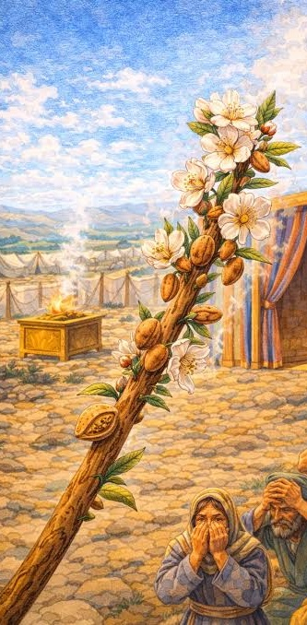
5. Aaron’s Rod
NUMBERS 17:8 And it came to pass, that on the morrow Moses went into the tabernacle of witness; and, behold, the rod of Aaron for the house of Levi was budded, and brought forth buds, and bloomed blossoms, and yielded almonds. 9 And Moses brought out all the rods from before the LORD unto all the children of Israel: and they looked, and took every man his rod. 10 And the LORD said unto Moses, Bring Aaron's rod again before the testimony, to be kept for a token against the rebels; and thou shalt quite take away their murmurings from me, that they die not.

Slide 45
THE.MARK.OF.THE.BEAST
114 When the darkest age was on of the Jews was when Ahab, in the bloom after the great king before him; and before that, had Israel all in a beautiful condition. And Ahab come in as a borderline believer, a lukewarm condition, and went over and married this little princess, Jezebel, which was an idolater, and brought her in, and brought idolatry into Israel. 54-0513

Slide 46
THE.TOKEN
95 Moses chose twelve man to spy out the land; and bring back a token... When they got there, ten of them was scared to death. "Why, them Amalekites, we look like grasshoppers to them." Joshua and Caleb, bringing the evidence, "We can do it!“ That's borderline believers.
They come through these different elements, joining church, and forms. But when it comes right up to crossing over to get the Token... Jesus Christ is not dead. It's another dimension. He lives in it… He is now in us. They couldn't believe that. And everyone, died in the wilderness, not one of them went over. 64-0308

