Slide 1
The Bride-body
of Jesus Christ
Gen. 2, 23 - 24
And Adam said, This is now bone of my bones, and flesh of my flesh: she shall be called Woman, because she was taken out of Man.
Therefore shall a man leave his father and his mother, and shall cleave unto his wife: and they shall be one flesh.
Hickory, 7. October 2026

Slide 2
Eph. 5, 30
For we are members of His body, of His flesh, and of His bones.
Col. 1, 18
And He is the head of the body, the church: who is the beginning, the firstborn from the dead; that in all things He might have the preeminence.

Slide 3
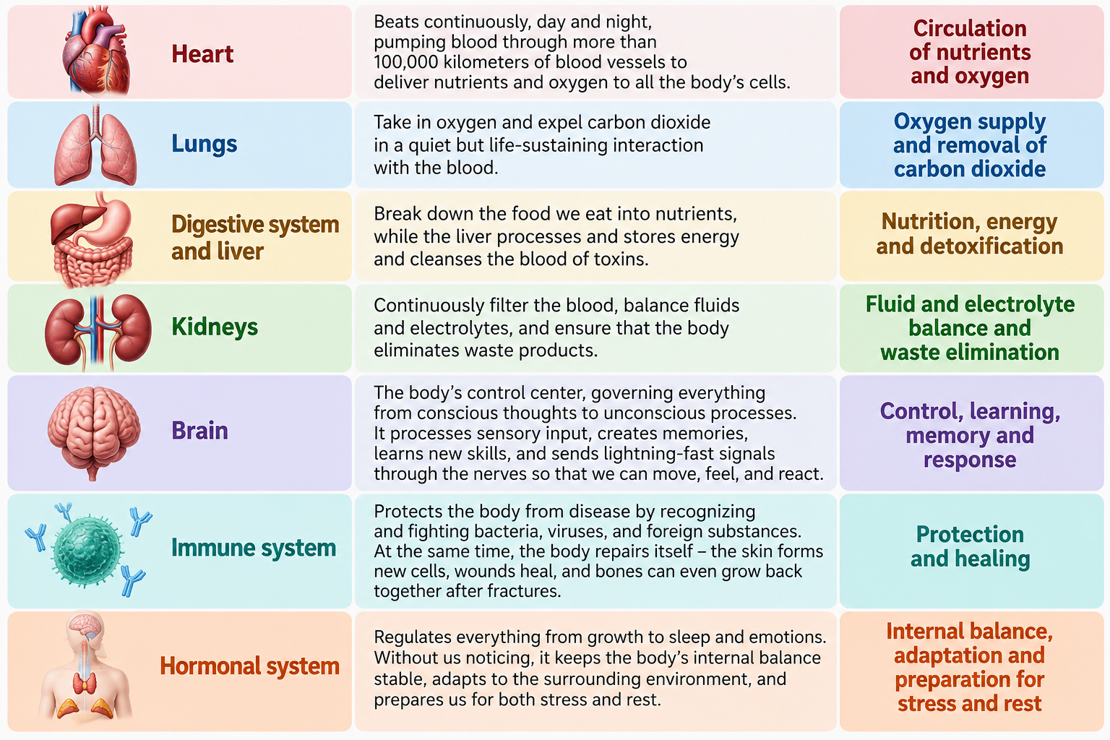

Slide 4
Eph. 4, 11 - 14
And He gave some, apostles; and some, prophets; and some, evangelists; and some, pastors and teachers;
For the perfecting of the saints, for the work of the ministry, for the edifying of the body of Christ:
Till we all come in the unity of the faith, and of the knowledge of the Son of God, unto a perfect man, unto the measure of the stature of the fulness of Christ:
That we henceforth be no more children, tossed to and fro, and carried about with every wind of doctrine, by the sleight of men, and cunning craftiness, whereby they lie in wait to deceive;

Slide 5
Eph. 4, 15 - 16
But speaking the truth in love, may grow up into Him in all things, which is the Head, even Christ:
From whom the whole body fitly joined together and compacted by that which every joint supplieth, according to the effectual working in the measure of every part, maketh increase of the body unto the edifying of itself in love.

Slide 6
Eph. 4, 15 – 16 (AMP)
But speaking the truth in love
[in all things—both our speech and our lives expressing His truth],
let us grow up in all things into Him
[following His example]
who is the Head—Christ.
From Him the whole body
[the church, in all its various parts],
joined and knitted firmly together by what every joint supplies, when each part is working properly, causes the body to grow and mature, building itself up in
[unselfish]
love

Slide 7
Eph. 5, 30 - 32
we are members of his body, of his flesh, and of his bones.
For this cause shall a man leave his father and mother, and shall be joined unto his wife, and they two shall be one flesh.
This is a great mystery: but I speak concerning Christ and the church.

Slide 8
1. Cor. 6, 16
What? know ye not that he which is joined to an harlot is one body? for two, saith He, shall be one flesh.

Slide 9
Php. 2, 6 - 7
Who, being in the form of God, thought it not robbery to be equal with God:
But made himself of no reputation, and took upon him the form of a servant, and was made in the likeness of men:

Slide 10
Php. 2, 6 – 7 (AMP)
Who, although He existed in the form and unchanging essence of God
[as One with Him, possessing the fullness of all the divine attributes—the entire nature of deity],
did not regard equality with God a thing to be grasped or asserted
[as if He did not already possess it, or was afraid of losing it];
but emptied Himself
[without renouncing or diminishing His deity, but only temporarily giving up the outward expression of divine equality and His rightful dignity]
by assuming the form of a bond-servant, and being made in the likeness of men
[He became completely human but was without sin, being fully God and fully man].

Slide 11

Metamorphosis
A profound transformation, of appearance.

Slide 12
1. Cor. 6, 16 - 17
What? know ye not that he which is joined to an harlot is one body? for two, saith He, shall be one flesh.
But he that is joined unto the Lord is one spirit.
Cor. 12, 13a
For by one Spirit are we all baptized into one body,

Slide 13
§ 413. God in His Body, Christ; and Christ in His Body, the Bride. Oh-oh-oh, my! God made manifest in Christ; Christ made manifest in the Bride!
And as God took from the body of Adam, the woman, and she fell; then God has took from the Body of Christ, His flesh, His Body, which is His Word, and is bringing a Bride out that won't fall by denomination or creed. No, sir.
But She is coming back with the pure, unadulterated Word of God being manifested.
Christ is the mystery of God revealed. 1963

Slide 14
§ 80. That's the way it has to be with every believer today, filled with the Holy Ghost; a Token that the shed Blood of the Lamb, that Life that was in the Lamb, has returned back and is publicly sealed in there.
That everybody passing by, talking to you, has any associates with you, seeing that the Blood has been applied, and the Token of the Life that was in that Blood is upon you.
You are safe from the wrath. That alone; not membership. No, sir!
The Token. 1963

Slide 15
§ 70. Christianity has to display its Token, see, publicly, in public life, at the office, on the street, when trouble is around, anything, in church, everywhere else.
The Blood is the Token, and the Token must be applied, see, or (it's not) even the covenant is not in effect.
The Token. 1963

Slide 16
§ 116. The Dynamics of this Church will be a refilling of the Holy Spirit that we have worked in a small measure while the Headstone is coming down to unite with the Body.
But when that Head and Body unites together, the full power of the Holy Ghost would raise Her up just exactly like that; even the dead, that's dead in Christ, for hundreds of years ago, will rise in the beauty of His holiness, and take a flight to the skies. The Dynamics is the Holy Spirit.
What shal we do with Jesus called Christ. 1963

Slide 17
§ 235b. When, the Word here unites with the person, and they two become one.
And then what does it do then? It manifests the Son of man again, not the church theologians. The Son of man!
The Word and the Church becomes one. Whatever the Son of man done, He was the Word, the Church does the same thing.
Proving His Word. 1964

Slide 18
§ 24. And I am looking for a time of a break forth, of the Spirit of God, in these last days that we're now living in; for another surge of the Holy Spirit, into the Church; for a rapturing faith, just before it comes.
And everything is sitting straight in order for that. And I believe that we're now at the time that the Word should have preeminence. I believe that the time to lay aside our creeds and our thoughts, and come back to the Word.
The Token. 1963

Slide 20
§ 111. And as He, being the Groom, the Bride has to come forth, 'cause It's part of Him.
And It can only be the manifestation of the fulfilling of all the revelations any others has spoke of the Bride; It can only manifest.
If it does something different from the Groom, it isn't the Bride. Because, She is flesh of His flesh, bone of His bone; Life of His Life, Power of His Power! She is Him!
As man and woman are one, and woman taken from his side; She had taken a Spirit, the feminish Spirit, from Him.
It is the rising of the Sun. 1965

Slide 21
§ 6-4. Now, we are approaching the Seven Seals.
We've just finished the seven church ages,
and this is a message on teaching that ties the man in that's going to be redeemed by the Blood of the Lord Jesus, and is going to be in that church age--that eternal church age at the end of the Seals.
The stature of a perfect man. 1962

Slide 22
Now watch what's come after the Seven Seals: the uniting of the people, united signs, the red light flashing in the last days, the sign of women getting prettier, and man, what they would do.
All these signs of the Holy Spirit leading up, then come right back here to the capping-off of all those Messages since the Seven Seals. It's capped off in this one thing, the Token, that we are all right, see, just check ourselves and see if we're in the Faith.
§ 29 Desperation. 01.09.63

Slide 23
With all the Message that I ever brought, that absolute was ordained of God, outside of the...
Course, the regular commission, like the Seven Seals and things, that was directly the Word of God.
I'm talking about a Message to preach; I believe that one was it, see, that--that, the one that's needed to follow those Seven Seals.
§ 28 Desperation. 01.09.63

Slide 24
This morning, the message this morning was, to me, the highlights Message of my entire ministry; this morning, see, a highlight Message of my entire ministry.
Someday I'll tell you how it come about. And I know that everything has worked for months and months and months, up to that one Message, moving up to come to that place. That was the capping-off time of it, you see.
§ 9 Desperation. 01.09.63

Slide 25
§ 111. Idet Han er Brudgom, må Bruden komme fram, for hun er en del av Ham. Det kan bare manifesteres gjennom oppfyllingen av åpenbaringen som er talt om Bruden. Det må manifesteres. Hvis det er forskjellig fra Brudgommen, er det ikke Bruden, fordi hun er kjød av Hans kjød, ben av Hans ben, Liv av Hans Liv, Kraft av Hans Kraft, hun er Ham!
Som man og kvinne er ett, kvinnen tatt fra Hans side, har hun fått en ånd, den feminine Ånd, fra Ham.
Det er Solens oppgang 1965

