Slide 1
The ascending order of our journey
PSALM 37:23
The steps of a good man are ordered by the LORD: and he delighteth in his way.

Slide 2
Birthdays & Anniversaries & Events
Oct. 3rd Sophie Cockman
Oct. 5th Jaron & Chenelle Brown
Oct. 8th Jason Hans
Oct. 15th (Noon) WYR Registration Opens
Oct. 24th Fall Festival

Slide 3
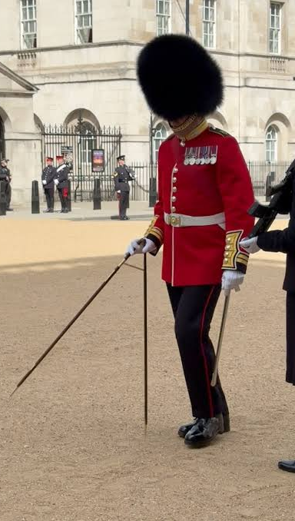
JUDGES 5:4-5
LORD, when thou wentest out of Seir, when thou marchedst out of the field of Edom, the earth trembled, and the heavens dropped, the clouds also dropped water. 5 The mountains melted from before the LORD, even that Sinai from before the LORD God of Israel.

Slide 4
HEBREWS 10:35
Cast not away therefore your confidence, which hath great recompence of reward.
Confidence:
Free and fearless confidence, cheerful courage, boldness, assurance;
The deportment by which one becomes conspicuous or secures publicity.

Slide 5
THE.WORKING.OF.THE.HOLY.SPIRIT
So friends, what do you Canadian people need? You got a lovely country; the prettiest in the world, if... I kinda believe in a Millennium. And you know where I want the Lord to let me live in the Millennium? I want to live at Banff and Jasper, over there in that part. So you all come over to see me. I'm going to be a Canadian during that time. 56-0816

Slide 6
THE.GREATEST.GIFT.IN.THE.BIBLE
36 Sometime ago, I was in a great city in this wonderful, beautiful, God-given Canada... If I was a young man, I'd want to become a citizen of Canada. It's got more to offer. I like Canada. All my travels, there's no prettier spot I ever seen in my life, than Banff and Jasper. I been to Jungfraujoch, and Eigerwand Mountain, all through the Swiss Alps, Germany, all around the world, but Banff and Jasper has got anything beat the world's got to offer. Maybe the Lord will let me live there in the Millennium. I hope He will. 57-0811

Slide 7
Leading Existential Threats
1. Artificial Intelligence (AI): Rapid advancements in superintelligence have prompted warnings from tech insiders and researchers. Some experts estimate a significant probability (around 10%) that autonomous systems could lead to catastrophic loss of control or human disempowerment. Regulatory concerns also cover AI-driven cyberattacks and automated biological weapons development.
2. Climate Change & Ecological Collapse: Unchecked global warming (such as warming exceeding 4°C above pre-industrial levels) risks triggering compounding feedback loops like permafrost melting and cascading failures across global food and water systems
3. Nuclear Warfare: Geopolitical tensions and the proliferation of nuclear arsenals continue to pose an immediate baseline risk of total catastrophe that could end human civilization abruptly.
4. Synthetic Biology & Bioweapons: The acceleration of synthetic biology increase the risk of engineered, highly virulent pathogens escaping labs or”won deployed intentionally.

Slide 8
THE.THYATIREAN.CHURCH.AGE (Rev. 13:3-4, 14-16)
141 And then you see here now that she caused all (rich, poor) to receive a mark; Revelation 13:3-4 And I saw one of his: heads as it were wounded to death; and his deadly wound was healed: and all the world wondered after the beast. 4 And they worshipped the dragon which gave power unto the beast: and they worshipped the beast, saying, Who is like unto the beast? who is able to make war with him?
14 And deceiveth them that dwell on the earth by the means of those miracles which he had power to do in the sight of the beast; saying to them that dwell on the earth, that they should make an image to the beast, which had the wound by a sword, and did live. 15 And he had power to give life unto the image of the beast, that the image of the beast should both speak, and cause that as many as would not worship the image of the beast should be killed. 16 And he causeth all, both small and great, rich and poor, free and bond, to receive a mark in their right hand, or in their foreheads:
Catholicism has swept into every nation under the heavens. As Daniel said about the iron going into the clay.

Slide 9
144 And I'll give you a little thing on that, "iron and clay…" Khrushchev headed the eastern nations, Eisenhower headed the western nations; the two big toes. Khrushchev, in Russia, means "clay." Eisenhower, in English, means "iron." We're at the end. And they worshipped the dragon which gave the power to the beast: and they worshipped the beast, saying, Who is liken unto the beast? and who is able to make war with him?
In other words Eisenhower has got a big name here in this US, but in Rome he ain't nothing; Russia, he's nothing. Khrushchev's big in Russia, but in US he's nothing. But there's one man big everywhere, that's that pope. 60-1208

Slide 10
Physics Problem:
(Your next meal depends on getting the right answer.)
A ray of starlight passes close to the edge of the Sun on its way to Earth. By how much is its path bent?
Given: the Sun's mass M = 1.989 × 10³⁰ kg, the Sun's radius R = 6.96 × 10⁸ m, the gravitational constant G = 6.674 × 10⁻¹¹ N·m²/kg², and the speed of light c = 3.00 × 10⁸ m/s.
Treat the spacetime around the Sun as described by the Schwarzschild metric:
ds² = −(1 − 2GM/rc²)c²dt² + (1 − 2GM/rc²)⁻¹dr² + r²(dθ² + sin²θ dφ²)

Slide 11
The Answer: The deflection angle is δ = 4GM/(c²R), which works out to about 1.75 arcseconds. That is roughly the width of a coin seen from a mile and a half away.
Anyone can understand the question. But answering it correctly requires Einstein's general theory of relativity, (tensor calculus, differential geometry, and solving the geodesic equation for a curved spacetime). If you use Newton's physics, you get an answer of about 0.87 arcseconds, exactly half the true value. The calculation feels right and produces a confident number, but it's wrong.*

Slide 12
JOHN 16:12-15
I have yet many things to say unto you, but ye cannot bear them now. 1 Howbeit when he, the Spirit of truth, is come, he will guide you into all truth: for he shall not speak of himself; but whatsoever he shall hear, that shall he speak: and he will shew you things to come.
14 He shall glorify me: for he shall receive of mine, and shall shew it unto you. 15 All things that the Father hath are mine: therefore said I, that he shall take of mine, and shall shew it unto you.

Slide 13
HEBREWS.CHAPTER.FIVE.AND.SIX.1
16 Notice Paul, being a Bible teacher, he set under the great teacher, one of the greatest of his days, Gamaliel. He knew it well. But became a persecutor of the way that was Christ's Way, because he had been trained in the Old Testament under teachers. But the teachers, usually carnal... But, usually, if a man has just the teaching and the way of the schools, it's usually man-made. [Noah] See, it isn't inspired, because it becomes a doctrine of a school. We have it today. Presbyterian… all these schools have their theory, and they just wind the Scriptures into this.

Slide 14
18 And it was the same in the Old Testament. But, Paul, being well trained, knew the Scriptures by the word. But the Scriptures, no matter how well you know them, if the Spirit doesn't quicken them, then the letter killeth. The Spirit giveth Life.
See, it must be quickened, or made alive, by the Spirit. If the Spirit doesn't liven the Word and make It a reality to you, then the letter is just intellectual. That's where we have so many professed Christians today, is that intellectual conception of Christ. 57-0908

Slide 15
EXODUS 33:15-18
And he [Moses] said unto him, If thy presence go not with me, carry us not up hence. 16 For wherein shall it be known here that I and thy people have found grace in thy sight? is it not in that thou goest with us? so shall we be separated, I and thy people, from all the people that are upon the face of the earth.
17 And the LORD said unto Moses, I will do this thing also that thou hast spoken: for thou hast found grace in my sight, and I know thee by name. 18 And he said, I beseech thee, shew me thy glory.

Slide 16
WHO.DO.YOU.SAY.THIS.IS
44 Everything in the Bible has a meaning. Every name has a meaning. Nothing’s written in the Scripture but has a profound meaning.
46 I preached up here two years ago, Why Little Bethlehem? These "Why?'s" got answers to them, and they're right here in the Bible. And we're living in a marvelous time, greatest time of all ages. We're living where, anytime time can cease and Eternity can blend right in with it and go on. 64-1227

Slide 17
(Blending) PERSEVERANT
270 [Pyramid] Now the top stone [Capstone] is going to have to be so perfect till, when the Headstone comes, it has to blend right with it. The ministry has to start out like this, and just come to the minority all the time, getting smaller groups, smaller group, until finally the Stone meets with the building.
He is the Headstone, takes the whole building with Him, which is the Church. All of them will raise up, plumb back from this first watch, to the seventh, all go in the Rapture. 64-0305

Slide 18
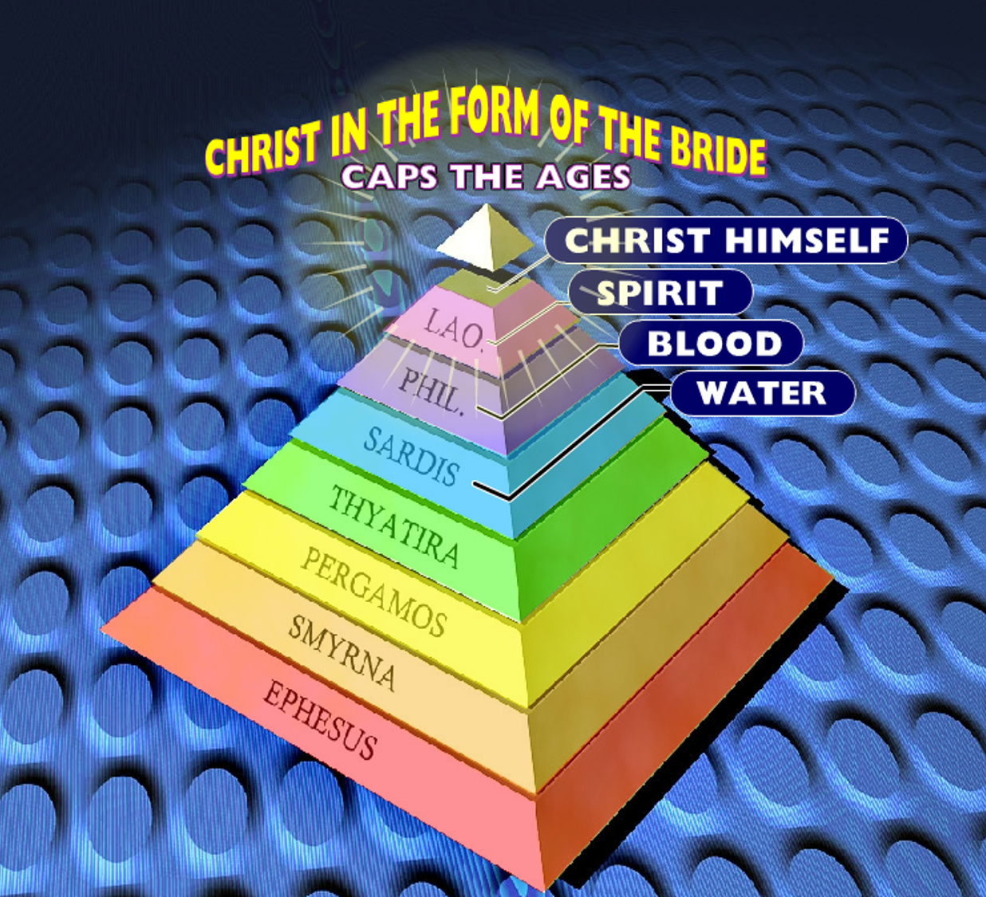
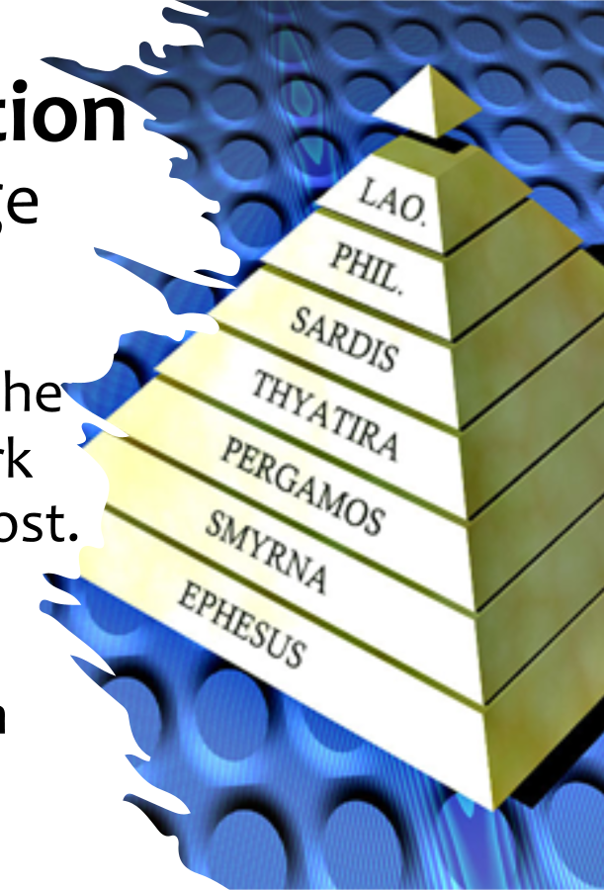

Slide 19
THERE.IS.A.MAN.HERE… LIGHT
…The baptism of the Holy Ghost served its time; until the Holy Spirit blends into the Church, and the Church into Christ, makes Jesus Christ reflected on the earth... 63-1229
HOW.CAN.I.OVERCOME
For, we believe that the hour is getting late, the sun is swiftly sinking in the west, soon be that "time shall be no more." Time and Eternity will blend together when God and His people blends together. 63-0825

Slide 20
THE.THIRD.EXODUS
299 The first exodus, what did He do? He brought them out of a natural land, to a natural land.
300 The second exodus, He brought them out from a spiritual condition, into a spiritual baptism of the Holy Ghost.
301 Now [Third Exodus] He is bringing them from the spiritual baptism of the Holy Ghost, right back into the Eternal Land of the Millennium and the great Hereafter. Same Pillar of Fire, by the same anointed system, the same God doing the same things!

Slide 21
And the same Word, declared the first one, declared the second one. The same Word, declared the second one, has declared the third one, and here we see It among us.
302 Come out. Oh! Come out of this chaos. Come to the living God. Come to the Word. "And the Word was made flesh and dwelt among us." And now He's in our flesh, dwelling among us. Come out and serve the living God. 63-0630

Slide 22
I CORINTHIANS 2:9-12
But as it is written, Eye hath not seen, nor ear heard, neither have entered into the heart of man, the things which God hath prepared for them that love him. 10 But God hath revealed them unto us by his Spirit: for the Spirit searcheth [examines] all things, yea, the deep [unsearchable] things of God.
11 For what man knoweth the things of a man, save the spirit of man which is in him? even so the things of God knoweth no man, but the Spirit of God. 12 Now we have received, not the spirit of the world, but the spirit which is of God; that we might know the things that are freely given to us of God.

Slide 23
LUKE 4:16-19
And he came to Nazareth, where he had been brought up: and, as his custom was, he went into the synagogue on the sabbath day, and stood up for to read. 17 And there was delivered unto him the book of the prophet Esaias. And when he had opened the book, he found the place where it was written, 18 The Spirit of the Lord is upon me, because he hath anointed me to preach the gospel to the poor; he hath sent me to heal the brokenhearted, to preach deliverance to the captives, and recovering of sight to the blind, to set at liberty them that are bruised, 19 To preach the acceptable year of the Lord.

Slide 24
ISAIAH 61:1-4
The Spirit of the Lord GOD is upon me; because the LORD hath anointed me to preach good tidings unto the meek; he hath sent me to bind up the brokenhearted, to proclaim liberty to the captives, and the opening of the prison to them that are bound; 2 To proclaim the acceptable year of the LORD, and the day of vengeance of our God; to comfort all that mourn; 3 To appoint unto them that mourn in Zion, to give unto them beauty for ashes, the oil of joy for mourning, the garment of praise for the spirit of heaviness; that they might be called trees of righteousness, the planting of the LORD, that he might be glorified. 4 And they shall build the old wastes, they shall raise up the former desolations, and they shall repair the waste cities, the desolations of many generations.

Slide 25
JESUS.CHRIST.THE.SAME…
30 And as these days especially, when people who are not, maybe, taught just in the deep things of this great move of God, in these past forty years, that swept around the world.
They might not understand just right, and they come just a little critical or something, or maybe not wanting to be, but not understanding the Word. So you can imagine what a job it would be for the Holy Spirit to press that into hearts at one night…. 58-0214

Slide 26
ABSOLUTE
39 A compass, it is magnetized to that North Pole. And when we're in trouble, and trusting Christ, there's one thing sure: the Holy Spirit will point us to the Word that will guide us to the North Star, and to deliver of everything we have need of. He is our Absolute.
63-0304

Slide 27
A person who has no desire to come to the Lord for continued cleansing has reason to doubt that he ever came to the Lord to receive salvation.
J. MacAthur

Slide 28
What is Human Nature?
Human nature was created by God, is corrupted by sin and can only be renewed and recreated through the grace of God. Redemption was achieved by Jesus Christ taking upon himself sinful human nature on the cross, so delivering from the power and penalty of sin.

Slide 29
FAITH.WITHOUT.WORKS.IS.DEAD
31 You could take a hog, scrub it up with soda, do that painting on her toe nails, like women do on their fingers, fixed up with clothes on, put it on a hardwood floor, give it grape-nuts for breakfast, that hog would die. You take him and turn him loose he’d go just as straight to the wallow and wallow again. Why? The nature of a hog in there... But you put a lamb out there, in that wallow, he'll bleat and cry until somebody gets him out of there. Now if you want to keep a hog out of the wallow, change the nature of the hog. That's the way to keep the sinner out of the things of the world, change the nature from a sinner to a Christian. That can only be done through that great powerful work. 0822

Slide 31
WHAT.DOES.IT.TAKE.TO.MAKE.A.
CHRISTIAN.LIFE
34 When you receive the Holy Spirit It goes right in the middle of that new disposition of yours. "Oh, I quit drinking; smoking. I just feel like a different person." He makes every motion, every intellectual, everything agreeing right into this middle of the wheel… And when you have these little temper fits and you fly off, tell lies and so narrow minded you couldn't hear another minister, remember, the Holy Spirit isn't ticking in the inside of you.
35 The Holy Spirit will make every movement like Christ. It'll make you Christ-like. The fruits of the Spirit is love, joy, peace, longsuffering, goodness, meekness,

Slide 32
gentleness, patience, faith. Those things are what the Holy Spirit controls, our emotions.
You could do that. A shindig will bring that to you. But the Holy Spirit brings you [under] control of God, that you walk in peace and in love and in joy with long-suffering, goodness, meekness, gentleness, patience. It isn't something that you do. It's something the Holy Spirit does in you. You see, it's no longer an intellectual thought of your own; it's a subconscious moving of the Holy Spirit. Church of the living God, there's where our Pentecostal move failed. We have some man-made musical, clap hands, jump up-and-down emotion. 57-0113

Slide 33
117 When you blow up at every little thing that happens, causes that disposition, when the pastor happens to hit something, that's in the Word, and you,
“I don't believe that," look out. Watch out. The new mainspring hasn't been set in there right yet. But it controls; it makes you believe; it makes you act in such a way till you become salty. And the whole world thirsts to be like you. That's the Holy Spirit setting in the middle of your Spirit. It's the Mainspring.

Slide 35
PRAYER.LINE
3 Come on, brother. 'Course I know you, and know that you're nervous, but let this be the night it's over, will you? God, be merciful to my dear brother. Knowing this nervousness was born in him from his mother and father before him, knowing his poor mother being a nervous woman, and here he is suffered all of his life, but may this be the night.
And we know, Lord, that nothing short of a miracle will ever heal the man. And I pray, God, that if he's staggered, and tried, trying his best to get faith, I pray, God, that You'll somehow

Slide 36
accept the little faith that he has, and perform a miracle, and heal him. And may he return to his home and get well, in Jesus Christ's Name. Amen. Now, that was an hereditary thing.
You been nervous all your life. Your mother was before you was nervous. Now, you go and just beginning to thank God. I believe that God has healed you tonight, my brother. You won't have to do it. Don't never use tobaccos no more; just go ahead and serve the Lord.
53-0500

Slide 37
JESUS.CHRIST.THE.SAME
14 It doesn't take long, it only takes Truth: "Go thy way." That settled it. It takes Truth. Long, drawed out prayer lines that we've had: we never found our Lord doing those things. He went into a city and He healed one man, maybe, and passed through the city: "I must preach the Gospel somewhere else."
We are commissioned to go pray for the sick, anoint them in oil, pray over them: "prayer of faith shall save the sick…"

Slide 38
But all through life, down through the ages, God has set men aside for certain works, not because they're any more than anyone else, and they're not any more worthy.
57-0922

Slide 39
Signs Of Spiritual Maturity
Waiting for God’s Will & Seeking God’s Way of Escape in Times of Temptation;
Sacrificing Our Rights & the Need to Always be Right & Always Win;
Confessing the Positive;
Separating Your State from Your Standing;*

Slide 40
Signs Of Spiritual Maturity
Enduring Our Cross & Bearing the Reproach of the Word;
Enduring Opposition and Responding Correctly to Criticism;
Not Despising or Resisting the Discipline of the Father;*
Not Discouraged at Rebuke & Open to Admonishment

Slide 41
Signs Of Spiritual Maturity
They Get Around the Right Influences;
They have “Another Spirit” than Doubters;
They “follow Him fully;”
They Step Out & Change a Negative Report;
Their Confession is “we are more than able…”
They are not intimidated by things bigger than themselves.

Slide 42
Signs Of Spiritual Maturity
Enduring Our Cross & Bearing the Reproach of the Word;
Enduring Opposition and Responding Correctly to Criticism;
Not Despising or Resisting the Discipline of the Father;*
Not Discouraged at Rebuke & Open to Admonishment

Slide 43
Signs Of Spiritual Maturity
Not Led by Emotion or Fear;
An Atmosphere Changer;
Taking Responsibility instead of Shifting the Blame;
Making the Spiritual Life a Priority:
Luke 10:42 But one thing is needful: and Mary hath chosen that good part, which shall not be taken away from her.

Slide 44
Signs Of Spiritual Maturity
Finding Your Place & Being Confident in It;
Willing to Give Abundant Grace to Others;
Willing to Restore a Fallen Brother;
Slow to Anger & Judgment;

