Slide 1
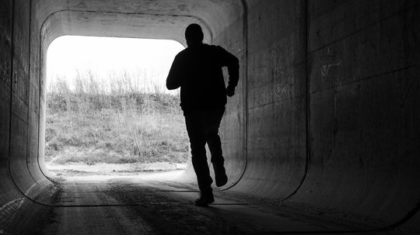
The True Sardis and the Walking Dead
Aaron Nengomazha : Hickory Bible Tabernacle

Slide 2
Revelation 3:1-6 KJV
And unto the angel of the church in Sardis write; These things saith he that hath the seven Spirits of God, and the seven stars; I know thy works, that thou hast a name that thou livest, and art dead. [2] Be watchful, and strengthen the things which remain, that are ready to die: for I have not found thy works perfect before God.

Slide 3
Revelation 3:1-6 KJV
[3] Remember therefore how thou hast received and heard, and hold fast, and repent. If therefore thou shalt not watch, I will come on thee as a thief, and thou shalt not know what hour I will come upon thee. [4] Thou hast a few names even in Sardis which have not defiled their garments; and they shall walk with me in white: for they are worthy. [5] He that overcometh, the same shall be clothed in white raiment; and I will not blot out his name out of the book of life, but I will confess his name before my Father, and before his angels. [6] He that hath an ear, let him hear what the Spirit saith unto the churches.

Slide 4
Fight-or-flight - The natural instinct to run away from danger is known as the flight response, which is a core part of the body's innate fight-or-flight survival mechanism.
Brain Activation: When you sense a threat, the amygdala (the brain's emotional and threat-detection center) instantly triggers a surge of stress hormones like adrenaline. Your body diverts blood flow to your muscles and increases your heart rate to prepare you to flee rapidly from harm

Slide 5
60-1209 - "The Sardisean Church Age"
101 Turn over to the next church here, you find out, “But thou has not denied my name.” Following church, “Not denied my name.” But in this church, “You have a name.” Watch here! This church kept His Name; this church kept His Name; this church kept His Name; and this church went through a Dark Age and there was nothing said about it; when they come out to the Life on this side, the first little escaped one, when Luther pulled them out, “You have a name that you are alive, but you are dead.” Now, what name did they use after they quit using Jesus’ Name? Father, Son, Holy Ghost. And there ain’t no such a thing. It’s a dead—it’s a dead theology.

Slide 6
An Exposition Of The Seven Church Ages (7 - The Sardisean Church Age)
Now I just said that this era gave tremendous growth to the denominational spirit. If the Corinthian attitude of “I am of Paul, I of Cephas” was ever exhibited, it was now. There were Lutherans, Hussites, Zwingli’s party, etcetera. Such fragmentation of the Body was deplorable. They were living a name but were dead. Certainly they were dead. They died the minute they organized. The great groups organized and tied themselves in matrimony to the state. That did it. They were finished. Here were those Lutherans who had criticised the Roman Church. They knew the unrighteousness of political and spiritual unions — yet Luther (as when Peter was overbalanced by the Judaizers) went right ahead and made the state instead of God, the defender of the faith. This is the first denomination of repute that came out of the harlot, but when Luther died it was not long until it had a hierarchy like the one it had fought.

Slide 7
60-1209 - "The Sardisean Church Age"
70 And so, Sardis, now we start out. The very word Sardis, the 1st verse. The word Sardis, in the English terms, means, if you want to look it up, means “the escaped one.” The true Sardis was “the escaped one.” That’s what Sardis means, all right, “the escaped one.” Now, see, and “the escaped one.”

Slide 8
1 Thessalonians 5:21-22 KJV
Prove all things; hold fast that which is good. [22] Abstain from all appearance of evil.

Slide 9
62-0408 - "Presuming"
O God, be merciful. I pray that every one, put their hand up will never meet the Judgment, out yonder, of God. May they escape the Judgment, and go in the Rapture, like Noah rode over the Judgment, grant it, Lord, like Abraham, be out of the Judgment. Have mercy, I pray.

Slide 10
1 Corinthians 10:13 KJV
There hath no temptation taken you but such as is common to man: but God is faithful, who will not suffer you to be tempted above that ye are able; but will with the temptation also make a way to escape, that ye may be able to bear it.

Slide 11
Proverbs 8:13 KJV
The fear of the LORD is to hate evil: pride, and arrogancy, and the evil way, and the froward mouth, do I hate.

Slide 12
Hebrews 11:7 KJV
By faith Noah, being warned of God of things not seen as yet, moved with fear, prepared an ark to the saving of his house; by the which he condemned the world, and became heir of the righteousness which is by faith.

Slide 13
Psalm 25:14 KJV
The secret of the LORD (friendship) is with them that fear him; and he will shew them his covenant.

Slide 14
Matthew 24:14-21 KJV
And this gospel of the kingdom shall be preached in all the world for a witness unto all nations; and then shall the end come. [15] When ye therefore shall see the abomination of desolation, spoken of by Daniel the prophet, stand in the holy place, (whoso readeth, let him understand): [16] Then let them which be in Judaea flee into the mountains: [17] Let him which is on the housetop not come down to take any thing out of his house: [18] Neither let him which is in the field return back to take his clothes. [19] And woe unto them that are with child, and to them that give suck in those days! [20] But pray ye that your flight be not in the winter, neither on the sabbath day: [21] For then shall be great tribulation, such as was not since the beginning of the world to this time, no, nor ever shall be.

Slide 15
57-0602 - "Life"
And life, the word life, has had a perverted aspect to it, because that even life itself has a perverted aspect. And many times, people want to refer to life as having a big time, drinking, riling, and going out. They say, “This is life.” How mistaken they are. That’s death. See? It’s not life. It’s death.

Slide 16
2 Peter 1:4 KJV
Whereby are given unto us exceeding great and precious promises: that by these ye might be partakers of the divine nature, having escaped the corruption that is in the world through lust.

Slide 17
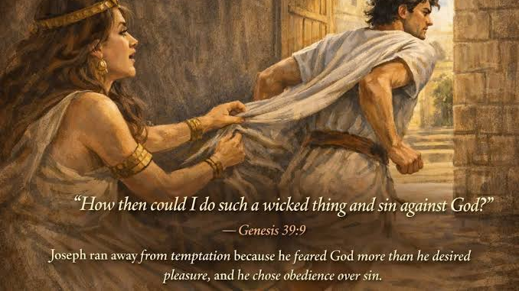

Slide 18
58-0209A - "Hear Ye Him"
128 Here some time ago when I went to India, just as soon as I got into India, I picked up a paper. Three days before that they had an earthquake, but way before the earthquake ever come, all the little birds flew out of their nests and went out in the fields in the trees, all the cattle that stood around the big stone walls, went out and stood in the fields away from the walls. When the earthquake come, it shook the walls down; God was preparing, preserving the animal life.

Slide 19
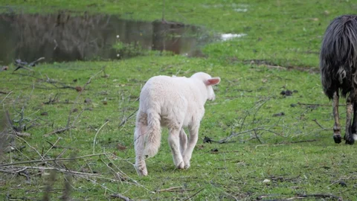

Slide 20
61-0218 - "Balm In Gilead"
89 Don’t see how close you can get to sin without sinning, see how far you can stay away from it, that’s the way it is. Keep off the territory altogether.

Slide 21
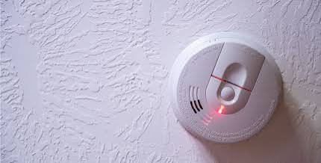

Slide 22
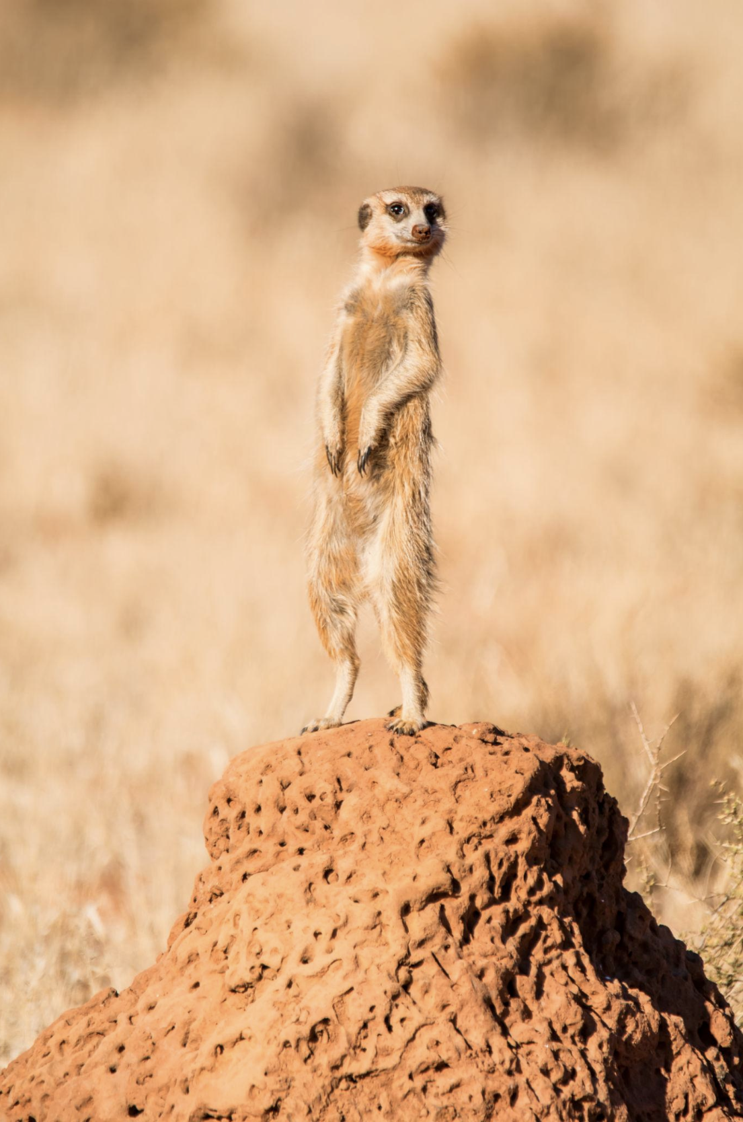

Slide 23
Zebra/herd animals: There’s protection in having many eyes and ears watching for predators.

Slide 24
64-0618 - "The Presence Of God Unrecognized"
53 And today we’re getting so slothful, the church is getting so worldly and so indifferent, and so their minds so muddled up with television, and We Love Susie and some of these old things, and staying home. That shows where the people’s hearts are. And you can tell them these things are wrong, and they think you’re crazy. What is it? “Lovers of pleasure more than lovers of God.” See?

Slide 25
  64-0823E - "Questions And Answers #2"
  The five’s wise, when they—the cry come, “Behold the Bridegroom…” they all trimmed, or, woke and trimmed their lamps to go into the wedding supper. But when the foolish virgin said, “Give us some of your oil, our lamps is gone out. (See?) Give us of your oil.” They said, “Not so, we just got enough for ourself. Go buy it.” And while they went to buy it, the Bridegroom came.

Slide 26
Isaiah 37:31-32 KJV
And the remnant that is escaped of the house of Judah shall again take root downward, and bear fruit upward: [32] For out of Jerusalem shall go forth a remnant, and they that escape out of mount Zion: the zeal of the LORD of hosts shall do this.

Slide 27
63-0118 - "Spirit Of Truth"
337 With your hands laid on one another, I trust that you’ll put your heart in God’s care right now, “Lord, search me. Have I become so numb by the things of the world, that I’m failing to see this great hour that’s passing by?”

