Slide 1
Therefore, Have I drawn thee
Jeremiah 31

Slide 2

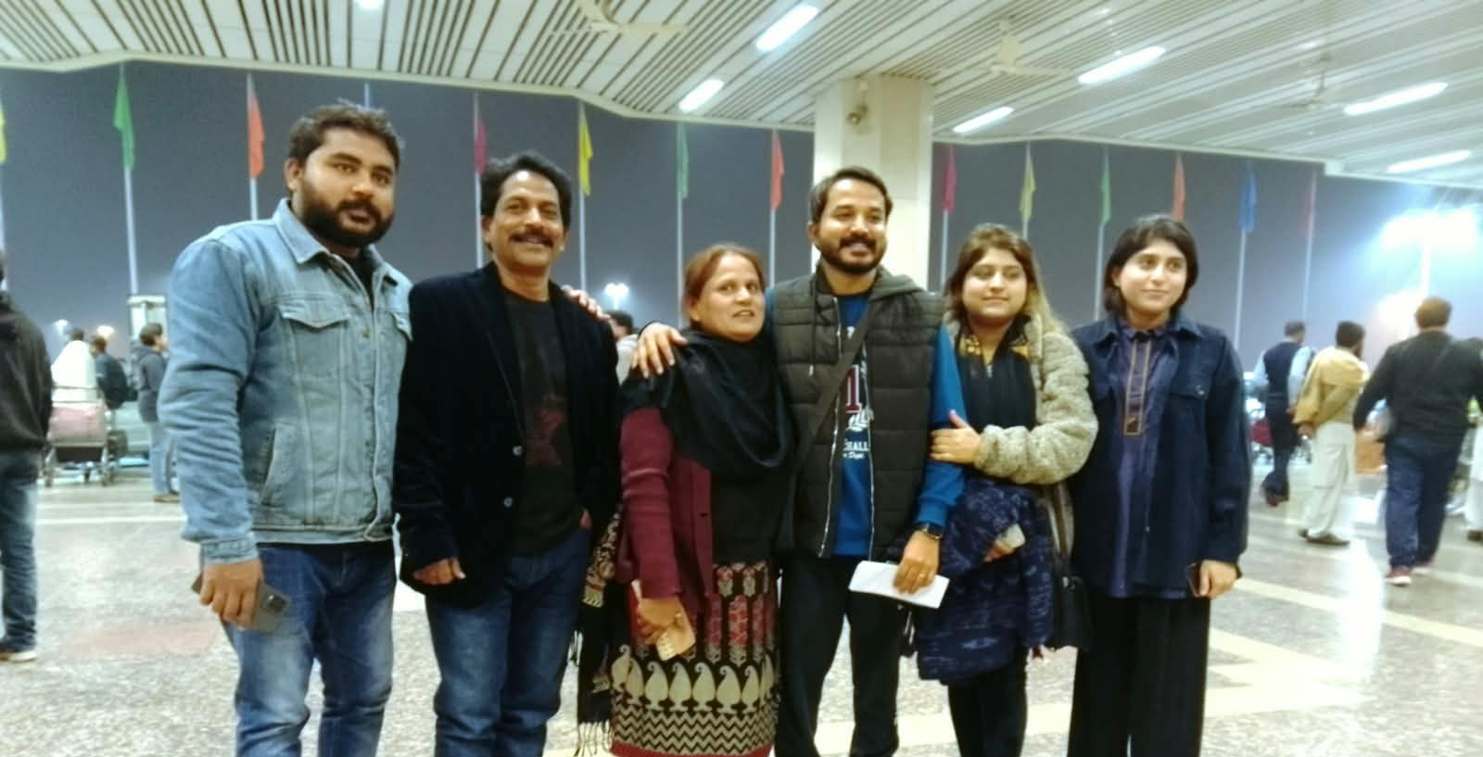

Slide 3
Birthdays & Anniversaries & Events
Sept. 29th Frieda Drum
Oct. 1st Kaitlyn Florian
Oct. 2nd David Cockman
Oct. 3rd Sophia Cockman
Oct. 5th Jaron & Chenelle Brown
Oct. 9-11 Men’s Meeting (No Church at HBT)
Oct. 24th Fall Festival

Slide 4

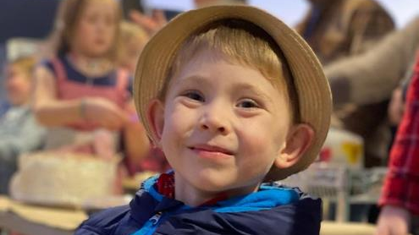
Fall
Fellowship

Slide 5
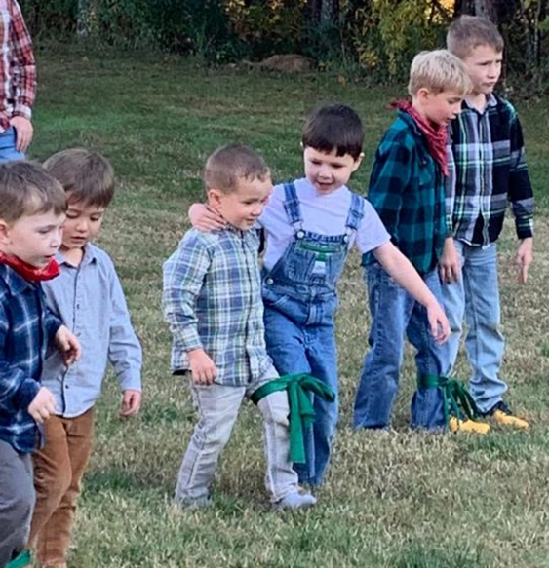
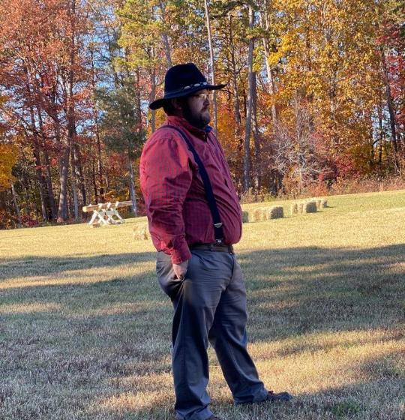

Slide 6
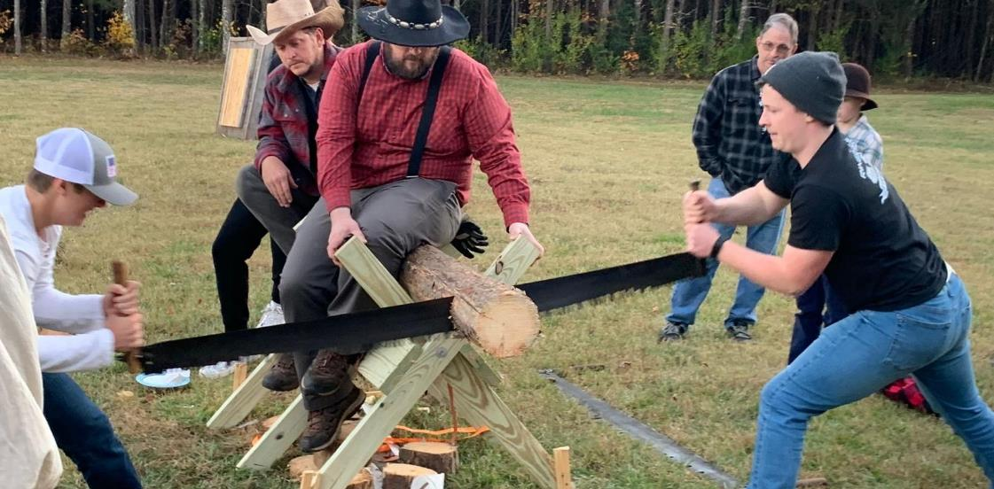

Slide 7
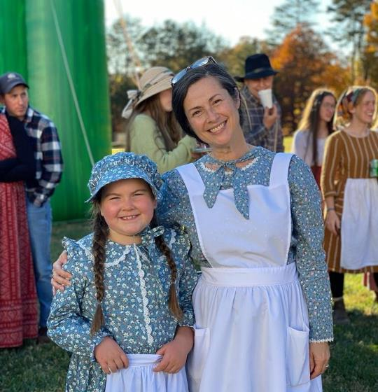
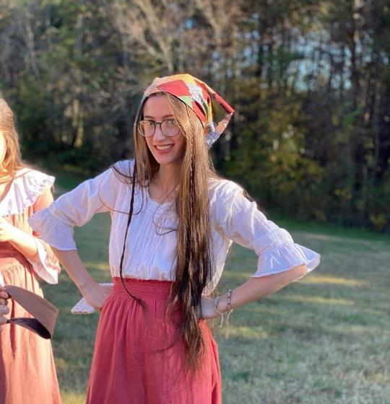

Slide 8
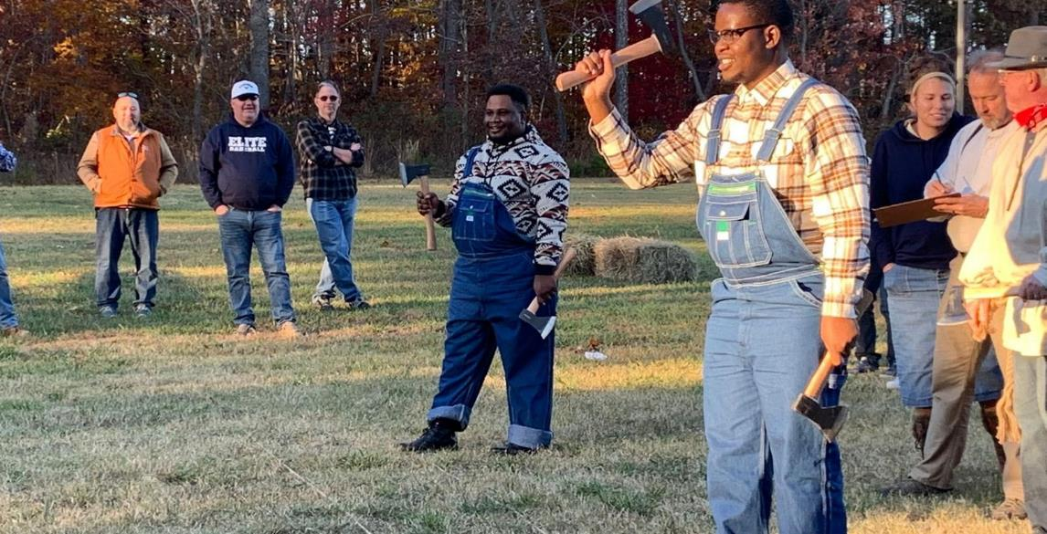

Slide 9
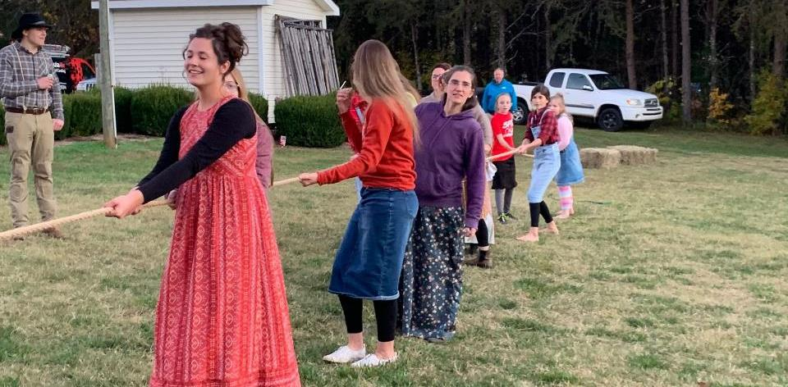

Slide 10
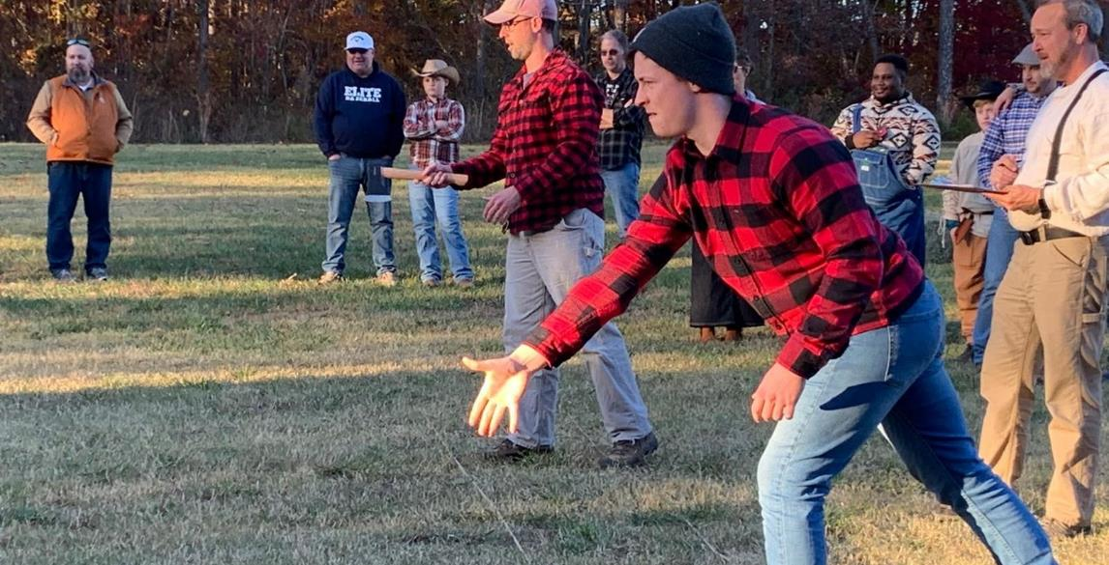

Slide 11
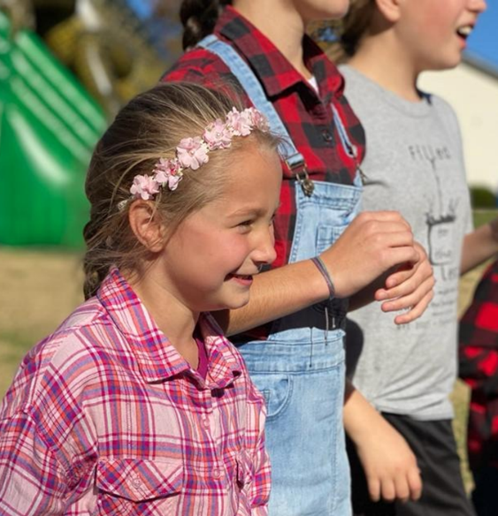
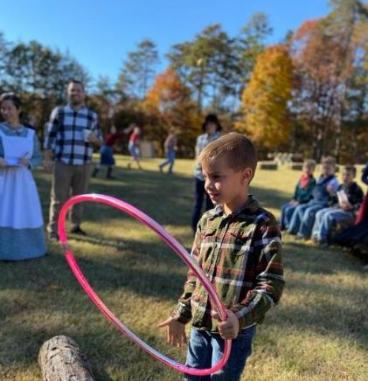

Slide 12

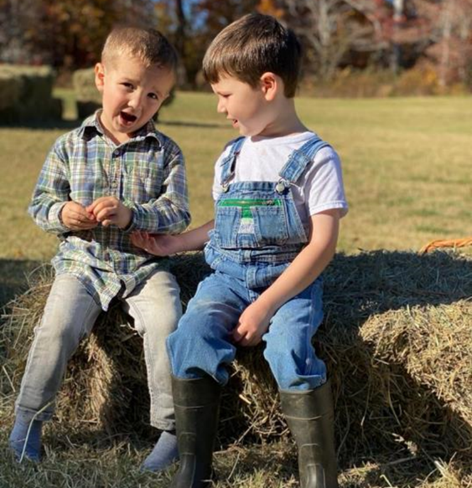
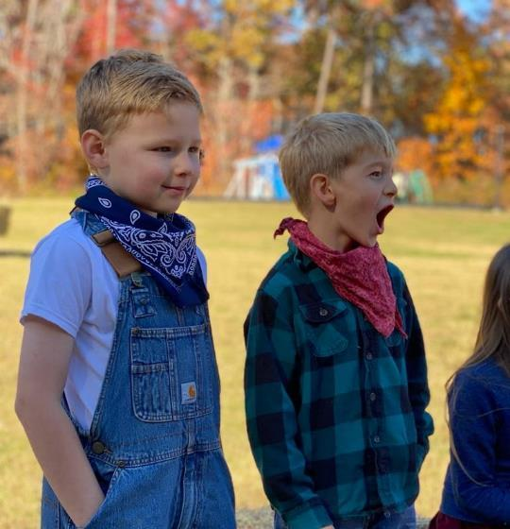

Slide 13
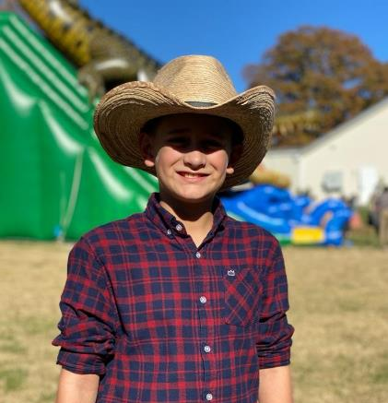
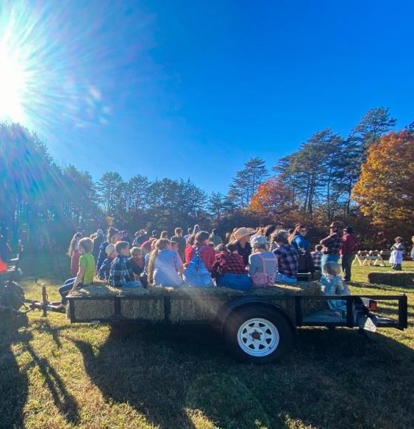

Slide 14
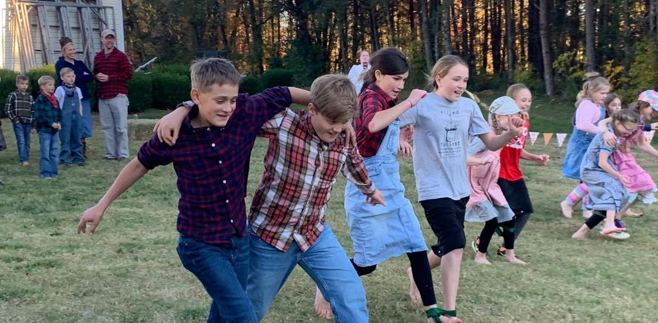

Slide 15

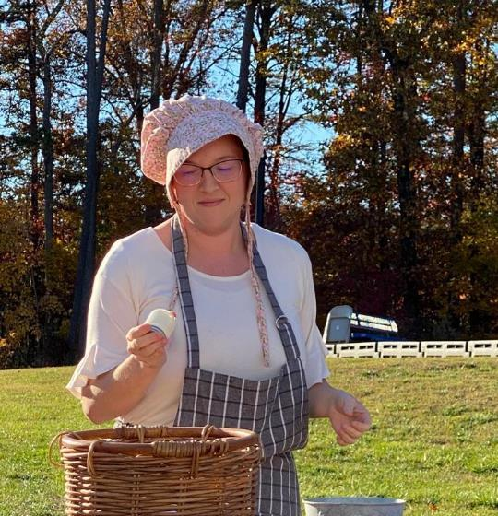

Slide 16
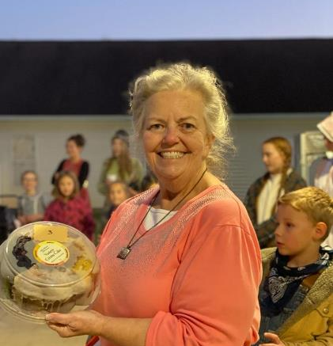
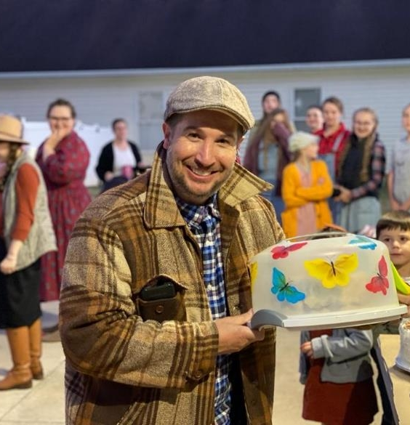

Slide 17
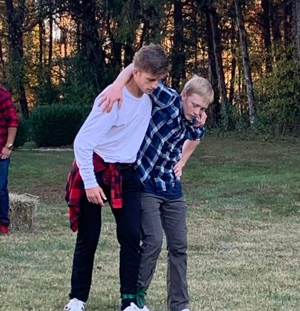
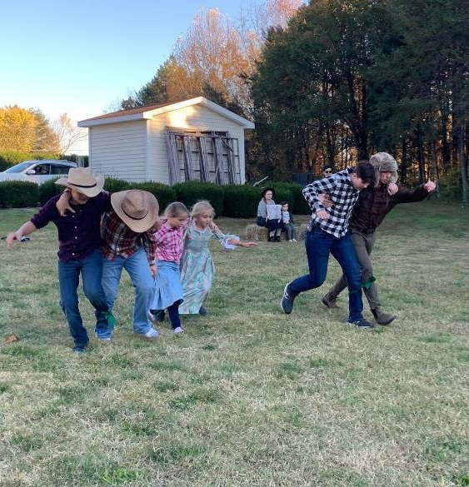

Slide 18
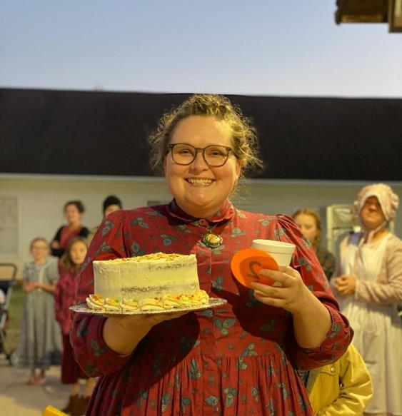
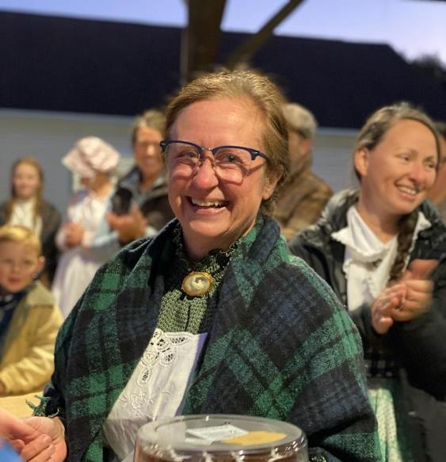

Slide 19
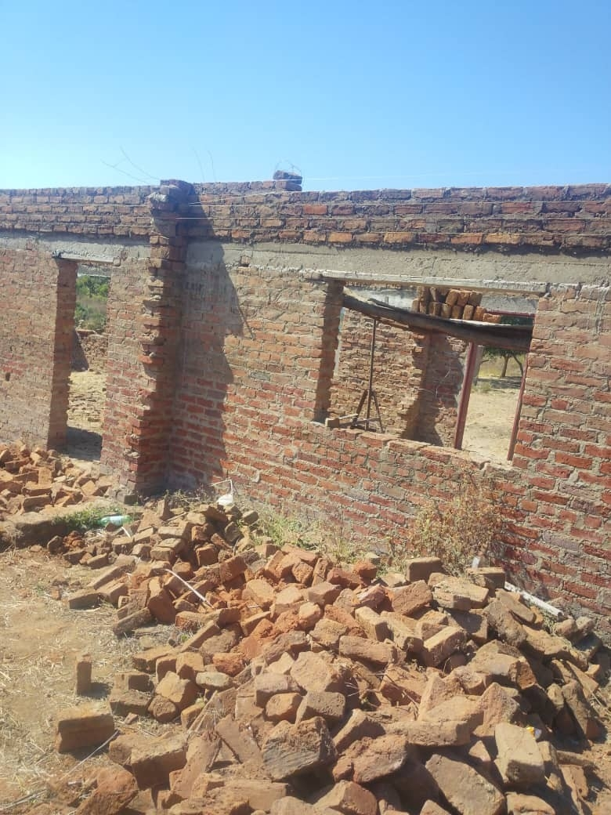
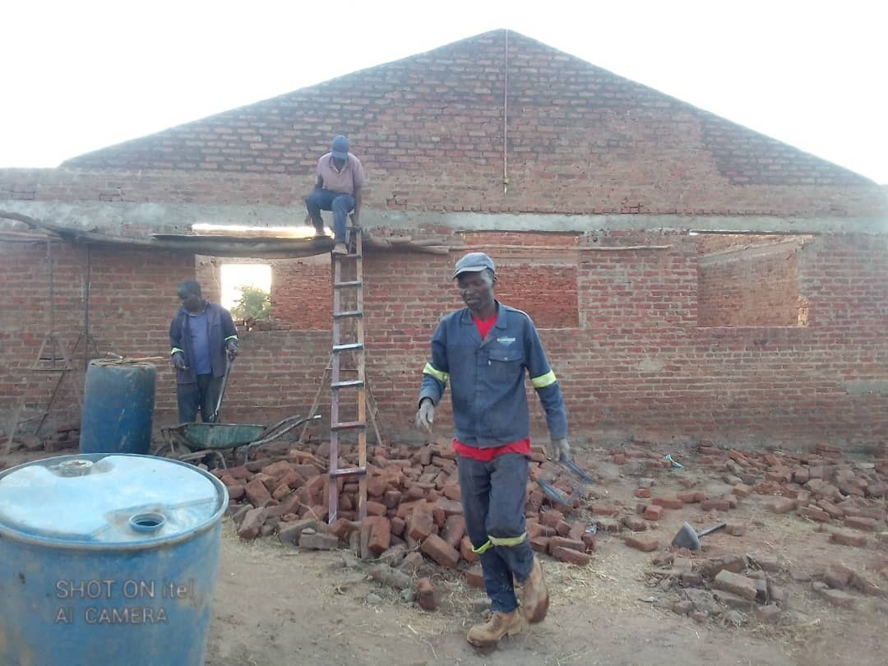
Zimbabwe

Slide 20
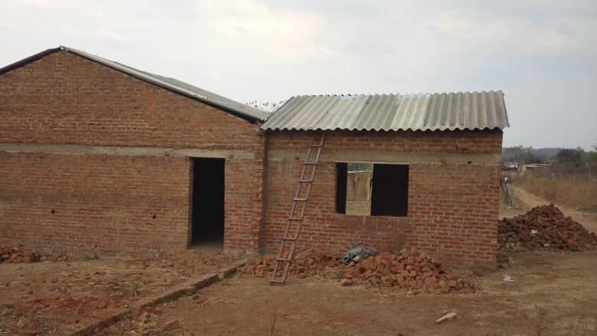
Completed: September 2026

Slide 21
Therefore, Have I drawn thee
Jeremiah 31

Slide 22
The Journey
To Eternity
From Here
The New Birth
Natural Birth
Family Life
Training & Education
New Birth
Spiritual Experiences
Adolescence & Marriage
Life Experiences
Aging

Slide 23
THIS.GREAT.WARRIOR.DAVID
26 Every man or woman in here that's a Christian knows that something's been on you all your life. When you was a child, you longed to serve God. Something beat at your heart; it was God's election. 55-0118

Slide 24
HEAR.YE.HIM
69 You love Him? You really want to meet Him? There's got to be something happen within you, a birth that changes all your disposition. Just a mental, dry-eyed conception won't work. 57-0519
Disposition (W)
  The predominant tendency of one's spirits; natural mental and emotional outlook; characteristic attitude.
  State of mind regarding something; inclination, bent.

Slide 25
WHEN.DIVINE.LOVE.IS.PROJECTED
19 When you become a son, a daughter of God, your disposition changes; your attitude changes; your look towards life and towards others changes.
It doesn't mean that you just have joined church; it means you have become a new creation in Christ. The old things have passed away, and God has spoken to you, and you have become a new creature.
57-0126

Slide 26
WHY.I'M.PRAYING.FOR.THE.SICK
74 I suppose us being strangers… Your trouble's in your ears… you're nervous, real nervous, upset.
And that's your disposition. You been that way practically all your life.
But you've come to me for another purpose. You've come to me, that I would lay hands on you for spiritual things, isn't that right…?
54-0314

Slide 27
IMPERSONATION.OF.CHRISTIANITY
116 When the Holy Spirit, not the new degree, new church, new thought, new emotion, not the new dance.. but when God places His Spirit in the middle of your new spirit, then you don't have to act meek; you don't have to act like a Christian.
It controls everything that's within you. It makes the church act orderly, makes the gifts work perfect… it controls you.

Slide 28
THE.SAME.JESUS.TONIGHT LAUSANNE.SWITZERLAND
32 You are suffering with a trouble in your mouth. It's very dark around you. It's a cancer. You are a mother. I see a boy, 10-12 years old, TB, in the lung.
All your life, you've had a longing, "Someday you'd become a Christian." You need Jesus as your Saviour. These things has happened to bring you to Him.
Do you now accept Jesus as your personal Saviour? Your sins be forgiven you, my child. Go in the Name of Jesus and live, and let your son live also. 55-0826

Slide 29
THE.END.TIME.EVANGELISM
23 (Children) Jesus said, "Take heed that you despise not one of these little ones, for their angels always beholds My Father's face which is in Heaven." Remember, they have an angel.
When you're born, it stays with you all through life. And now, then when you get saved, you have the Holy Spirit then, and It guides you and directs you.
62-0603

Slide 30
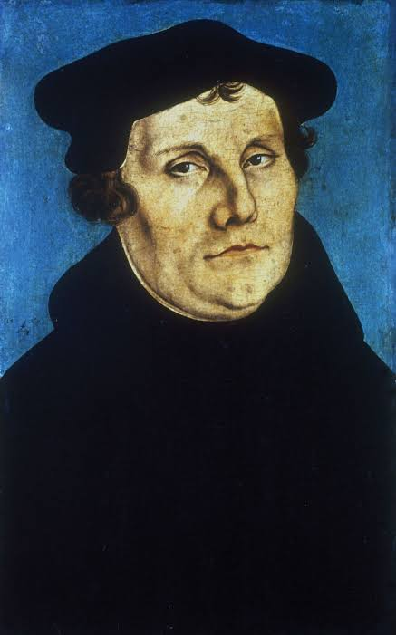
Conviction:
In law, a conviction is the verdict that results when a court of law finds a defendant guilty of a crime.
To have confidence, certainty, assurance and faith.
An unshakeable belief in something without need of proof.

Slide 31
Definition #1 QUESTIONS.AND.ANSWERS.1
292 Oh, how this world is contaminated. There's no hope for it at all; they have crossed the dividing line between reason and common sense, let alone between salvation.
Man can't even judge. We don't have men no more like we used to have. Where is Patrick Henry? Where is Abraham Lincoln? men that can stand for solid convictions.
64-0823

Slide 32
Definition #2 ONCE.MORE (NEW.YORK)
9 Now we are sorry that we did not have room to accommodate the people. But I know they have a fire marshal's law. And that they cannot help. Because we are, as Christians, we've got to… "Give Caesar those things that pertain to Caesar..." And if we will not obey Caesar, it's doubtful that we'd obey God.
I was asking for mercy for the people, seeing them up-and-down the streets, the sick, and trying to get in…

Slide 33
12 I want to express my gratefulness to the company that owns this building, and the management... They've been very, very nice. I say this because of I'm zealous for Christ.
I do pray that if this building be used at any time, from hereafter, for dances or worldly entertainment, that the Holy Spirit will throw such conviction upon those people until they'll weep. I pray that. Because I'm sure that the people even that owns it would rather see souls saved to the Kingdom of God, than to have the other going on.
63-1117

Slide 34
2. Conviction:
In the moral sense, conviction is the inward awareness that one is guilty and in the wrong. It is more than a feeling of regret. It is the experience of being proven guilty to oneself, so the person can no longer excuse or deny the wrong.
Webster's 1828 dictionary, (which is close to the KJV's English), defines it as the act of convincing someone of sin, and the state of being convinced by conscience and aware of their guilt.

Slide 35
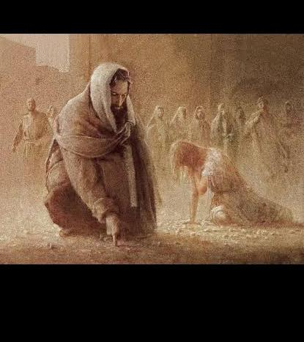
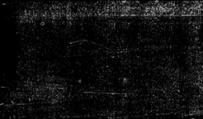
JOHN 8:9
And they which heard it, being convicted by their own conscience, went out one by one, beginning at the eldest, even unto the last: and Jesus was left alone, and the woman standing in the midst.
Pardon 63-1028
The Holy Spirit has proved to them that they are wrong and brought conviction that they want to be right. Conviction shows the wrong and creates the desire to be right.

Slide 36
Acts 2:37 Now when they heard this, they were pricked in their heart, (1x Inward wound) and said unto Peter and to the rest of the apostles, Men and brethren, what shall we do?“
Acts 5:33 When they heard that, they were cut to the heart, and took counsel to slay them.
Acts 7:54 When they heard these things, they were cut to the heart, and they gnashed on him with their teeth.

Slide 37
JOHN 16:7
Nevertheless I tell you the truth; It is expedient for you that I go away: for if I go not away, the Comforter will not come unto you; but if I depart, I will send him unto you. 8 And when he is come, he will reprove the world of sin, and of righteousness, and of judgment: 9 Of sin, because they believe not on me; 10 Of righteousness, because I go to my Father, and ye see me no more; 11 Of judgment, because the prince of this world is judged.

Slide 38
Reprove: Gr. Elegcho
To convict, refute, generally with a suggestion of shame of the person convicted; by conviction to bring to the light, to expose;
Eg: MATT. 18:15 Moreover if thy brother shall trespass against thee, go and tell him his fault between thee and him alone: if he shall hear thee, thou hast gained thy brother.
LUKE 3:19 But Herod the tetrarch, being reproved by him [JB] for Herodias his brother Philip's wife, and for all the evils which Herod had done…

Slide 39
CHURCH.AGE.BOOK
289-2 Wesley now began to preach the Gospel in those pulpits in London to which he formerly had access; but soon they turned him out. (George Whitefield) Wesley at first was incredulous that he should preach in the open instead of a building, but when he saw the throngs and saw the working of the Gospel in the power of the Spirit he turned wholeheartedly to such preaching.
There was violent opposition to his work but God was with him. The workings of the Spirit were mightily manifested and often such a spirit of conviction took hold of the people as to take away their strength and they would fall to the ground crying in great distress over their sins.

Slide 40
THE.ODDBALL
27 Br. Troy, of the FGBM, a friend of mine, he's a meat cutter. There was a little German who worked with him in a butcher shop, in LA, he kept trying to lead the little [German] to Christ… So one night Brother Troy had the privilege of getting him to go to church. "Well, I believe I'll go." So he went down to an old-fashion meeting where they was having a prayer meeting, and he really got under conviction, and give his heart to Christ…
Every once in a while he would just walk through the building, with his hands up in the air, "Praise be to God! Thank You, Lord Jesus!" and he attracted the attention of all of them. You see, he become an oddball to the whole line of meat cutters. 64-0614

Slide 41
Revelation 3:19 As many as I love, I rebuke and chasten: be zealous therefore, and repent."
"Rebuke" in that verse is elegchō. It is the same verb as John 16:8, and it is motivated by "as many as I love."
Hebrews 12:5–6
And ye have forgotten the exhortation which speaketh unto you as unto children, My son, despise not thou the chastening of the Lord, nor faint when thou art rebuked of him: For whom the Lord loveth he chasteneth, and scourgeth every son whom he receiveth.

Slide 42
2 Corinthians 7:10 For godly sorrow worketh repentance to salvation not to be repented of: but the sorrow of the world worketh death.
Romans 2:4 Or despisest thou the riches of his goodness and forbearance and longsuffering; not knowing that the goodness of God leadeth thee to repentance?
The One who reproves is the Comforter:
John 14:18 I will not leave you comfortless: I will come to you.
The Spirit who convicts is the same Jesus who wept over Jerusalem, now at work in Spirit form.

Slide 43
Peter & Judas: Luke 22:61–62
And the Lord turned, and looked upon Peter. And Peter remembered the word of the Lord, how he had said unto him, Before the cock crow, thou shalt deny me thrice. And Peter went out, and wept bitterly.
Matthew 27:3–5 Then Judas, which had betrayed him, when he saw that he was condemned, repented himself, and brought again the thirty pieces of silver to the chief priests and elders, Saying, I have sinned in that I have betrayed the innocent blood. And they said, What is that to us? see thou to that. And he cast down the pieces of silver in the temple, and departed, and went and hanged himself.

Slide 44
Peter's conviction came through the look of the Lord, and it drew him back.
Judas had remorse, but "repented himself" (melomai) a word for regret. It is not metanoeō, the change of mind Peter preached at Pentecost.
Judas carried his remorse to the priests instead of to Christ, and it became condemnation. The difference was not how deeply each man felt. The difference was where each man turned.

Slide 45
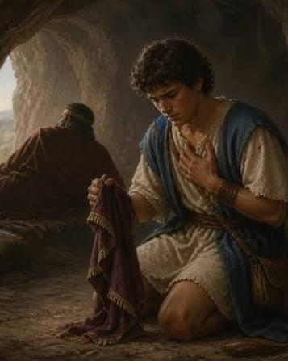
Old Testament Examples
1 Samuel 24:5 And it came to pass afterward, that David's heart smote him, because he had cut off Saul's skirt.
2 Samuel 24:10 And David's heart smote him after that he had numbered the people. And David said unto the LORD, I have sinned greatly in that I have done: and now, I beseech thee, O LORD, take away the iniquity of thy servant; for I have done very foolishly.

Slide 46
GENESIS 42:18-23
And Joseph said unto them the third day, This do, and live; for I fear God: 19 If ye be true men, let one of your brethren be bound in the house of your prison: go ye, carry corn for the famine of your houses: 20 But bring your youngest brother unto me; so shall your words be verified, and ye shall not die. And they did so.
21 And they said one to another, We are verily guilty concerning our brother, in that we saw the anguish of his soul, when he besought us, and we would not hear; therefore is this distress come upon us. 22 And Reuben answered them, saying, Spake I not unto you, saying, Do not sin against the child; and ye would not hear? therefore, behold, also his blood is required.

Slide 47
The Unbeliever in the Assembly:
1 Corinthians 14:24–25
But if all prophesy, and there come in one that believeth not, or one unlearned, he is convinced of all, he is judged of all: And thus are the secrets of his heart made manifest; and so falling down on his face he will worship God, and report that God is in you of a truth.
"Convinced" here is elegchō again.
Its result is worship, not shame.

Slide 48
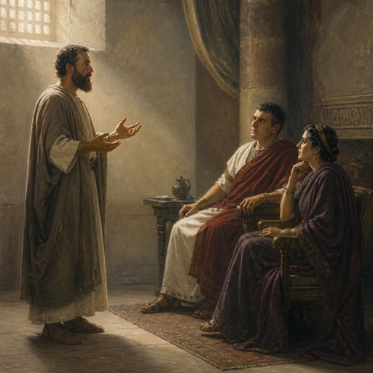
Felix, a warning.
Acts 24:25 And as he reasoned of righteousness, temperance, and judgment to come, Felix trembled, and answered, Go thy way for this time; when I have a convenient season, I will call for thee.
Felix heard the same three subjects as John 16:8: righteousness, temper-ance, and judgment. He trembled but put it off. Conviction can be felt and still refused.

Slide 49
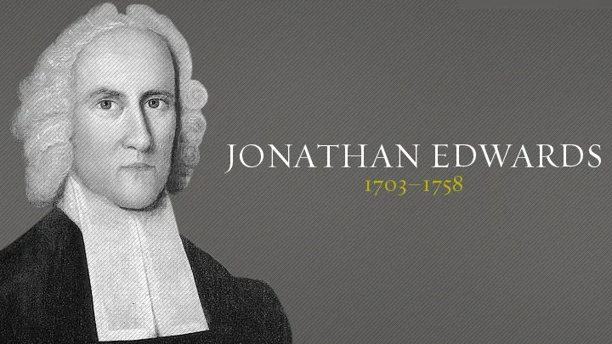

“…Strong distress and outcry neither prove nor disprove a true work. The test is whether the work raises esteem for Jesus, sets men against sin and Satan, honors the Scripture, and produces love to God and man. In other words, the test is where the conviction leads.
Jonathan Edwards, "The Distinguishing Marks of a Work of the Spirit of God"

Slide 50
Israel and the Church 4
226 What's making that desire? God is here.
53-0328

Slide 52
(Blending) PERSEVERANT
270 [Pyramid] Now the top stone is going to have to be so perfect till, when the Headstone comes, it has to blend right with it. The ministry has to start out like this, and just come to the minority all the time, getting smaller groups, smaller group, until finally the Stone meets with the building. He is the Headstone, takes the whole building with Him, which is the Church. All of them will raise up, plumb back from this first watch, to the seventh, all go in the Rapture. 64-0305

Slide 53
THERE.IS.A.MAN.HERE… LIGHT
…The baptism of the Holy Ghost served its time; until the Holy Spirit blends into the Church, and the Church into Christ, makes Jesus Christ reflected on the earth... 63-1229
HOW.CAN.I.OVERCOME
For, we believe that the hour is getting late, the sun is swiftly sinking in the west, soon be that "time shall be no more." Time and Eternity will blend together when God and His people blends together. 63-0825

Slide 54
I do not understand how a man can be a true believer, in whom sin is not the greatest burden, sorrow and trouble.
John Owen
A person who has no desire to come to the Lord for continued cleansing has reason to doubt that he ever came to the Lord to receive salvation.
J. MacAthur

Slide 55
What is Human Nature?
Human nature was created by God, is corrupted by sin and can only be renewed and recreated through the grace of God. Redemption was achieved by Jesus Christ taking upon himself sinful human nature on the cross, so delivering from the power and penalty of sin.

Slide 56
FAITH.WITHOUT.WORKS.IS.DEAD
31 You could take a hog, scrub it up with soda, do that painting on her toe nails, like women do on their fingers, fixed up with clothes on, put it on a hardwood floor, give it grape-nuts for breakfast, that hog would die. You take him and turn him loose he’d go just as straight to the wallow and wallow again. Why? The nature of a hog in there... But you put a lamb out there, in that wallow, he'll bleat and cry until somebody gets him out of there. Now if you want to keep a hog out of the wallow, change the nature of the hog. That's the way to keep the sinner out of the things of the world, change the nature from a sinner to a Christian. That can only be done through that great powerful work. 0822

Slide 57
ENDING: WHO.DO.YOU.SAY.THIS.IS
44 Everything in the Bible has a meaning. Every name has a meaning. Nothing’s written in the Scripture but has a profound meaning.
46 I preached up here two years ago, Why Little Bethlehem? These "Why?'s" got answers to them, and they're right here in the Bible.
And we're living in a marvelous time, greatest time of all ages. We're living where, anytime time can cease and Eternity can blend right in with it and go on. The ages all the prophets and sages, looked forward to. We ought to be every hour on our guard… 64-1227

Slide 59
WHAT.DOES.IT.TAKE.TO.MAKE.A.
CHRISTIAN.LIFE
34 When you receive the Holy Spirit It goes right in the middle of that new disposition of yours. "Oh, I quit drinking; smoking. I just feel like a different person." He makes every motion, every intellectual, everything agreeing right into this middle of the wheel… And when you have these little temper fits and you fly off, tell lies and so narrow minded you couldn't hear another minister, remember, the Holy Spirit isn't ticking in the inside of you.
35 The Holy Spirit will make every movement like Christ. It'll make you Christ-like. The fruits of the Spirit is love, joy, peace, longsuffering, goodness, meekness,

Slide 60
gentleness, patience, faith. Those things are what the Holy Spirit controls, our emotions.
You could do that. A shindig will bring that to you. But the Holy Spirit brings you [under] control of God, that you walk in peace and in love and in joy with long-suffering, goodness, meekness, gentleness, patience. It isn't something that you do. It's something the Holy Spirit does in you. You see, it's no longer an intellectual thought of your own; it's a subconscious moving of the Holy Spirit. Church of the living God, there's where our Pentecostal move failed. We have some man-made musical, clap hands, jump up-and-down emotion. 57-0113

Slide 61
117 When you blow up at every little thing that happens, causes that disposition, when the pastor happens to hit something, that's in the Word, and you,
“I don't believe that," look out. Watch out. The new mainspring hasn't been set in there right yet. But it controls; it makes you believe; it makes you act in such a way till you become salty. And the whole world thirsts to be like you. That's the Holy Spirit setting in the middle of your Spirit. It's the Mainspring.

Slide 63
PRAYER.LINE
3 Come on, brother. 'Course I know you, and know that you're nervous, but let this be the night it's over, will you? God, be merciful to my dear brother. Knowing this nervousness was born in him from his mother and father before him, knowing his poor mother being a nervous woman, and here he is suffered all of his life, but may this be the night.
And we know, Lord, that nothing short of a miracle will ever heal the man. And I pray, God, that if he's staggered, and tried, trying his best to get faith, I pray, God, that You'll somehow

Slide 64
accept the little faith that he has, and perform a miracle, and heal him. And may he return to his home and get well, in Jesus Christ's Name. Amen. Now, that was an hereditary thing.
You been nervous all your life. Your mother was before you was nervous. Now, you go and just beginning to thank God. I believe that God has healed you tonight, my brother. You won't have to do it. Don't never use tobaccos no more; just go ahead and serve the Lord.
53-0500

Slide 65
JESUS.CHRIST.THE.SAME
14 It doesn't take long, it only takes Truth: "Go thy way." That settled it. It takes Truth. Long, drawed out prayer lines that we've had: we never found our Lord doing those things. He went into a city and He healed one man, maybe, and passed through the city: "I must preach the Gospel somewhere else."
We are commissioned to go pray for the sick, anoint them in oil, pray over them: "prayer of faith shall save the sick…"

Slide 66
But all through life, down through the ages, God has set men aside for certain works, not because they're any more than anyone else, and they're not any more worthy.
57-0922

Slide 67
Signs Of Spiritual Maturity
Waiting for God’s Will & Seeking God’s Way of Escape in Times of Temptation;
Sacrificing Our Rights & the Need to Always be Right & Always Win;
Confessing the Positive;
Separating Your State from Your Standing;*

Slide 68
Signs Of Spiritual Maturity
Enduring Our Cross & Bearing the Reproach of the Word;
Enduring Opposition and Responding Correctly to Criticism;
Not Despising or Resisting the Discipline of the Father;*
Not Discouraged at Rebuke & Open to Admonishment

Slide 69
Signs Of Spiritual Maturity
They Get Around the Right Influences;
They have “Another Spirit” than Doubters;
They “follow Him fully;”
They Step Out & Change a Negative Report;
Their Confession is “we are more than able…”
They are not intimidated by things bigger than themselves.

Slide 70
Signs Of Spiritual Maturity
Enduring Our Cross & Bearing the Reproach of the Word;
Enduring Opposition and Responding Correctly to Criticism;
Not Despising or Resisting the Discipline of the Father;*
Not Discouraged at Rebuke & Open to Admonishment

Slide 71
Signs Of Spiritual Maturity
Not Led by Emotion or Fear;
An Atmosphere Changer;
Taking Responsibility instead of Shifting the Blame;
Making the Spiritual Life a Priority:
Luke 10:42 But one thing is needful: and Mary hath chosen that good part, which shall not be taken away from her.

Slide 72
Signs Of Spiritual Maturity
Finding Your Place & Being Confident in It;
Willing to Give Abundant Grace to Others;
Willing to Restore a Fallen Brother;
Slow to Anger & Judgment;

