Slide 1
I Am Always Right 7
In my own eyes at least…
Genesis 6:1-6
And GOD saw that the wickedness of man was great in the earth, and that every imagination of the thoughts of his heart was only evil continually. And it repented the LORD that he had made man on the earth, and it grieved him at his heart.

Slide 2
BE.CERTAIN.OF.GOD
24 We take things for granted.... So had Ahab and all of Israel in that day had taken things for granted that every-thing was all right. Their priests and preachers tried to tell them, "All is well; everything's just fine."
But they had one; he cried out against the wrong thing, because [he] knowed that a holy God could not be satisfied with modern trends of an unholy religion. So does the God of heaven remain the same today… 59-0125

Slide 3
THINGS.THAT.ARE.TO.BE
103 Christians, I may never see you again. See, it's been years since I been here. May never see you again. Line up with God's Word. Look in the mirror.
65-1205

Slide 4
WHAT.IT.TAKES.TO.OVERCOME.ALL
UNBELIEF: OUR.FAITH
Listen for the voice of God to speak to you. It'll change you; it'll take all the doubt out of your mind, knowing the Lord Jesus is the same…
Go home, take your Bibles, reason it out, see if it's right. Search the Scriptures. Has to come from Gen. to Rev., through the Bible. That's exactly your promise, and hear God; it'll change you. It'll give you faith to believe.
60-0729

Slide 5


Slide 6
FELLOWSHIP.BY.REDEMPTION
118 The reason we can't see the television pictures our bodies are not set as instruments to pick up mechanical sent things. But when our body becomes in tune with God, a part of Him, then our soul can pick up the power of the Holy Spirit to vindicate the Presence of the Lord Jesus Christ…
He lives among us today. And He wants fellowship… He's desiring to fellowship again with His people like He did in the garden of Eden. 55-0403

Slide 7
THE.ARROW.OF.GOD'S.DELIVERANCE
18 Brother, if we'd ever come in the Presence of God like Moses did, it was revolutionary to him…
And I think if men and women today would ever step into the Light of the Holy Spirit, under the unction of God's Spirit and the Light of God's Word, everything that God has promised will illuminate to you and be real again.
56-0801

Slide 8
I JOHN 5:19
And we know that we are of God, and the whole world lieth in wickedness. 20 And we know that the Son of God is come, and hath given us an understanding, that we may know him that is true, and we are in him that is true, even in his Son Jesus Christ. This is the true God, and eternal life.

Slide 9
INFLUENCE
41 We all know of men in the field today, great men. Some of them gets to a spot they feel so secure till they think they can even sin and get by with it. And many times, that's because that they feel secured "Oh, the people will let me get by with anything." The people might, my brother, but God won't. See, you're going to answer to God. You must be a servant to Christ, stay honorable with that Word.
63-1130

Slide 10
DOOR.TO.THE.HEART
42 You want Him to be your Saviour, but He wants to be your Lord. Lord is rulership. You want Him as a Saviour, but what about being your Lord, that'll control you, control your emotions, your thinking, every fiber of you, that you could say like [Paul], "For me to live is Christ and to die is gain." Let Him in that way to be Ruler and Lord over you.
58-0316

Slide 11
Luke 17:28-30 Likewise also as it was in the days of Lot; they did eat, they drank, they bought, they sold, they planted, they builded; But the same day that Lot went out of Sodom it rained fire and brimstone from heaven, and destroyed them all. Even thus shall it be in the day when the Son of man is revealed.
Matthew 24:37-39 But as the days of Noe were, so shall also the coming of the Son of man be. 38 For as in the days that were before the flood they were eating and drinking, marrying and giving in marriage, until the day that Noe entered into the ark, 39 And knew not until the flood came, and took them all away; so shall also the coming of the Son of man be.

Slide 12
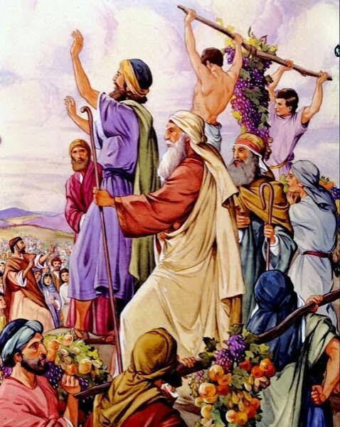
1 Peter 3:18 -20
For Christ also hath once suffered for sins, the just for the unjust, that he might bring us to God, being put to death in the flesh, but quickened by the Spirit: By which also he went and preached unto the spirits in prison; 20 Which sometime were disobedient, when once the longsuffering of God waited in the days of Noah, while the ark was a preparing, wherein few, that is, eight souls were saved by water.

Slide 13
In His Presence
…I just come back from Africa, jungles and found out just exactly where earrings, where all that stuff come, a lot of jewelry wrapped your necks and ears. It's the heathens. And the Bible don't want a Christian to be a heathen. I don't say that you are a heathen because you do it, but you're making yourself look like one. It's because your pastor didn't tell you the truth. 56-0226

Slide 14
Native Boy Wearing Ear Rings / Ornaments
Questions And Answers #1
The next come was a little boy. He was a Zulu. They cut their ears like this and make great, long things. They wear a lot of earrings... they had some permanent earrings. They cut the flesh and keep putting chunks of wood in it, till the rings hang down like that, of flesh where their ears had been spread out. This little boy was a Zulu. 54-0103

Slide 15
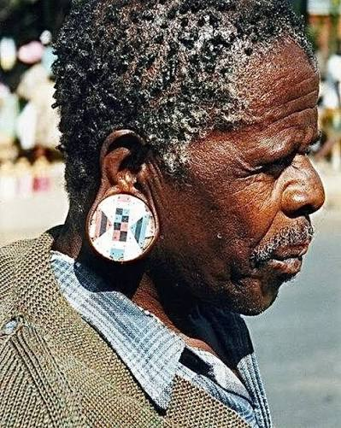



Slide 16
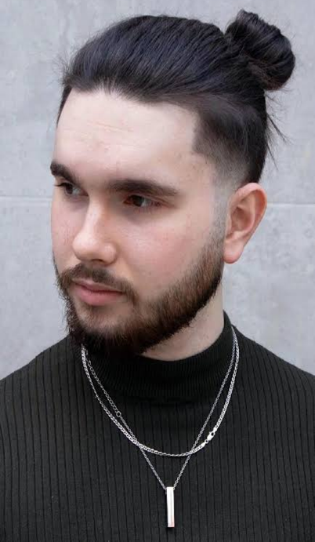
Men and Effeminate Appearance
The Baptism Of The Holy Spirit
And when you see a man that's manicuring (or whatever you call it) his fingernails, slicking his hair down, holding his mouth open and such stuff, one of these pretty boys; just remember, sis, there's something wrong with that bird. There's something wrong. You better keep your eye on him.
58-0928

Slide 17


Slide 18
First Marker: When Men Began to Multiply
40 The very first word presents us with a absolutely flashing light that the day is at hand, for there has never been a time in all the history that there's ever been so many people, and so quickly multiplying, as we have today, until it's hard to get a place to stay.
”Flashing Red Light”

Slide 19
Flashing Red Light of the Sign of His Coming:
June 1963, world population at just over three billion.
July 2024 the world reached 8.2 billion people,
Projects a peak of about 10.3 billion in the mid-2080s.
India, which Bro. Branham numbered at 470 million, passed China in 2022 to become the most populous nation on earth, at about 1.45 billion in 2024.
The population of the earth has more than doubled within the lifetime of many who heard that sermon.
The United Nations World Population Prospects 2024

Slide 20
Strange contradiction inside the multiplying:
An exploding population alongside rampant destruction of the unborn. That contradiction has not eased.
The Guttmacher Institute reported 1,038,100 clinician-provided abortions in 2024 (US) and the Society of Family Planning's #WeCount study, tallied about 1.1 million abortions nationwide for the year, (95,000 a month.)
Bro. Branham was shocked by thirty thousand every sixty days in Chicago.
Today the national count is well over three thousand every single day.

Slide 21
Second Marker: The Daughters of Men Were Fair
44 Oh, what a subject that we got here! Now, one of the first things I want you to notice, that the sons of God saw the daughters of man, that they were fair. Now I'm pointing this at the whole world. But there never has been a time on the earth, as I can think, only that time, that there ever was such a wholesale beauty among women.

Slide 22
Bro. Branham spoke of lipstick, makeup, and face lifts.
What he saw in its infancy has become an industry that reshapes the human body itself.
The International Society of Aesthetic Plastic Surgery (ISAPS) reported (June 2025) that nearly 38 million cosmetic procedures were performed worldwide in 2024, about 17.4 million surgical and 20.5 million non-surgical, an increase of 42.5 percent in just four years. (The United States led the world with more than 6.1 million procedures.)

Slide 23
One detail from the same survey shows how far the pursuit of fairness has reached down the generations: rhinoplasty, the surgical reshaping of the nose, was the most common cosmetic procedure among patients seventeen years of age or younger.
The daughters are being surgically made fair before they are grown.

Slide 24
Third Marker: They Took Them Women of All Which They Chose
58 It never said nothing about marriage? "The sons of God came unto the daughters of man," nothing about marriage. And if you take in the original Greek, the word says, a "wife." In the 3rd verse, "taken them wives." In the Greek, I looked it up this afternoon, it didn't say, "Take to them wives." It said, "Took to them women," not wives.

Slide 25
Bro. Branham understood this as the breakdown of the covenant of marriage itself.
1969 (California) nation's first no-fault divorce law, allowing a marriage to be dissolved without any finding of wrongdoing, and within a generation every state had followed.
Reno's quick divorce, which Bro. Branham called out of date, became the law of the land.

Slide 26
The Pew Research Center, (National Survey of Family Growth), 2013-2017, found among American adults (18-44), 59% lived with an unmarried partner, while only 50% have ever been married.
In 2002 those figures were reversed. Among young adults ages (18-29) those who have cohabited outnumber those who have married almost two to one, 44 percent to 23 percent.
69% of Americans told Pew that living together is acceptable even if a couple has no plans to marry.
The CDC (2023) 1,440,031 babies were born to unmarried mothers in the US, 40.0% of all births.
Two out of every five children in this nation now begin life outside the covenant of marriage.

Slide 27
Fourth Mark: Shrines to Female Flesh
63 Even look at our churches today, look at everything you wish to, notice it. Everywhere, it looked in that day, must have been pretty women. Man became slaves to them, says history, because they were so pretty, they become slaves. They literally made shrines, and worshipped. And, just think, they literally worshipped female flesh and blood in that day. That's history.

Slide 28
It is no longer confined to billboards and magazines; it has become a trade conducted from a telephone. [One] subscription platform (sexually explicit), reported in its annual filing (2024) revenues of $7.22 billion to its content creators.
The platform listed 4.63 million creator accounts and 377.5 million fan accounts, the fan count having grown 24 percent in a single year.
Today's "shrine" in modern form: millions of men paying month by month, to bow before the image of female flesh.

Slide 29
The shrine is also in the bedrooms of children.
In January 2023 Common Sense Media released a national survey (teens 13 to 17). 73% said they had viewed online pornography. The average age of first exposure was twelve, and fifteen percent had seen it by age ten or younger.
30% of teens who had seen it reported being exposed during the school day, sometimes on a school-issued device. More than half of those who had seen it reported seeing depictions of sexual violence.

Slide 30
5th Mark: Calling Evil Good
75 Pretty women increase; social life broke down. Oh, my, what a great thing in the day we're living in! How they do this, [and] get by with that. They won't get by with it. Just as they did then, they're making the Commandments of God a mock.
God said, "Thou shalt not commit adultery." They think they're going to get by with it, but they'll never do it. However, God said that this would be the time that the red light would be flashing.

Slide 31
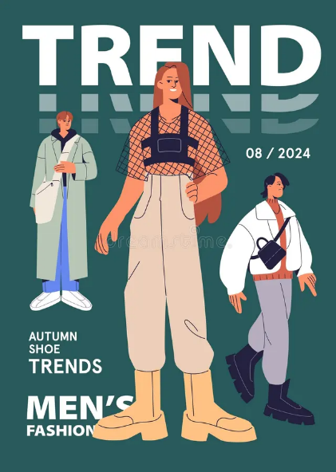
Satan's Eden
141 She has got her Adam to wear her underneath clothes. A man put on them little old sissy-looking shorts, and get out here, I don’t think there is much man to him…
42 Now, he now wears her bangs, also. He combs them down, puts a curler in them… You big sissy! That’s a horrible thing to say from a pulpit, but judgment begins at the house of God.

Slide 32
You don’t even know whether you’re a man or woman. And I understand that our United States Army… She wears his outside clothes, and he wears her inside clothes. It’s the absolute Gospel Truth. If you don’t know it, then there’s something wrong with you; you’re either blind or never been on the streets. And she thinks and he thinks that it’s right, they’re getting along somewhere.
65-0829

