Slide 1
I Am Always Right 7
In my own eyes at least…
Judges 17:5–6
And the man Micah had an house of gods, and made an ephod, and teraphim, and consecrated one of his sons, who became his priest. 6 In those days there was no king in Israel, but every man did that which was right in his own eyes.

Slide 2
Two Points of View
Pharaoh
Moses
EXODUS 5:2
And Pharaoh said, Who is the LORD, that I should obey his voice to let Israel go? I know not the LORD, neither will I let Israel go.
NUMBERS 12:2-3
And they said, Hath the LORD indeed spoken only by Moses? hath he not spoken also by us? And the LORD heard it. 3 (Now the man Moses was very meek, above all the men which were upon the face of the earth.)

Slide 3
*(Key) MARRIAGE.AND.DIVORCE
54 Now, remember, these things that I say must come from the Word of God. It can't be my own opinion, 'cause my opinion is just like anybody else's. But it's got to be in continuity with the Word of God. Remember, God keeps everything in continuity. He never changes. 65-0221

Slide 4
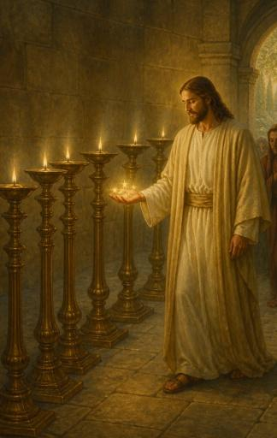
REVELATION 1:16-17
And he had in his right hand seven stars: and out of his mouth went a sharp twoedged sword: and his countenance was as the sun shineth in his strength.
REVELATION 1:20
The mystery of the seven stars which thou sawest in my right hand, and the seven golden candlesticks. The seven stars are the angels of the seven churches: and the seven candlesticks which thou sawest are the seven churches.

Slide 5
REVELATION.CHAPTER.FOUR.2
230 “And out of the throne proceed lightnings... thunders... voices: and there were seven lamps of fire burning before the throne, which are the seven Spirits of God.”
Reflecting the Light of God into the Church, right straight from the Throne of God… them seven stars standing there reflecting that Shekinah Light, from the Holiest of holy. Seven lamps on fire, setting on top of these candlesticks, reflecting His Light, His colors, of His power of His resurrection, right into the Church. 61-0101

Slide 6
THE.PATMOS.VISION
222 And, remember, the seven stars was in His right hand. Just think, they were drawing their current, their Light from Him. They were completely under His control, in His right hand. Oh! Every true servant of God is the same way. Who can harm them?
60-1204

Slide 7
QUESTIONS.AND.ANSWERS.2
I Cor. 13 says: "When that which is perfect is come, that which is in part shall be done away with." So all these little things of jumping up-and-down like a kid, trying to talk in tongues, all these other things, when that which is perfect...
And we do have today, by God's help, the perfect interpretation of the Word with Divine vindication. Then that which is in part is done away with.
64-0823

Slide 8
THE.FOURTH.SEAL
310 Here they are joining themselves together, coming to that showdown to Armageddon and riding on a mixed colored horse, with one horse of white, one horse of red, one horse of black: political power, spiritual power controlled by demon power which is the antichrist, mixing that all together, you got a pale, sickly looking thing he's riding on; pale looking, grisled colored horse, mixed with black, red, and white… gathering his subjects from every nation under heaven. 63-0321

Slide 9
RECOGNIZING.YOUR.DAY & ITS.MESSAGE
41 Those women throwing themselves, twists, with holding just paper, gray, hypocritical... The gray is between a white and a black, which is a deceiving color… neither white nor black. And gray-looking paper, holding in front of them, with lace-like hula skirts in front of them, and completely nude from their waist up. And was marching to… Or twisting, and carrying on with that music, walking up. And said, "That is the church.“ 64-0726

Slide 10
THE.QUEEN.OF.SHEBA
23 …I am here to say that any angel of God, or any messenger of God, must stay strictly in the Word of God.
61-0219

Slide 11
THE.RAPTURE
130 Three things happens. A shout, a voice, a trumpet, has to happen before Jesus appears. Jesus does all three of them when He's descending. What is the shout? It's the Message going forth, first, the living Bread of Life bringing forth the Bride.
131 Now, God has a way of doing things. And He never changes His policy. He's the unchanging God. In Amos 3:7, He said, "He would do nothing on the earth until first He revealed it to His servants the prophets."

Slide 12
141 The first thing comes, when He starts descending from the Heaven, there's a shout. What is it? Is a Message, to get the people together. Now, lamp-trimming time, "Rise and trim your lamps." What watch was that? The seventh, not the sixth. The seventh, "Behold, the Bridegroom cometh. Rise and trim your lamps." And they did. Some of them found they didn't even have any Oil in their lamp. But it's lamp-trimming time. Malachi 4 time. Is Luke 17.

Slide 13
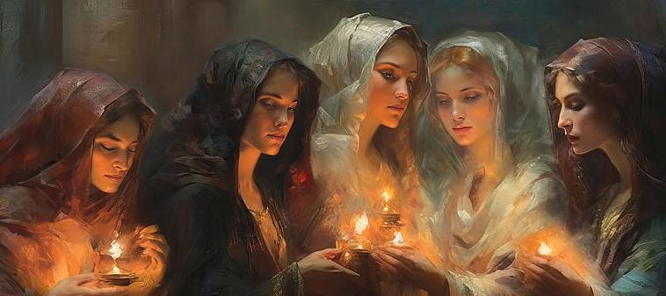
164 Therefore, the Message calls the Bride together, see, the shout. The same One, He, with a loud voice, screamed out with that shout and a voice, and woke Lazarus. With a loud voice He cried, "Lazarus, come forth." The voice wakes up the sleeping Bride, the sleeping dead.
65-1204

Slide 14
Example: Levites I CHRONICLES 23:1-5
So when David was old and full of days, he made Solomon his son king over Israel. 2 And he gathered together all the princes of Israel, with the priests and the Levites. 3 Now the Levites were numbered from the age of thirty years and upward: and their number by their polls, man by man, was thirty and eight thousand. 4 Of which, twenty and four thousand were to set forward the work of the house of the LORD; and six thousand were officers and judges:5 Moreover four thousand were porters; and four thousand praised the LORD with the instruments which I made, said David, to praise therewith.

Slide 15
Levites: NUMBERS 18:21-23
And, behold, I have given the children of Levi all the tenth in Israel for an inheritance, for their service which they serve, even the service of the tabernacle of the congregation. 22 Neither must the children of Israel henceforth come nigh the tabernacle of the congregation, lest they bear sin, and die. 23 But the Levites shall do the service of the tabernacle of the congregation, and they shall bear their iniquity: it shall be a statute for ever throughout your generations, that among the children of Israel they have no inheritance.

Slide 16
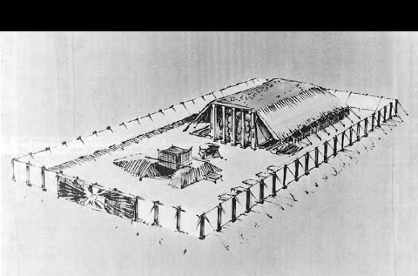

Aaron & his Sons
Levites
Congregation
NUMBERS 18:3
And they shall keep thy charge, and the charge of all the tabernacle: only they shall not come nigh the vessels of the sanctuary and the altar, that neither they, nor ye also, die.

Slide 17
Example: JUDGES 17:7
And there was a young man out of Bethlehem-judah of the family of Judah, who was a Levite, and he sojourned there. 9 And Micah said unto him, Whence comest thou? And he said unto him, I am a Levite of Bethlehemjudah, and I go to sojourn where I may find a place. 10 And Micah said unto him, Dwell with me, and be unto me a father and a priest, and I will give thee ten shekels of silver by the year, and a suit of apparel, and thy victuals. So the Levite went in.

