Slide 1
I Am Always Right 4
In my own eyes at least…
JOHN 8:31-32
Then said Jesus to those Jews which believed on him, If ye continue in my word, then are ye my disciples indeed; 32 And ye shall know the truth, and the truth shall make you free.

Slide 2

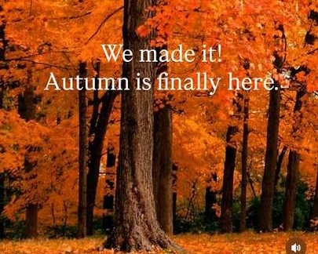
Sept. 1 Caroline McIntosh
Sept. 2 Abigail McCafferty
Sept. 5 Karen Mourglea
Sept. 7 Jason Ashdown
Aug. 30th Jeremiah & Kaitlyn Sheffield
Sept. 6th Joel Brown
Sept. 13th Sam Browning
11:00am & 5:00 pm

Slide 3

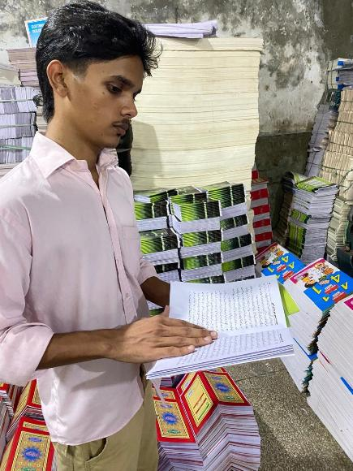
Faith Cometh By Hearing (Urdu)

Slide 4
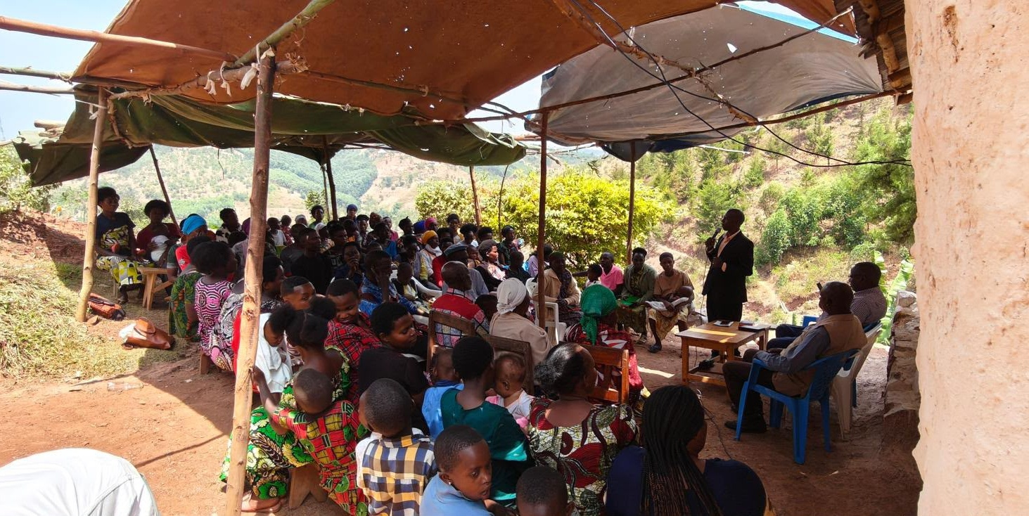
Rwanda

Slide 5
SHOW.US.THE.FATHER & IT.WILL.SUFFICETH.US
5 In a group like this it's the closest place to heaven that there is on earth. When we are setting together this morning, we are already dead; we are buried. And not only that, but we're raised and in Christ in His resurrection. We're part of it. And now we're assembling together in heavenly places in Christ Jesus. We are in Him by baptism. 62-0609

Slide 6
II TIMOTHY 4:2
Preach the word; be instant in season, out of season; reprove, rebuke, exhort with all longsuffering and doctrine.
II TIMOTHY 3:16
All scripture is given by inspiration of God, and is profitable for doctrine, for reproof, for correction, for instruction in righteousness: 17 That the man of God may be perfect, throughly furnished unto all good works.

Slide 7
WHY.ARE.PEOPLE.SO.TOSSED.ABOUT 56-0101
20-4 Take a dead sinner, alienated from God, without hope, without Christ, and put him in the Presence of God, in this great glorious tabernacle he will yield forth fruit of the Holy Spirit: love, joy, peace, long-suffering.
And every Christian comes the same way when he comes into the Presence of God. First, he has to be refreshed. The Holy Spirit has to take a hold of a man and renew him and make him another person. The Holy Ghost comes in... The Holy Ghost comes in the quiet of the hour.

Slide 8
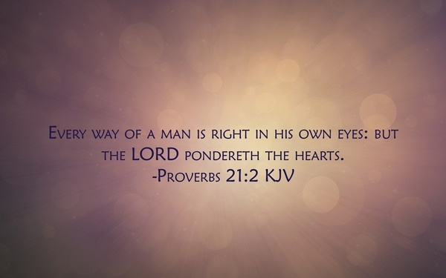

Slide 9
EXODUS 15:26
26 And said, If thou wilt diligently hearken to the voice of the LORD thy God, and wilt do that which is right in his sight, and wilt give ear to his commandments, and keep all his statutes, I will put none of these diseases upon thee, which I have brought upon the Egyptians: for I am the LORD that healeth thee.

Slide 10
ISRAEL.AND.THE.CHURCH.2
43 God's just now loosening up the church…
The people are in the spirit of the last days, just like they was in the days of Noah, eating, drinking, marrying, giving in marriage, unconcerned, don't care, walk around, and anything else.
And these American people is the worst on the face of the earth: heady, high-minded, incontinent, fierce, and despisers, a know-it-all. 53-0326

Slide 11
Our Warfare…
Among Us…
NUMBERS 16:41
But on the morrow all the congregation of the children of Israel murmured against Moses and against Aaron, saying, Ye have killed the people of the LORD. 42 And it came to pass, when the congregation was gathered against Moses and against Aaron, that they looked toward the tabernacle of the congregation: and, behold, the cloud covered it, and the glory of the LORD appeared.
From Without…
II CHRONICLES 20:1
It came to pass after this also, that the children of Moab, and the children of Ammon, and with them other beside the Ammonites, came against Jehoshaphat to battle. 2 Then there came some that told Jehosha-phat, saying, There cometh a great multitude against thee from beyond the sea on this side Syria; and, behold, they be in Hazazontamar, which is Engedi. 3 And Jehoshaphat feared, and set himself to seek the LORD, and proclaimed a fast throughout all Judah.

Slide 12
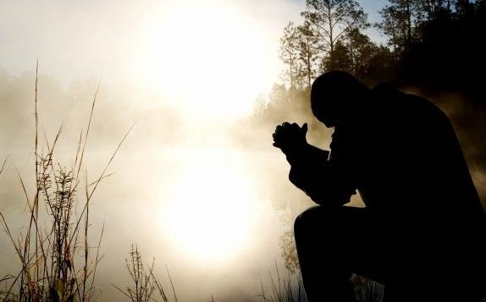
The Battle
Within

Slide 13
THE.WORD.BECAME.FLESH.INDIA.TRIP.REPORT
108 I want to ask the church one more thing, that you'll pray for me. I've developed a critical spirit, and it haunts at me. I told my wife yesterday. Something happened, I was sitting in the yard, and I told her. "Honey, I've got to a place till I'm become critical of people." I don't want to be… whose job is it? It's not mine. And God's the One to criticize, not me.
54-1003

Slide 14

The faculty or action of forming new ideas, or images or concepts of external objects not present to the senses.
ROMANS 1:21
Because that, when they knew God, they glorified him not as God, neither were thankful; but became vain in their imaginations, and their foolish heart was darkened.

Slide 15


Slide 16
II COR. 10:4-5
(For the weapons of our warfare are not carnal, but mighty through God to the pulling down of strong holds;) 5 Casting down imaginations, and every high thing that exalteth itself against the knowledge of God, and bringing into captivity every thought to the obedience of Christ;
Imaginations: (Gr.) logismos
A reckoning, computation. Reasoning such as is hostile to the Christian faith.

Slide 17
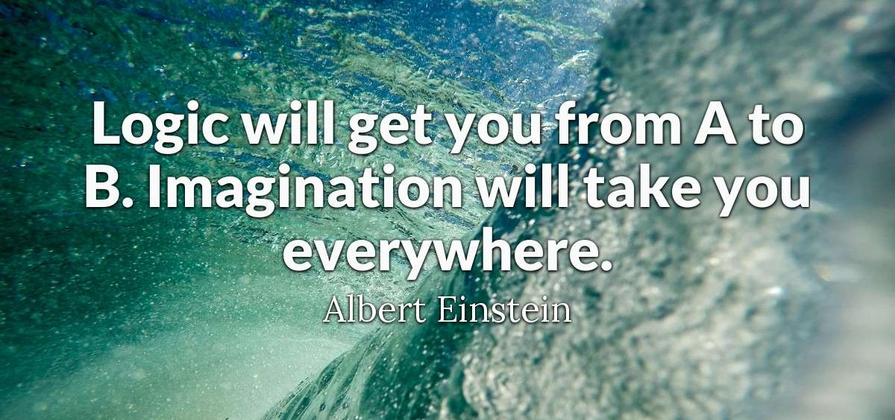

Slide 18


Slide 19


Slide 20
AN.UNCERTAIN.SOUND
52 Now, the mind reasons but the heart doesn't reason. There's where the devil abides, he reasons it out. "I'm sick. I can't get well. I can't be saved. I've done too much." But we are to cast down reasonings, we believe with our heart.
53 In the garden of Eden, man was divided in two parts. The devil took his head and God took his heart. The devil makes him look at things and say, "Well, it just can't happen. I can reason it out."

Slide 21
And God took his heart to dwell in his heart to make him believe things that his head don't even know nothing about. Down here's where the real certain sound comes from, is from the heart. There's where God talks. And here's where the devil talks from.
So let's cast down what the devil said and take a certain sound. And that certain sound is God talking in our heart. That's truth, God's promises.
61-0315

Slide 22


Slide 23
JUDGES 6:11-12
And there came an angel of the LORD, and sat under an oak which was in Ophrah, that pertained unto Joash the Abiezrite: and his son Gideon threshed wheat by the winepress, to hide it from the Midianites. 12 And the angel of the LORD appeared unto him, and said unto him, The LORD is with thee, thou mighty man of valour.

Slide 24
Judges 17-18
18:1 Now in those days Israel had no king. And the tribe of Dan was trying to find a place where they could settle, for they had not yet moved into the land assigned to them when the land was divided among the tribes of Israel. 2 So the men of Dan chose from their clans five capable warriors from the towns of Zorah and Eshtaol to scout out a land for them to settle in…

Slide 25
Judges 17:1-3
17 And there was a man of mount Ephraim, whose name was Micah. 2 And he said unto his mother, The eleven hundred shekels of silver that were taken from thee, about which thou cursedst, and spakest of also in mine ears, behold, the silver is with me; I took it. And his mother said, Blessed be thou of the Lord, my son.
3 And when he had restored the eleven hundred shekels of silver to his mother, his mother said, I had wholly dedicated the silver unto the Lord from my hand for my son, to make a graven image and a molten image: now therefore I will restore it unto thee.

Slide 26
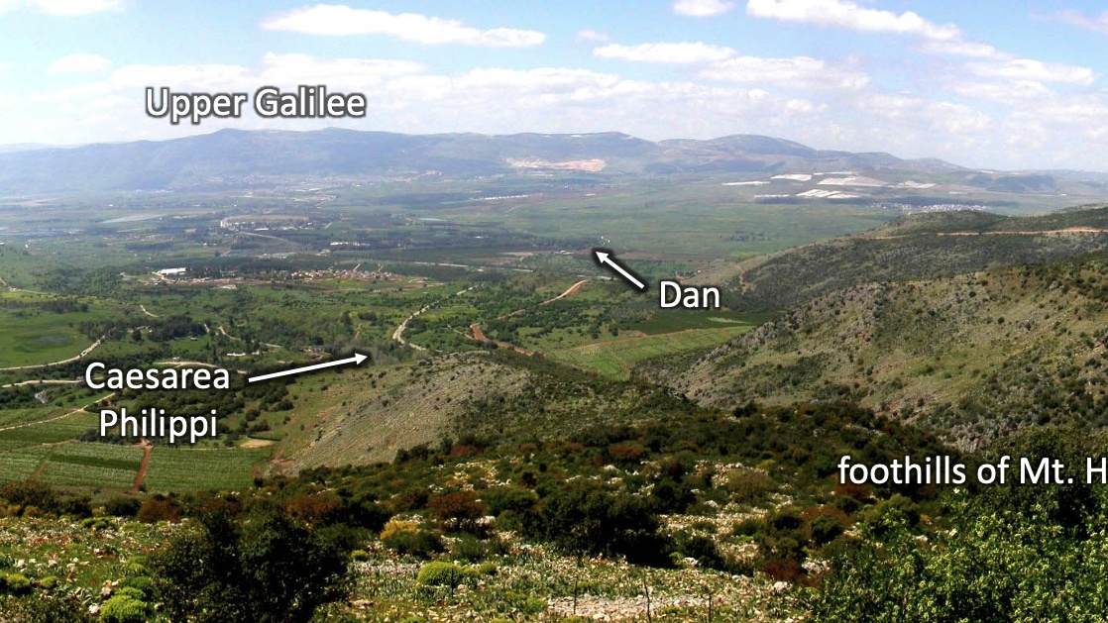

Slide 27
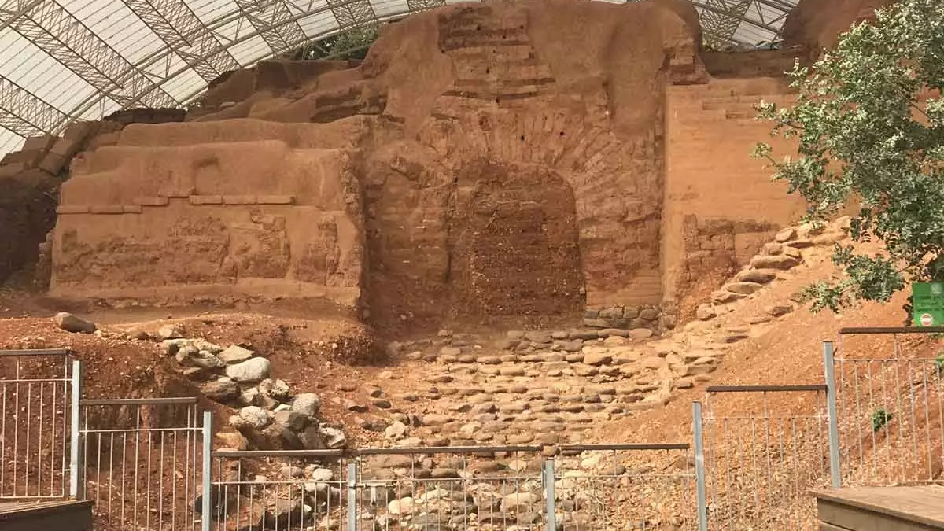
THE.SEVENTH.SEAL
214 Ephraim at Beth-el, and Dan; and they set up idols, and these went out to worship this. And here we are plumb down into the Millennium age almost, and God still remembered that sin. They're not even counted in there. 63-0324

Slide 28
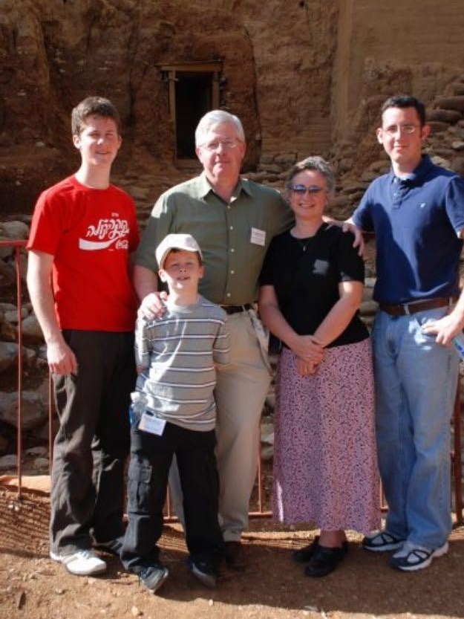

Slide 29
273-1 CHURCH.AGE.BOOK
It is more than evident that names have been, and will be removed from the Book of Life ere time shall be no more. In this particular place it was because of idolatry, even as when Dan and Ephraim lost their rights as tribes for worshipping the golden calves. All who worshipped the idols had their names removed from the Book of Life.
THE.SEVENTH.SEAL
225 When He called them over there, 144,000, they were missing. They're not even numbered in there. And Joseph and Levi is put in the place of Dan and Ephraim. And here's God's promise way back there hundreds and hundreds of years before that.
63-0324

Slide 30
Post of Duty
FORSAKING.ALL
37 I am just a little late, as usual. And so we are, tomorrow night, at some place. And now, if you have church at your own church here, tomorrow night, don't come down. But if you don't have church, we'd be glad to have you. We always want the people to stay at their post of duty, regardless. When the church is open, every soldier ought to be in his rank and in his place.
62-0123

Slide 31
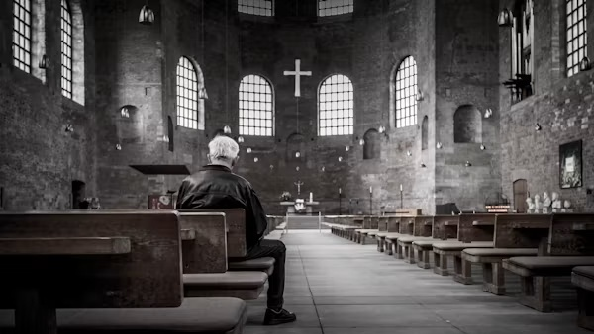

Slide 32
QUESTIONS & ANSWERS.ON.THE.SEALS
92 You say, "Bro. Branham, if He was to come this morning, shouldn't you be out there?"
No, sir. This is my post of duty. I'll be standing right here preaching when He comes, saying the same things I am. When He comes, I'll just move right on out with Him. If I'm hoeing potatoes, I'll just be hoeing away just as hard as I can, I'll just drop the hoe and take off.
63-0324

Slide 33
GOD.KEEPS.HIS.WORD
123 The Gospel come and give a mercy call throug the nations for years; and we've turned it down. And the devil taking his seat, is turning the hearts of these political men against Israel, they're hooking up yonder with the Arabs. Brother, we're as good as gone. I love my nation. I love what it stands for; but I love my Lord above everything. And I love to see my nation to its knees, but I'm afraid we'll never do it. We're at the end time. What happened? A mixed multitude got in.
57-0407

Slide 34
LETTING.OFF.THE.PRESSURE 62-0513
Commit your case to God, and go on as if it was all over. Don't build up pressure; it lets off pressure. "Well," you say, "I am so worried, Bro. Branham, I just don't know." Let off the pressure…
Cast your cares on Him, for He careth for you. Don't you worry about your cares; that's His business.

Slide 35
ONENESS
62 Now, when Adam and Eve listened to the lie of the Devil, the holy image of God left them, their fellowship was broken, their fellowship of oneness with God was broken.
The very minute they listened to the lie of the Devil, that broke their fellowship. And the very minute you listen to the lie of the Devil, it'll break your fellowship, the very minute that you go out from the Presence of God, like she did, is when you failed to take God's Word just as It is.
62-0211

Slide 36
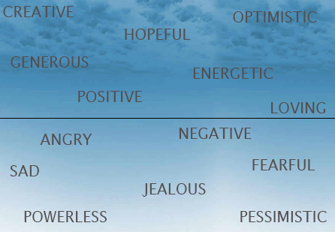

Slide 37
DEMONOLOGY.RELIGIOUS.REALM
236 (Ohio) That woman slipped out of that seat there in that restaurant, and we had a prayer meeting, and she come to Christ. What was it? Don't condemn them; tell them the Gospel. They're demon possessed; they're mortals in this realm.
They're influenced from over here. Our influence comes from above. Let's see what we can do with our talents to win others to Christ.
53-0609

Slide 38
JEHOVAH.JIREH
40 You come to America, get American spirit. That's a long ways from being God's Spirit... This is your nation. You should be thankful for it. But you're really not an American. You are a Christian, your Spirit comes from above, makes you act like they do up there, not like they do down here. Holy, clean, righteous, love, respects for one another, godly love for one another, you're born from above. That's the reason you act different, because your spirit come from up There.
61-0226

Slide 39
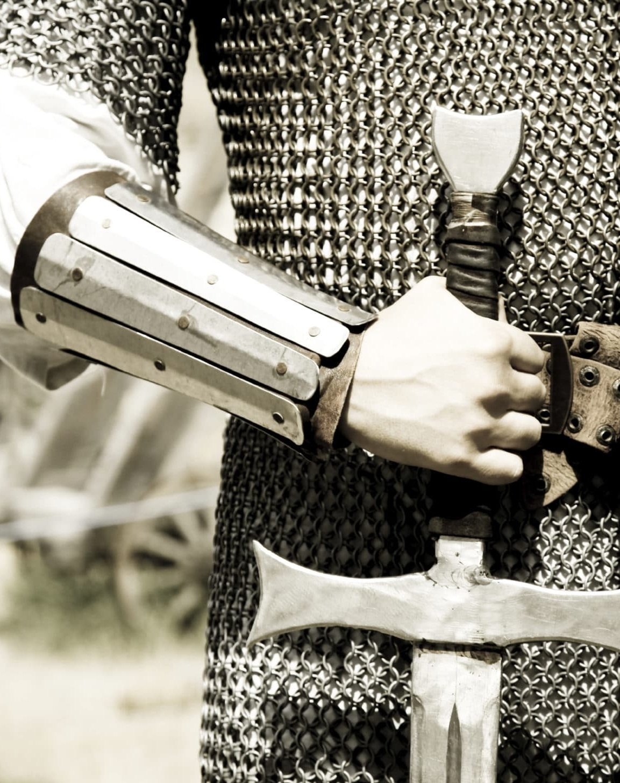
DEUTERONOMY 20:1-3
When thou goest out to battle against thine enemies, and seest horses, and chariots, and a people more than thou, be not afraid of them: for the LORD thy God is with thee, which brought thee up out of the land of Egypt. 2 And it shall be, when ye are come nigh unto the battle, that the priest shall approach and speak unto the people, 3 And shall say unto them, Hear, O Israel, ye approach this day unto battle against your enemies: let not your hearts faint, fear not, and do not tremble, neither be ye terrified because of them…

