Slide 1
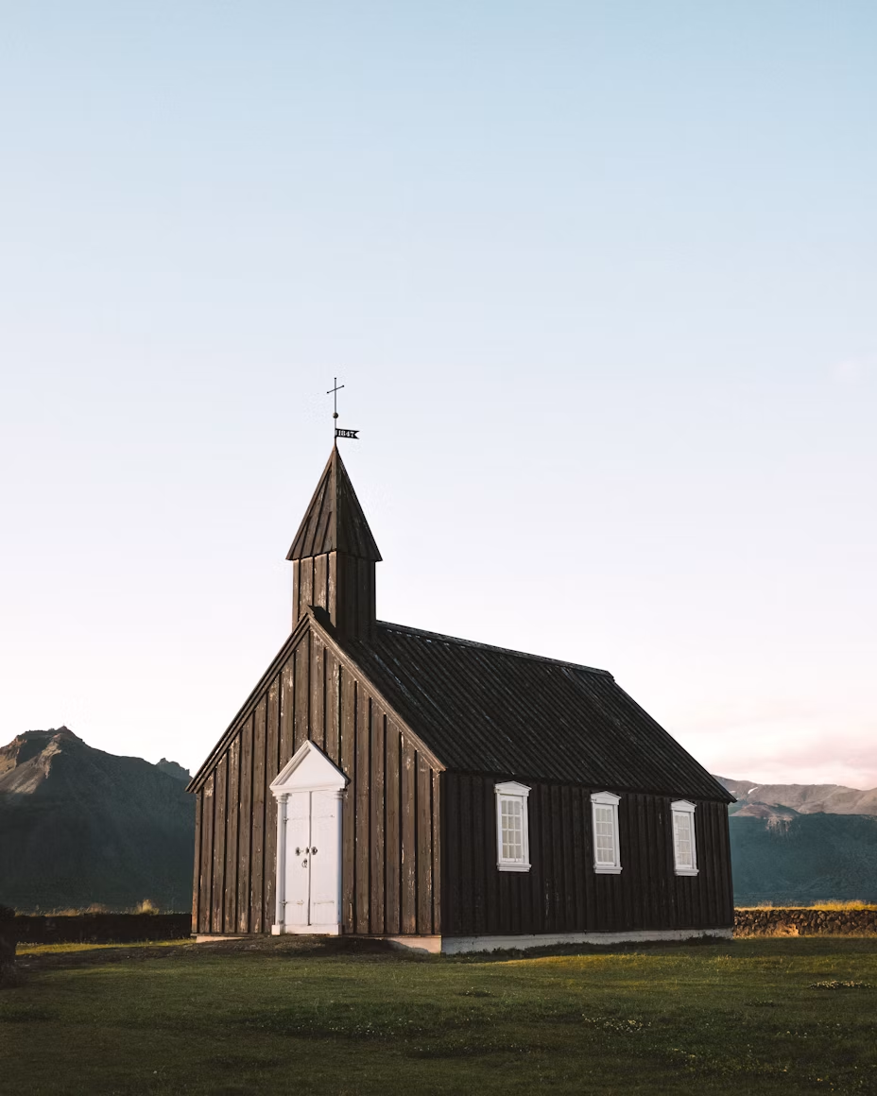
I Am Always Right 3
In my own eyes at least…
“I Don’t Want to Go to Church”
Psalm 122:1
I was glad when they said unto me, Let us go into the house of the LORD.

Slide 2
PALMERWORM.LOCUST.CANKERWORM
CATERPILLAR
37 Put a chain on a sprocket then …you might be able to make a little bit of time. But the only way that you'll ever make correct time with that chain, is to put a sprocket that's equal to the sprocket in the back, those holes in that chain meet, timed with the sprocket, then you go somewhere. And I'm sure that we got a wrong sprocket somewhere.

Slide 3
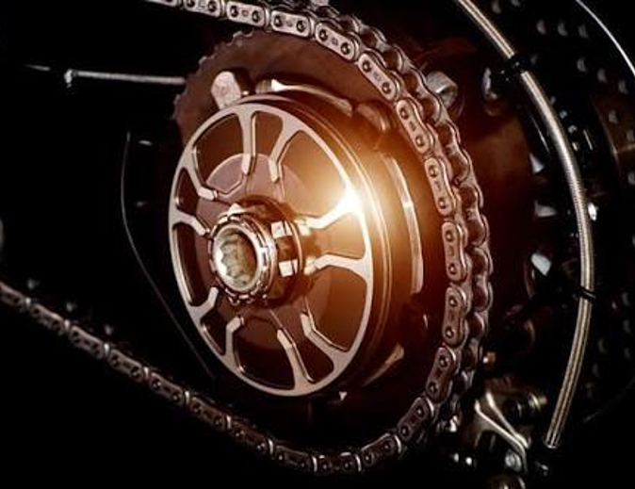

The church is moving too slow for the hour we're living in. There's something radic-ally wrong. And it behooves us in this day, near coming of the Lord, to sit down and study this and see what's wrong, find the cause. You can never find the cure till you find the cause. 59-0823

Slide 4
SUDDEN.SECRET.GOING.AWAY.OF.THE.CHURCH 10 (Reading) on the sudden attack on Pearl Harbor. That wasn't no exactly any unknown attack. They had already been warned that the Japs were going to do that. But the sad part was, they ignored that warning. They seen signs, Japanese army assembling themselves, big ships being loaded with ammunition, and the threat was in the air. They were in line for the invasion. But they ignored it.
That's the way it is today with the Church. The Church is in line of judgment. But they are ignoring the coming of the Lord. So You can't blame Him. 58-1012

Slide 5
Hebrews 10:25
And let us consider one another to provoke unto love and to good works: Not forsaking the assembling of ourselves together, as the manner of some is; but exhorting one another: and so much the more, as ye see the day approaching.

Slide 6
Assembling: HEB.
To go forth, wage war, fight, serve (at sacred tent).
To muster.
I.WILL.RESTORE
3 To be assembled this morning, here at this breakfast, with such men as I am assembled with, it certainly is a privilege that kings of the earth don't have. Because on assembling like this, we have a promise that the King of Kings will be with us: "Wherever two or three are gathered in My Name, I'll be in their midst." And I just love that. 57-0309

Slide 7
II TIMOTHY 4:2
Preach the word; be instant in season, out of season; reprove, rebuke, exhort with all longsuffering and doctrine.
II TIMOTHY 3:16
All scripture is given by inspiration of God, and is profitable for doctrine, for reproof, for correction, for instruction in righteousness: 17 That the man of God may be perfect, throughly furnished unto all good works.

Slide 8
HEAR.YE.HIM
21 I wonder tonight, we that claims the new birth: how the Holy Spirit must blush, to bring our character record before the Father. We call ourselves believers, and we dilly-dally around in the world. The men have got away from God. The women has got away from God. It used to be, in the old fashioned church, it was wrong for women to cut their hair… It was wrong for women to wear manicure, or ever what you call it, on their lips... And today, the Pentecostal women wear shorts…

Slide 9
That's awful old fashion, but brother, it'll scour you out. It's what the church needs: We've taken different teachers; we've not let the Holy Spirit do the teaching. And oh, how we get away with some little fancy, slick-tongue fellow "Oh, that's old-fashion. Don't believe in that." But that's the teaching of God's Bible. We're guilty before God, if we neglect to preach the entire truth of that Bible. 57-0725

Slide 10
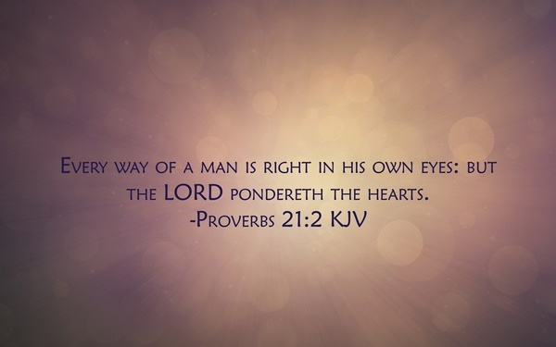

Slide 11
Word Notes
Assembling” episynagoge a gathering-together, a mustering.
It is a rare word in the New Testament, used in only one other place: 2 Thes. 2:1, “our gathering together unto him,” referring to the return of Christ.
Paul’s choice of this word ties the local, weekly gathering of the saints to the final gathering at Christ's appearing — the church's regular assembling is a rehearsal of and a preparation for, that ultimate assembling. To neglect the one is to grow cold toward the other.

Slide 12
“Forsaking” (egkataleipo)
To abandon, to leave behind in a place of danger, to desert. It is a strong word; it is the word Christ used from the cross, “why hast thou forsaken me,” and the word Paul used of Demas, who forsook him, “having loved this present world” (2 Timothy 4:10).
*Paul is not describing an occasional missed service out of illness or hardship. He is describing a pattern of desertion and rooting it in the pull of the present world rather than any single dramatic sin.

Slide 13
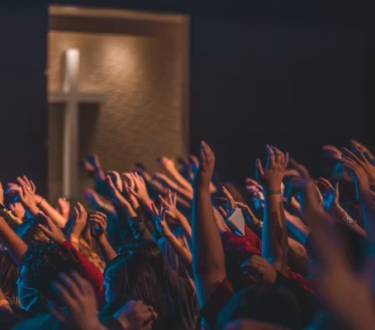
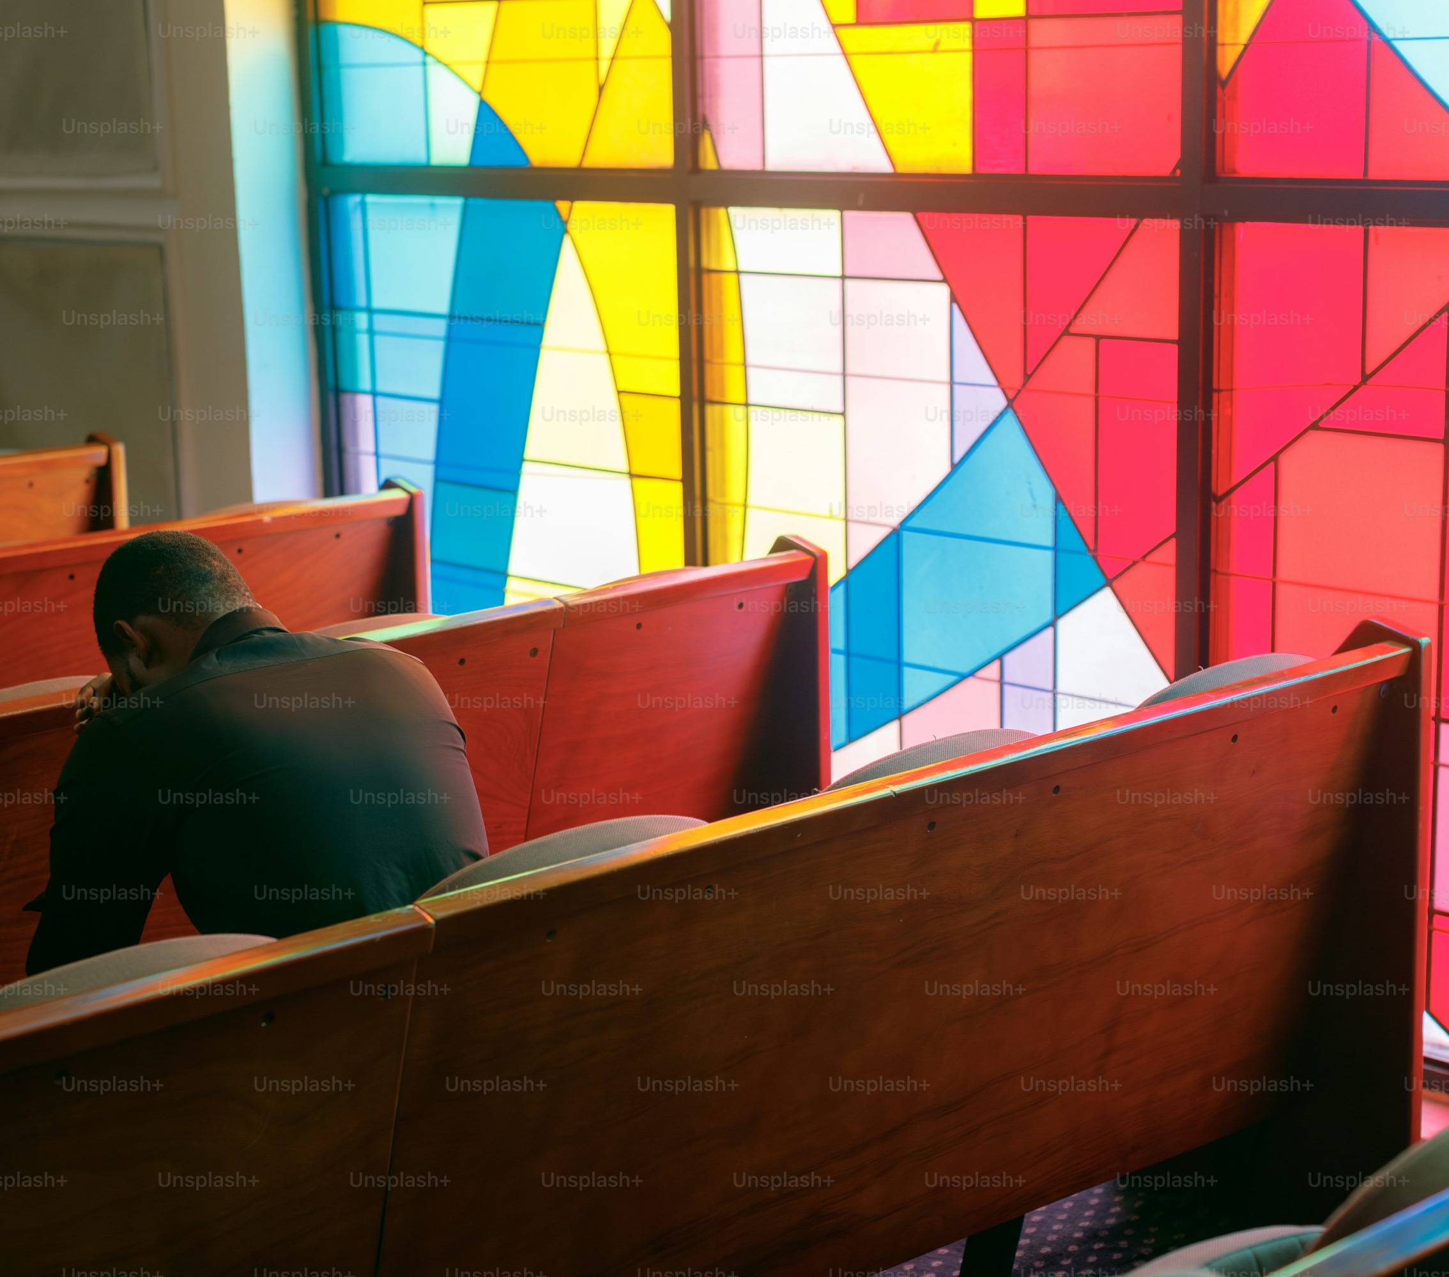

Slide 14
“The day approaching”
Literally, “the day that is continually drawing near.” It is not a fixed point but an ongoing, present, felt nearness.
“Provoke”
The believers are to stir one another up, provoke one another, not to strife but to love and good works. Assembling together is where that provoking happens; it cannot happen in isolation.

Slide 15
HEAR.YE.HIM
16 Our church has become lukewarm, gone after fantastic, every little emotion, and keeping our head from the Word of God. If there ever was a time that we ought to be assembling ourselves together, Oh, there should be every hall and every arena throughout the United States and world rented by ministers, and preaching the Gospel, and warning the people of the things to come. We are near the end and how can we set still? 57-0322

Slide 16
DISCERNING.THE.BODY.OF.THE.LORD
12-4 Paul said those days would be. It's on us. We hear it from everywhere and what do we do? It ought to draw us together. "Assembling ourselves together..."
It ought to be one revival after another and bonfires of God's glory built in every church and every place: a great coming together where all the churches with one heart and one accord assemble themselves together and forget their man-made theology and cry out to God for spiritual power and spiritual discernment. That's the hour we need. 59-0812

Slide 17
WHO.IS.JESUS
18 (Shakarians). Across the nation, around the world, I've helped them in their chapters. They're a very fine group of men. I think that you are missing something by not having your fellowship strengthened here... "We should assemble ourselves together..." It'll not only do that, it'll strengthen you. And your strength will strengthen the church. The Full Gospel Business Men is not an organization to set aside, and say, "This is our group." It's for all believers, to come together. And it's just a unit of the church itself, the spiritual believers.
64-0620

Slide 18
Post of Duty
FORSAKING.ALL
37 I am just a little late, as usual. And so we are, tomorrow night, at some place. And now, if you have church at your own church here, tomorrow night, don't come down. But if you don't have church, we'd be glad to have you. We always want the people to stay at their post of duty, regardless. When the church is open, every soldier ought to be in his rank and in his place.
62-0123

Slide 19
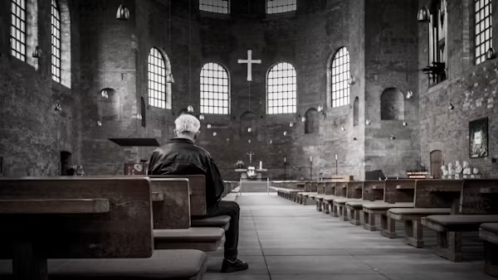

Slide 20
QUESTIONS.AND.ANSWERS.ON.THE.SEALS
92 You say, "Bro. Branham, if He was to come this morning, shouldn't you be out there?"
No, sir. This is my post of duty. I'll be standing right here preaching when He comes, saying the same things I am. Then, when He comes, I'll just move right on out with Him.
If I'm hoeing potatoes, I'll just be hoeing away just as hard as I can. When He comes, I'll just drop the hoe and take off.
63-0324

Slide 21
SHOW.US.THE.FATHER & IT.WILL.SUFFICETH.US
5 In a group like this it's the closest place to heaven that there is on earth. When we are setting together this morning, we are already dead; we are buried. And not only that, but we're raised and in Christ in His resurrection. We're part of it. And now we're assembling together in heavenly places in Christ Jesus. We are in Him by baptism. By one Spirit all baptized in one body, and here we are now assembled, the body of the Lord Jesus. 62-0609

Slide 22
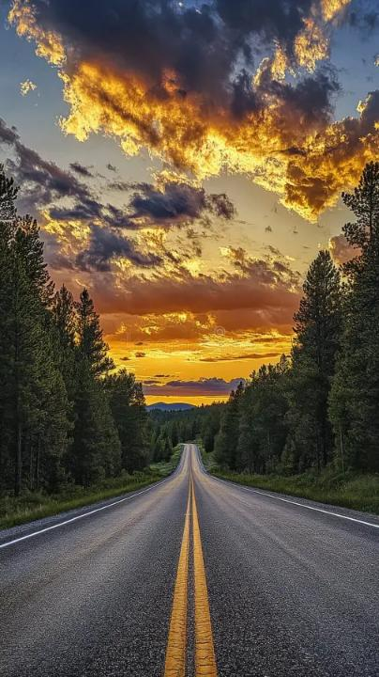
Prov. 21:2–3 "right in his own eyes"
(Heb.) yashar — straight, level, upright. It's a word that pictures a road with no bend in it, a line with no crook.
What Solomon is saying is not that man merely excuses his way — he genuinely, in his own sight, sees his way as straight.

Slide 23
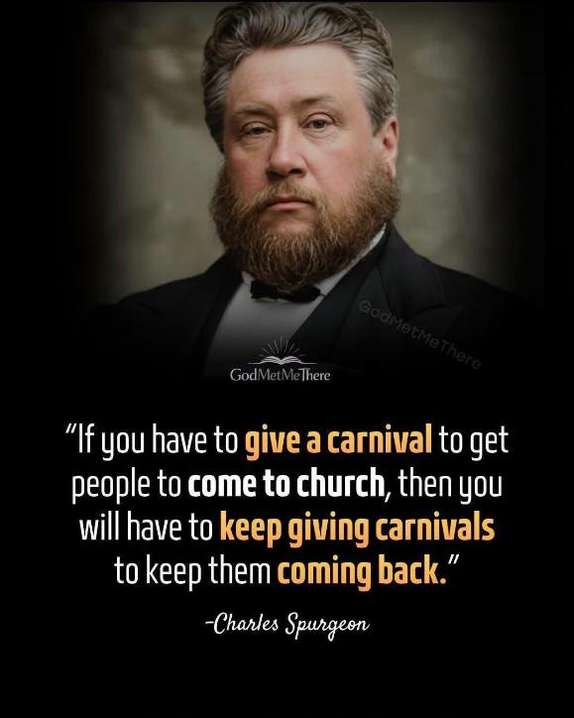

Slide 24
EXODUS 15:25-26
And he cried unto the LORD; and the LORD shewed him a tree, which when he had cast into the waters, the waters were made sweet: there he made for them a statute and an ordinance, and there he proved them,
26 And said, If thou wilt diligently hearken to the voice of the LORD thy God, and wilt do that which is right in his sight, and wilt give ear to his commandments, and keep all his statutes, I will put none of these diseases upon thee, which I have brought upon the Egyptians: for I am the LORD that healeth thee.

Slide 25
Hebrews 7-10
Hebrews 10:19–27
And let us consider one another to provoke unto love and to good works: Not forsaking the assembling of ourselves together, as the manner of some is; but exhorting one another: and so much the more, as ye see the day approaching.

Slide 26
THE.UNPARDONABLE.SIN
97 Not forsaking the assembling yourselves together (coming to church) as you see the day approaching... People forsaking going to church, churches are beginning to be evacuated now. The war is over. Everybody's well-fed and got a change of clothes, pretty good job, settled down. They ain't got time to wait on you when you go to the store. Called the other day to get my furnace fixed, said, "Did we put it in?“ Said, "No, someone else, but they're out of business."
"Then, see to the people that went out of business," just unconcerned. Few years ago they'd have solicited every bit of business they could. But they got enough money. They don't care. 54-1024

Slide 27
CHURCH.AGE.BOOK
347 The attitude of this age is exactly what it was then. People have it all. They know it all. They cannot be taught. If a point of truth from the Word comes up and a man tries to explain his view to one with an opposing view, the listener is not at all listening that he might learn, but is listening only to refute what is being said. Can Scripture fight Scripture?
Does the Bible contradict the Bible? NO. IT CANNOT BE SO. Yet how many of God's people have their eyes open to that truth? Not even one percent...

Slide 28
Darkness: ignorance respecting divine things or human duties, and ungodliness and immorality (with their consequent misery following);
I PETER 2:9
But ye are a chosen generation, a royal priesthood, an holy nation, a peculiar people; that ye should shew forth the praises of him who hath called you out of darkness into his marvellous light…
Light: (heavenly) such as surrounds angels when they appear on earth; of truth, together with the spiritual purity associated with it; the power of understanding esp. moral and spiritual truth.
Notes:
A generation within a generation like Israel in Goshen.
A people set apart for a specific purpose, with a correspondingly higher standard.
Darkness: Abortion, Divorce

Slide 29
THE.CHURCH.AND.ITS.CONDITION
98 Oh, you think, "I know a whole lot." Yeah, you get your brain all worked up and it can't even work itself. You know all the books, and all the answers, and all the Greek and all the Hebrew, till it ain't got no place for the Dove to roost. That's right. But you know it all; then the Dove can't lead, 'cause you know too much. 56-0805

Slide 30
ISAIAH 5:18-23
…let the counsel of the Holy One of Israel draw nigh and come, that we may know it! 20 Woe unto them that call evil good, and good evil; that put darkness for light, and light for darkness; that put bitter for sweet, and sweet for bitter!
21 Woe unto them that are wise in their own eyes, and prudent in their own sight! 22 Woe unto them that are mighty to drink wine, and men of strength to mingle strong drink: 23 Which justify the wicked for reward, and take away the righteousness of the righteous from him!

Slide 31
61-0209 | Jehovah-Jireh
37Now, notice, we find that Abraham, God told him, said, "Separate yourself from all of your kindred. Come out, be with me and I will bless you. [Oh, isn't that wonderful?] I'll bless you if you'll separate yourself." But there's where the trouble come. They don't want to separate from their card parties, things of the world. They're trying to bring that right into church with them. You have to separate yourself from unbelievers. Don't yoke yourself up with unbelievers. "Come out, and be separated," saith the Lord. Now, the world's looking for mixers. You know many times, when I was in another denominational church, they used to tell me, they'd say, "He's a real good mixer. I believe that we'll send him down there." Sure, he takes all the ladies and their husbands and goes swimming, he plays Bunco with them, and they have a dance down in the basement and ... a good mixer. God don't want mixers; He wants separators. "Separate me Paul and Barnabas."

Slide 32
ISRAEL.AND.THE.CHURCH.2
43 God's just now loosening up the church everywhere, getting in order now so He can get into the rapture, got to give it rapturing faith before it can go in the rapture.
The people are in the spirit of the last days, just like they was in the days of Noah, eating, drinking, marrying, giving in marriage, unconcerned, don't care, walk around, and anything else. And these American people is the worst on the face of the earth: heady, high-minded, incontinent, fierce, and despisers, a know-it-all. 53-0326

Slide 34
Judges 17-18
18:1 Now in those days Israel had no king. And the tribe of Dan was trying to find a place where they could settle, for they had not yet moved into the land assigned to them when the land was divided among the tribes of Israel. 2 So the men of Dan chose from their clans five capable warriors from the towns of Zorah and Eshtaol to scout out a land for them to settle in…

Slide 35
Judges 17:1-3
17 And there was a man of mount Ephraim, whose name was Micah. 2 And he said unto his mother, The eleven hundred shekels of silver that were taken from thee, about which thou cursedst, and spakest of also in mine ears, behold, the silver is with me; I took it. And his mother said, Blessed be thou of the Lord, my son.
3 And when he had restored the eleven hundred shekels of silver to his mother, his mother said, I had wholly dedicated the silver unto the Lord from my hand for my son, to make a graven image and a molten image: now therefore I will restore it unto thee.

Slide 36
JUDGES 6:11-12
And there came an angel of the LORD, and sat under an oak which was in Ophrah, that pertained unto Joash the Abiezrite: and his son Gideon threshed wheat by the winepress, to hide it from the Midianites. 12 And the angel of the LORD appeared unto him, and said unto him, The LORD is with thee, thou mighty man of valour.

Slide 37
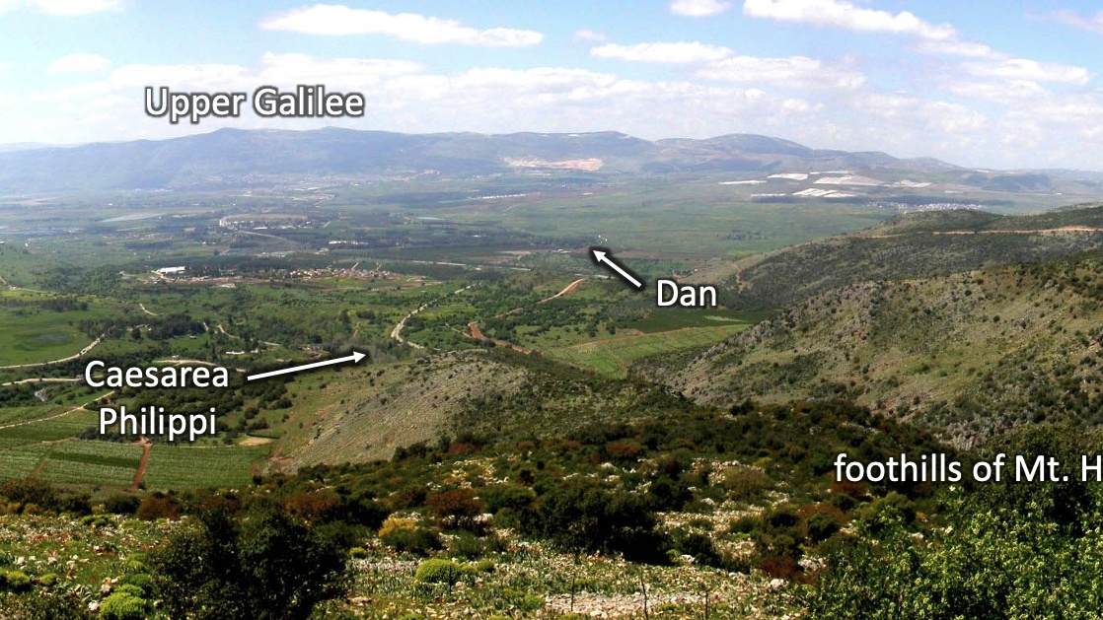

Slide 38
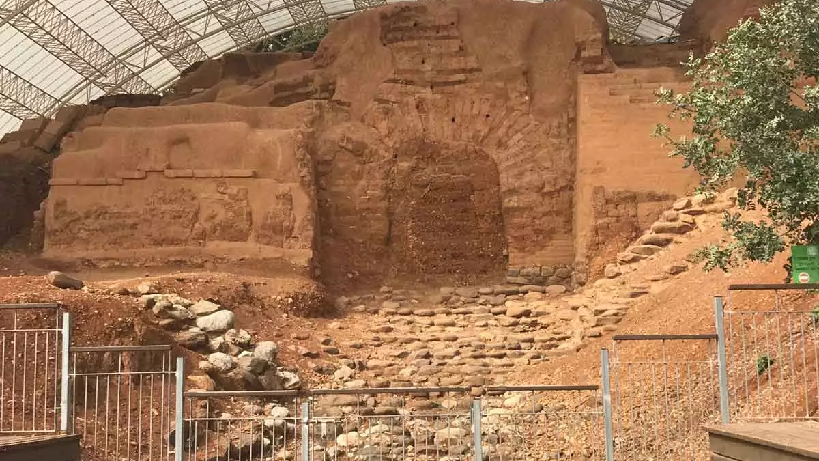
THE.SEVENTH.SEAL
214 Ephraim at Beth-el, and Dan; and they set up idols, and these went out to worship this. And here we are plumb down into the Millennium age almost, and God still remembered that sin. They're not even counted in there. 63-0324

Slide 39
273-1 CHURCH.AGE.BOOK
It is more than evident that names have been, and will be removed from the Book of Life ere time shall be no more. In this particular place it was because of idolatry, even as when Dan and Ephraim lost their rights as tribes for worshipping the golden calves. All who worshipped the idols had their names removed from the Book of Life.
THE.SEVENTH.SEAL
225 When He called them over there, 144,000, they were missing. They're not even numbered in there. And Joseph and Levi is put in the place of Dan and Ephraim. And here's God's promise way back there hundreds and hundreds of years before that.
63-0324

