Slide 1
I Am Always Right 2
In my own eyes at least…
PROVERBS 21:2-3
Every way of a man [is] right in his own eyes: but the LORD pondereth the hearts. 3 To do justice and judgment [is] more acceptable to the LORD than sacrifice.

Slide 2

Aug. 23rd Ron Knoblauch
Aug. 26th David Whitlock, Wellington & Tendai Esau
Aug 27th Ashley Koplau,
Emma Harwell
Aug. 29th Lorien Cockman
Sep. 6th Joel Brown
Sep. 13th Bro. Sam Browning

Slide 3
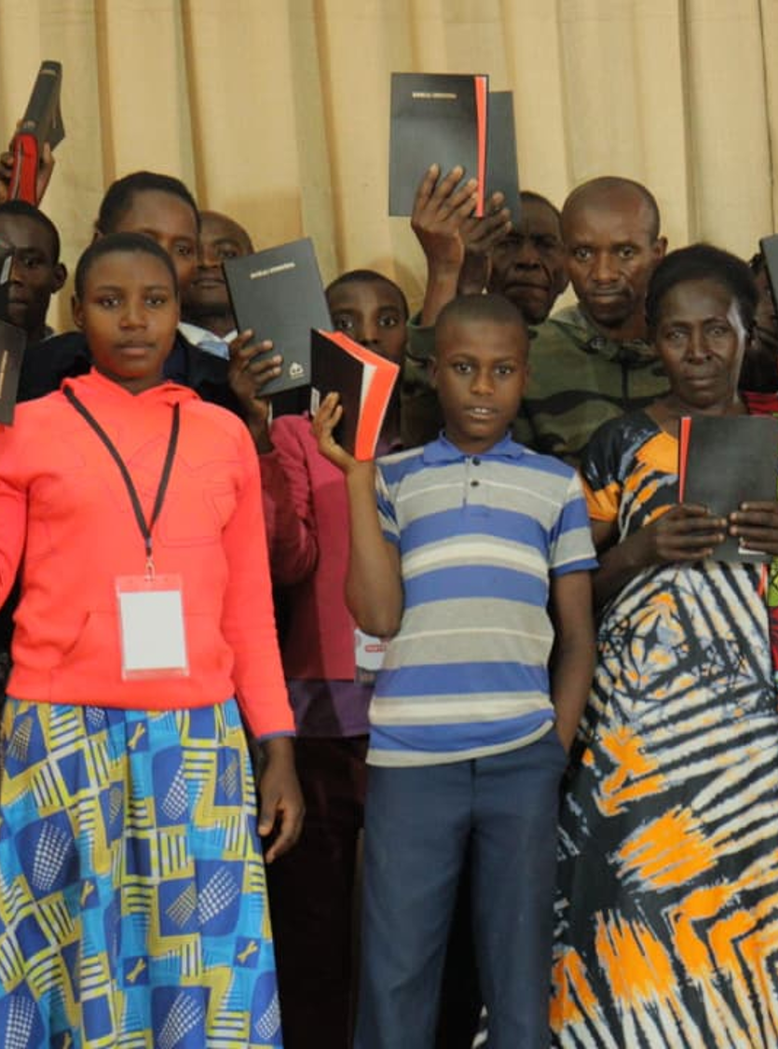
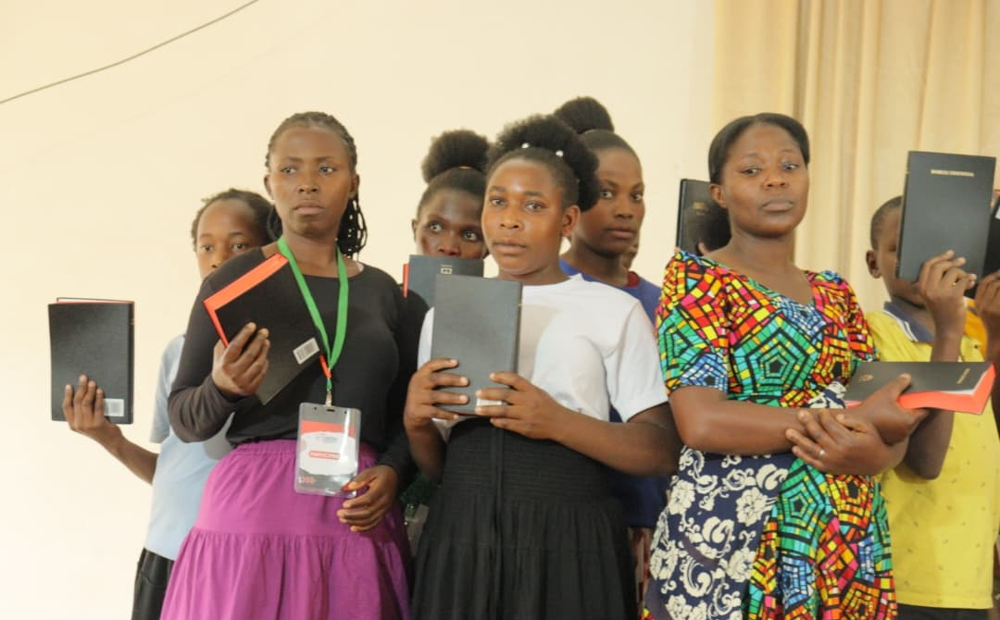
The Pastor took the opportunity to deliver Runyankole Bibles (Uganda) to the Believers who travelled to the Young people's meeting.

Slide 4
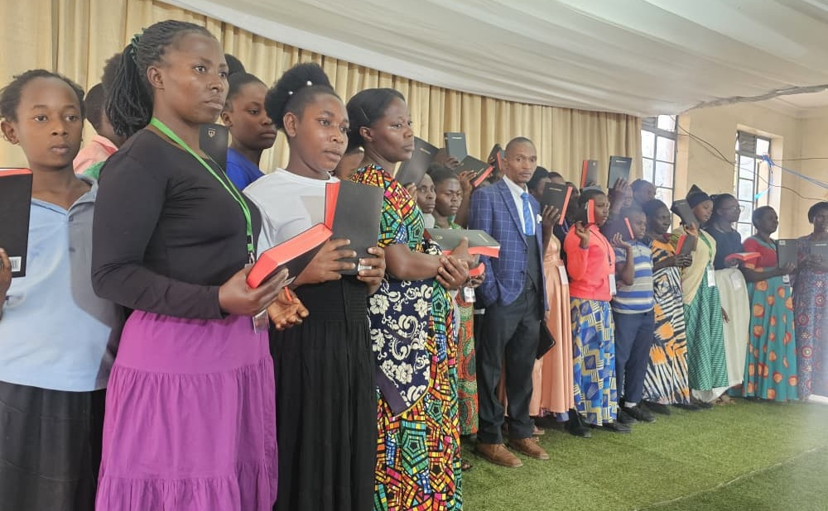
Uganda

Slide 5
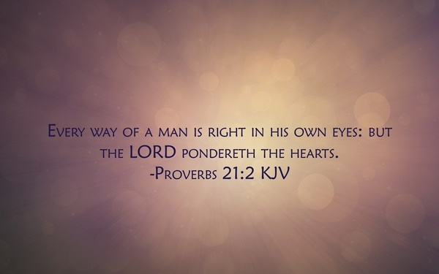

Slide 6
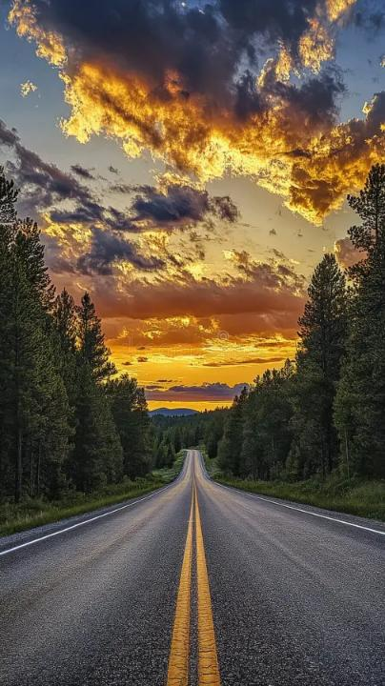
Proverbs 21:2–3 "right in his own eyes"
(Heb.) yashar — straight, level, upright. It's a word that pictures a road with no bend in it, a line with no crook. What Solomon is saying is not that man merely excuses his way — he genuinely, in his own sight, sees his way as straight.
There's no “felt” crookedness. This is deeper than hypocrisy; it's self-blindness. A man does not usually walk in sin feeling like he's walking in sin. He has rationalized and reframed his path until it looks level to him.

Slide 7
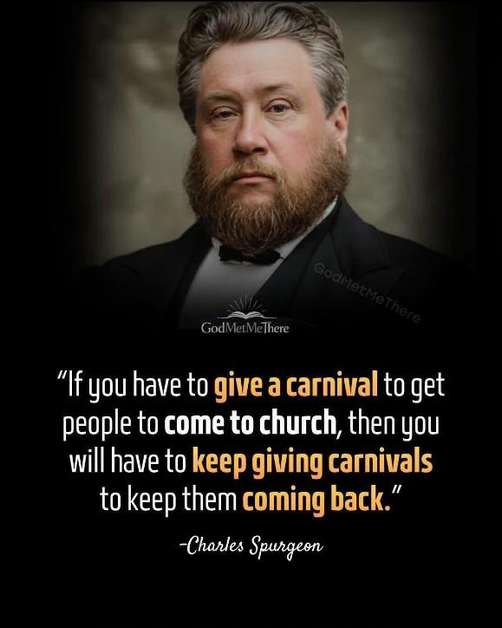
GREATER.THAN.SOLOMON
216 I think, today, that the whole world should be interested. If we believe that we're living in the end time, and we believe that the Coming of the Lord Jesus is at hand, we ought to be exactly interested in the things that's going on of this day. We ought to examine it by the Word of God.
63-0605

Slide 8
THE.RESURRECTION.OF.JAIRUS.DAUGHTER
58 …God's set some to preach the Gospel, teach, play music, deacons, speak with tongues, interpret tongues, pray for the sick, and some prophets. All those are set in the Church to edify the Church, to bring the Church together.
The time is at hand. Just like He did with the Jews, He's showing a great measure of grace to them, making His last call, so that the unbelievers will blaspheme the Holy Ghost and be worthy of the condemnation they're fixing to receive. But how blessed those will be that’ll… outshine the stars, believe on Him, and His great works of this day. 54-0302

Slide 9

Moving further away from the Light (Or, receding light)

Slide 10
CONDEMNATION.BY.REPRESENTATION
17-3 …The first generation of Pentecostals was on fire. The second generation begin to die out. That's now. Watch what the third generation will bring. It ain't going to go all the way out before Jesus comes, because the Laodicean church was lukewarm: neither warm, nor hot; it still had a little bit of the blessing left in it…. They were mixed up, not all together cold, but warm.
60-1113

Slide 11
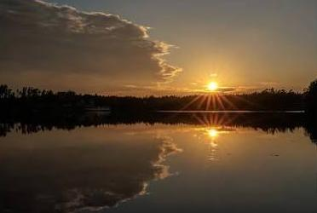
Receeding Light

Slide 12
EXODUS 15:25-26
And he cried unto the LORD; and the LORD shewed him a tree, which when he had cast into the waters, the waters were made sweet: there he made for them a statute and an ordinance, and there he proved them,
26 And said, If thou wilt diligently hearken to the voice of the LORD thy God, and wilt do that which is right in his sight, and wilt give ear to his commandments, and keep all his statutes, I will put none of these diseases upon thee, which I have brought upon the Egyptians: for I am the LORD that healeth thee.

Slide 13
CHURCH.AGE.BOOK
347 The attitude of this age is exactly what it was then. People have it all. They know it all. They cannot be taught. If a point of truth from the Word comes up and a man tries to explain his view to one with an opposing view, the listener is not at all listening that he might learn, but is listening only to refute what is being said. Can Scripture fight Scripture?
Does the Bible contradict the Bible? NO. IT CANNOT BE SO. Yet how many of God's people have their eyes open to that truth? Not even one percent...

Slide 14
Darkness: ignorance respecting divine things or human duties, and ungodliness and immorality (with their consequent misery following);
I PETER 2:9
But ye are a chosen generation, a royal priesthood, an holy nation, a peculiar people; that ye should shew forth the praises of him who hath called you out of darkness into his marvellous light…
Light: (heavenly) such as surrounds angels when they appear on earth; of truth, together with the spiritual purity associated with it; the power of understanding esp. moral and spiritual truth.
Notes:
A generation within a generation like Israel in Goshen.
A people set apart for a specific purpose, with a correspondingly higher standard.
Darkness: Abortion, Divorce

Slide 15
I KINGS 3:9
Give therefore thy servant an understanding heart to judge thy people, that I may discern between good and bad: for who is able to judge this thy so great a people?
Understanding: the faculty of perceiving divine things, of recognizing goodness and of hating evil; the power of considering and judging soberly, calmly and impartially.
Discernment: To perceive; distinguish; discriminate; To see or understand the difference; to make distinction as between good and evil, truth and falsehood.
Notes:
Heb. 5:14
But strong meat belongeth to them that are of full age, even those who by reason of use have their senses exercised to discern between good and evil.

Slide 16
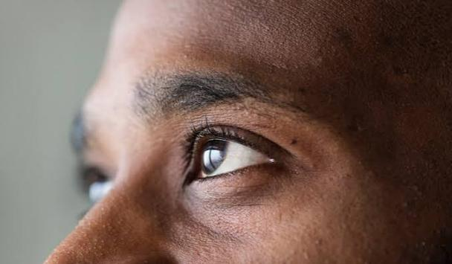
The Sixth Sense
PROVERBS 20:12
The hearing ear, and the seeing eye, the LORD hath made even both of them.
I SAMUEL 16:7
But the LORD said unto Samuel, Look not on his countenance, or on the height of his stature; because I have refused him: for the LORD seeth not as man seeth; for man looketh on the outward appearance, but the LORD looketh on the heart.

Slide 17
LOOKING.AT.THE.UNSEEN
12 I was listening to a program on the radio, coming to Sunday school, it was a round table discussion with teen-agers in Louisville. One of the most important things, was a girl to find the boy with the curly hair, or the girl with the pretty blue or brown eyes? Did that make the difference? It seems like that that would be the great thing to a teen-ager.
But that isn't the greatest thing. The greatest thing is find your God, your Maker.

Slide 18
Don't mix marry. Marry a boy that believes just exactly like you do, for after all, God is the main important thing that we are in the earth to do, is to serve Him.
And if you do marry or anything contrary to that, you'll pay for it in the days that lays ahead of you. You must always remember, by faith and not by sight. The just shall live by faith. And we look at the Unseen.
58-1003

Slide 19
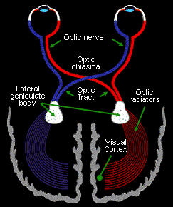
THE.MIGHTY.CONQUEROR
5 And truly, if there is any conquering to be done, it'll have to come through the cross. That's the only way there is to conquer, is through the cross.
58-0610
Notes:
The optic chiasm is an X-shaped brain structure where optic nerve fibers partially cross over. Its primary function is to sort and redirect visual information from both eyes so that the opposite (contralateral) side of the brain processes everything in your opposite field of view, making unified depth perception and single vision possible

Slide 20
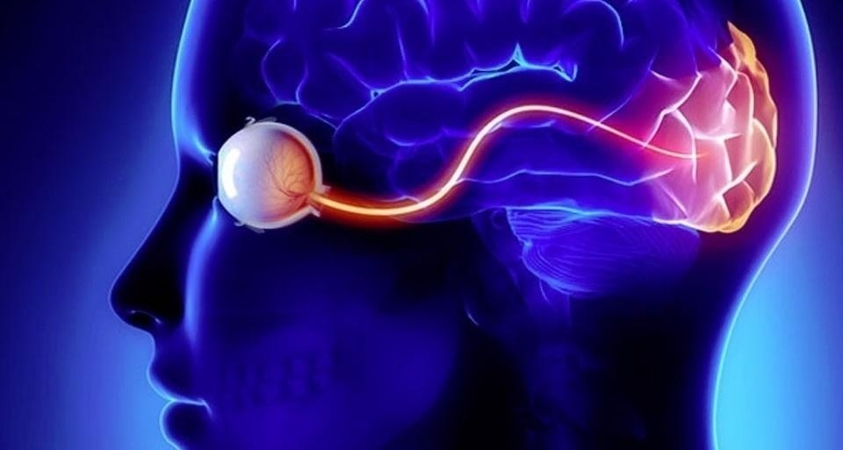
II CORINTHIANS 5:7
(For we walk by faith, not by sight:)

Slide 21
HEAR.YE.HIM
22 The other day a young lady come to my house, beautiful woman... she looked terrible. Said, "I like to talk to you, privately.“ I said, "All right, sis, what is it?"
I thought she was a sinner. She was dressed like one, a beautiful woman, but all poured into a little old dress that was terrible looking, wasn't made for women to wear... She kept telling me about her nervous spells. I said, "Well now, the first thing you ought to do, is to accept Christ.“ She said, "I am a Christian.“ "Oh, excuse me.“ I looked at her and she said, "Yes, I'm a Christian. I've got the Holy Ghost.“

Slide 22
I thought, "Merciful Father. Well lady, why don't you dress like it then?“ She said, "Oh, you're of the old school of thought. My pastor don't believe it like that. We got liberation of women.“ I said, "You got liberation of something: it's from the Bible, that you've liberated yourself from."
I said, "Did anyone ever tell you, you were a attractive woman?“ She messed her hair up on the side, "Oh, yes.“
"Do you realize, the way that you're dressed, you'll send more men to hell than all the barrooms in the country?“ And by God's grace, there come a vision, I seen what she was doing. I said, "Now, you work in a office…

Slide 23
You was lifting a fan around, you hurt your back. If you'll put your hand there, you'll find it's sore.“ She said, "It is.“ "There is your nervous trouble.” She said, "Well, thank the Lord.“ "Now, go put on some clothes."
Said, "Bro. Branham, we don't believe in that kind of old fashion stuff.“ I said, "Then what about last night? That boy you was with in that place?“ And she started crying. And it exposed her sin, and told her the adultery that she was living in…
Notes:
This is another type of “seeing” beyond the human realm.

Slide 24
II Thes. 2:11-12
And for this cause God shall send them strong delusion, that they should believe a lie: 12 That they all might be damned who believed not the truth, but had pleasure in unrighteousness.
Delusion: (Gr.) plane
A fixed, false belief that is held firmly despite clear proof to the contrary and has no basis in reality. Wrong opinion in morals, religion; a wrong way of acting which leads into error.

Slide 25
Illusion:
A thing that is or is likely to be wrongly perceived or interpreted by the senses: a deceptive appearance or impression: a false idea or belief:

Slide 27


Slide 28

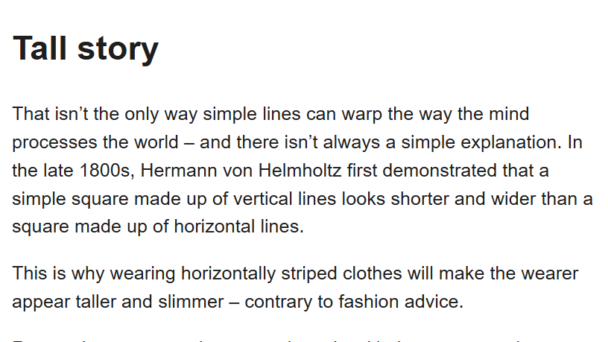

Slide 29
ISAIAH 5:18-23
…let the counsel of the Holy One of Israel draw nigh and come, that we may know it! 20 Woe unto them that call evil good, and good evil; that put darkness for light, and light for darkness; that put bitter for sweet, and sweet for bitter!
21 Woe unto them that are wise in their own eyes, and prudent in their own sight! 22 Woe unto them that are mighty to drink wine, and men of strength to mingle strong drink: 23 Which justify the wicked for reward, and take away the righteousness of the righteous from him!

Slide 30
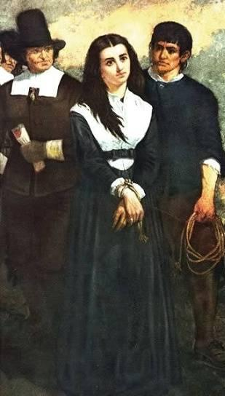
The Salem Witch Trials, 1692
The magistrates and accusers of Salem didn’t see themselves as murderers but purifiers, rooting out a genuine spiritual threat, convinced their discernment was sound and their cause was the Lord's. 19 people were hanged on the testimony of "spectral evidence" — visions they were certain they were rightly interpreting.
Later the colony repented; Judge Sewall later stood in a Boston church and had a confession read aloud, and the colony held a day of fasting for the injustice. It stands as a rare case where "every way right in his own eyes" was followed.

Slide 31
The Laodicean Church — Revelation 3:14-18
Laodicea says of itself, "I am rich, and increased with goods, and have need of nothing" — and Christ answers that this church, in its own self-assessment, is blind to the fact that it is "wretched, and miserable, and poor, and blind, and naked."
Nothing has changed about their self-report and Christ's diagnosis; what has changed is the instrument of judgment. Their own eyes told them one story. His examination of the heart told an opposite one.

Slide 32
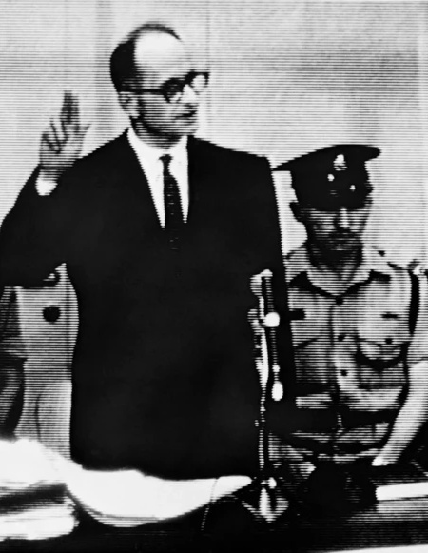
Nazi Officers: Adolph Eichman
The observation from coverage of the Eichmann trial in Jerusalem was that Adolf Eichmann, one of the chief administrators of the Holocaust's logistics, did not present in court as a monster who knew himself to be monstrous. He presented as an ordinary bureaucrat who believed he was competently fulfilling his duty. The historical fact of Eichmann's own courtroom self-defense — that he was simply doing his job made this seem right to him — remains one of the starkest modern illustrations of a man's way being "right in his own eyes" while producing horror on a massive scale.

Slide 33
Saul Refusing Correction — 1 Samuel 15
Saul is commanded to destroy Amalek utterly. He spares Agag and the best of the livestock, then greets Samuel with astonishing self-assurance: "Blessed be thou of the LORD: I have performed the commandment of the LORD" (15:13).
In his own eyes, he has obeyed perfectly. Samuel has to asks, "What meaneth then this bleating of the sheep in mine ears?" Saul is the example of Prov. 21:2 — a man whose way is right in his own eyes while Samuel exposes what partial obedience actually is: rebellion, and stubbornness as iniquity and idolatry (15:23).

Slide 34
The Pharisee and Publican — Luke 18:9-14
“…unto certain which trusted in themselves that they were righteous, and despised others." The Pharisee's prayer is a masterpiece of self-blindness: "God, I thank thee, that I am not as other men are…"
Every clause of that prayer is technically true and morally worthless. His "way" was flawlessly yashar in his own eyes — he can find no fault in himself because he has appointed himself the judge. "I tell you, this man went down to his house justified rather than the other."

Slide 35
2 Cor. 10:12
For we dare not make ourselves of the number, or com-pare ourselves with some that commend themselves: but they measuring themselves by themselves, and comparing themselves among themselves, are not wise.
¹² Oh, don’t worry; we wouldn’t dare say that we are as wonderful as these other men who tell you how important they are! But they are only comparing themselves with each other, using themselves as the standard of measurement. How ignorant!

Slide 36
THE.CHURCH.AND.ITS.CONDITION
98 Oh, you think, "I know a whole lot." Yeah, you get your brain all worked up and it can't even work itself. You know all the books, and all the answers, and all the Greek and all the Hebrew, till it ain't got no place for the Dove to roost. That's right. But you know it all; then the Dove can't lead, 'cause you know too much. 56-0805

Slide 37
ISRAEL.AND.THE.CHURCH.2
43 God's just now loosening up the church everywhere, getting in order now so He can get into the rapture, got to give it rapturing faith before it can go in the rapture.
The people are in the spirit of the last days, just like they was in the days of Noah, eating, drinking, marrying, giving in marriage, unconcerned, don't care, walk around, and anything else. And these American people is the worst on the face of the earth: heady, high-minded, incontinent, fierce, and despisers, a know-it-all. 53-0326

Slide 38
ZECHARIAH 9:12-15
Turn you to the strong hold, ye prisoners of hope: even to day do I declare that I will render double unto thee; 13 When I have bent Judah for me, filled the bow with Ephraim, and raised up thy sons, O Zion, against thy sons, O Greece, and made thee as the sword of a mighty man. 14 And the LORD shall be seen over them, and his arrow shall go forth as the lightning: and the Lord GOD shall blow the trumpet, and shall go with whirlwinds of the south. 15 The LORD of hosts shall defend them; and they shall devour, and subdue with sling stones; and they shall drink, and make a noise as through wine; and they shall be filled like bowls, and as the corners of the altar.

Slide 39
Judges 17-18
18:1 Now in those days Israel had no king. And the tribe of Dan was trying to find a place where they could settle, for they had not yet moved into the land assigned to them when the land was divided among the tribes of Israel. 2 So the men of Dan chose from their clans five capable warriors from the towns of Zorah and Eshtaol to scout out a land for them to settle in…

Slide 41
Judges 17:1-3
17 And there was a man of mount Ephraim, whose name was Micah. 2 And he said unto his mother, The eleven hundred shekels of silver that were taken from thee, about which thou cursedst, and spakest of also in mine ears, behold, the silver is with me; I took it. And his mother said, Blessed be thou of the Lord, my son.
3 And when he had restored the eleven hundred shekels of silver to his mother, his mother said, I had wholly dedicated the silver unto the Lord from my hand for my son, to make a graven image and a molten image: now therefore I will restore it unto thee.

Slide 42
JUDGES 6:11-12
And there came an angel of the LORD, and sat under an oak which was in Ophrah, that pertained unto Joash the Abiezrite: and his son Gideon threshed wheat by the winepress, to hide it from the Midianites. 12 And the angel of the LORD appeared unto him, and said unto him, The LORD is with thee, thou mighty man of valour.

Slide 43
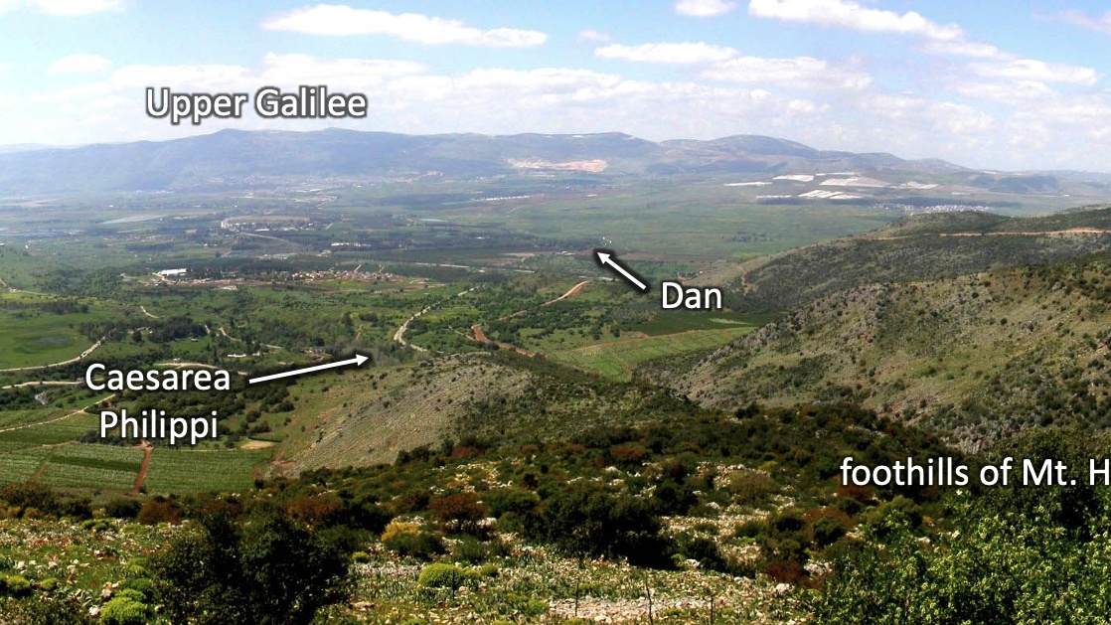

Slide 44
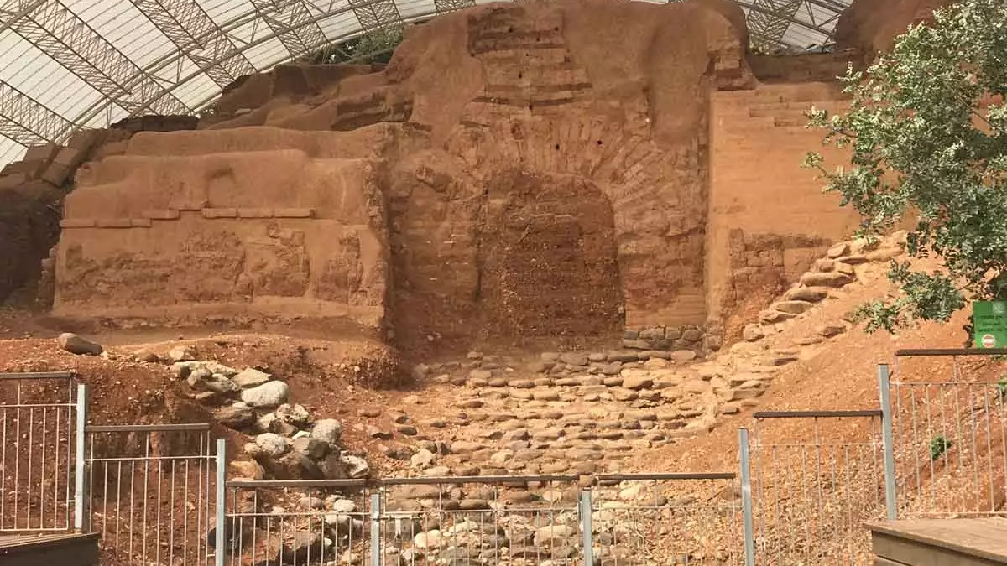
THE.SEVENTH.SEAL
214 Ephraim at Beth-el, and Dan; and they set up idols, and these went out to worship this. And here we are plumb down into the Millennium age almost, and God still remembered that sin. They're not even counted in there. 63-0324

Slide 45
273-1 CHURCH.AGE.BOOK
It is more than evident that names have been, and will be removed from the Book of Life ere time shall be no more. In this particular place it was because of idolatry, even as when Dan and Ephraim lost their rights as tribes for worshipping the golden calves. All who worshipped the idols had their names removed from the Book of Life.
THE.SEVENTH.SEAL
225 When He called them over there, 144,000, they were missing. They're not even numbered in there. And Joseph and Levi is put in the place of Dan and Ephraim. And here's God's promise way back there hundreds and hundreds of years before that.
63-0324

