Slide 1
The Greater Light
JOHN 1:1-4 & I John 1:5-7
In the beginning was the Word, and the Word was with God, and the Word was God. The same was in the beginning with God. All things were made by him; and without him was not any thing made that was made. In him was life; and the life was the light of men.

Slide 2

Birthdays & Anniversaries
Aug. 11th Elliana James
Aug 13th Anthony Clayville
Aug. 16th Tedd Doucette
Aug. 18th Ella Kate Jackson, Keith & Sarah Buchanan,
Jeremiah Sheffield
Aug. 21 Kristen Godwin
Aug. 22nd Hunter McIntosh, Mike & Ellen Parks
Sept. 6th Bro. Joel Brown
Sept. 13th Bro. Sam Browning

Slide 3

Family Day
2026

Slide 4



Slide 5



Slide 6

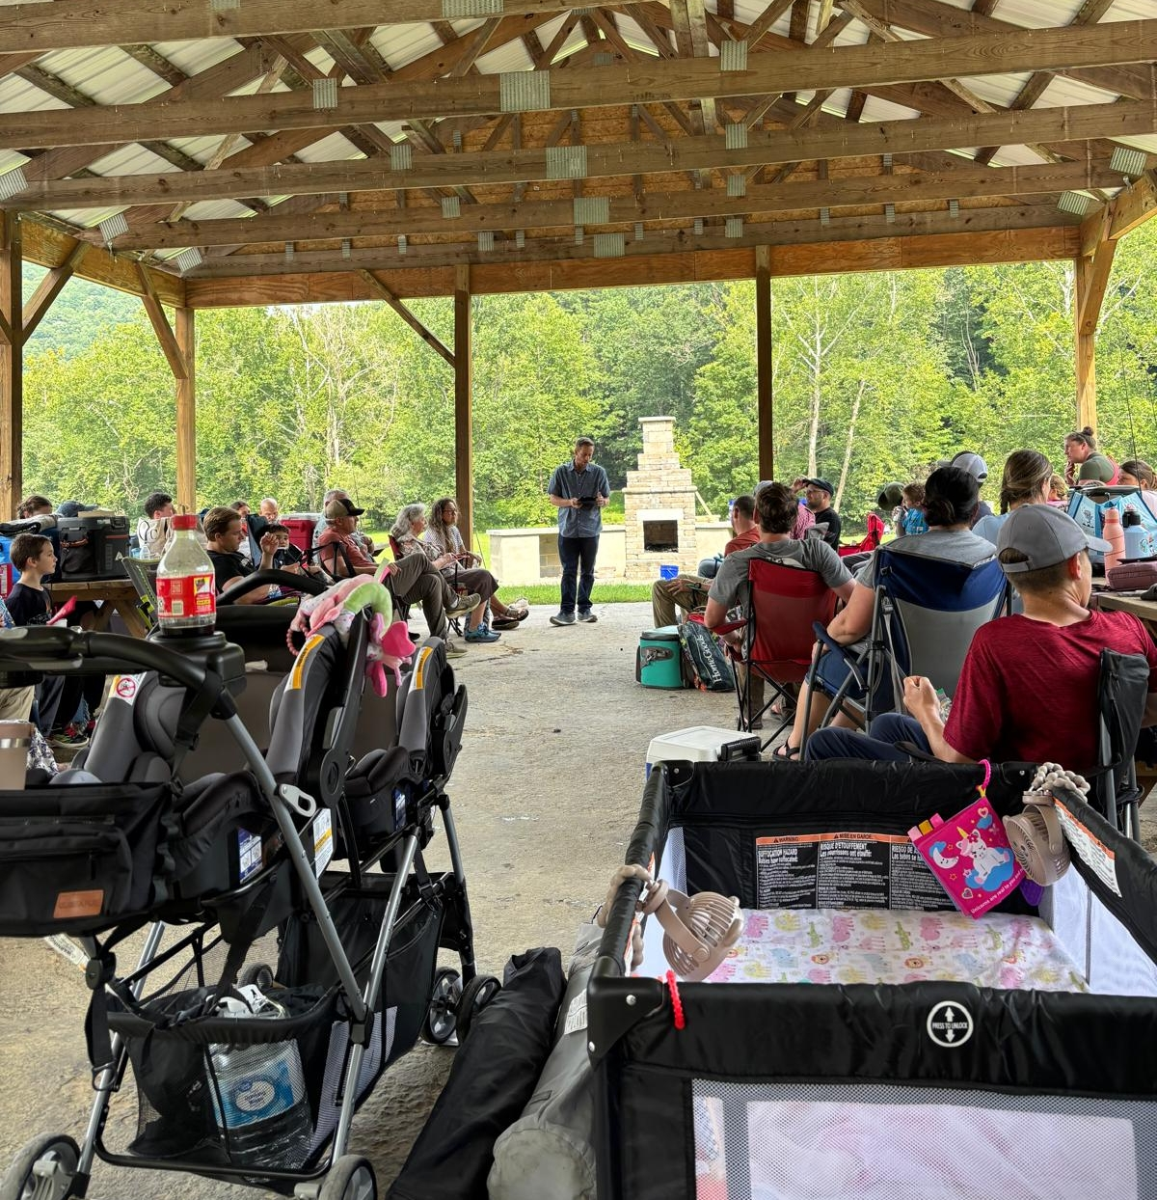

Slide 7
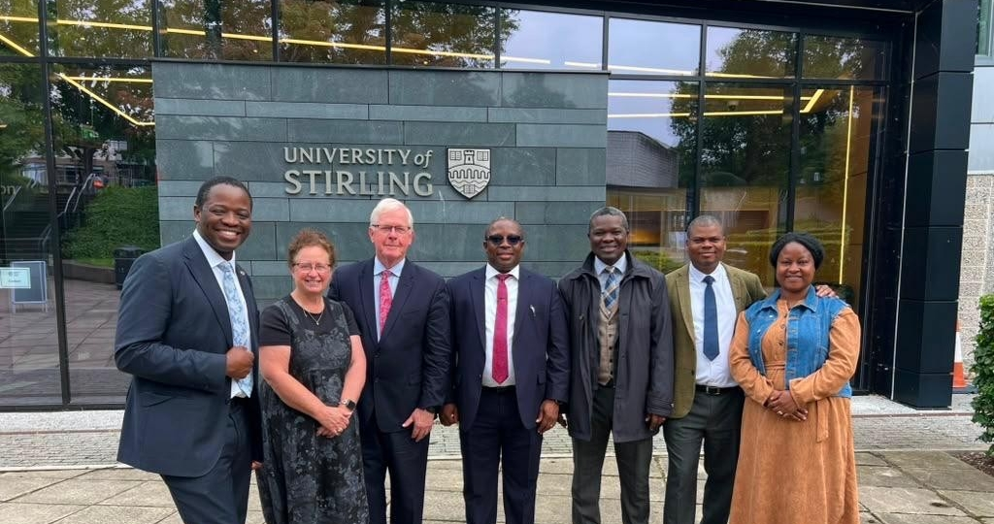

Slide 8
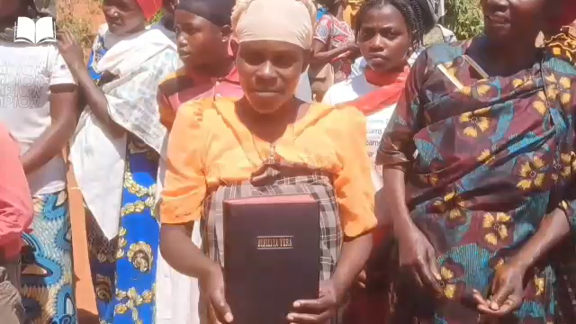

Slide 9
The Greater Light
JOHN 1:1-4
In the beginning was the Word, and the Word was with God, and the Word was God. The same was in the beginning with God. All things were made by him; and without him was not any thing made that was made. In him was life; and the life was the light of men.

Slide 10
THE BIG IDEA
Two Lights
Scripture speaks of light two ways: light God created, and light God IS. One is a thing He made. The other is who He is.
Natural light — sun, moon, day — types the revelation and understanding God gives us.
But living in a world full of natural light does not guarantee anyone sees the Light of God shining in their own day.

Slide 11
THE LIGHT GOD MADE
GENESIS 1:1-4
In the beginning God created the heaven and the earth. And the earth was without form, and void; and darkness was upon the face of the deep. And the Spirit of God moved upon the face of the waters. And God said, Let there be light: and there was light. And God saw the light, that it was good: and God divided the light from the darkness.

Slide 12
THE LIGHT GOD IS
1 JOHN 1:5-7
This then is the message which we have heard of him, and declare unto you, that God is light, and in him is no darkness at all. If we say that we have fellowship with him, and walk in darkness, we lie, and do not the truth: But if we walk in the light, as he is in the light, we have fellowship one with another, and the blood of Jesus Christ his Son cleanseth us from all sin.

Slide 13
NOT THE SAME LIGHT
Genesis 1:3 vs. 1 John 1:5
Genesis 1:3 speaks of light as something God spoke into being — a created reality.
1 John 1:5 speaks of light as who God IS — not made, not produced, self-existent. This “Light” is prior to and greater than any created illumination — making the deeper claim that God Himself, not the sun, is the true Light
(Isaiah 60:19-20; Daniel 2:22).

Slide 14
THE WORD IS LIGHT
Old Testament: the Word itself was light.
PSALMS 119:105 — Thy word is a lamp unto my feet, and a light unto my path.
New Testament: the Word being lived out is light.
JOHN 1:4 In him was life; and the life was the light of men.
JOHN 5:35 He was a burning and a shining light: and ye were willing for a season to rejoice in his light.

Slide 15
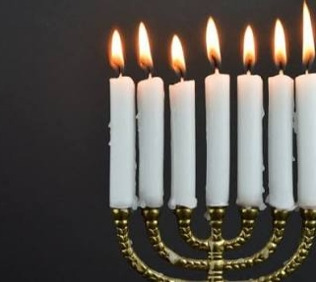
REFLECTING THE LIGHT OF GOD
Revelation Chapter Four #2, 61-0101, §230
And there were seven lamps of fire burning before the throne, which are the seven Spirits of God. Reflecting the Light of God into the Church, straight from the Throne of God, not through a seminary, some bishop, but from the Throne of God, by a revelation of the power of His resurrection, making Him the same yesterday and forever…

Slide 16
Church Age Book, pg. 79
There He is with the seven stars in His right hand. (Ps. 44:3) In that right hand of power are seven stars, who according to Rev. 1:20, are the seven church messengers. This signifies that the very power and authority of God are behind His messengers to every age. They go forth in the fire and power of the Holy Ghost with the Word. They are stars because they reflect light. The light they reflect is His light. They have no light of their own. (Is. 50:11)

Slide 17
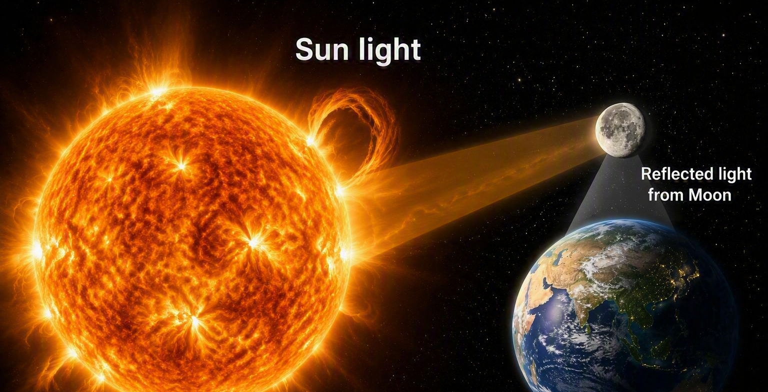

Slide 18
THE LIGHT IS NOT THE VESSEL
God Commissioning Moses 53-0603, §41
I believe we are strangers… God has knowed you since you was a baby... knows what's the matter with you, knows what's going to be the outcome; knows what started it... I don't know none of that. But He does. Well, if He would happen to speak to you through His servant…“Just like that electric bulb is a servant to that electrical current. It isn't the bulb that's giving light; it's the current in the bulb that's giving light..... I'd be the bulb to shed light on the path of God's Word.

Slide 19
A LIGHT THAT SHINES IN DARKNESS (1 of 2)
The God of This Evil Age, 65-0801, §76
That's what the Word of God is. It is a Light that shines in darkness.
PSALMS 119:105 Thy word is a lamp unto my feet, and a light unto my path.

Slide 20
MEN LOVED DARKNESS RATHER THAN LIGHT
JOHN 3:19-21
And this is the condemnation, that light is come into the world, and men loved darkness rather than light, because their deeds were evil. For every one that doeth evil hateth the light, neither cometh to the light, lest his deeds should be reproved. But he that doeth truth cometh to the light, that his deeds may be made manifest, that they are wrought in God.

Slide 21
A.THINKING.MAN'S.FILTER
71 Israel was all outwardly spiritual, how they reverenced God, but that didn't work. The inside of them couldn't recognize the Word Itself.
65-0822

Slide 22
A LIGHT SOME DID NOT SEE (1 of 2)
LUKE 2:25-26
And, behold, there was a man in Jerusalem, whose name was Simeon; and the same man was just and devout, waiting for the consolation of Israel: and the Holy Ghost was upon him. And it was revealed unto him by the Holy Ghost, that he should not see death, before he had seen the Lord's Christ.

Slide 23
A LIGHT SOME DID NOT SEE (2 of 2)
LUKE 2:27-32
And he came by the Spirit into the temple: and when the parents brought in the child Jesus, to do for him after the custom of the law, Then took he him up in his arms, and blessed God, and said, Lord, now lettest thou thy servant depart in peace, according to thy word: For mine eyes have seen thy salvation, Which thou hast prepared before the face of all people; A light to lighten the Gentiles, and the glory of thy people Israel.

Slide 24
A LIGHT TO THE GENTILES (1 of 2)
ISAIAH 49:6 I will also give thee for a light to the Gentiles, that thou mayest be my salvation unto the end of the earth.
ACTS 13:46-47 Then Paul and Barnabas waxed bold, and said, It was necessary that the word of God should first have been spoken to you: but seeing ye put it from you, and judge yourselves unworthy of everlasting life, lo, we turn to the Gentiles. For so hath the Lord commanded us, saying, I have set thee to be a light of the Gentiles, that thou shouldest be for salvation unto the ends of the earth.

Slide 25
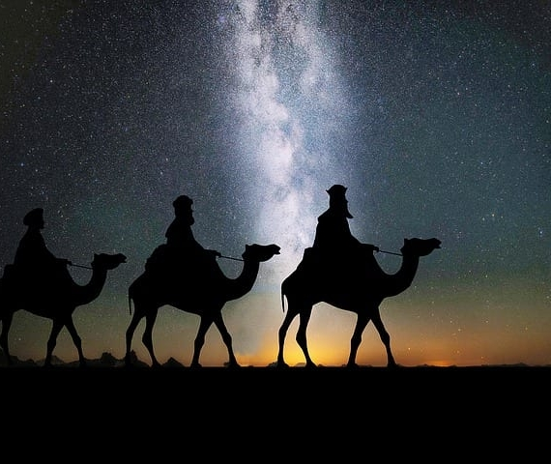
MATTHEW 2:9
When they had heard the king, they departed; and, lo, the star, which they saw in the east, went before them, till it came and stood over where the young child was.
We Have Seen His Star

Slide 26
THE.CHURCH.OF.THE.LIVING.GOD
14 They watched the stars, and they knew about what time it was. But this, mysterious light came over every one of those observatories. It said, "We have seen His Star in the east." But His Star wasn't in the East to them. They were in the east, looking west towards Palestine, and saw His Star. And none of the observatories, none of the historians has anything written of it, or no man in that day saw the star, except the Magi, and it led them to the Christ. It was God's provided compass. 51-0727

Slide 27
MICAH 5:2
But thou, Bethlehem Ephratah, though thou be little among the thousands of Judah, yet out of thee shall he come forth unto me that is to be ruler in Israel…
THE.GREAT.SHINING.LIGHT
80 The Light was gone… And they told the king, "It is written, 'Thou Bethlehem, are you not the least among all the princes of Judah? Therefore, it must be Bethlehem where the Christ is to be born, the King of the Jews."

Slide 28
Well, no one would tell them how to get to Beth-lehem. But they walked out the gate, and when they left that city of darkness, the Light appeared before them again. The Star appeared. And the Bible said they rejoiced with exceeding great joy.
They must've actually shouted a little. They rejoiced with exceeding great joy. They were overwhelmed. Star had appeared to lead them to their final destination of their journey. 57-1222

Slide 29
THERE.IS.A.MAN.HERE... THE.LIGHT
93 No matter how many observatories told the wise man, "Why, you're out of your mind!" Two years they was in travel. They passed by many nations, and they would say, "Where you going?“ "Oh, we have seen His Star in the East, and we come to worship Him."
And when they lined up in Jerusalem, the denomina-tional headquarters, they didn't have the answer. They went up-and-down the streets, crying, "Where is He, born King of the Jews?" They knowed nothing about it.

Slide 30
So, they called on the Word, to find out. And the Word is what guides you to the Light, and the Light is what makes the Word vindicated. They were wise man.
95 The wisdom of this world is foolishness to God. All your scientists, and you people who are depending on some great scholarship, telling you how to split a atom; it can't give you Life. There is nothing can give you Life but the spoken Word of God.
63-1229

Slide 31
THE.DEITY.OF.JESUS.CHRIST
79 Who is He? Some of them thinks Him a little baby back there. He's the One that… reached out His hands, spoke, "Let there be light," and there was light. That was Jesus Christ.
"For He was in the world, and the world was made by Him, and the world recognized Him not." He was, and is the Deity of God. 49-1225

Slide 32
CHILDREN OF THE LIGHT
We're living in the age that His Coming will be in… We are to be the children of the Light, and the Light is the Word which is made Light for this age… The Word made flesh is the Light of the age; when you see It…

Slide 33
A LIGHT THAT SHINES IN DARKNESS (2 of 2)
The God of This Evil Age 65-0801, §76
They cannot live in the Light of the Word... For, the God of Heaven has sent His Light in this last days, that He might lighten the path for His children, that they might not walk in darkness and stumble, but they might walk in the Light of the shining of Jesus Christ, the same…

Slide 34
I AM THE LIGHT OF THE WORLD
JOHN 8:12
Then spake Jesus again unto them, saying, I am the light of the world: he that followeth me shall not walk in darkness, but shall have the light of life.

Slide 35
THE TRUE LIGHT, WHICH LIGHTETH EVERY MAN
JOHN 1:9-11
That was the true Light, which lighteth every man that cometh into the world. He was in the world, and the world was made by him, and the world knew him not. He came unto his own, and his own received him not.

Slide 36
CHILDREN OF LIGHT (1 of 2)
EPHESIANS 5:8-11
For ye were sometimes darkness, but now are ye light in the Lord: walk as children of light: For the fruit of the Spirit is in all goodness and righteousness and truth; Proving what is acceptable unto the Lord. And have no fellowship with the unfruitful works of darkness, but rather reprove them.

Slide 37
CALLED OUT OF DARKNESS INTO HIS MARVELLOUS LIGHT
1 PETER 2:9
But ye are a chosen generation, a royal priesthood, an holy nation, a peculiar people; that ye should shew forth the praises of him who hath called you out of darkness into his marvellous light.

Slide 39
WALKING IN A GLARE, NOT THE LIGHT (2 of 2)
Turn On the Light 64-0125, §53
His works thoroughly vindicated Who He was. ‘Search the Scriptures…’ proved to you that He was the Light of the hour, because it was all prophesied that this Messiah should be this way, and here bloomed to Life, but their traditions had separated them from the real Light of the Word.

Slide 40
THEY COULD NOT SEE THE REAL LIGHT (1 of 2)
Turn On the Light 64-0125, §55
Pharisees, Sadducees, they got the Word so gaummed up, like all ages, they could not see the real Light. They was used to walking in the glare, ‘Next day it'll be this, tomorrow be this. We'll join this, join that.’ We find it's a false mirage. Jesus Christ is just as real today, to a human heart, as He ever was. His power and living Presence is just as real today as it ever was.”

Slide 41
THEY COULD NOT SEE THE REAL LIGHT (3 of 3)
Turn On the Light 64-0125, §57
That great promise is today. The world is as blind as they can be, but there is a ‘ye that shall see Me,’ and that's what we're trying to get today. What the full Gospel means, is to express Christ in the power of His resurrection, and all the fulness of His promises; that the Holy Ghost manifest these things and make them right, that God has promised, and He will do it.

Slide 42
SEEING, YET BLIND
JOHN 9:39-41
And Jesus said, For judgment I am come into this world, that they which see not might see; and that they which see might be made blind. And some of the Pharisees which were with him heard these words, and said unto him, Are we blind also? Jesus said unto them, If ye were blind, ye should have no sin: but now ye say, We see; therefore your sin remaineth.

Slide 43
WALKING IN A GLARE, NOT THE LIGHT (1 of 2)
Turn On the Light, 64-0125, §53
“People thinking they're walking in the Light, the traditions of the fathers, first thing you know, they're walking in a glare of a light, not the same Light, rejected the very Light that they claim to be worshiping.”

Slide 44
THE LIGHT OF THE GLORIOUS GOSPEL (1 of 2)
2 CORINTHIANS 4:3-4
But if our gospel be hid, it is hid to them that are lost: In whom the god of this world hath blinded the minds of them which believe not, lest the light of the glorious gospel of Christ, who is the image of God, should shine unto them.

Slide 45
THE LIGHT OF THE GLORIOUS GOSPEL (2 of 2)
2 CORINTHIANS 4:5-6
For we preach not ourselves, but Christ Jesus the Lord; and ourselves your servants for Jesus' sake. For God, who commanded the light to shine out of darkness, hath shined in our hearts, to give the light of the knowledge of the glory of God in the face of Jesus Christ.

Slide 46
SUDDENLY, A LIGHT FROM HEAVEN (1 of 2)
ACTS 9:1-2
And Saul, yet breathing out threatenings and slaughter against the disciples of the Lord, went unto the high priest, And desired of him letters to Damascus to the synagogues, that if he found any of this way, whether they were men or women, he might bring them bound unto Jerusalem.
And as he journeyed, he came near Damascus: and suddenly there shined round about him a light from heaven: And he fell to the earth, and heard a voice saying unto him, Saul, Saul, why persecutest thou me?

Slide 47
YE ARE THE LIGHT OF THE WORLD
MATTHEW 5:14-16
Ye are the light of the world. A city that is set on an hill cannot be hid. Neither do men light a candle, and put it under a bushel, but on a candlestick; and it giveth light unto all that are in the house. Let your light so shine before men, that they may see your good works, and glorify your Father which is in heaven.

Slide 48
CHILDREN OF LIGHT (2 of 2)
EPHESIANS 5:12-14
For it is a shame even to speak of those things which are done of them in secret. But all things that are reproved are made manifest by the light: for whatsoever doth make manifest is light. Wherefore he saith, Awake thou that sleepest, and arise from the dead, and Christ shall give thee light.

Slide 49
There Is a Man Here That Can Turn On the Light 63-1229
278 When the persecution comes, don't get scared; there's a Light said He'd catch His people away. She'll not go through the tribulation. She'll never do it; He said She wouldn't. She'll be caught away. No matter how dark it gets, if you can't see your hand before you, just remember, there's a Man here that can turn on the Light, can rapture that church.

Slide 50
THE LIGHT DWELLETH WITH HIM
DANIEL 2:22
He revealeth the deep and secret things: he knoweth what is in the darkness, and the light dwelleth with him.

Slide 51
THE FATHER OF LIGHTS
JAMES 1:17
Every good gift and every perfect gift is from above, and cometh down from the Father of lights, with whom is no variableness, neither shadow of turning.
James 1:17
¹⁷ Whatever is good and perfect is a gift coming down to us from God our Father, who created all the lights in the heavens. He never changes or casts a shifting shadow. (NLT)

Slide 52
DON'T WALK PAST THE LIGHT
The Point
The world was full of natural light in the days of Jesus Christ — yet many walked past the very Presence of God and never saw Him. Natural light reveals a path; it does not guarantee the heart will recognize the Light that made it. When the true Light shines in your day, will you see Him — or only the light around Him?

Slide 53
THE LAMB IS THE LIGHT THEREOF
REVELATION 21:23
And the city had no need of the sun, neither of the moon, to shine in it: for the glory of God did lighten it, and the Lamb is the light thereof.

