Slide 1

The Godly Sound Mind- The True Word View pt 2
Aaron Nengomazha | Hickory Bible Tabernacle

Slide 2
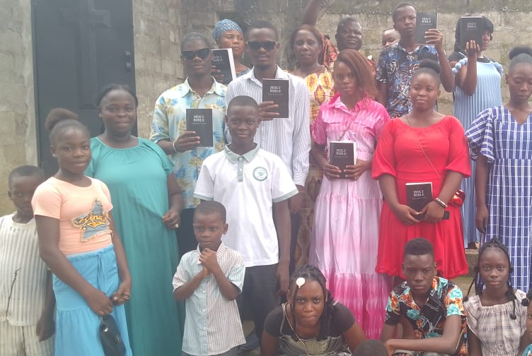
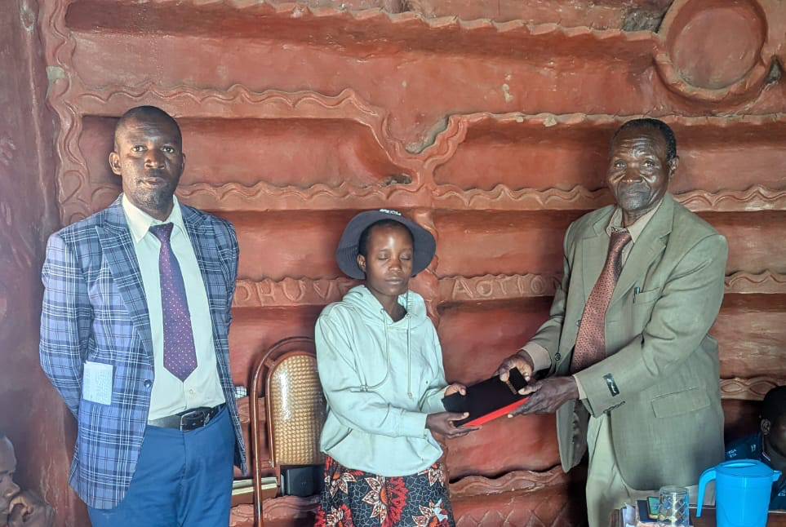
Bibles

Slide 3
2 Timothy 1:7-8 KJV
For God hath not given us the spirit of fear; but of power, and of love, and of a sound mind. [8] Be not thou therefore ashamed of the testimony of our Lord, nor of me his prisoner: but be thou partaker of the afflictions of the gospel according to the power of God;

Slide 4
61-0516A - "Jesus Christ The Same Yesterday, Today, And Forever"
30 And just remember, you can take me to record for this, that the right mental attitude towards any Divine promise of God will bring it to pass, if you can take the right attitude towards that promise.

Slide 5
63-0604 - "Jesus Christ The Same Yesterday, Today, And Forever"
47 Now, it will depend on what you’re looking for. You usually get what you look for. I want you to remember that. Now, if you want to see God, God could be seen.

Slide 6
John 1:1-5 KJV
In the beginning was the Word, and the Word was with God, and the Word was God. [2] The same was in the beginning with God. [3] All things were made by him; and without him was not any thing made that was made. [4] In him was life; and the life was the light of men. [5] And the light shineth in darkness; and the darkness comprehended it not.

Slide 7
John 14:6 KJV
Jesus saith unto him, I am the way, the truth, and the life: no man cometh unto the Father, but by me.

Slide 8
World View - A worldview is a way you look at the world.
It’s the lens through which you interpret all your experiences and through which you make decisions. It’s your colored glasses you wear, even if you don’t know you’re wearing them
- - - - - - - - - - - - - - - - - - - - - - - - - - - - - - - - - - - - - - - - - - - - - - - - - - - - - - - - - - - -
The framework from which we view reality and make sense of life and the world. “[It’s] any ideology, philosophy, theology, movement or religion that provides an overarching approach to understanding

Slide 9
Examples of worldviews.
Destiny (Eschatology)
Victimhood
Cynicism
Hypervigilence
Paranoid

Slide 10
Distorted reality - When our worldview is disconnected from truth / reality

Slide 11
Creed - A creed is a formal statement of religious beliefs, a set of guiding principles, or a system of opinions. The word comes from the Latin term credo, meaning "I believe”
Dogma - is a fixed belief or set of beliefs that people must accept without any doubts, such as a religious doctrine, a political rule, or an authoritative principle.

Slide 12
57-0306 - "God Keeps His Word #1"
22 Along come the new issue, the Oneness. They started baptizing in Jesus’ Name. That was all right; that’s in the Bible. But what happened? You made a issue out of it, and where are you at tonight? On the sidelines too. Because you didn’t hold the torchlight you organized, and put a period after that, and that settled it.

Slide 13
1 Corinthians 13:12 KJV
For now we see through a glass, darkly; but then face to face: now I know in part; but then shall I know even as also I am known.

Slide 14
Mark 7:13 KJV
Making the word of God of none effect through your tradition, which ye have delivered: and many such like things do ye.

Slide 15
64-0629 - "The Mighty God Unveiled Before Us"
88 Now, the traditions has made a veil. They say that the days of miracles is passed. A man spoke to me, a fine, cultured gentleman in Tucson, Arizona, where I live. I had a meeting at the Ramada. And we been speaking at the Business Men’s Convention where the Lord Jesus had come present and done great things. And this Christian gentleman came to me, and he said…A minister of the church, fine man, and he said, “Brother Branham, you are trying to project to the people an apostolic age,” he said, “and when the apostolic age has ceased.”

Slide 16
Jude 1:4 KJV
For there are certain men crept in unawares, who were before of old ordained to this condemnation, ungodly men, turning the grace of our God into lasciviousness, and denying the only Lord God, and our Lord Jesus Christ.

Slide 17
61-0827 - "The Message Of Grace"
And the Message of grace has been tramped under the feet of men until it’s become a disgrace. Some of them runs out into Eternal security, some runs out into everything. But, the true Message of grace remains the same, and there’s where Satan tries to knock it out from the Church. But it’s the grace of God that we’re all saved by.

Slide 18
Matthew 15:13-14 KJV
But he answered and said, Every plant, which my heavenly Father hath not planted, shall be rooted up. [14] Let them alone: they be blind leaders of the blind. And if the blind lead the blind, both shall fall into the ditch.

Slide 19
Ephesians 1:9-10 KJV
Having made known unto us the mystery of his will, according to his good pleasure which he hath purposed in himself: [10] That in the dispensation of the fulness of times he might gather together in one all things in Christ, both which are in heaven, and which are on earth; even in him:

Slide 20
65-0822M - "Christ Is Revealed In His Own Word"
52 So, the Bible is the complete revelation of Jesus Christ. And It was wrote by prophets. Hebrews 1:1, in…“God, Who in sundry times spake to the fathers by the prophets, in this last day speaks to us through His Son, Jesus Christ,” which was the prophets, all of them, put together. Jesus was Malachi; Jesus was Jeremiah, Isaiah, Elijah. All that they were, were in Him. And all that you are, and all I am, is in Him; Words, witnesses of the Word.

Slide 21
Philippians 4:8 KJV
Finally, brethren, whatsoever things are true, whatsoever things are honest, whatsoever things are just, whatsoever things are pure, whatsoever things are lovely, whatsoever things are of good report; if there be any virtue, and if there be any praise, think on these things.

Slide 22
Mark 2:22 KJV
And no man putteth new wine into old bottles: else the new wine doth burst the bottles, and the wine is spilled, and the bottles will be marred: but new wine must be put into new bottles.

Slide 23
62-0712 - "We Would See Jesus"
84 They had the way the Messiah was coming probably down the golden corridors and shake hands with Caiaphas, the high priest, if He come in his way. But look what He come, He never come contrary to the Scriptures, He come exactly the way the Scripture said. He said, “Search the Scriptures, They are They that testify of Me. They…I make the Scriptures manifest. And if I do not the manifestation by My works, then don’t believe Me.”

Slide 24
Revelation 3:18 KJV
I counsel thee to buy of me gold tried in the fire, that thou mayest be rich; and white raiment, that thou mayest be clothed, and that the shame of thy nakedness do not appear; and anoint thine eyes with eyesalve, that thou mayest see.

Slide 25
Matthew 6:22-23 KJV
The light of the body is the eye: if therefore thine eye be single, thy whole body shall be full of light. [23] But if thine eye be evil, thy whole body shall be full of darkness. If therefore the light that is in thee be darkness, how great is that darkness!

Slide 26
2 Corinthians 3:13-16 KJV
Seeing then that we have such hope, we use great plainness of speech: And not as Moses, which put a vail over his face, that the children of Israel could not stedfastly look to the end of that which is abolished: [14] But their minds were blinded: for until this day remaineth the same vail untaken away in the reading of the old testament; which vail is done away in Christ. [15] But even unto this day, when Moses is read, the vail is upon their heart. [16] Nevertheless when it shall turn to the Lord, the vail shall be taken away.

Slide 27
65-0801M - "The God Of This Evil Age"
And He said to them, “Search the Scriptures for this hour; and if I do not meet the qualification that was spoke for Me to do, then don’t believe Me.”
They said, “We believe Moses.”
73 He said, “If you would have believed Moses, you would have believed Me, for Moses spoke of Me.” And still they didn’t see it. The very God of Heaven dying on the cross, and saying the same words the prophet said He would say, and still they didn’t see it. See?

Slide 28
Romans 12:2 KJV
And be not conformed to this world: but be ye transformed by the renewing of your mind, that ye may prove what is that good, and acceptable, and perfect, will of God.

