Slide 1
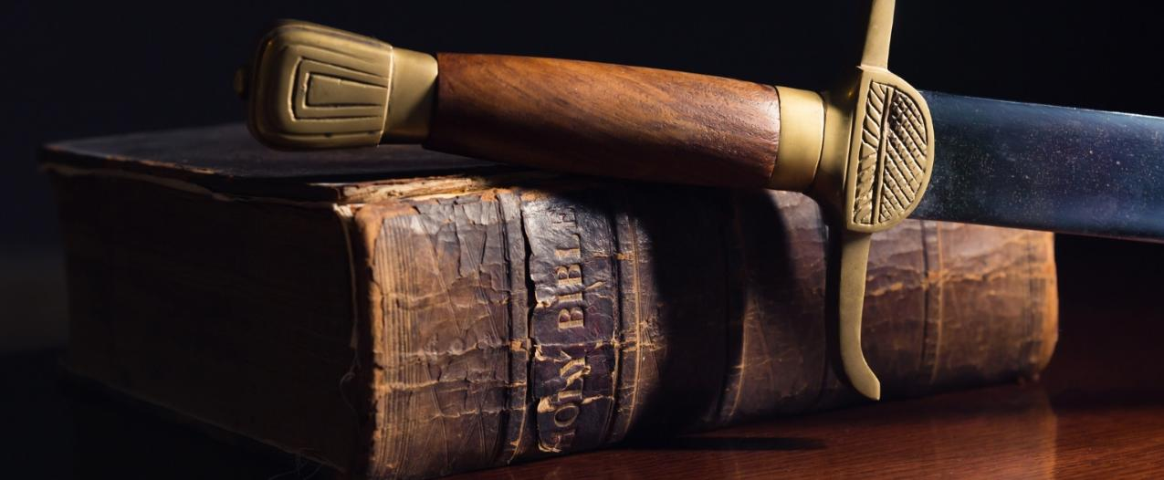
Waging Spiritual
Warfare in Satan’s Eden
Waging Spiritual Warfare
EXODUS 15:3
The LORD is a man of war: the LORD is his name.

Slide 2
Birthdays & Anniversaries
July 27th Harrison Jackson
July 28th Miles Coffey
July 29th Kaitlyn Sheffield
July 29th Liam Godwin
Aug. 5th Josh Godwin
Aug. 6th Daniel Amarteifio, Lydie Ivy
Aug. 7th Tracy Rabon, Cassia Clayville
Aug. 8th Megan Buchanan

Slide 3
Birthdays & Anniversaries
August 1st Florence & Ezekiel Amarteifio
Aug. 8th Ethan & Anna Pritchard
Aug. 10th John & Jennifer Cockman
Aug. 12th Dennis & Sue Sheppard

Slide 4
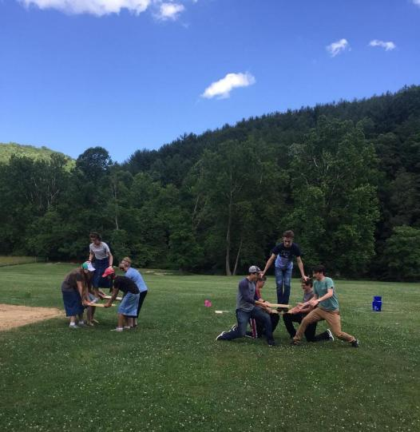
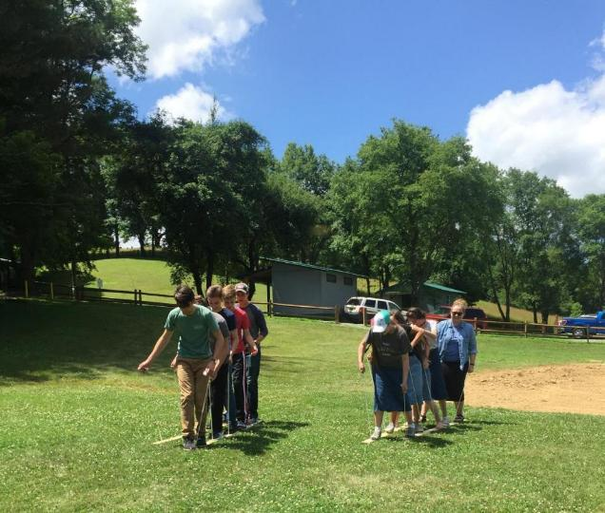
Family Day 2018

Slide 5
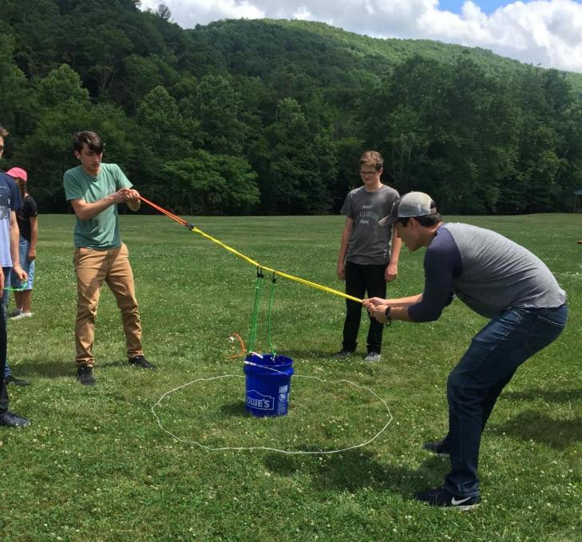
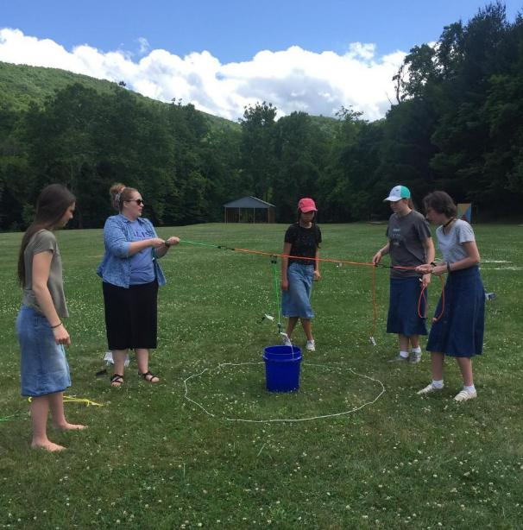

Slide 6
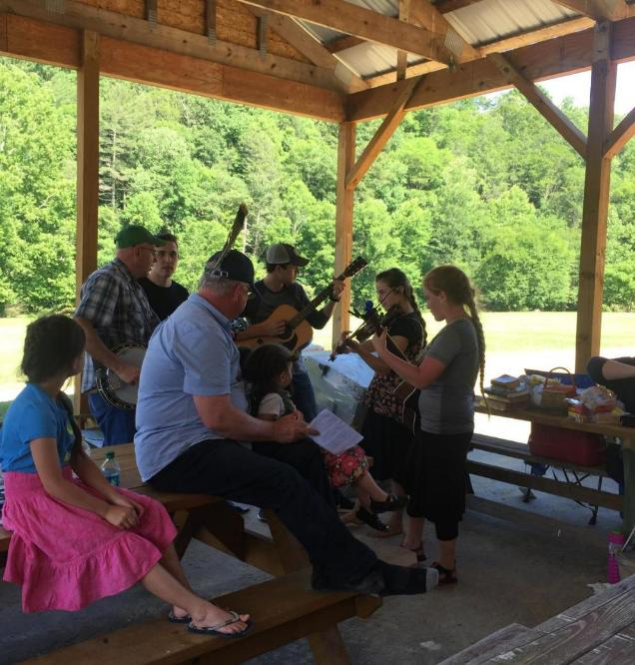
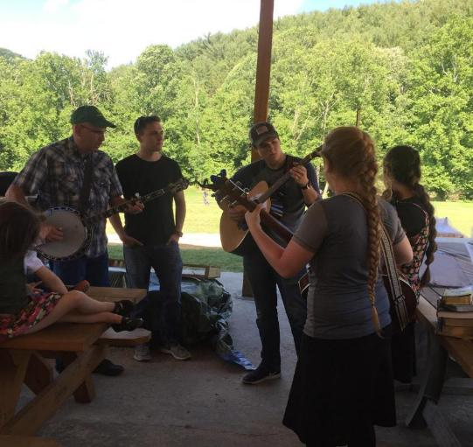
Family Day 2026
Saturday, August 15th

Slide 7
Waging Spiritual
Warfare in Satan’s Eden
Waging Spiritual Warfare
EXODUS 15:3
The LORD is a man of war: the LORD is his name.

Slide 8
DIVINE.LOVE.AND.SOVEREIGN.GRACE
2 (Earnestly Contending for the Faith)… We are contending against the wiles of the devil, against Mohammedanism, hundreds of idols, gods of the world, the god of America, of Canada, their idols of worldliness. We're contending there's one true, living God, and He's just as live tonight, as He ever was.
And we are not here with a fictitious belief; emotionally wrapped up in some emotion, psychology, or enthusiasm. We're here in the Presence of the living, resurrected Jesus Christ, Who stands with us each night, proves Himself to be alive, raised from the dead, and is here with us, now. 56-0814

Slide 9
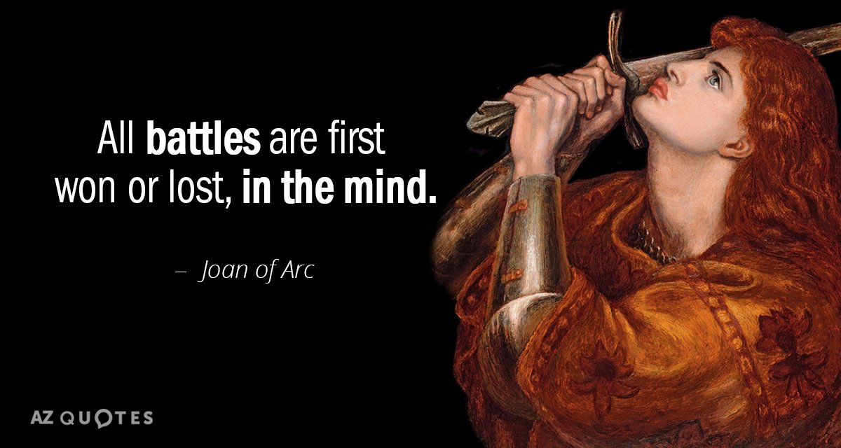
1 Peter 5:8
Be sober, be vigilant; because your adversary the devil, as a roaring lion, walketh about, seeking whom he may devour:

Slide 10
EXPERIENCES
46 [A brother speaks before Bro. Branham prays:] …Of hundreds and hundreds of preachers of different faiths, and our own faith, I have never yet met a man manifesting the humility from day to day, that Bro. Branham manifests. The weight of this is crushing the very life out of him. You don't realize what it means to fight the powers of darkness. All the powers of the enemy are turned loose against him. You, perhaps, only have a small portion against you. Remember, the reason that Jesus suffered so on the cross was not because of His own sins, but because the powers of hell were determined to crush him. So if you have anything special from God, the powers of darkness are going to do the best to crush you.
47-1207

Slide 11
THIRST
29 Now we find, God gives the control tower to you, to give to you the things that you need, the control tower in you is what directs you… There is a control tower in the body, that tells you the need that's needed in your body, and it's brought to you by thirst.
Also, there is a control tower in your soul, that tells you the spiritual things that you have need of, something in your spirit, and, by this you can tell what kind of a life is controlling you.

Slide 12
33 Rom. 7:21, "When I would do good, then evil is nigh." Did you ever have that experience, Christians? When you're trying to do something that's worthwhile, go to make an effort to do something that's good, find out that there is the Devil, on every hand, just to upset you…
When you are starting to do something, and there is something always trying to upset you in doing it, do it anyhow. That's the Devil there, trying to keep you from doing what's right.
65-0919

Slide 13
The enemy is not after your money…
Or your stuff. He wants your Mind. Your Attitude. Your Heart. Your Faith. Your Peace. Your Joy.
Understand that you’re not being attacked over the tangible things in your life, the enemy is fighting over things you cannot see.

Slide 14
II THESSALONIANS 2:1-4
Now we beseech you, brethren, by the coming of our Lord Jesus Christ, and by our gathering together unto him, 2 That ye be not soon shaken in mind, or be troubled, neither by spirit, nor by word, nor by letter as from us, as that the day of Christ is at hand. 3 Let no man deceive you by any means: for that day shall not come, except there come a falling away first, and that man of sin be revealed, the son of perdition; 4 Who opposeth and exalteth himself above all that is called God, or that is worshipped; so that he as God sitteth in the temple of God, shewing himself that he is God.
Shaken: (Gr.) saleuo overthrow, cast down from one’s (secure and happy) state

Slide 15
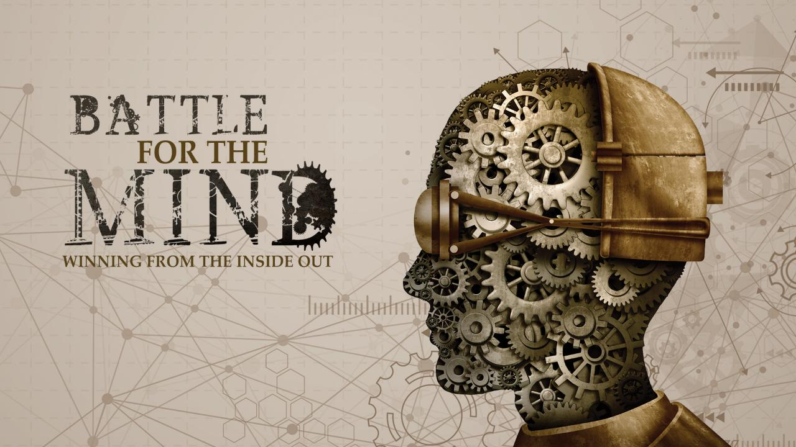

Slide 16
The Greatest Battle Ever Fought
It's your mind that opens up the door; or closes the door, and listens to your conscience, your memory, affections. But when your mind closes itself to these things, let God, the Spirit of His Word, come in, It blows the rest of the stuff out. Every doubt every fear… There's nothing standing there but the Word of God, and Satan cannot battle against That. These battles has raged since the day of the garden of Eden, the battle in the human mind. Satan started it. What did he do when he met Eve? He didn't deny God's Word, but he whitewashed It.
62-0311

Slide 17
God's Provided Way
Now, if Russia ever comes to the United States (one of the leading nations of the western world), they wouldn't want to blow it up. They could do it, if they wanted to right now, or we could blow that up. But they'll never do it. Because they would destroy everything. They want the wealth of the nation. So therefore, they'll try to put them to sleep. 26 And one thing, I do not think the war will be a missile warfare. But I think it'll be a spiritual warfare, that'll come in and just take the nation over and put them to sleep, till they get in and get a hold. 61-0516

Slide 18
The General Command:
EPHESIANS 6:10
Finally, my brethren, be strong in the Lord, and in the power of his might.
The Specific Command:
EPHESIANS 6:11 Put on the whole armour of God, that ye may be able to stand against the wiles of the devil.
The Reason for the Command:
EPHESIANS 6:12
For we wrestle not against flesh and blood, but against principalities, against powers, against the rulers of the darkness of this world, against spiritual wickedness in high places.

Slide 19
PERFECT.STRENGTH.BY.PERFECT.WEAKNESS
347 Brother, the lid's come off of hell and streams of demon power is pouring from everywhere.
It's conquered the nations. It's conquered politics till it's rotten to the core. It's conquered the churches until they know nothing but denomination.
61-1119

Slide 20
Rev. 9:13-16 And the sixth angel sounded…Loose the four angels which are bound in the great river Euphrates. 15 And the four angels were loosed, which were prepared for an hour, and a day, and a month, and a year, for to slay the third part of men. 16 And the number of the army of the horsemen were two hundred thousand thousand: and I heard the number of them.
This is to the Jews, WW2 (200 million demons) against the Jews, purging Europe. The Jews had settled down outside the Promised Land and were now being “ushered” back to the Promised Land.

Slide 21
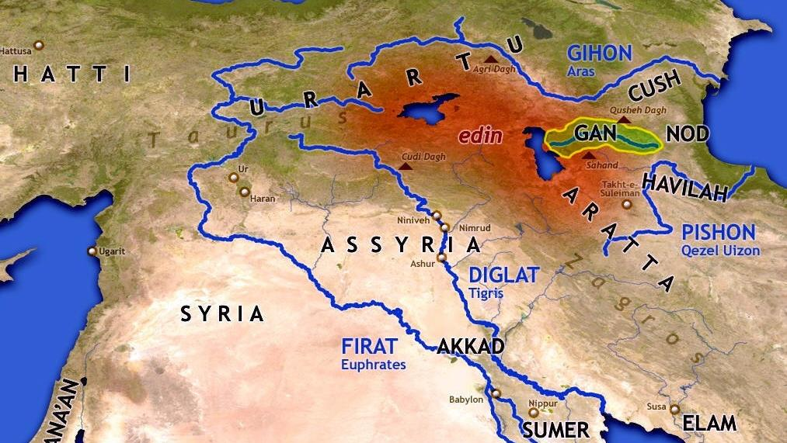
Pison
Hiddekel
(Tigris)
Gihon
Euphrates
Gen 2:11-14

Slide 22
Prepared: (Gr.) hetoimazo
To make ready, prepare: make necessary preparations; figuratively, drawn from the oriental custom of sending on before kings on their journeys persons to level the roads and make them passable; to prepare the minds of men to give the Messiah a fit reception and secure his blessings.
JOHN 1:17
For the law was given by Moses, but grace and truth came by Jesus Christ.

Slide 23
THE.FEAST.OF.THE.TRUMPETS
159 Rev. 9:13, (6th Trumpet) there was 2,000,000 horsemen that had been bound in the river of Euphrates, turned loose under the 6th Trumpet. Now there's not 2,000,000 horsemen in the world; but there was 2,000,000 horsemen. They wasn't natural horses.
They breathed fire, breastplates of jasper, the end of the tail looked like a snake's head on the end of it, stinging. It was spiritual horses, spiritual devils, been bound in Euphrates all these years, supernatural devils. What was it? The old Roman Empire being revived; the persecution of the Jews... Bound there, two hundred thousand devils of persecution. 64-0719

Slide 24

GENESIS 2:14
And the name of the third river is Hiddekel: that is it which goeth toward the east of Assyria. And the fourth river is Euphrates.

Slide 25
THE.FEAST.OF.THE.TRUMPETS 64-0719
159 (Rev. 9:13) …bound for nearly two thousand years, at the river Euphrates, can't cross to the promise; a religious sect that was trying to get to the other side. Euphrates come through Eden. But bound there, two hundred thousand devils of persecution.
161 Notice what happens under that Sixth Trumpet. They were turned loose on the Jews; the persecution of the Jews. Super-natural devils, nearly two thousand years, then loosed by Stalin, Hitler, upon the Jews. You say, "Well, that isn't Roman." It's the same spirit. Same things they did to the Christians, in the old pagan Roman days. Watch the natural Israel, and the spiritual Church now, as we separate it here.

Slide 26
Ephesians 2:2-3
Wherein in time past ye walked according to the course of this world, according to the prince of the power of the air, the spirit that now worketh in the children of disobedience: Among whom also we all had our conversation in times past in the lusts of our flesh, fulfilling the desires of the flesh and of the mind; and were by nature the children of wrath, even as others.

Slide 27

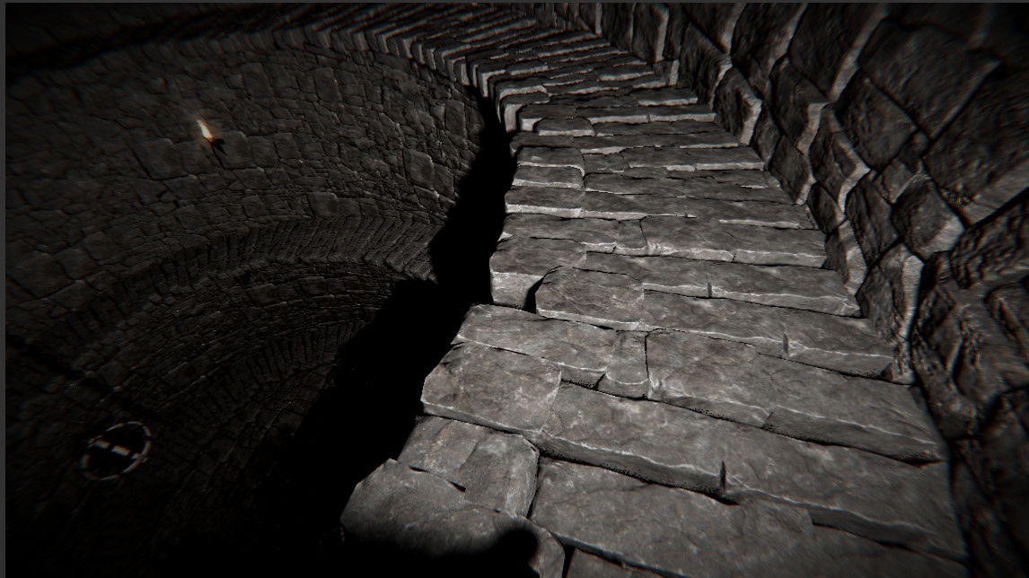
SHOW.US.THE.FATHER
43 I can see Him when He died. His soul went down into the regions of the lost. I can see Him knock at the door of the lost.
54-0811

Slide 28
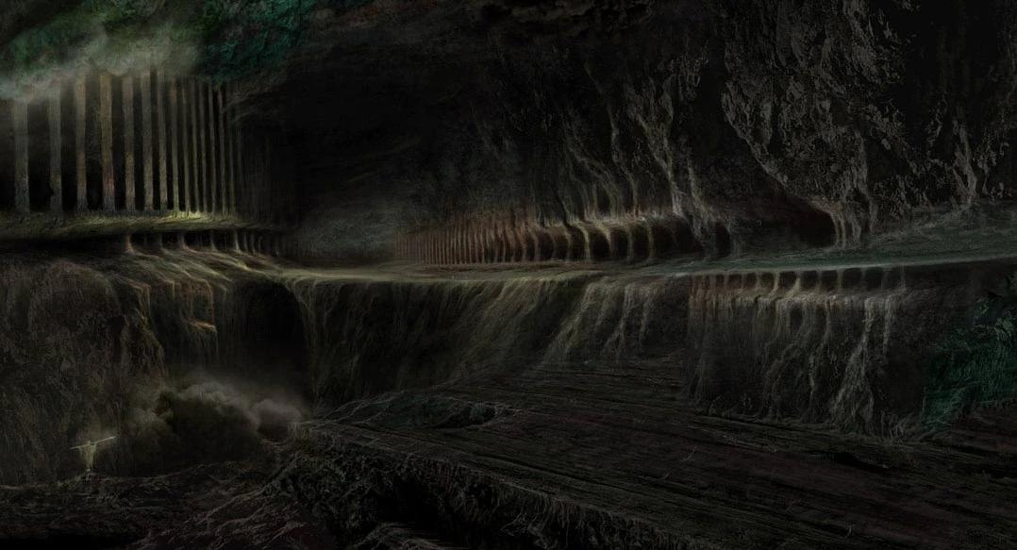
GREAT.&.MIGHTY.CONQUEROR
24 Adam's race was all in bondage. They were without hope, without God, without chance, without mercy, without anything that could help them. The great enemies of the lower regions of the lost, had them shut up in darkness. There was not a way out. There was no one could help. Nothing could be done. It looked like a total, complete loss.
57-0421

Slide 29
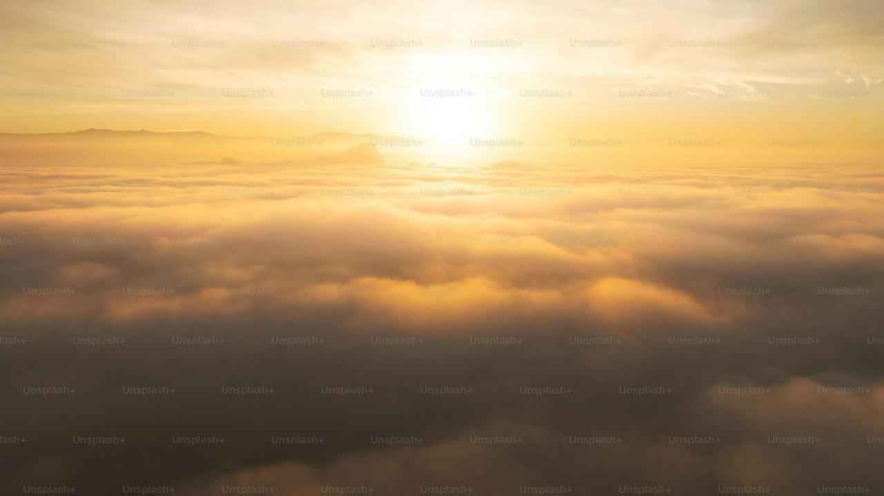
THE.MIGHTY.CONQUEROR
41 The devil said, "Now, I've got You.“ I can see Him walk over to the devil, put His hands to his face, say, "Satan, you've been in authority a long time. But I am the virgin born Son of God. My Blood's still wet on the cross. I've come down to take over." I can see Him reach on his side, and jerk off those keys of death and hell, and hang them on His own side. Satan would be pushed right back and slammed the door in his face. He took over; He conquered hell.

Slide 30
He was going out. Wait, there's somebody else that believed Him. Way over yonder in paradise, there's a group of believers that couldn't enter into the Presence of the Father, because they went under the burnt offering: sheep, goats, sprinkling of heifer's ashes.
They could not go into the Presence of the Father, because animal blood would not atone for sin. It had to wait. It was just a substitute. That was the place called paradise.

Slide 31
LUKE 24:36-38
And as they thus spake, Jesus himself stood in the midst of them, and saith unto them, Peace be unto you. 37 But they were terrified and affrighted, and supposed that they had seen a spirit. 38 And he said unto them, Why are ye troubled? and why do thoughts arise in your hearts?
Thoughts: (Gr.) dialogismos
Deliberate, questioning about what is true, hesitation, doubting, arguing.

Slide 32
Example: PSALM 104:1-2, 4
Bless the LORD, O my soul. O LORD my God, thou art very great; thou art clothed with honour and majesty. 2 Who coverest thyself with light as with a garment: who stretchest out the heavens like a curtain: 4 Who maketh his angels spirits; his ministers a flaming fire:
II CORINTHIANS 11:13-15
13 For such are false apostles, deceitful workers, transforming themselves into the apostles of Christ. 14 And no marvel; for Satan himself is transformed into an angel of light. 15 Therefore it is no great thing if his ministers also be transformed as the ministers of righteousness; whose end shall be according to their works.

Slide 33
Spiritual Warfare
Spirits are never “Neutral.”
Spirits are always trying to take you to some destination.
GO.WAKE.JESUS 63-1103
29 ...And sin is unbelief. There's only two types, two things that every person in the world is living by, that is, either faith or unbelief. There is no halfway between.

Slide 34

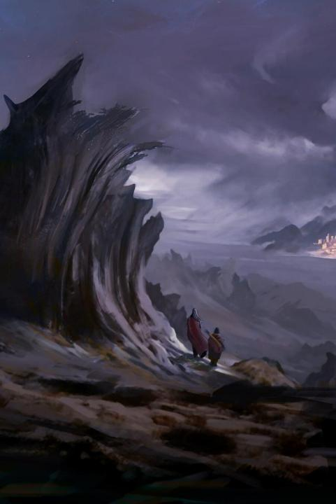
Spirits Seek to…
Make you feel good, but only temporarily;
Take you deeper and deeper into a valley which becomes darker and darker. Find yourself getting farther and farther from God. You can never satisfy a wrong spirit, it always wants more.
Prov. 27:20 Hell and destruction are never full; so the eyes of man are never satisfied.

Slide 35
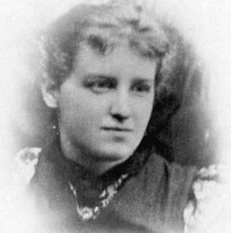
THE.CHOOSING.OF.A.BRIDE 65-0429
144 The woman was the one that was changed
over, for the perversion. See where beauty takes her
to? Today, we find that women on the increase of
beauty. Take Pearl Bryan, ever see her picture?
Supposed to be American's great beauty. There isn’t
a school kid out of any school but what would have
her in a back row... The end is going to wind up the same way, women coming into authority, ruling over men… the day she puts on man's clothes, bobs her hair, all those things are contrary to God's Word. And you know she represents the church?

Slide 36
2 Corinthians 10:3-5
For though we walk in the flesh, we do not war after the flesh: 4 (For the weapons of our warfare are not carnal, but mighty through God to the pulling down of strong holds;) 5 Casting down imaginations, and every high thing that exalteth itself against the knowledge of God, and bringing into captivity every thought to the obedience of Christ;

Slide 37
*THE.ANGEL.OF.GOD
9 And it so got the Armenian people over there to see that the Lord Jesus was such a great Healer, there's people calling now. There's another cancer case, which is a friend to the woman. By the way, the lady was just given a few more hours to live by some of the noted specialists of St. Louis, where they had flew her there by plane to be operated. But now, she's well.
Makes me think of that song, "Amazing Grace…” Demons that come... It darkens the people's thoughts to see it. 47-1102

Slide 38
THE.ONENESS.OF.UNITY
20-5 God be merciful, tonight, to those who are raising their hands, willing for the Holy Spirit to come in. May He come down the streams of His blessings, pouring into every heart and filling them to overrunning joy, that they might know that He lives. Give them understanding of how to accept You, understanding that You're more anxious to get in their heart than they are to have You. May every demon setting around hissing, "Now, you won't receive it; you won't receive it." May they call that devil a liar. God made the promise, and God will keep His promise. 58-0128

Slide 39
The Greatest Battle Ever Fought
And if one little iota of God’s Word was disbelieved, caused all this trouble, how we going to get back disbelieving the Word? You can’t do it. Got to shut off all these other things, conscience, memories, reasonings, all these other things. We just accept the Word upon the basis of, “God said so,” and sets a stream between you and God. Every channel comes open between you and God, then.There’s the battle, the very front line. 62-0311

Slide 40
INFLUENCE
28 Our markets are loaded with vulgar and filth, to poison the minds of our young children, and then we lay the fault onto them. When, I think, many times it belongs to us Christian people who will not stand up for the thing that's right, and have those things lawed off our shelves. And then in our homes, also, that we let loose and permit all these vulgarities and things to come into our home, to influence the children.
63-1130B

Slide 41
GOD'S.PROVIDED.PLACE.OF.WORSHIP
199 (Civilizations) The sun rises in the east and sets in the west... And now we've come right straight back again, and here we sit, on the West Coast, where the sin barrier of all the powers of darkness heaps in here.
These movies, television, and man kissing women on there, and poisoning the minds of little girls.
65-0425

Slide 42
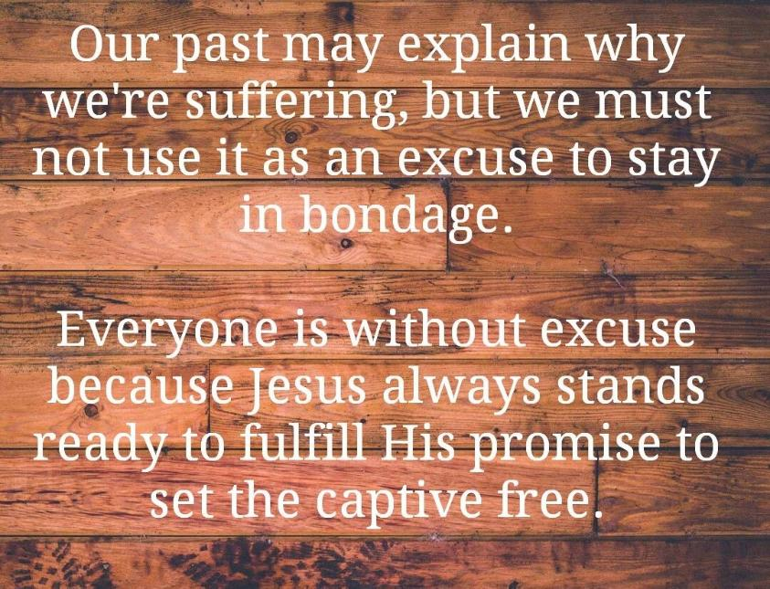

Slide 43
AND.KNOWETH.IT.NOT
82 Let me prophesy: The whole world is groping in insanity, and will get worse and worse, until they'll be a bunch of maniacs… Could you imagine a young woman, and a bloom of womanhood, beautiful, well-built, shaped, profile, face; the very thing of her being pretty shows that we're at the end time.
She has went all together to worldly things and not the beauty of holiness, sweetness in her soul. I've seen women, on the outside wasn't nothing to look at, but speak to them a few minutes, they're real, genuine, you can't get away from. Beauty of the outside is of the devil, it's of the world. 65-0815

Slide 44
Ephesians 6:10-18 [Amplified]
Finally, my brethren, be strong in the Lord, and in the power of his might. 11 Put on the whole armour of God, that ye may be able to stand against the wiles [schemes, strategies, deceit] of the devil. 12 For we wrestle [a contest between two in which each tries to throw the other, and is decided when the victor is able to hold his opponent down with his hand upon his neck)] not against flesh and blood, but against principalities [the first person/thing in a series, leader], against powers [authorities], against the rulers…

Slide 45
[lord of this world] of the darkness of this world [the age of ignorance of divine things], against spiritual wickedness in high places. 13 Wherefore take unto you the whole armour of God, that ye may be able to withstand in the evil day, and having done all, to stand. 14 Stand therefore, having your loins girt about with truth, and having on the breastplate of righteousness; 15 And your feet shod with the preparation of the gospel of peace; 16 Above all, taking the shield of faith, wherewith ye shall be able to quench all the fiery darts of the wicked. 17 And take the helmet of salvation, and the sword of the Spirit, which is the word of God: 18 Praying always with all prayer and supplication in the Spirit, and watching thereunto with all perseverance and supplication for all saints;

Slide 46
NAHUM 1:3,7
The LORD is slow to anger, and great in power, and will not at all acquit the wicked: the LORD hath his way in the whirlwind and in the storm, and the clouds are the dust of his feet.
NAHUM 1:7
The LORD is good, a strong hold in the day of trouble; and he knoweth them that trust in him.

