Slide 1
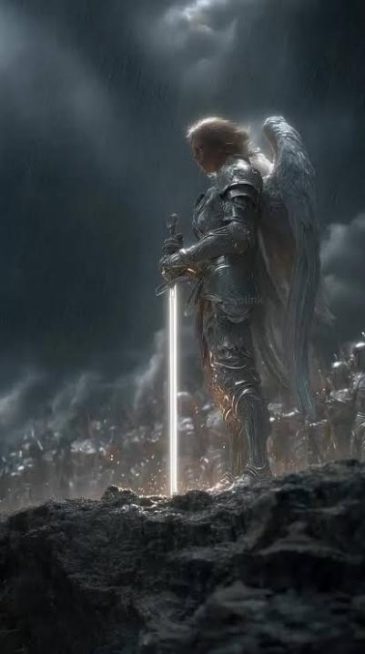
Weapons of Our Warfare:2
A Study on the Reality, Recognition, and Defeat of Spiritual Enemies
I SAMUEL 2:8-9
He will keep the feet of his saints, and the wicked shall be silent in darkness; for by strength shall no man prevail.

Slide 2

Birthdays & Anniversaries
July 20th Naomi Mukadi
July 21st Titus Mayl
July 22nd David & Carrie Whitlock
July 24th Jeff & Anna Jackson
Sept. 13th Bro. Sam Browning
at HBT
Family Day (Aug. 15th)
2
Notes:
Birthdays, anniversaries & upcoming events.

Slide 3
HBT Family Day
August 15th
10:00 am to 6:00 pm
Camp Broadstone
1431 Broadstone Rd., Banner Elk, NC
Family Picnic
Fishing

Slide 4
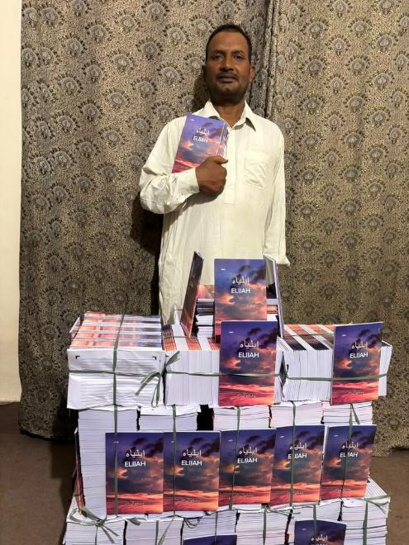
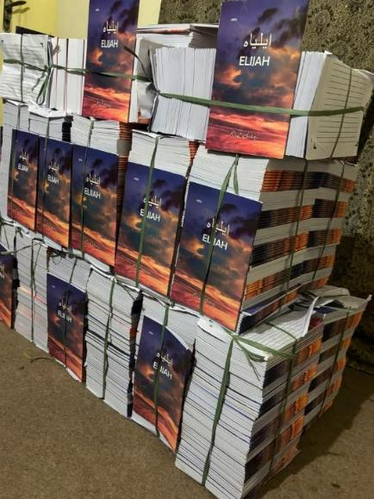
Pakistan

Slide 5
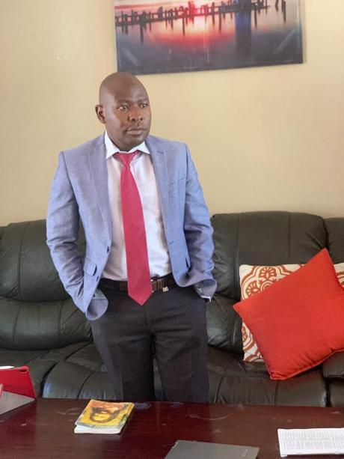
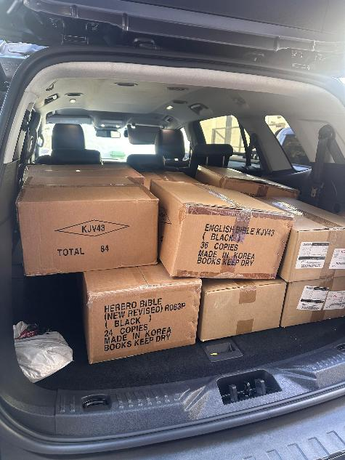
Bibles for Namibia
Bro. Shepherd Chikoro

Slide 6
Weapons of Our Warfare:2
A Study on the Reality, Recognition, and Defeat of Spiritual Enemies
I SAMUEL 2:8-9
He will keep the feet of his saints, and the wicked shall be silent in darkness; for by strength shall no man prevail.

Slide 7

Paul does not place the battlefield on a military field, in a government building, or even in the open streets of some pagan city. He places it squarely in the mind — in the realm of imaginations, thoughts, and high things that exalt themselves against the knowledge of God. The war is waged in the invisible dimension that wraps itself around us at every moment of every day.

Slide 8

II CORINTHIANS 10:3-5
For though we walk in the flesh, we do not war after the flesh: 4 (For the weapons of our war-fare are not carnal, but mighty through God to the pulling down of strong holds;) 5 Casting down imaginations, and every high thing that exalteth itself against the knowledge of God, and bringing into captivity every thought to the obedience of Christ;

Slide 9
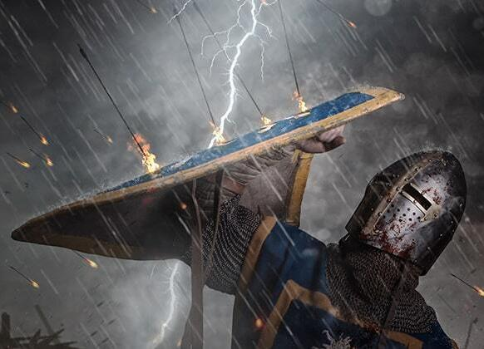
Spiritual Warfare:
Two primary errors in spiritual warfare: over-emphasis and under-emphasis. Some blame every sin, conflict, problem on demons to be cast out.
Others completely ignore the spiritual realm and the fact that the Bible tells us our battle is against spiritual powers. Jesus sometimes cast demons out of people; other times He healed people with no mention of the demonic.

Slide 10
The apostle Paul instructs Christians to wage war against the sin in themselves (Rom. 6) and warns us to oppose the schemes of the devil (Eph. 6:10–18).
ROMANS 6:4
Therefore we are buried with him by baptism into death: that like as Christ was raised up from the dead by the glory of the Father, even so we also should walk in newness of life.
EPHESIANS 6:12
For we wrestle not against flesh and blood, but against principalities, against powers, against the rulers of the darkness of this world, against spiritual wickedness in high places. 13 Wherefore take unto you the whole armour of God, that ye may be able to withstand in the evil day, and having done all, to stand.

Slide 11
"The weapons [of the Lord] are designed to uphold you and protect you. Satan's forces are designed to destroy you and bring you down. Two armies. Two objectives. One invisible battleground.”
Bro. Ed Byskal

Slide 12
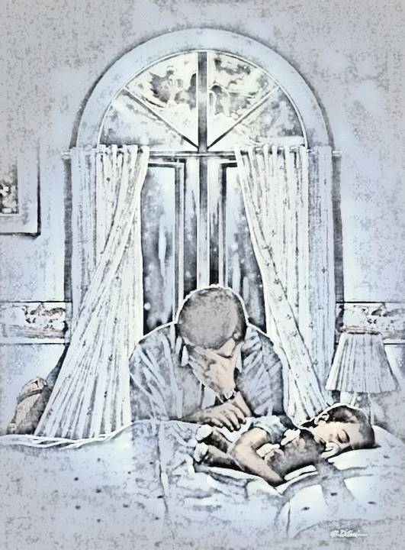
PROVERBS 19:21
There are many devices in a man's heart; nevertheless the counsel of the LORD, that shall stand.
Proverbs 19:21 (Amplified)
Many plans are in a man’s mind, But it is the Lord’s purpose for him that will stand (be carried out).

Slide 13
1. Warfare Always Targets the Word First
From Eden, the enemy's first move has always been against the Word of God. "Yea, hath God said?" (Gen. 3:1)
When a person finds themselves suddenly filled with doubts about Scripture, when previously settled convic-tions become uncertain, when the Word grows cold and abstract — this is most often not an intellectual development. It is spiritual warfare targeting the Word, which is the foundation of all faith and the weapon of all victory.

Slide 14
IS.YOUR.LIFE.WORTHY.OF.THE.GOSPEL
170 Dr. Adair wouldn't let me go in, "She got meningitis. You'll take it back to Billy Paul." There laid the baby, the isolated ward, flies all in her little eyes like that. I said, "God, there lays my daddy and brother, yonder, and the flowers on their grave. There lays Hope, laying yonder. And here is my baby, dying. Don't take her, Lord."

Slide 15
171 He just pulled down the curtain, as if say, "I don't want to hear you, at all." He wouldn't even talk to me.
172 Then, if He wouldn't talk to me, it was Satan's time. He said, "And I thought you said He was a good God. What's all this you're hollering about? You're just a boy…” Now, he couldn't tell me there's no God, 'cause I had already seen It. But he told me He didn't care for me. 63-0630

Slide 16
2. Warfare Works Thru the 2 Spirits Running Parallel
Bro. Branham warned us about the two spirits — the spirit of Christ and the spirit of antichrist — that run parallel through every age, every revival, every congregation, and through every individual heart. They are not merely theories that exist some-where in the world, they are competing influences contending for the same territory: the human mind.

Slide 17
CHURCH.AGE.BOOK
15-3 Christ in the True Church is a continuation of the Book of Acts. But the Book of Revelation shows how that the antichrist spirit would come into the church and defile it, making it lukewarm, formal and powerless. It exposes Satan, revealing his works (attempted destruction of God's people and the discrediting of God's word) right down to the time he is cast into the lake of fire. He fights that.

Slide 18
He cannot stand it. He knows that if the people get the TRUE REVELATION of the TRUE CHURCH and what she is, what she stands for and that SHE CAN DO THE GREATER WORKS, she will be an invincible army. If they get a true revelation of the two spirits within the framework of the Christian church, and by God's Spirit discern and withstand the antichrist spirit, Satan will be powerless before her.

Slide 19
Hearing, Receiving, and Acting
18 Now, these differences has always been since Cain and Abel — the first human beings that produced life on earth. Adam and Eve brought forth two, one of one kind and one of another. There was Cain and Abel. There was Esau and Jacob. All along down the line, there's always been that, the two spirits warring against one and another in the churches. 60-0607

Slide 20
3. Warfare Produces Fruits That Can Be Identified
Matthew 7:16 Ye shall know them by their fruits“
Jonathan Edwards wrote:
"Christian practice [the consistent, persistent, universal practice of a holy life ] is the chief of all the signs of the sincerity of [Believers], both as an evidence of the sincerity unto others, and also to their own consciences... And the degree in which experiences have influence on a person's practice is the surest evidence of the degree of that which is spiritual and divine in his experiences."

Slide 21
The Queen of Sheba
19 Watch them by the fruit that they bear. Fortunetellers are out there on the street making money. And they're guessing, and they're taking telepathy and mental psychology. But the power of God preaches the Gospel and warns of the hell that there is before you, a heaven to go to, calls sinners to repentance, heals the sick, and does good things. Then by their fruits you shall know them. 60-0110

Slide 22
WHAT.SHALL.WE.DO.WITH.THIS.JESUS.CALLED.CHRIST
109 Luther said, "Believe, and walk out." The devil believes, too. Wesley, "Shout, and you got It," but he found out he didn't. Pentecost said, "Speak in tongues, and you got It." They didn’t…What is the evidence of It? When that spirit that's in you can punctuate every promise with an amen, and God will confirm it. That's exactly the way it was with Jesus Christ. They had more fruits of the spirit, all kinds of evidences. You can't pin any evidence down to anything but God Himself manifesting His Word. That's the only true evidence that there is that you're a Christian. 64-0126

Slide 23
4. Warfare Targets the Reasoning About One's Own State
One of the most sophisticated tools in the enemy's arsenal is false assurance.
Jonathan Edwards: “Satan's most effective counterfeit is not the production of gross sin, but the production of a false peace — a counterfeit conviction of salvation that removes all holy fear, vigilance, self-examination, and replaces it with a settled confidence that has no genuine foundation in the [word of the Age].”

Slide 24
How to Win: The Weapons of Our Warfare
1. The Word of God — Absolute, Non-Negotiable
Greatest Battle Ever Fought
You throw aside everything and open up the channel and say, 'God, Your Word is eternally true, and It's for me. If the whole church fails, if the whole world fails, yet I can't fail, because I'm taking Your Word.’ 62-0311

Slide 25
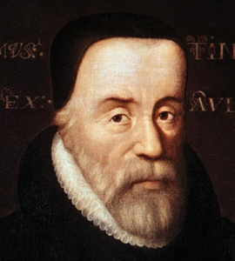
William Tyndale (1490 – 1536)
English biblical translator, Protestant martyr. Educated at the University of Oxford and became an instructor at the University of Cambridge. Tyndale became convinced that the Bible alone should determine the practices and doctrines of the church and that all believers should be able to read the Bible in their own language.
Because of the influence of printing and a demand for Scriptures in the vernacular, William Tyndale began working on a New Testa-ment translation directly from the Greek in 1523.

Slide 26
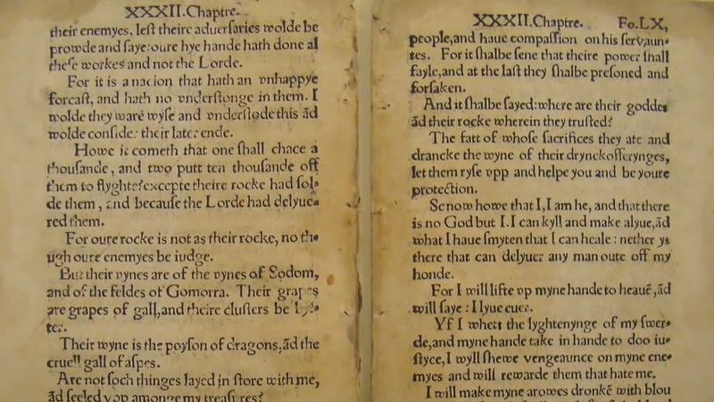
William Tyndale's Bible:
The opening page of chapter 1 of the Gospel of John from William Tyndale's translation of the Bible, 1525–26; in the British Library.

Slide 27
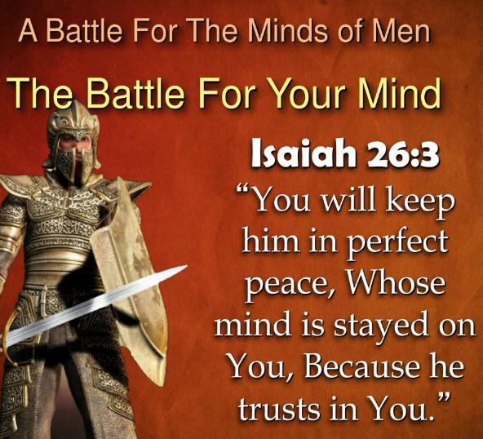
Greatest Battle Ever Fought
Kill him at the beginning; stop him dead in his tracks. It ain't how long you can make the war linger; it's stop it right now. If you'll come, you'll keep them memories, conscience, thinking about, 'Well, I might fail. It might not be right.’
Don't you do that at all. Throw aside everything, open up the channel and say, 'God, Your Word is eternally true, and It's for me.
62-0311

Slide 28
2. Faith That Holds Its Ground
The highest expression of faith is not the initial moment of spiritual awakening, but the obedience: faithfulness under trial, perseverance through the furnace, the maintaining of obedience when everything in the natural world screams to abandon it.
The soldier of Jesus Christ is not measured by his enthusiasm at enlistment. He is measured by whether he is still standing when the battle is done.
Paul's final testimony was not "I had a great conversion experience." It was: "I have fought a good fight, I have finished my course, I have kept the faith" (2 Timothy 4:7).

Slide 29
The most important thing to understand about this warfare is its outcome. The battle is not in question. The cross settled it. The empty tomb confirmed it. The resurrection of Jesus Christ sealed it.
Every demon in hell knows it. Every principality and power is operating on borrowed time!
The warfare we engage in is not to achieve victory. It is to enforce a victory that already exists. We are not fighting a war that is uncertain in its outcome but occupying the conquered ground of an enemy who refuses to acknowledge his defeat.

Slide 30
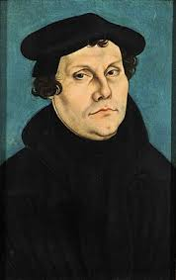
The Reformation and Its Counterfeit
Martin Luther broke the stronghold of a system that held the Western world in spiritual bondage for centuries. But immediately Satan introduced the counterfeits — Anabaptists, antinomian spirits, fanaticism of Thomas Münzer and the Zwickau prophets — men who claimed direct visions and revelations, who stirred enormous crowds with signs and wonders, and who produced exactly the kind of emotional intensity that the genuine Reformation had generated, but without its submission to the Word.

Slide 31
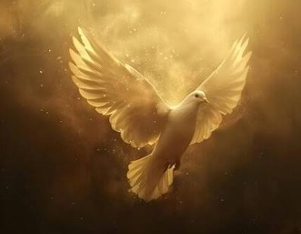
Luther recognized the pattern. He wrote of the Schwärmer — the enthusiasts — that “they swallowed the Holy Ghost feathers and all”, claiming direct divine communi-cation that superseded Scripture.

Slide 32
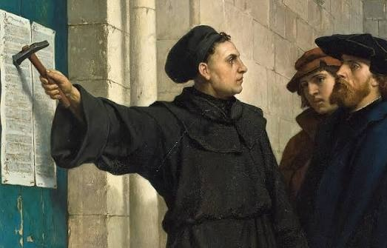
Church Age Book
329-1 It is by this means, principally, that he has against all revivings of religion... By this, Satan prevailed against the reformation, began by Luther — ten times more than by all those bloody, cruel persecutions of the church of Rome."

Slide 33
3. The Weapon of Love: Conquering What Force Cannot Reach
Great and Mighty Conqueror
49 He went to the lowest city there is in the earth, Jericho, and the littlest man in the city had to look down to see Him. But when God, nineteen hundred years ago, raised Him up — that's what man done to Him. But with the weapon of love, He conquered every devil. 57-0421

Slide 34
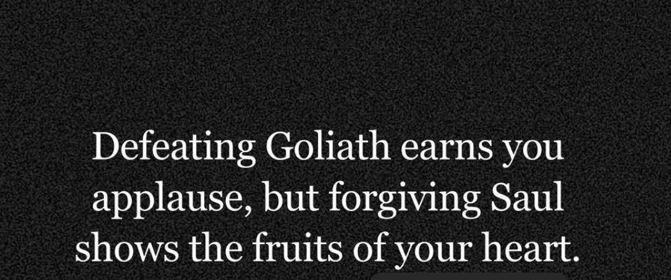

Slide 35
4. Prayer as Active Spiritual Combat
The Book of Daniel provides a picture of what prayer actually accomplishes in the spiritual realm:
Daniel prayed. The answer was dispatched immediately from heaven. But for 21 days, the messenger was withstood by the prince of Persia — until Michael came to assist (Daniel 10:12–13). The warfare was real.
The delay was caused by an actual spiritual battle in the unseen realm. And Daniel's continued prayer was not just “waiting,” it was active participation in the warfare from his side of the veil.

Slide 37

Inheriting Victory
That ye be not slothful, but followers of them who through faith and patience inherit the promises.
HEBREWS 6:12

Slide 38

Inheritance
kleronomeo
To receive the portion assigned to one, receive an allotted portion, receive as one's own or as a possession; to become partaker of. (e.g. Jonah)
To receive by lot; especially to receive a part of an inheritance, obtain by right of inheritance; to be an heir.
(Eg. Jacob & Esau)

Slide 39
I SAMUEL 2:8
He raiseth up the poor out of the dust, and lifteth up the beggar from the dunghill, to set them among princes, and to make them inherit the throne of glory: for the pillars of the earth are the LORD'S, and he hath set the world upon them. 9 He will keep the feet of his saints, and the wicked shall be silent in darkness; for by strength shall no man prevail.
MATTHEW 25:34
Then shall the King say unto them on his right hand, Come, ye blessed of my Father, inherit the kingdom prepared for you from the foundation of the world:

Slide 40
Adoption #4 60-0522
Now that 11th verse: “In whom also we have obtained an inheritance....” Oh, an inheritance. Somebody has to leave you something to inherit it - what inheritance do we have? God left me an inheritance, when He put my name on the Lamb's book of life before the foundation of the world.
You say, “Wait a minute. Jesus did that when He died for you." No, He never. Jesus come to purchase that inheritance for me. Read the next line: In whom we also have obtained an inheritance, being predestinated according to the purpose of him who worketh all things after the counsel of his own good will:

Slide 41
EPHESIANS 1:10-12
That in the dispensation of the fulness of times he might gather together in one all things in Christ, both which are in heaven, and which are on earth; even in him: 11 In whom also we have obtained an inheritance, being predestinated according to the purpose of him who worketh all things after the counsel of his own will: 12 That we should be to the praise of his glory, who first trusted in Christ.

Slide 42
LUKE 18:27
And he said, The things which are impossible with men are possible with God. 28 Then Peter said, Lo, we have left all, and followed thee. 29 And he said unto them, Verily I say unto you, There is no man that hath left house, or parents, or brethren, or wife, or children, for the kingdom of God's sake,
30 Who shall not receive manifold more in this present time, and in the world to come life everlasting.

Slide 43
II PETER 1:1-5
Simon Peter, a servant and an apostle of Jesus Christ, to them that have obtained like precious faith with us through the righteousness of God and our Saviour Jesus Christ… 3 According as his divine power hath given unto us all things that pertain unto life and godliness, through the knowledge of him that hath called us to glory and virtue:
4 Whereby are given unto us exceeding great and precious promises: that by these ye might be partakers of the divine nature, having escaped the corruption that is in the world through lust. 5 And beside this, giving all diligence, add to…

Slide 44
I CORINTHIANS 6:9-20
Know ye not that the unrighteous shall not inherit the kingdom of God? Be not deceived: neither forni-cators, nor idolaters, nor adulterers, nor effeminate, nor abusers of themselves with mankind, 10 Nor thieves, nor covetous, nor drunkards, nor revilers, nor extortioners, shall inherit the kingdom of God. 11 And such were some of you: but ye are washed, but ye are sanctified, but ye are justified in the name of the Lord Jesus, and by the Spirit of our God.

Slide 45
ISAIAH 25:8
He will swallow up death in victory; and the Lord GOD will wipe away tears from off all faces; and the rebuke of his people shall he take away from off all the earth: for the LORD hath spoken it.
I CORINTHIANS 15:54
So when this corruptible shall have put on incorrupttion, and this mortal shall have put on immortality, then shall be brought to pass the saying that is written, Death is swallowed up in victory.

Slide 46
GOD.MAKING.HIS.PROMISE
4 A real, borned again, child of God looks to heaven and knows that Father holds the reigns of all things. He does all things well. And there's neither death nor sorrow for a Christian.
Christians doesn't die. There's not one Scripture that says a Christian dies... So he has no death. And that is the greatest thing that put fear over man, was death. And Jesus died for us, and death is swallowed up in victory. 56-1209

Slide 47
HEBREWS 2:14
Forasmuch then as the children are partakers of flesh and blood, he also himself likewise took part of the same; that through death he might destroy him that had the power of death, that is, the devil; 15 And deliver them who through fear of death were all their lifetime subject to bondage. 16 For verily he took not on him the nature of angels; but he took on him the seed of Abraham.

Slide 48
REDEMPTION.BY.POWER
105 Don't wait for people to persuade you to Christ. Stand like a man or a lady, accept Him, and walk forward in victory. Amen. That's what God wants, rugged, ready soldiers. You might not be, weigh a hundred and five pounds, but you can still be ruddy, brother, and full of power, if you'll just let God have His way…
54-0329

