Slide 1


“The Message”
A Study of Psalm 78​
Principles to Live By 5

Slide 2
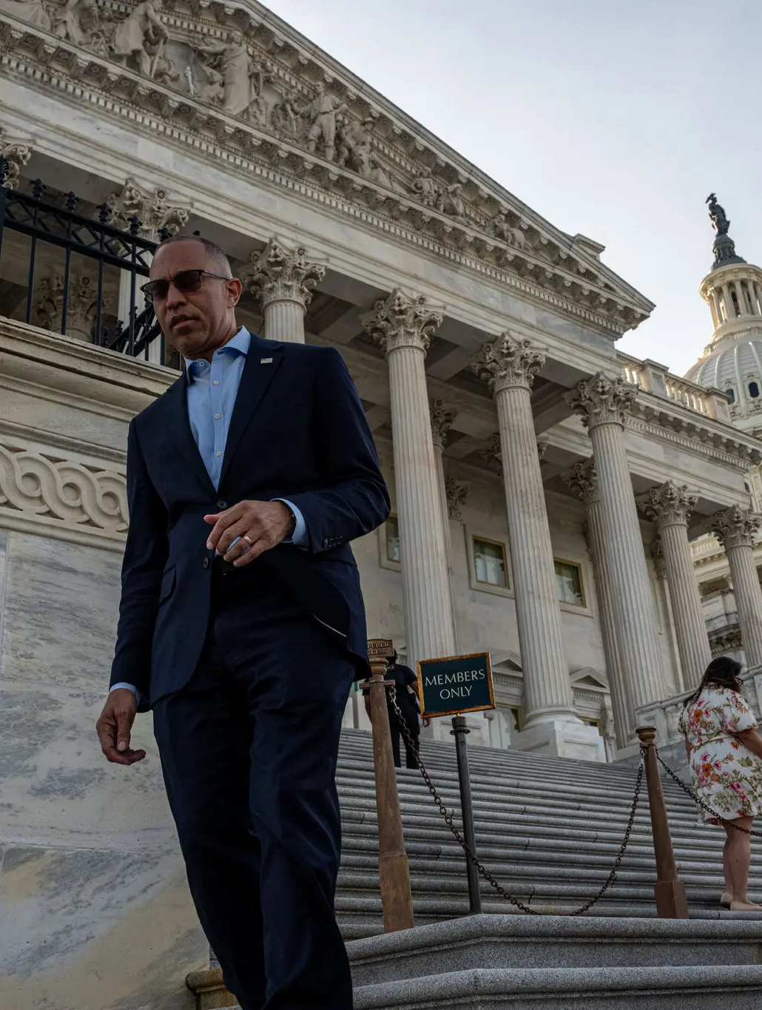
New York Times
Almost Half of House Democrats Vote to End Aid to Israel
The measure failed, but the level of support among Democrats exposed a stark shift in the party away from backing the Jewish state.

Slide 3
July 15, 2026Updated 5:42 p.m. ET
The House on Wednesday rejected a measure to eliminate U.S. aid to Israel, but almost half of Democrats supported the move, reflecting a rapid and dramatic shift within the party away from decades of unequivocal support for the Jewish state.

Slide 4
II CHRONICLES 16:7-10
And at that time Hanani the seer came to Asa king of Judah, and said unto him, Because thou hast relied on the king of Syria, and not relied on the LORD thy God, therefore is the host of the king of Syria escaped out of thine hand.8 Were not the Ethiopians and the Lubims a huge host, with very many chariots and horsemen? yet, because thou didst rely on the LORD, he delivered them into thine hand. 9 For the eyes of the LORD run to and fro throughout the whole earth, to shew himself strong in the behalf of them whose heart is perfect toward him. Herein thou hast done foolishly: therefore from hence-forth thou shalt have wars. 10 Then Asa was wroth with the seer, and put him in a prison house; for he was in a rage with him because of this thing. And Asa oppressed some of the people the same time.

Slide 5
QUESTIONS AND ANSWERS 1, 64-0823
243 Dear, Bro. Branham, will all the sons and daughters of true, borned again believers be saved? No, brother; no, they sure won't. See, they'll have to be born just exactly like their father and mother was born of the Spirit. That's what makes a man a new person, is because he's born again… "Believe on the Lord Jesus Christ, thou and thy house shall be saved." You pray and commit your children to God and hold onto God, believing that they will be saved.

Slide 6
Martin Luther prefaced each section of his Small Catechism (1529) with a charge addressed not to the clergy but to the household: "As the head of the family should teach it in a simple way to his household."
It was written for fathers, not pastors, to place the testimony directly into the hands of their children. Each of these, in its own generation, was simply Deuteronomy 6:7 and Psalm 78:5 — proof that the mandate of this psalm has never belonged to Israel alone.

Slide 7
60-0309 WHY
12 Paul told Timothy to stir up the gift that was in him, that come from his grandmother, Lois. (Heb. 7) Paul speaking on tithe paying, he said, Levi, who had an order from God to receive tithing of his brother, paid tithes, for he was yet in the loins of Abraham when he met Melchisedec, which was his great, great-grandfather. And it was accounted to him for paying tithing. Your life will impress your children, and influence your children by the example you set before them. And I think it's a good thing that we put every effort we can before our children as godly parents.

Slide 8
…That night after all of her efforts and weak. The old faithful minister come, got into the pulpit, and prayed, sung a song, him and the lady. She set out in his audience. After while, staggered in the door, was that little ragged-looking kid with the hair hanging down in his face. You know who that was? Dwight Moody. That night he knelt at the altar: See, you don't know what you're doing. Speak a little word for Jesus, testify, sing, or pray. And like bread upon the water, it will return to you someday. The single clearest New Testament link to this passage is a direct quotation.
The Lamb’s Book of Life 56-0603

Slide 9
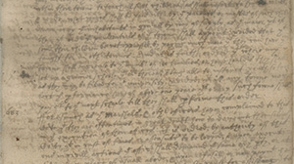
In 1647 the Massachusetts General Court passed what became known as the Old Deluder Satan Act, requiring every town of fifty families to maintain a teacher of reading.
The law stated its purpose plainly: to thwart "ye old deluder, Satan" in his design "to keepe men from the knowledge of ye Scriptures."

Slide 10
Mashal ("parable," v.2) Comparison or likeness: a riddle or enigma, the same word used of Samson's riddle in Judges 14:12. Together they mark this history as something to be searched, not skimmed.
Eduth ("testimony," v.5) comes from a root meaning to repeat or solemnly attest — it is the word used of the Ark and Tabernacle "of the testimony," and it is never a private opinion but a formal witness meant to be re-testified.
Dor ("generation," v.4, 6, 8) carries the sense of a circle or cycle — an age that turns and gives way to the next, which is exactly the warning built into the word: every dor passes, and each one must either receive the testimony or let it die with them.

Slide 11
DEUTERONOMY 6:6–9 And these words, which I command thee this day, shall be in thine heart: And thou shalt teach them diligently unto thy children, and shalt talk of them when thou sittest in thine house, and when thou walkest by the way, and when thou liest down, and when thou risest up. And thou shalt bind them for a sign upon thine hand, and they shall be as frontlets between thine eyes. And thou shalt write them upon the posts of thy house, and on thy gates.
DEUTERONOMY 4:9–10 Only take heed to thyself, and keep thy soul diligently, lest thou forget the things which thine eyes have seen, and lest they depart from thy heart all the days of thy life: but teach them thy sons, and thy sons' sons; Specially the day that thou stoodest before the LORD thy God in Horeb, when the LORD said unto me, Gather me the people together, and I will make them hear my words, that they may learn to fear me all the days that they shall live upon the earth, and that they may teach their children.

Slide 12
EXODUS 12:26–27 And it shall come to pass, when your children shall say unto you, What mean ye by this service? That ye shall say, It is the sacrifice of the LORD'S passover, who passed over the houses of the children of Israel in Egypt, when he smote the Egyptians, and delivered our houses. And the people bowed the head and worshipped.
JOEL 1:3 Tell ye your children of it, and let your children tell their children, and their children another generation.
GENESIS 18:19 For I know him, that he will command his children and his household after him, and they shall keep the way of the LORD, to do justice and judgment; that the LORD may bring upon Abraham that which he hath spoken of him.

Slide 13
2 TIMOTHY 1:5 When I call to remembrance the unfeigned faith that is in thee, which dwelt first in thy grandmother Lois, and thy mother Eunice; and I am persuaded that in thee also.
2 TIMOTHY 3:14–15 But continue thou in the things which thou hast learned and hast been assured of, knowing of whom thou hast learned them; And that from a child thou hast known the holy scriptures, which are able to make thee wise unto salvation through faith which is in Christ Jesus.
2 TIMOTHY 2:2 And the things that thou hast heard of me among many witnesses, the same commit thou to faithful men, who shall be able to teach others also.

Slide 14
TITUS 2:3–5 The aged women likewise, that they be in behaviour as becometh holiness, not false accusers, not given to much wine, teachers of good things; That they may teach the young women to be sober, to love their husbands, to love their children, To be discreet, chaste, keepers at home, good, obedient to their own husbands, that the word of God be not blasphemed.
ACTS 22:3 I am verily a man which am a Jew, born in Tarsus, a city in Cilicia, yet brought up in this city at the feet of Gamaliel, and taught according to the perfect manner of the law of the fathers, and was zealous toward God, as ye all are this day.

Slide 15
What Happens When The Chain Breaks?
JUDGES 2:10 And also all that generation were gathered unto their fathers: and there arose another generation after them, which knew not the LORD, nor yet the works which he had done for Israel.
2 KINGS 22:11 And it came to pass, when the king [Josiah] had heard the words of the book of the law, that he rent his clothes.

Slide 16
Judges 2:10 is the very failure Asaph writes to prevent [Ps. 78] — not rebellion, but simple neglect: a generation that "knew not" because no one declared it to them.
Under Josiah, the book of the covenant had been lost within the temple itself and was rediscovered only by accident during repair work (2 Kings 22:8) — a sober picture of how completely a neglected testimony can vanish even from the house of God.

Slide 17
Why The Testimony Cannot Be Inherited
JOHN 3:3 Jesus answered and said unto him, Verily, verily, I say unto thee, Except a man be born again, he cannot see the kingdom of God. 3:7 Marvel not that I said unto thee, Ye must be born again.
ROMANS 9:8 That is, They which are the children of the flesh, these are not the children of God: but the children of the promise are counted for the seed.
EZEKIEL 18:20 The soul that sinneth, it shall die. The son shall not bear the iniquity of the father, neither shall the father bear the iniquity of the son: the righteousness of the righteous shall be upon him, and the wickedness of the wicked shall be upon him.

Slide 18
1 CHRONICLES 28:9
And thou, Solomon my son, know thou the God of thy father, and serve him with a perfect heart and with a willing mind: for the LORD searcheth all hearts, and understandeth all the imaginations of the thoughts: if thou seek him, he will be found of thee; but if thou forsake him, he will cast thee off for ever.
PSALM 71:18 Now also when I am old and greyheaded, O God, forsake me not; until I have shewed thy strength unto this generation, and thy power to every one that is to come.

Slide 19
David does not tell Solomon, "you will inherit my God." He says, "know thou the God of thy father" — an act David could urge but could not perform for his son.
That single line carries the whole burden of Psalm 78:1–8.

