Slide 1
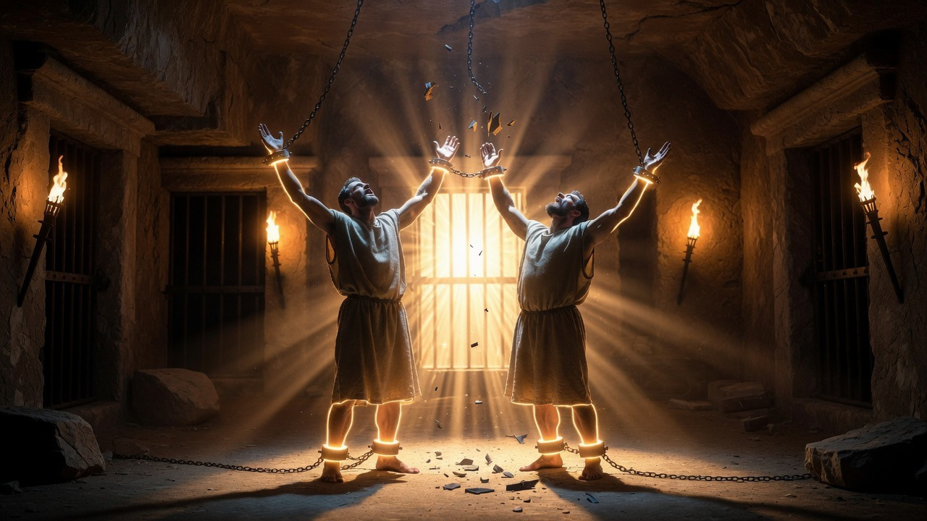

From the Tyranny of the Flesh to the Liberty of Christ
Aaron Nengomazha : Hickory Bible Tabernacle

Slide 2
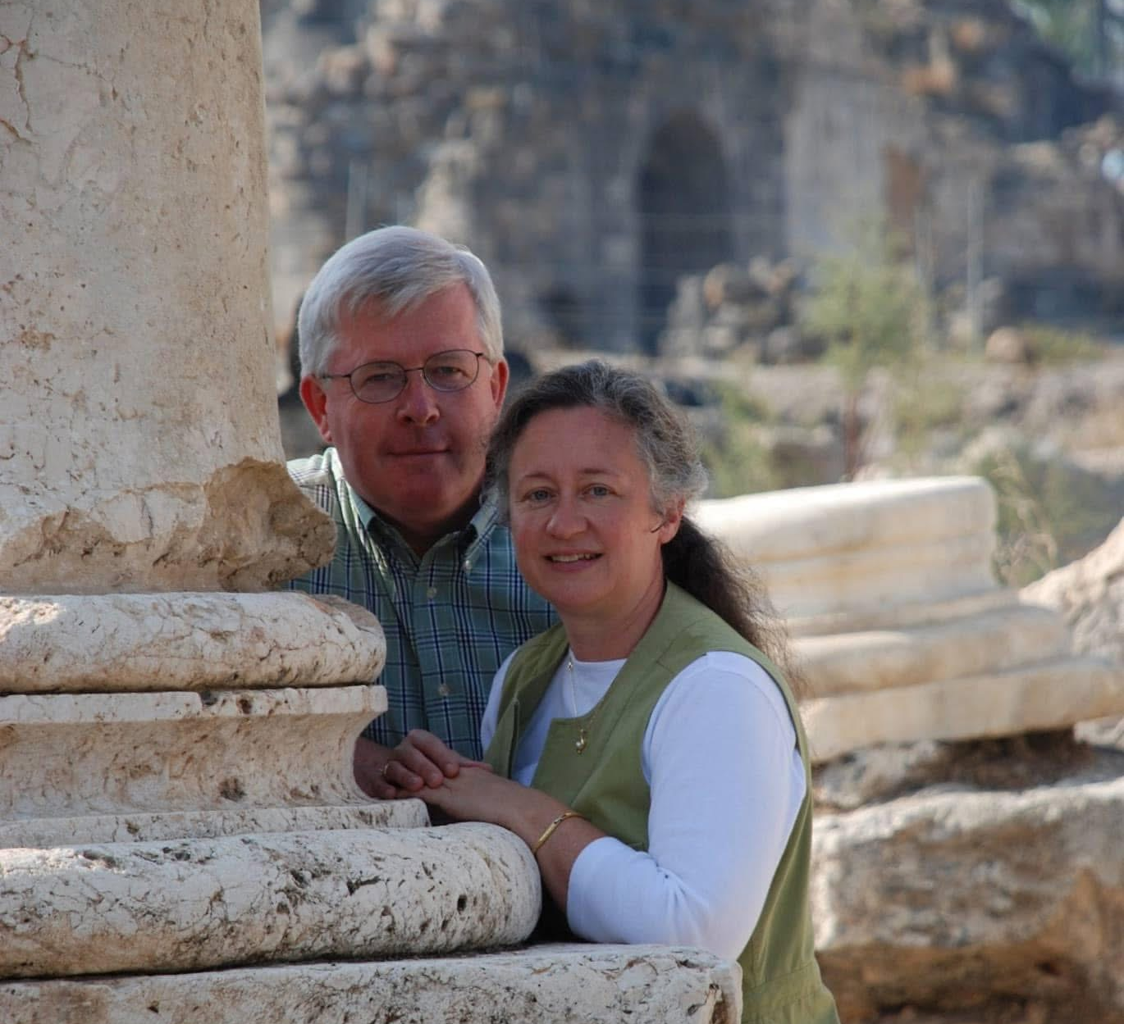
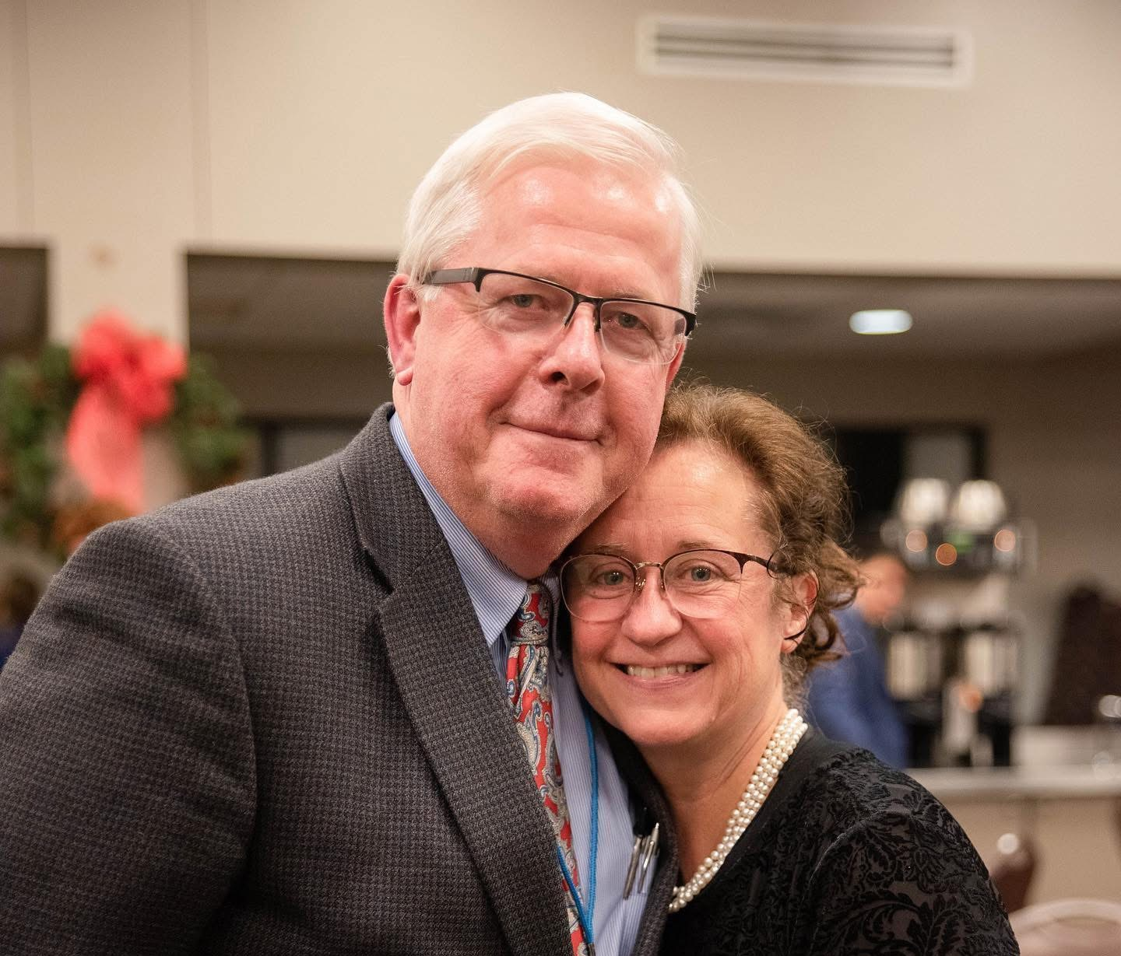
Happy 43rd Anniversary to Our Pastor & wife - Barry & Becky Coffey

Slide 3
“I think marriage is a good thing, I know marriage is a good thing” Barry Coffey

Slide 4
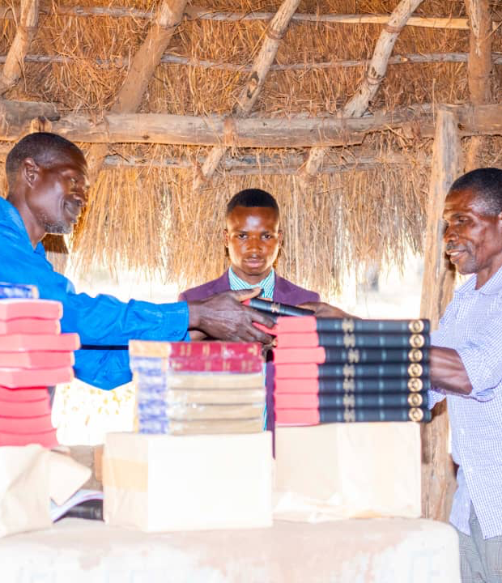
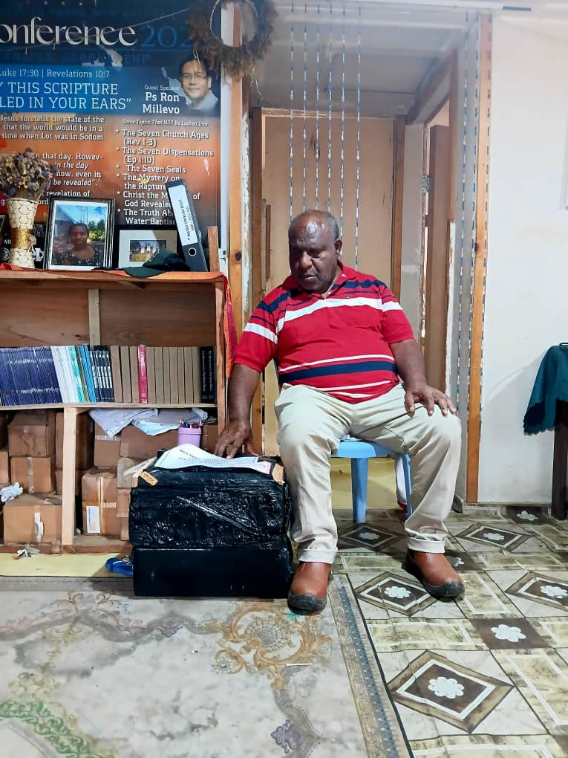
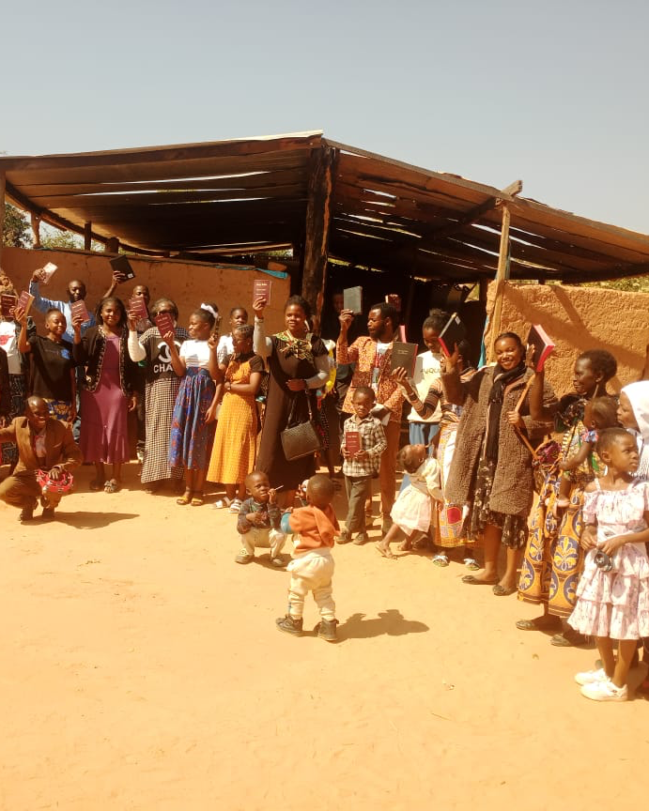
Missions
FamilyID=Office_ArchiveTorn

Slide 5
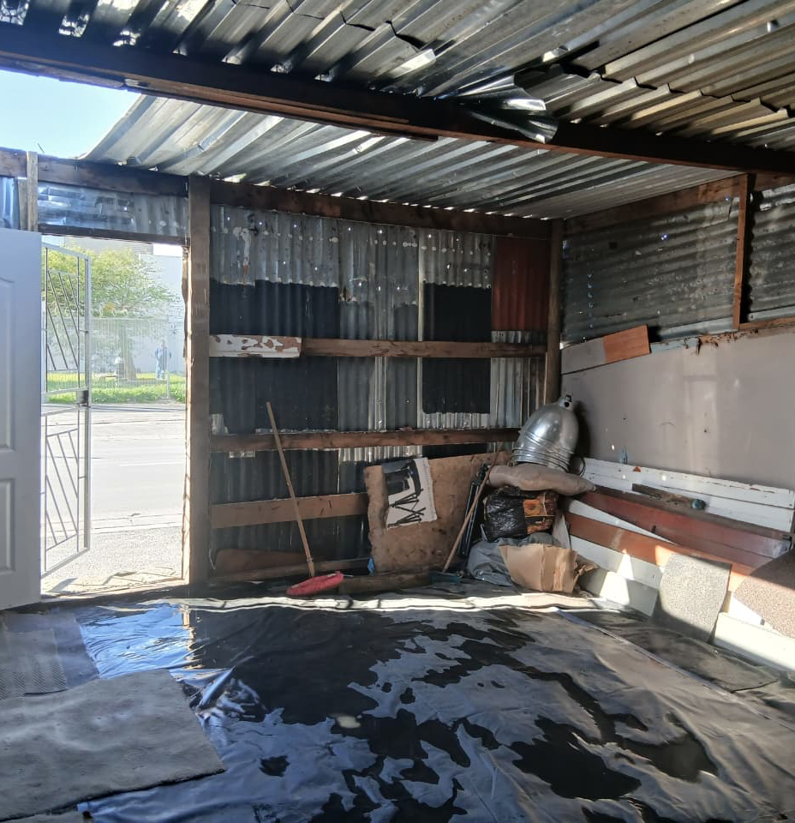
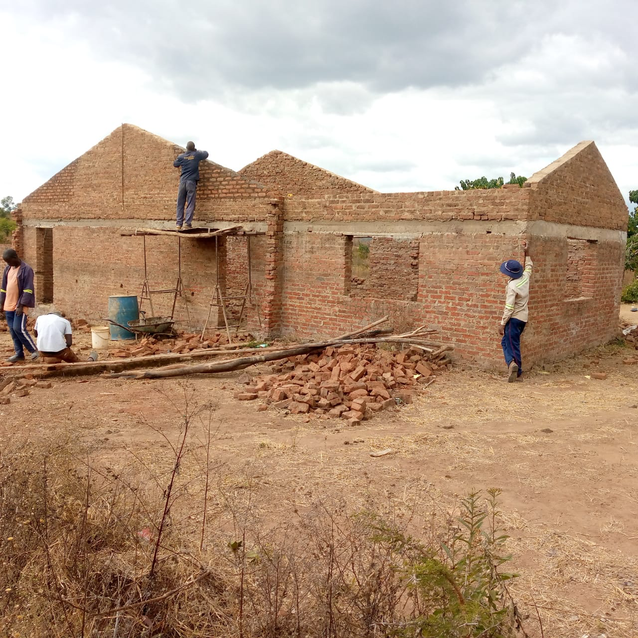
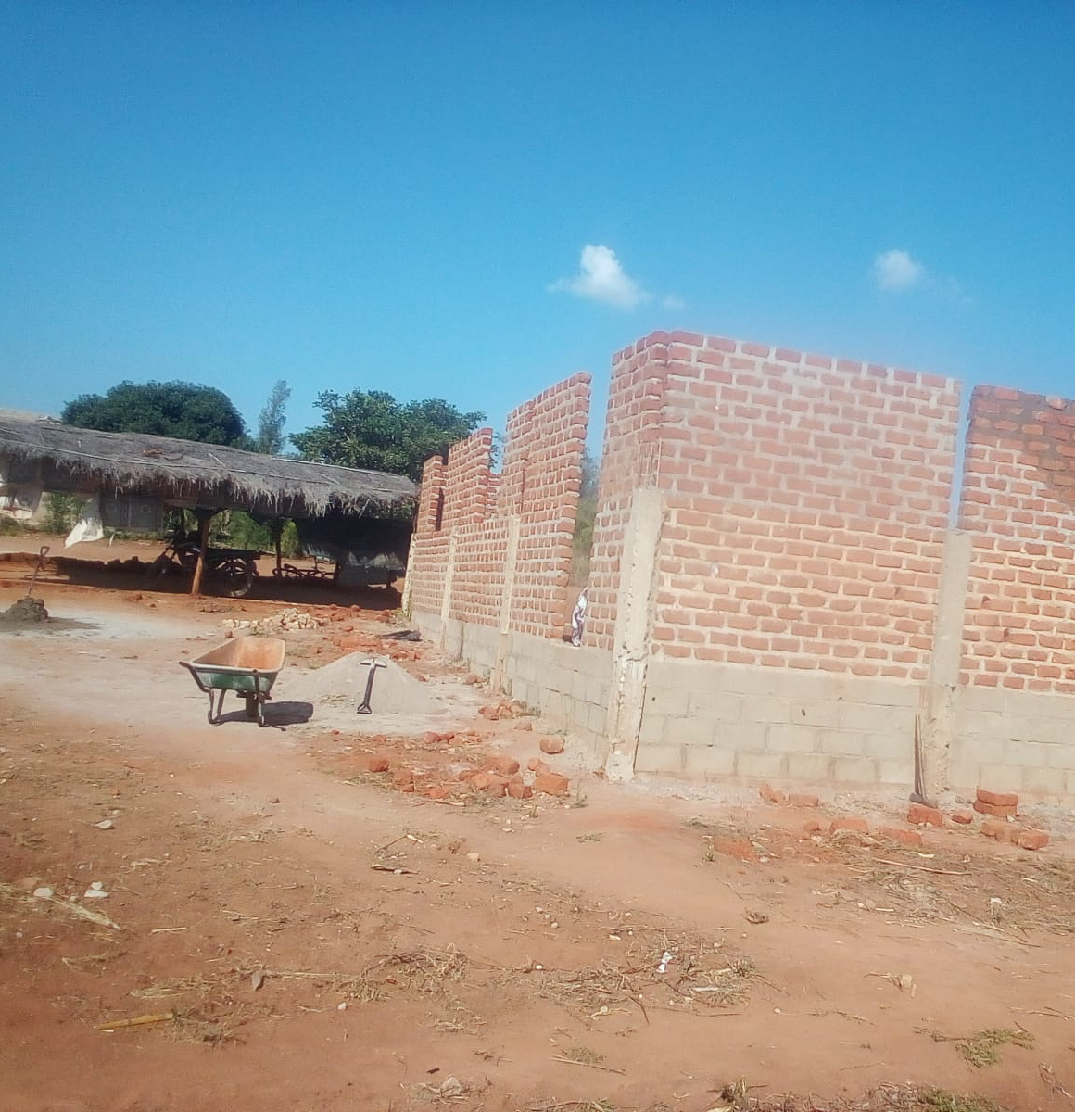
Zimbabwe, Mozambique & South Africa

Slide 6
Romans 7:19-25 KJV
For the good that I would I do not: but the evil which I would not, that I do. [20] Now if I do that I would not, it is no more I that do it, but sin that dwelleth in me. [21] I find then a law, that, when I would do good, evil is present with me. [22] For I delight in the law of God after the inward man: [23] But I see another law in my members, warring against the law of my mind, and bringing me into captivity to the law of sin which is in my members. [24] O wretched man that I am! who shall deliver me from the body of this death? [25] I thank God through Jesus Christ our Lord. So then with the mind I myself serve the law of God; but with the flesh the law of sin.

Slide 7
Romans 7:1-5 KJV
Know ye not, brethren, (for I speak to them that know the law,) how that the law hath dominion over a man as long as he liveth? [2] For the woman which hath an husband is bound by the law to her husband so long as he liveth; but if the husband be dead, she is loosed from the law of her husband…

Slide 8
Romans 7:1-5 KJV
…[3] So then if, while her husband liveth, she be married to another man, she shall be called an adulteress: but if her husband be dead, she is free from that law; so that she is no adulteress, though she be married to another man. [4] Wherefore, my brethren, ye also are become dead to the law by the body of Christ; that ye should be married to another, even to him who is raised from the dead, that we should bring forth fruit unto God. [5] For when we were in the flesh, the motions of sins, which were by the law, did work in our members to bring forth fruit unto death.

Slide 9
Toxic relationship;
A toxic relationship is one where the overall pattern of interaction consistently harms rather than supporting.

Slide 10
(8 - The Philadelphian Church Age)
I saw a man that I supposed was my father. He was a great big burly man. I also saw a woman who was supposed to be my mother, but she didn’t look like her, even as the man did not look like my father. This man was very mean to his wife. He had a large club with three corners on it…

Slide 11
(8 - The Philadelphian Church Age)
…You know when you take a log and set it up on end and hit it with an axe, it makes a three cornered wedge-like piece of fire wood. It was like that. He would take this club and hit her with it, and knock her down. As she would lie there crying, he would walk around with his chest stuck out and on his face was such a proud, boastful look that he appeared to take great pride and satisfaction in beating up a poor little woman…

Slide 12
(8 - The Philadelphian Church Age)
Every time she tried to get up he would hit her. I did not like what he was doing, but as I considered stopping him, I thought, “I can’t tackle that man — he is too big. Then he’s supposed to be my father.” But down inside I knew he wasn’t my father, and I knew that no man had the right to treat a woman like that. I went over and grabbed him by the collar and turned him around and said, “You have no right to strike her.” And when I said that my muscles grew and I looked like a giant. The man saw them and then he was scared of me. I said, “You strike her again and you’ll deal with me.” He hesitated to strike her again, and then the dream left me.

Slide 13
65-1125 - "The Invisible Union Of The Bride Of Christ"
56 The prophet, Paul, here is saying that a woman cannot remarry until her first husband is dead. She cannot remarry as long as her first husband is living; she, by no circumstances, at all. She must remain single as long as her first husband is living. And if she should do such a sin, “she shall be called an adulteress.” I’m speaking of the natural now, to type it with the spiritual.

Slide 14
65-1125 - "The Invisible Union Of The Bride Of Christ"
151 Now notice. The Bible plainly says here, that, “Her first husband must be dead,” not just put away. He’s got to be dead.

Slide 15
65-1125 - "The Invisible Union Of The Bride Of Christ"
212 Now, it was nature, associated with death. Your first husband, that had rule over you, was your nature by natural birth. Natural, you love the world because you are the world, and part of the world. That right? Your desires was, by nature, to love the world which you’re a part of. You’re a part of nature. You believe that? And that’s your natural thing….

Slide 16
65-1125 - "The Invisible Union Of The Bride Of Christ"
…213 That’s the reason you have to be born again. You have to separate; you have to die to that first husband. You can’t live with it. You just can’t say, “Well, I’ll divorce him, and hang him up here till occasion.” No, sir. No writing of divorcement! He dies. The nature of the world has to die. Every speck of him has to die. You have to be reunited, again, with another Nature.

Slide 17
Romans 6:16 KJV
Know ye not, that to whom ye yield yourselves servants to obey, his servants ye are to whom ye obey; whether of sin unto death, or of obedience unto righteousness?

Slide 18
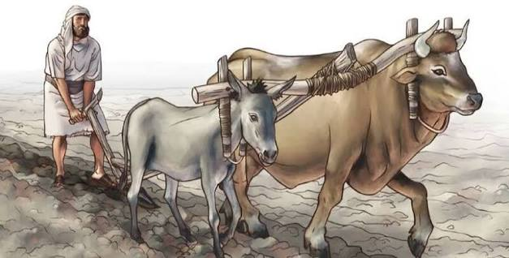

Slide 19
John 12:37-38 KJV
But though he had done so many miracles before them, yet they believed not on him: [38] That the saying of Esaias the prophet might be fulfilled, which he spake, Lord, who hath believed our report? and to whom hath the arm of the Lord been revealed?

Slide 20
65-1205 - "Things That Are To Be"
This is a pesthouse. How many knows what a pesthouse is? [Congregation says, “Amen.”—Ed.] Sure. Well, that’s what you’re living in. A pesthouse is where they put all the diseased people. Well, that’s just what sin done to us, put us in an earthly pesthouse. Were you…They wouldn’t let anyone else come in the pesthouse, because there’s all kinds of germs flying around in there, and—and the people will take these germs and—and be sick, themself. And sin brought us into the devil’s pesthouse.

Slide 21
61-1231M - "You Must Be Born Again"
but, if that offering has been received by God, it’s consumed; the world is dead to you. You’re gone, for we reckon ourselves dead and buried. We are dead and are…We are hid in Christ. Hid in Christ! And, besides that, then—then after that we’re dead and buried and hid in Christ,

Slide 22
2 Corinthians 11:2-3 KJV
For I am jealous over you with godly jealousy: for I have espoused you to one husband, that I may present you as a chaste virgin to Christ. [3] But I fear, lest by any means, as the serpent beguiled Eve through his subtilty, so your minds should be corrupted from the simplicity that is in Christ.

Slide 23
65-1125 - "The Invisible Union Of The Bride Of Christ"
But it also pertains to a greater portion of marriage and divorce, of how that he’s trying to set in order here that we, as a—as a Church, can no more be married to the world and to Christ, at the same time, and—and be legal and lawful about it, than it can be for a woman to be living with a husband while she’s got a living husband.

Slide 24
Galatians 5:1 KJV
Stand fast therefore in the liberty wherewith Christ hath made us free, and be not entangled again with the yoke of bondage.

Slide 25
Romans 7:1-6 KJV
Know ye not, brethren, (for I speak to them that know the law,) how that the law hath dominion over a man as long as he liveth? [2] For the woman which hath an husband is bound by the law to her husband so long as he liveth; but if the husband be dead, she is loosed from the law of her husband. [3] So then if, while her husband liveth, she be married to another man, she shall be called an adulteress: but if her husband be dead, she is free from that law; so that she is no adulteress, though she be married to another man…

Slide 26
Romans 7:1-6 KJV
…[4] Wherefore, my brethren, ye also are become dead to the law by the body of Christ; that ye should be married to another, even to him who is raised from the dead, that we should bring forth fruit unto God. [5] For when we were in the flesh, the motions of sins, which were by the law, did work in our members to bring forth fruit unto death. [6] But now we are delivered from the law, that being dead wherein we were held; that we should serve in newness of spirit, and not in the oldness of the letter.

Slide 27
Revelation 12:10 KJV
And I heard a loud voice saying in heaven, Now is come salvation, and strength, and the kingdom of our God, and the power of his Christ: for the accuser of our brethren is cast down, which accused them before our God day and night.

Slide 28
Matthew 4:2-3 KJV
And when he had fasted forty days and forty nights, he was afterward an hungred. [3] And when the tempter came to him, he said, If thou be the Son of God, command that these stones be made bread.

Slide 29
1 Peter 5:8 KJV
Be sober, be vigilant; because your adversary the devil, as a roaring lion (predator), walketh about, seeking whom he may devour:

Slide 30
John 8:44 KJV
Ye are of your father the devil, and the lusts of your father ye will do. He was a murderer from the beginning, and abode not in the truth, because there is no truth in him. When he speaketh a lie, he speaketh of his own (Pathological liar): for he is a liar, and the father of it.

Slide 31
1 Timothy 1:19 KJV
Holding faith, and a good conscience; which some having put away concerning faith have made shipwreck:

Slide 32
Revelation 6:8 KJV
And I looked, and behold a pale horse: and his name that sat on him was Death, and Hell followed with him. And power was given unto them over the fourth part of the earth, to kill (serial killer) with sword, and with hunger, and with death, and with the beasts of the earth.

Slide 33
John 10:1 KJV
Verily, verily, I say unto you, He that entereth not by the door into the sheepfold, but climbeth up some other way, the same is a thief and a robber (scammer).

Slide 34
Galatians 5:12-13 KJV
I would they were even cut off which trouble you. [13] For, brethren, ye have been called unto liberty; only use not liberty for an occasion to the flesh, but by love serve one another.

Slide 35
63-0728 - "Christ Is The Mystery Of God Revealed"
because you and the Word are the same. He has the preeminences. He’s got the rulership. You’re a—you’re a prisoner to Him. The world is dead. You have nothing more…You see the rest of the people living the way they do, but yet you do not do it. You’re a prisoner. You’re yoked with Him. “My yoke is easy.” Yoked with Christ, with His Word. “I do that only which the…pleases the Father. And if you can’t believe that I am He, then believe the Word.” So perfect! Notice.

Slide 36
Luke 4:16-19 KJV
And he came to Nazareth, where he had been brought up: and, as his custom was, he went into the synagogue on the sabbath day, and stood up for to read. [17] And there was delivered unto him the book of the prophet Esaias. And when he had opened the book, he found the place where it was written, [18] The Spirit of the Lord is upon me, because he hath anointed me to preach the gospel to the poor; he hath sent me to heal the brokenhearted, to preach deliverance to the captives, and recovering of sight to the blind, to set at liberty them that are bruised, [19] To preach the acceptable year of the Lord.

Slide 37
John 5:6 KJV
When Jesus saw him lie, and knew that he had been now a long time in that case, he saith unto him, Wilt thou be made whole?

