Slide 1
Weapons of Our Warfare:
A Study on the Reality, Recognition, and Defeat of Spiritual Enemies
2 Corinthians 10:3–5

Slide 2

Birthdays & Anniversaries
July 5th Jason & Mary Elizabeth Ashdown
July 6th Isaac Clayville,
Reinhard Shamoon
July 7th Haven Pritchard
July 8th Barry & Becky Coffey
Wells Pritchard
July 10 Cody Harwell,
Waqas Javed
Family Day (Aug. 15th)
2
Notes:
Birthdays, anniversaries & upcoming events.

Slide 3
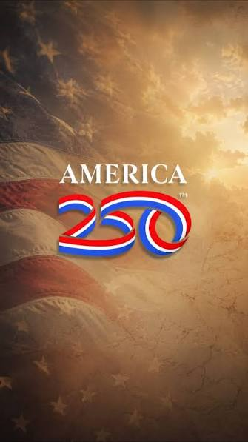
"America was not built on fear. America was built on courage, on imagination and an unbeatable determination to do the job at hand." Harry S. Truman
LIFE.STORY
36 I'm American; I love my nation; I'm willing to go to war any time it goes to war. There's Branham after Branham laying dead around France and Germany... If it would come necessary, I'd be very happy to lay myself with them, to keep freedom where we can have religion, like we've got it now. No greater nation in the world than our America. I mean that from my heart. 51-0415

Slide 4
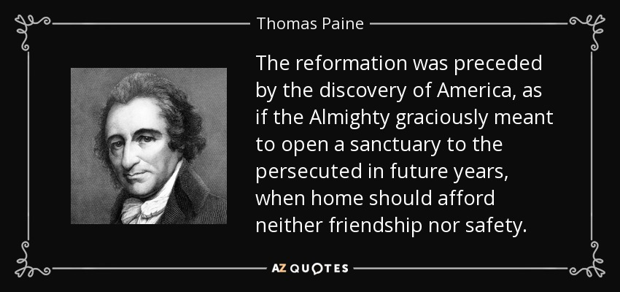

Slide 5
THE.CHOOSING.OF.A.BRIDE
36 You have a choice of church, here in America, so far, that you can go to. That's your American privilege, to choose any church that you want to belong to… if you want to change from the Methodist to Baptist, or Catholic to a Protestant, there's nobody can tell you or make you come to any certain church.
That's our freedom. That's what our democracy is. Freedom of religion, and that's a great thing. God help us to keep it as long as we can. 65-0429

Slide 6
Weapons of Our Warfare:
A Study on the Reality, Recognition, and Defeat of Spiritual Enemies
2 Corinthians 10:3–5

Slide 7

Paul does not place the battlefield on a military field, in a government building, or even in the open streets of some pagan city. He places it squarely in the mind — in the realm of imaginations, thoughts, and high things that exalt themselves against the knowledge of God. The war is waged in the invisible dimension that wraps itself around us at every moment of every day.

Slide 8
"The weapons [of the Lord] are designed to uphold you and protect you. Satan's forces are designed to destroy you and bring you down. Two armies. Two objectives. One invisible battleground.”
Bro. Ed Byskal

Slide 9
God Hiding Himself In Simplicity
106 It's just like an army going to fight. We got spies in England. England has got spies here. The spies are in and out, around the world. Why? They're searching out our military secrets... The greatest warfare is a spiritual warfare.“
63-0412

Slide 10
Treatise Concerning Religions Affections
Jonathan Edwards (Written in 1746)
"It is by the mixture of counterfeit religion with true, not discerned and distinguished, that the devil has had his greatest advantage against the cause and kingdom of Christ, all along. It is by this means, principally, that he has prevailed against all revivings of religion, that ever have been since the first founding of the Christian church.

Slide 11
By this, Satan prevailed against the reformation, began by Luther — ten times more than by all those bloody, cruel persecutions of the church of Rome... And so it was in that great outpouring of the Spirit upon the Jews, that was in the days of John the Baptist; the Jews believed for a while, that they were willing for a season to rejoice in his light. And when it finally came to pass — they went back and walked no more with him."

Slide 12
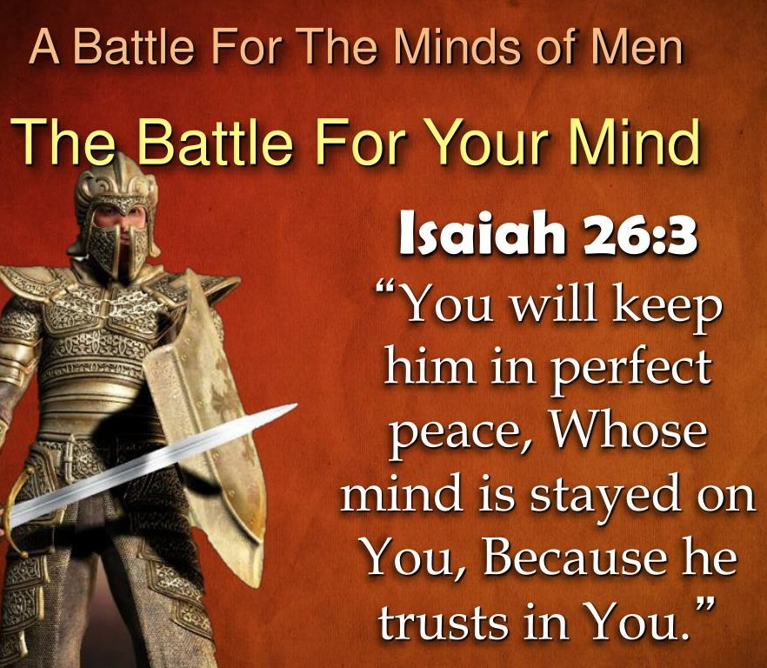
Greatest Battle Ever Fought
Kill him at the beginning; stop him dead in his tracks. It ain't how long you can make the war linger; it's stop it right now. If you'll come, you'll keep them memories, conscience, thinking about, 'Well, I might fail. It might not be right.’
Don't you do that at all. Throw aside everything, open up the channel and say, 'God, Your Word is eternally true, and It's for me.
62-0311

Slide 13
1. Warfare Always Targets the Word First
From the Garden of Eden onward, the enemy's first move has always been against the Word of God. "Yea, hath God said?" (Genesis 3:1)
When a person finds themselves suddenly filled with doubts about Scripture, when previously settled convic-tions become uncertain, when the Word grows cold and abstract — this is most often not an intellectual development. It is spiritual warfare targeting the Word, which is the foundation of all faith and the weapon of all victory.

Slide 14
2. Warfare Works Thru the 2 Spirits Running Parallel
Bro. Branham warned us about the two spirits — the spirit of Christ and the spirit of antichrist — that run parallel through every age, every revival, every congregation, and through every individual heart. They are not merely theories that exist some-where in the world, they are competing influences contending for the same territory: the human mind.

Slide 15
Hearing, Receiving, and Acting
18 Now, these differences has always been since Cain and Abel — the first human beings that produced life on earth. Adam and Eve brought forth two, one of one kind and one of another. There was Cain and Abel. There was Esau and Jacob. All along down the line, there's always been that, the two spirits warring against one and another in the churches. 60-0607

Slide 16
3. Warfare Produces Fruits That Can Be Identified
Matthew 7:16 Ye shall know them by their fruits“
Jonathan Edwards wrote:
"Christian practice [the consistent, persistent, universal practice of a holy life ] is the chief of all the signs of the sincerity of [Believers], both as an evidence of the sincerity unto others, and also to their own consciences... And the degree in which experiences have influence on a person's practice is the surest evidence of the degree of that which is spiritual and divine in his experiences."

Slide 17
The Queen of Sheba
19 Watch them by the fruit that they bear. Fortunetellers are out there on the street making money. And they're guessing, and they're taking telepathy and mental psychology. But the power of God preaches the Gospel and warns of the hell that there is before you, a heaven to go to, calls sinners to repentance, heals the sick, and does good things. Then by their fruits you shall know them. 60-0110

Slide 18
WHAT.SHALL.WE.DO.WITH.THIS.JESUS.CALLED.CHRIST
109 Luther said, "Believe, and walk out." The devil believes, too. Wesley, "Shout, and you got It," but he found out he didn't. Pentecost said, "Speak in tongues, and you got It." They didn’t…What is the evidence of It? When that spirit that's in you can punctuate every promise with an amen, and God will confirm it. That's exactly the way it was with Jesus Christ. They had more fruits of the spirit, all kinds of evidences. You can't pin any evidence down to anything but God Himself manifesting His Word. That's the only true evidence that there is that you're a Christian. 64-0126

Slide 19
4. Warfare Targets the Reasoning About One's Own State
One of the most sophisticated tools in the enemy's arsenal is false assurance.
Jonathan Edwards: “Satan's most effective counterfeit is not the production of gross sin, but the production of a false peace — a counterfeit conviction of salvation that removes all holy fear, vigilance, self-examination, and replaces it with a settled confidence that has no genuine foundation in the [word of the Age].”

Slide 20
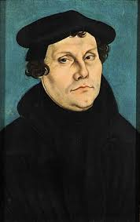
The Reformation and Its Counterfeit
Martin Luther broke the stronghold of a system that held the Western world in spiritual bondage for centuries. But immediately Satan introduced the counterfeits — Anabaptists, antinomian spirits, fanaticism of Thomas Münzer and the Zwickau prophets — men who claimed direct visions and revelations, who stirred enormous crowds with signs and wonders, and who produced exactly the kind of emotional intensity that the genuine Reformation had generated, but without its submission to the Word.

Slide 21
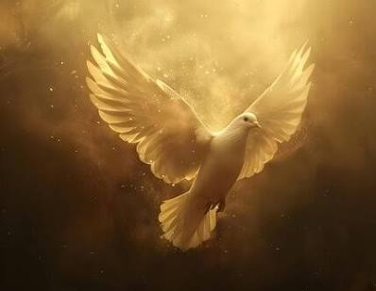
Luther recognized the pattern. He wrote of the Schwärmer — the enthusiasts — that “they swallowed the Holy Ghost feathers and all”, claiming direct divine communi-cation that superseded Scripture.

Slide 22
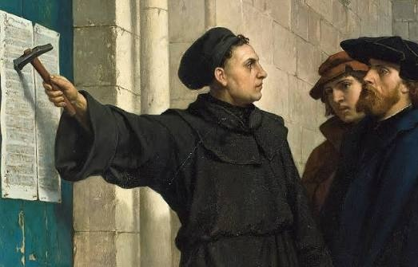
Church Age Book
329-1 It is by this means, principally, that he has against all revivings of religion... By this, Satan prevailed against the reformation, began by Luther — ten times more than by all those bloody, cruel persecutions of the church of Rome."

Slide 23
How to Win: The Weapons of Our Warfare
1. The Word of God — Absolute, Non-Negotiable
Greatest Battle Ever Fought
You throw aside everything and open up the channel and say, 'God, Your Word is eternally true, and It's for me. If the whole church fails, if the whole world fails, yet I can't fail, because I'm taking Your Word.’ 62-0311

Slide 24
2. The Weapon of Love: Conquering What Force Cannot Reach
Great and Mighty Conqueror
49 He went to the lowest city there is in the earth, Jericho, and the littlest man in the city had to look down to see Him. But when God, nineteen hundred years ago, raised Him up — that's what man done to Him. But with the weapon of love, He conquered every devil. 57-0421

Slide 25
3. Prayer as Active Spiritual Combat
The Book of Daniel provides a picture of what prayer actually accomplishes in the spiritual realm:
Daniel prayed. The answer was dispatched immediately from heaven. But for 21 days, the messenger was withstood by the prince of Persia — until Michael came to assist (Daniel 10:12–13). The warfare was real.
The delay was caused by an actual spiritual battle in the unseen realm. And Daniel's continued prayer was not just “waiting,” it was active participation in the warfare from his side of the veil.

Slide 26
4. Faith That Holds Its Ground
The highest expression of faith is not the initial moment of spiritual awakening, but the obedience: faithfulness under trial, perseverance through the furnace, the maintaining of holy practice when everything in the natural world screams to abandon it.
The soldier of Jesus Christ is not measured by his enthusiasm at enlistment. He is measured by whether he is still standing when the battle is done.
Paul's final testimony was not "I had a great conversion experience." It was: "I have fought a good fight, I have finished my course, I have kept the faith" (2 Timothy 4:7).

Slide 27
The most important thing to understand about this warfare is its outcome. The battle is not in question. The cross settled it. The empty tomb confirmed it. The resurrection of Jesus Christ sealed it.
Every demon in hell knows it. Every principality and power is operating on borrowed time!
The warfare we engage in is not to achieve victory. It is to enforce a victory that already exists. We are not fighting a war that is uncertain in its outcome, but occupyingthe conquered ground of an enemy who refuses to acknowledge his defeat.

