Slide 1
The Mind of Christ
Principles to Live By 4
I Cor. 2:12-16 & Phil 1:9-10

Slide 2
UNDERSTANDING: (Gr.) nooce
The faculties of perceiving, understanding and feeling, judging, determining; recognizing goodness and of hating evil; The power of considering and judging soberly, calmly and impartially.
And thy servant is in the midst of thy people which thou hast chosen, a great people, that cannot be numbered nor counted for multitude. 9 Give therefore thy servant an understanding heart to judge thy people, that I may discern between good and bad: for who is able to judge this thy so great a people? I KINGS 3:8

Slide 3
LUKE 12:56-59
Ye hypocrites, ye can discern the face of the sky and of the earth; but how is it that ye do not discern this time? 57 Yea, and why even of yourselves judge ye not what is right? 58 When thou goest with thine adversary to the magistrate, as thou art in the way, give diligence that thou mayest be delivered from him; lest he hale thee to the judge, and the judge deliver thee to the officer, and the officer cast thee into prison.
59 I tell thee, thou shalt not depart thence, till thou hast paid the very last mite.

Slide 4
Hearing God’s Voice
I have a decision to make…
How can I know that what is happening is God dealing with me or the enemy hindering me?
I have two choices…
“But everybody seems to think it is Ok!”

Slide 5
DISCERNING.BODY.OF.LORD
11-2 ...God can start moving, and spiritual things happening, people getting saved and filled with the Holy Spirit; many thousands who call themselves Christians will pull back from it and say, "Oh, that's holy-rollers."
You haven't got spiritual discernment, for everything the Holy Ghost does is written in the Bible. Judge all things by the Scripture. That's how we discern to see if our discernment is right.
59-0812

Slide 6
I CORINTHIANS 2:15
But he that is spiritual judgeth all things, yet he himself is judged of no man.
Judgeth: (Gr.) anakrino
To investigate, examine, inquire into, scrutinize, sift, question. In a forensic sense of a judge to hold an investigation; determine excellence or defect of a person or thing.

Slide 7
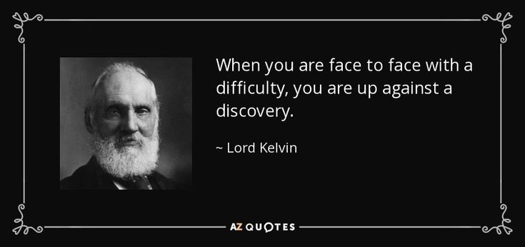

Slide 8
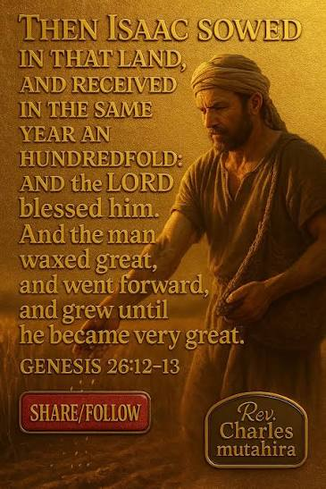
GENESIS 26:12-14
Then Isaac sowed in that land, and received in the same year an hundredfold: and the LORD blessed him. 13 And the man waxed great, and went forward, and grew until he became very great: 14 For he had possession of flocks, and possession of herds, and great store of servants: and the Philistines envied him.

Slide 9
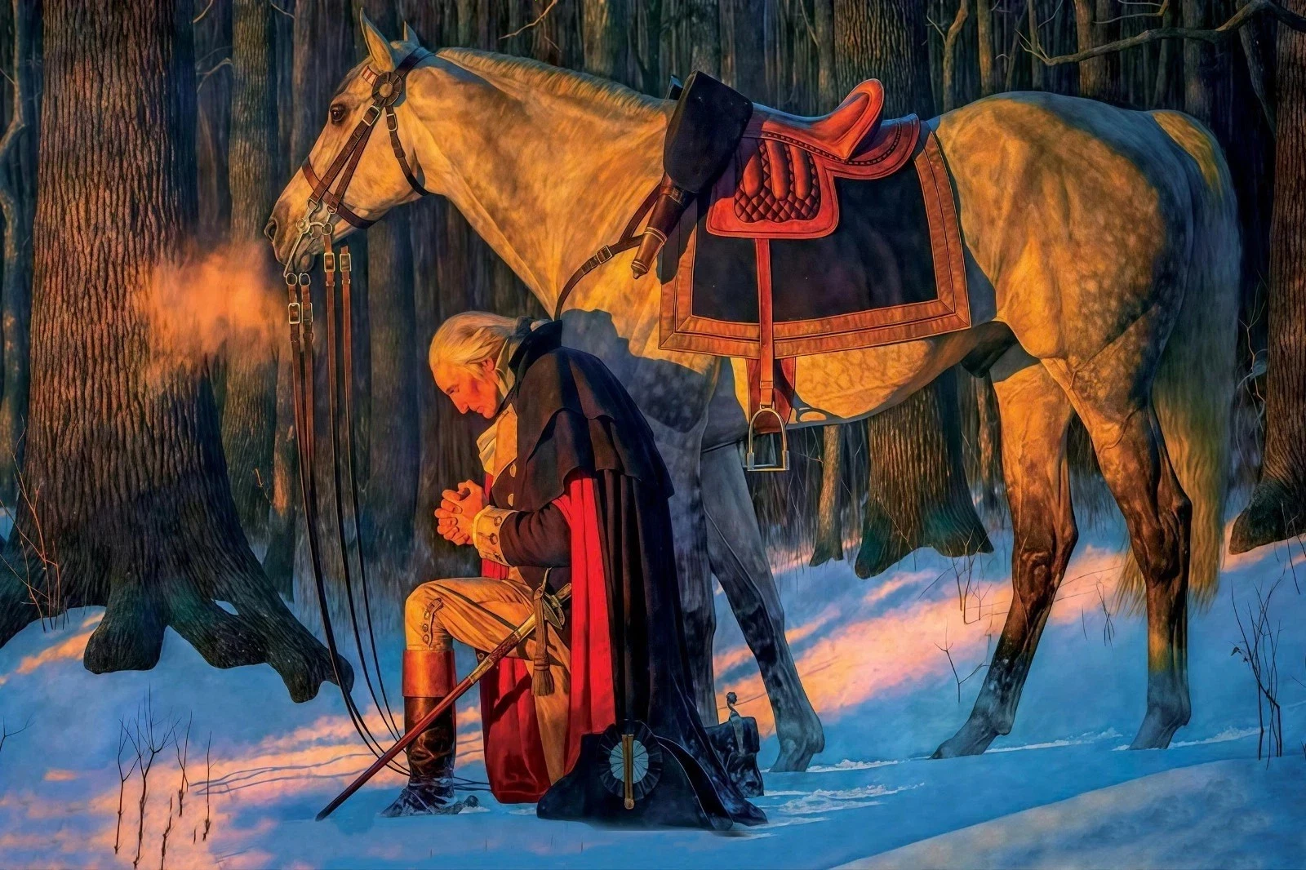

Slide 10
ABSOLUTE
98 George Washington, when America was young and we were fighting for life, the life of this great nation that we have. George Washington was a Christian. He was a believer. And down at Valley Forge… he goes out in the nighttime and kneels down in the snow, and prays… until he got the absolute, the answer from God, that God was going to give him the victory.
100 Next day, at Valley Forge, was nothing to him. He crossed the Delaware, pushed through the ice with half-dressed soldiers, half froze, their bare feet on the ground. And three rifle bullets went through his coat. [Battle of Monongahala] He was trusting in the absolute of an answered prayer. 63-0304

Slide 11
STAND.STILL
24 (Joshua) came in the month April, and …if God was figuring out anything, He sure done a poor job. He would've made a crossover in the fall of the year when Jordan was almost dry. But God brought His people to Jordan when she was raging highest. Maybe you've been brought up against the difficult right in your Christian experience, that you question God, "Why?" But God wants you to stand still just a moment. (Rom. 8:28) And when God spoke, Jordan stood still and listened to Jehovah. She walled herself up, and the water stayed. When God speaks, something takes place. 57-0518

Slide 12
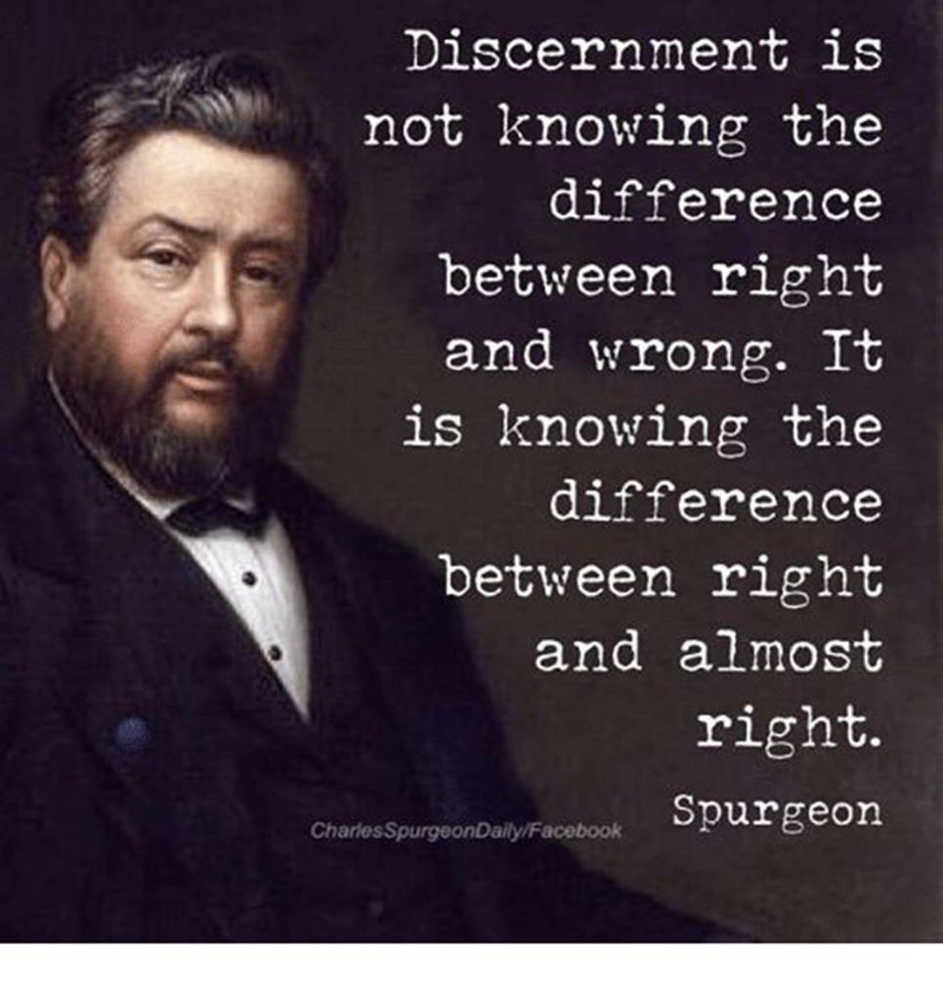
Spiritual Matt. 24:23
Then if any man shall say unto you, Lo, here is Christ, or there; believe it not. 24 For there shall arise false Christs, and false prophets, and shall shew great signs and wonders; insomuch that, if it were possible, they shall deceive the very elect.

Slide 13
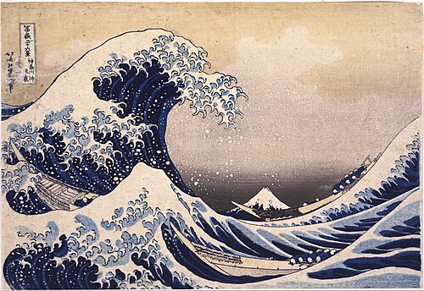
THE.QUEEN.OF.SHEBA
12 And I say this with respects: Friends and Christians, if God lets this nation get by... He just can't let him get by with this awful wave of sin that’s sweeping our nation. If God would let us go on in the way we are, without judging, then He being just would have to raise Sodom and Gomorrah, and apologize for destroying them, with such a wave of sin of the same kind.
58-0503

Slide 14
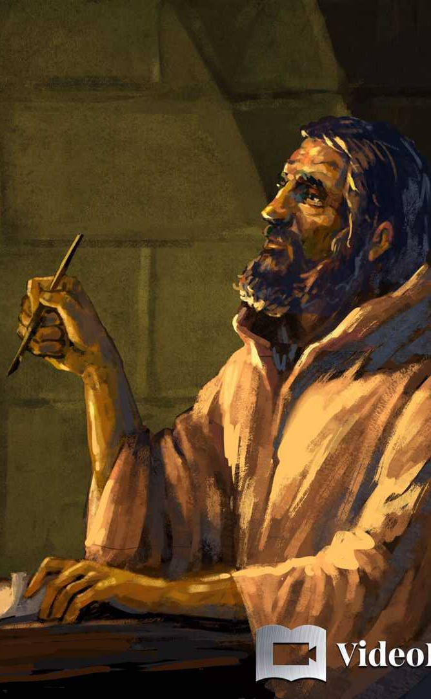
Jude 17-21
But, beloved, remember ye the words which were spoken before of the apostles of our Lord Jesus Christ; ¹⁸ How that they told you there should be mockers in the last time, who should walk after their own ungodly lusts.¹⁹ These be they who separate themselves, sensual, having not the Spirit. ²⁰ But ye, beloved, building up yourselves on your most holy faith, praying in the Holy Ghost,
²¹ Keep yourselves in the love of God, looking for the mercy of our Lord Jesus Christ unto eternal life.

Slide 15
ISAIAH 40:13
Who hath directed the Spirit of the LORD, or being his counsellor hath taught him?
14 With whom took he counsel, and who instructed him, and taught him in the path of judgment, and taught him knowledge, and shewed to him the way of understanding?

Slide 16
DEUTERONOMY 4:35-38
35 Unto thee it was shewed, that thou mightest know that the LORD he is God; there is none else beside him. 36 Out of heaven he made thee to hear his voice, that he might instruct thee: and upon earth he shewed thee his great fire; and thou heardest his words out of the midst of the fire.
37 And because he loved thy fathers, therefore he chose their seed after them, and brought thee out in his sight with his mighty power out of Egypt; 38 To drive out nations from before thee greater and mightier than thou art, to bring thee in, to give thee their land for an inheritance, as it is this day.

Slide 17
JEREMIAH 31:32
Not according to the covenant that I made with their fathers in the day that I took them by the hand to bring them out of the land of Egypt; which my covenant they brake, although I was an husband unto them, saith the LORD: 33 But this shall be the covenant that I will make with the house of Israel; After those days, saith the LORD, I will put my law in their inward parts, and write it in their hearts; and will be their God, and they shall be my people.

Slide 18
SPEAK.TO.THE.ROCK
31 Oh, if we were looking to see Jesus... Well, He's with us. What will it be when we see Him? He said, "A little while and the world will see Me know more…”
Now, if He's here tonight, His Spirit will be working with His people. "I will be with you. When the Holy Ghost is come, He will bring these things to your memory that I have taught, and will show you things to come." That's the work of the Holy Spirit.
53-0512

Slide 19
LUKE 24:45
Then opened he their understanding, that they might understand the scriptures,
ROMANS 1:28
And even as they did not like to retain God in their knowledge, God gave them over to a reprobate mind, to do those things which are not convenient;

Slide 20
THE.ANOINTED.ONES.AT.THE.END.TIME
26 Jesus said, that, "The rain falls on the just and the unjust."
28 Now, someone might say to me, "Do you believe that that anointing on those people means that it's the anointing of the Holy Spirit?" Yes, sir, the genuine Holy Spirit of God upon a person, and yet they are false.
Now listen close and see what He said. "And they shall show signs and wonders, insomuch that it would deceive the very Elected if it were possible." And they are anointed with the genuine Holy Spirit.
65-0725

Slide 21
THE.INVISIBLE.UNION
323 "Let no man, by his creed, deceive you." You stay right straight in the promise of God, the Word of God. The Word that fell on the Day of Pentecost will not work this day. That was for Pentecost. This is for the Bride, going Home of the Bride. We got something different. The Pentecostals represented that, again. We're in the Bride age. No more than the Word of Noah would work in the days of Moses; no more than Moses' law would have worked in the time of Paul here.
65-1125

Slide 22
THE.VOICE.OF.GOD.IN.THIS.LAST.DAYS
25 God has promised to meet the need of the hour. He always does that. We need the Voice of God today, to meet the need of the hour, the time we're living in.
26 And, today, one reason that the church is in the condition that it's in, is because there is so many voices, so many other voices to attract the church from the Voice of God, till it's very doubtful that many would hear the Voice of God though It spoke right in their midst… They have got themselves so much centered on the voices of the day! 63-0120

Slide 23
CONFERENCES
17 When we come together in these revivals is to bring our gifts and our ministry together, to pool it together for a revival to bring inspiration upon the peoples: to get together for an outbreak of a real revival, now, going home of the church, for we're near the end-time. That is definitely known, we're near the end.
61-0410

Slide 24
ISAIAH 58:11
And the LORD shall guide thee continually, and satisfy thy soul in drought, and make fat thy bones: and thou shalt be like a watered garden, and like a spring of water, whose waters fail not.
63-0412 GOD.HIDING.HIMSELF.IN.SIMPLICITY
111 You've got to believe His Word and act upon the same. That's the only way. That's God's program at the beginning… That's God's program now, is the Church must stay behind the Word.

Slide 26
COLOSSIANS 1:9-11
9 For this cause we also, since the day we heard it, do not cease to pray for you, and to desire that ye might be filled with the knowledge of his will in all wisdom and spiritual understanding; 10 That ye might walk worthy of the Lord unto all pleasing, being fruitful in every good work, and increasing in the knowledge of God; 11 Strengthened with all might, according to his glorious power, unto all patience and longsuffering with joyfulness;

Slide 27
PSALM 32:8-9
I will instruct thee and teach thee in the way which thou shalt go: I will guide thee with mine eye. 9 Be ye not as the horse, or as the mule, which have no understanding: whose mouth must be held in with bit and bridle, lest they come near unto thee.
PROVERBS 3:5
Trust in the LORD with all thine heart; and lean not unto thine own understanding. 6 In all thy ways acknowledge him, and he shall direct thy paths.

Slide 28
Example: JOSHUA 2:22
22 And they went, and came unto the mountain, and abode there three days, until the pursuers were returned: and the pursuers sought them throughout all the way, but found them not. 23 So the two men returned, and descended from the mountain, and passed over, and came to Joshua the son of Nun, and told him all things that befell them: 24 And they said unto Joshua, Truly the LORD hath delivered into our hands all the land; for even all the inhabitants of the country do faint because of us.

Slide 29
Basic (Fundamental) Truths
ACTS 22:13-15
Came unto me, and stood, and said unto me, Brother Saul, receive thy sight. And the same hour I looked up upon him. 14 And he said, The God of our fathers hath chosen thee, that thou shouldest know his will, and see that Just One, and shouldest hear the voice of his mouth. 15 For thou shalt be his witness unto all men of what thou hast seen and heard.

Slide 30
Basic (Fundamental) Truths
ROMANS 12:17-18
  17 Recompense to no man evil for evil. Provide things honest in the sight of all men.18 If it be possible, as much as lieth in you, live peaceably with all men.

Slide 31
Basic (Fundamental) Truths
COLOSSIANS 3:18-21
Wives, submit yourselves unto your own husbands, as it is fit in the Lord. Husbands, love your wives, and be not bitter against them. Children, obey your parents in all things: for this is well pleasing unto the Lord. Fathers, provoke not your children to anger, lest they be discouraged.

Slide 32
Basic (Fundamental) Truths
ROMANS 12:20-21
20 Therefore if thine enemy hunger, feed him; if he thirst, give him drink: for in so doing thou shalt heap coals of fire on his head. 21Be not overcome of evil, but overcome evil with good.

Slide 33
Basic (Fundamental) Truths
ROMANS 12:19
Dearly beloved, avenge not yourselves, but rather give place unto wrath: for it is written, Vengeance is mine; I will repay, saith the Lord.
EPHESIANS 4:27
Neither give place to the devil.

Slide 34
Basic (Fundamental) Truths
James 1:5-8
5 If any of you lack wisdom, let him ask of God, that giveth to all men liberally, and upbraideth not; and it shall be given him. 6 But let him ask in faith, nothing wavering. For he that wavereth is like a wave of the sea driven with the wind and tossed. 7 For let not that man think that he shall receive any thing of the Lord. 8 A double minded man is unstable in all his ways.

Slide 35
Basic (Fundamental) Truths
LUKE 16:10
He that is faithful in that which is least is faithful also in much: and he that is unjust in the least is unjust also in much.
PROVERBS 13:20
He that walketh with wise men shall be wise: but a companion of fools shall be destroyed.

Slide 36
Basic (Fundamental) Truths
ROMANS 13:9
For this, Thou shalt not commit adultery, Thou shalt not kill, Thou shalt not steal, Thou shalt not bear false witness, Thou shalt not covet; and if [there be] any other commandment, it is briefly comprehended in this saying, namely, Thou shalt love thy neighbour as thyself.

Slide 37
Example: JOSHUA 2:22-24
And they went, and came unto the mountain, and abode there three days, until the pursuers were returned: and the pursuers sought them throughout all the way, but found them not. 23 So the two men returned, and descended from the mountain, and passed over, and came to Joshua the son of Nun, and told him all things that befell them: 24 And they said unto Joshua, Truly the LORD hath delivered into our hands all the land; for even all the inhabitants of the country do faint because of us.

Slide 38
JEHOVAH.JIREH 57-0326
36 Abraham had to separate hisself from his kindred, his people. Another thing he was asked to sojourn in a strange land, with a strange people, speaking a strange language.
Well, it's just the same today, just doesn't change. Men are to separate yourself and to walk with a different people. You young men that come to Christ, you used to go down to the pool room, you stay away from that territory, and go with those boys who's goes to church and to prayer meeting.

Slide 39
WHY.IS.IT.THAT.SO.MANY.CHRISTIANS. FIND.IT. SO.HARD.TO.LIVE.THE.CHRISTIAN.LIFE
55 Intellectual will never do it. Mental conception will never do it. It's the work of the Holy Spirit that brings the human being to his place.
57-0303

Slide 40
THE.LAMB'S.BOOK.OF.LIFE
69 Anything that you have need of, no matter what it is. If it's sickness, you have need of healing; if it's a trouble, and you have need of relief; if you're wearied and bothered, need of peace, come now, won't you?
You see, it's a work of the Holy Spirit. He does this. Not emotional; solid, deep, not fanatically, it's not formal. It's love that draws, constrains us.
56-0603

Slide 41
DESPERATIONS
182 This sweetness and fellowship of the great Token of God, the Holy Ghost, may He richly abide with you all until we meet again. God's grace go with you, smite death's ways before you; making your path clear, that you might see Jesus always before your face, and you shall not be moved.
63-0901

