Slide 1
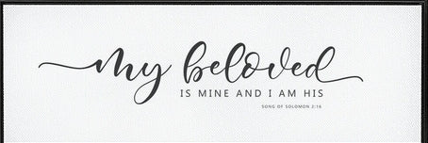
Romans 9:13
As it is written, Jacob have I loved, but Esau have I hated.
Song of Solomon 6:3
I am my beloved's, and my beloved is mine

Slide 2

BIRTHDAYS
Anniversaries & Events
JUNE
Ava Brown
28th
Rufaro Nengomazha
Heidi Ashdown
JUNE
^{30th}
July 1 Arne Cross, Henson Florian,
Sam & Nadia Brittain
July 3 Ruby Pugh, Peter Coffey
Anna Pritchard
Family Day (Aug. 15th)
6-21-2026
CREATION'S RELEASE 3 ISRAEL
2
Notes:
Birthdays, anniversaries & upcoming events.

Slide 3
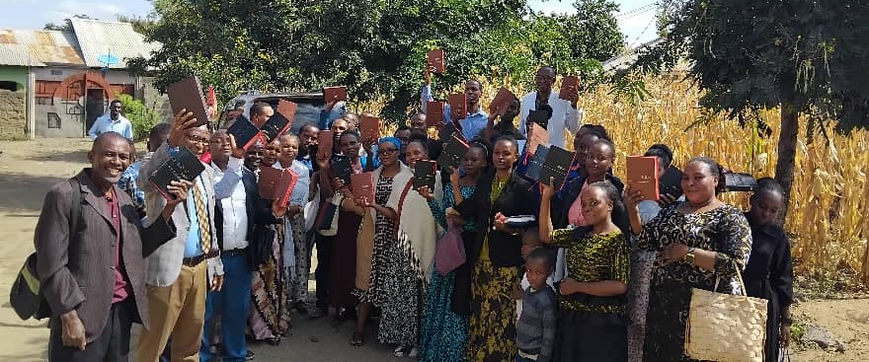
Kilimanjaro, Tanzania

Slide 4
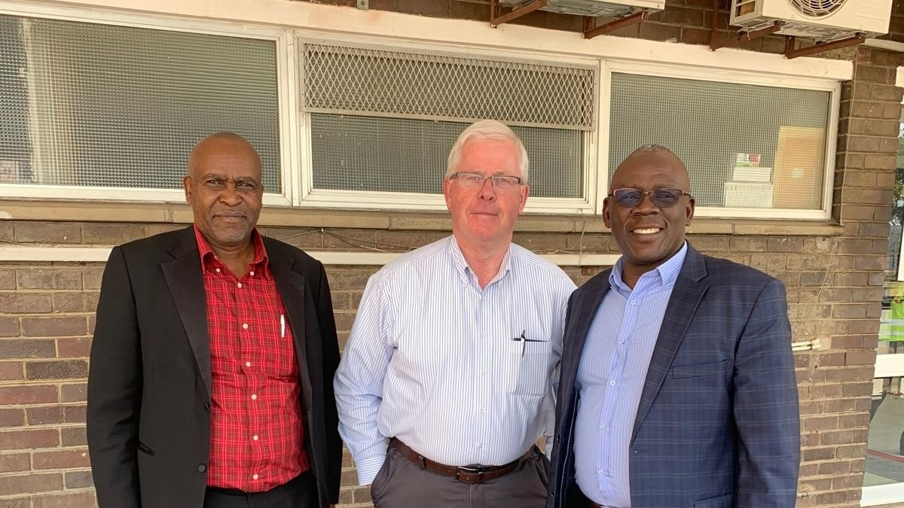
Bro. Elias, Bro. Barry and Bro. Ronny Kapisha
Lusaka, Zambia
August 2019

Slide 5
Romans 9:13
As it is written, Jacob have I loved, but Esau have I hated.
Song of Solomon 6:3
I am my beloved's, and my beloved is mine

Slide 6
ACTS 10:34-35
Then Peter opened his mouth, and said, Of a truth I perceive that God is no respecter of persons: 35 But in every nation he that feareth him, and worketh righteousness, is accepted with him.
MALACHI 1:2
I have loved you, saith the LORD. Yet ye say, Wherein hast thou loved us? Was not Esau Jacob's brother? saith the LORD: yet I loved Jacob, 3 And I hated Esau, and laid his mountains and his heritage waste for the dragons of the wilderness.

Slide 7
The Hebrew: śānē' (שָׂנֵא)
In Malachi 1:3 the Hebrew verb śānē’ in its strongest usage it does mean active, emotional enmity — the same word used in Genesis 37:4 when Joseph's brothers hated him and could not speak peaceably to him.
But śānē' is also used in a covenant sense meaning to reject, to set aside, to not choose — as opposed to “not loving.”

Slide 8
GENESIS 29:30-31
And he went in also unto Rachel, and he loved also Rachel more than Leah, and served with him yet seven other years. 31 And when the LORD saw that Leah was hated [sane: “the less loved wife”] he opened her womb: but Rachel was barren. 32 And Leah conceived…
LUKE 14:26
If any man come to me, and hate not his father, and mother, and wife, and children, and brethren, and sisters, yea, and his own life also, he cannot be my disciple.

Slide 9
ROMANS 9:13
As it is written, Jacob have I loved, but Esau have I hated [miseo=sane].
9:14-16 What shall we say then? Is there unrighteousness with God? God forbid. 15 For he saith to Moses, I will have mercy on whom I will have mercy, and I will have compassion on whom I will have compassion. 16 So then it is not of him that willeth, nor of him that runneth, but of God that sheweth mercy.
He is not describing emotional hatred; he is addressing sovereign election in a national sense. The "love" and "hate" here are covenant categories: whom God chose for His redemptive purpose, and whom He passes by.

Slide 10
GENESIS 4:3-5
And in process of time it came to pass, that Cain brought of the fruit of the ground an offering unto the LORD. 4 And Abel, he also brought of the firstlings of his flock and of the fat thereof. And the LORD had respect unto Abel and to his offering: 5 But unto Cain and to his offering he had not respect. And Cain was very wroth, and his countenance fell.
Respect: (Sha-ah) To look at with favor. (Not hate!) He simply knew where Cain got his revelation from and He could
not accept it.

Slide 11
ROMANS 9:9
For this is the word of promise, At this time will I come, and Sara shall have a son. 10 And not only this; but when Rebecca also had conceived by one, even by our father Isaac; 11 (For the children being not yet born, neither having done any good or evil, that the purpose of God according to election might stand, not of works, but of him that calleth;)
God went to Cain (Gen. 4:6–7) with a word of invitation, warning: "If thou doest well, shalt thou not be accepted?" — actually mercy extended, not judgment. God marked Cain for protection after the murder of Abel (4:15). These are not the actions of "hatred."

Slide 12
ACTS 10:34-35
Then Peter opened his mouth, and said, Of a truth I perceive that God is no respecter of persons: 35 But in every nation he that feareth him, and worketh righteousness, is accepted with him.
It forbids favoring the rich over the poor (James 2:1–4)
It forbids favoring the Jew over the Gentile in matters of salvation (Romans 2:11, Acts 10:34)
It forbids showing preference based on human outward distinctions.
In Election, God looks at no human quality at all.

Slide 13
Romans 9:7-13
Neither, because they are the seed of Abraham, are they all children: but, in Isaac shall thy seed be called. That is, They which are the children of the flesh, these are not the children of God: but the children of the promise are counted for the seed.
Galatians 3:29
And if ye be Christ's, then are ye Abraham's seed and heirs according to the promise."

Slide 14
HEARING.RECOGNIZING.ACTING…
15 God calls by election... It must be. No matter how good your father and mother was, how much Christians your father and mother was, it still lays to you as an individual, your standing before God.
This lesson teaches that, a virgin woman and a holy man [Abraham & Sarah], even through his seed came Jesus Christ… And out of a man like that, and his blood so pure that God would not even let the Philistine [Abimelech] touch the mother… holding that bloodstream pure.

Slide 15
And that Rebekah, a righteous, holy, God-called mother, from that holy seed came forth a renegade and a believer. See, so it lays within God's callings, God's election.
16 Before either one was born, God said, "I love Jacob and hate Esau," before either one was born. These two boys, if we'd notice their nature, one of them was a spiritual man; that was Jacob. And the carnal man was Esau…he never was in him to be able to climb a past the things of the world, the carnal things.

Slide 16
22 Jacob had one thing that he wanted, because according to the Word, the blessings and good things laid in the birthright. And Jacob, that was his only objective, the only thing he had in mind was get that birthright. And Esau despised it…
That's the way with the spiritual believer today. He doesn't care how much you laugh at him, how much fun you make, how ridiculous he has to act to the carnal mind, his only objective is the birthright. He wants to get to God, 'cause it's borned in him. 60-0221

Slide 17
Birthright & Covenant: CHURCH.AGE.BOOK
154 (Rom. 9:13) “And neither had done good or evil...” Jacob, alone had the seed; that is why he had respect to the birthright and covenant of God. If you are true seed, you will hear that Word; the Spirit will baptize you into the body of Christ, filling you and empowering you, and you will receive the Word for your day and age. See how clear the true evidence becomes when the Word is revealed to you?
WHY.I.AM.A.HOLY.ROLLER
45 Esau was much more of a gentleman, religiously speaking, than Jacob was. Esau taking care of his old blind daddy... But Jacob (Hallelujah) had the birthright. He believed that there's where it laid. So he got it. Jacob was accepted with God and Esau was condemned before God. 53-0830

Slide 18
1. The Covenant Sanctifies the Table (Acts 10:9–16; Rom. 14:14)
Peter at Joppa (the sheet descends from heaven with all manner of four-footed beasts, creeping things, and fowls and the voice says: "Rise, Peter; kill, and eat" (Acts 10:13). Peter's response is the instinctive response of a man under the old covenant frame:
(14-15) "Not so, Lord; for I have never eaten any thing that is common or unclean. What God hath cleansed, that call not thou common".

Slide 19
The food has not changed. The animals are the same animals forbidden in Leviticus 11. But the new covenant declared: "What God hath cleansed" — has transformed their status. The covenant of the new economy has sanctified the table.
Romans 14:14: "I know, and am persuaded by the Lord Jesus, that there is nothing unclean of itself: but to him that esteemeth any thing to be unclean, to him it is unclean.

Slide 20
2. Passover: A Meal Made Salvation (Ex. 12:1–14)
**The roasting and eating of a lamb is an ordinary domestic act. Add unleavened bread, bitter herbs, the blood on the doorposts, the specific hour, the specific posture ("your loins girded, your shoes on your feet") and the covenant has transformed a supper into the definitive act of deliverance!
The same food eaten without the covenant command at the identical hour would simply be a meal.
With it, the LORD said: "when I see the blood, I will pass over you" (Ex. 12:13). The covenant word attached to the blood is what gave the blood its power to protect.

Slide 21
QUESTIONS.AND.ANSWERS.4
181 I believe with all my heart that it's written in the Scripture that no food should be received without it be received with thanksgiving, for it's sanctified by the Word of God and prayer. If you eat it, say, "Lord Jesus, You prepared the food for me. Now, with faith I sanctify this food to the strength of our bodies." Then eat it, for in all we do is by faith. 64-0830

Slide 22
THE.HARVEST.TIME
96 A vegetarian met me, said, "Bro. Branham, I had a lot of confidence in you till I heard you say you eat bacon and eggs for breakfast. How could a godly man eat a thing like that?” I said, "Well, what's wrong with it?"
97 All things are unclean, but it's sanctified by the Word of God and prayer. "If thou be a good minister of Jesus Christ, thou shall remind the brother of these things.”
All things are sanctified, nothing to be refused, if it be received with thanksgiving." (I Tim. 4:4-5) 64-1212

Slide 23
3. The Touch Made Holy (1 Cor. 7:1–5)
1 Cor. 7:1 "It is good for a man not to touch a woman" (Gr.) haptō, which “kindling, setting alight” used in the sense of lighting a fire, a chain reaction: a touch that lights the flame of desire leading toward intimacy. Outside covenant, this is forbidden.
7:2 "Nevertheless, to avoid fornication, let every man have his own wife, and let every woman have her own husband."

Slide 24
Paul does not here condemn our bodies or the act of physical union — he rather establishes that the covenant of marriage is the only proper place for it, the covenant has transformed the act from a danger into a blessing!
The marital act, used by Satan in the fall, is none-theless rendered just, even virtuous by the marriage covenant. Outside the covenant the act is sinful; inside, it is right. The same act that is fornication outside marriage is sanctified within it.

Slide 25
4. The Blood Sacrifice Lev. 1:1-9
The killing of an animal is, in itself, merely the act of slaughter. The Gen. 9:4, Lev. 17:14) Yet under the Levitical covenant, the priest’s sacrificing, the blood caught in basins, the blood sprinkled on the altar these acts are the very essence of worship. Outside the covenant structure, this is bloodshed.
Inside it, this is atonement. Heb. 9:22 "And almost all things are by the law purged with blood; and without shedding of blood is no remission."

Slide 26
5. Circumcision: A Wound Made a Sign (Gen. 17:10–14)
The cutting of human flesh is, by ordinary standard, an act of bodily harm. Gen. 17:10, God commands it as the covenant sign. "This is my covenant, which ye shall keep, between me and you and thy seed after thee; Every man child among you shall be circumcised…"
The cutting of flesh without covenant authority is mutilation. The identical cutting of flesh under divine covenant command becomes the seal of righteousness.

Slide 27
Romans 4:11 "a seal of the righteousness of the faith" Abraham had before the rite was administered.
Circumcision (as a physical act) has nothing “holy” about it. It is the covenant Word that transforms it into a holy sign.
Baptism as well: the water is water, the immersion is immersion — it is the covenant that makes it a gospel ordinance.
This is why the same act (washing with water) can be the idol-worshipper's ritual bath or Christian baptism — the covenant word of institution is what sanctifies it.

Slide 28
6. The Lord's Supper: Common Elements/A Covenant Memorial
(1 Cor. 11:23–29)
The covenant institution transforms ordinary elements (bread, wine) into bearers of divine purpose. The elements are not the source of the power; the covenant is. Paul's account of the Lord's Supper makes the sanctifying principle explicit: "For I have received of the Lord that which also I delivered unto you, That the Lord Jesus the same night in which he was betrayed took bread: And when he had given thanks, he brake it, and said, Take, eat: this is my body, which is broken for you: this do in remembrance of me" (vv. 23–24).

Slide 29
The bread is bread. The cup is the fruit of the vine. Outside the covenant context of the Lord's Table they remain entirely common. But Paul then issues a warning that reveals just how seriously God regards the covenant frame of the ordinance: "he that eateth and drinketh unworthily, eateth and drinketh damnation to himself, not discerning the Lord's body" (v. 29). The covenant puts weight to it, so to eat it as a common meal brings judgment.
This is the sanctifying power of covenant working in both directions: it elevates the ordinary into the holy — and therefore to treat the holy as ordinary becomes a transgression of the covenant itself. Remove that word, and you have bread and wine. With that word, you have communion.

Slide 30
7. The Tithe: Common Income Made Holy (Lev. 27:30)
And all the tithe of the land, whether of the seed of the land, or of the fruit of the tree, is the LORD's: it is holy unto the LORD.
Money is money. Grain is grain. But the declaration: "it is the LORD's" — sanctifies a specific portion, setting it apart from the realm of the common and placing it in the realm of the holy.
What the farmer grew in his field is his. The tenth of it belongs to a different category entirely.

Slide 31
HEARING.RECEIVING.AND.ACTING
68 A bunch of artists, went to Rome to study art. Most all of them would go out nighttime, get drunk, boys and girls, and lay out together just as some of the modern Americans do. I went to a place, here in this state, where they was having a convention. I never was so embarrassed in all my life. There's a big fellow setting up there with a big hat on, flowered up like this, all kinds of robes on. And the boys and girls 16-17 years old, sleeping together in the hotel room.

Slide 32
The next morning, all of them coming down, bowing down and "Father So-and-so..." Oh, just think; perverting them poor children's mind into such stuff as that, when God raised them to be sons and daughters of God, to be pure and holy, sanctified by the power of God, washed in the Blood of the Lamb. 60-0607

