Slide 1
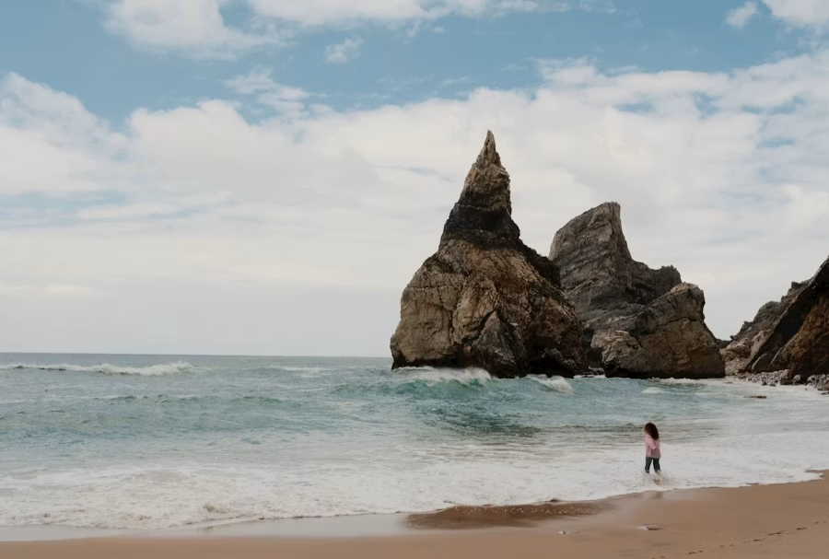
Guarding My Heart
Principles to Live By 3
Arrogance & Pride
Prov. 16:18
Pride goeth before destruction
and an haughty spirit before a fall.
Prov. 4:23
Keep thy heart with all diligence; for out of it are the issues of life.

Slide 2
QUESTIONS.AND.ANSWERS.ON.GENESIS
63 And two thirds of the earth is in sin, more than that, which two thirds of the angels was kicked out. And those demon spirits come into people and habitate their body. They once existed and they come into the people and give them a nature. Jesus cast seven of them out of Mary Magdalene: Pride, boast (big people), unclean, filthy, vulgarity, emulations, strife, all these things.
Them was spirits that was made up back there when God began to make man off of there in His Own image, created those supernatural beings, those spirits... 53-0729

Slide 3
292 “God said it [hair] was your glory; wear it with pride. Hallelujah! Wear it with pride, as you would wear a crown of thorns for your Lord. Wear it with pride. Don’t be ashamed.”
THE INDICTMENT, 63-0707

Slide 4
1. The pride God hates:
The swelling, the self-inflation, the presumption that rises from within and displaces God from the center;
The insolence of a man who acts as though God is not watching, the premeditated arrogance of one who knows the boundary and crosses it anyway.
2. The Glory: honorable bearing, the dignified carriage of one who knows whose they are. When “hadar” is present in a creature, it is because God placed it there and the creature simply refuses to be ashamed of what God said.

Slide 5
MARK 7:20
And he said, That which cometh out of the man, that defileth the man. 21 For from within, out of the heart of men, proceed evil thoughts, adulteries, fornications, murders, 22 Thefts, covetousness, wickedness, deceit, lasciviousness, an evil eye, blasphemy, pride, foolishness: 23 All these evil things come from within, and defile the man.

Slide 6
II. Where It Began
Isaiah 14:12–14 “How art thou fallen from heaven, O Lucifer, son of the morning! how art thou cut down to the ground, which didst weaken the nations! For thou hast said in thine heart, I will ascend into heaven, I will exalt my throne above the stars of God: I will sit also upon the mount of the congregation, in the sides of the north: I will ascend above the heights of the clouds; I will be like the most High.”
Ezekiel 28:17 “Thine heart was lifted up because of thy beauty, thou hast corrupted thy wisdom by reason of thy brightness.”
—

Slide 7
QUESTIONS.AND.ANSWERS.ON.GENESIS
63 …Them was spirits that was made up back there when God began to make man off of there in His Own image, created those supernatural beings, those spirits... 53-0729
Nebuchadnezzar — Open, Boasting Pride
Daniel 4:30
The king spake, and said, Is not this great Babylon, that I have built for the house of the kingdom by the might of my power, and for the honour of my majesty?

Slide 8
INFLUENCE
65 We find out that Uzziah, because of his arrogance, he was smitten with leprosy. He never did recover. He never recovered. He had to separate himself from the Presence of God, and die in a lepers' house.
66 Oh, that line, demarcation, that line where men and women can so easily cross! That line that a teen-age boy or girl can cross, between judgment and mercy. All of us! The line that the businessmen can cross! Any of us can cross it, between right and wrong. Remember, God's Word is always the thing that's right. 63-1130

Slide 9
2 Chronicles 16:7–9
Because thou hast relied on the king of Syria, and not relied on the LORD thy God, therefore is the host of the king of Syria escaped out of thine hand. Were not the Ethiopians and the Lubims a huge host, with very many chariots and horsemen? yet, because thou didst rely on the LORD, he delivered them into thine hand. For the eyes of the LORD run to and fro throughout the whole earth, to shew himself strong in the behalf of them whose heart is perfect toward him. Herein thou hast done foolishly: therefore from henceforth thou shalt have wars.

Slide 10
2 Chronicles 16:10
Then Asa was wroth with the seer, and put him in a prison house; for he was in a rage with him because of this thing.
He did not argue or weep. He imprisoned the prophet. Pride at full maturity does not debate God’s word — it silences the voice that carries it. And then: “Asa in the thirty and ninth year of his reign was diseased in his feet, until his disease was exceeding great: yet in his disease he sought not to the LORD, but to the physicians” (2 Chron. 16:12).

Slide 11
GO.TELL.MY.DISCIPLES
93 Mary Magdalene, she knew His power. She knew there was something about Him was different from anyone else. She had seven devils cast out of her. No one can ever come in His great Divine Presence, and ever be the same person any more. You're changed. There's something happens to you. Oh, you can stand off, and psychology, imagine this, accept this certain thing, and some theories. But we don't believe in theology. We believe in the power of the resurrection of Jesus Christ.

Slide 12
And when you come into His Presence, there's something that happens in your life, that changes you. And you're never the same any more, a man that's ever been in the Presence of Christ. So she had seven devils cast out of her: pride and envy, and she thought she was so pretty and there was no one like her. But when Jesus spoke and said, "Be thou clean," all that left her. She become a new person. She wasn't so pretty any more in her own sight. But she wrapped herself in the robe of meekness and gentleness, and followed the Master. She loved Him. 53-0405

Slide 13
Prov 6:16–17
These six things doth the LORD hate: yea, seven are an abomination unto him: A proud look…
Prov. 8:13
Pride, and arrogancy…do I hate.
Isaiah 2:12
For the day of the LORD of hosts shall be upon every one that is proud and lofty, and upon every one that is lifted up; and he shall be brought low.”

Slide 14
James 4:6-7
But he giveth more grace. Wherefore he saith, God resisteth the proud, but giveth grace unto the humble. 7 Submit yourselves therefore to God. Resist the devil, and he will flee from you.
1 Peter 5:5
Likewise, ye younger, submit yourselves unto the elder. Yea, all of you be subject one to another, and be clothed with humility: for God resisteth the proud, and giveth grace to the humble.

Slide 15
1. Gifting Without Gratitude: The talent is noticed. God is forgotten. Deuteronomy 8:17 names this precisely: “My power and the might of mine hand hath gotten me this wealth.” The moment a man stops tracing his ability back to its Source, the drift has begun.
2.Comparison: The proud man begins measuring himself by others rather than before God.
Luke 18:11: “God, I thank thee, that I am not as other men are.” He is praying, but he is praying to himself. The audience has shifted from God to self.

Slide 16
3. Independence: A subtle withdrawal from accountability, from counsel, from correction. Asa stopped praying and started negotiating. The shift was quiet. No announcement was made. He simply began trusting other resources.
4. Hardening: Prov. 13:10 “Only by pride cometh contention.” The proud man cannot receive reproof because reproof requires the acknowledgment of a higher authority. By this stage, that acknowledgment has become intolerable.

Slide 17
5. Open Resistance The proud man has not merely lost God’s blessing. He has positioned himself as God’s adversary. Asa imprisoned the prophet. Uzziah raged at the priests. Sennacherib mocked Jehovah by name. When a man reaches this stage, the fall is not approaching, it is already underway.
INFLUENCE 38–39 There is many people, even preaching, that oughtn’t to be there, because it’s more of a meal ticket, or to be popular, or have a little more than someone else, or somebody patting you on the back. Jesus said, ‘You devour widows’ houses, and desire the high seats, and for a showing, make long prayers.’ He said, ‘You will just receive that much more damnation for it.’” 63-0803

Slide 18
GO TELL MY DISCIPLES
93 She had seven devils cast out of her: pride and envy, and she thought she was so pretty and there was no one like her. But when Jesus spoke and said, ‘Be thou clean,’ all that left her. She become a new person. She wasn’t so pretty any more in her own sight. But she wrapped herself in the robe of meekness and gentleness, and followed the Master. She loved Him.” 53-0405

Slide 19
The Paradox of Greatness:
James 4:10
Humble yourselves in the sight of the Lord, and he shall lift you up.
1 Peter 5:6
Humble yourselves therefore under the mighty hand of God, that he may exalt you in due time.

Slide 20
THE ANGEL OF THE COVENANT
18 The way up is down. ‘He that humbles himself shall be exalted. He that exalts himself shall be abase.’ I think of how the Holy Spirit hid those mysteries in there. And all the Bible schools and seminaries will never be able to pull it out. God knows it alone and will reveal it to who He will. 54-0301
INFLUENCE 40 The way up is down. Humble yourself, you’re exalted. And if you exalt yourself, you will be brought [down]. 63-0803

Slide 21

I PETER 5:6-7
Humble yourselves therefore under the mighty hand of God, that he may exalt you in due time: 7 Casting all your care [anxiety] upon him; for he careth for you.

Slide 22
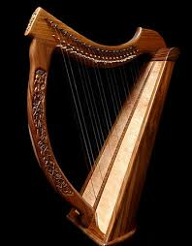
Philippians 4:8
Finally,brethren, whatsoever things are true, whatsoever things are honest whatsoever things are just, what-soever things are pure, whatsoever things are lovely, whatsoever things are of good report; if there be any virtue, and if there be any praise, think on these things.

