Slide 1

A STUDY ON THE MANIFESTATION OF THE SONS OF GOD
Creation’s Release 3
Israel. Alone.
ZECHARIAH 12:8
In that day shall the LORD defend the inhabitants of Jerusalem; and he that is feeble among them at that day shall be as David; and the house of David shall be as God, as the angel of the LORD before them.
6-21-2026
CREATION'S RELEASE 3 ISRAEL
1
Notes:
Creation's Release 3 — A Study on the Manifestation of the Sons of God. Open with Zechariah 12:8.

Slide 2

BIRTHDAYS
Anniversaries & Events
JUNE
Simona Walters
22nd
JUNE
Jedidiah Chirkoro
25th
Kiley James
Family Day (Aug. 15th)
6-21-2026
CREATION'S RELEASE 3 ISRAEL
2
Notes:
Birthdays, anniversaries & upcoming events.

Slide 3

Men’s Meeting HBT
Oct. 9-11, 2026 Carson Springs Conference Center
Jason Watkins
Matthew Watkins
Donnie Reagan
Paul LaFontaine
Tim Dodd
Jan Hansen, Norway
Brian Naidoo, South Africa

Slide 4
“
MARK.OF.THE.BEAST.AND.THE.SEAL.OF.GOD.2
48 God had to harden Pharaoh's heart to drive them out the first time. He done the same thing this time, hardened Hitler's heart against the Jews: “Ever who curses Israel, I'll curse them. Who blesses Israel, I'll bless him.” And it was scattered all over the world… He hardened them and finally opened up the way, and Israel is… already in her homeland.
If you want to see what day of the month it is, look on the calendar. If you want to see what day in the season it is of the coming of the Lord, watch where Israel's setting. That's God's timepiece … Israel, Palestine blossoming as a rose, and watch how they come back, way down in Iran and so forth.
61-0217
6-21-2026
CREATION'S RELEASE 3 ISRAEL
4
Notes:
Mark of the Beast and the Seal of God 2 — God hardened hearts; Israel is God's timepiece.

Slide 5
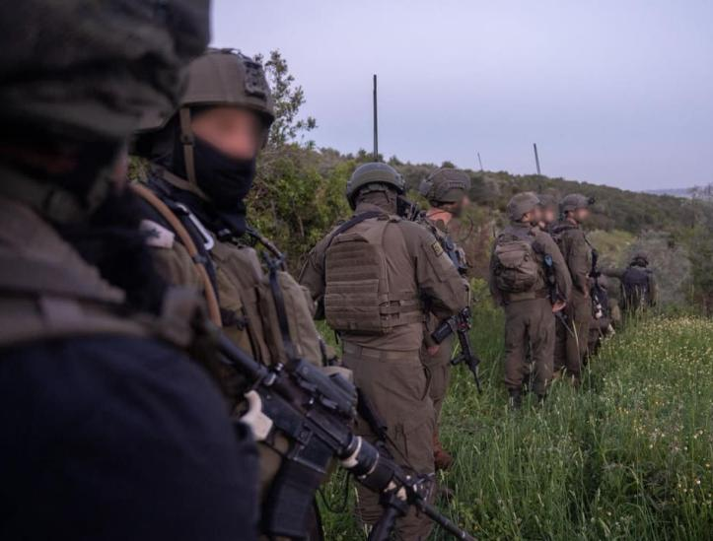
FRONT LINES
IDF Troops Corner 30 Hezbollah Terrorists In Tebnit Tunnel Headquarters
The network of tunnels is over a kilometer in total length, and IDF forces have engaged in combat both above and below ground.
6-21-2026
CREATION'S RELEASE 3 ISRAEL
6
Notes:
News: IDF troops corner 30 Hezbollah terrorists in Tebnit tunnel HQ.

Slide 6
CHURCH.AGE.BOOK
82-2 God's people have always been and always will be persecuted. There we see that Cain persecuted and killed Abel because the latter pleased God. Then we see a perfect picture in Abraham's son of the flesh, Ishmael, who teased and fought the son of promise, Isaac. And there was Esau, who hated Jacob and would have killed him, had not God intervened. In the New Testament we find Judas betraying Jesus, while the religious orders of the first century attempted to destroy the early believers. The children of this world, controlled by the devil, hate the children of God who are controlled by the Spirit.

Slide 7
ZECHARIAH 12:10
And I will pour upon the house of David, and upon the inhabitants of Jerusalem, the spirit of grace and of supplications: and they shall look upon me whom they have pierced, and they shall mourn for him, as one mourneth for his only son, and shall be in bitterness for him, as one that is in bitterness for his firstborn.
6-21-2026
CREATION'S RELEASE 3 ISRAEL
8
Notes:
Zechariah 12:10 — they shall look upon me whom they have pierced.

Slide 8
NUMBERS 23:9
For from the top of the rocks I see him, and from the hills I behold him: lo, the people shall dwell alone, and shall not be reckoned among the nations.
6-21-2026
CREATION'S RELEASE 3 ISRAEL
9
Notes:
Numbers 23:9 — the people shall dwell alone.

Slide 9
The purpose of this manifestation is for the sons of God to take back the dominion over the earth that Adam lost in the fall.
61-0117 THE MESSIAH
16 Man was made to be a god, a lesser god. He was made in the image and likeness of God. That's why the Bible says the earth is groaning, crying, waiting, for the manifestation of the sons of God. The world is waiting for the man to come back into his right estate.

Slide 10
HEAR.YE.HIM
46 God put man to control the earth. Bible said that a man is a god. He sure is. "Is it not written in your laws, that you are gods?" And if they're gods, the prophets, who the Word God came to, how can you condemn Me when I say, 'I'm the Son of God?'" They're gods, fallen gods. They get a domain, the world. They're supposed to take care of it.
The trees, animal life, everything's waiting for the manifestation of the sons of God. Oh, for the great Millennium when they'll be manifested. We're getting ready now for this time to come. The church has got to get ready. 60-0806

Slide 11
“Despite — and because of — this isolation, Israel has been building perhaps the most advanced multi-layered defense architecture in human history, a development that carries profound prophetic overtones when set beside Zechariah 12:8's promise that "he that is feeble among them at that day shall be as David.“
https://thedefensepost.com/

Slide 12
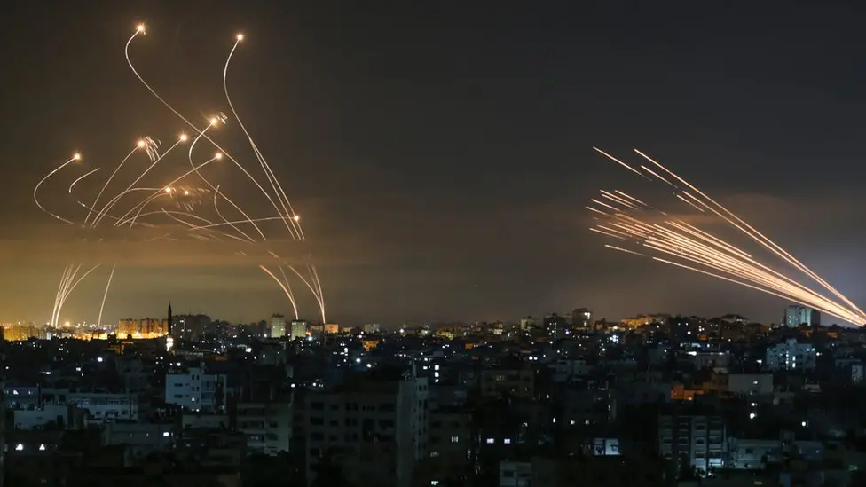
What are Israel’s Iron Dome, David’s Sling, Arrow and Thaad missile defences?

Slide 13
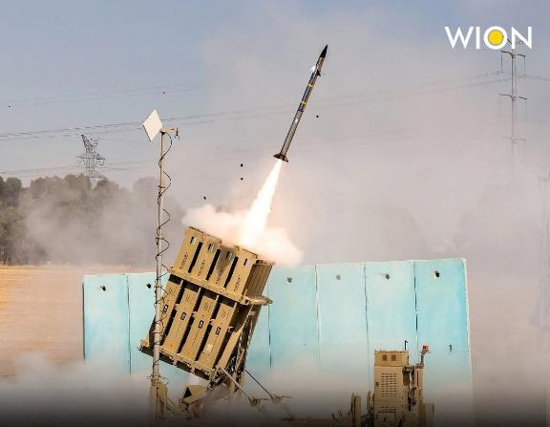
Israel's air defense relies on a four-tier shield to block Iranian attacks. The Iron Dome handles short-range rockets, David's Sling targets mid-range threats, and the Arrow 3 system destroys ballistic missiles outside the Earth's atmosphere.

Slide 14
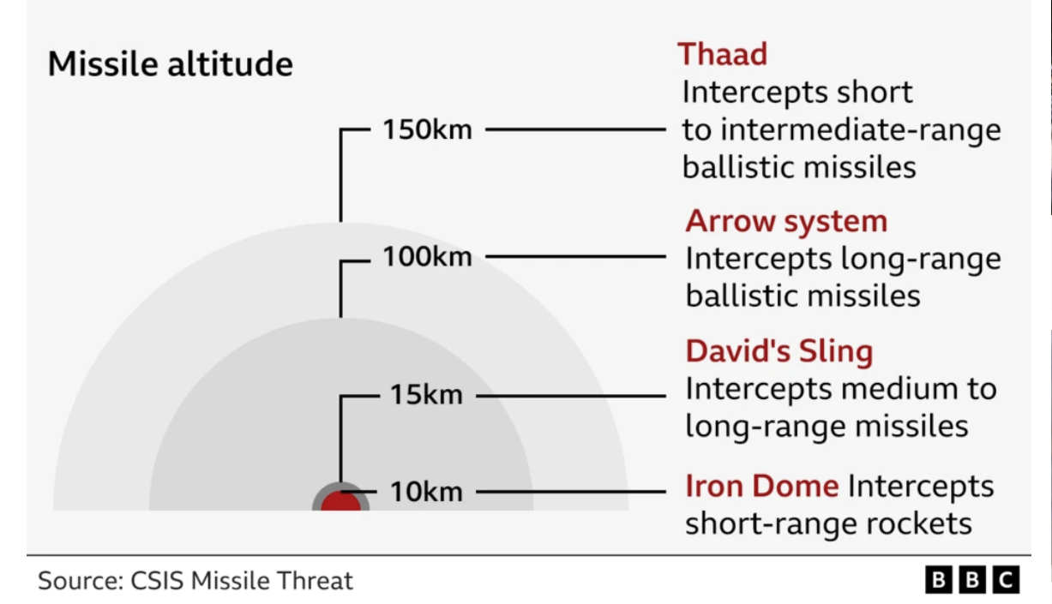

Slide 15
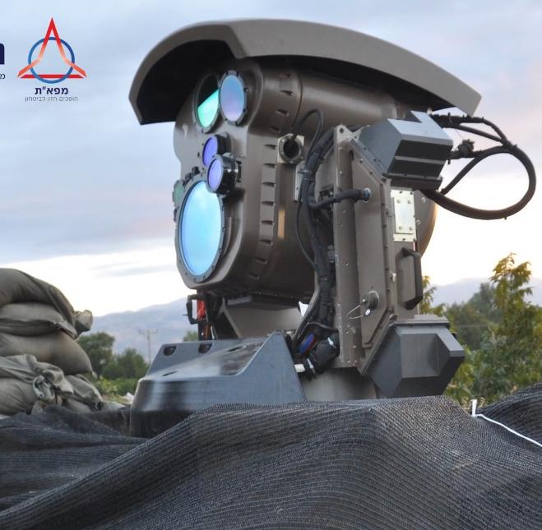
Israeli Defense Forces
“Handout Video”
https://www.youtube.com/c/IsraelDefenseForces/featured

Slide 16
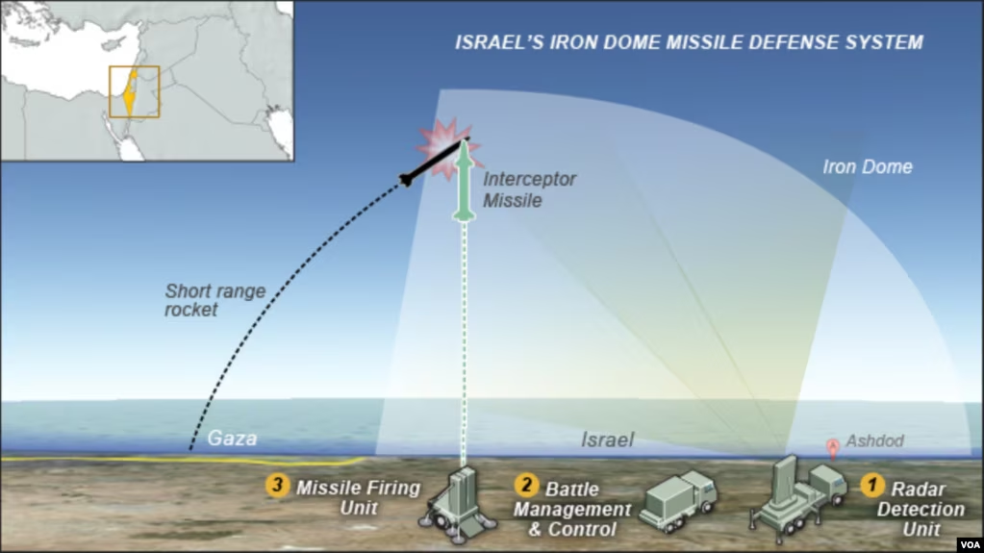

Slide 17
Israel Taking Center Stage…Alone (Joel Rosenburg)
Scripture foretells of a time when all nations will gather against Jerusalem to engage her in battle (Zech. 14:2). Although we do not know the exact order of events… we do know that they are beginning…and that we are quite likely the generation that will witness them. Since Israel became a sovereign nation in May 1948, after 2,500 years in exile among the Nations, the time of the “last days” entered in.
The re-gathering of the Jewish people back to their ancient homeland was a direct fulfillment of prophecies made thousands of years ago (Isaiah 11:12,66:8; Ezekiel 36:1,8,24; Ezekiel 37:21).

Slide 18
While no one can know the exact amount of time that these last days will continue, a study of biblical prophecy will lead one to understand that the current events we are witnessing in the Middle East (and throughout the world) are the “birth pains” that Yeshua foretold would happen (Matthew 24; Mark 13).
Israel is the key to understanding where we are in God’s timeline of the last days, which will ultimately usher in the return of the Messiah; what happens in and around Israel today foretells what is coming tomorrow.
https://hope4israel.org/israel-taking-center-stagealone/

Slide 19
Israel can count its political allies on one hand – and those “friends” are beginning to turn on her: The EU’s new “guidelines” which boycott Israeli companies; (not allowing European banks to loan money to such companies)… The rise in Israel boycotts throughout the world are astounding, especially within academic institutions, NGOs, and the UN.
While such bias against Israel is nothing new, what are particularly alarming are the threats and subsequent actions against Israel by high-ranking politicians and heads of governments. [This] will only bring further destruction and judgment upon itself, as God has promised severe punishment to those who divide His land (Joel 3).

Slide 20
The Dual Warning of Zechariah 12
To the World: In the last days, global opposition to Israel—whether through war, diplomacy, or boycott—will trigger divine judgment. Nations that “burden themselves” with Jerusalem will be cut in pieces, struck with madness and blindness, and ultimately destroyed (v. 9). This is Genesis 12:3 in apocalyptic form: “I will curse him that curseth thee.”

Slide 21
To the Church: Zechariah 12 warns that cheering the nations gathered against Jerusalem—whether through anti-Zionist activism or spiritual indifference—places believers on the wrong side of God’s war.
Paul’s admonition: “Boast not against the branches… thou standest by faith. Be not highminded, but fear” (Rom 11:18–20). To treat Israel as abandoned is to ignore the God who still calls them “the house of David” and “the inhabitants of Jerusalem” and promises to fight for them personally.

Slide 22
THE.REVELATION.OF.JESUS.CHRIST
311 (Zechariah 12) And it shall come to pass in that day, that I will seek to destroy all... nations that come against Jerusalem. (Think of it.) And I will pour out upon the house of David…
312 When is the Gospel returning to the Jews? When the day of the Gentile is finished. And this great thing is fixing to happen, will carry over to Rev. 11, pick up those two prophets, Elijah and the Moses returning back again for the Jews. Every-thing is setting in order, just ready. This Gentile Message, as the Jews brought it to the Gentiles, the Gentiles will take it right back to the Jews again. And the Rapture will come. 60-1204

Slide 23
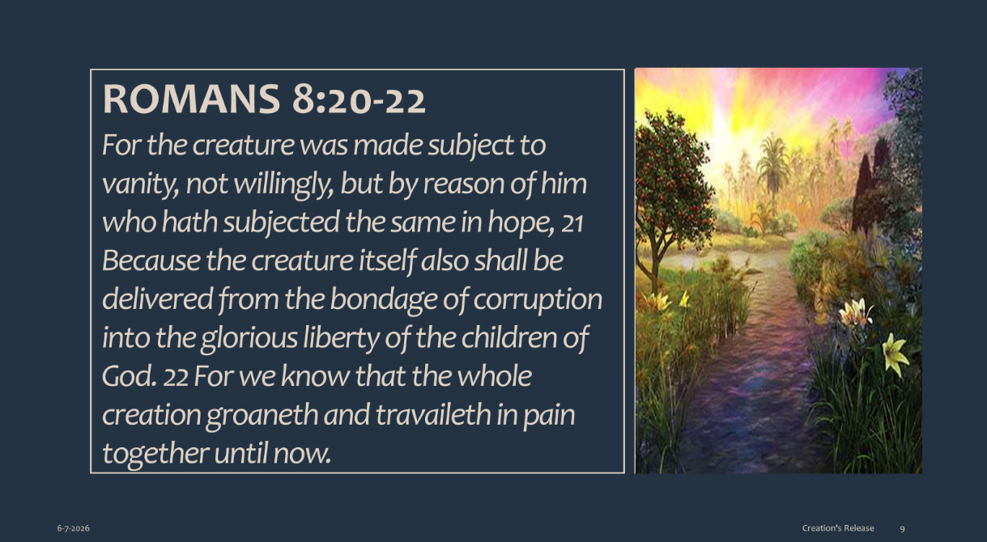

Slide 24
GALATIANS 4:4-7
But when the fulness of the time was come, God sent forth his Son, made of a woman, made under the law, 5 To redeem them that were under the law, that we might receive the adoption of sons. 6 And because ye are sons, God hath sent forth the Spirit of his Son into your hearts, crying, Abba, Father. 7 Wherefore thou art no more a servant, but a son; and if a son, then an heir of God through Christ.
When you are adopted by God, you have a
Divine origin,
with a Divine likeness and the
Object of Divine Love.

