Slide 1
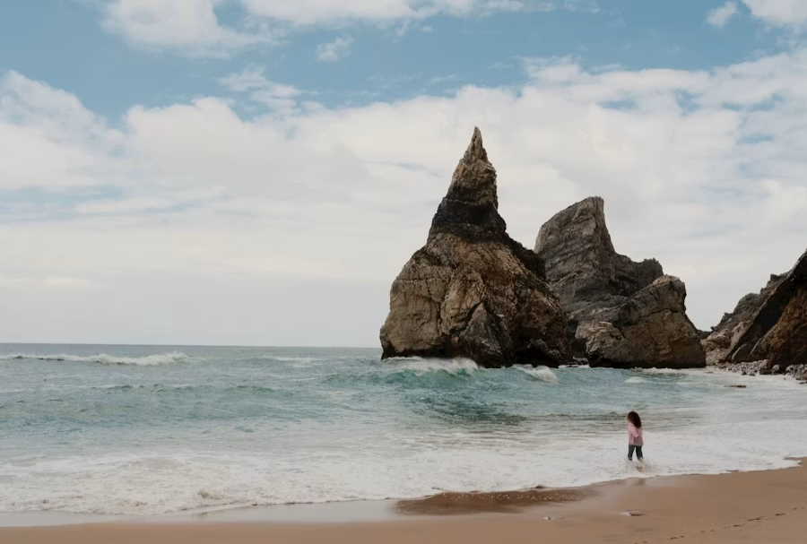
Guarding My Heart
Principles to Live By
Prov. 4:23
Keep thy heart with all diligence;
for out of it are the issues of life.

Slide 2
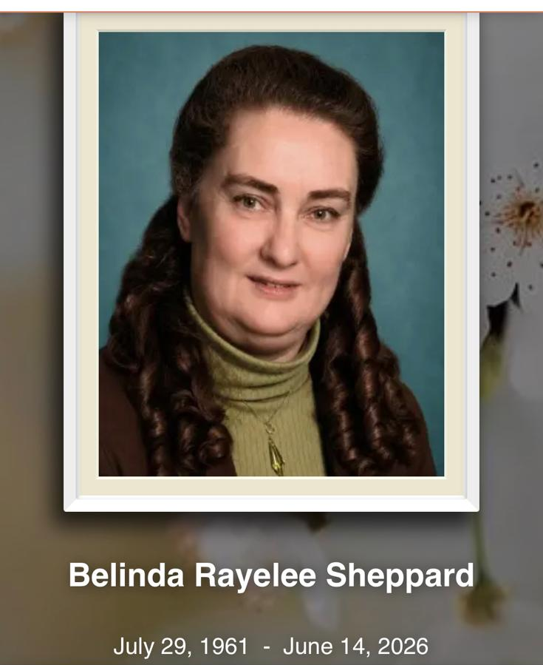

Slide 3
I.KNOW.MY.REDEEMER.LIVETH
12 No matter how little you are, how big, how important or unimportant you are, you are here to serve a purpose... And if we were put here for a purpose, there is nothing can destroy us until God's purpose is fulfilled.
Nothing can harm us until that purpose that God has put us here for has been made manifest. No matter how much trouble we have, how much heartaches or sorrows that we go through, all of these are reasons, and there's a reason for it.
58-0406

Slide 4

If you have adversity, its source would have to be an adversary:
MATTHEW 4:10
Then saith Jesus unto him, Get thee hence, Satan: for it is written, Thou shalt worship the Lord thy God, and him only shalt thou serve.

Slide 5
INFLUENCE.OF.ANOTHER 62-1013
89 …Sometimes God lets the very props be knocked from under us. Sometimes He lets sickness strike us. He lets disappointments, heartaches, strike us. Sometimes He does that to get you where you'd be influenced by the Gospel. Be wise enough to catch it. Don't be stupid enough to walk away from it.

Slide 6
HEBREWS 2:16-18
For verily he took not on him the nature of angels; but he took on him the seed of Abraham. 17 Wherefore in all things it behoved him to be made like unto his brethren, that he might be a merciful and faithful high priest in things pertaining to God, to make reconciliation for the sins of the people. 18 For in that he himself hath suffered being tempted, he is able to succour them that are tempted.

Slide 7

Adversity
Adverse fortune or fate; a condition marked by misfortune, calamity, or distress: adverse or unfortunate events or circumstances.

Slide 8

Proverbs 4:23, "guard your heart" means to protect your inner life—your thoughts, desires, choices, and values—from toxic and sinful influences.
In the OT culture, the "heart" did not just represent romantic emotions. It was viewed as the "command center" of a person, the seat of the mind, will, and conscience.

Slide 9
BELIEVEST.THOU.THIS
70 Jesus, it come to a place where He had to leave the home. And when He went out, sorrow and troubles came in. And when He goes out of your home, sorrow and troubles come in.
When He goes out of your church, confusion and backslidings is coming in. When trouble's on its road, keep Him with you all the time.
50-0716

Slide 10
What "Guarding Your Heart" Does NOT Mean:
1. It does not mean building walls against people:
It is not an excuse to become cold, cynical, or emotionally unavailable out of a fear of getting hurt.
2. It does not mean running from relationships:
God designed humans for community and vulnerability. True guarding secures the heart against sin and distraction, not against love.

Slide 11
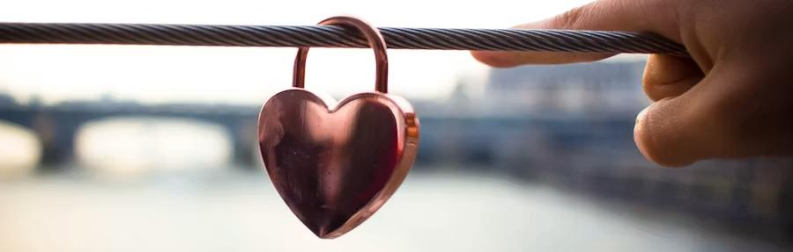
In the kingdom of God, righteousness is not measured by what we avoid doing,
but by the condition of what we are becoming.

Slide 12
FELLOWSHIP
27 Nothing against joining church, or whatever you may be, it's all right, but it'll never, never produce until the Blood's been applied. The Blood applied to the human heart will always bring a result.
56-0212

Slide 13
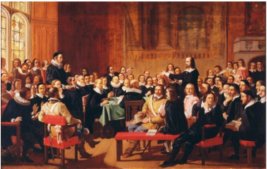
In November 1646, the General Court of the Massachusetts Bay Colony enacted two historically significant civil and legal statutes: the Stubborn Child Law and the Blasphemy Act…

Slide 14
(Prov. 30:17) …He appears to have been a very wicked and incorrigible person. Specially, he violated the Massachusetts law by carrying himself as a stubborn, rebellious son; he did not listen to the voice of his natural parents “who are persons of good repute for piety, honesty, and estate”. He had committed many crimes such as using unacceptable words to call his parents, frequently threatening to burn his father's house, killing his cattle and horse, beating his father’s servants, etc. However, his parents still accepted his behavior, loving him with an excessive indulgence which made him, unable to be improved person, become more cruel. He was finally punished to stand on the ladder of the gallows with a rope around his neck for an hour. Fortunately for the accused, he was not put to death due to his mom.

Slide 15
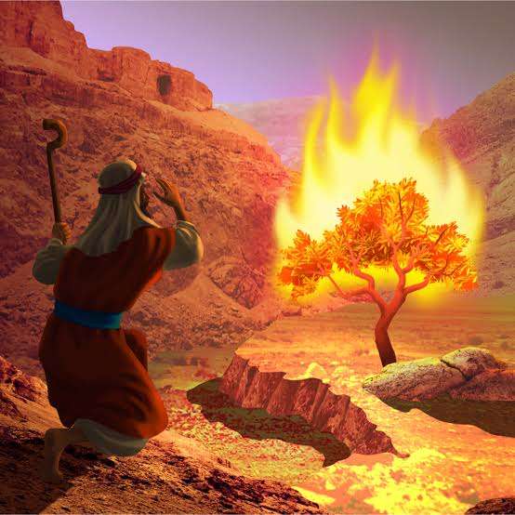
EXODUS 2:23
And it came to pass in process of time, that the king of Egypt died: and the children of Israel sighed by reason of the bondage, and they cried, and their cry came up unto God by reason of the bondage. 24 And God heard their groaning, and God remembered his covenant with Abraham, with Isaac, and with Jacob. 25 And God looked upon the children of Israel, and God had respect unto them.

Slide 16
Genesis 4:4
And Abel, he also brought of the firstlings of his flock, and of the fat thereof. And the LORD had respect unto Abel and to his offering.
Leviticus 26:9
For I will have respect unto you, and make you fruitful, and multiply you, and establish my covenant with you.

Slide 17
James 2:1–9
My brethren, have not the faith of our Lord Jesus Christ, the Lord of glory, with respect of persons...
9 if ye have respect to persons, ye commit sin, and are convinced of the law as transgressors.
1 Peter 1:17
And if ye call on the Father, who without respect of persons judgeth according to every man’s work, pass the time of your sojourning here in fear.

Slide 18
Genesis 4:4 And Abel, he also brought of the firstlings of his flock, and of the fat thereof. And the LORD had respect unto Abel and to his offering…
Abel’s offering was accepted “by faith,” not because God arbitrarily preferred Abel to Cain. The offering itself testified to the heart behind it. God’s respect in both passages is never detached from the substance of faith and obedience that it calls for.
Gen. 4:7 If thou doest well, shalt thou not be accepted? and if thou doest not well, sin lieth at the door. And unto thee shall be his desire, and thou shalt rule over him.

Slide 19
Leviticus 26:9
For I will have respect unto you, and make you fruitful, and multiply you, and establish my covenant with you.
LEVITICUS 26:3-4
If ye walk in my statutes, and keep my commandments, and do them; 4 Then I will give you rain in due season, and the land shall yield her increase, and the trees of the field shall yield their fruit.

Slide 20
James 2:1–9 & 1 Peter 1:17
My brethren, have not the faith of our Lord Jesus Christ, the Lord of glory, with respect of persons...
9 if ye have respect to persons, ye commit sin, and are convinced of the law as transgressors.
Gr. (prosopolēmpsia) literally judging or favoring someone based purely on externals: wealth, clothing, social status, appearance — with no reference at all to character, faith, or merit. That is the sin Scripture names.

Slide 21
James 2: A man with a gold ring and fine clothing is given the best seat, while a poor man in shabby clothing is told to stand or sit on the floor. James calls this partiality, and sin. The root of this principle runs back into the Law itself.
LEVITICUS 19:15-16
Ye shall do no unrighteousness in judgment: thou shalt not respect the person of the poor, nor honour the person of the mighty: but in righteousness shalt thou judge thy neighbour. 16 Thou shalt not go up and down as a talebearer among thy people: neither shalt thou stand against the blood of thy neighbour: I am the LORD.

Slide 22
"I speak to everyone in the same way, whether he is the garbage man or the president of the university."
Albert Einstein

Slide 23
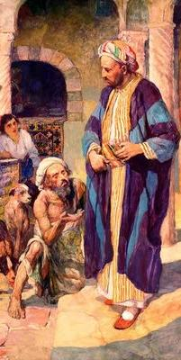
(Example) LUKE 16:19-31
There was a certain rich man, which was clothed in purple and fine linen, and fared sumptuously every day: 20 And there was a certain beggar named Lazarus, which was laid at his gate, full of sores, 21 And desiring to be fed with the crumbs which fell from the rich man's table: moreover the dogs came and licked his sores…

Slide 24
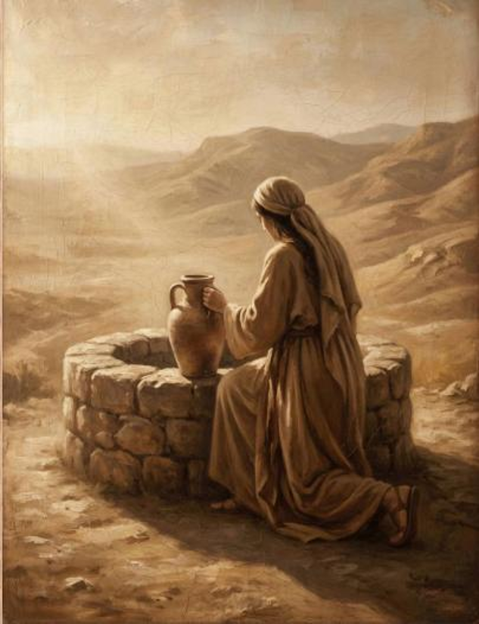
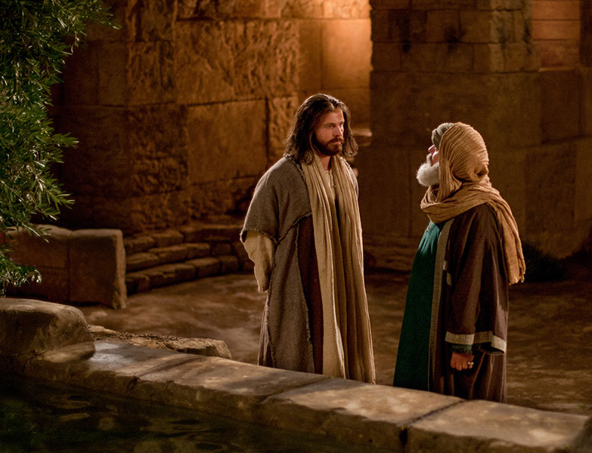
Woman at the Well
Jesus & Nicodemus

Slide 25
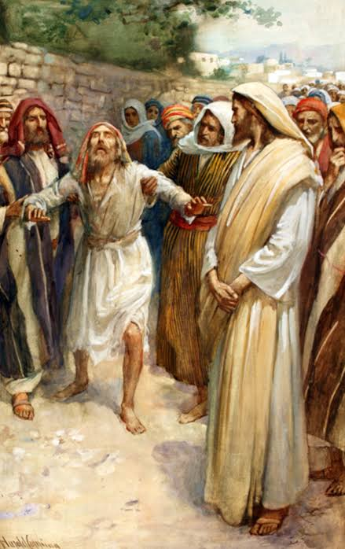
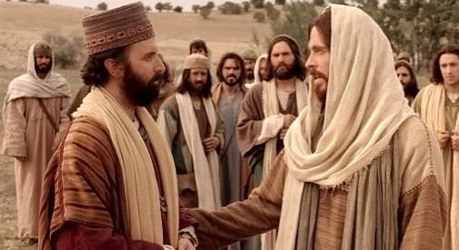
Blind Bartimaeus & the Rich Young Ruler

Slide 26
THOU.KNOWEST.ALL.THINGS
44 So then you know you have to have order, that's the reason we call prayer cards is merely to get order. Look, who's going to be first? I don't know.
Well, if you say, "Well, he chose this one here”… that's respect of persons. He knew that one was coming.“ No, sir, we give out prayer cards to whoever wants them. Then I come here, and nobody knows where it's going to be. I ask my Lord, "Where should I call that line?" Whatever comes upon my heart, I start from right there.
52-0716

Slide 27
(Example) I Corinthians 11: 17-22
But in giving you this next instruction I do not praise you, because when you meet together it does more harm than good! ¹⁸ For, in the first place, I hear that when you gather together as a congregation you divide up into cliques; and to a degree I believe it ¹⁹ (granted that there must be some divisions among you in order to show who are the ones in the right). ²⁰ Thus, when you gather together, it is not to eat a meal of the Lord; ²¹ because as you eat your meal, each one goes ahead on his own; so that one stays hungry while another is already drunk! ²² Don’t you have homes to eat and drink in? Or are you trying to show your contempt for God’s community and embarrass those who are poor? What am I supposed to say to you? Am I supposed to praise you? Well, for this I don’t praise you!

Slide 28
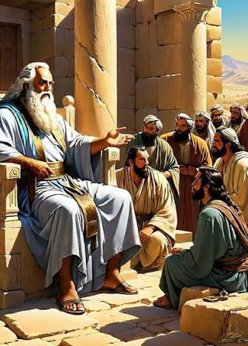
DEUTERONOMY 1:16-17
And I charged your judges at that time, saying, Hear the causes between your brethren, and judge righteously between every man and his brother, and the stranger that is with him.17 Ye shall not respect persons in judgment; but ye shall hear the small as well as the great; ye shall not be afraid of the face of man; for the judgment is God's: and the cause that is too hard for you, bring it unto me, and I will hear it.

Slide 29
63-1226 CHURCH.ORDER 83a Others will not listen to anything we say, especially the children.
84 The children are supposed to know discipline, they should get it at home. But even if it's mine, they get disorderly, I don't want you to draw one string; Sarah, Rebekah, Joseph, Billy... You tell me, I'll see to it. If they can't behave, then they'll stay away from church till they do learn to behave. This is not an arena, this is the house of God. This is not a place to play, and skate, and write notes, and laugh, and cut up, this is the house of God, and is to be carried out godly.

Slide 30
COLOSSIANS 3:20
Children, obey your parents in all things: for this is well pleasing unto the Lord.
EPHESIANS 6:1-4
Children, obey your parents in the Lord: for this is right. 2 Honour thy father and mother; (which is the first commandment with promise;) 3 That it may be well with thee, and thou mayest live long on the earth. 4 And, ye fathers, provoke not your children to wrath: but bring them up in the nurture and admonition of the Lord.

Slide 31
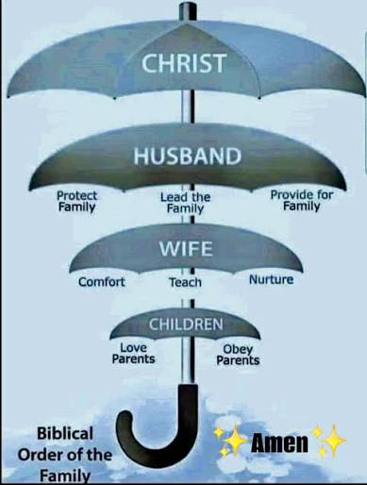
GOD'S.ONLY.PROVIDED.PLACE
237 The family of God obeys the order of the Father of the family. "And He is the Prince of Peace, the Mighty God, the everlasting Father..." And Him being Governor, King… everlasting Father, every one of His children obey every Word to the order because they're a part of Him.
238 We live in our home like Branhams live. You live in your home, the Joneses, like the Joneses live.

Slide 32
DEUTERONOMY 16:18
Judges and officers shalt thou make thee in all thy gates, which the LORD thy God giveth thee, throughout thy tribes: and they shall judge the people with just judgment. 19 Thou shalt not wrest judgment; thou shalt not respect persons, neither take a gift: for a gift doth blind the eyes of the wise, and pervert the words of the righteous. 20 That which is altogether just shalt thou follow, that thou mayest live, and inherit the land which the LORD thy God giveth thee.

Slide 33
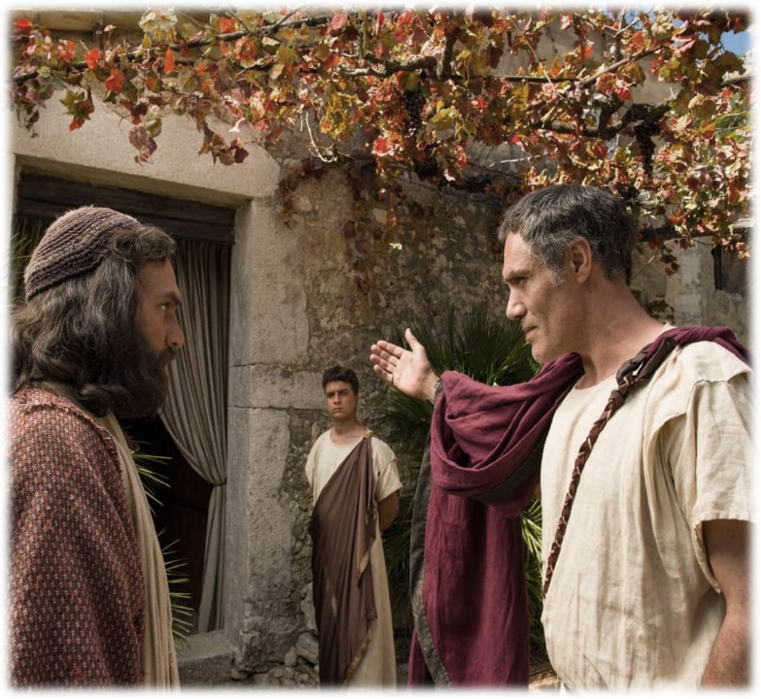
ACTS 10:34-35
Then Peter opened his mouth, and said, Of a truth I perceive that God is no respecter of persons: 35 But in every nation he that feareth him, and worketh righteousness, is accepted with him.

Slide 35
HEBREWS 12:9-11
Furthermore we have had fathers of our flesh which corrected us, and we gave them reverence: shall we not much rather be in subjection unto the Father of spirits, and live? 10 For they verily for a few days chastened us after their own pleasure; but he for our profit, that we might be partakers of his holiness. 11 Now no chastening for the present seemeth to be joyous, but grievous: nevertheless afterward it yieldeth the peaceable fruit of righteousness unto them which are exercised thereby.

Slide 36
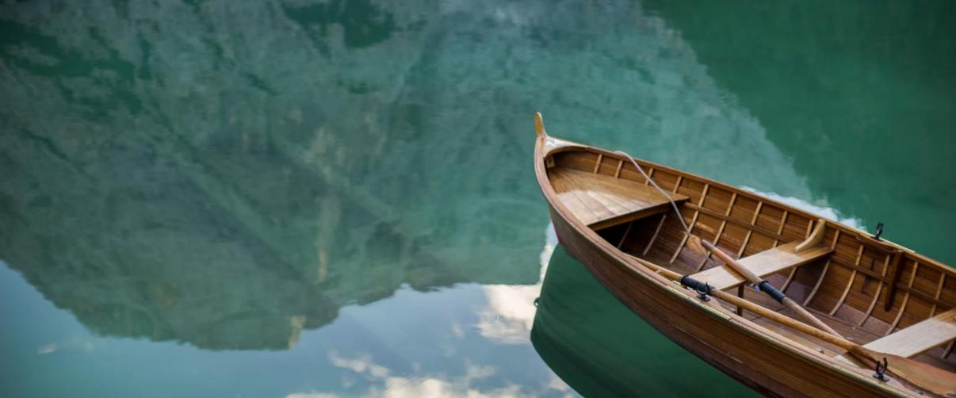

Slide 37
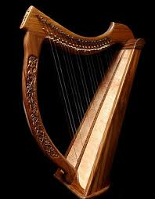
Philippians 4:8
Finally,brethren, whatsoever things are true, whatsoever things are honest whatsoever things are just, what-soever things are pure, whatsoever things are lovely, whatsoever things are of good report; if there be any virtue, and if there be any praise, think on these things.

Slide 38

I PETER 5:6-7
Humble yourselves therefore under the mighty hand of God, that he may exalt you in due time: 7 Casting all your care [anxiety] upon him; for he careth for you.

