Slide 1

Creation’s Release 2
A Study on the Manifestation of the Sons of God
Galatians 4:4-7
6 And because ye are sons, God hath sent forth the Spirit of his Son into your hearts, crying, Abba, Father.

Slide 2

Birthdays
Anniversaries & Events
June 9th Hazel & Oliver Buchanan
June 15th Nayab Reinhardt, Machaela Sheffield, Richard Smith
.
June 14th Communion Service 4:00 pm
Men’s Meeting Registration 6:00 pm
Family Day (Aug. 15th)

Slide 3
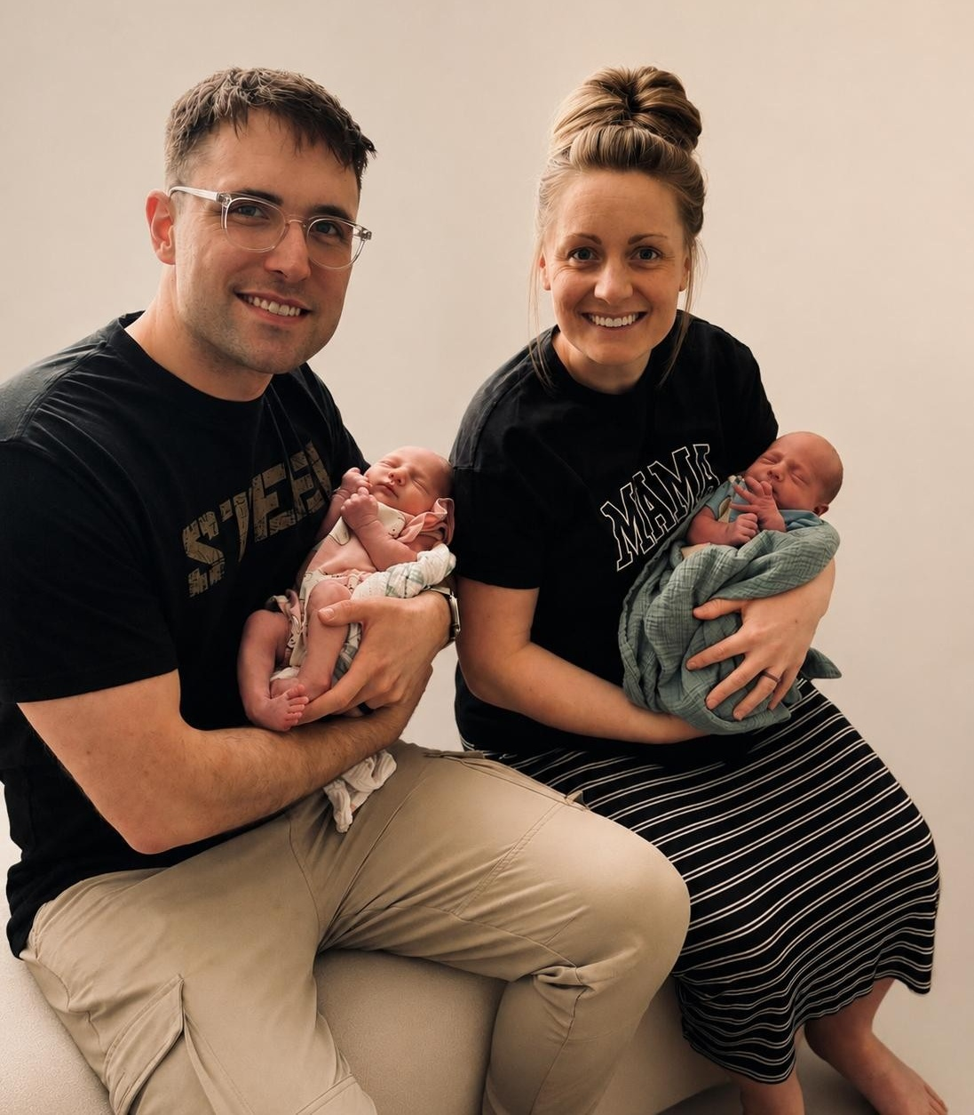
Welcome
Oliver & Hazel
Buchanan
Born 6-9-2026

Slide 4
Birthdays
Anniversaries & Events
June 9th Hazel & Oliver Buchanan
June 15th Nayab Reinhardt, Machaela Sheffield, Richard Smith
.
June 14th Communion Service 4:00 pm
Men’s Meeting Registration 6:00 pm
Family Day (Aug. 15th)

Slide 5

Men’s Meeting HBT
Oct. 9-11, 2026 Carson Springs Conference Center
Jason Watkins
Matthew Watkins
Donnie Reagan
Paul LaFontaine
Tim Dodd
Jan Hansen, Norway
Brian Naidoo, South Africa

Slide 6
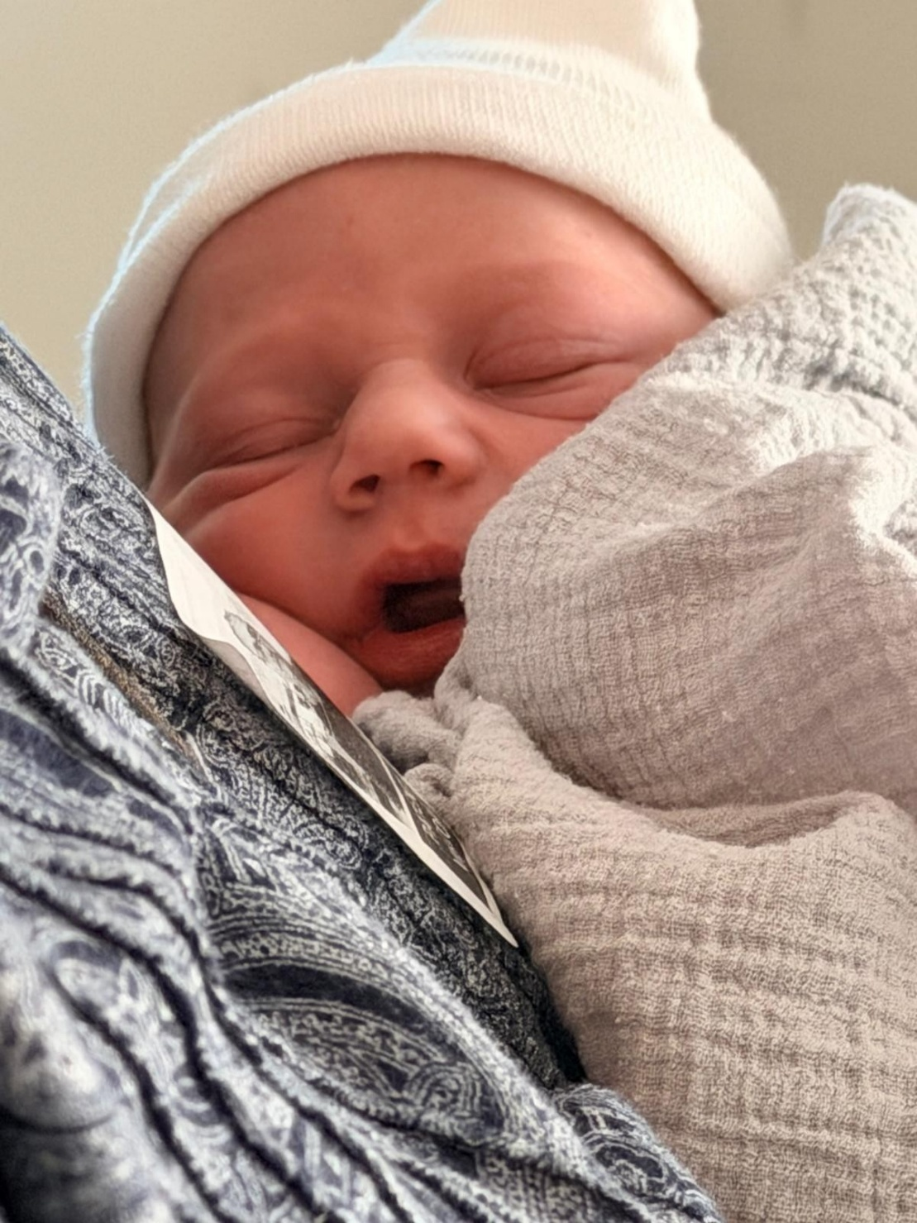
Welcome
Ellis Coffey
Born 6-13-2026

Slide 7

Creation’s Release 2
A Study on the Manifestation of the Sons of God
Galatians 4:4-7 6 And because ye are sons, God hath sent forth the Spirit of his Son into your hearts, crying, Abba, Father.

Slide 8

STATURE.OF.A.PERFECT.MAN
361 Then the Word, coming from Here, manifests Itself through each one of these beings and makes this complete Being a Tabernacle of the living God, a walking, living example of Christianity. What Christ was, these people are, because His Life is in here. They are in Christ. Their life is dead and hid in Christ, through God, sealed in there by the Holy Ghost. I Cor. 12. You reckon yourself dead, then you're born of faith. Then virtue and these other things is added to you till you're a perfect, living image of God. 62-1014

Slide 9
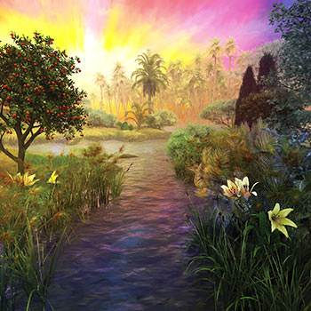
ROMANS 8:20-22
For the creature was made subject to vanity, not willingly, but by reason of him who hath subjected the same in hope, 21 Because the creature itself also shall be delivered from the bondage of corruption into the glorious liberty of the children of God. 22 For we know that the whole creation groaneth and travaileth in pain together until now.

Slide 10
ADOPTION.4
15 “…the mystery of His will." Now, it is not just a little thing; God's will is a mystery. And each man has to seek out the will of God for his or herself.
God, since the beginning of the world, predestinated us to the adoption of sons. Now, the whole creation groaning, waiting for the manifestation of the sons of God.
60-0522

Slide 11
QUESTIONS.AND.ANSWERS
177 Where is that one that's going to sow that seed for that end-time church? …that promised Elijah? And immediately after his days shall the great tribulation set in…And the heathens that's never heard the Gospel shall be raised in that time, and the sons of God will be manifested. "And they ruled and reigned with Christ," and Christ ruled with a rod of iron the nations. Then the manifested sons of God with the authority just like He had when He was here, there will come the Millennium in that reign, upon the ashes.

Slide 12
179 So I've watched for something. Has it slipped by us in humility and we've missed it? If that be so, then it's later than you think. If not, then there's coming one with a message that's straight on the Bible, and quick work will circle the earth. The seeds will go in newspapers, reading material, until every predestinated seed of God has heard it. None of them will come unless the Father's drawed them, and everyone the Father has drawed will hear it and come. That'll be the predestinated Seed will hear the Word. 62-0527

Slide 13
I KINGS 18:21
And Elijah came unto all the people, and said, How long halt [limp] ye between two opinions? if the LORD be God, follow him: but if Baal, then follow him. And the people answered him not a word.

Slide 14
52-0726 EXPERIENCES
15 The night down in Houston… Bro. Bosworth, one of the old soldiers here from Zion; he called me today. He's fixing to go back to Africa, about seventy-five years old. He said, "Oh, Bro. Branham, Americans are lovely, but them people wouldn't want God. Why preach it over and over and over, and they're all mixed up anyhow, and don't know what to believe, when them people down there hasn't heard It one time? Go take It to them." And that's my heart too, friends.

Slide 15
ADOPTION 3
87 God trying to place his church in position, to manifest Hisself, getting one that He can work through like this, say, "There's my Spirit flowing freely. There it is. I can work here." Get another one over here and place him: "I can place him." Adoption, placing, manifesting. 60-0522
Ephesians 1:5 Having predestinated us unto the adoption of children by Jesus Christ to himself, according to the good pleasure of his will…

Slide 16
Adoption: (w)
To bring (a person) into a new kind of relationship.
It means giving to one the name and privileges of a son. Naturally, Pharaoh's daughter adopted Moses (Ex. 2:10).
An act of God's grace by which he brings men into proper position in His redeemed family and makes them partakers of all the blessings He has provided for them. Adoption teaches the new relationship into which the Believer is introduced by justification, and the privileges connected therewith.

Slide 17
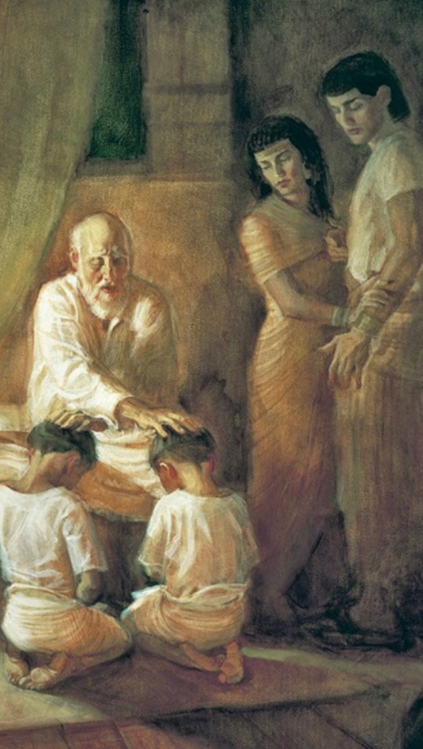
GENESIS 48:3-6
And Jacob said unto Joseph, God Almighty appeared unto me at Luz in the land of Canaan, and blessed me, 4 And said unto me, Behold, I will make thee fruitful, and multiply thee, and I will make of thee a multitude of people; and will give this land to thy seed after thee for an everlasting possession. 5 And now thy two sons, Ephraim and Manasseh, which were born unto thee in the land of Egypt before I came unto thee into Egypt, are mine; as Reuben and Simeon, they shall be mine. 6 And thy issue, which thou begettest after them, shall be thine, and shall be called after the name of their brethren in their inheritance.

Slide 18
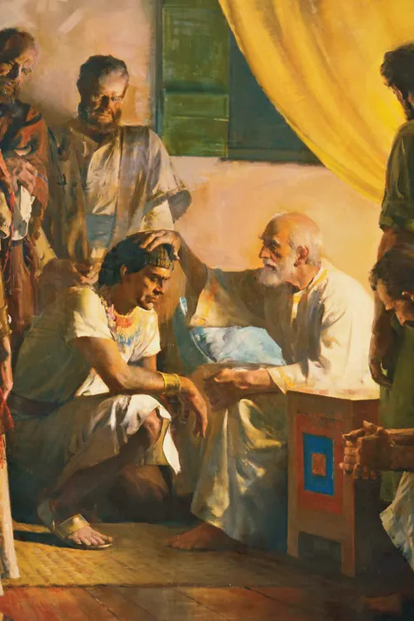
GENESIS 50:22-24
And Joseph dwelt in Egypt, he, and his father's house: and Joseph lived an hundred and ten years. 23 And Joseph saw Ephraim's children of the third generation: the children also of Machir the son of Manasseh were brought up upon Joseph's knees. 24 And Joseph said unto his brethren, I die: and God will surely visit you, and bring you out of this land unto the land which he sware to Abraham, to Isaac, and to Jacob.

Slide 19
Understanding Code of Hammurabi with AI
The Code of Hammurabi is a stone monument covered in 282 laws that were issued by Babylonian King Hammurabi around 1754 BCE. The text is one of the best-preserved legal documents from ancient times. These laws addressed daily life, covering areas such as trade, property disputes, family issues, and crime.

Slide 20
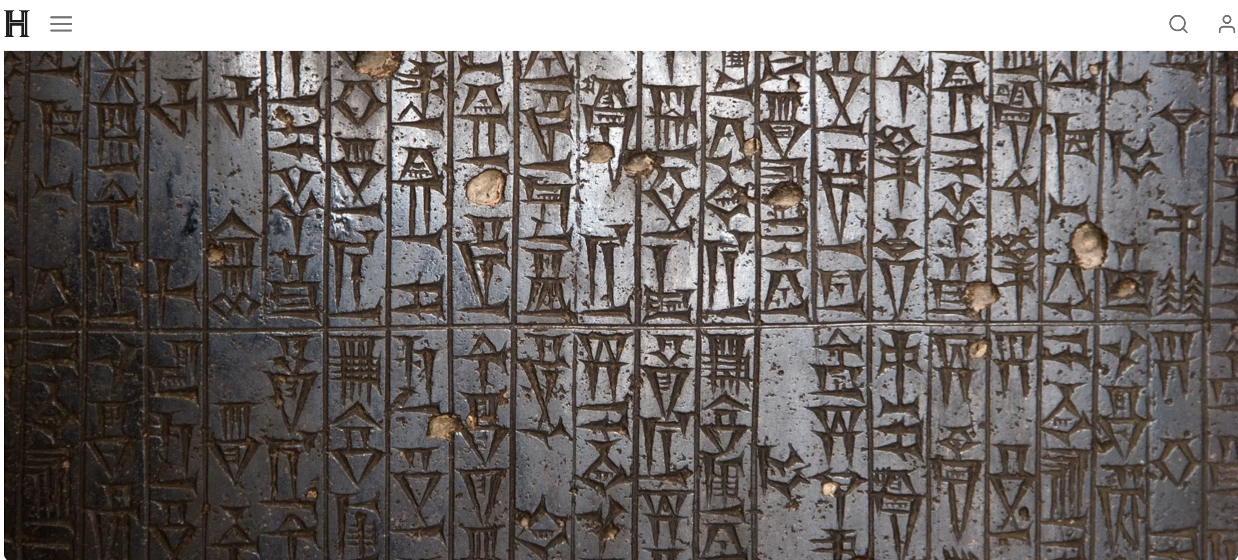
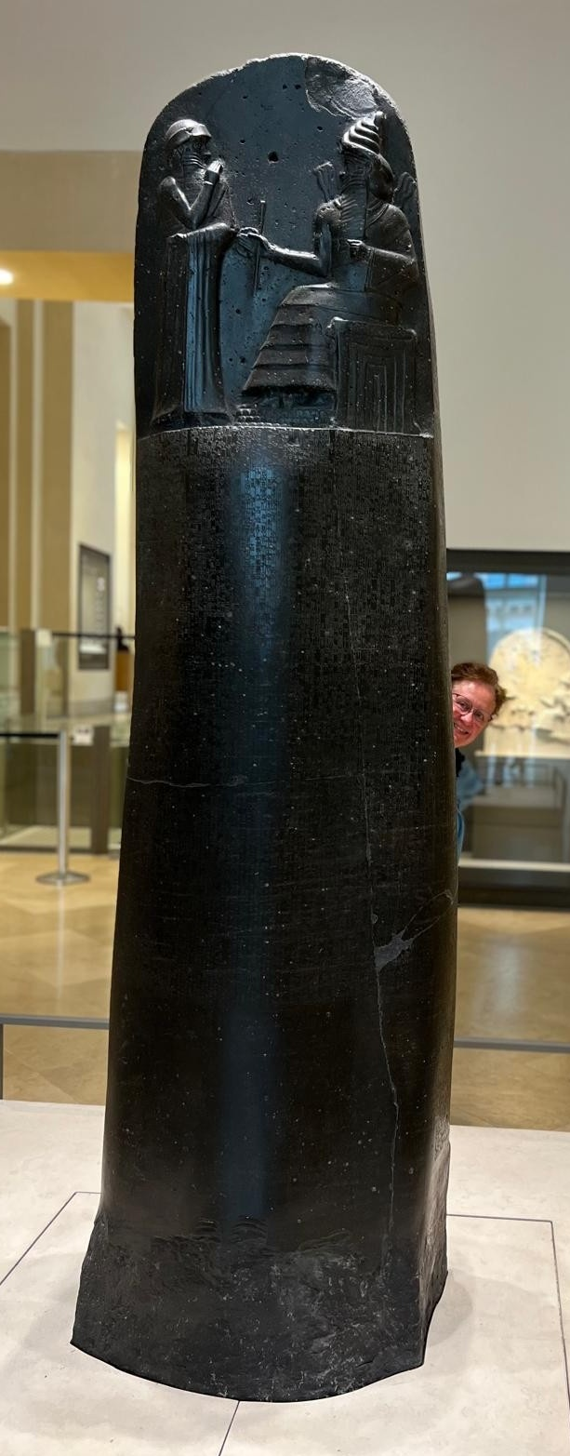

Slide 21
EXODUS 4:19-23
And the LORD said unto Moses in Midian, Go, return into Egypt: for all the men are dead which sought thy life.20 And Moses took his wife and his sons, and set them upon an ass, and he returned to the land of Egypt: and Moses took the rod of God in his hand. 21 And the LORD said unto Moses, When thou goest to return into Egypt, see that thou do all those wonders before Pharaoh, which I have put in thine hand: but I will harden his heart, that he shall not let the people go. 22 And thou shalt say unto Pharaoh, Thus saith the LORD, Israel is my son, even my firstborn: 23 And I say unto thee, Let my son go, that he may serve me: and if thou refuse to let him go, behold, I will slay thy son, even thy firstborn.

Slide 22
GALATIANS 4:4-7
But when the fulness of the time was come, God sent forth his Son, made of a woman, made under the law, 5 To redeem them that were under the law, that we might receive the adoption of sons. 6 And because ye are sons, God hath sent forth the Spirit of his Son into your hearts, crying, Abba, Father. 7 Wherefore thou art no more a servant, but a son; and if a son, then an heir of God through Christ.
When you are adopted by God, you have a
Divine origin,
with a Divine likeness and the
Object of Divine Love.

Slide 23
The purpose of this manifestation is for the sons of God to take back the dominion over the earth that Adam lost in the fall.
61-0117 THE MESSIAH
16 Man was made to be a god, a lesser god. He was made in the image and likeness of God. That's why the Bible says the earth is groaning, crying, waiting, for the manifestation of the sons of God. The world is waiting for the man to come back into his right estate.

Slide 24
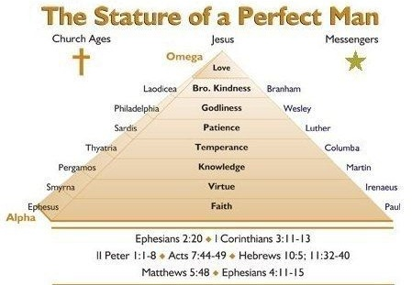

Slide 25
ADOPTION.4
19 When were there ever a time in history… Nature itself is groaning, waiting for the time of the manifestation…It had to wait till this time. All things has been coming, shaping up to a headstone, to the manifestation of sons of God coming back, and the Spirit of God coming into these men, so perfectly, until their ministry will be so close like Christ's, till it'll join Him and His church together.
60-0522

Slide 26
58-0928 | The Serpent's Seed
64 He was not a reptile. The curse made him a reptile... Even the curse didn't take all of his beauty away… God told him that his legs would come off and he'd go on his belly. God hid it from the eyes of the wise and prudent… When God's sons that rejoiced with Him before the foundation of the world, when the great revelation of the Godhead and things would be brought down in the last days,

Slide 27
He would manifest these things to the sons of God. And here we are. God is bringing His sons into manifestation. He's going beyond the limitations of any human knowledge, way into the spiritual revelations and bringing it down.
66 Here's the serpent. I'm going to give you my description of him…

Slide 28
LAW.HAVING.A.SHADOW
34 You must come under teaching. You say, "I don't need no one to teach me after the Holy Ghost is come." My friends, that gives me a little room to doubt whether you've really got it, or not. Why did the Holy Spirit put teachers in the church, to set the church in order? Sure. We don't need any seminaries: the Holy Spirit is a teacher, and It gives some fellow a gift of teaching, then you must be subject to that gift. 54-0516

Slide 29
HEAR.YE.HIM
46 God put man to control the earth. Bible said that a man is a god. He sure is. "Is it not written in your laws, that you are gods?" And if they're gods, the prophets, who the Word God came to, how can you condemn Me when I say, 'I'm the Son of God?'" They're gods, fallen gods. They get a domain, the world. They're supposed to take care of it.
The trees, animal life, everything's waiting for the manifestation of the sons of God. Oh, for the great Millennium when they'll be manifested. We're getting ready now for this time to come. The church has got to get ready. 60-0806

Slide 30
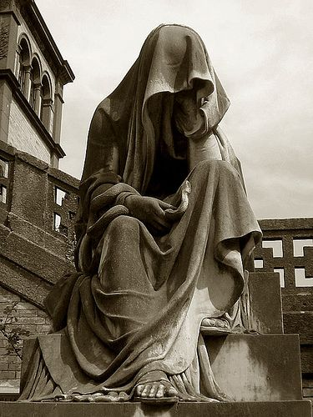
I JOHN 3:1-2
Behold, what manner of love the Father hath bestowed upon us, that we should be called the sons of God: therefore the world knoweth us not, because it knew him not. 2 Beloved, now are we the sons of God, and it doth not yet appear what we shall be: but we know that, when he shall appear, we shall be like him; for we shall see him as he is.

