Slide 1
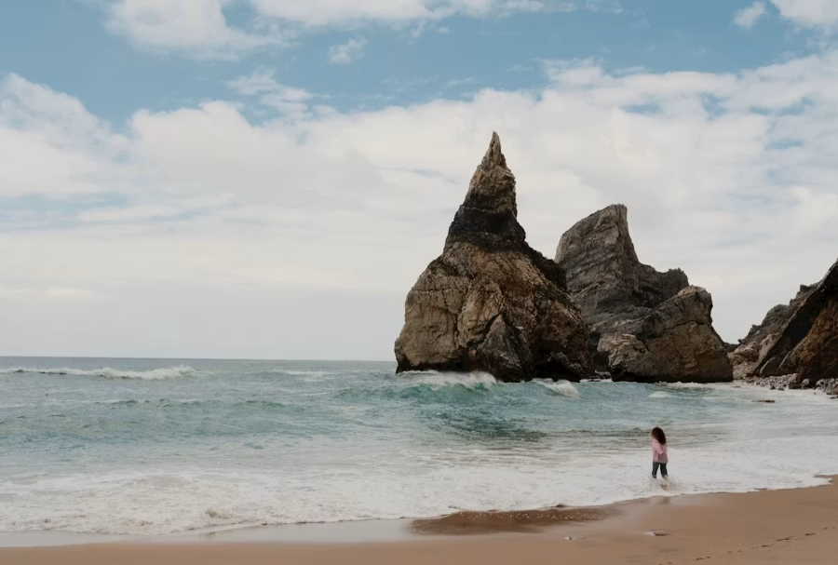
Guarding My Heart
Principles to Live By
Deut. 29:18 & Prov. 4:23
Keep thy heart with all diligence;
for out of it are the issues of life.

Slide 2
HEBREWS 2:16-18
For verily he took not on him the nature of angels; but he took on him the seed of Abraham. 17 Wherefore in all things it behoved him to be made like unto his brethren, that he might be a merciful and faithful high priest in things pertaining to God, to make reconciliation for the sins of the people. 18 For in that he himself hath suffered being tempted, he is able to succour them that are tempted.

Slide 3

Adversity
Adverse fortune or fate; a condition marked by misfortune, calamity, or distress: adverse or unfortunate events or circumstances.

Slide 4

If you have adversity, its source would have to be an adversary:
MATTHEW 4:10
Then saith Jesus unto him, Get thee hence, Satan: for it is written, Thou shalt worship the Lord thy God, and him only shalt thou serve.

Slide 5
INFLUENCE.OF.ANOTHER 62-1013
89 …Sometimes God lets the very props be knocked from under us. Sometimes He lets sickness strike us. He lets disappointments, heartaches, strike us. Sometimes He does that to get you where you'd be influenced by the Gospel. Be wise enough to catch it. Don't be stupid enough to walk away from it.

Slide 6
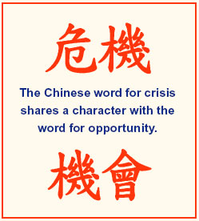
A "crisis" generally refers to a difficult or dangerous situation, especially one involving many problems, requiring a decisive response. It can be personal, a social issue, even a turning point in a disease. Crises can range from financial, political issues to natural disasters and individual emotional struggles.

Slide 7
Adversary: (Gr.) Satanas
One who opposes another in purpose or act;
The prince of evil spirits, the adversary of God; he causes apostasy from God and to sin; the worshippers of idols are said to be under his control;
By his demons he is able to take possession of men and inflict; by God’s help he is overcome; on Christ's return he will be bound with chains for a thousand years…

Slide 8
PSALM 17:4-7
Concerning the works of men, by the word of thy lips I have kept me from the paths of the destroyer. 5 Hold up my goings in thy paths, that my footsteps slip not. 6 I have called upon thee, for thou wilt hear me, O God: incline thine ear unto me, and hear my speech. 7 Shew thy marvellous lovingkindness, O thou that savest by thy right hand them which put their trust in thee from those that rise up against them.

Slide 9
PHILIPPIANS 1:27-29
27 Only let your conversation be as it becometh the gospel of Christ: that whether I come and see you, or else be absent, I may hear of your affairs, that ye stand fast in one spirit, with one mind striving together for the faith of the gospel; 28 And in nothing terrified by your adversaries: which is to them an evident token of perdition, but to you of salvation, and that of God. 29 For unto you it is given in the behalf of Christ, not only to believe on him, but also to suffer for his sake;

Slide 10
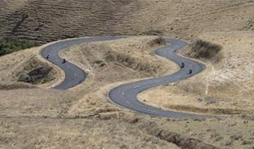
A Bend In The Road Is Not The End Of The Road
Unless You Fail To Make The Turn.

Slide 11

Proverbs 4:23, "guard your heart" means to protect your inner life—your thoughts, desires, choices, and values—from toxic and sinful influences.
In the OT culture, the "heart" did not just represent romantic emotions. It was viewed as the "command center" of a person, the seat of the mind, will, and conscience.

Slide 12
Guarding is Defensive/Offensive:
Defensive Boundary: You must filter what you let in through your eyes and ears. This means setting boundaries with the media you consume, the thoughts you dwell on, and the company you keep.
Offensive Strengthening: You protect a fortress by reinforcing it from within. According to the surrounding context in Proverbs 4:20-22, you do this by filling your mind with Scripture, prayer, and wise teaching.

Slide 13
PROVERBS 4:20
My son, attend to my words; incline thine ear unto my sayings. 21 Let them not depart from thine eyes; keep them in the midst of thine heart. 22 For they are life unto those that find them, and health to all their flesh.
PROVERBS 4:24-27
Put away from thee a froward mouth, and perverse lips put far from thee. 25 Let thine eyes look right on, and let thine eyelids look straight before thee. 26 Ponder the path of thy feet, and let all thy ways be established. 27 Turn not to the right hand nor to the left: remove thy foot from evil.

Slide 14
What "Guarding Your Heart" Does NOT Mean:
1. It does not mean building walls against people:
It is not an excuse to become cold, cynical, or emotionally unavailable out of a fear of getting hurt.
2. It does not mean running from relationships:
God designed humans for community and vulnerability. True guarding secures the heart against sin and distraction, not against love.

Slide 15

In the kingdom of God, righteousness is not measured by what we avoid doing,
but by the condition of what we are becoming.

Slide 16
CHRIST.IS.THE.MYSTERY.OF.GOD.REVEALED
86 If the brother, you think he's a little wrong, or sister, say, "Lord, don't let me never have the root of bitterness spring up, 'cause it'll affect him, and it'll take the Christ right out of my life." That poison acids of malice, jealousy, hatred, that will just take the Holy Spirit right away from you. It will run Him from the tabernacle here. It'll kill the Spirit of God, or drive It away from here, hurt you pastor. Don't you do that.

Slide 17
87 You just wax that much closer together. Take the buckle, that buckles on the whole armor of God. Just pull her on, tighten up, move right up close to one another. Love one another, anyhow. Talk nice about one another, say nice things about one another, and then God will bless you.
63-0728

Slide 18
DEUTERONOMY 29:18
Lest there should be among you man, or woman, or family, or tribe, whose heart turneth away this day from the LORD our God, to go and serve the gods of these nations; lest there should be among you a root that beareth gall and wormwood; 19 And it come to pass, when he heareth the words of this curse, that he bless himself in his heart, saying, I shall have peace, though I walk in the imagination of mine heart, to add drunkenness to thirst:
HEBREWS 12:15
Looking diligently lest any man fail of the grace of God; lest any root of bitterness springing up trouble you, and thereby many be defiled;

Slide 19
¹⁴ Keep pursuing shalom with everyone and the holiness without which no one will see the Lord. ¹⁵ See to it that no one misses out on God’s grace, that no root of bitterness springing up causes trouble and thus contaminates many, ¹⁶ and that no one is sexually immoral, or godless like Esav, who in exchange for a single meal gave up his rights as the firstborn. ¹⁷ For you know that afterwards, when he wanted to obtain his father’s blessing, he was rejected; indeed, even though he sought it with tears, his change of heart was to no avail. (CJB)

Slide 20
The Anatomy of a Root of Bitterness
1. A Wound: Bitterness almost always begins with a genuine hurt. (Eg. Naomi)
2. A Choice is Made not to Release it. (Matt. 18:21) Every time forgiveness is declined the root goes deeper.
3. Concealment: Many bitter people are outwardly composed. (Eg. Absalom II Samuel 13:28–29 )

Slide 21
4. Reinterpretation:
              A bitter person begins to see everything through the lens of the wound. Everything becomes evidence. Eg. Saul & David
5. Defilement of Others:
Children absorb a parent’s bitterness. Congregations absorb a leader’s unresolved wounds. Friends are recruited into camps.

Slide 22
The Remedy: Grace
The standard of forgiveness is: “as God for Christ's sake hath forgiven you.” The bitter person has not yet laid hold of the full depth of what God forgave them.
The bitter person rarely sees themselves as bitter — they see themselves as wronged, which they usually are.
The question is not "Were you hurt?" but "Have you released it to God?" Heb. 12:1 reminds us to "lay aside every weight" — and bitterness is a weight that the runner cannot afford to carry.

Slide 23
The root of bitterness is not evidence that a person was not wounded. It is evidence that the wound was taken to the wrong place. Every hurt that belongs at the cross has been left somewhere else.
"Keep thy heart with all diligence…"
The issues of your life: relationships, ministry, joy, your usefulness to God, all of it flows from what you have permitted to take root in the ground of the heart.

Slide 24

Bitterness demands a perpetual sacrifice that it can never honor. It costs everything and yields nothing.
Grace, by contrast, costs nothing and yields everything — "even as God for Christ's sake hath forgiven you."

Slide 25
THE.MESSIAH
30 Now you don't have to die to get this. You have to spiritually die, but you don't have to physically die. The inside is where God gets in to control you. As He presses Hisself forward in you, don't let any root of bitterness, hatred, malice, strife... That'll run Him right back again. Just get all the meanness, and the superstitions, and all the unbelief out of you. And every time you move out a little unbelief, God steps right in and takes over. 61-0117

Slide 26

I PETER 5:6-7
Humble yourselves therefore under the mighty hand of God, that he may exalt you in due time: 7 Casting all your care [anxiety] upon him; for he careth for you.

Slide 27
I.KNOW.MY.REDEEMER.LIVETH
12 No matter how little you are, how big, how important or unimportant you are, you are here to serve a purpose... And if we were put here for a purpose, there is nothing can destroy us until God's purpose is fulfilled.
Nothing can harm us until that purpose that God has put us here for has been made manifest. No matter how much trouble we have, how much heartaches or sorrows that we go through, all of these are reasons, and there's a reason for it.
58-0406

Slide 28
BELIEVEST.THOU.THIS
70 Jesus, it come to a place where He had to leave the home. And when He went out, sorrow and troubles came in. And when He goes out of your home, sorrow and troubles come in.
When He goes out of your church, confusion and backslidings is coming in. When trouble's on its road, keep Him with you all the time.
50-0716

Slide 29
EPHESIANS 4:32
And be ye kind one to another, tenderhearted, forgiving one another, even as God for Christ's sake hath forgiven you.
Kind: (Gr.) chrestos
Manageable, mild, pleasant (as opp. to harsh, hard sharp, bitter.) More pleasant, of people, kind, benevolent.

Slide 30
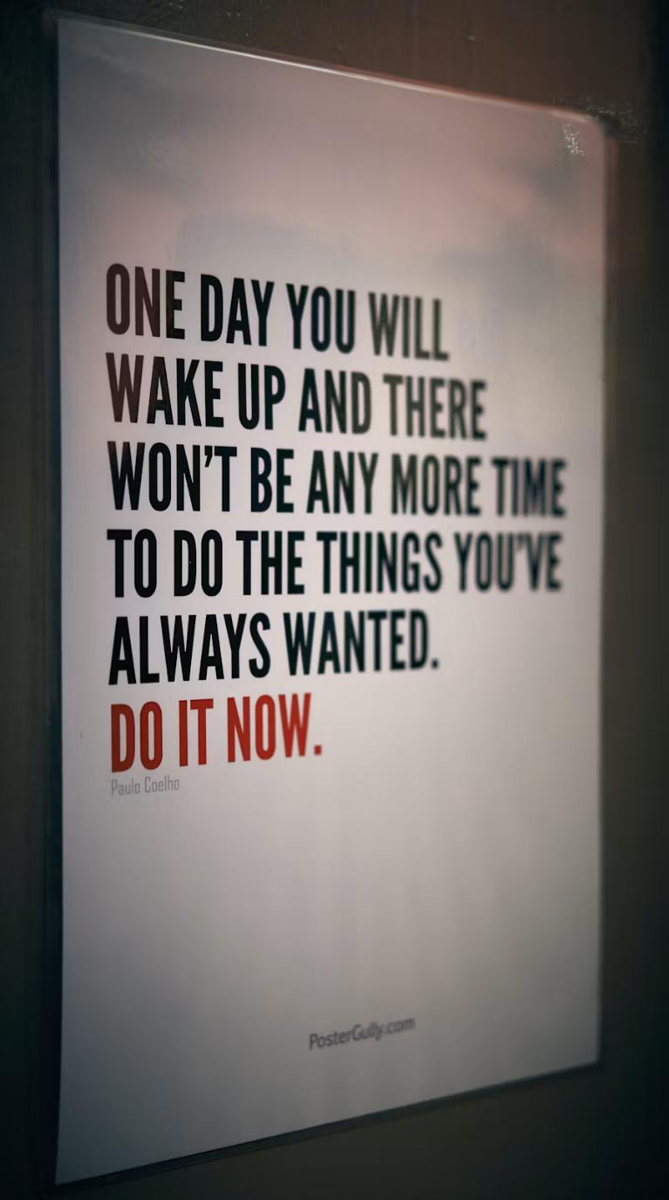
LUKE 6:35
But love ye your enemies, and do good, and lend, hoping for nothing again; and your reward shall be great, and ye shall be the children of the Highest: for he is kind unto the unthankful and to the evil.
“…He is kind to the ungrateful and wicked.” (CJB)

Slide 31
BE.CERTAIN.OF.GOD
5 And instead of marrying among his own people, he went over and married a sinner, a worshipper of idols: Jezebel, she was not a believer. No believer should ever marry an unbeliever, under no circumstances...
But Ahab had done this evil thing. And no doubt but what Jezebel was a beautiful woman. And he'd fell for what she looked like in the stead of what she was. And she had brought idolatry in the nation, among the people. And the people, the priests, their ministers, had fell victim to this great popular demand.

Slide 32
And it's a picture of our country today. We have fallen under the popular demand. No doubt that the priests thought it would be all right as long as their government okayed it. But I don't care what the government okays; it's got to be what God okays. And the people thought that it would be all right if they anticipated in some of their worldly things.
People today are idol worshippers… Some of them worship movie stars…worship money... television stars. But all that you put before God is an idol.

Slide 33
11 Satan, our great adversary is such a smart one, until he even [sometimes] puts the church before God. You might have a great church, a great building, a great congregation but let nothing come before God in your heart. Anything before God is an idol.
These people thought because they was a religious nation that everything would be all right. And we have come to that place also. 59-0125

Slide 34
EXPECTATIONS
23 If they'd only realize who you are. You're sons and daughters of God, heirs of the Kingdom. Right now we are kings. Claim your legal rights. Don't let Satan press anything on you. You're of God. He's has got no rights to hold it.
53-0507
PSALM 147:3
He healeth the broken in heart, and bindeth up their wounds.

Slide 35
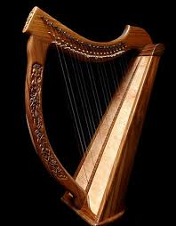
Philippians 4:8
Finally,brethren, whatsoever things are true, whatsoever things are honest whatsoever things are just, what-soever things are pure, whatsoever things are lovely, whatsoever things are of good report; if there be any virtue, and if there be any praise, think on these things.

Slide 36
FAITH
24 He taken our sins, that we might take His righteousness… Man just can't keep his promise to God. His adversary's too great. God knowing that, He was determined to save man, so He made the covenant unconditionally. How can anything happen to you? "Those who He foreknew… glorified." So quit being scared. God's driving the ship, not you and I. We're just to stay on it. God made a promise; God keeps His promise. 56-0815

