Slide 1

Creation’s Release
A Study on the Manifestation of the Sons of God
ROMANS 8:19
For the earnest expectation of the creature waiteth for the manifestation of the sons of God.

Slide 2

Birthdays
Anniversaries & Events
June 4th John & Hannah Harwell
Lillian Godwin, Jeremy Clayville
June 5th John & Laura Harwell
June 7th Mark & Jackie Sylvester, John James
June 7th Men’s Meeting Registration HBT Only
June 14th Communion Service 4:00 pm
Family Day (Aug. 15th)

Slide 3

Men’s Meeting HBT
Oct. 9-11, 2026 Carson Springs Conference Center
Jason Watkins
Matthew Watkins
Donnie Reagan
Paul LaFontaine
Tim Dodd
Jan Hansen, Norway
Brian Naidoo, South Africa

Slide 4


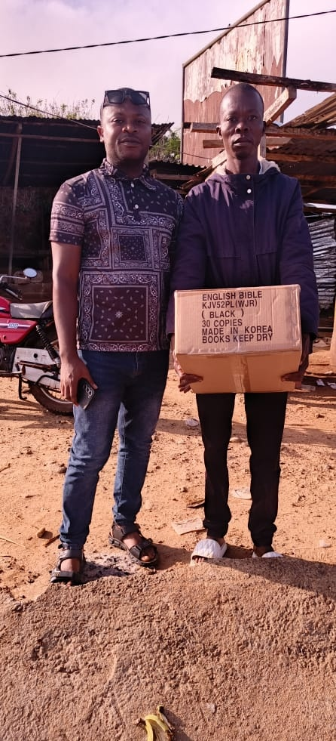
Tanzania
Sierra Leone
Liberia

Slide 5
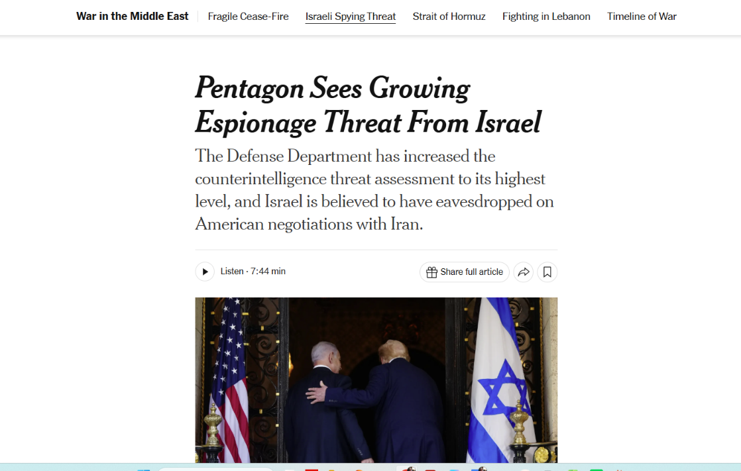

Slide 6
Creation’s Release
A Study on the Manifestation of the Sons of God
ROMANS 8:19
For the earnest expectation of the creature waiteth for the manifestation of the sons of God.

Slide 7

STATURE.OF.A.PERFECT.MAN
361 Then the Word, coming from Here, manifests Itself through each one of these beings and makes this complete Being a Tabernacle of the living God, a walking, living example of Christianity. What Christ was, these people are, because His Life is in here. They are in Christ. Their life is dead and hid in Christ, through God, sealed in there by the Holy Ghost. I Cor. 12. You reckon yourself dead, then you're born of faith. Then virtue and these other things is added to you till you're a perfect, living image of God. 62-1014

Slide 8
JOHN 15:16
Ye have not chosen me, but I have chosen you, and ordained you…
59-1223 QUESTIONS.AND.ANSWERS
123 Before there was a world you were in God's thoughts to give you the Holy Ghost, because He knew that you'd be wanting It... He chose you in Christ before you or Jesus, any of you, was on the earth.

Slide 9
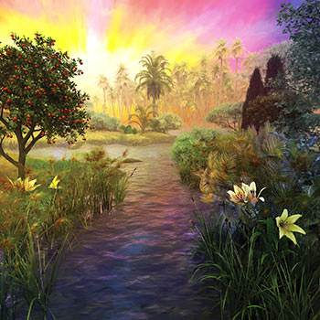
ROMANS 8:20-22
For the creature was made subject to vanity, not willingly, but by reason of him who hath subjected the same in hope, 21 Because the creature itself also shall be delivered from the bondage of corruption into the glorious liberty of the children of God. 22 For we know that the whole creation groaneth and travaileth in pain together until now.

Slide 10
ADOPTION.4
15 “…the mystery of His will." Now, it is not just a little thing; God's will is a mystery. And each man has to seek out the will of God for his or herself.
God, since the beginning of the world, predestinated us to the adoption of sons. Now, the whole creation groaning, waiting for the manifestation of the sons of God. Oh, I'd imagine Paul had a wonderful time. I'd like to have been there with him, wouldn't you?
60-0522

Slide 11
QUESTIONS.AND.ANSWERS
177 Where is that one that's going to sow that seed for that end-time church? …that promised Elijah? And immediately after his days shall the great tribulation set in and burn the earth…And the heathens that's never heard the Gospel shall be raised in that time, and the sons of God will be manifested. If he's to reign, he's got to have something to reign over; he's got a domain. "And they ruled and reigned with Christ," and Christ ruled with a rod of iron the nations. Then the manifested sons of God with the authority just like He had when He was here, there will come the Millennium in that reign, upon the ashes.

Slide 12
179 So I've watched for something. Has it slipped by us in humility and we've missed it? If that be so, then it's later than you think. If not, then there's coming one with a message that's straight on the Bible, and quick work will circle the earth. The seeds will go in newspapers, reading material, until every predestinated seed of God has heard it. None of them will come unless the Father's drawed them, and everyone the Father has drawed will hear it and come. That'll be the predestinated Seed will hear the Word. 62-0527

Slide 13
“Earnest Expectation” (apokaradokía),
A rare and vivid word built from the picture of a head (kara) thrust forward and away (apo), the neck stretched, the eyes locked on the horizon, watching for the first sign of what is coming.
The watcher who, with head erect, out-stretched, turns away from all else to fix the gaze upon the one object expected.

Slide 14
“The Creature” (κτίσις, ktísis)
The created order — not believers, who are named separately in verse 23, but the sub-human creation: the ground, the beasts, the heavens, the whole world that fell under the curse with Adam. Paul personifies it; he lends senseless things a longing.

Slide 15
“Waiteth” ἀπεκδέχεται (apekdéchetai)
To await fully and persistently, an enduring expectancy. And not a single sigh but an unbroken, sustained ache that does not let up.
It is the very verb Paul uses of believers in verse 23 (“waiting for the adoption”) and verse 25 (“then do we with patience wait for it”), and the same word that describes our looking for the Saviour from heaven (Phil. 3:20). Creation and church wait!

Slide 16
“The Manifestation” ἀποκάλυψις (apokálupsis)
An unveiling, the drawing back of a curtain on what was there all along but hidden. The sons of God are sons now; the world simply cannot yet see it. “It doth not yet appear what we shall be” (1 John 3:2); “your life is hid with Christ in God” (Colossians 3:3). The apokálupsis is the day the covering is removed and the hidden heirs stand revealed in glory.

Slide 17
THE.PRESENCE.OF.GOD.UNRECOGNIZED
115 Today, how the people will stay home, call themselves Christians, and listen to such characters as Pat Boone, Elvis Presley, Ernie Ford, and those who sing hymns on Sunday; and look at them things, they look at them kissing them women, and things out there.
116 When, no man should ever kiss a woman till he is married to her. That's male and female glands crossing. Let it be wherever it may be, it's wrong. It's potentially a sex act. 64-0618

Slide 18
IT.IS.I 72 Jesus said, "At that day, you will know that I'm in the Father…“ It's God in you. All that God was He poured into Christ; and all Christ was He poured into the church. So it's God above us, God with us, God in us… condescending, making a way for me to get back. And bring His people back to manifested sons of God, like… in the garden of Eden.
The whole world's a-groaning and waiting for that hour for the manifestation of the sons of God. He has no voice tonight but our voice. He has no hands but our hands. He has your hands; that whose hands it is. He said, "I am the Vine; you are the branches." 61-0517

Slide 19
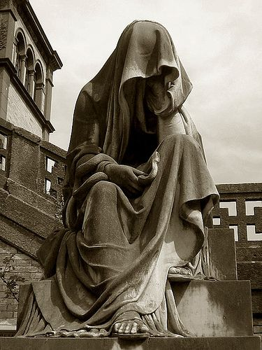
I JOHN 3:1-2
Behold, what manner of love the Father hath bestowed upon us, that we should be called the sons of God: therefore the world knoweth us not, because it knew him not. 2 Beloved, now are we the sons of God, and it doth not yet appear what we shall be: but we know that, when he shall appear, we shall be like him; for we shall see him as he is.

Slide 20
ADOPTION.4
19 When were there ever a time in history… Nature itself is groaning, waiting for the time of the manifestation…It had to wait till this time. All things has been coming, shaping up to a headstone, to the manifestation of sons of God coming back, and the Spirit of God coming into these men, so perfectly, until their ministry will be so close like Christ's, till it'll join Him and His church together.
60-0522

Slide 21
HEAR.YE.HIM
46 God put man to control the earth. Bible said that a man is a god. He sure is. Jesus said, "Is it not written in your laws, that you are gods?" And if they're gods, the prophets, who the Word God came to, how can you condemn Me when I say, 'I'm the Son of God?'" They're gods, fallen gods. They get a domain, the world. They're supposed to take care of it. The trees, animal life, everything's waiting for the manifestation of the sons of God. Oh come, Lord Jesus, is my prayer. Oh, for the great Millennium when they'll be manifested. We're getting ready now for this time to come. The church has got to get ready. 60-0806

