Slide 1

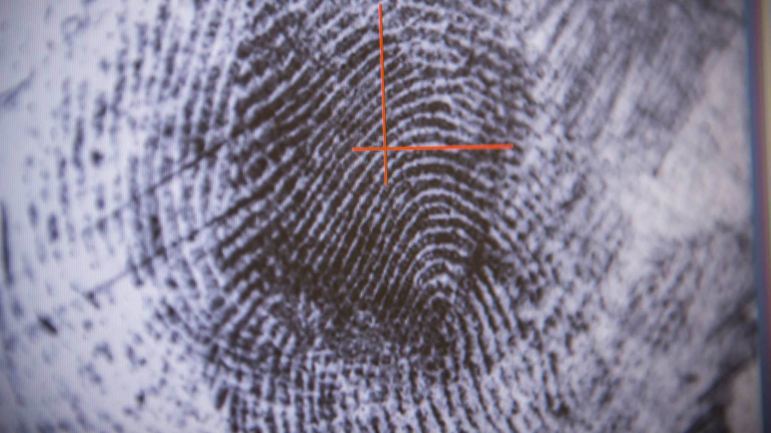
Fourth Dimension Prisoners

Slide 2
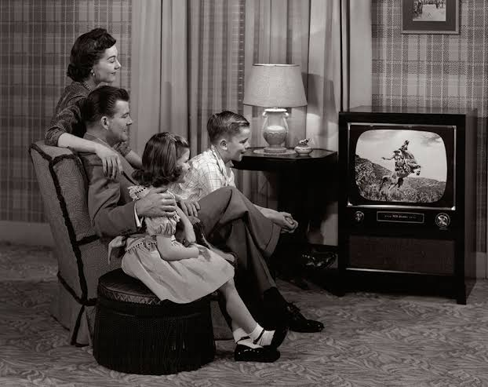

Slide 3
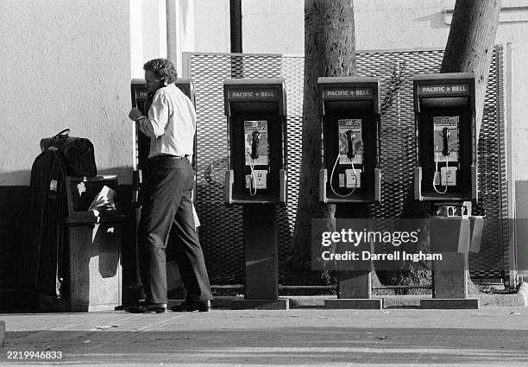

Slide 4
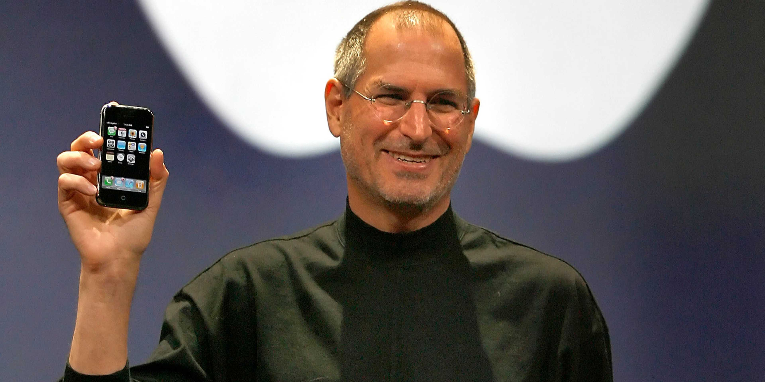

Slide 5
Now, light, matter, and time. And our five senses contact them dimensions. Our sight contacts light, our feeling contacts matters, and so forth.
Now, but we have contact through science, the fourth dimension, as it was. Because coming right through this building now comes pictures, voices of radio, pictures on television, that our senses does not contact that, but yet they have a—a tube or a crystal that picks up those ether waves and manifests them
62-0908 - Present Stage Of My Ministry

Slide 6
So, you see, right in this building now is live actions of people, in the air, live voices. They’re here. We know it. They’re absolutely the truth. And the only thing you do, they—they catch it on…I don’t understand the mechanics of—of those things that science has invented, but we know that it proves to us there is a fourth dimension.
62-0908 - Present Stage Of My Ministry

Slide 7
Now, the fifth dimension is where the sinner, the unbeliever dies and goes to. The fifth dimension is the, kind of the, well, the horrible dimension. Now this man… And when a Christian dies, he goes into the sixth dimension. And God is in the seventh dimension.
62-0908 - Present Stage Of My Ministry

Slide 8
Now then, you see, the Christian when he dies, he goes under the altar of God, right into the Presence of God, under the altar. And he’s at rest.
To break it down, when a man has a nightmare, he’s not altogether asleep, neither is he awake. He’s between sleep and awake, and that’s what makes him have a horrible shaking and screaming, because he’s not asleep, he’s not awake. And to take that, shows where a man goes when he dies unconverted.
Present Stage Of My Ministry

Slide 9
He’s lived his time up, he’s dead on earth; and he cannot go in the Presence of God, because he’s not fit to go there without the Blood. And he’s caught. And he cannot come back to earth, because his time’s finished here on earth, and he’s caught between, and he’s in a nightmare. See? He can’t go in the Presence of God, to rest. And he can’t back, come to earth, because his time’s up. He’s in a nightmare, and there he stays until the day of the judgment. A horrible thing to be in, see.
Present Stage Of My Ministry

Slide 10
And now in this vision, I believe I was caught to that sixth dimension, looking back down here and could see back. See, the sight isn’t exactly with the eyes, that’s earthly. But sight is a greater thing than…The sight that they have there, their contact is far beyond any contact that our natural senses would contact.
Present Stage Of My Ministry

Slide 11
Now, the same thing is wrong with you is wrong with that woman setting over yonder looking right at me on the end of the row, right out there with the little round hat on. There's a dark string. The lady looking across this lady's head, looking at me right here, with her hand up. That's it, lady. That's right. Here it is, coming from one to the other. It's evil powers pulling, a dark streak.
Proof of His Resurrection

Slide 12
Now, here's two spirits calling one to another. I only wish that my lovely audience could only be in this dimension and see this. This woman standing here is suffering with the same thing that woman setting there with her hands crossed, right like that. Here's a dark line. Because the spirit that's on this woman is calling to this spirit for help. And it's both the same disease: arthritis to both.
Darkest Hour Jesus Comes

Slide 13
Now, there’s a spirit in here, a demon calling for help. That’s what it is. It’s—it’s on a—a white woman, a little kinda aged, and it’s the same thing that this woman has…?…stand here…?…out there…Oh, here she is. You don’t have a prayer card, do you? No, sir. Do you believe me to be God’s prophet? Do you believe me to be God’s servant? Look this way, lady. Both of you have TB. You have TB; you have TB. It’s them demons calling one to another. Yes, lady, that is right.
54-0305 - God's Provided Way Of Dealing With Sin

Slide 14
Now, just a moment. There’s a demon in the audience a screaming to this woman. On that woman right there, you have asthma, don’t you, lady? You do too, don’t you? Asthmatic. All right. Stand up to your feet. That’s right. Stand up, lady, with the black coat on. That’s right. Go home, both of you now, and be healed. God bless you. Go, in Jesus’ Name.
53-1112 - Demonology

Slide 15
What if I told you that your heart trouble can be made well in Jesus' Name? You believe it? Then go. As you... Just a minute. Demons screamed. Something called for help. Demon power... It come from the audience. When this woman was healed, that demon spirit screaming to one another for help. It's the spiritual world. We're not talking about the outside
Earnestly Contending

Slide 16
Just a moment. It wasn’t this woman. Now, just a moment, everybody reverent now. Is—is Satan, tried to do something. Here it is. Tumor, tumor, both of you. That’s right. You got tumor, she has got tumor, and that devil screaming for help from one another. But the Holy Spirit is screaming, too. Who you going to believe, Him? All right. Get up out of that cot, lady. Raise up out of that stretcher. Get up off of that, and believe. Go, believe Him now. Amen.
64-0307 - A Testimony On The Sea

Slide 17
Now, come would you, sir. Do you believe with all your heart? Of course, sir, as a brother, there’s nothing I could do to help you in the way of healing you. See? I—I couldn’t do it. And you look like a good strong man. But perhaps you’re not, I don’t know. But our Lord Jesus knows you and He knows me. And now, if you believe that He is here, His Presence is here…You believe that He is here? It’s cancerous condition. And that man setting right there has the same thing. Them demons are screaming one to another (You see?) for pity, mercy. They’re calling, and so’s the Angels of God calling. The battle is here. Now, your faith will determine which way it goes.
53-0907E - Healing Line

Slide 18
Now, you’re both under the shadows of death, that dark streak coming from this. What is it? It’s that devil in here called cancer. Cancer is a Greek word, or, a medical word, means “crab.” But it’s a devil, it’s a killer, a tormentor, it’s on this man, and in that woman. And see, he was calling for help to try to get this man to disbelieve it, and the Holy Spirit beat him to it, and throwed faith on the woman. She touched Something. See, that devil thought he could get by with it. Will you both believe on Jesus Christ, and accept Him as your Healer? Raise your hands. Then in the Name of Jesus Christ, I condemn that devil to leave you both, and go. Go, and be well. Go, and be well.
61-0412 - A Greater Than Solomon Is Here

Slide 19
Friends, they’re just as real as—as you’re real. And I see them, many times, when they leave right… I’ve seen them leave right from this platform here. I see them, some of them in shape of bats, look like long hairs hanging on their legs. But an epileptic demon look like a tortoise with round legs, hanging up like that. But usually, a demon of—of oppression seems to be more of a—of a cloud form, like a wave; and it just makes a real funny sound when it’s a—when you’re in that other dimension to see the spirit.
Demonology

Slide 20
Now, you may think that’s wrong, but some of these days you’ll realize. If you could only take a spiritual looking glass and look into your soul, you doubt, and you’d find out what it looks like. And the greatest devil, and the chief of all devils is unbelief.
Demonology

Slide 21
50-0810 - Expectations
And I’m so thankful that in these past few nights, You have confirmed and testified that I have told that which is true. And I’m very thankful, Father. I trust that it’s believed among all, Lord, giving Thee all praise and all the glory, for we know it comes only through You. We believe You, Father, tonight with all we can. Oh, Satan would take my very life, but I’m depending on You. And I realize that I shall face demons after while, supernatural beings, who will come out in that poor old form of a dark cloud going against my very soul.

Slide 22
50-0810 - Expectations
Then, Father, if You don’t cover me with Your Blood and protection, it quickly would come upon me, and I could have no more services, for I would be laying helpless. Oh, help Thou me, Lord. Help me to be sincere, for I realize that we’re not wrestling against flesh and blood now, but spiritual powers. Which men who…?… the five senses could not understand how these things could be. But with You, all things are possible. And especially when it’s in Thy Word which has come to pass.

Slide 23
50-0810 - Expectations
Protect us. May the Angels of God…?… their post…?… May they stand in the aisles, and may the great, the Angel of God spread forth His great wings throughout this tent tonight. May He distill dew drops of Divine…?… and drop them on every soul. May there not be a feeble one in our midst when the service is over.

Slide 24
The Spirit keeps moving. Right behind the man there sets a nervous trouble. You believe that God heals you? Raise up your hand, accept it if you believe it. It’s all over now. 163 There’s a kidney trouble, lady, right back there with a kidney condition. You believe that God makes you well, lady? If you do, raise up your hand, accept it. Respond to God’s call! You missed it.
58-0325 - Faith By Experience

Slide 25
164 I’ll show you whether you missed it or not: It falls on this lady setting right here with her handkerchief over her mouth, this lady setting right here had a back trouble, too. That’s right, lady, didn’t you? Yes, sir. You just come from an operation, a cancer operation. That’s right. Your name is Virginia. That’s right. You’re healed, Virginia. Jesus Christ makes you well. 165 You missed it, Mr. Anderson, because you didn’t respond. See?
58-0325 - Faith By Experience

Slide 26
A very beautiful picture. Jesus said, "When the unclean spirit is gone out of a man." Did you notice He never said, "When he's cast out of a man"? But when he goes out by his own will, "When the unclean spirit is gone out of a man, and he returns back to this man and finds that the house that he lived in has been swept, garnished, then he goes and gets seven other devils, demons, unclean spirits,
63-0803B INVESTMENTS

Slide 27
and enters into this man, and the last estate of this man is seven times worse than it was at the first." Did you notice the devil went out by his own will, and he returned by his own will? Now, if this house had already been occupied, when he returned, he would not been able to get in. But, you see, he just found it swept and garnished
63-0803B INVESTMENTS

Slide 28
It's a very beautiful picture of a moralist, as we would think today of a man that's a--a... tries to think he's going to Heaven just because that he quit gambling, or maybe he quit running with the woman that wasn't his wife, or stopped his drinking, on New Year's Day, and turned over a new leaf and joined church.
63-0803B INVESTMENTS

Slide 29
See? You see, he doesn't, he really isn't converted. He's just a moralist. And the--the devil using moralists just to--to go out and--and make a foolish representation, when, really, the real power of the living Christ isn't there
63-0803B INVESTMENTS

Slide 30
The world is wanting to see Christ. Jesus said, "I am the Vine, ye are the branches." And the branch bears record of the Vine, because it draws its energy and Life from the Vine. Well, the first Vine, first branch that came from this Vine, it, they wrote a Book of Acts behind that branch.
63-0803B INVESTMENTS

Slide 31
We see the way the Holy Spirit acted in that first church, that church of pentecost. And then when we--we believe that if this original Vine ever puts forth another branch, they'll write another Book of Acts behind it, because it's the same Life that's in the Vine
63-0803B INVESTMENTS

Slide 32
And if the first branch put forth a bunch of grapes, and then we find a bunch out here that's got watermelons growing on it, or pumpkins, or cucumbers, we know that it isn't the--the life that's in the vine.
63-0803B INVESTMENTS

Slide 33
63 Therefore, I think, even where we would call ourselves ”Pentecostals," has failed to represent the--the real thing that Christ has set forth for us to represent, the--the Holy Spirit and the Life of the Spirit. See, we represent sometimes sensations, and we represent joy, but, and--and that's good, but there is more to it than that. There is a fruit that goes with it, that the hungry man is looking for this fruit of the Spirit, and this is the quality that was in Jesus.
63-0803B INVESTMENTS

Slide 34
We see this age that we're living in. It's one of the grandest ages of all ages. This Laodicea Church Age is the grandest of all the church ages, because it's the ending of time and the blending of Eternity. And, then, it's the greatest sinful age. It's more sin in this age than there's ever been. And the powers of Satan is--is many times harder to fight against than it was in any age. See? Here!
63-0825M HOW.CAN.I.OVERCOME

Slide 35
Back there in early ages, a Christian could, for his profession of in a church, of belonging to Christ, could be beheaded for it. He could be killed, and put out of his misery, and go to meet God, quickly.
But now the enemy has come in, in the name of the church, and it's so deceiving. This is the great age of deception.
63-0825M HOW.CAN.I.OVERCOME

Slide 36
When, Christ said so, "The two spirits would be so close in the last days till it would deceive the very Elected if it was possible." See? See? See? Remember, Christ spoke of an elected people for the last day. See? "It would deceive the very Elected if it were possible." So close! The people so live, people can live a clean, holy life; not be sinful, adulterers, and drinkers, and liars, gamblers. They can live above that, and still not with It. That's right.
63-0825M HOW.CAN.I.OVERCOME

Slide 37
This is the--the age of Life, personal Life of Christ, where, the--the chemical of His Body, what was in Him.
First, under justification, the water baptism. Second, under the new Birth, of Wesley, sanctification, which cleanses. And thirdly, under the baptism of the Holy Spirit, putting that sanctified vessel into service. See? The word sanctify means, it's a compound Greek word which means "cleaned and set aside for service," set aside for service. Now the Holy Spirit puts it in service. See?
63-0825M HOW.CAN.I.OVERCOME

Slide 38
And we'll notice, "When the unclean spirit is gone from a man, he walks in dry places." That's exactly what the church has done, Baptists, Methodists, those who believed in sanctification. "Then," Jesus said, "the unclean spirit that went out, returns back to this church body and finds the house garnished, swept clean, living pure, clean lives."
63-0825M HOW.CAN.I.OVERCOME

Slide 39
All right. "But then if that house isn't filled, occupied, then he comes in with seven other evil demons worse than he was, and the last stage of this place is seven times worse than it was at the first place." They had been better to stay Lutheran, than it would to be to receive that Light and fail to follow It. So will the Pentecostals, see, you know what I mean, the house is garnished.
63-0825M HOW.CAN.I.OVERCOME

Slide 40
As I was talking to someone, the other day, said, "They're very careful, even many of the holiness groups, not to call the Holy Ghost, 'Holy Ghost,' 'cause they identify themselves with Pentecostals when they do that. They say, 'Holy Spirit,' see, keep from saying, 'Holy Ghost.’”
63-0825M HOW.CAN.I.OVERCOME

Slide 41
Because, the Pentecostal, common people, just call It what the Bible says, "Holy Ghost." Which, Holy Spirit and Holy Ghost is the same thing. But they're very careful about it. They don't want to be identified with them tongues-speaking people; and that's the Holy Spirit, Itself. See?
63-0825M HOW.CAN.I.OVERCOME

Slide 42
What happened then? When the enemy, that went out under sanctification, that was washed out, returned back and found the house not filled with the Holy Spirit, now the state of the church is joined with the--with the league of churches, with the World Council of Churches. And it's a state now that connects it with Roman Catholicism and all the rest of it, and now it's seven times worse than it was when it come out of Lutheranism. That's where man takes it.
63-0825M HOW.CAN.I.OVERCOME

Slide 43
Now watch these two churches. Oh, if I could…if there was some way I could just make the people see it. Just burns in my soul! This…these churches are just as clean and holy as this one; if they’re all virgins, they’re all virgins, just as clean. The only difference was—was the Oil in the lamp, the Holy Ghost. And the Holy Ghost, if It’s in there, It produces the very same kind of fire It did on Pentecost. But they don’t have no fire, no Oil in their lamp.
60-1211M - The Ten Virgins, And The Hundred And Forty-Four Thousand Jews

Slide 44
They have church ritual, church just as ritual as—as it can be, fine ceremonies (nothing against it), creeds that would shake your conscience, and songs like Angels singing. And they’re…you’ll…put your finger on your…their life, you couldn’t do it. But still that’s wrong! It’s not…it’s—it’s part of It, but not all of It. That’s the kind that misses the Rapture
60-1211M - The Ten Virgins, And The Hundred And Forty-Four Thousand Jews
Notes:
Borrowed faith and hand-me-down Christianity is one of the biggest dangers on Message pews today—because it looks right but has no root. Kids can grow up around Truth, talk the language, and live off their parents’ experience, but it won’t hold when temptation and pressure hits. Matthew 13:20–21 “Yet hath he not root in himself… for when tribulation… ariseth… by and by he is offended.” You can’t borrow the Oil either—Matthew 25:8–9 “Give us of your oil… our lamps are gone out… buy for yourselves.” Christianity is not inherited by bloodline or tradition, it must be a personal new birth—John 3:3 “Except a man be born again, he cannot see the kingdom of God.” That’s why every Ricky and Ricketta has to become first generation: not mama’s faith, not daddy’s testimony, but Christ living in them.

