Slide 1
God’s Power in God’s Program

Slide 2
ROMANS 8 : 14 - 16
. . . LED by His Spirit . . .

Slide 3
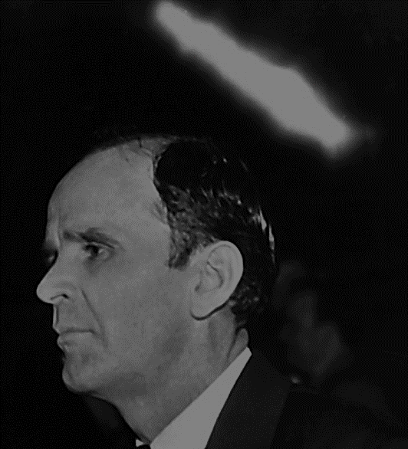
61-0117 The Messiah
Now, when a man is converted, say, just like that little, white Button starts in his heart, now, that part is God, God, when he’s borned again with the Spirit of God, God’s Spirit dwells in him.

Slide 4
60-1218 The Uncertain Sound
Now, if you can take all the malice and envy, and strife and unbelief, out, that little button-like of the Light and Power of God will keep growing, growing, growing, growing, crowding out unbelief. And you don’t do it by exhortations of bodily exercise. You do it by a sanctified, consecrated Life that the Holy Spirit moves through you.

Slide 5
61-0117 The Messiah
There you are, you’re pressing out. From that little Button is taking over the fibers of you, spreading out, God working through you, in you, around you.

Slide 6
61-1231M You Must Be Born Again
Yes, sir, brother, God is getting manifested sons right now. Manifesting, tell them all about this. Tonight you’re a sinner, tomorrow you’re manifested sons of God.” Nonsense! Where you get that in the Word? Babies are not born men, they’re born babies and grow to men.

Slide 7
60-0518 Adoption #2
Listen. Your adoption is not your birth. Your adoption is your placing. When you were born again, John 1:17, I believe, when we are born of the Spirit of God, we are sons of God. …

Slide 8
60-0518 Adoption #2
… But we were predestinated. Now here’s what I’m trying to get you to, for this sons of the last day, you see, to…See? We were predestinated to (unto) adoption.

Slide 9
60-0518 Adoption #2
Now, now here we are. Now, this is what hurts Pentecostal a little. They say, “I got born again! Praise the Lord, got the Holy Ghost!” Fine. You’re a child of God. …

Slide 10
60-0518 Adoption #2
… That’s right. But yet that ain’t what I’m talking about. See, you were predestinated unto adoption. Adoption, it’s placing a son.

Slide 11
Born again, now you have power. For what…?

Slide 12
Power, yes! Program….?

Slide 13
I CORINTHIANS 9 : 25 - 27
. . . beating the air . . .

Slide 14
Your sincere faith won’t be successful working AGAINST the program of God.

Slide 15
Promised Land Day #1

Slide 16
“Arc of life”

Slide 17
“Arc of life”
20 - 40
40 - 60
60 - 80
0 - 20

Slide 18
“Arc of life”
BUILD
STEWARD
COUNCIL
GROW

Slide 19
BUILD
STEWARD
COUNCIL
GROW

Slide 20
BUILD
STEWARD
PUBERTY
COUNCIL
GROW

Slide 21
BUILD
STEWARD
PUBERTY
COUNCIL
GROW

Slide 22
MENOPAUSE
BUILD
STEWARD
PUBERTY
COUNCIL
GROW

Slide 23
64-0830M Questions And Answers #3
Maybe it’s a woman here might be in the menopause time. That’s when everything is wrong with her, and there’s nothing wrong with her, yet everything’s wrong with her. And she’s not just putting on, she really feels that; it’s just as real. Any person that’s nervous is that way. And don’t never disagree.

Slide 24
64-0830M Questions And Answers #3
And you husbands to your wives, when they’re in that time of life, if you ever…if she ever was your sweetheart, you let her be right then, ’cause she needs you. She really needs your help; she needs somebody to help her, and
understand her.

Slide 25
64-0830M Questions And Answers #3
… Talk to her, take her up in your arms like she was your sweetheart, and she should be. And understand her, because she’s going through a time that her entire makeup is changing, and you must be good to her at that time.

Slide 26
LEVITICUS 26 : 20
And your strength shall be spent in vain: for your land shall not yield her increase, neither shall the trees of the land yield their fruits .

Slide 27
LEVITICUS 26 : 21
And if ye walk contrary unto me, and will not hearken unto me; I will bring seven times more plagues upon you according to your sins.

Slide 28
61-0409 Sirs, We Would See Jesus
Now, you could stand out in that field and scream as loud as you wish to, “I’m lost, I’m lost! Great electric, come now and light the way up, that I can see how to get in out of this darkness,” it’ll never do it. …

Slide 29
61-0409 Sirs, We Would See Jesus
… But if you’ll work according to the laws of electricity, why, it’ll light the way up, so you could get out. But you have to work according to those laws.

Slide 30
61-0409 Sirs, We Would See Jesus
Now, God has a law, too. And there’s healing and salvation in God’s determination for you, if you’ll work according to His plans, and His laws on such. …

Slide 31
61-0409 Sirs, We Would See Jesus
… I have seen great things that our Lord has did, but I always notice that it takes people that will humble themselves, and lay aside their own thoughts of it, and just take God’s thought of it, and work according to His plan, which is faith in what He said.

Slide 32
God’s Power in God’s Program

