Slide 1
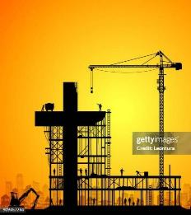
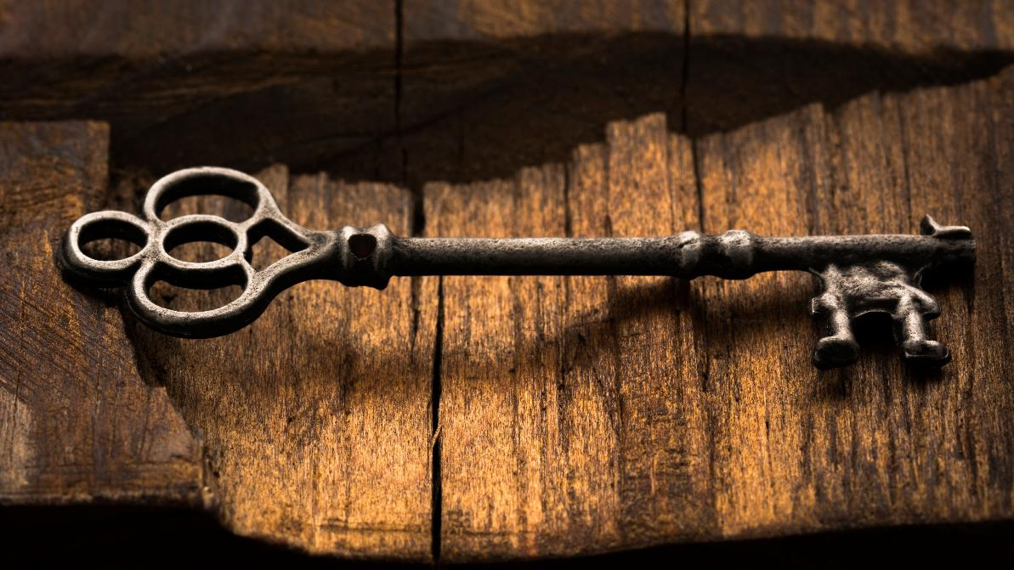
The Glorius Spirit Made Church 3
The Glorious Spirit-Made Church 3
The Glorious Spirit-Made Church 3
The Glorious Spirit-Made Church 3
Matthew 16:19
And I will give unto thee the keys of the kingdom of heaven: and whatsoever thou shalt bind on earth shall be bound in heaven: and whatsoever thou shalt loose on earth shall be loosed in heaven.

Slide 2

Birthdays Anniversaries & Events
May 10 Angela Pritchard
May 11th Risa Brown
May 14th Nathan Brown
Dates to Remember: May 16th Ladies Tea & May 17th Nathaniel Sias
May 24th Matthew Watkins
May 27th Samuel Taylor
May 31st Tim Dodd June 3rd Brian Naidoo
June 14th Communion Service
Family Day (Possibly Aug. 15th)

Slide 3

MOTHER'S.DAY
But mother's day should be every day, not send her a bunch of flowers on Mother's Day, but to love her and care for her 365 days through the year.. She'd appreciate a whole lot more, just set down and talk to her just a little bit, write her a line, pat her on the shoulder, kiss her on the cheek, tell her you love her. It'll go a lot farther than all the flowers that you could buy from the florist. 59-0510

Slide 4
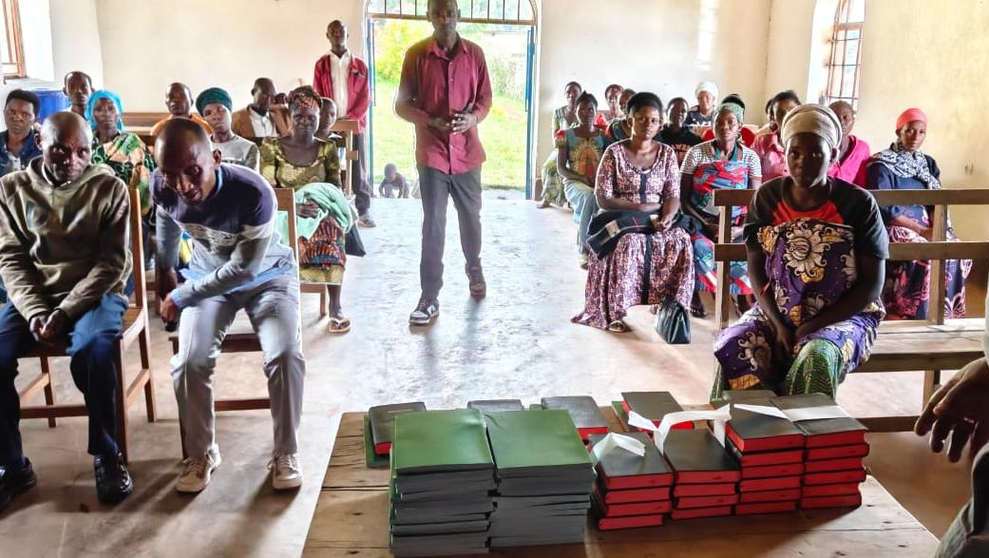
Rwanda

Slide 5
MATTHEW 16:13
When Jesus came into the coasts of Caesarea Philippi, he asked his disciples, saying, Whom do men say that I the Son of man am?
MATTHEW 16:15
He saith unto them,
But whom say ye that I am?

Slide 6
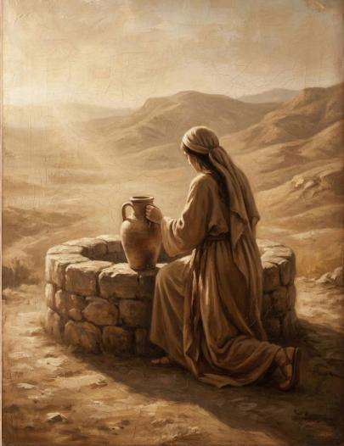
JOHN 4:18
For thou hast had five husbands; and he whom thou now hast is not thy husband: in that saidst thou truly. 19 The woman saith unto him, Sir, I perceive that thou art a prophet.

Slide 7
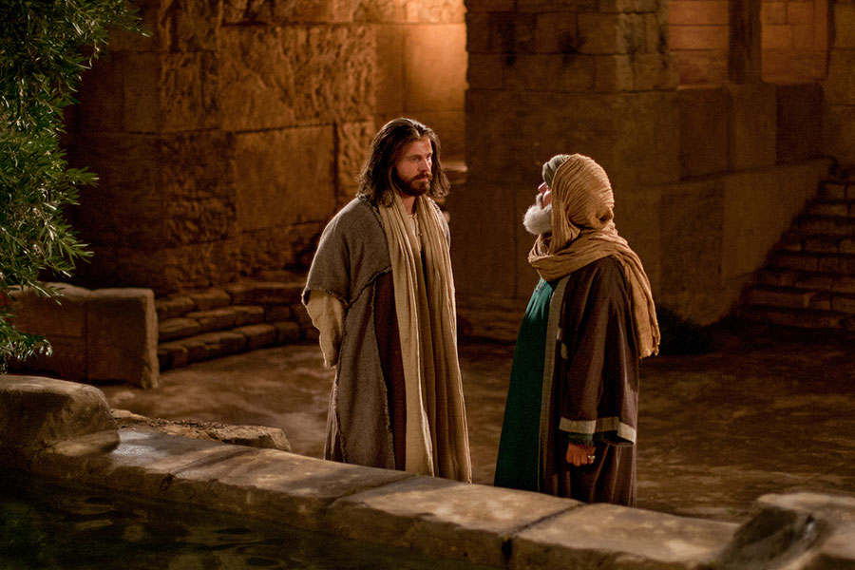
JOHN 3:2
The same came to Jesus by night, and said unto him, Rabbi, we know that thou art a teacher come from God: for no man can do these miracles that thou doest, except God be with him.

Slide 8
MATTHEW 16:13
When Jesus came into the coasts of Caesarea Philippi, he asked his disciples, saying, Whom do men say that I the Son of man am?
MATTHEW 16:15
He saith unto them,
But whom say ye that I am?

Slide 9
MATTHEW 16:17-19
And Jesus answered and said unto him, Blessed art thou, Simon Barjona: for flesh and blood hath not revealed it unto thee, but my Father which is in heaven. 18 And I say also unto thee, That thou art Peter, and upon this rock I will build my church; and the gates of hell shall not prevail against it.
19 And I will give unto thee the keys of the kingdom of heaven: and whatsoever thou shalt bind on earth shall be bound in heaven: and whatsoever thou shalt loose on earth shall be loosed in heaven.

Slide 10
Matthew 16:19
And I will give unto thee the keys of the kingdom of heaven: and whatso-ever thou shalt bind on earth shall be bound in heaven: and whatsoever thou shalt loose on earth shall be loosed in heaven.
The Key.
From the verb pathach "to open." In Hebrew, the noun is named not for what it shuts but for what it opens, the very word preaches access. A key is, by definition, that which opens.

Slide 11
GOING.BEYOND.THE.CAMP
135 Those apostles …couldn't explain how they was going to eat His flesh and drink His Blood…The people couldn't explain it. Nobody could explain it.
But Peter made those notable words. No wonder He give him the keys. He said, "Lord, who would we go to? We are persuaded. We know that You, and You alone, are the vindication of the promised Word today. We know that Thou alone has the Word of Life. We can't explain those things, but we believe It, anyhow.“
64-0719

Slide 12
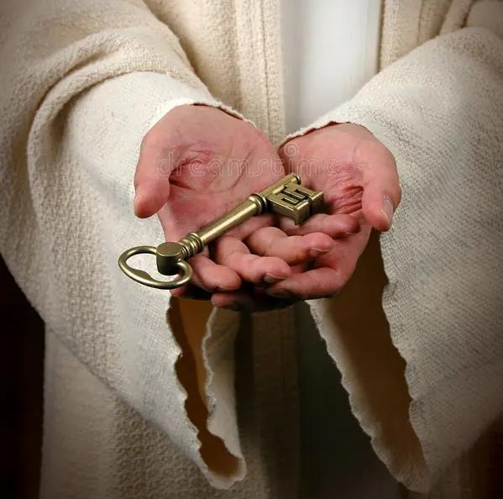
Revelation 1:18
I am he that liveth, and was dead; and, behold, I am alive for evermore, Amen; and have the keys of hell and of death.

Slide 13
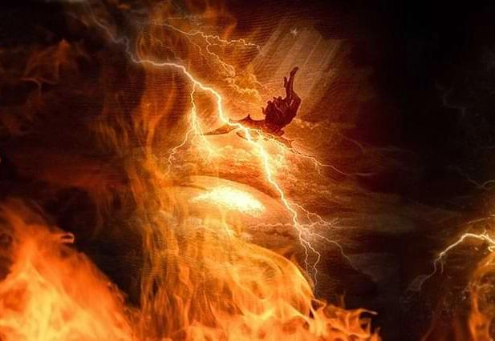
REVELATION 20:1
And I saw an angel come down from heaven, having the key of the bottomless pit and a great chain in his hand. 2 And he laid hold on the dragon, that old serpent, which is the Devil, and Satan, and bound him a thousand years,

Slide 14
QUESTIONS & ANSWERS.ON.HEBREWS
169 "Flesh and blood has not revealed this to you… the gates of hell can't prevail against it. And I say that you're Peter, and I'll give to you the keys of the Kingdom.
Because you've got a spiritual open channel between here and heaven... you never took a seminary; schooling; a course of theology. But you depended on God, and God revealed it to you; and it's absolutely the clear Scriptures that tied together.

Slide 15
And I'll give to you the keys; and what you bind on earth, I'll bind it in heaven…“ Peter had the keys and he had the authority, or Jesus lied. And it's impossible for Him to lie… He had the keys.
Jesus give him the keys. When He rose on on the third day like that, He had the keys of death and hell, but not the keys to the Kingdom. Peter had them.
57-0925

Slide 16
ACTS 2:1
And when the day of Pentecost was fully come, they were all with one accord in one place…
ACTS 2:14
But Peter, standing up with the eleven, lifted up his voice, and said unto them, Ye men of Judaea, and all ye that dwell at Jerusalem, be this known unto you, and hearken to my words:

Slide 17
Peter: ACTS 5:1-11, -3-4
But Peter said, Ananias, why hath Satan filled thine heart to lie to the Holy Ghost, and to keep back part of the price of the land? 4 Whiles it remained, was it not thine own? and after it was sold, was it not in thine own power? why hast thou conceived this thing in thine heart? thou hast not lied unto men, but unto God.
5:15 Insomuch that they brought forth the sick into the streets, and laid them on beds and couches, that at the least the shadow of Peter passing by might overshadow some of them.
18 And laid their hands on the apostles, and put them in the common prison. 19 But the angel of the Lord by night opened the prison doors, and brought them forth…
ACTS 5:3
» 3 † But Peter said, Ananias, why hath Satan filled thine heart to lie to the Holy Ghost, and to keep back part of the price of the land?
ACTS 5:4
» 4 † Whiles it remained, was it not thine own? and after it was sold, was it not in thine own power? why hast thou conceived this thing in thine heart? thou hast not lied unto men, but unto God.

Slide 18
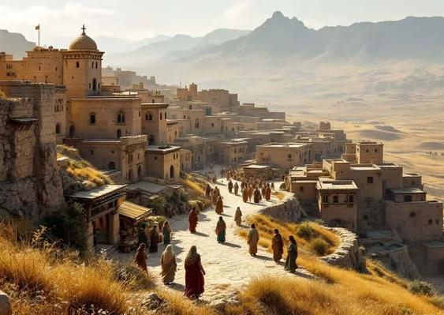
Samaria
ACTS 8:5-6
Then Philip went down to the city of Samaria, and preached Christ unto them. 6 And the people with one accord gave heed unto those things which Philip spake, hearing and seeing the miracles which he did.

Slide 19
THE.WATER.BAPTISM
63 (Acts 8) Philip went down and preached to the Samaritans. They had all baptized… but the Holy Ghost fell on none of them yet.
Peter had the keys. He had to unlock to that generation. When he goes down... and the Holy Ghost had fallen on none of them yet, yet they were baptized in the name of Jesus Christ. Peter went down, him and John, and Peter laid hands upon them and they received the Holy Ghost. 61-0119

Slide 20
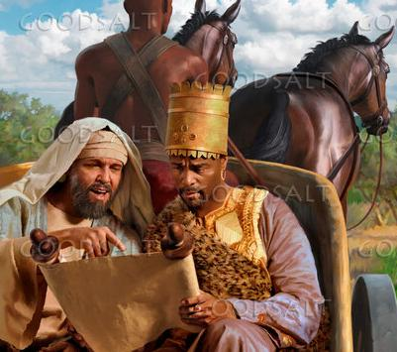
ACTS 8:34-36
And the eunuch answer-ed Philip, and said, I pray thee, of whom speaketh the prophet this? of himself, or of some other man? 35 Then Philip opened his mouth, and began at the same scripture, and preach-ed unto him Jesus. 36 And as they went on their way, they came unto a certain water: and the eunuch said, See, here is water; what doth hinder me to be baptized?

Slide 21
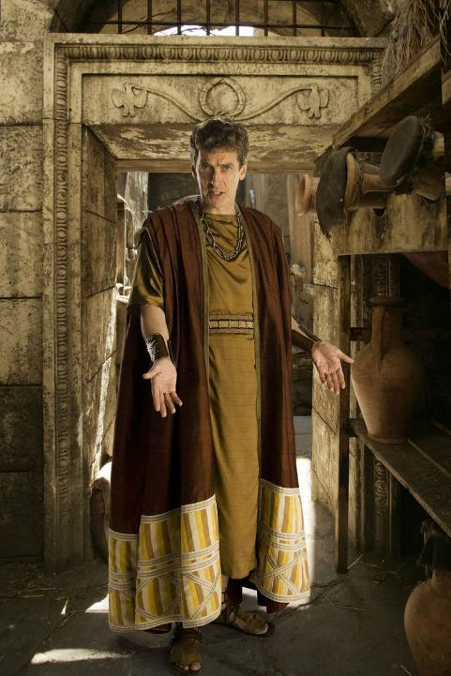
ACTS 10:1
There was a certain man in Caesarea called Cornelius, a centurion of the band called the Italian band, 2 A devout man, and one that feared God with all his house, which gave much alms to the people, and prayed to God alway.

Slide 22
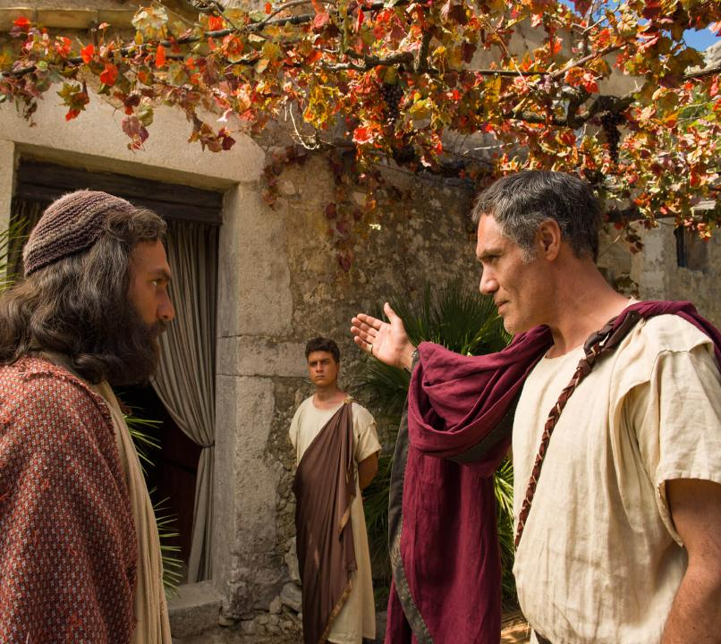
ACTS 10:32-33
Send therefore to Joppa, and call hither Simon, whose surname is Peter; he is lodged in the house of one Simon a tanner by the sea side: who, when he cometh, shall speak unto thee. 33 Immediately therefore I sent to thee; and thou hast well done that thou art come. Now therefore are we all here present before God, to hear all things that are com-manded thee of God.

Slide 23
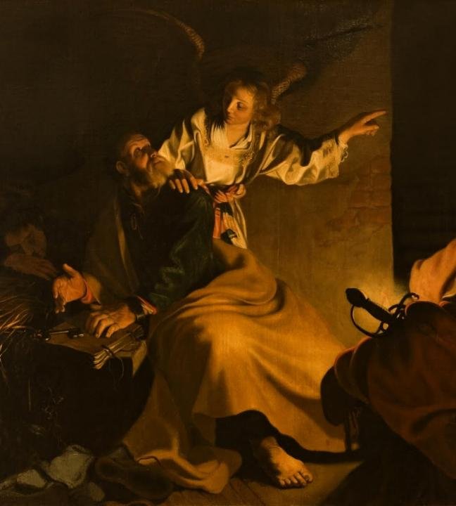
ACTS 12:7-10
And, behold, the angel of the Lord came upon him, and a light shined in the prison: and he smote Peter on the side, and raised him up, saying, Arise up quickly. And his chains fell off from his hands. 8 And the angel said unto him, Gird thyself, and bind on thy sandals. And so he did. And he saith unto him, Cast thy garment about thee, and follow me. 9 And he went out, and followed him; and wist not that it was true which was done by the angel; but thought he saw a vision. 10 When they were past the first and the second ward, they came unto the iron gate that leadeth unto the city; which opened to them of his own accord: and they went out, and passed on through one street; and forthwith the angel departed from him.

Slide 24
THE.RAPTURE
70 Cain and Abel didn't have a Bible to read, but it was revealed to Abel, by faith, a revelation... Matt. 16:17-18, "Who does man say I the Son of man am?" "One of them said You're 'Moses, Elias.'" He said, "But Who do you say I am?“ He said, "Thou art the Christ, the Son of the living God." He said, "Blessed art thou, Simon… Upon this rock," the spiritual revelation of Who God is, Who Jesus is. And He is the revelation of God, God made in flesh and revealed to the world.

Slide 25
"He was in the world,” God was in Christ, reconciling the world to Himself, revealing what God was, in a body of flesh. “…Upon this rock I'll build My Church, the revelation of the Word in Its season…”
74 The Book of the Revelations…It's sealed to unbelievers. It was altogether given for believers. And It opens the Book and reveals Who the Author of this entire Book is... reveals His complete mystery of Himself, His plans for His church ages that's to come, and was sealed in there by Seven Seals. 65-1204

Slide 26
The Key of the House of God (Levites)
1 Chronicles 9:26-27
For these Levites, the four chief porters, were in their set office, and were over the chambers and treasuries of the house of God. And they lodged round about the house of God, because the charge was upon them, and the opening thereof every morning pertained to them.

Slide 27
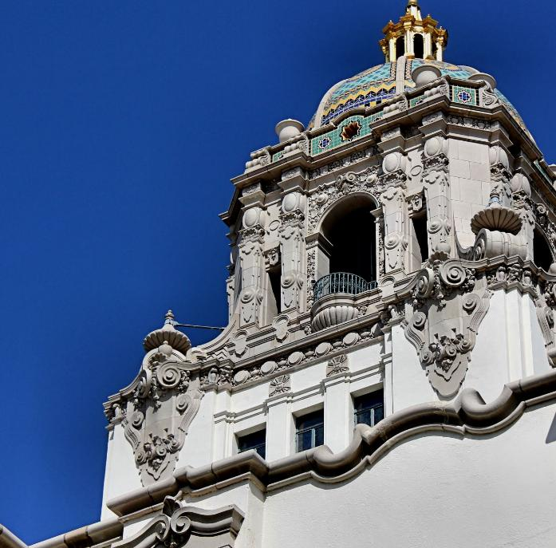
WHAT.DOES.IT.TAKE.TO.MAKE.A.CHRISTIAN.LIFE God never intended Christianity to be governed by denominations, by creeds. If God intended for the church to be gover-ned by creeds, denominations and intellectuals, then we do not need the Holy Spirit in the church, Its success would be largely placed upon the intellectuals of the best of us. The better intellectuals we would have in our church, the more progressive our church would be. 57-0113

Slide 28
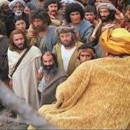
Luke 11:51-52
From the blood of Abel unto the blood of Zacharias, which perished between the altar and the temple: verily I say unto you, It shall be required of this generation. Woe unto you, lawyers! for ye have taken away the key of knowledge: ye entered not in yourselves, and them that entered in ye hindered.

Slide 29

GALATIANS 1:6-8
I marvel that ye are so soon removed from him that called you into the grace of Christ unto
another gospel: 7 Which is not another; but there be some that trouble you, and would pervert the gospel of Christ. 8 But though we, or an angel from heaven, preach any other gospel unto you than that which we have preached unto you, let him be accursed.

Slide 30
A.TOTAL.DELIVERANCE
78 What would He do if we were one heart and one accord? And the only way we can do that is unify our hearts together with brotherly love, obey the offices of the church, the pastor, and the pastor obey God; then God works through the pastor, through the board, down into the church, all together one unit to the Kingdom of God.
Then God will hear when we have a unified group. Let nothing bother you. Don't be dismayed in anything. That's the kind of a person that God ordained to take the land.
59-0712

Slide 31
WHAT.DOES.IT.TAKE.TO.MAKE.A.CHRISTIAN.LIFE
11 God intended this Church to be a powerful Church, a glorious Church, a Church that the whole world could look upon as a Bride of Christ well expected and espoused, and live in such an atmosphere and conduct itself in such a way God would be proud of this Church to present it to Christ at the coming of the Lord.
It should be living that way. But we find out that many times that with good intentions that people are trying to make themselves act like Christians.

Slide 32
Sinners do that, but you don't have to do that… The Lord is here. If things are going good, things are going good in my soul and bad in my body, it makes any difference, God is always there, and I'm always stimulated with a pleasure that's, "Joy unspeakable and full of glory." That's what He does for the believer.
55-0806

Slide 33
“If all the sleeping folks will wake up, and all the lukewarm folks will fire up, and all the disgruntled folks will sweeten up, and all the discouraged folks will cheer up, and all the depressed folks will look up, and all the estranged folks will make up, and all the gossiping folks will shut up, and all the dry bones will shake up, and all the true soldiers will stand up, and all the church members will pray up, and if the Savior of all will be lifted up . . . then we can have the greatest renewal this world has ever known.”

Slide 34
HEBREWS.CHAP. 5-6
138 When the new Birth is come, you are changed. You don't have to do anything to prove it. Your life proves it, as you walk: love, peace, long-suffering, gentleness, meekness, patience. That's what you are, the whole world sees the reflection of Jesus Christ in you.
57-0908M

Slide 35
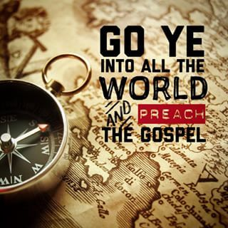
MARK 16:15-16
And he said unto them,
Go ye into all the world, and preach the gospel to every creature. 16 He that believeth and is baptized shall be saved; but he that believeth not shall be damned.

Slide 37
(Example) JEHOVAH.JIREH
35 We find Abraham was just an ordinary man. And God called him, and said that through him He was going to make him a father of nations. That's the way... Now, many of the brethren laying hands on the sick. That's all right but that's a Jewish tradition. That was never meant for the Gentiles. The Jew said, "Come, lay your hand on my daughter and she'll be well.“
But the Gentile said, "Just speak the word; my servant will live." That's the difference. Just say the word. 61-0209

Slide 38
The Tates In Your Church
How many members of the Tate family belong to your church? There is old man Dic Tate who wants to run everything, while Uncle Ro Tate tries to change everything. Their sister Agi Tate stirs up plenty of trouble, with help from her husband, Irri Tate.
Whenever new projects are suggested, Hesi Tate and his wife, Vege Tate, want to wait until next year. Then there is Aunt Imi Tate, who wants our church to be like all the others. Devas Tate provides the voice of doom, while Poten Tate wants to be a big shot. But not all members of the family are bad. Bro. Facili Tate is helpful in church matters. Medi Tate always thinks things over and of course there is the black sheep of the family, Ampu Tate, who has completely cut himself off from the church.

Slide 39
A.GUIDE
57 Don't travel your denominational routes now, stay right behind the Word, 'cause you haven't passed this way before... The Word will lead you across, because the Word is Christ...
58 Stay behind the Word! Yes, sir! Stay with that Guide. Don't get in front of It, stay behind It. Let It lead you, don't you lead It. Joshua said, "Now, you've never passed this way before, you know nothing about the road.“ 62-1014

Slide 40
THE.RESULTS.OF.DECISION
75 JOSH. 3:3 And they commanded the people, saying, When ye see the ark of the covenant of the LORD your God, and the priests the Levites bearing it, then ye shall remove from your place, and go after it. 4 Yet there shall be a space between you and it, about two thousand cubits by measure: come not near unto it, that ye may know the way by which ye must go: for ye have not passed this way heretofore.
I believe there's an experience for the Church “…you've never passed this way before.”

Slide 41
76 Let's move out towards Jordan. God's here leading you. The Angel of God took Jordan first. The Angel of God will lead you every step of the way. Sometimes you think that the trials are hard. God ain't in no hurry. You're the only one that's in a hurry.
God let the Hebrew children go right in the fiery furnace…Daniel get right in the lion's den, before He ever come. Just rise up and start walking by faith. "God, I believe you. I'm bound for the promised land. God, You promised it to me, and here I come…

Slide 42
Matt. 19:26
But Jesus beheld them, and said unto them, With men this is impossible; but with God all things are possible.

