Slide 1
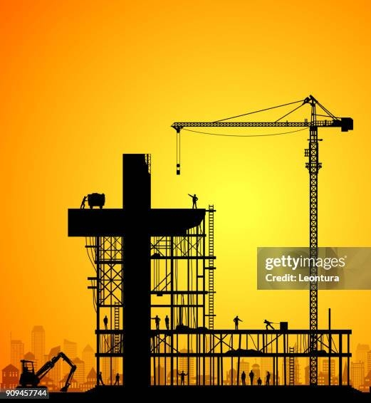
The Glorious Spirit-Made Church
MATTHEW 16:17
And Jesus answered and said unto him, Blessed art thou, Simon Barjona: for flesh and blood hath not revealed it unto thee, but my Father which is in heaven. 18 And I say also unto thee, That thou art Peter, and upon this rock I will build my church; and the gates of hell shall not prevail against it.

Slide 2
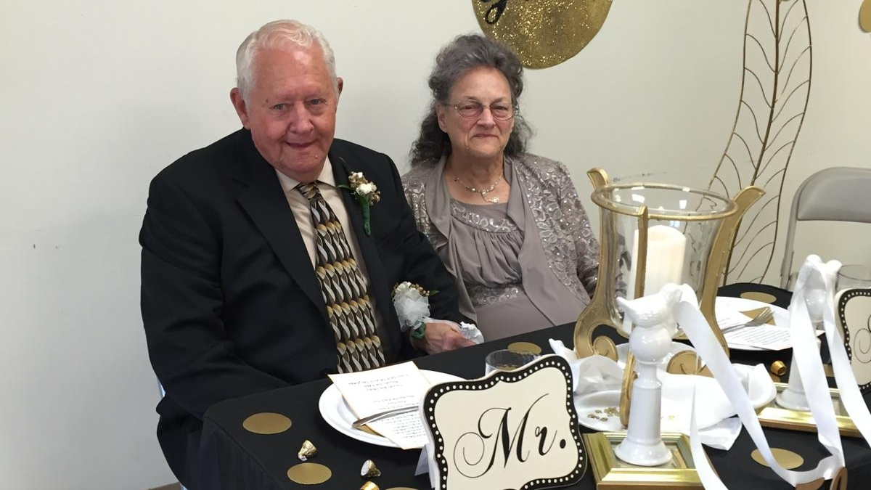

Slide 3

Birthdays Anniversaries & Events
April 21st John Cockman
April 23rd Sean Ashdown
April 24th Ellen Parks
April 25th Anderson Pritchard, Lea Brittain
April 27th Aaron & Trish Nengomazha
April 28th Noah Brittain
April 29th Ashley James
Dates to Remember: May 16th Ladies Tea Oct. 9-11th Men’s Meeting
Family Day (Possibly Aug. 15th)

Slide 4
A.SUPER.SIGN
8 Now, we're hoping someday soon, the Lord willing, to have a nice, big tabernacle, where we'll have all kinds of Sunday school rooms for the classes…
There'll be no interfering in the services, at all, walking or tromping around. These little fellows are restless, and they don't understand. We have to understand them; they can't understand us. 59-1227

Slide 5
GOD.HIDING.HIMSELF.IN.SIMPLICITY
32 Now, there's little children, little babies, they don't know no different. The only way they can get what they want is cry for it. Sometimes it's a drink of water [or] they need attention. And so we have by the grace of God dedicated room; it was called on the list a "cry room," where the mothers can take their baby.
(Now, maybe I won't even notice it, being anointed) but other people setting near, it bothers them. And they come to hear the service. So the mothers, if your little baby starts whimpering, you can't help that. You should, you ought to bring it. A real mother wants to take her baby to church, that's the thing you should do. 63-0317

Slide 6
CHURCH.ORDER
69 There should be a little bitty baby class, there should be from about five years old.
And all the others under that should be kept with the mother, and taken to the nursery if it's necessary during the time of the preaching, if they go to carrying on. That's what the nursery's out there for. 63-1226

Slide 7
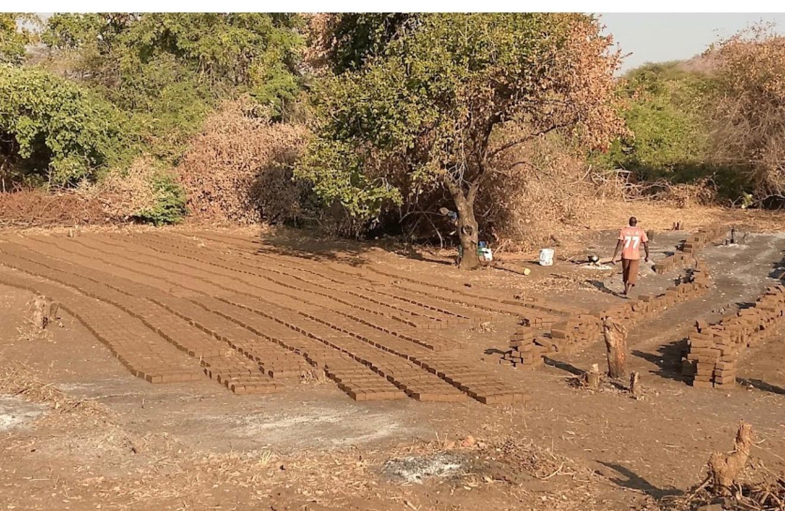
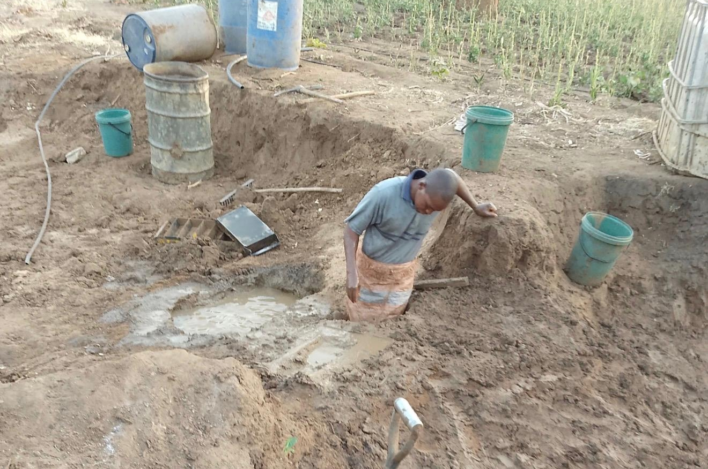

Mahuhwe Church in Muzarabani. Very remote and often called the most dangerous area to drive in Zimbabwe

Slide 8
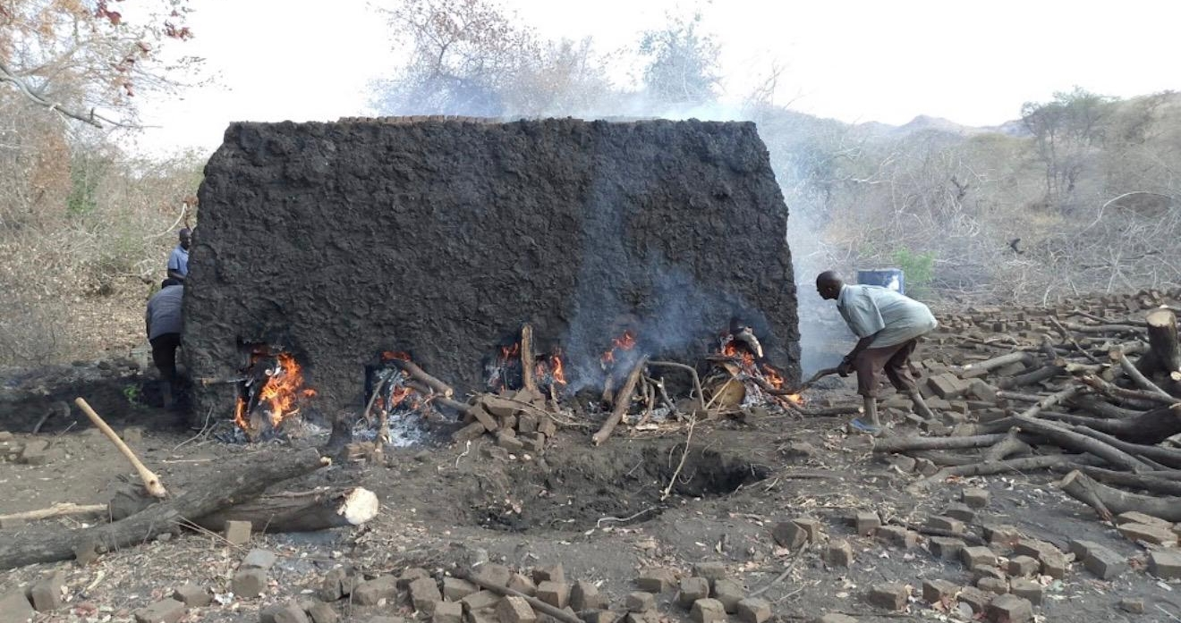

Slide 9
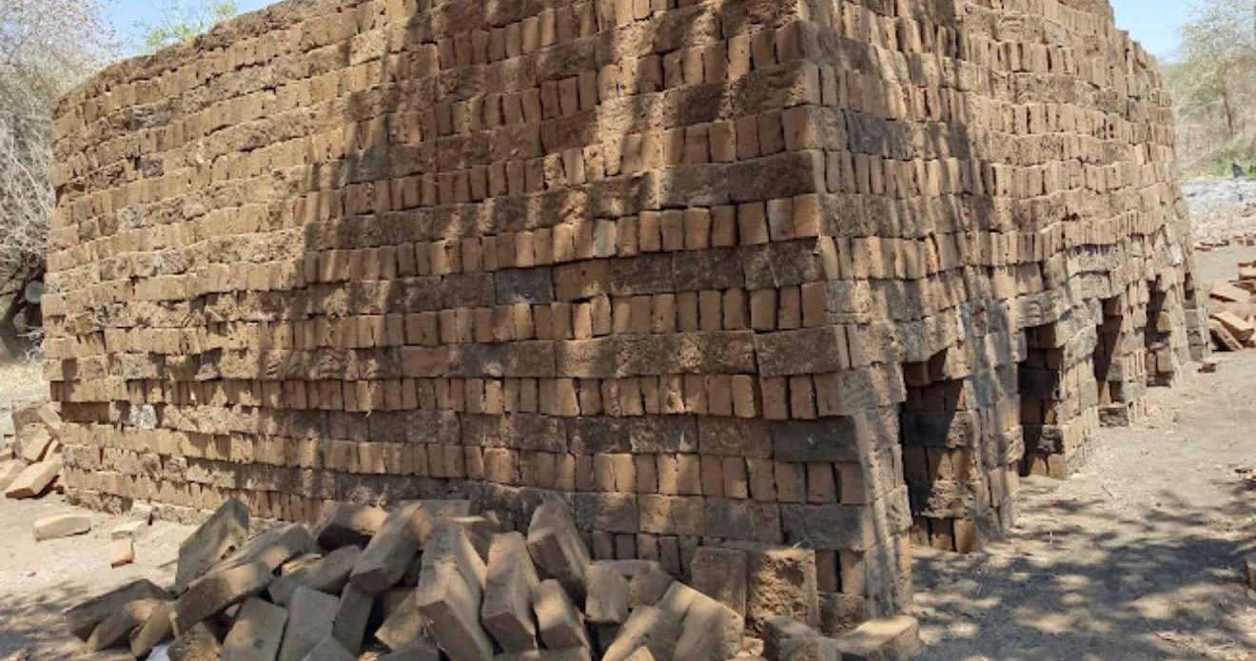

Slide 10
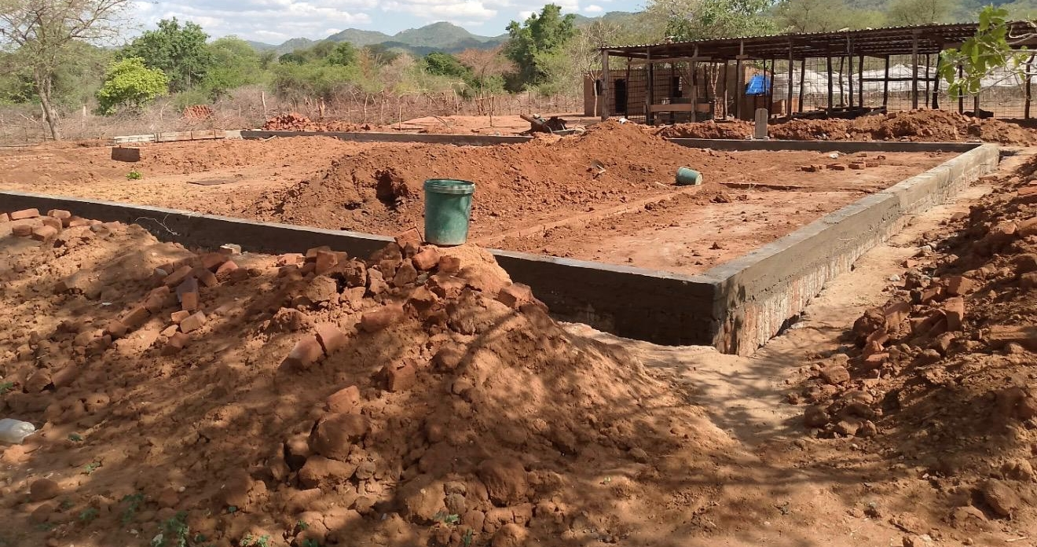

Slide 11
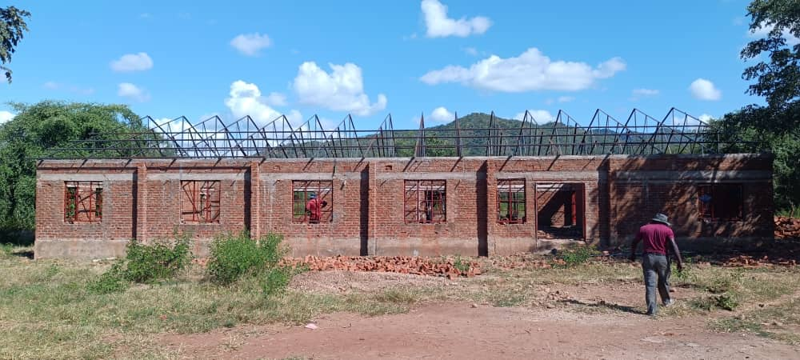

Slide 12
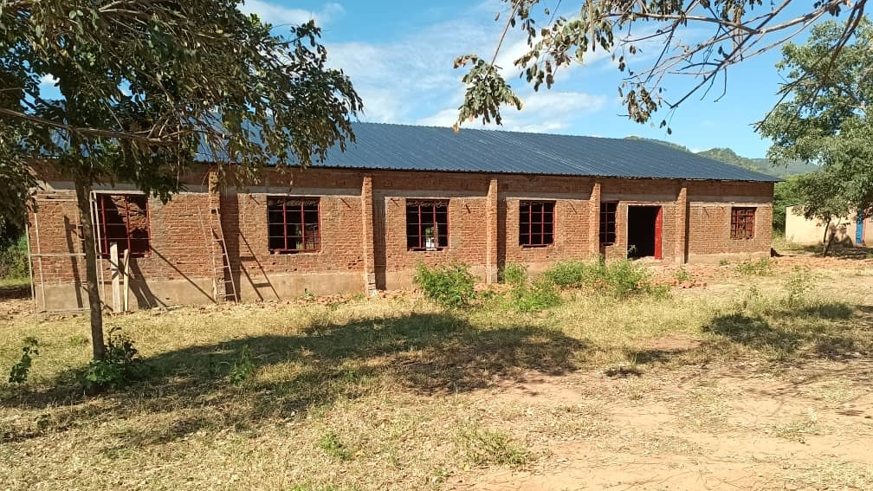

Slide 13
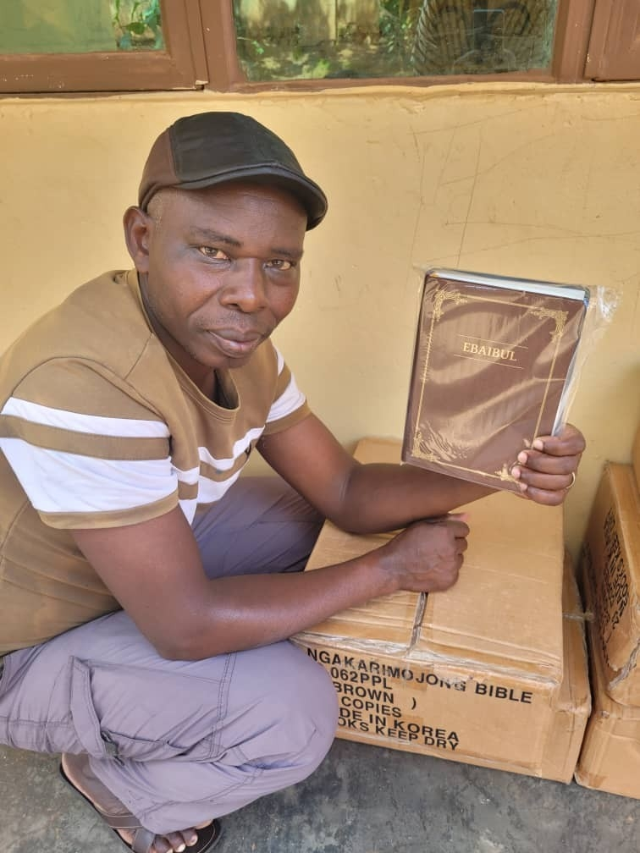
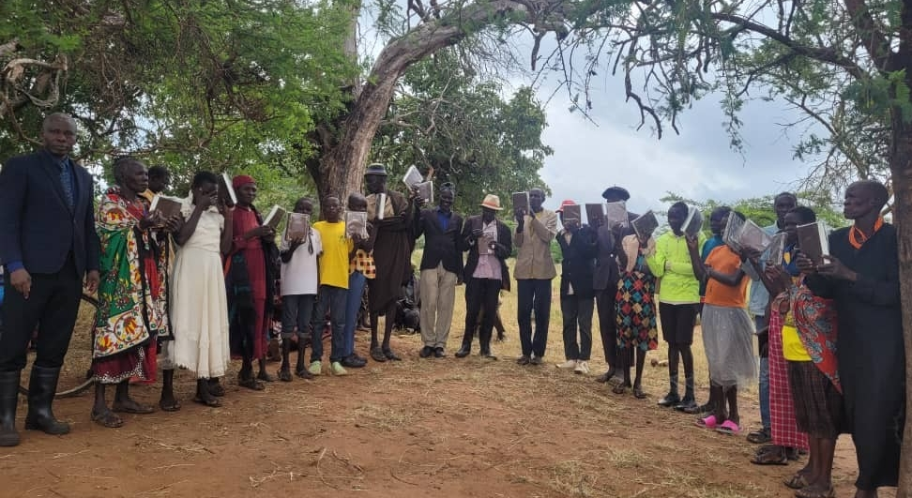
Karamojong Bibles
Karamoja, Uganda

Slide 14
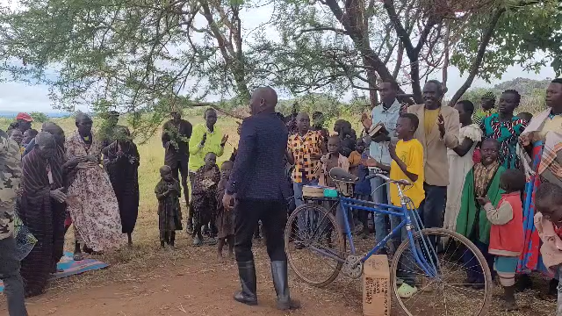

Slide 15
The Glorious Spirit-Made Church
MATTHEW 16:17
And Jesus answered and said unto him, Blessed art thou, Simon Barjona: for flesh and blood hath not revealed it unto thee, but my Father which is in heaven. 18 And I say also unto thee, That thou art Peter, and upon this rock I will build my church; and the gates of hell shall not prevail against it.

Slide 16
THE.ONENESS.OF.UNITY
3-4 That's the way all sin is, is righteousness perverted. God made you to thirst after Him; and God made the church to be oneness under His dominion, but the devil makes them oneness under his domain.
58-0128
COLOSSIANS 3:1
If ye then be risen with Christ, seek those things which are above, where Christ sitteth on the right hand of God. 2 Set your affection on things above, not on things on the earth.

Slide 17
WHO.IS.THIS.MELCHISEDEC
42 The Bible has been a work of God that's been covered up. [He] promised in this day He would take the mask off, and we could see It.
43 God, en morphe, masked in the Pillar of Fire. God, en morphe, in a Man called Jesus. God, en morphe, in His Church. God above us, God with us, God in us; the condescending of God.
65-0221

Slide 18
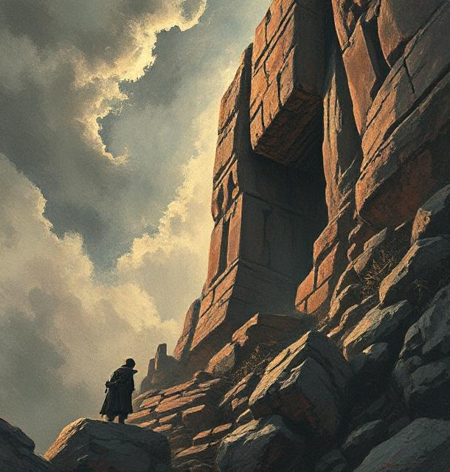
Condescend
To behave as one descending from a superior position, or rank.
To put aside one's superiority voluntarily and assume equality with one regarded as inferior.

Slide 19
PHILIPPIANS 2:5-8
Let this mind be in you, which was also in Christ Jesus: 6 Who, being in the form of God, thought it not robbery to be equal with God: 7 But made himself of no reputation, and took upon him the form of a servant, and was made in the likeness of men: 8 And being found in fashion as a man, he humbled himself, and became obedient unto death, even the death of the cross.

Slide 20
SPIRITUAL.ADOPTION
42 "And I say unto thee, thou art Peter (little rock.) I am the great Rock, the Cornerstone… The builders chose you. You never chose yourself. The Angels of God, working in the quarry, called you out, you submitted yourself to Me. And I made you the way that I wanted you to be. I done the sawing...
I placed you now as a little stone to fit in with some other stone, and this stone leads that stone, that stone.

Slide 21
And the cement of love is bringing you together, making the foundation which I am, to be fitted together with every stone that professes My Name and receives this revelation.
And upon this rock, the revelation of God that'll stand still and be cut, the stone by the revelation, I will build My Church and all the gates of hell shall not prevail against It," showing that surely all the gates of hell would be against It, but shall never prevail. 56-0923

Slide 22
LEAN.NOT.UNTO.THY.OWN.UNDERSTANDING
49 And when the Word is made manifest, revealed, they won't accept It, because they lean to their own understanding. "This church was built here, a beautiful place. It's a great organization... Why shouldn't we belong to that? I'll trust in it."
Trust not in your own understanding, but trust in the Word of the Lord! 65-0120

Slide 23
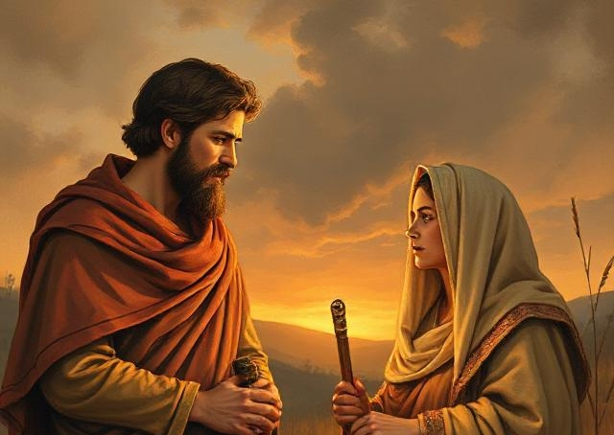
RUTH 2:11-12
And Boaz answered and said unto her, It hath fully been shewed me, all that thou hast done unto thy mother in law since the death of thine husband: and how thou hast left thy father and thy mother, and the land of thy nativity, and art come unto a people which thou knewest not heretofore.
12 The LORD recompense thy work, and a full reward be given thee of the LORD God of Israel, under whose wings thou art come to trust.

Slide 24
MATTHEW 6:31-34
33 But seek ye first the kingdom of God, and his righteousness; and all these things
shall be added unto you.
All

Slide 25
Eg: QUESTIONS & ANSWERS.2
89 …She kept messing around without receiving the Holy Ghost, called me and wanted to leave her own husband, and marry [another] man. She had come to such a place, maybe one time being in contact with God, but had been lusting after the things of the world. I asked her, "Have you received the Holy Ghost?“ She said, "Not yet, but I'm seeking It.“
I said, "You get the Holy Ghost first, and He'll tell you what husband to have." 54-0103

Slide 26
5
Things
To Remember:

Slide 27

1. ISRAEL & THE.CHURCH
43 God's now loosening up the church everywhere… got to give it rapturing faith before it can go in the rapture. The people are in the spirit of the last days, like they was in the days of Noah, eating, drinking, marrying, giving in marriage, unconcerned, don't care…
53-0326

Slide 28
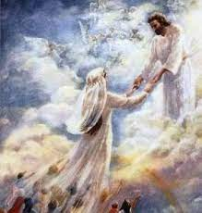
2. THE.BREACH
106-4 The Lamb broke the Seals and revealed them to His church in order to collect His subjects for His Kingdom, His Bride. He wants to bring His subjects to Him now.
63-0317

Slide 29
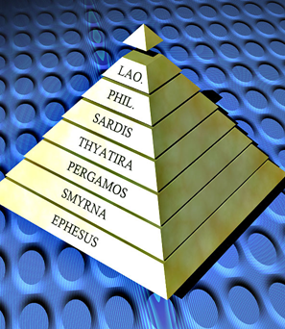
3. Gentile Dispensation: From Early Church
To the Bride Age
INVISIBLE.UNION
324 The Word that fell on the Day of Pentecost will not work this day. That was for Pentecost. This is for the Bride, going Home of the Bride. We got something different. We're in the Bride age. 65-1125

Slide 30
4. THE.TRUE.VINE.AND.A.FALSE.VINE
12 We've been drug through every school of theology, one vice versa from the other one. "Well, my pastor says, the guy is a devil.“ The other one said, "Well, it's not the Lord; I will tell you that."
And the people don't know what to believe. You believe God's Bible; that's the thing that's right. "Let ever man words be a lie…“ If God says it in His Word, and He produces it, believe it, and go on. Forget the rest of it and just let God be truth.
55-0607

Slide 31
5. I CORINTHIANS 13:9-12
For we know in part, and we prophesy in part. 10 But when that which is perfect is come, then that which is in part shall be done away. 11 When I was a child, I spake as a child, I understood as a child, I thought as a child: but when I became a man, I put away childish things. 12 For now we see through a glass, darkly; but then face to face:
COD 1005-56 ...We do have today, by God's help, the perfect interpretation of the Word with Divine vindication. Then that which is in part is done away with.
64-0823

Slide 32
Daniel 1:5,8
And the king appointed them a daily provision of the king's meat, and of the wine which he drank: so nourishing them three years, that at the end thereof they might stand before the king.
⁸ But Daniel purposed in his heart that he would not defile himself with the portion of the king's meat, nor with the wine which he drank: therefore he requested of the prince of the eunuchs that he might not defile himself.

Slide 33
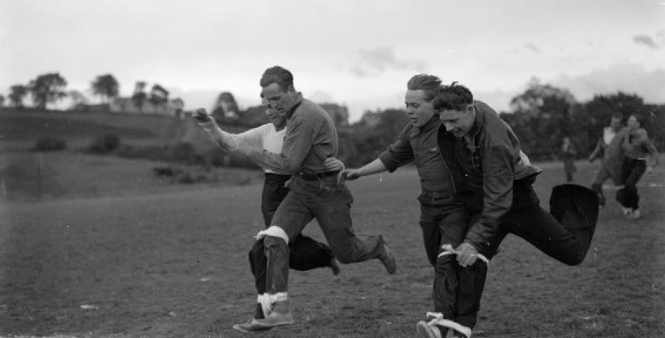
JOHN 15:7
If ye abide in me, and my words abide in you, ye shall ask what ye will, and it shall be done unto you.
Agreement(Gr.) sugkatathesis
A putting together or joint deposit; agreement.

Slide 34
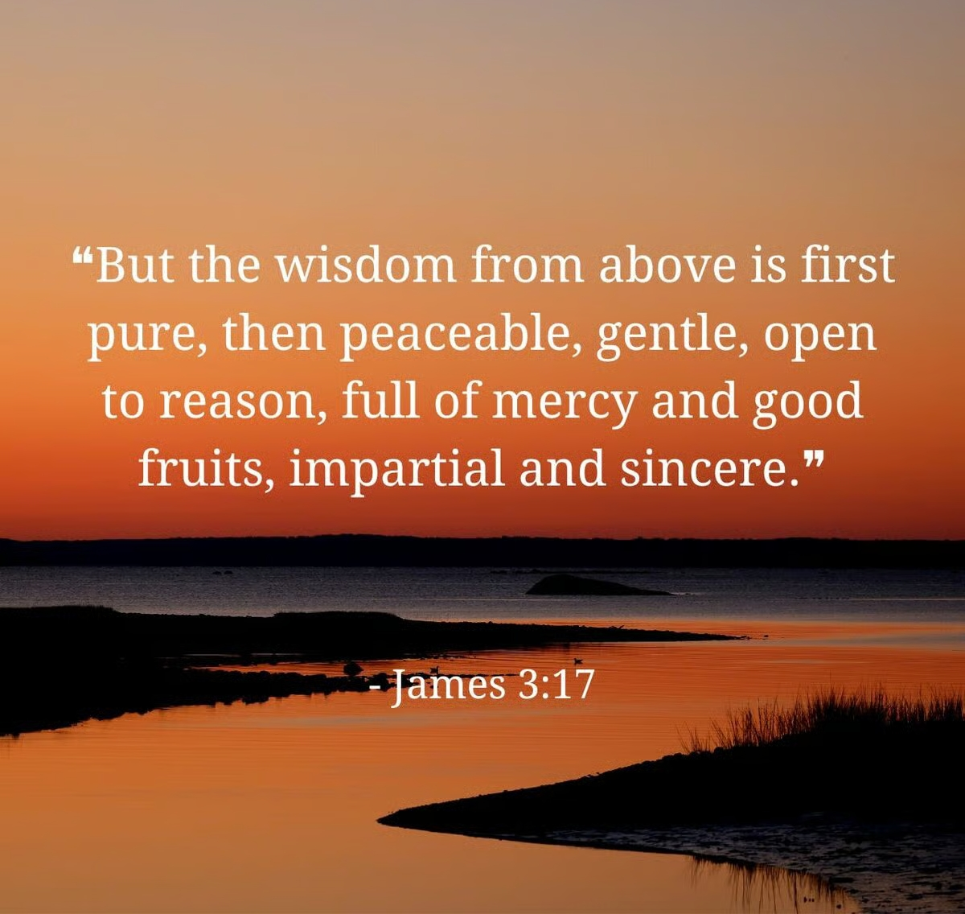
James 3: 14-16
But if ye have bitter envying and strife in your hearts, glory not, and lie not against the truth.
¹⁵ This wisdom descendeth not from above, but is earthly, sensual, devilish. ¹⁶ For where envying and strife is, there is confusion and every evil work.

Slide 35
God Keeps His Word
38 The first gift in the line of gifts is wisdom. The second is knowledge. And if you don't have any wisdom, how do you know what to do with knowledge? Seek the best things first: wisdom. And if you haven't got wisdom, what can you do with knowledge, or speaking with tongues, or these other things? It takes God's wisdom. The Pentecostal received the speaking in tongues, and they made a denomination out of it. 57-0407

Slide 36
Faith in God’s Existence; and,
Faith in God’s Trustworthiness
EXODUS 4:1-3
And Moses answered and said, But, behold, they will not believe me, nor hearken unto my voice: for they will say, The LORD hath not appeared unto thee. 2 And the LORD said unto him, What is that in thine hand? And he said, A rod. 3 And he said, Cast it on the ground. And he cast it on the ground, and it became a serpent; and Moses fled from before it.

Slide 37
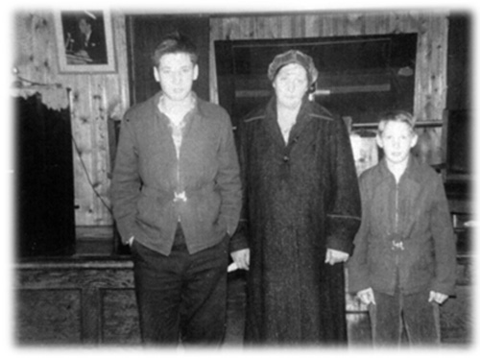
MY.NEW.MINISTRY
86 …All signs that He spoke of will follow the believer. God is no respect of persons. What He did for Hattie, He will do for you. What He did for the blind, He will do for you blind… Any-thing that He's done for anybody else, He will do for you, if you will only believe.
59-1115

Slide 38
UNCONDITIONAL.COVENANT.GOD.MADE.
WITH.HIS.PEOPLE
11 If I ever heard of anybody in my meeting ever making one pull or straining for any money... Just pass the collection plate. When the Lord won't supply my needs, then it's time for me to go home.
But the Lord will supply. And if I can't trust Him for money, how can I trust Him for healing? How can I trust Him for anything else? I've got to trust Him.
54-0306

Slide 39
IMPERSONATION.OF.CHRISTIANITY
114 He said, "Then I'll put My Spirit..." God's new heart that He put in you, sets right in the center of you. And… It controls your emotions. It's just like the mainspring in a watch, it's self-winding. You don't have to wind it every day. God's wound it once for all. And it sets right in the middle of your new life. And as the mainspring, it controls every little [part] of that watch to perfect time.

Slide 40
116 And when the Holy Spirit, not the new degree, new church, new thought, new emotion, new oil, new dance, new hat, but when God places His Spirit in the middle of your new spirit, then you don't have to act meek; you don't have to act like a Christian. It controls everything that's within you. It puts you in decent, makes the church act orderly, makes the gifts work perfect.
57-0120

Slide 41
ISAIAH 41:9-13
Fear thou not; for I am with thee: be not dismayed; for I am thy God: I will strengthen thee; yea, I will help thee; yea, I will uphold thee with the right hand of my righteousness.
Dismayed: sha’ah
To look at, gaze ; look afar, look away.
To look in dismay, or anxiety.

Slide 42


JOSHUA 1:7-9
Only be thou strong and very courageous, that thou mayest observe to do according to all the law, which Moses my servant commanded thee: turn not from it to the right hand or to the left, that thou mayest prosper whithersoever thou goest… 9 Have not I commanded thee? Be strong and of a good courage; be not afraid, neither be thou dismayed: for the LORD thy God is with thee whithersoever thou goest.

Slide 43
ISAIAH 31:1-3
Woe to them that go down to Egypt for help; and stay on horses, and trust in chariots, because they are many; and in horsemen, because they are very strong; but they look not unto the Holy One of Israel, neither seek the LORD…!
3 Now the Egyptians are men, and not God; and their horses flesh, and not spirit. When the LORD shall stretch out his hand, both he that helpeth shall fall, and he that is holpen shall fall down, and they all shall fail together.

Slide 44
MATTHEW 19:26
But Jesus beheld them, and said unto them, With men this is impossible; but with God all things are possible.
*HEBREWS 2:13
And again, I will put my trust in him. And again, Behold I and the children which God hath given me.

Slide 45
HUMBLE.THYSELF
77 People want power, and really don't know what power is…don't really know what goes with it. The way up is down, always. If you want power, see how humble you can get. Get away from all your worldly thinking, and humble yourself before God, then you've got more power than the man that runs all over the building and makes a big lot of noise; because you have been able to conquer yourself, commit yourself to Christ, to humble yourself before Him. That's really power. Show me a church real humble, not arrogant; sweet, humble, I'll show you a church that has the favor and power of God in it. 63-0714

Slide 46
II CORINTHIANS 7:1
Having therefore these promises, dearly beloved, let us cleanse ourselves from all filthiness of the flesh and spirit, perfecting holiness in the fear of God.

Slide 47
THE.RESULTS.OF.DECISION
75 JOSH. 3:3 And they commanded the people, saying, When ye see the ark of the covenant of the LORD your God, and the priests the Levites bearing it, then ye shall remove from your place, and go after it. 4 Yet there shall be a space between you and it, about two thousand cubits by measure: come not near unto it, that ye may know the way by which ye must go: for ye have not passed this way heretofore.
I believe there's an experience for the Church “…you've never passed this way before.”

Slide 48
76 Let's move out towards Jordan. God's here leading you. The Angel of God took Jordan first. The Angel of God will lead you every step of the way. Sometimes you think that the trials are hard. God ain't in no hurry. You're the only one that's in a hurry.
God let the Hebrew children go right in the fiery furnace. He let Daniel get right in the lion's den, before He ever come. Just rise up and start walking by faith. "God, I believe you. I'm bound for the promised land. God, You promised it to me, and here I come…

Slide 49
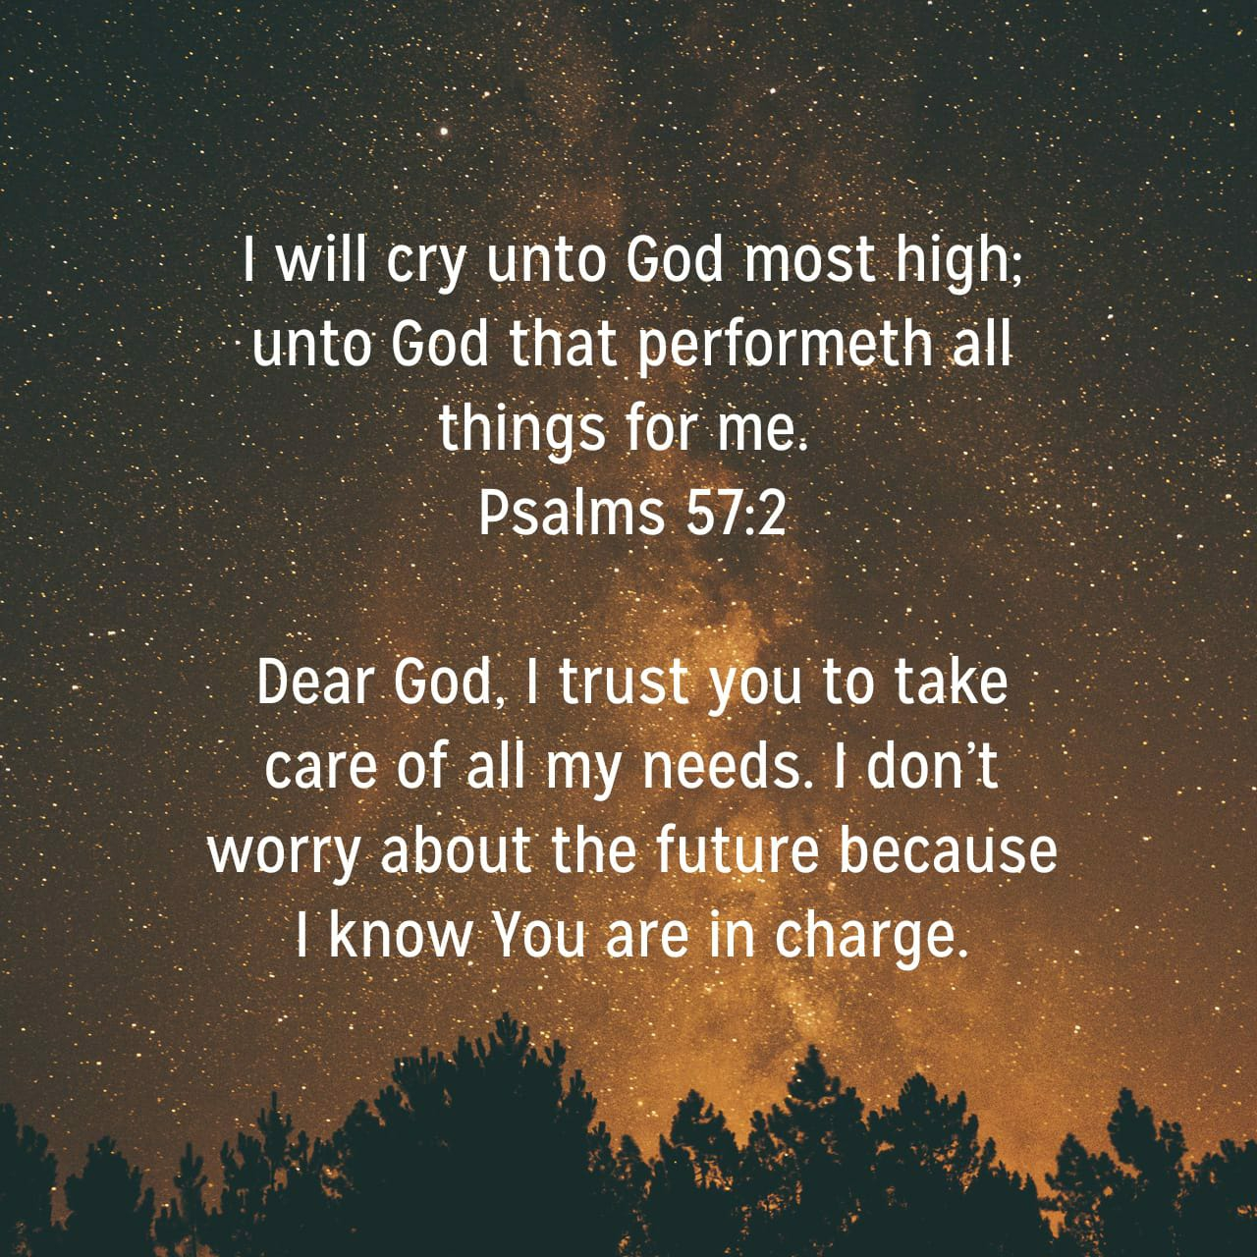
Matt. 19:26
But Jesus beheld them, and said unto them, With men this is impossible; but with God all things are possible.

Slide 50
JESUS.CHRIST.THE.SAME
21 But you should be born again. "Well, if I get that kind of experience, I won't be able to do this or that…“ Well, the devil will tell you that you're going to lose some good time…
But he's a lying to you, especially you young people. You don't have to drink, smoke…. Why, the Holy Spirit is a million times better than all the devil could offer you. You don't have to get drunk on strong drink to have a big time.

Slide 51
Sinners do that, but you don't have to do that… The Lord is here. If things are going good, things are going good in my soul and bad in my body, it makes any difference, God is always there, and I'm always stimulated with a pleasure that's, "Joy unspeakable and full of glory." That's what He does for the believer.
55-0806

Slide 52
A.TOTAL.DELIVERANCE
78 What would He do if we were one heart and one accord? And the only way we can do that is unify our hearts together with brotherly love, obey the offices of the church, the pastor, and the pastor obey God; then God works through the pastor, through the board, down into the church, all together one unit to the Kingdom of God. Then God will hear when we have a unified group. Let nothing bother you. Don't be dismayed in anything. Now, that's the kind of a person that God ordained to take the land. 59-0712

Slide 53
HEBREWS.CHAP. 5-6
138 When the new Birth is come, you are changed. You don't have to do anything to prove it. Your life proves it, as you walk: love, peace, long-suffering, gentleness, meekness, patience. That's what you are, the whole world sees the reflection of Jesus Christ in you.
57-0908M

Slide 54
A.GUIDE
57 Don't travel your denominational routes now, stay right behind the Word, 'cause you haven't passed this way before... The Word will lead you across, because the Word is Christ...
58 Stay behind the Word! Yes, sir! Stay with that Guide. Don't get in front of It, stay behind It. Let It lead you, don't you lead It. Joshua said, "Now, you've never passed this way before, you know nothing about the road.“ 62-1014

