Slide 1
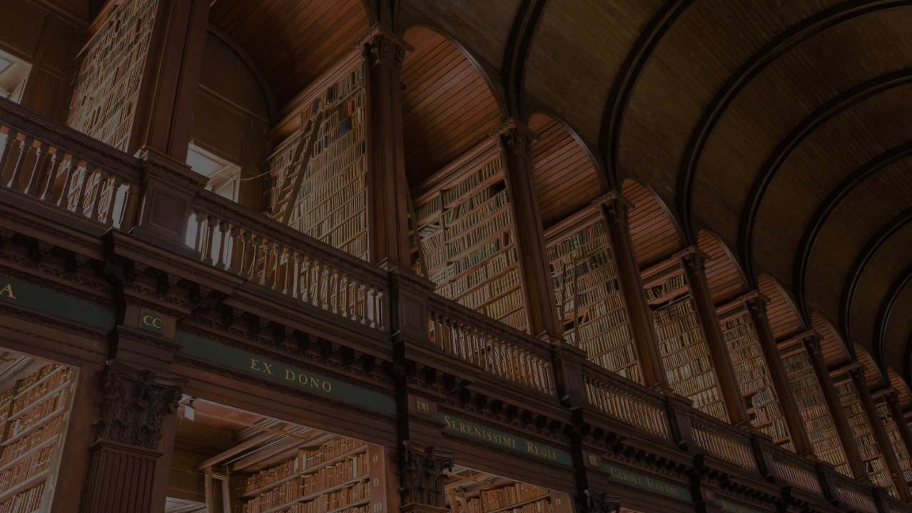
Faith
GENESIS 15:6
And he believed in the LORD;
and he counted it to him for righteousness.

Slide 2
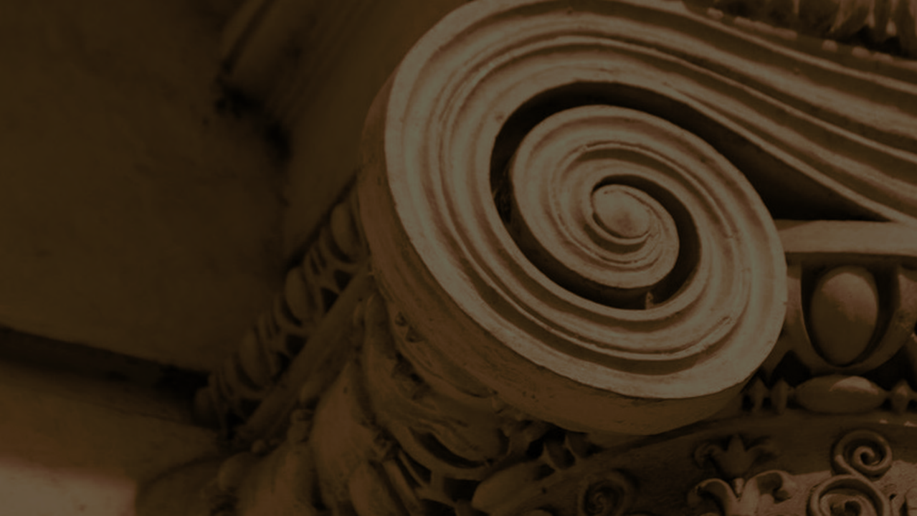
Birthdays Anniversaries
April 6th Joe & Frieda Drum, Becky Coffey
Nathaniel Reynolds
April 7th Sarah Buchanan, Anna Jackson
April 8th Rachel Pritchard
April 11th Crystal Johnson, Theo Cross
April 13th Lukas Coffey
Dates to Remember: May 16th Ladies Tea Oct. 9-11th Men’s Meeting
June 13th Kids Day

Slide 3
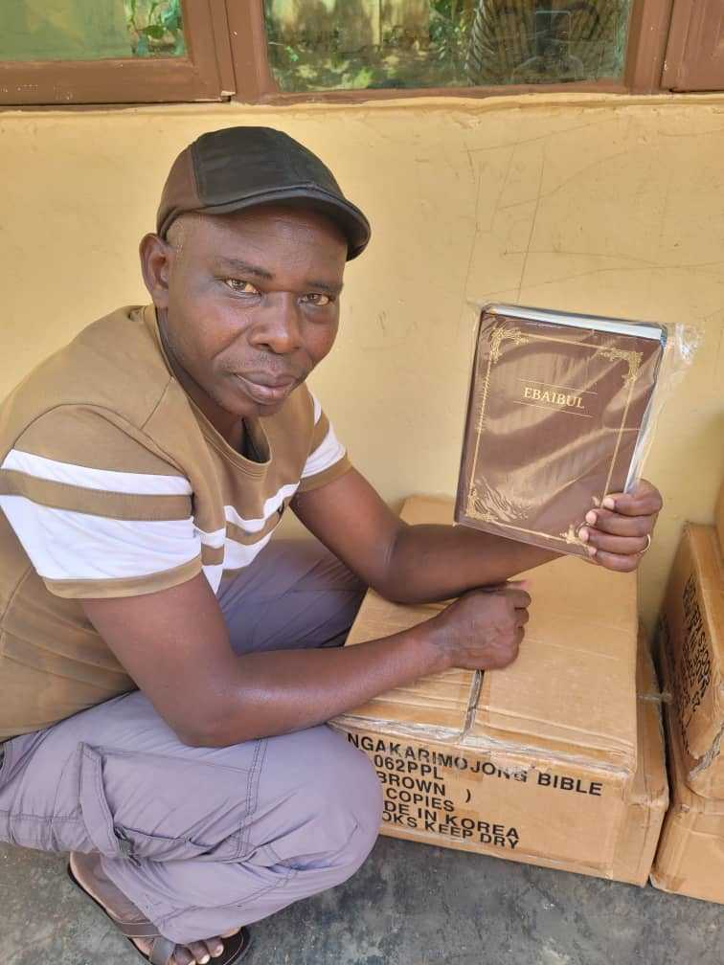
Karamoja, Uganda
100 Bibles have arrived in Karamoja, Uganda, and are now being distributed freely among believers in the region.
These Bibles are printed in the Ngakarimojong language. In a culture where much knowledge has traditionally been passed down orally, access to Bibles is both rare and valuable.

Slide 4
Faith
GENESIS 15:6
And he believed in the LORD;
and he counted it to him for righteousness.

Slide 5
PERSEVERANT
26 God gave you those five senses to contact your earthly home. But that has nothing to do with God. There isn't any of them that will declare God, not a one of them.
Faith is something different. Faith is the sixth sense which you contact God. You can only contact God by the sixth sense which is faith. "He that cometh to God must believe that He is, and a rewarder of those that diligently seek after Him. 62-0729

Slide 6
GENESIS 15:1, 6
After these things the word of the LORD came unto Abram in a vision, saying, Fear not, Abram: I am thy shield, and thy exceeding great reward…
6 And he believed in the LORD; and he counted it to him for righteousness.
“Believed” 'aman
Pillars, supporters of the door
Established, carried by a nurse;
Made firm, sure, lasting;
To trust, to be certain;
To believe in.
(The mason’s line)

Slide 7

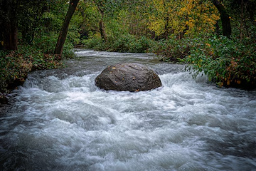

Slide 8
THE.POWER.OF.THE.DEVIL
49 Night after night, standing on the platform before thousands of people around the world, critics saying, "It's this, that, and the other," witch doctors trying to throw spells on you, challenge you to a duels and things, never one time, by the grace of God, has one speck of fear ever hit my heart.
Not one time. Why? He said He would take care of me, and I believe Him. If I'd get scared, I'd run.

Slide 9
But I tell you, when Jesus Christ anoints you, you're not made out of running material. Not the rock of Gibraltar but the Rock of Ages...
You climb up on the Rock of Ages; that's God's Word, take your position there and stand while the gates of hell is a battling against it, with this perfect assurance: That He Who promised it not fail, will never fail. That's faith. That's when you're not scared. 55-1005

Slide 10
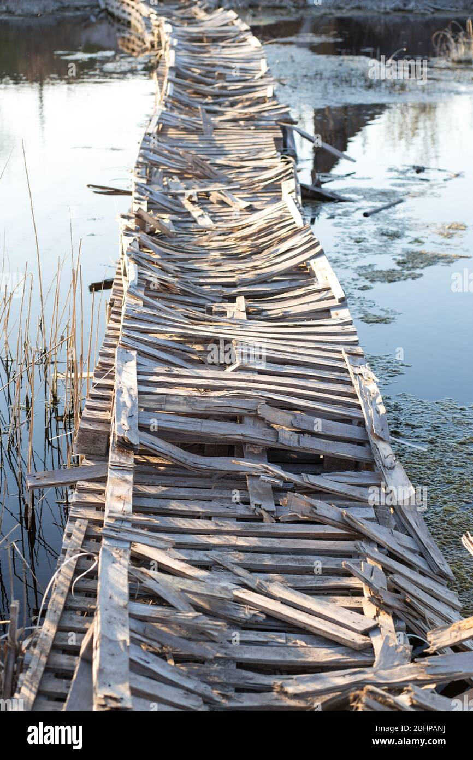
If you had to cross a river, which
Bridge would you rather use?
I Cor. 7:32
But I would have you
without carefulness...

Slide 11
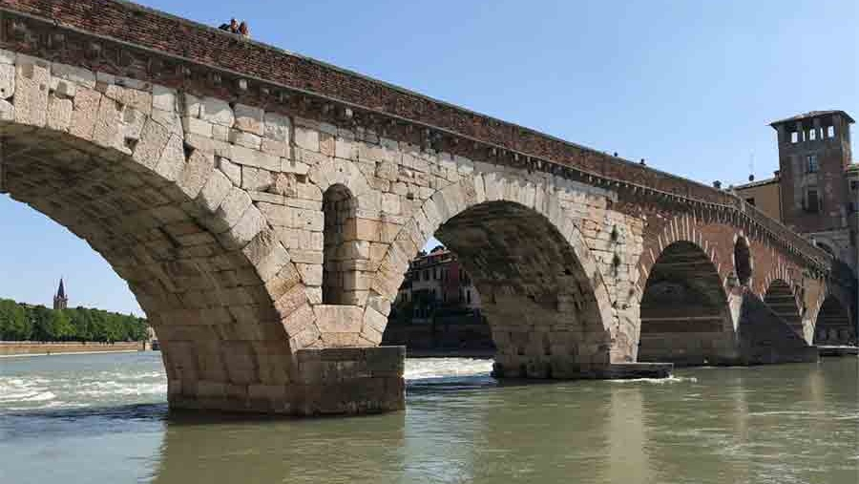

Slide 12
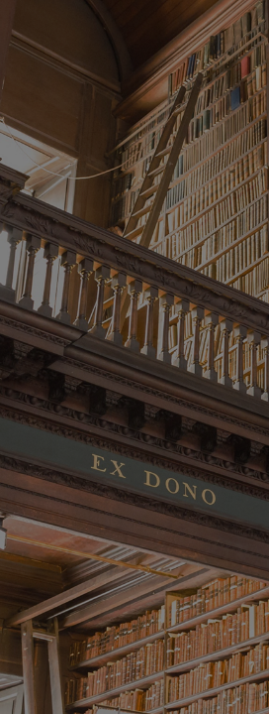
II CHRONICLES 9:5-8
And she said to the king, It was a true report which I heard in mine own land of thine acts, and of thy wisdom: 6 Howbeit I believed not their words, until I came, and mine eyes had seen it: and, behold, the one half of the greatness of thy wisdom was not told me: for thou exceedest the fame that I heard. 7 Happy are thy men, and happy are these thy servants, which stand continually before thee, and hear thy wisdom.
8 Blessed be the LORD thy God, which delighted in thee to set thee on his throne, to be king for the LORD thy God: because thy God loved Israel, to establish them for ever, therefore made he thee king over them, to do judgment and justice.

Slide 13
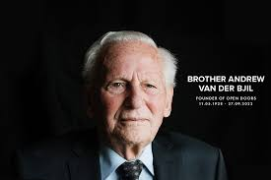
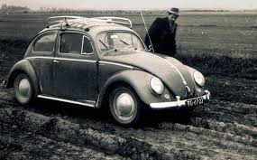
“Of course it’s dangerous. But it’s a lot more dangerous for all of us if we don’t do it. Even in a conquering army there are casualties. Safety is not the issue when we look at the Great Commission. The purpose of the church cannot be to survive, or even to thrive, but to serve.”

Slide 14
What made his faith ʾāman: Noah had no flood to reference. No rain had ever fallen in the way God described. He had no community of Believers around him — every single person in his world was moving in the opposite direction. Yet for approximately 120 years, he kept building.
“
”

Slide 15
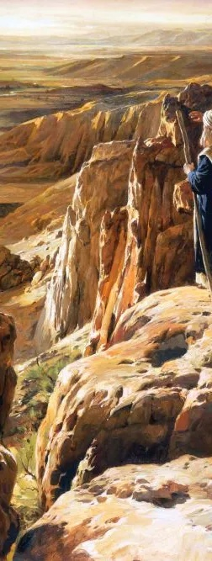
ISAIAH 7:9
…If ye will not believe, surely ye shall not be established.
DEUTERONOMY 9:23
Likewise when the LORD sent you from Kadesh-barnea, saying, Go up and possess the land which I have given you; then ye rebelled against the commandment of the LORD your God, and ye believed him not, nor hearkened to his voice.

Slide 16
GOD.KEEPS.HIS.WORD
100 My faith is stayed on that solid Rock. There's nothing can ever harm, when you're anchored to that place. The storms may shake and batter us, but my anchor holds within the veil.
When a man or a woman has anchored against that rock. Hallelujah. There ain't nothing can ever shake you from it. 57-0407

Slide 17
JOHN 6:28
Then said they unto him, What shall we do, that we might work the works of God? 29 Jesus answered and said unto them, This is the work of God, that ye believe on him whom he hath sent.
“pisteuo” (Gr.)
The conviction and trust to which a man is impelled by a certain inner and higher prerogative and law of soul; to trust in God as able to aid either in obtaining or in doing something.

Slide 18
Rahab. James 2:25 holds her up as proof that genuine ʾāman produces action. She had less revelation than anyone in Israel — and her faith shamed the generation that had seen the Red Sea and still refused to believe.
“
”
JAMES 2:25
Likewise also was not Rahab the harlot justified by works, when she had received the messengers, and had sent them out another way?

Slide 19
ROMANS 10:16-17
But they have not all obeyed the gospel. For Esaias saith, Lord, who hath believed our report? 17 So then faith cometh by hearing, and hearing by the word of God.

Slide 20
WHY.I'M.AGAINST.ORGANIZED.RELIGION
4 He's made a way for us. Now, if there was any healing power within myself I'd come there and do it. But, healing power, I have none, no other man has healing power.
But we are commissioned from Christ, to pray for the sick, Who has already put on deposit the healing power. And we're only coming, as it was, to write a check on that. "And whatever you ask the Father in My Name," that's the blank check, "whatever you ask the Father in My Name, that I'll do."

Slide 21
What a promise! Just can't fail. And I have helped my brothers and sisters, around the world make these drawings on these notes in God's Bank, on the Blood of Jesus Christ. And it's been very successful. He's always paid off because the deposit's already there.
"He was wounded for our transgressions, with His stripes we were healed." See, it's all over. And we're happy tonight for your faith.
62-1111

Slide 22
JEHOVAH.JIREH
45 When God saves a man, He gives him a whole big checkbook.... Name of Jesus wrote at the bottom of the checkbook. "Whatever you ask in My Name, that will I do." Abraham's seed believes that. Just fill out the check and send it in. The deposit's already made.
Not through your righteousness, but through the righteousness of the righteous royal Seed, Christ. He was the one put the deposit in there. Then don't be afraid to write out the check. The Bank of Heaven will pay off every check.

Slide 23
First thing it has to go through the clearing house, to see if you really believe it or not. If you believe it, it'll pass the clearing house, don't worry about that. And the funds will return to you just as soon as she passes through the clearing house. If down in your heart you truly believe that's the promise of God, and you've accepted it in your heart, asked for it in the Name of Jesus Christ, it's coming back.
God promised so. We're heirs of salvation and joint-heirs with Him… heirs with Abraham, because we are Abraham's seed. 61-0209

Slide 24
THE.TRUE.VINE.AND.A.FALSE.VINE
12 And the people don't know what to believe. You believe God's Bible; that's the thing that's right. "Let ever man words be a lie…“ If God says it in His Word, and He produces it, believe it, and go on. Forget the rest of it, and just let God be truth.
55-0607

Slide 25
MATTHEW 8:7-8, 13
And Jesus saith unto him, I will come and heal him. 8 The centurion answered and said, Lord, I am not worthy that thou shouldest come under my roof: but speak the word only, and my servant shall be healed.
13 And Jesus said unto the centurion, Go thy way; and as thou hast believed, so be it done unto thee. And his servant was healed in the selfsame hour.

