Slide 1

Revive, Renew & Refresh
Aaron Nengomazha : Hickory Bible Table

Slide 2
Job 14:7-8 KJV
For there is hope of a tree, if it be cut down, that it will sprout again, and that the tender branch thereof will not cease. [8] Though the root thereof wax old in the earth, and the stock thereof die in the ground;

Slide 3
Isaiah 40:29-31 KJV
He giveth power to the faint; and to them that have no might he increaseth strength. [30] Even the youths shall faint and be weary, and the young men shall utterly fall: [31] But they that wait upon the LORD shall renew their strength; they shall mount up with wings as eagles; they shall run, and not be weary; and they shall walk, and not faint.

Slide 4
Judges 16:16 KJV
And it came to pass, when she pressed him daily with her words, and urged him, so that his soul was vexed unto death;

Slide 5
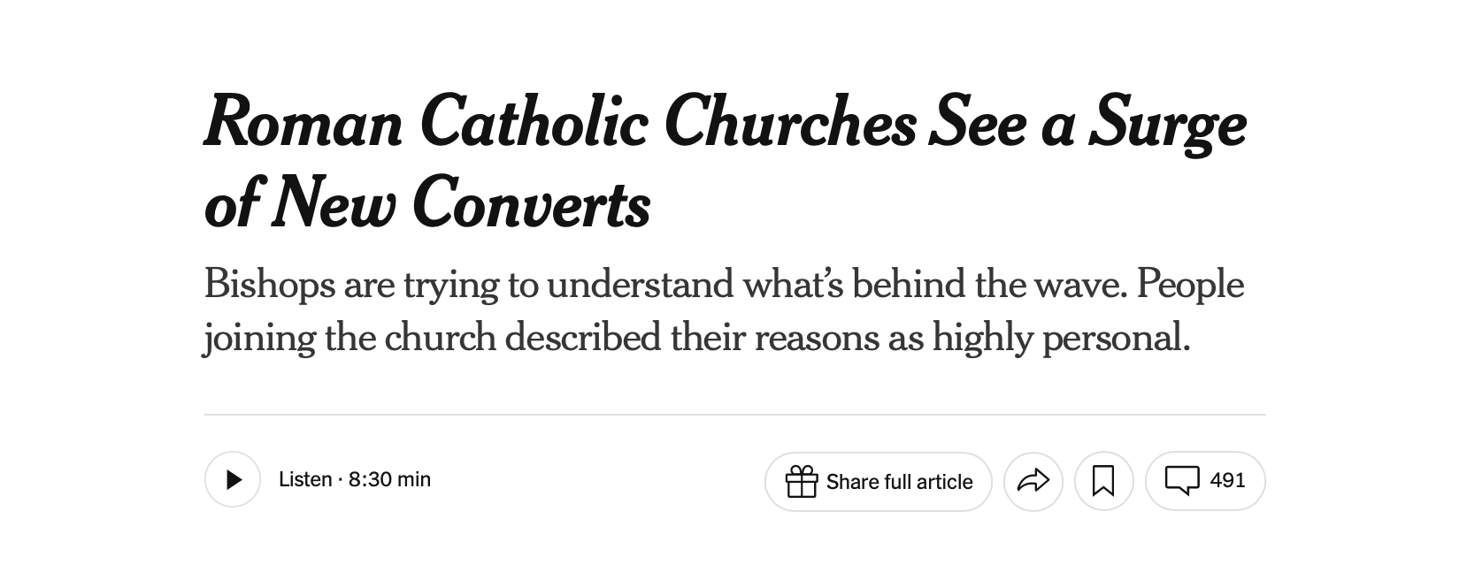

Slide 6
64-0719M - "The Feast Of The Trumpets"
160 They wasn’t natural horses. They breathed fire, and they had breastplates of jasper, and—and they had tails. And the end of the tail looked like a serpent, a snake’s head on the end of it, stinging. See? It was spiritual horses, spiritual devils, chargers, that had been bound in Euphrates all these years, supernatural devils. What was it? The old Roman Empire being revived; the persecution of the Jews. They had been bound for nearly two thousand years, at the river Euphrates, can’t cross to the promise; a religious sect that was trying to get to the other side. Euphrates, you know, come through Eden. But they were bound there, two hundred thousand devils of persecution.

Slide 7
53-0325 - "Israel And The Church #1"
A revival, to my opinion, doesn’t consist of, well, bringing in new members. A revival doesn’t consist of a bunch of conversions, although those things go along with a revival. But a revival is “to revive what you’ve already got,” just to get them revived.

Slide 8
64-0401 - "The Identified Christ Of All Ages"
A revival doesn’t mean getting new members. It’s reviving that what we’ve already got. See? It’s reviving.
I stood, some time ago, and watching the waves on Lake Michigan, seeing, standing out there, after a great revival in Chicago. I seen the—the waves, how they were coming in, just in a great tide, just sweeping in and out. I thought, you know, it remind me of the song, “Floods of joy over my soul, like the sea billows roll.” And them waves start somewhere, out into the lake or in the ocean. And as they come, they build up momentum, all the time. Then, finally, they strike the shore; just to go out, to come in again.

Slide 9
64-0401 - "The Identified Christ Of All Ages"
Same reason God has, a revival, is the same reason He puts a revival on the ocean, puts a revival in the lake. And the water, churning up-and-down, takes all the trash out of the water, throws it up on the bank. And I think that’s a good thing, that we have revivals, and kind of get all the superstitions away from us, and all the—the—the world out, churning it out, and throw it out on the bank, so the waters can be free of such.

Slide 10
Revelation 7:15-17 KJV
Therefore are they before the throne of God, and serve him day and night in his temple: and he that sitteth on the throne shall dwell among them. [16] They shall hunger no more, neither thirst any more; neither shall the sun light on them, nor any heat. [17] For the Lamb which is in the midst of the throne shall feed them, and shall lead them unto living fountains (Springs) of waters: and God shall wipe away all tears from their eyes.

Slide 11
Revelation 2:4-5 KJV
Nevertheless I have somewhat against thee, because thou hast left thy first love. [5] Remember therefore from whence thou art fallen, and repent, and do the first works; or else I will come unto thee quickly, and will remove thy candlestick out of his place, except thou repent.

Slide 12
Revelation 3:1-2 KJV
And unto the angel of the church in Sardis write; These things saith he that hath the seven Spirits of God, and the seven stars; I know thy works, that thou hast a name that thou livest, and art dead. [2] Be watchful, and strengthen the things which remain, that are ready to die: for I have not found thy works perfect before God.

Slide 13
Genesis 18:2-4 KJV
And he lift up his eyes and looked, and, lo, three men stood by him: and when he saw them, he ran to meet them from the tent door, and bowed himself toward the ground, [3] And said, My Lord, if now I have found favour in thy sight, pass not away, I pray thee, from thy servant: [4] Let a little water, I pray you, be fetched, and wash your feet, and rest yourselves under the tree:

Slide 14
Amos 5:21-24 KJV
I hate, I despise your feast days, and I will not smell in your solemn assemblies. [22] Though ye offer me burnt offerings and your meat offerings, I will not accept them: neither will I regard the peace offerings of your fat beasts. [23] Take thou away from me the noise of thy songs; for I will not hear the melody of thy viols. [24] But let judgment run down as waters, and righteousness as a mighty stream.

Slide 15
Matthew 15:6 KJV
And honour not his father or his mother, he shall be free. Thus have ye made the commandment of God of none effect by your tradition.

Slide 16
59-0611 - "The Time Of Decision"
84 O Lord, You see them, and You know them. Let the Holy Spirit now bring that Rebekah to the Waters of Life, where the cooling refreshing comes, the Presence of God shall bathe their hearts, souls, and bring unto them new Life and new hope. Let the Angel of God, Who has been sent before the Message, speak to the Blood relation that’s been bought by the precious Christ.

Slide 17
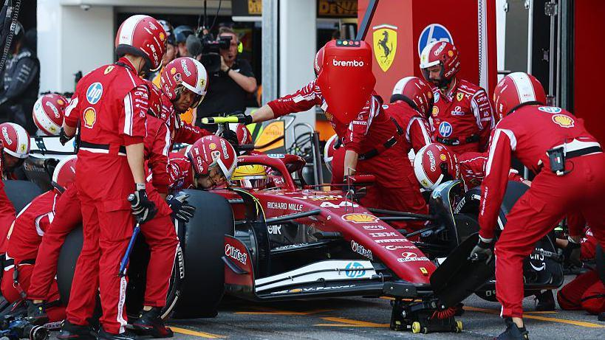
Pit Stop

Slide 18
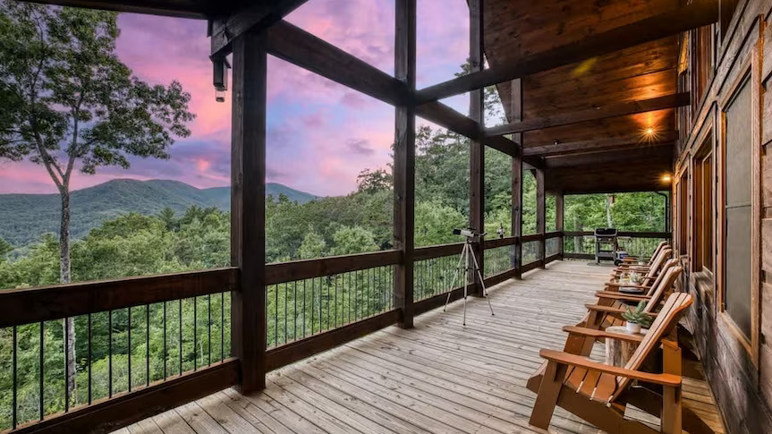
Reset & Recharge

Slide 19
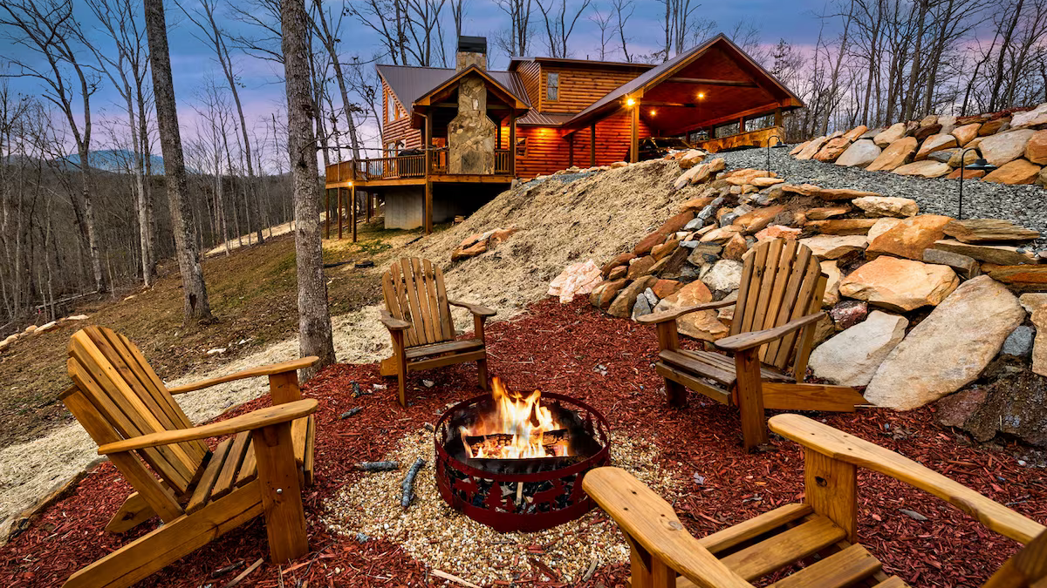

Slide 20


Slide 21
The Best way to Keep your engine running
“The best way to keep your engine running longer is to
change the oil and filter regularly (every 3,000–7,500 miles) using high-quality synthetic oil”

Slide 22
Psalm 133:1-3 KJV
Behold, how good and how pleasant it is for brethren to dwell together in unity! [2] It is like the precious ointment upon the head, that ran down upon the beard, even Aaron's beard: that went down to the skirts of his garments; [3] As the dew of Hermon, and as the dew that descended upon the mountains of Zion: for there the LORD commanded the blessing, even life for evermore.

