Slide 1
LIVING ABOVE YOUR CARES
PSALM 55:22
Cast thy burden upon the LORD, and he shall sustain thee: he shall never suffer the righteous to be moved.

Slide 2

Birthdays & Anniversaries
Mar. 20th Aaron Nengomazha
Mar. 25th Chris Clayville
Mar. 29th Mike & Angela Pritchard
Mar. 31st Noah Cockman
April 1st Ted & Suzanne Doucette
April 4th Tendai Esau

Slide 3
A.SUPER.SIGN
8 Now, we're hoping someday soon, the Lord willing, to have a nice, big tabernacle, where we'll have all kinds of Sunday school rooms for the classes…
There'll be no interfering in the services, at all, walking or tromping around. These little fellows are restless, and they don't understand. We have to understand them; they can't understand us. 59-1227

Slide 4
GOD.HIDING.HIMSELF.IN.SIMPLICITY
32 Now, there's little children, little babies, they don't know no different. The only way they can get what they want is cry for it. Sometimes it's a drink of water [or] they need attention. And so we have by the grace of God dedicated room; it was called on the list a "cry room," where the mothers can take their baby.
(Now, maybe I won't even notice it, being anointed,) but other people setting near, and it bothers them. And they come to hear the service. So the mothers, if your little baby starts whimpering, you can't help that. You should, you ought to bring it. A real mother wants to take her baby to church, and that's the thing you should do. 63-0317

Slide 5
CHURCH.ORDER
69 There should be a little bitty baby class, there should be from about five years old.
And all the others under that should be kept with the mother, and taken to the nursery if it's necessary during the time of the preaching, if they go to carrying on. That's what the nursery's out there for. 63-1226

Slide 6
LIVING ABOVE YOUR CARES
PSALM 55:22
Cast thy burden upon the LORD, and he shall sustain thee: he shall never suffer the righteous to be moved.

Slide 7
SHALOM
38 We're facing two Scriptures, [Is. 61] a contrast one to the other. "Arise, and shine, for the glory of God has come upon you. Thy Light is here." The next verse "Gross darkness is upon this people."
The world is in one of the most chaotic times of darkness that it's ever stood in, and yet it's standing in, again, the most blessed Light that it ever shined in.
64-0112

Slide 8
TO.WHOM.WOULD.WE.GO
41 ...It wasn't meant for you to have peace here. If you did, you'd get customized to the world. God don't want you customized to this world.
He wants you to rest in Him. Come to Him, then you have peace.
60-0606

Slide 9
DANIEL 7:23-25
Thus he said, The fourth beast shall be the fourth kingdom upon earth, which shall be diverse from all kingdoms, and shall devour the whole earth, and shall tread it down, and break it in pieces…
25 And he shall speak great words against the most High, and shall wear out [exhaust, harass constantly] the saints of the most High, and think to change times and laws: and they shall be given into his hand until a time and times and the dividing of time.

Slide 10
WATCHMAN.WHAT.OF.THE.NIGHT
6 There is none of us that is immune from troubles. God has not promised to excuse us from all sickness, but it is written that His strength is sufficient.
And He will never put so much upon us, but what He will give us grace to bear. So we have that consolation of knowing.
58-1130

Slide 11
The Bottom Line
This is a real, measurable, multi-generational shift, not simply "kids these days complaining." The causes are layered:
1. Technology that was designed to capture attention,
2. The erosion of deep community and face-to-face
relationship,
3. The COVID years,
4. Economic uncertainty, and
5. The collapse of extended family structures that once absorbed stress across generations.

Slide 12
1. Social Media and Smartphones
This is probably the most discussed factor. Studies show a correlation between heavy social media use and depression, anxiety, loneliness, and suicidal thoughts. The platforms are designed to be addictive, using algorithms that feed users content based on their preferences and interactions, keeping them engaged for longer periods.

Slide 13
Viewed through the lens of Psalm 55:22, it is worth noting that what the data describes is a generation carrying enormous yehâb — assigned burdens — with fewer and fewer people around them to share the weight, and with tools (phones, social media) that promise relief but often deepen the isolation.

Slide 14
“One document stated: "If we wanna win big with teens, we must bring them in as tweens." Another internal memo showed that 11-year-olds were four times as likely to keep coming back to Instagram, compared with competing apps, despite the platform requiring users to be at least 13 years old. The Addictive Features at Issue: Her case argued that Meta and YouTube made deliberate design choices — for example, "infinite scroll" — to make their platforms more addictive to children in order to boost profits.

Slide 15
PSALM 42:6-9
O my God, my soul is cast down within me: (tarasso - shaken, troubled, agitated, distressed, acute mental/spiritual agitation) therefore will I remember thee from the land of Jordan, and of the Hermonites, from the hill Mizar. 7 Deep calleth unto deep at the noise of thy waterspouts: all thy waves and thy billows are gone over me. 8 Yet the LORD will command his lovingkindness in the daytime, and in the night his song shall be with me, and my prayer unto the God of my life. 9 I will say unto God my rock, Why hast thou forgotten me? why go I mourning because of the oppression of the enemy?

Slide 16
THE ATTACKS OF THE ENEMY
Physical Diseases
Mental Disease
Spiritual Warfare

Slide 17
FROM.THAT.TIME
29 …Now, there is times, and things that happen that changes the whole course of our life. We know that. We're all aware.
Certain things take place along life's journey that changes the whole course of life for us.
62-0713

Slide 18
(Example) PERSEVERANT
269 Now you looking this way, as we talk. And do you believe what the Bible says is true…? You believe that this is the hour that Jesus is to come; that the Church has come from justification, sanctification, baptism of the Holy Spirit, just like the pyramid like that coming?
272 Now, what's your trouble, you've had an accident. In that accident, you were gassed with carbon monoxide gas. It poisoned you in your liver, and you had trouble with that.

Slide 19
You had trouble with your stomach. You had trouble with your heart. ["Right."] And it's made you so nervous until you built yourself in a complex. You're poor, must go back to work.
But you're afraid to go back to work, you're afraid of that carbon monoxide gas. But it's going to be all right. Now, remember, if He'll tell me who you are, will you accept it and go on back and be of a good cheer? Your name is Mr. Wagner. Go on back, on your road.
64-0305

Slide 20
WHAT.DOES.THOU.HERE
56 Meda and I were riding around. And going around, riding around over the roads, thinking. "Oh God, something must be done. I just got to get a hold of You somewhere." The hour's pressing. The end time is here… See the presence of the enemy, the shaking, the nervous condition, the tension of their world…Let's mount up with wings as an eagle now, fly into the arms of Him that's the same yesterday, today, and forever. 59-0301

Slide 21
THE.BREACH
79-3 “For we know that the whole creation groaneth and travaileth in pain together until now…” We understand this will take place at the first resurrection. See, nature is groaning; we are groaning; everything is groaning, because we realize there's something not right. And the only way you can groan and wait for it, is because there has been new life come in here that speaks of a new world.
63-0317

Slide 22
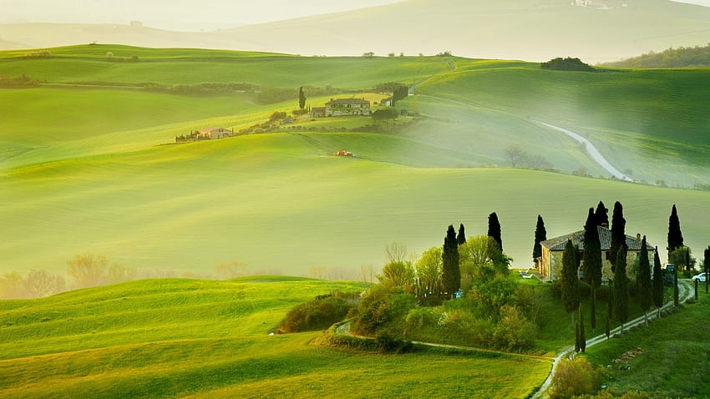
LEADING.OF.THE.SPIRIT
71 My brother, knowing that life is very short for you unless something can happen. You have cancer, blackness gathering over you. The devil knows that if you could just use a little faith, he's whipped.
55-0807

Slide 23
FAITH.WITHOUT.WORKS.IS.DEAD 50-0822
45 …I wished I could just take the faith that's in my heart and spread it out to you now… “Bro Branham, I don't know whether I can move my hand or not." You'll never move it as long as you think that. Believe that He's done it, and go say He's done it, and act like He's done it. Move it an inch. If you can't move it, move it a little bit farther. Next day a little farther. Satan said, "That's far as you can go." Say, Oh, no, I'm going on." Keep on with it. Stay with it.
Great faith will bring you right now. A little faith will bring you on anyhow if you'll stay with it.

Slide 24
PREPARATION
47 You say, "Bro. Branham, I hardly got enough faith to get out here.” One time there was a little boy came to Jesus. The whole 5,000 people there was hungry… Wasn't very much in his hands. But when it once got into Jesus' hands, it fed thousands.
That little faith that you've got tonight, just enough to get you out to church, turn it loose. Put it in His hands and say, "Lord, I don't care if they call me

Slide 25
holy- roller, or whatever they want to, I'm accepting the baptism of the Holy Ghost right now. God kindle a fire in my heart; let me come forth."
You don't have to wait for the Holy Ghost to come. It's been here two thousand years. "While Peter yet spake these words, the Holy Ghost fell on them that believed."
The waiting was just for the day of Pentecost to come.
53-1111

Slide 26
MARK 4:35-38*
And the same day, when the even was come, he saith unto them, Let us pass over unto the other side. 36 And when they had sent away the multitude, they took him even as he was in the ship. And there were also with him other little ships. 37 And there arose a great storm of wind, and the waves beat into the ship, so that it was now full. 38 And he was in the hinder part of the ship, asleep on a pillow: and they awake him, and say unto him, Master, carest thou not that we perish?

Slide 27
I.KNOW
27 And sometimes we have more troubles when we become a Christian than we did when we were sinners. "Many is the afflictions of the righteous…" God promised many afflictions, strange feelings, strange things that would be beyond our understanding, but it's always done for our good. Just can't understand it, because if we did, it would not be of faith; we’d go with an understanding. But we believe by faith His Word, that it's going to work some good thing for us.... And there's none of us immune from them. 60-0417

Slide 28
Fatalism: (w)
A submissive mental attitude resulting from acceptance of the thinking that everything that happens is predetermined and inevitable;
A doctrine holding that all events are predeter-mined in advance for all time and human beings are powerless to change them.

Slide 29
RESURRECTION.OF.LAZARUS
69 …When they went in and laid down, it not their business to worry. Wasn't nothing to eat, no corn fields to get into. No place to grow any corn, there was nothing but a big old desert, not even a sprig of grass. "How we going to get anything to eat?"
That's not your question; that's God's question. He said, "I will take care of you. I'm the Lord. I'm Jehovah-jireh… I'll make a way when there is no way. I am the way.“

Slide 30
Next morning when they went out, there laid bread laying all over the ground: Manna… Now, that was the beginning of the journey of the first church of the natural. Now, look at the beginning of the journey of the second Church in the spiritual. When the day of Pentecost was fully come, they come out of their the churches everywhere…
How long was it to stay? That manna fell until they entered the promised land. And the Holy Ghost is here from the day of Pentecost, and will stay with us until the day we enter the promised land.
53-1122

Slide 31
EARNESTLY.CONTENDING.FOR.THE.FAITH
55 The lady's a stranger. I do not know you. We are strangers. But I notice around you, you have phobia of wintertime.
When wintertime comes, you resent it, get scared. It makes you all upset. And it makes you constipated, and you can't eat right. I curse that devil, in the Name of Jesus Christ. Go home; it won't bother you no more. It has left you. Amen. God bless you.
55-0815

Slide 32
GOD.REVEALING.HIMSELF.TO.HIS.PEOPLE
36 Sister. You have troubles, inward troubles… Yes, it's a nervous condition, mental nervousness. You feel like you're going lose your mind. Upset, aren't you? It works on you; worst time is evening. Sometimes you go set in a chair.
You are doing something when you were praying too. I believe you were washing dishes when you were praying. When you heard about the meeting, you prayed then you'd get a card. You come tonight and your card was called…

Slide 33
1) I PETER 5:6
Humble yourselves therefore under the mighty hand of God, that he may exalt you in due time: 7 Casting all your care [anxiety] upon him; for he careth for you.
PSALM 55:22
Cast thy burden [lot, thing assigned] upon the LORD, and he shall sustain thee: he shall never suffer the righteous to be moved.

Slide 34
ACCEPTING.GOD'S.PROVIDED.WAY.
AT.THE.END.TIME 63-0115
189 Cry for your needs. That's God's provided way. Didn't Jesus explain it when He said the unjust judge, to the woman that cried day and night? How much more will the Heavenly Father give them the Spirit who cry out for It, day and night? Seek, keep seeking. Knock, keep knocking.
Just keep on till He opens. Stay out with it. Cry until the promised Word is vindicated, then you got it. You don't have to worry no more.

Slide 35
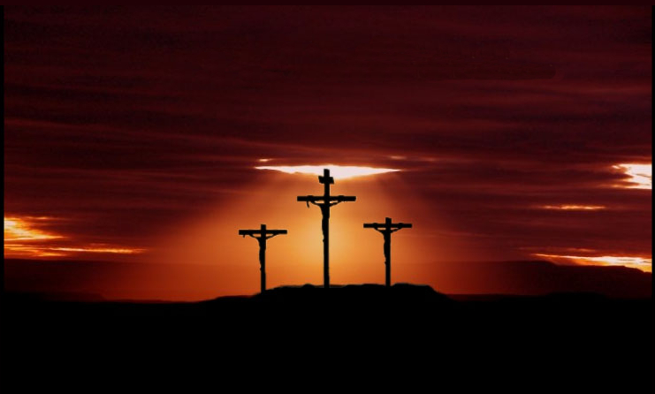
ISAIAH 53:5
But he was wounded for our transgressions, he was bruised for our iniquities: the chastisement of our peace was upon him; and with his stripes we are healed.

Slide 37
PRINCIPLES.OF.DIVINE.HEALING
92 You feel a lot different now, that nervousness has left you, that tension. Many times they say, "Get next to yourself." That isn't to be done. It's something that causes that. When you're standing here awhile ago, a black cloud come floating up against me, 'Whewww” [Bro. Branham makes a blowing sound]."
Now it's gone from you. Go and the peace of God be upon you, 'cause you're going to be well. 51-0923

Slide 38
ROMANS 8:26-31
Likewise the Spirit also helpeth our infirmities: for we know not what we should pray for as we ought: but the Spirit itself maketh intercession for us with groanings which cannot be uttered.
27 And he that searcheth the hearts knoweth what is the mind of the Spirit, because he maketh intercession for the saints according to the will of God. 28 And we know that all things work together for good to them that love God, to them who are the called according to his purpose.

Slide 39
29 For whom he did foreknow, he also did predestinate to be conformed to the image of his Son, that he might be the firstborn among many brethren. 30 Moreover whom he did predestinate, them he also called: and whom he called, them he also justified: and whom he justified, them he also glorified.
31 What shall we then say to these things? If God be for us, who can be against us?

Slide 40
ROMANS 8:26-31
Likewise the Spirit also helpeth our infirmities: for we know not what we should pray for as we ought: but the Spirit itself maketh intercession for us with groanings which cannot be uttered. 27 And he that searcheth the hearts knoweth what is the mind of the Spirit, because he maketh intercession for the saints according to the will of God.
28 And we know that all things work together for good to them that love God, to them who are the called according to his purpose.
29 For whom he did foreknow, he also did predestinate to be conformed to the image of his Son, that he might be the firstborn among many brethren. 30 Moreover whom he did predestinate, them he also called: and whom he called, them he also justified: and whom he justified, them he also glorified. 31 What shall we then say to these things? If God be for us, who can be against us?

Slide 41
WHO.HAS.BELIEVED.OUR.REPORT
41 Are you the patient... It's nervous trouble. And one of the main things you need is Jesus Christ. Will you accept Him as your personal Saviour right now? O Father, have mercy on the woman… And now, satan, you had a right to hold her, as long as she was a sinner, but you don't have any right now. Come out of the woman, in the Name of Jesus Christ.

Slide 42
Now, lady, You're saved now. You've accepted Him as your Saviour. You've been having all kinds of mental trouble, and Satan has set into you to take you to… a nervous breakdown. And now, you can go home, be well, and serve God all your life, reverently. Now, if God let me know what was wrong with you, He will let me know what will be and what was for you. But you done the greatest thing that you ever done in your life, when you got to the platform. Now, not because I was here, but because that you accepted Jesus Christ. God bless you. 52-0720

Slide 43
HEBREWS 2:16-18
For verily he took not on him the nature of angels; but he took on him the seed of Abraham. 17 Wherefore in all things it behoved him to be made like unto his brethren, that he might be a merciful and faithful high priest in things pertaining to God, to make reconciliation for the sins of the people. 18 For in that he himself hath suffered being tempted, he is able to succour them that are tempted.

Slide 44
LUKE 18:1-8
And he spake a parable unto them to this end, that men ought always to pray, and not to faint; 2 Saying, There was in a city a judge, which feared not God, neither regarded man: 3 And there was a widow in that city; and she came unto him, saying, Avenge me of mine adversary. 4 And he would not for a while: but afterward he said within himself, Though I fear not God, nor regard man; 5 Yet because this widow troubleth me, I will avenge her, lest by her continual coming she weary me. 6 And the Lord said, Hear what the unjust judge saith. 7 And shall not God avenge his own elect, which cry day and night unto him, though he bear long with them? 8 I tell you that he will avenge them speedily. Nevertheless when the Son of man cometh, shall he find faith on the earth?

Slide 45
MATTHEW 7:7-11
Ask, and it shall be given you; seek, and ye shall find; knock, and it shall be opened unto you: 8 For every one that asketh receiveth; and he that seeketh findeth; and to him that knocketh it shall be opened. 9 Or what man is there of you, whom if his son ask bread, will he give him a stone? 10 Or if he ask a fish, will he give him a serpent? 11 If ye then, being evil, know how to give good gifts unto your children, how much more shall your Father which is in heaven give good things to them that ask him?

Slide 46
EXPECTATIONS
23 If they'd only realize who you are. You're sons and daughters of God, heirs of the Kingdom. Right now we are kings. Claim your legal rights. Don't let Satan press anything on you. You're of God. And he's has got no rights to hold it.
53-0507

Slide 47
EXODUS 3:9
Now therefore, behold, the cry of the children of Israel is come unto me: and I have also seen the oppression wherewith the Egyptians oppress (pressure, distress) them.
EXODUS 23:9
Also thou shalt not oppress a stranger: for ye know the heart of a stranger, seeing ye were strangers in the land of Egypt.
Ger (Heb.) A newcomer lacking inherited rights.

Slide 48
HANDWRITING.ON.THE.WALL
21 …The devil likes to work on you and oppress you. You know, that's a trick of the devil to oppress. But when the Christian knows his legal rights, when you can quote God's Word, "I'll never leave thee nor forsake thee," that takes all the oppression away.
And the clouds begin to clear back. But if you just know that God has promised and God's faithful, He can keep His promise or He'd never promised it.
56-0902

Slide 49
37 Now, you believe that God will hear my prayer? Ask God… Now, do you believe if I would tell you then, that it left you, you would know that I told you the truth, because I told you the truth on this side...
And everything seems like a phobia; you get scared at things. And it isn't normal… You're wanting to get well. And I'm going to ask Jesus now to heal you. I believe He will do it. You've had quite a struggle in life anyhow… I don't have to say it, 'cause this is alive here. But you know what I'm speaking of.

Slide 50
38 “Our heavenly Father, by Your Spirit, look down through the stream of time. You're so lovely and kind… And our sister standing here, bound by an oppression of Satan. Foul spirits have tried to put pride upon her. But Thou art here to remove this curse of the enemy. Help me, dear God, this duel of faith against the enemy…”
... I was trying to get her in the right mental attitude; she wouldn't have to be prayed for. The right mental attitude towards any promise of God will bring it to pass.

Slide 51
And every Seed will bring forth of its kind. If you need salvation, the Seed's here. If you need healing, here's the Seed in the Word.
The Word of God is a Seed. Put it in your heart. Don't dig it up every morning to see if it's sprouted, put it in there and leave it there.
It's God's business to bring forth the harvest. You just leave it there; water it by faith and praise every day thanking God for it.

Slide 52
GOD.HAS.A.PROVIDED.WAY
56 Now, this is the last night of the service. I want each one of you to give me your undivided attention and listen close now. We're trying to go in for the greatest victory of the meeting. Usually there's more people healed on the last night than there is in the rest of the meeting: their great anticipation. Satan fights harder. Everything goes wrong, seemingly, because Satan is trying to keep that people in tension and everything else, so that he can keep them away from this great time of strain that we're now entering into, as we'd say, "Going in for the kill now."

Slide 53
He's already beat up in the corner. He's been exposed and all of his devises is exposed. And men and women has accepted Jesus Christ as their Saviour. People with cancer, and tumors, everything else, has been healed: doctors' statements proving it's the truth. And Satan, if he can interrupt your mind, that's all he has to do. But let's go in now for the great kill, to drive Satan and all of his powers plumb out of the building, that God can have the right of way and heal every sick person, for the glory of God.
54-0404E

Slide 54
JOB 23:14-16
For he performeth the thing that is appointed for me: and many such things are with him. 15 Therefore am I troubled at his presence: when I consider, I am afraid of him. 16 For God maketh my heart soft, and the Almighty troubleth me: (shock)
Job 23:16 (NLT)
God has made me faint at heart; the Almighty has terrified me.

