Slide 1
MAN IN THE
IMAGE OF GOD 2
I KINGS 2:2
I go the way of all the earth: be thou strong therefore,
and shew thyself a man;
A Word Study on Manhood, Leadership, and Purpose
(Principles to Live By 11)

Slide 2
God: New Birth
Our Witness
Outsiders
The Church
Local Body
Me
So we, being many, are one body in Christ, and every one members one of another. (Rom. 12:5)
Walk in wisdom toward them that are without, redeeming the time.
(Col. 4:5)

Slide 3
Pulpit
Congregation

Slide 4
Heart for One Another: I Cor. 12:25-26
That there should be no schism in the body; but that the members should have the same care one for another. 26 And whether one member suffer, all the members suffer with it; or one member be honoured, all the members rejoice with it.
GALATIANS 6:1-3
Brethren, if a man be overtaken in a fault, ye which are spiritual, restore such an one in the spirit of meekness; considering thyself, lest thou also be tempted. 2 Bear ye one another's burdens, and so fulfil the law of Christ. 3 For if a man think himself to be something, when he is nothing, he deceiveth himself.

Slide 5
2. Integrity: LEADERSHIP
190 We're supposed to represent God and Eternal Life. There's only one form of Eternal Life, and that's God. And we are products of His, because we're genes of His Spirit.
Then we should conduct ourself, women and men, like the Bible said for us to do; Christian gentlemen, sons and daughters of God, borned of the Spirit of God, manifesting the Light in our days and scattering It.
65-1207

Slide 6

Wherefore is there a price in the hand of a fool to get wisdom, seeing he hath no heart to it?
PROVERBS 17:16

Slide 7
“So God created man in his own image, in the image of God created he him.”
Genesis 1:27
Before the Fall. Before the Law. Before any moral failure — the image is established. You were made to look like Him, to represent Him, and to reflect His glory on the earth He made.

Slide 8
BARA’ — בָרָא (Created)
Bara’ appears 3x (Gen. 1:27) — the divine origin of man.
It is a verb used EXCLUSIVELY with God as subject. No human ever bara’s anything. Only God can bara’.
To cut into a precise, purposeful shape. God did not rearrange material — He brought man into existence by sovereign design. Man is not an accident, a biological coincidence. (Ps 139:14)
You were designed, not derived.
*(Squirrels)

Slide 9
Adam
Ish
“Man”
Definition
Enosh
Geber

Slide 10
THE.MASTERPIECE
198 God, the great Sculptor, has made Him a Masterpiece... Like He made in the garden of Eden, and took a piece, and made another piece and that was marred and fell, now He's been all this time building it up again. 64-0705

Slide 11

HE.CARETH.FOR.YOU
48 "Cast our cares upon Him, for He careth for you.“ When He made man, He didn't make man to do that. He made man to be happy, to have satisfaction, to be comforted. God doesn't want His children to be uncomfortable. 60-0301

Slide 12
The Fall — The Image Marred, Not Destroyed
Sin did not erase the “image” Gen. 9:6 commands the protection of human life based on the image.
The “mirror” was cracked — distorted. Violence, pride, etc. are not what God made; they are the cracks in the mirror.
He who dominates through cruelty, or retreats into passivity, is a broken image of original design.

Slide 13
GENESIS 9:1, 5-6
And God blessed Noah and his sons, and said unto them, Be fruitful, and multiply, and replenish the earth.
5 And surely your blood of your lives will I require; at the hand of every beast will I require it, and at the hand of man; at the hand of every man's brother will I require the life of man. 6 Whoso sheddeth man's blood, by man shall his blood be shed: for in the image of God made he man.

Slide 14

The Gospel answer:
God does not abandon the cracked mirror — He restores it!

Slide 15
Gen. 5:1-3:
The image passes from God to Adam, Adam to Seth.
GENESIS 5:1
This is the book of the generations of Adam. In the day that God created man, in the likeness of God made he him; 2 Male and female created he them; and blessed them, and called their name Adam, in the day when they were created. 3 And Adam lived an hundred and thirty years, and begat a son in his own likeness, after his image; and called his name Seth:

Slide 16
BUT.FROM.THE.BEGINNING.IT.WAS.NOT.SO
12 When man gets a hold of anything, he perverts the main cause, making anything perverted is different from the original. God made man to live happily with one another. Perversion changes them and makes them enemies one to another. Man makes us enemies one to another, while God made us brothers. Man made man to be immoral. God made man to live true to his wife.
God gave us good clear water to drink. Man's got to mix alcohol or something else with it before he drinks it. It's perverting from the real beginning of it. 58-1002

Slide 17
The Plan of Redemption — Image Restored
Genesis 1:27 — Humanity created in God’s image. Man appointed to lead, warrior, provide, and carry legacy.
The Fall — The image is marred. Man becomes passive, fearful, self-serving.
Christ — The perfect image [eikon] of God takes on flesh. The image is fully expressed in one Man.
New Birth — Colossians 3:10: “Renewed in knowledge after the image of him that created him.”
Glorification — Romans 8:29: “Conformed to the image of his Son.” Full restoration of the Genesis 1:27 man.

Slide 18
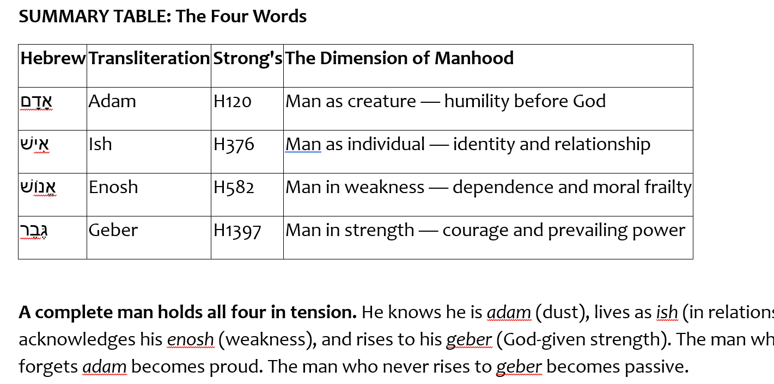

Slide 19
1. ADAM — אָדָם (Man)
Adam (Man) = “the earth-creature, the one from the red clay, the one who carries blood.”
Man is bound to the earth and responsible for it yet made in the image of the Creator. Earthy by origin, heavenly in design.
True Manhood never forgets his origin, dependent on God for every breath. The first temptation of men is to forget they are adam and to act as though they are God!
Ps. 103:14-15 For he knoweth our frame; he remembereth that we are dust. 15 As for man, his days are as grass: as a flower of the field, so he flourisheth.

Slide 20
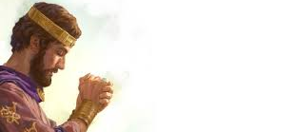
I KINGS 3:11
And God said unto him, Because thou hast asked this thing, and hast not asked for thyself long life; neither hast asked riches for thyself, nor hast asked the life of thine enemies; but hast asked for thyself understanding to discern judgment;

Slide 21
PSALM 62:5
My soul, wait thou only upon God; for my expectation is from him. 6 He only is my rock and my salvation: he is my defence; I shall not be moved. 7 In God is my salvation and my glory: the rock of my strength, and my refuge, is in God.
THE.MANIAC.OF.GADARA
God has to take you off your feet sometime to let you know that you don't know. We have to depend on Him. 54-0720

Slide 22
2: אִישׁ Ish An individual; In Relationship to Woman
Means: to be a man, to act in a manly way.
A man is not a man in isolation — he is ish in relation to those he is called to protect, lead, and love. The ish who abandons his relationships or responsibilities has abandoned his manhood.

Slide 23
I KINGS 11:4-6
For it came to pass, when Solomon was old, that his wives turned away his heart after other gods: and his heart was not perfect with the LORD his God, as was the heart of David his father. 5 For Solomon went after Ashtoreth the goddess of the Zidonians, and after Milcom the abomination of the Ammonites. 6 And Solomon did evil in the sight of the LORD, and went not fully after the LORD, as did David his father.

Slide 24
3: אֱנוֹשׁ — Enosh Man in his Weakness and Mortality
Denotes man in both his physical weakness and his moral weakness, moral vulnerability.
This understanding helps us read Psalm 8:4 in a new light: "What is man (adam) that thou art mindful of him? and the son of man (enosh), that thou visitest him? "
Manhood: The Bible never pretends that men are invulnerable. The man who acknowledges his enosh — his weakness, need for God, his capacity for moral failure — is a man who is truly strong.
Peter walking on water is the picture of manhood; Peter beginning to sink when he took his eyes off Christ is the picture of enosh.

Slide 25
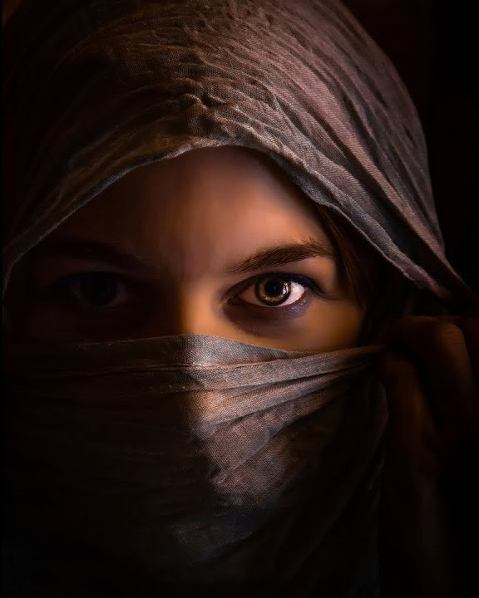
PROVERBS 5:3-5
For the lips of a strange woman drop as an honey-comb, and her mouth is smoother than oil: 4 But her end is bitter as wormwood, sharp as a twoedged sword.
5 Her feet go down to death; her steps take hold on hell.

Slide 26
4: גֶּבֶר — Geber: Man in his fully developed strength
Geber means one able-bodied, well-developed, physically strong — a mighty one. The root is gabar: "to prevail.” Geber is the man who prevails, who overcomes, who stands firm and does not retreat.
I KINGS 2:2 “Be what you were made to be, step into your true identity.”

Slide 27
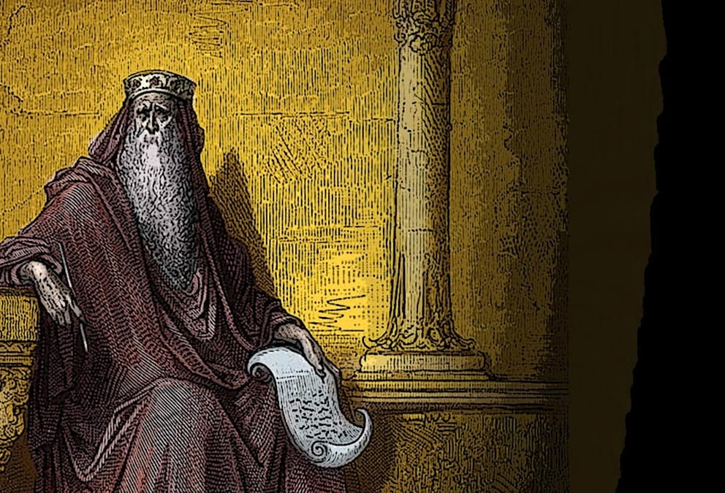
I Chron. 28:20
And David said to Solomon his son, Be strong and of good courage, and do it: fear not, nor be dismayed: for the LORD God, even my God, will be with thee; he will not fail thee, nor forsake thee, until thou hast finished all the work for the service of the house of the LORD.

Slide 28
When God addressed Job 38:3 out of the whirlwind:
"Gird up now thy loins like an [able-bodied] man (geber), for I will demand of thee and answer thou me." God was calling Job to his full potential — as a summons to rise to the level of the confrontation.
The geber does not shrink from hard encounters with truth.

Slide 29
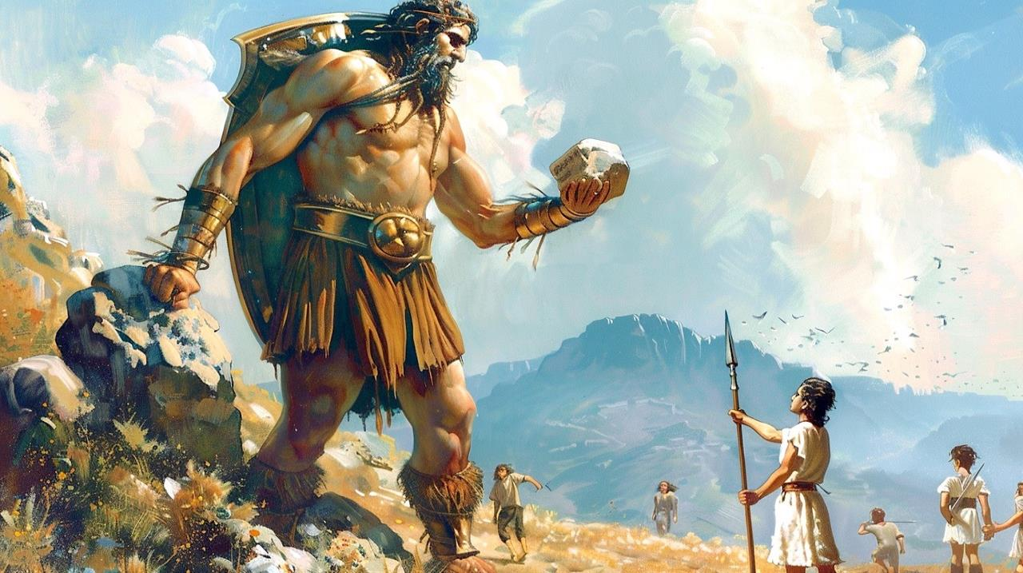
I SAMUEL 17:8
…Why are ye come out to set your battle in array? am not I a Philistine, and ye servants to Saul? choose you a man for you, and let him come down to me. 9 If he be able to fight with me, and to kill me, then will we be your servants: but if I prevail against him, and kill him, then shall ye be our servants, and serve us. 10 And the Philistine said, I defy the armies of Israel this day; give me a man, that we may fight together.

Slide 30
Adam
Ish
“Man”
Enosh
Geber

Slide 31
I CORINTHIANS 16:13
Watch ye, stand fast in the faith, quit (behave/become) you like men, be strong.
I SAMUEL 4:9
Be strong, and quit yourselves like men, O ye Philistines, that ye be not servants unto the Hebrews, as they have been to you: quit yourselves like men, and fight.

Slide 32
ENTICING.SPIRITS
51 When these kings, before they started out... Before Jehoshaphat ever made an alliance with Ahab, he ought to have first said, "Let us pray and see what the will of the Lord is."
Give me a preacher; give me a Christian; give me a housewife that's a Christian; give me a farmer or a factory worker that'll put God first in everything, I'll show you a man that'll be successful in the spite of all the devil can put on him. He seeks God first. 55-0724

Slide 33
Definition: THE.EASTER.SEAL
141 How many Presbyterians, Methodists, Baptists in the world today, how many Pentecostals, knows the Truth and afraid to make a stand on the It? I'm persuaded to wonder, what was that fell on you?
Are you a part of His resurrection? [Or] some man's theory and idea? Or, have you got the real boldness and the real manhood it takes, to stand out and call right "right," and wrong "wrong"?
65-0410

Slide 34

The Particular Temptations of Young Men
Purposelessness
Idleness
Pride
Lack of self-control
What God means to accomplish in young men are rarely great deeds that are visible to the public, but the invisible construction of a foundation of godly character that will serve them for the rest of their lives.

Slide 35
TSELEM ֶלֶם (Image) The Crown Jewel
Derived from (tsal צֵל) what is revealed about the object by its shadow.
Man is God’s shadow on the earth — not God Himself, but bearing His outline, His shape, His representative form.
After the Fall, the image is MARRED, not erased. Genesis 9:6 still upholds the image as the ground of human sanctity.
Christ is the perfect: “image of the invisible God” (Col. 1:15). Redemption is the restoration of the image.

Slide 36
THE.WORLD.IS.FALLING.APART
182 This world, men can either live for this world, the world to come. Depends on where your thoughts are at, there's where your treasures are also. Let it be on Heaven and the Coming of the Lord.
Be an example of womanhood. Be example of manhood. Be example of Christian. Live the Life. Do what's right.
63-0412

Slide 37
Cornerstones of Manhood
Reject Passivity
Lead Courageously
Accept Responsibility
Expect God’s Reward
II TIMOTHY 2:15
Study to shew thyself approved unto God, a workman that needeth not to be ashamed, rightly dividing the word of truth.

Slide 38
Man as Leader — Made to Have Dominion
Genesis 1:26 links the image directly to dominion: “Let them have dominion over… all the earth.”
In the ancient Near East, a king was described as the “image” of his god — meaning he represented that god’s rule on earth.
To lead is not optional for the man who bears the image. Dominion is woven into the definition of what man is.
The man who abdicates leadership does not become humble — he becomes a contradiction of his own image.

Slide 39
Man as Warrior: Strength in the Image of the Strong One
Elohim = “the Mighty One.” Man, bearing His image, is called to reflect strength, not passivity.
1 Cor. 11:7 — “For a man indeed ought not to cover his head, forasmuch as he is the image and glory of God.” Man represents God’s glory: a warrior stands ready to face battles.
Throughout Scripture, the men God calls are called into conflict: Adam rescues Lot, David faces Goliath, the Lord Himself to overcome death.
Implication: The warrior nature of man is not cultural: it is embedded in the image. Men are designed to stand between what is good and what threatens it.

Slide 40
The Innocence of Youth
A.DECEIVED.CHURCH.BY.THE.WORLD
2 Lord, speak to us through Thy living Word, let the living Word dwell in us and abide in us, that we might be shaped and formed, not to the world, but be transformed by the renewing of our spirit into the form of the Son of God. 59-0628
My God hath sent his angel, and hath shut the lions' mouths, that they have not hurt me: forasmuch as before him innocency was found in me; and also before thee, O king, have I done no hurt.
DANIEL 6:19-22

Slide 41

Vulnerability of Innocence
Capable of being wounded or hurt;
Open to moral attack or temptation;
Open to assault and difficult to defend.

Slide 42
IDENTIFIED.WITH.CHRIST
77 But there come a time when God made us an Example. And He gave us the Lord Jesus. And when a sinner puts his hands upon His precious head and confesses his sins, and his sins is transformed or transferred from the sinner to Jesus and the innocence of Jesus is transferred by the Holy Ghost back into that person; he's a new creature in Christ Jesus.
59-1220

Slide 43
Man as Legacy-Builder — ZAKAR
Zakar (זָכָר) — male. From a root meaning: “to remember.” The male is the one through whom the memorial of parents is continued.
Pictographic meaning: tool + open palm + head of man — the covenant blessing passed from generation to generation through the man.
Maleness is connected to remembrance, covenant continuity, and the transmission of legacy (cf. Jacob blessing his sons).
Genesis 5:3 — Adam fathered Seth “in his own likeness, after his image (tselem).” The tselem passes through fathers. A man’s character is his legacy.
Implication: A man who does not pass on faith, covenant, and character to the next generation has failed at the most fundamental level of what zakar means.

Slide 44
Man as Provider — Steward of the Earth
Adam from adamah — man is bound to the earth. Genesis 2:15: “to dress it and to keep it.” He was given a domain to cultivate and protect.
Dominion (Gen. 1:26) includes provision: over the fish of the sea, the fowl of the air, the cattle, all the earth.
The provider is not merely an economic role — it is an image-bearing responsibility. God provides for His creation; man, as tselem, reflects that provision in his household and community.
1 Timothy 5:8 — “But if any provide not for his own… he hath denied the faith, and is worse than an infidel.” Providence is not praise-worthy; it is the baseline expectation of a man.
Implication: A man’s provision is an act of worship — it images the providing God who sustains all things.

Slide 45
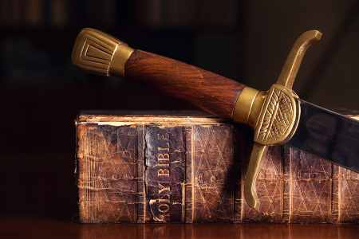
Men Approved
II TIMOTHY 2:15
Study to shew thyself approved unto God, a workman that needeth not to be ashamed, rightly dividing the word of truth.

Slide 46
II TIMOTHY 2:15
Study to shew thyself approved unto God, a workman that needeth not to be ashamed, rightly dividing the word of truth.
Approved (Gr.) Gdikaiosune
The state of him who is as he ought to be, the condition acceptable to God;
The doctrine concerning the way in which man may attend a state approved of God;
Integrity, virtue, purity of life, rightness, correctness of thinking feeling, and acting.

Slide 47
2 TIMOTHY 2:1-4
Thou therefore, my son, be strong in the grace that is in Christ Jesus. 2 And the things that thou hast heard of me among many witnesses, the same commit thou to faithful men, who shall be able to teach others also. 3 Thou therefore endure hardness, as a good soldier of Jesus Christ. 4 No man that warreth entangleth himself with the affairs of this life; that he may please him who hath chosen him to be a soldier.

Slide 48
Men Approved…
Heart of a Servant
BLIND.BARTIMAEUS
I pastored there seventeen years without one penny, not because they didn't want to pay me, because I was young, able to work... I'd do it right now if I could just wait on my ministry and be with them. And I love to work. 57-0127

Slide 49
SIRS.BE.OF.A.GOOD.CHEER
23 What is gifts and callings? They are without repentance; is that right? You can't make yourself something you're not.
I wanted to be 6’ tall and weigh 190 lbs., or... It didn't do me any good. He said, "Who, taking thought can add one cubit to his stature?" You are what you are by the grace of God. You can't add nothing; you can't take nothing. If God wanted you to be a minister, He ordained you to be a minister before the world ever began.
54-0721

Slide 50
EXODUS 18:21
Moreover thou shalt provide out of all the people able men, such as fear God, men of truth, hating covetousness; and place such over them, to be rulers of thousands, and rulers of hundreds, rulers of fifties, and rulers of tens... 25 And Moses chose able men out of all Israel, and made them heads over the people, rulers of thousands, rulers of hundreds, rulers of fifties, and rulers of tens.

Slide 51
SHALOM
17 Now, the prophet said, "Gross darkness upon this people; upon the people of the world, gross darkness."
18 Have you noticed, in the last few years, some of you man and women around my age [55] , that how each year, it seems like that darkness comes more and more? I was speaking the other day, and I said to my wife, "You know, it seems like that, as the years go on, and as it just seems like that people begin to get further and further away from the real thing that they should be coming closer and closer to."

Slide 52
19 I've noticed, amongst man… and most amongst the women, watch their desires and what they like to do, they're changing attitudes all the time. Man are becoming more like women, and women are becoming more like man, seems like there is no way to stop it. Them people want to do right, but, there is something that won't let them do right.
It just presses down, forces them. Like a heavy, dark fog over the whole earth. All over the world, seems to be a grouping darkness, getting more dense and dense, all the time, just smothering out real manhood, real womanhood. I'm talking in the natural.
64-0119

Slide 53
Awesome Husbands
Don’t Speak to Your Wife As One of the Guys
Be Her Support, Not Her Father
Listening is the Key to the Heart
Make Her Feel Wonderful
Keep Growing

Slide 54
THE.MARRIAGE.OF.THE.LAMB
81 Now, marriage, in one sense, is a type. The earthly marriage here is a type of the heavenly marriage. The first thing is, in natural marriage, is a decision has to be made. The young lady has to make her decision, whether she wants this young man; and the young man, whether he wants the young woman. She must be the only woman in the world that you love, and he must be the only man. If it isn't, then you made a wrong decision.
62-0121

