Slide 1
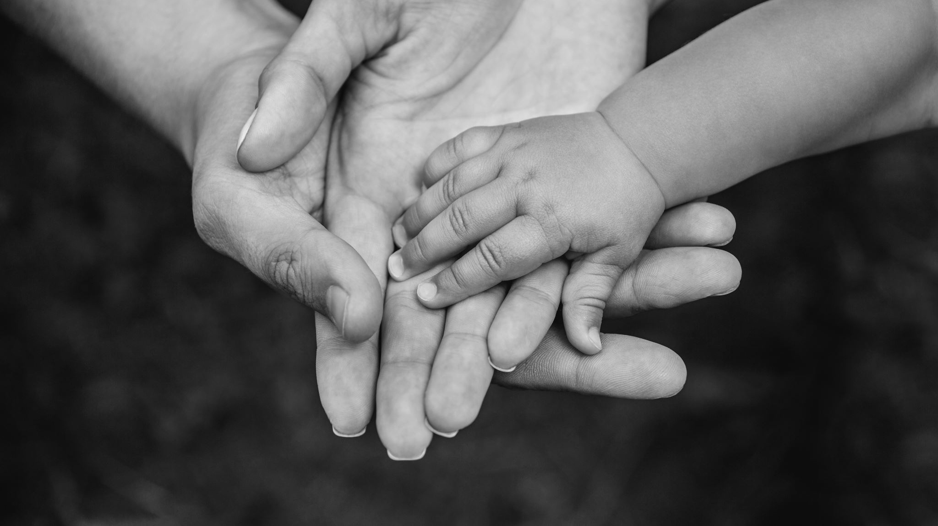
The Spirit Controlled Family 9
Ephesians 3:14-16
For this cause I bow my knees unto the Father of our Lord Jesus Christ, 15 Of whom the whole family in heaven and earth is named…

Slide 2


Birthdays
Mar. 25th Chris Clayville
Mar. 26th Ben & Rachel Pritchard
Troy & Connie Hughes
Mar. 27th Johnny & Doris Reynolds

Slide 3
Agenda Sunday March 29th Bro. Burley & Company Easter Weekend: Sat. April 4th 6:00 pm Youth Meeting Easter Sunday April 5th Services: 11:00 am & 5:00 pm Church Potluck Dinner Sunday after Morning Service*

Slide 4
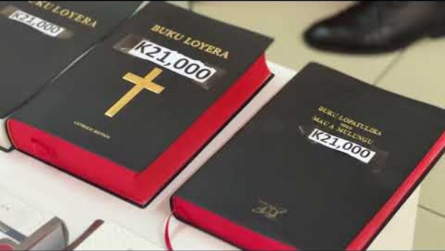

Slide 5
WHEN.DIVINE.LOVE.IS.PROJECTED
SOVEREIGN GRACE.TAKES.ITS.PLACE
7 Be merciful and heal the sick and afflicted. For in this Thou has atoned for at Calvary, and we feel that it is our personal property...
May the Holy Spirit take the Word, open the Book, and loose the power of the Spirit in the Word, and may it find Its resting place in each heart. For we ask it in the Name of Thy beloved Child, the Lord Jesus. 57-0126

Slide 6
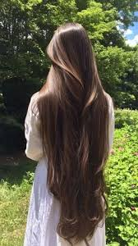
I CORINTHIANS 11:15
…But if a woman have long hair, it is a glory to her: for her hair is given her for a covering.
II CORINTHIANS 3:12
Seeing then that we have such hope, we use great plainness of speech: 13 And not as Moses, which put a vail over his face,

Slide 7
The Spirit Controlled Family 9
Ephesians 3:14-16
For this cause I bow my knees unto the Father of our Lord Jesus Christ, 15 Of whom the whole family in heaven and earth is named…

Slide 8
Plus: 1. Healing for the Body
2. Healing for the Spirit
LUKE 17:20-21
And when he was demanded of the Pharisees, when the kingdom of God should come, he answered them and said, The kingdom of God cometh not with observation: 21 Neither shall they say, Lo here! or, lo there! for, behold, the kingdom of God is within you. (already among you.)
Revelation from the Father
Body
Spirit
Soul

Slide 9
SPIRITUAL.AMNESIA
29 We are identified with our families, in this human life, by marriage. And with our wives, we marry, and our family is identified by the union of our marriage. And what to think, if this horrible thing would happen to you and you wouldn't be able to remember who you married, your wife, which is your children, who is your father and mother, who is your neighbor?

Slide 10
You must be identified… either in Christ or out of Christ. You are not halfway. There's no such a thing as a drunk sober man.
You're either a saved, or you're not saved. You're a saint or a sinner, one or the other. And your spiritual attitude towards God's Word identifies you, exactly where you're standing.

Slide 11
SPIRITUAL.AMNESIA
46 We forget, sometimes, what the Christian Church is. We act like the world. That shows that we got spiritual amnesia, because you don't act like the Christian. You act like the world. You receive the heart of the world, and it causes this. We find that Israel got exposed to the world and had fell into this rut. And this prophet [Amos] was sent to dig them out of it, if he could... God, by His grace, chose Israel from all the rest of the families on the earth. Grace had did that.

Slide 12
He had given them the choice lands, houses they never had to build, farms they never bought, food they never planted… wells they never dug. He gave them victories that they never won, grace that they never merited. God did that by His grace for this people, Israel, His chosen, His beloved.
64-0411

Slide 13
EZEKIEL 37:11
Then he said unto me, Son of man, these bones are the whole house of Israel: behold, they say, Our bones are dried, and our hope is lost: we are cut off for our parts. 12 Therefore prophesy and say unto them, Thus saith the Lord GOD; Behold, O my people, I will open your graves, and cause you to come up out of your graves, and bring you into the land of Israel. 13 And ye shall know that I am the LORD, when I have opened your graves, O my people, and brought you up out of your graves, 14 And shall put my spirit in you, and ye shall live, and I shall place you in your own land: then shall ye know that I the LORD have spoken it, and performed it, saith the LORD.

Slide 14
ROMANS 8:14 For as many as are led by the Spirit of God, they are the sons of God.
MATTHEW 16:18
And I say also unto thee, That thou art Peter, and upon this rock I will build my church; and the gates of hell shall not prevail against it.
COLOSSIANS 1:18
And he is the head of the body, the church: who is the beginning, the firstborn from the dead; that in all things he might have the preeminence.

Slide 15
FIVE.DEFINITE.IDENTIFICATIONS
78 [Col. 1:17-18] Who is the Head of this church? Jesus Christ, What Kingdom is it? Messianic Kingdom, the church, not an organization, a church, a mystic Body to which Christ is the Head… walking in the Spirit, obeying the King; foolish to the world, precious in the sight of God; misunderstood, laughed at... "All that live godly in Christ Jesus…"
You're walking in the Spirit, turning your back on the things of the world, not bound by any fetters. "He who the Son has made free is free indeed." That's the church of the living God. That's Who set it up. 60-0911

Slide 16
NEHEMIAH 8:17; 9:1-3
And all the congregation of them that were come again out of the captivity made booths, and sat under the booths: for since the days of Jeshua the son of Nun unto that day had not the children of Israel done so. And there was very great gladness…
9:2 And the seed of Israel separated themselves from all strangers, and stood and confessed their sins, and the iniquities of their fathers. 3 And they stood up in their place, and read in the book of the law of the LORD their God one fourth part of the day; and another fourth part they confessed, and worshipped the LORD their God.

Slide 17
NEHEMIAH 9:19
Yet thou in thy manifold mercies forsookest them not in the wilderness: the pillar of the cloud departed not from them by day, to lead them in the way; neither the pillar of fire by night, to shew them light, and the way wherein they should go. 20 Thou gavest also thy good spirit to instruct them, and withheldest not thy manna from their mouth, and gavest them water for their thirst. 21 Yea, forty years didst thou sustain them in the wilderness, so that they lacked nothing; their clothes waxed not old, and their feet swelled not.

Slide 18
ACTS 2:46
And they, continuing daily with one accord in the temple, and breaking bread from house to house, did eat their meat with gladness and singleness of heart…
Homothumadon A unique Greek word, a compound of two words meaning to "rush along" and "in unison" helps us understand the uniqueness of the Christian community. The image is musical; a number of notes sounded which, while different, harmonise in pitch and tone. As the instruments of a great concert under the direction of a concertmaster, so the Holy Ghost blends together the lives of members of Christ's church.

Slide 19
7 Characteristics of the Spirit Controlled Church:
Doctrine: Steadfastly teaching the Word of God for the hour.
2. Fellowship: Deep, community atmosphere. Not a Sunday gathering, but a family.
Ordinances: with sincere participation.
4. Prayer: interceding for the Body (Acts. 2:42, 4:31)
5. Fear of God: reverence for the temple, the Body vs.
casual religion.
6. Generosity: Caring for one another’s needs, a Spirit controlled Body does not hoard, it shares.
7. Worship: Continuous, joyful sincere worship! He delights in the praises of His people.” (Ps. 22:3)

Slide 20
The Christian Family:
Whether in the household or the Body of Christ — the Family is the Spirit's primary place of formation. It is where the nature of Christ is either demonstrated or denied.
Where fathers lead with Christlike sacrifice, where mothers intercede with Christlike love, where children are trained in truth, and where the community of believers serves one another with humility and love — there the Spirit finds His dwelling place and the world sees the character of Jesus Christ alive and among His chosen people.

Slide 21
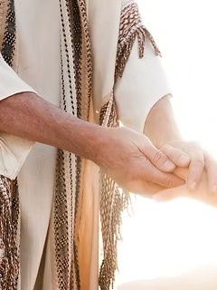
Acts 241-47
Then they that gladly received his word were baptized: and the same day there were added unto them about three thousand souls. 42 And they continued stedfastly in the apostles' doctrine and fellowship, and in breaking of bread, and in prayers. 43 And fear came upon every soul: and many wonders and signs were done by the apostles. 44 And all that believed were together, and had all things common; 45 And sold their possessions and goods, and parted them to all men, as every man had need. 46 And they, continuing daily with one accord in the temple, and breaking bread from house to house, did eat their meat with gladness and singleness of heart, 47 Praising God, and having favour with all the people. And the Lord added to the church daily such as should be saved.

Slide 22
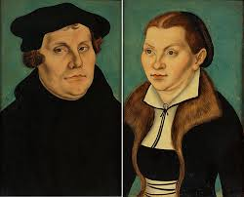
Katharina (Van Bora) Luther
On October 31, 1517, German monk Martin Luther nailed a 95-point critique of Catholicism to the door of a church in Wittenberg. The move incited a religious revolution, the Reformation.
Katharina Van Bora, a Catholic nun escaped her convent and married Luther at age 26.

Slide 23
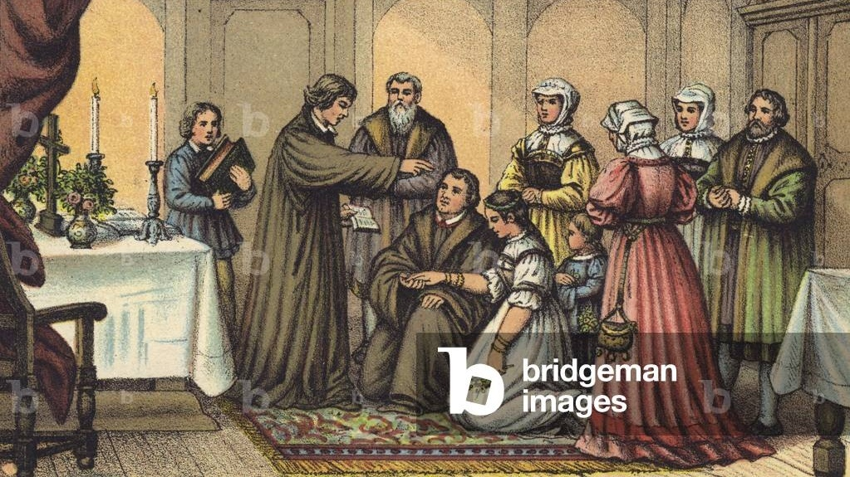
Katharina
& Martin
Luther
June 13, 1525

Slide 24
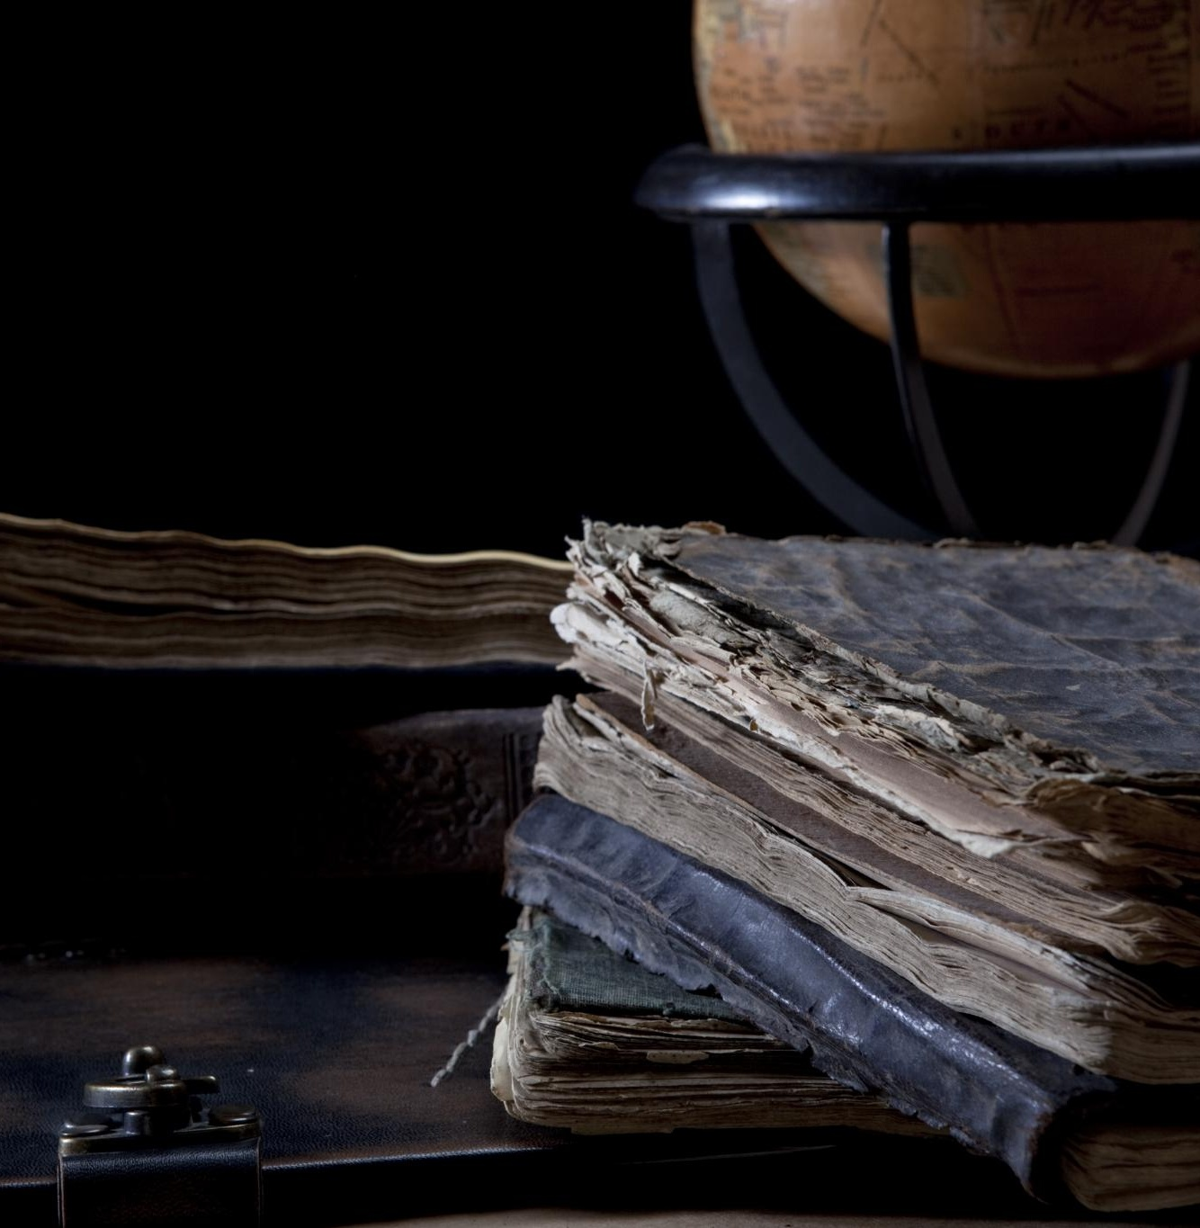
Katharina Luther: A Remarkable Partner
Escape from Convent Life
Katharina von Bora bravely left her convent and began a new life by marrying Martin Luther in 1525.
Household Management
Katharina efficiently managed the Luther household, showing remarkable organizational skills and supporting her husband's work.
Protestant Family Model
She played a key role in shaping Protestant family life, admired for her intelligence and strength.
Notes:
Image source: Microsoft 365 content library Katharina von Bora, Martin Luther’s wife, was a former nun who escaped convent life and married Luther in 1525. She managed the Luther household, supported her husband's work, and played a key role in shaping Protestant family life. Katharina was admired for her intelligence, strength, and resourcefulness.

Slide 25
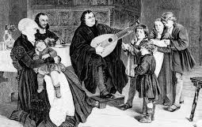
The Luther household was saturated with Scripture, prayer, and music every day. He led the family morning and eveningin prayers built around the Ten Commandments, Apostles' Creed, Lord's Prayer: The Small Catechism, which he wrote as a guide for fathers to use with their families. It’s introduction addresses not clergy but fathers: 'The head of the family is to teach it in a simple way to his household.'
“My Lord Katie drives a team, farms, pastures, and sells cows; she brews, cleans, and governs the house. And I believe, between land and life, she rules me.”
Martin Luther, Letter to a friend

Slide 26
WHAT THE “BLACK CLOISTER” HOUSED AT ANY GIVEN TIME
Luther's six children: Hans, Elisabeth, Magdalena, Martin, Paul, Margarete 4 orphaned children, including Katharina's nephew Fabian Up to 25-40 university students boarding as paying lodgers, sat at Luther's table daily Exiled clergy, escaped nuns, government officials, foreign visitors, and theological colleagues passing through Wittenberg A working farm with cattle, pigs, a garden, a fishpond, orchard — run by Katharina A brewery operated by Katharina, whose beer Luther praised in his letters A makeshift infirmary where Katharina nursed the sick — including during Wittenberg's plague outbreaks

Slide 27
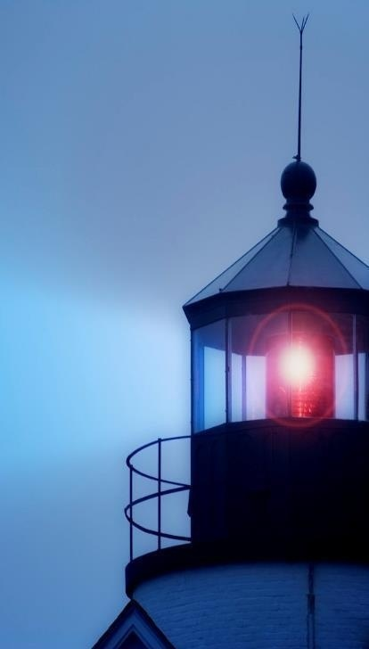
“…at evening time it shall be light.”
I JOHN 1:7
But if we walk in the light, as he is in the light, we have fellowship one with another, and the blood of Jesus Christ his Son cleanseth us from all sin.

