Slide 1
MAN IN THE
IMAGE OF GOD
I KINGS 2:2
I go the way of all the earth: be thou strong therefore,
and shew thyself a man;
A Word Study on Manhood, Leadership, and Purpose
(Principles to Live By 10)

Slide 2
God: New Birth
Our Witness
Outsiders
The Church
Local Body
Me
So we, being many, are one body in Christ, and every one members one of another. (Rom. 12:5)
Walk in wisdom toward them that are without, redeeming the time.
(Col. 4:5)

Slide 3
Pulpit
Congregation

Slide 4
Heart for One Another: I Cor. 12:25-26
That there should be no schism in the body; but that the members should have the same care one for another. 26 And whether one member suffer, all the members suffer with it; or one member be honoured, all the members rejoice with it.
GALATIANS 6:1-3
Brethren, if a man be overtaken in a fault, ye which are spiritual, restore such an one in the spirit of meekness; considering thyself, lest thou also be tempted. 2 Bear ye one another's burdens, and so fulfil the law of Christ. 3 For if a man think himself to be something, when he is nothing, he deceiveth himself.

Slide 5
BLIND.BARTIMAEUS
The world's a dying, not for better economics, better buildings, a bigger denomination. But it's dying for somebody to reach out a hand of love, to show that we care one for the other.
And that's the very sign that Jesus told us that, "By this all men would know that you were My disciples," when we got love one for the other.
61-0124

Slide 6
2. Integrity: LEADERSHIP
190 We're supposed to represent God and Eternal Life. There's only one form of Eternal Life, and that's God. And we are products of His, because we're genes of His Spirit.
Then we should conduct ourself, women and men, like the Bible said for us to do; Christian gentlemen, sons and daughters of God, borned of the Spirit of God, manifesting the Light in our days and scattering It.
65-1207

Slide 7

Wherefore is there a price in the hand of a fool to get wisdom, seeing he hath no heart to it?
PROVERBS 17:16

Slide 8
God is not Afraid to Test Your Integrity
JOB 2:3
And the LORD said unto Satan, Hast thou considered my servant Job, that there is none like him in the earth, a perfect and an upright man, one that feareth God, and escheweth evil? and still he holdeth fast his integrity, although thou movedst me against him, to destroy him without cause.

Slide 9
Genesis 1:26-27
“And God said, Let us make man in our image, after our likeness: and let them have dominion over the fish of the sea, and over the fowl of the air, and over the cattle, and over all the earth...
So God created man in his own image in the image of God created he him male and female created he them.”
This is Hebrew poetry — three parallel lines that build in intensity. The repetition is not accidental. It is emphasis!

Slide 10
BARA’ — בָרָא (Created)
Bara’ appears 3x (Gen. 1:27) — the divine origin of man.
It is a verb used EXCLUSIVELY with God as subject. No human ever bara’s anything. Only God can bara’.
To cut into a precise, purposeful shape. God did not rearrange material — He brought man into existence by sovereign design. Man is not an accident, a biological coincidence. He is the result of a deliberate, intentional, divine act. (Ps 139:14)
Manhood: You were “cut” to a specific purpose before you were born. You were designed, not derived.

Slide 11
THE.JUNCTION.TIME
46 When God first made creation in the phenomenal way, when He spoke the world into existence, blowed the stars and moon off His hands... Expressed the Word, and it come into existence. The very earth that you're sitting on today was the created Word of God. If He didn't speak the world into existence, where did He get the material to make it out of? Where did it come from? Sure He did. The very dirt and things that you're setting on today, is the creative Word of God. You're here because you come into creation by the speaking of the Word of God, everyone one of you. 56-0122

Slide 12
1. ADAM — אָדָם (Man)
Adam (Man) = “the earth-creature, the one from the red clay, the one who carries blood.”
Man is bound to the earth and responsible for it yet made in the image of the Creator. Earthy by origin, heavenly in design.
True Manhood never forgets his origin, dependent on God for every breath. The first temptation of men is to forget they are adam and to act as though they are God!
Ps. 103:14-15 For he knoweth our frame; he remembereth that we are dust. 15 As for man, his days are as grass: as a flower of the field, so he flourisheth.

Slide 13
PSALM 62:5
My soul, wait thou only upon God; for my expectation is from him. 6 He only is my rock and my salvation: he is my defence; I shall not be moved. 7 In God is my salvation and my glory: the rock of my strength, and my refuge, is in God.

Slide 14
THE.MANIAC.OF.GADARA
God has to take you off your feet sometime to let you know that you don't know. We have to depend on Him.
And one day way atop the Adirondack... My little boy, Billy, was just a little bitty fellow then. We was in a little old lean-to. The ranger hadn't come up yet. We was going to go bear hunting. I said to the wife, I said, "There's a group of deer that goes down here in the giants. I want to walk down there today.“ 54-0720

Slide 15
2: אִישׁ — Ish An individual; relationship to woman
Means: to be a man, to act in a manly way.
I KINGS 2:2 “Be what you were made to be, step into your identity.”
A man is not a man in isolation — he is ish in relation to those he is called to protect, lead, and love. The ish who abandons his relationships or responsibilities has abandoned his manhood.

Slide 16
55-1119 REDEEMER.REDEMPTION
32 Job here, in the speaking of Him as a Redeemer, how that everything had gone wrong for him, seemingly... You know, God hasn't promised a flower bed of ease, but He's promised a lot of mountains, but He's promised grace to go over every one of them. After Job went through his trials and testings, as upon every child of God, first has to be tried, tested. You know how to act then, how to conduct yourself as a Christian. God gives you a little bit of whipping once in a while, turns you around a few times; you know what it's all about, lays you on your back, so you can look up.

Slide 17
3: אֱנוֹשׁ — Enosh Man in his Weakness and Mortality
Denotes man in both his physical weakness and his moral weakness, moral vulnerability.
This understanding helps us read Psalm 8:4 in a new light: "What is man (adam) that thou art mindful of him? and the son of man (enosh), that thou visitest him? "
Manhood: The Bible never pretends that men are invulnerable. The man who acknowledges his enosh — his weakness, need for God, his capacity for moral failure — is a man who is truly strong.
Peter walking on water is the picture of manhood; Peter beginning to sink when he took his eyes off Christ is the picture of enosh.

Slide 18
GOD.USING.HIS.GIFT
18 He began to think, setting in the warm sun. He'd gathered up his ragged coat around him, which he could not afford a new one. He was a provider for his family; he thought of his family first before himself. Any real true dad will do that and husband.
Any Christian will think of others before himself. Every Christian tries to put God first, his family second; he's number three. I've tried to make that a practice in my own life. 56-0311

Slide 19
IMAGES.OF.CHRIST
25 I don't care how intellectual you are, we still got canary brains, because we're only human beings. God's knowed by the Spirit and by the revelation by the Holy Ghost. We'll never be able to understand Him through intellectuals…
That's the man that's reflecting Christ in his life, a man who is humble. A man who will walk with God will act like Jesus.
59-0525

Slide 20
THE.FALLING.APART.OF.THE.WORLD 62-1216
44 …Look at the immorality of the world: never was in a lower state, hardly. I got an article here… The Death of Modesty. Feminine modesty that beautiful quality that God has placed in the human family to safeguard its moral standard is dying today, as innocent mere women and girls have bowed their knees to the goddess of fashion and do not hesitate to confirm to the most extreme of shamefulness of modest modern styles. And sex appeal is regarded as legitimate both among Christians and non-Christians."

Slide 21
46 It's hard to find a girl with enough modesty to blush. They've heard so many dirty jokes and filth, you couldn't say nothing to make them blush. When a few years ago, when I was a boy, a little thing wrong, their face would color up, a little thing pass by, and another little girl's little underneath skirt was showing in school, and I was standing, talking, and when she looked over and seen this little girl's underneath skirt showing, her little face turned red, and she walked away from me, a sixteen year old girl. That's the God-given quality to safeguard our morals.

Slide 22
4: גֶּבֶר — Geber: Able-bodied, strong warrior; Man in his fully developed strength
Geber means one able-bodied, well-developed, physically strong — a mighty one. The Hebrew writers use it to keep men aware of their relationship to their Maker — their strength is derivative, not absolute. The root is gabar — "to prevail." Geber is the man who prevails, who overcomes, who stands firm and does not retreat.

Slide 23
When God addressed Job 38:3 out of the whirlwind, He used geber: "Gird up now thy loins like an [able-bodied] man (geber), for I will demand of thee and answer thou me." God was calling Job to his full potential — as a summons to rise to the level of the confrontation.
The geber does not shrink from hard encounters with truth.

Slide 24
Adam
Ish
“Man”
Enosh
Geber

Slide 25
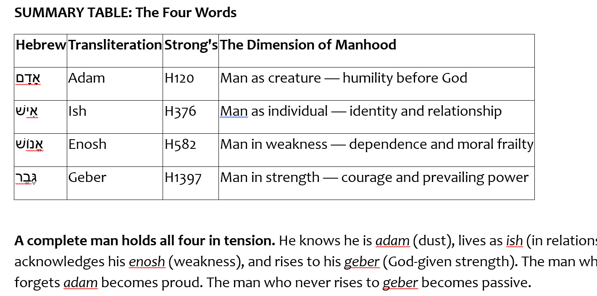

Slide 26
I CORINTHIANS 16:13
Watch ye, stand fast in the faith, quit (behave/become) you like men, be strong.
I SAMUEL 4:9
Be strong, and quit yourselves like men, O ye Philistines, that ye be not servants unto the Hebrews, as they have been to you: quit yourselves like men, and fight.

Slide 27
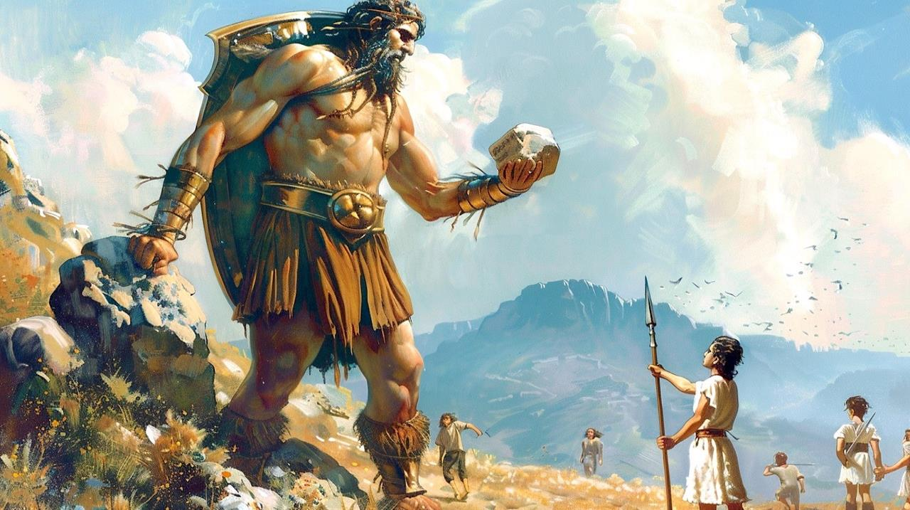
I SAMUEL 17:8
…Why are ye come out to set your battle in array? am not I a Philistine, and ye servants to Saul? choose you a man for you, and let him come down to me. 9 If he be able to fight with me, and to kill me, then will we be your servants: but if I prevail against him, and kill him, then shall ye be our servants, and serve us. 10 And the Philistine said, I defy the armies of Israel this day; give me a man, that we may fight together.

Slide 28

The Particular Temptations of Young Men
Purposelessness
Idleness
Pride
Lack of self-control
What God means to accomplish in young men are rarely great deeds that are visible to the public, but the invisible construction of a foundation of godly character that will serve them for the rest of their lives.

Slide 29
ENTICING.SPIRITS
51 When these kings, before they started out... Before Jehoshaphat ever made an alliance with Ahab, he ought to have first said, "Let us pray and see what the will of the Lord is."
Give me a preacher; give me a Christian; give me a housewife that's a Christian; give me a farmer or a factory worker that'll put God first in everything, I'll show you a man that'll be successful in the spite of all the devil can put on him. He seeks God first. 55-0724

Slide 30
GENESIS 9:1, 5-6
And God blessed Noah and his sons, and said unto them, Be fruitful, and multiply, and replenish the earth.
5 And surely your blood of your lives will I require; at the hand of every beast will I require it, and at the hand of man; at the hand of every man's brother will I require the life of man. 6 Whoso sheddeth man's blood, by man shall his blood be shed: for in the image of God made he man.

Slide 31
TSELEM — צֶלֶם (Image) — The Crown Jewel
Derived from tsal (צֵל) — a shadow. Tselem is the outline of a shadow: what is revealed about the object by its shadow.
Man is God’s shadow on the earth — not God Himself, but bearing His outline, His shape, His representative form.
Three dimensions of the tselem: (1) What we ARE — rationality, will, morality; (2) What we DO — royal dominion over creation; (3) How we RELATE — in community and covenant.
After the Fall, the image is MARRED, not erased. Genesis 9:6 still upholds the tselem as the ground of human sanctity.
Christ is the perfect tselem — “the image of the invisible God” (Col. 1:15). Redemption is the restoration of the image.

Slide 32
Definition: THE.EASTER.SEAL
141 How many Presbyterians, how many Methodists, how many Baptists, in the world today, how many Pentecostals, that knows the Truth and afraid to make a stand on the It? I'm persuaded to wonder, what was that fell on you? Are you a part of His resurrection? Would you dare scream off for some man's theory and idea? Or, have you got the real boldness and the real manhood it takes, to stand out and call right "right," and wrong "wrong"?
65-0410

Slide 33
THE.WORLD.IS.FALLING.APART
182 This world, men can either live for this world, the world to come. Depends on where your thoughts are at, there's where your treasures are also. Let it be on Heaven and the Coming of the Lord.
Be an example of womanhood. Be example of manhood. Be example of Christian. Live the Life. Do what's right.
63-0412

Slide 35
Goals for Young Men
Spiritual Life
Establish Good Moral Boundaries
Stewardship & Mentorship
Pursuing Your Calling

Slide 36
The Innocence of Youth
A.DECEIVED.CHURCH.BY.THE.WORLD
2 Lord, speak to us through Thy living Word, let the living Word dwell in us and abide in us, that we might be shaped and formed, not to the world, but be transformed by the renewing of our spirit into the form of the Son of God. 59-0628
My God hath sent his angel, and hath shut the lions' mouths, that they have not hurt me: forasmuch as before him innocency was found in me; and also before thee, O king, have I done no hurt.
DANIEL 6:19-22

Slide 37

Vulnerability of Innocence
Capable of being wounded or hurt;
Open to moral attack or temptation;
Open to assault and difficult to defend.

Slide 38
SHALOM
17 Now, the prophet said, "Gross darkness upon this people; upon the people of the world, gross darkness."
18 Have you noticed, in the last few years, some of you man and women around my age [55] , that how each year, it seems like that darkness comes more and more? I was speaking the other day, and I said to my wife, "You know, it seems like that, as the years go on, and as it just seems like that people begin to get further and further away from the real thing that they should be coming closer and closer to."

Slide 39
19 I've noticed, amongst man… and most amongst the women, watch their desires and what they like to do, they're changing attitudes all the time. Man are becoming more like women, and women are becoming more like man, seems like there is no way to stop it. Them people want to do right, but, there is something that won't let them do right. It just presses down, forces them. Like a heavy, dark fog over the whole earth. All over the world, seems to be a grouping darkness, getting more dense and dense, all the time, just smothering out real manhood, real womanhood. I'm talking in the natural.
64-0119

Slide 40
IDENTIFIED.WITH.CHRIST
77 But there come a time when God made us an Example. And He gave us the Lord Jesus. And when a sinner puts his hands upon His precious head and confesses his sins, and his sins is transformed or transferred from the sinner to Jesus and the innocence of Jesus is transferred by the Holy Ghost back into that person; he's a new creature in Christ Jesus.
59-1220

Slide 41
SEED.IS.NOT.HEIR.WITH.THE.SHUCK
175 How will you know, how will the world know that you love Jesus? When we love one another. That's how the world... See, God sees your faith; the world sees your action. Love one another now. Be kind to one another. Talk with one another. Be patient with one another.
65-0218

Slide 42
THE.STATURE.OF.A.PERFECT.MAN
273 Then Israel was going to be taken out. The great contrasts came, and Moses waited. Then he got in the wilderness. It's only about a 3-4 days journey. It's only forty miles from where he crossed there, right across where they crossed again. But, Moses, in the wilderness, waited forty years. Patience. And we should have patience with one another, too. We get so much impatient with one another. We think we got to be like Moses. Moses had patience with the people. 62-1014

Slide 43
Awesome Husbands
Don’t Speak to Your Wife As One of the Guys
Be Her Support, Not Her Father
Listening is the Key to the Heart
Make Her Feel Wonderful
Keep Growing

Slide 44
THE.MARRIAGE.OF.THE.LAMB
81 Now, marriage, in one sense, is a type. The earthly marriage here is a type of the heavenly marriage. The first thing is, in natural marriage, is a decision has to be made. The young lady has to make her decision, whether she wants this young man; and the young man, whether he wants the young woman. She must be the only woman in the world that you love, and he must be the only man. If it isn't, then you made a wrong decision.
62-0121

Slide 45
Cornerstones of Manhood
Reject Passivity
Lead Courageously
Accept Responsibility
Expect God’s Reward
II TIMOTHY 2:15
Study to shew thyself approved unto God, a workman that needeth not to be ashamed, rightly dividing the word of truth.

Slide 46
Keys for Husbands
Don’t Speak to Your Wife As One of the Guys
Be Her Support, Not Her Father
Listening is the Key to the Heart
Make Her Feel Appreciated, Special
Keep Growing Together Despite Differences

Slide 47
GENESIS 1:26-29
So God created man in his own image, in the image of God created he him; male and female created he them. 28 And God blessed them, and God said unto them, Be fruitful, and multiply, and replenish the earth, and subdue it: and have dominion over the fish of the sea, and over the fowl of the air, and over every living thing that moveth upon the earth. 29 And God said, Behold, I have given you every herb bearing seed, which is upon the face of all the earth, and every tree, in the which is the fruit of a tree yielding seed; to you it shall be for meat.

Slide 49
The Fall — The Image Marred, Not Destroyed
Sin did not erase the tselem. Genesis 9:6 still commands the protection of human life ON THE BASIS of the image.
The tselem was cracked — distorted. Violence, pride, passivity, abdication — these are not what God made; they are the crack in the mirror.
The man who dominates through cruelty, or who retreats into passivity, is a broken image of what he was designed to be.
Genesis 5:1-3: The image passes from God to Adam, and from Adam to Seth — even in a fallen world, the structure remains. The image endures.
The gospel answer: God does not abandon the cracked mirror — He restores it.

Slide 50
The Arc of Redemption — Image Restored
Genesis 1:27 — Humanity created as tselem Elohim. Man appointed to lead, warrior, provide, and carry legacy.
The Fall — The image is marred. Man becomes passive, fearful, self-serving.
Christ — The perfect eikon of God takes on flesh. The image is fully expressed in one Man.
New Birth — Colossians 3:10: “Renewed in knowledge after the image of him that created him.”
Glorification — Romans 8:29: “Conformed to the image of his Son.” Full restoration of the Genesis 1:27 man.

Slide 51
Key Verses on Manhood and the Image
Genesis 1:27 — “So God created man in his own image… male and female created he them.”
1 Corinthians 11:7 — “A man… is the image and glory of God.”
Genesis 9:6 — “For in the image of God made he man.” — Dignity is not earned; it is image-inherent.
Psalm 8:5 — “Thou hast made him a little lower than the angels, and hast crowned him with glory and honour.”
Romans 8:29 — “Conformed to the image of his Son.” — The goal of every man who follows Christ.

Slide 52
“So God created man in his own image, in the image of God created he him.”
Genesis 1:27
Before the Fall. Before the Law. Before any moral failure — the tselem is established. You were made to look like Him, to represent Him, and to reflect His glory on the earth He made.

Slide 53
Man as Leader — Made to Have Dominion
Genesis 1:26 links the image directly to dominion: “Let them have dominion over… all the earth.”
The Functional/Royal View of tselem: In the ancient Near East, a king was described as the “image” of his god — meaning he represented that god’s rule on earth.
Man is God’s vice-regent. His leadership is not self-derived — it is delegated authority from Elohim.
To lead is not optional for the man who bears the tselem. Dominion is woven into the very definition of what man is.
The man who abdicates leadership does not become humble — he becomes a contradiction of his own image.

Slide 54
Man as Warrior — Strength in the Image of the Strong One
Elohim = “the Mighty One.” Man, bearing His image, is called to reflect strength, not passivity.
The pictographic structure of zakar (male) includes: tool + open palm + head of man — the one through whom covenant memory and protection are carried forward.
1 Cor. 11:7 — “For a man indeed ought not to cover his head, forasmuch as he is the image and glory of God.” Man represents God’s glory — a warrior stands uncovered, unashamed, face to the battle.
Throughout Scripture, the men God calls are called into conflict: Adam to guard the garden, David to face Goliath, the Lord Himself to overcome death.
Implication: The warrior nature of man is not a cultural artifact — it is embedded in the tselem. Men are designed to stand between what is good and what threatens it.

Slide 55
Man as Legacy-Builder — ZAKAR
Zakar (זָכָר) — male. From a root meaning: “to remember.” The male is the one through whom the memorial of parents is continued.
Pictographic meaning: tool + open palm + head of man — the covenant blessing passed from generation to generation through the man.
Maleness is connected to remembrance, covenant continuity, and the transmission of legacy (cf. Jacob blessing his sons).
Genesis 5:3 — Adam fathered Seth “in his own likeness, after his image (tselem).” The tselem passes through fathers. A man’s character is his legacy.
Implication: A man who does not pass on faith, covenant, and character to the next generation has failed at the most fundamental level of what zakar means.

Slide 56
Man as Provider — Steward of the Earth
Adam from adamah — man is bound to the earth. Genesis 2:15: “to dress it and to keep it.” He was given a domain to cultivate and protect.
Dominion (Gen. 1:26) includes provision: over the fish of the sea, the fowl of the air, the cattle, all the earth.
The provider is not merely an economic role — it is an image-bearing responsibility. God provides for His creation; man, as tselem, reflects that provision in his household and community.
1 Timothy 5:8 — “But if any provide not for his own… he hath denied the faith, and is worse than an infidel.” Providence is not praise-worthy; it is the baseline expectation of a man.
Implication: A man’s provision is an act of worship — it images the providing God who sustains all things.

