Slide 1
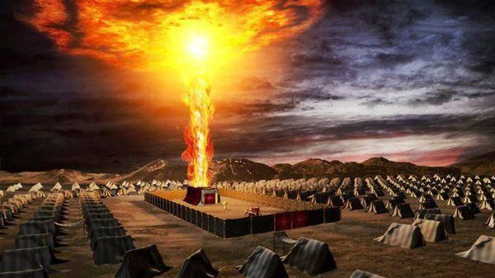
Abiding in the Shadow of the Almighty!
Hickory Bible Tabernacle: Aaron Nengomazha

Slide 2
Psalm 91:1-5 KJV
He that dwelleth in the secret place of the most High shall abide under the shadow of the Almighty. [2] I will say of the LORD, He is my refuge and my fortress: my God; in him will I trust. [3] Surely he shall deliver thee from the snare of the fowler, and from the noisome pestilence. [4] He shall cover thee with his feathers, and under his wings shalt thou trust: his truth shall be thy shield and buckler. [5] Thou shalt not be afraid for the terror by night; nor for the arrow that flieth by day;

Slide 3
Matthew 24:7-8 KJV
For nation shall rise against nation, and kingdom against kingdom: and there shall be famines, and pestilences, and earthquakes, in divers places. [8] All these are the beginning of sorrows (birth pains).

Slide 4
Revelation 6:7-8 KJV
And when he had opened the fourth seal, I heard the voice of the fourth beast say, Come and see. [8] And I looked, and behold a pale horse: and his name that sat on him was Death, and Hell followed with him. And power was given unto them over the fourth part of the earth, to kill with sword, and with hunger, and with death, and with the beasts of the earth.

Slide 5
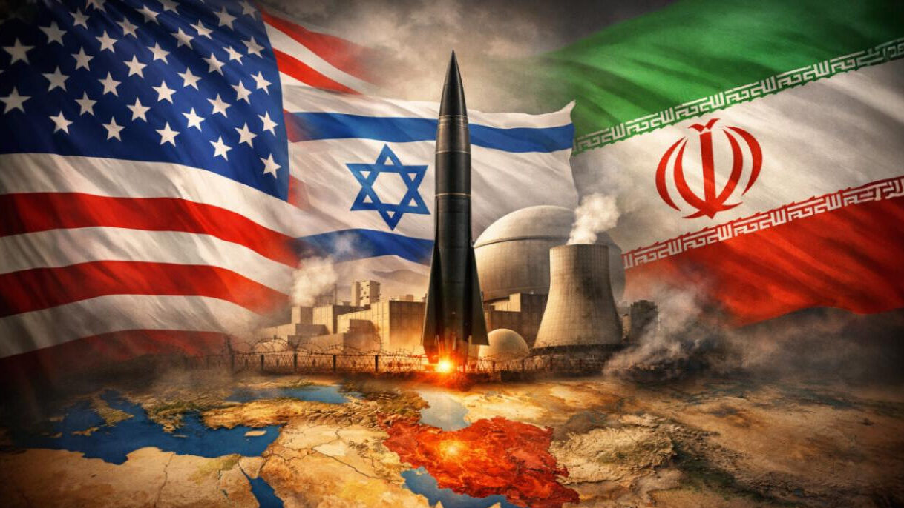

Slide 6
How many countries are in War?
As of early 2026, there are 56 active conflicts worldwide, the highest number since World War II. Over 30 countries are directly experiencing war within their borders, with up to 92 countries involved in internationalized conflicts outside their borders. Major conflicts include Ukraine-Russia, Sudan, and intensified tensions in the Middle East

Slide 7
Exodus 33:10,12-22 KJV
And all the people saw the cloudy pillar stand at the tabernacle door: and all the people rose up and worshipped, every man in his tent door. [12] And Moses said unto the LORD, See, thou sayest unto me, Bring up this people: and thou hast not let me know whom thou wilt send with me. Yet thou hast said, I know thee by name, and thou hast also found grace in my sight. [13] Now therefore, I pray thee, if I have found grace in thy sight, shew me now thy way, that I may know thee, that I may find grace in thy sight: and consider that this nation is thy people. [14] And he said, My presence shall go with thee, and I will give thee rest.

Slide 8
Exodus 33:10,12-22 KJV
[15] And he said unto him, If thy presence go not with me, carry us not up hence. [16] For wherein shall it be known here that I and thy people have found grace in thy sight? is it not in that thou goest with us? so shall we be separated, I and thy people, from all the people that are upon the face of the earth. [17] And the LORD said unto Moses, I will do this thing also that thou hast spoken: for thou hast found grace in my sight, and I know thee by name.

Slide 9
Exodus 33:10,12-22 KJV
[18] And he said, I beseech thee, shew me thy glory. [19] And he said, I will make all my goodness pass before thee, and I will proclaim the name of the LORD before thee; and will be gracious to whom I will be gracious, and will shew mercy on whom I will shew mercy. [20] And he said, Thou canst not see my face: for there shall no man see me, and live. [21] And the LORD said, Behold, there is a place by me, and thou shalt stand upon a rock: [22] And it shall come to pass, while my glory passeth by, that I will put thee in a clift of the rock, and will cover thee with my hand while I pass by:

Slide 10
55-1009 - "The Way To Have Fellowship"
But fellowship with God is what…The first and original fellowship that human beings had was with God. There wasn’t even another—another living creature on the earth that He could fellowship with, Adam, but God.

Slide 11
63-1130B - "Influence"
When man sinned, he crossed the chasm between him and God, and left. There is no way back, at all. But God, rich in mercy, accepted a Substitute. And that Substitute today, for us, is Jesus Christ.

Slide 12
63-0127 - "An Absolute"
332 Next morning, when I woke up, I was laying there. I said, “I better get up and take the children to school.” I looked over, and there was this hideous looking thing. Looked like it was Alley Oop in the funny paper, great big horns sticking out of it. He was going, sounded like a hen cackling, or—or singing, like they’re going from the barn. I looked at it.
I said, “Meda, Meda, honey.” And she didn’t wake up.
333 I thought, “Yeah, that’d scare her to death.” I waited there just a minute, and stand and watch.

Slide 13
63-0127 - "An Absolute"
335 And after while, he was accusing me. Said, “You have no power with God. You’re just a bluff. You have no power.”
336 I said, “Satan, you’re an offense to me. Get out of my way, in the Name of Jesus Christ.” And he left.
337 I laid there a little bit, in the bed. Started to raise up, I felt a real sweet feeling come over me. I thought, “Wonder if the Holy Spirit now is close?”

Slide 14
….And over in the corner…So help me, here is my Bible over my heart. The sweetest Voice I ever heard in my life, said, “Don’t fear to go anywhere, and don’t fear to do anything, for the never-failing Presence of Jesus Christ is with you wherever you go.”
338 That settled it, with me. Let them rage. I got an Absolute. My anchor holds yonder, because it’s the Word of the living God. Amen. Yeah.

Slide 15
An Exposition Of The Seven Church Ages (3 - The Ephesian Church Age)
“And Cain said unto the Lord, My punishment is greater than I can bear. Behold, Thou hast driven me out this day from the face of the earth; and from Thy face shall I be hid; and I shall be a fugitive and a vagabond in the earth; and it shall come to pass, that every one that findeth me shall slay me.”

Slide 16
Luke 11:24-26 KJV
When the unclean spirit is gone out of a man, he walketh through dry places, seeking rest; and finding none, he saith, I will return unto my house whence I came out. [25] And when he cometh, he findeth it swept and garnished. [26] Then goeth he, and taketh to him seven other spirits more wicked than himself; and they enter in, and dwell there: and the last state of that man is worse than the first.

Slide 17
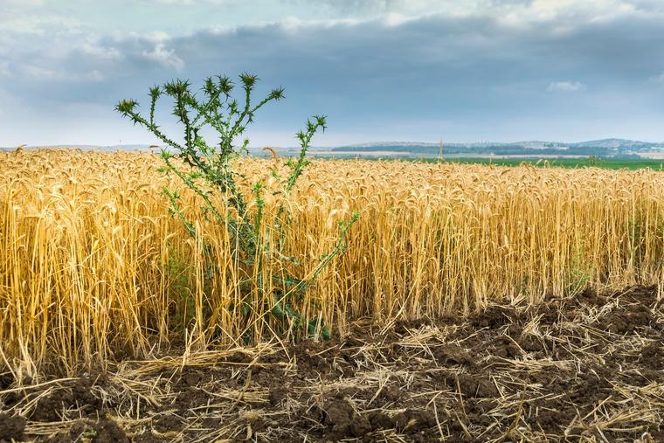

Slide 18
Exodus 25:8-9 KJV
And let them make me a sanctuary; that I may dwell among them. [9] According to all that I shew thee, after the pattern of the tabernacle, and the pattern of all the instruments thereof, even so shall ye make it.

Slide 19
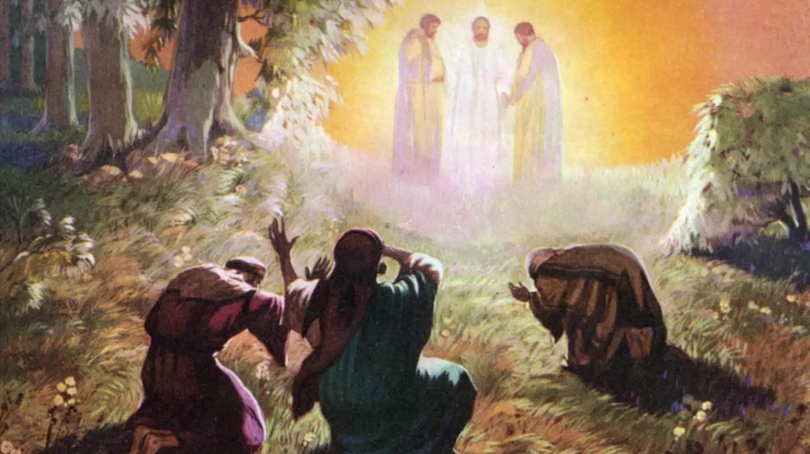

Slide 20
62-0909E - "In His Presence"
11 Then we realize how little we are when we realize how great He is, and how close we come in of coming to His Presence.

Slide 21
61-0410 - "Conferences"
103 Aaron left his rod there one year and it bloomed out and blossomed while it was in the presence of the Shekinah Glory. Any man laying in the Presence of God’s Shekinah Glory, will take an old dead sinner, dead in sin and trespasses, and bloom him out to a new creature in Christ Jesus.
Notes:
Numbers 16

Slide 22
62-0909E - "In His Presence"
30 Isaiah saw visions. He was a prophet. Isaiah preached the Word. He was a minister. Isaiah was a holy man. But one day, standing in the temple, he fell into a trance and he saw the Glory of God. He saw the Angels with wings over Their face, wings over Their feet, flying with wings, crying, “Holy, holy, holy is the Lord God Almighty!”
31 That prophet realized he was nothing. He said, “Woe is me, for I am a man of unclean lips.” A prophet, a mightiest prophet of the Bible, one of them. “I am a man with unclean lips, and I dwell among people that’s unclean lips. Woe is me, because I see the Glory of God.”

Slide 23
58-0301B - "The Great Commission"
If you want to be a blessing, and get a blessing, when a man has done you wrong, and he has absolutely, justly, he…I mean he has done you wrong and you know that he’s done you wrong, he’s done you evil, don’t mention that, you take him to prayer before God.
25 And don’t take it in a way of just a selfish, and say, “Well, I’m supposed to do this,” but stand with your shoulder to his shoulder, and stand in the Presence of God our Father, way a prayer should be made in the Presence of God, say,…

Slide 24
58-0301B - "The Great Commission"
….“Father, here’s my brother, and he—he, justly, he deserves punishment because he has—he has done me evil, and I don’t see why he did it.” Then let God go to talking to you, and you’ll see maybe, what that man has been through, the devil has twisted him up somewhere and caused him to do that. Though he’s absolutely wrong, before you leave the Throne of God you’ll be feeling sorry for that man, you’ll be sympathizing with that brother….

Slide 25
58-0301B - "The Great Commission"
…26 And when you get back down to where…earth again, you’ll go over to that brother and shake his hand, ’cause you know what he’s been through. You can’t stand with a mortal in the Presence of God and condemn anybody, I don’t believe, no, sir, even if he is a rank sinner.

Slide 26
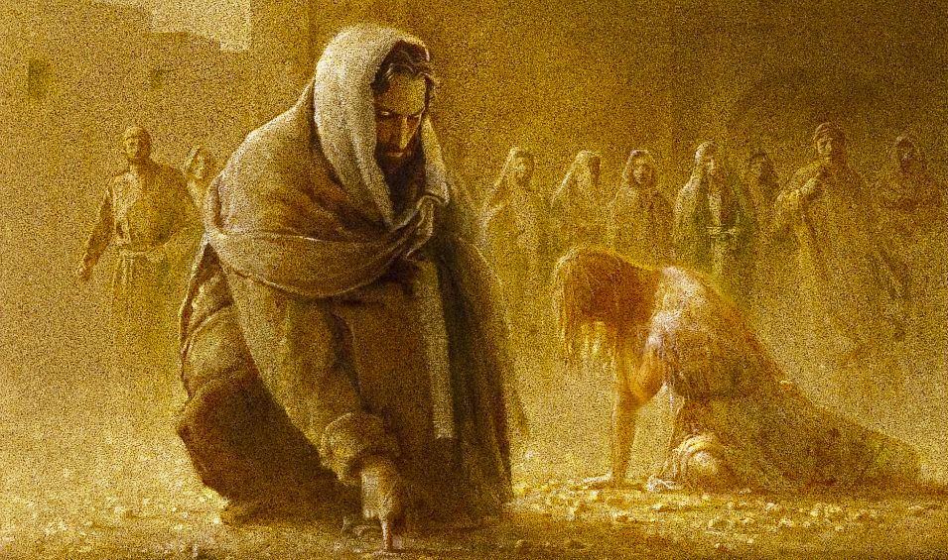

Slide 27
54-0809E - "The Manifestation Of Thy Resurrection To The People Of This Day"
You know it’s more than a man standing here. Your brother wouldn’t put that feeling on you. That the people might know that you’re truly…You’ve a feeling that’s on you now that you’ve never felt before. If that’s right, raise up your hand to the audience. You’re standing in His Presence, not mine, His.

Slide 28
56-0101 - "Why Are People So Tossed About?"
God sending it down to provide life for the children of Israel in their journey, then God told Moses and Aaron to go make a great, golden pot, and to fill it full of—of manna and to put it in the Holy Place, or, the Holiest of holy places, by the ark. This manna was to be set by the ark, and there it never failed, it never got old, it never lost its sweetness, it was always good inside there.

Slide 29
56-0101 - "Why Are People So Tossed About?"
107 Did you ever meet a person that’s been in there, and has tasted, and living on this Manna? You can meet him on Monday, Tuesday, Wednesday, Thursday, Friday, Saturday, or Sunday, cloudy day, bright day, gloomy day, things going right, wrong, he is always sweet, always full of love, never to talk or do anything wrong, he is living under the glory of God, he never gets hungry, he never has to go to church to get built up, he—he is just always full of God.

Slide 30
2 Corinthians 2:15-16 KJV
For we are unto God a sweet savour of Christ, in them that are saved, and in them that perish: [16] To the one we are the savour of death unto death; and to the other the savour of life unto life. And who is sufficient for these things?

Slide 31
65-0118 - "The Seed Of Discrepancy"
83 He was the Rose of Sharon. What did they do with the Rose of Sharon? They squeezed It out, mashed It out, to get the perfume out of It. A beautiful rose has to be squeezed down to get the perfume from the rose. That was a beautiful Life, there never was a life lived like It, but It had to be squeezed out on Calvary.

