Slide 1

The
Spirit Controlled
Family 8
GENESIS 17:7
And I will establish my covenant between me and thee and thy seed after thee in their generations for an everlasting covenant, to be a God unto thee, and to thy seed after thee.

Slide 2
Birthdays & Anniversaries
Mar. 8th Sharon McCafferty
Mar. 9th Matt Cross
Mar. 12th Timothy Gutierrez
Mar. 14th Connie Hughes
Mar. 29th Fellowship Meeting (Bro. Burley)
April 5th Easter Meetings
May 16th Ladies Tea

Slide 3

Tehran
THE.HANDWRITING.ON.THE.WALL
14 In the vision of Daniel, seeing the interpretation of the image of the Gentile age, how one Kingdom would succeed another until it come down to the very end days that where we're living now. And in the middle east these things rising up, these troubles. Little nations up there who has not been thought of or spoke of for many, hundreds, thousands of years... Maybe 2000 – 2500 years nothing has been said much about those little countries, until just these last days. 56-0902

Slide 4
The
Spirit Controlled
Family 8
GENESIS 17:7
And I will establish my covenant between me and thee and thy seed after thee in their generations for an everlasting covenant, to be a God unto thee, and to thy seed after thee.

Slide 5
Is Marriage a “good” thing?
It is God’s provided way for men and women to live and fulfill His purpose.
PROV. 18:22 Whoso findeth a wife findeth a good thing, and obtaineth favour of the LORD.
2. Marriage is bound by a Covenant.
MAL. 2:14 Yet ye say, Wherefore? Because the LORD hath been witness between thee and the wife of thy youth, against whom thou hast dealt treacherously: yet is she thy companion, and the wife of thy covenant.

Slide 6

Part 2: Marriage is a “Covenant” Agreement
Covenant: (w) an agreement.

Slide 7
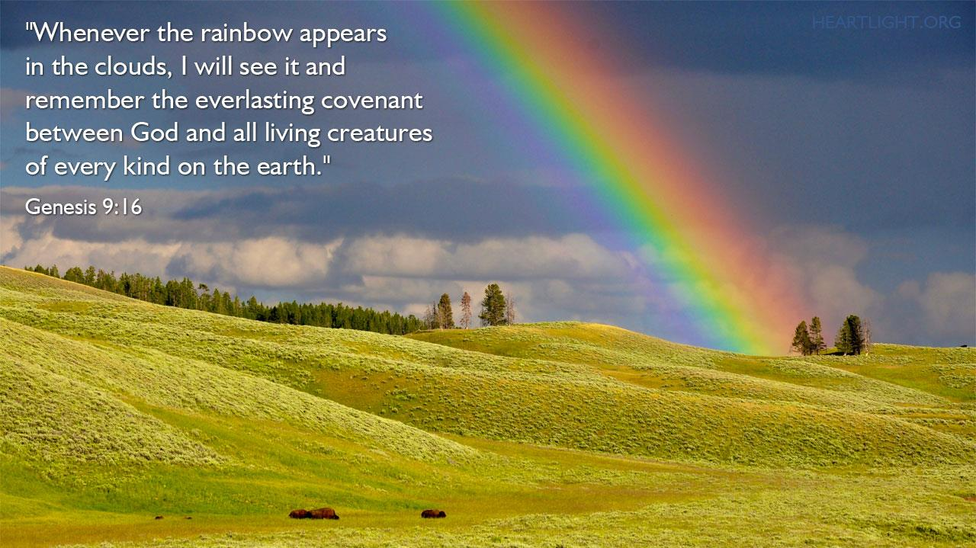

Slide 8
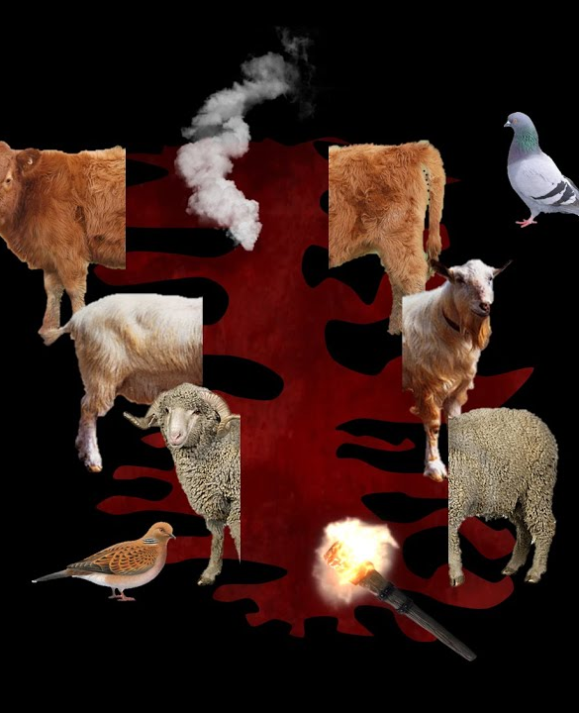
GENESIS 15:17-18
And it came to pass, that, when the sun went down, and it was dark, behold a smoking furnace, and a burning lamp that passed between those pieces. 18 In the same day the LORD made a covenant with Abram, saying, Unto thy seed have I given this land, from the river of Egypt unto the great river, the river Euphrates…

Slide 9
PSALM 89:1-4
I will sing of the mercies of the LORD for ever… 2 For I have said, Mercy shall be built up for ever: thy faithfulness shalt thou establish in the very heavens. 3 I have made a covenant with my chosen, I have sworn unto David my servant, 4 Thy seed will I establish for ever, and build up thy throne to all generations.

Slide 10
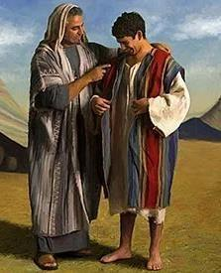
THE.CHILDREN.OF.ISRAEL
31 Joseph…he wore a coat of seven colors. And the seven colors, of course, represented seven colors in the rainbow, which was a covenant. And God always has His covenant people. 47-1123

Slide 11
I AM NO LONGER MY OWN
Mark 8:31-38; Rom 7:7-25
John Wesley’s Covenant prayer, "I am no longer my own but Thine, put me to what thou wilt, rank me with whom thou wilt, put me to doing, put me to suffering, let me be employed for thee or laid aside for thee, exalted for thee or brought low for thee; let me be full, let me be empty; let me have all things, let me have nothing; I freely and heartily yield all things to thy pleasure and disposal."

Slide 12
ISAIAH 49:14
But Zion said, The LORD hath forsaken me, and my Lord hath forgotten me. 15 Can a woman forget her sucking child, that she should not have compassion on the son of her womb? yea, they may forget, yet will I not forget thee. 16 Behold, I have graven thee upon the palms of my hands; thy walls are continually before me.

Slide 13
ZECHARIAH 12:8-10
In that day shall the LORD defend the inhabitants of Jerusalem; and he that is feeble among them at that day shall be as David; and the house of David shall be as God, as the angel of the LORD before them. 9 And it shall come to pass in that day, that I will seek to destroy all the nations that come against Jerusalem. 10 And I will pour upon the house of David, and upon the inhabitants of Jerusalem, the spirit of grace and of supplications…

Slide 14
THE.REVELATION.OF.JESUS.CHRIST
36-5 This is the revelation story of Zech. 12:9-14, prophesied this about 2500 years ago. It is just about to take place. Now, when is the Gospel returning to the Jews? When the day of the Gentiles is finished. The Gospel is ready to go back to the Jews. Oh, if I could just tell you something that is about to happen right in this our day. This great thing that is about to happen will carry over to Rev. 11 and pick up those two prophets, Moses and Elijah, turning the Gospel back to the Jews. We're ready for it. As the Jews brought the message to the Gentiles, even so the Gentiles will take it right back to the Jews, and the Rapture will come.

Slide 15
JEREMIAH 31:33
But this shall be the covenant that I will make with the house of Israel; After those days, saith the LORD, I will put my law in their inward parts, and write it in their hearts; and will be their God, and they shall be my people.
HEBREWS 10:16
This is the covenant that I will make with them after those days, saith the Lord, I will put my laws into their hearts, and in their minds will I write them; 17 And their sins and iniquities will I remember no more.

Slide 16
JEREMIAH 31:31-34*
Behold, the days come, saith the LORD, that I will make a new covenant with the house of Israel, and with the house of Judah: 32 Not according to the covenant that I made with their fathers in the day that I took them by the hand to bring them out of the land of Egypt; which my covenant they brake, although I was an husband unto them, saith the LORD: 33 But this shall be the covenant that I will make with the house of Israel;

Slide 17
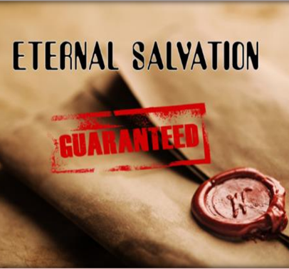
33 After those days, saith the LORD, I will put my law in their inward parts, and write it in their hearts; and will be their God, and they shall be my people. 34 And they shall teach no more every man his neighbour, and every man his brother, saying, Know the LORD: for they shall all know me, from the least of them unto the greatest of them, saith the LORD: for I will forgive their iniquity, and I will remember their sin no more.

Slide 18
II SAMUEL 23:5 (David)
Although my house be not so with God; yet he hath made with me an everlasting covenant, ordered in all things, and sure: for this is all my salvation, and all my desire, although he make it not to grow.
2 Samuel 23:5 (NLT)
“Is it not my family God has chosen? Yes, he has made an everlasting covenant with me. His agreement is arranged and guaranteed in every detail. He will ensure my safety and success.

Slide 19
Contemporary View:
“Marriage, even among Christians, is perceived as a capstone that marks a successful young adult life, not the foundational entry into adulthood.
A capstone is the finishing touch of a structure. A foundation, however, is what a building rests upon. In the foundational vision, being newly married and poor was common, expected, and difficult, but often temporary. In the capstone standard, being poor is a sign that you’re just not marriage material yet.”

Slide 20
“Nadia, a 28-year-old unmarried Pentecostal from Lagos, was clear about the conditions under which she would marry. “When I have everything I want, when I am able to achieve every thing I want to achieve for myself. Then I will get married.”
Another 24-year-old unmarried woman from Lagos concurred. “Oh, please!” she said, laughing. “I can’t marry and suffer.”

Slide 21
“…Fewer and fewer people are interested in participating in what marriage actually is: the mutual provision and transfer of resources within a formalized sexual union.
That may sound old-fashioned, but it’s not untrue. Matrimony has long depended on an exchange based on inequalities between the spouses: He needs what she has, and she needs what he has.” (Helpmeet)

Slide 22
MAL. 2:14
Yet ye say, Wherefore? Because the LORD hath been witness between thee and the wife of thy youth, against whom thou hast dealt treacherously: yet is she thy companion, and the wife of thy covenant.
Malachi 2:14 You cry out, “Why doesn’t the Lord accept my worship?” I’ll tell you why! Because the Lord witnessed the vows you and your wife made when you were young. But you have been unfaithful to her, though she remained your faithful partner, the wife of your marriage vows.

Slide 23
PSALM 16:11
Thou wilt shew me the path of life: in thy presence is fulness of joy; at thy right hand there are pleasures for evermore.

Slide 24
IT.IS.I
19 Let your wife know that you love her; she loves you. When you're young and you find favor with one another, it makes you join yourselves together for a lifetime journey: that's phileo love; human love.
What will Agapao love do, when you can really get into a place that you can show God that you love Him and you got confidence in Him? How you'll join yourself to Him, not only for a life's journey, but for eternity. 60-0720

Slide 26
"Commitment"
Unpopular in our culture which emphasizes individual rights, personal freedom, independence and mobility. The idea of giving these up because of dedication to another person or loyalty to a relationship makes people feel trapped.
But you can’t have it both ways. You can't build a divorce-proof marriage and remain unbending toward your personal rights. That doesn't mean you give up all your freedoms or choices, but it does mean your commitment to the relationship supersedes your individual rights.

Slide 27
EPHESIANS 5:21-24
Submitting yourselves one to another in the fear of God. 22 Wives, submit yourselves unto your own husbands, as unto the Lord. 23 For the husband is the head of the wife, even as Christ is the head of the church: and he is the saviour of the body. 24 Therefore as the church is subject unto Christ, so let the wives be to their own husbands in everything.

Slide 28
Accept that the Person You Chose Is Not Perfect.
You’re not perfect and neither is your partner. If there a red flags at the outset — say, a partner who lies or treats you with disrespect — you’re wise to think twice. But the ordinary challenging stuff — his car is like a dump, or she looses her keys — isn’t going to disappear once you say ‘I do.’ The key is to appreciate all the good things and to somehow find peace with what’s less than ideal.

Slide 29
Respond To Each Others’ Needs For Connection
Partners who catch the ways in which their partners turn toward them to try to connect on an emotional level do better in relationship.
This means that they connect in small ways when they spend time together. If one tells a joke, the other laughs. If one texts, the other texts back. If one is hurting and needs to talk, the other stops what they’re doing and listens.

Slide 30
This builds a strong sense of emotional connection over time. It also builds trust, which is fundamental in a good strong relationship.
A solid foundation for marriage doesn’t rest on the intensity of love but rather on whether the relationship is positive. Is there a sense of safety in the relationship? Can each person really listen to the other, and stay curious about their partner’s experience?
All of these things strengthen the foundation of your marriage.

Slide 31
Share How Much You Love Each Other.
Partners who are in the habit of telling one another what they appreciate about each other have a solid foundation. If they see something positive, they point it out.
When we appreciate the positives we avoid the very negative habit of scanning for the negatives, which results in contempt — one of the strongest predictors of divorce.

Slide 32
Marriage
Marriage is viewed as a contractual bond commanded by God in which a man and a woman come together to create a relationship in which God is directly involved. (Gen. 1:28)
Marriage is understood to mean that the husband and wife are merging into a single soul which is why a man is considered “incomplete” if he is not married, as his soul is only one part of a larger whole that remains to be unified.

Slide 33
Shalom in the Home:
A man has to love his wife as he loves himself and honor her more than he honors himself. The Talmud forbid a husband from being overbearing to his household, and domestic abuse was unheard of. It was said of a wife that God counts her tears.

Slide 34
Minimum Provisions for the Wife
1. Enough bread for at least two meals a day;
2. Sufficient oil for cooking and lighting;
3. Sufficient wood for cooking;
4. Fruit and Vegetables;
5. Wine, if customary;
6. Three meals on the Sabbath (fish and meat);
7. An allowance of a silver coin each week;
8. One hat, one belt, three pairs of shoes annually.

Slide 35
“Marriage is just texting each other – “do we need anything from the grocery store?” – until one of you dies.”

