Slide 1
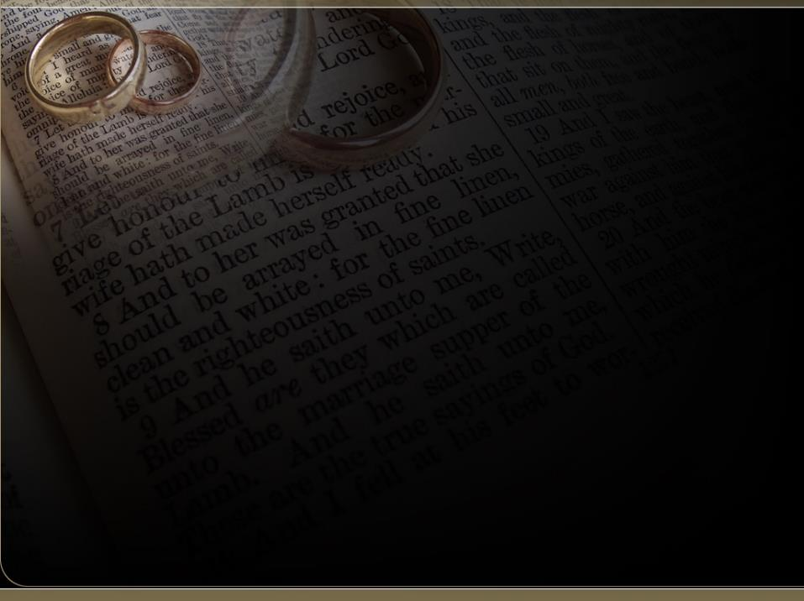
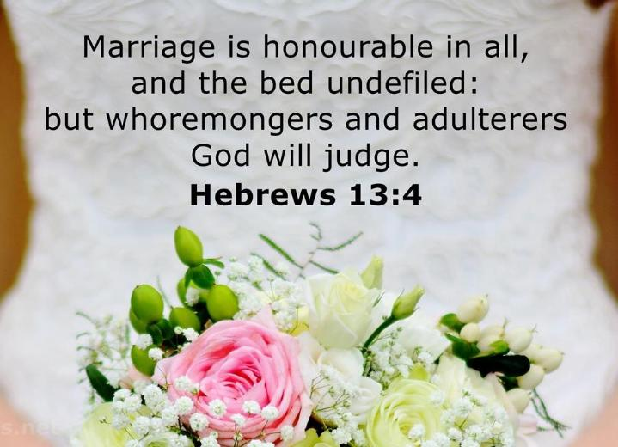
The Spirit Controlled Marriage (2) 7

Slide 2
Birthdays & Anniversaries
Feb. 22nd Jeremy & Julia Clayville,
Sam & Jessica Pugh
Feb. 24th Judy Arnold
Feb. 26th Rachel Coffey, Jew Nengomazha
Feb. 28th Bill & Cindy Walters, Cohen Pritchard
Feb. 29th Joel Johnson

Slide 3
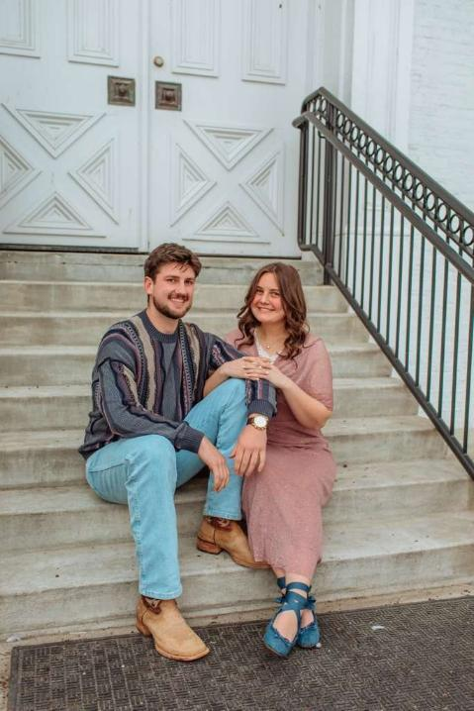
Noah
& Lilah

Slide 4
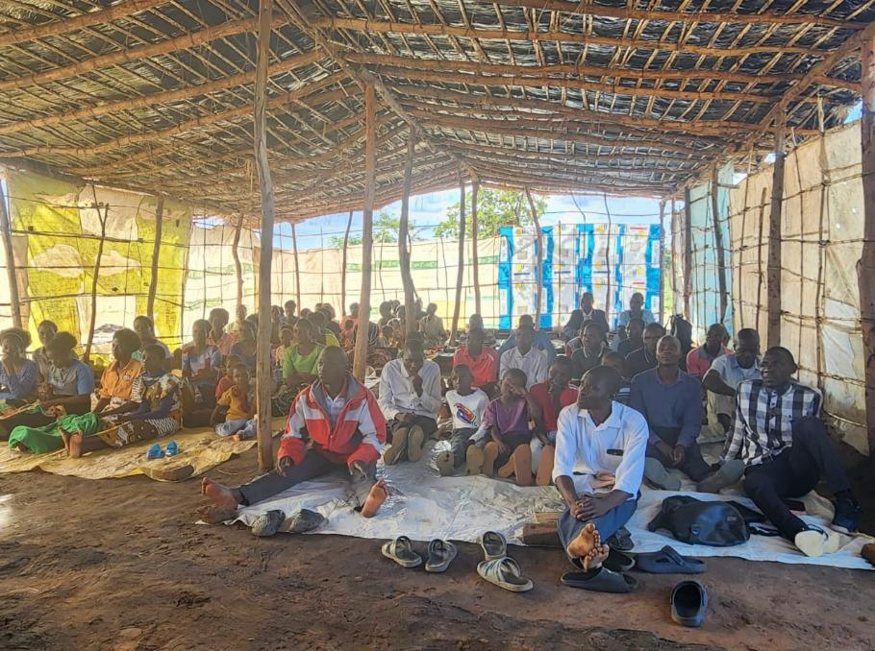
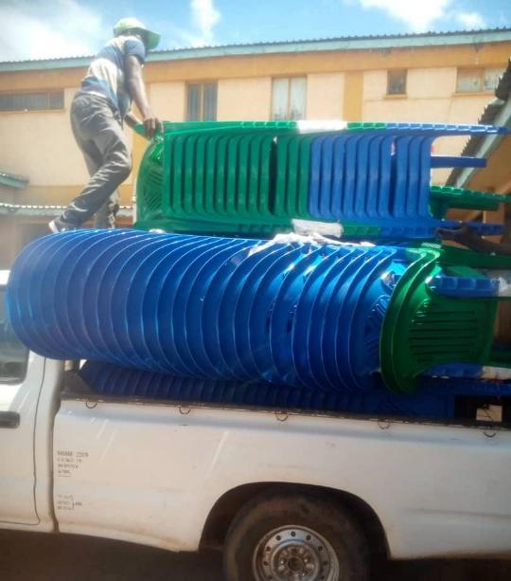
“Chairs for this flock in Malawi $1200.”

Slide 5
The Spirit Controlled Marriage 7

Slide 6
I CHRONICLES 29:17-19
17 I know also, my God, that thou triest the heart, and hast pleasure in uprightness. As for me, in the uprightness of mine heart I have willingly offered all these things: and now have I seen with joy thy people, which are present here, to offer willingly unto thee. 18 O LORD God of Abraham, Isaac, and of Israel, our fathers, keep this for ever in the imagination of the thoughts of the heart of thy people, and prepare their heart unto thee: 19 And give unto Solomon my son a perfect heart, to keep thy commandments, thy testimonies, and thy statutes, and to do all these things, and to build the palace, for the which I have made provision.

Slide 7
¹⁷ I know, my God, that you examine our hearts and rejoice when you find integrity there. You know I have done all this with good motives, and I have watched your people offer their gifts willingly and joyously.
¹⁸ “O Lord, the God of our ancestors Abraham, Isaac, and Israel, make your people always want to obey you. See to it that their love for you never changes. ¹⁹ Give my son Solomon the wholehearted desire to obey all your commands, laws, and decrees, and to do everything necessary to build this Temple, for which I have made these preparations.”

Slide 8
Marriage Myth:
“Is marriage something I should be
worried about? Isn’t it a good thing?
We often hear about marriage problems
and challenges in relationships, even
among Christians.”

Slide 9
Is Marriage a “good” thing?
It is God’s provided way for men and women to live and fulfill His purpose.
PROV. 18:22 Whoso findeth a wife findeth a good thing, and obtaineth favour of the LORD.
2. Marriage is bound by a Covenant.
MALACHI 2:14 Yet ye say, Wherefore? Because the LORD hath been witness between thee and the wife of thy youth, against whom thou hast dealt treacherously: yet is she thy companion, and the wife of thy covenant.

Slide 10
WHAT.IS.THAT.IN.YOUR.HAND
12 I hope and trust that every young man in this building and every young couple today... when you get married, that your life will be just as happy together as she and I have been together the fifteen years nearly that we been married, been like heaven on earth. 55-1120

Slide 11
What is the greatest problem between married couples?
Communication breakdown is consistently cited as the single greatest problem in marriage, fueling other issues like emotional disconnection, conflict, and resentment. It involves a failure to effectively express needs, listen actively, or handle disagree-ments constructively, often leading to the "four horsemen" (criticism, contempt, defensiveness, and stonewalling).

Slide 12
Communication
The number one problem for couples. None of us are perfect at it, but when we can talk about difficult topics like money, kids, religion or politics, and do so respectfully, we’ve got a good foundation for a happy future together.

Slide 13
“Dearest Darling,
I want you to know I have arrived
safely. Looking forward to you joining me tomorrow.
Your loving Husband
PS. Sure is hot down here.

Slide 14
What time is it?
What is time?
The indefinite continued progress of existence and events in the past, present, and future regarded as a whole.
A point of time as measured in hours and minutes past midnight or noon.

Slide 15
Can Love last a lifetime?
Hebrews, Chap. 7 #2
362 Marriage is honorable, but it should be entered prayerfully, reverently. And genuine love for that woman will bind you together forever. “What you bind on the earth...”

Slide 16
You may get stoop-shouldered, bald-headed, wrinkled-faced and everything else, but she’ll love you just like you did when you stood with wide shoulders and curly hair, if it’s really God.
For you’re looking to the time when you’ve crossed the river yonder, when you’ll spring back, again to young men and women, to live together forever. That’s God’s Eternal promise. 57-0922

Slide 17
HEBREWS 13:4
Marriage is honourable in all, and the bed undefiled…
Esteemed, held in honor, great price.
ACTS 5:34 Then stood there up one in the council, a Pharisee, named Gamaliel, a doctor of the law, had in reputation among all the people…
REVELATION 17:4 And the woman was arrayed in purple and scarlet colour, and decked with gold and precious stones and pearls…

Slide 18
JAMES 5:7
Be patient therefore, brethren, unto the coming of the Lord. Behold, the husbandman waiteth for the precious fruit of the earth, and hath long patience for it…
I PETER 1:7
That the trial of your faith, being much more precious than of gold that perisheth, though it be tried with fire, might be found unto praise and honour and glory at the appearing of Jesus Christ:

Slide 19
I PETER 1:19
But with the precious blood of Christ, as of a lamb without blemish and without spot:
II PETER 1:4
Whereby are given unto us exceeding great and precious promises: that by these ye might be partakers of the divine nature, having escaped the corruption that is in the world through lust.

Slide 20
HEBREWS 13:4
Marriage is honourable in all, and the bed undefiled: but whoremongers and adulterers God will judge.

Slide 21
The Story of Abigail:
I SAMUEL 25:2
And there was a man in Maon, whose possessions were in Carmel; and the man was very great, and he had three thousand sheep, and a thousand goats: and he was shearing his sheep in Carmel. 3 Now the name of the man was Nabal; and the name of his wife Abigail: and she was a woman of good understanding, and of a beautiful countenance: but the man was churlish and evil in his doings; and he was of the house of Caleb.

Slide 22
I SAMUEL 25:31
That this shall be no grief unto thee, nor offence of heart unto my lord, either that thou hast shed blood causeless, or that my lord hath avenged himself: but when the LORD shall have dealt well with my lord, then remember thine handmaid. 32 And David said to Abigail, Blessed be the LORD God of Israel, which sent thee this day to meet me: 33 And blessed be thy advice, and blessed be thou, which hast kept me this day from coming to shed blood, and from avenging myself with mine own hand.

Slide 23
Conflict:
Stress characterized by incompatible desires, needs or environmental demands. The competition of two or more contradictory impulses. This is usually accompanied by emotional tension.
EPHESIANS 4:26
Be ye angry, and sin not: let not the sun go down upon your wrath:

Slide 24
QUESTIONS.AND.ANSWERS.2
299. If you in a second marriage where both parties are divorced is repentance enough, or do you have to end your marriage relationship to be right?

Slide 25
I wish we didn't have to go through these things... I got friends setting here... It just nearly kills, but I got to say it. Some poor, little, old woman make a mistake and marry some alcoholic, or some poor man married some street-walker and not know it, then be bound to that woman or man as long as they live. That's a horrible thing. Marriage is a sacred thing.
Many times sinner kids run in and do those things, and then they wonder what it's all about. If the Lord will permit me to explain this marriage and divorce the way it should be, I believe it'll clear up a whole lot of that.
64-0823

Slide 26
AN.EXODUS
19 Moses, being spiritual, understood that God was going to take the children of Israel out and he called him to do it. Now, he tried in himself… Notice, he failed, miserably failed, run into the desert for another forty years while God had him back on the backside of the desert, where he married Zipporah. And she was high tempered. Moses was too, so I guess there was some little trouble on the backside of the desert once in a while.

Slide 27
Don't turn your wife down 'cause she's got a little temper. Maybe that's your cross. God might've give it to kinda keep you lined up: same thing with you women to your husbands. Stick together: promised God you would, so stay with it.
Notice, I'm a person don't believe in marriage and divorce. You know that, so... Look, my brother. If you went at that more prayerfully, there'd be less of it. 56-0615

Slide 28
Let the wife make the husband glad to come home and let him make her
sorry to see him leave.
Martin Luther
PROVERBS 12:4
A virtuous woman is a crown (wreath) to her husband: but she that maketh ashamed is as rottenness in his bones.

Slide 29
Never speak badly about your spouse to others.
Don’t stop courting each other, ever.
Keep some things just between you two – forever.
Argue to solve, not to win.
Don’t compare your marriage to anyone else’s.
Speak up before resentment builds.
Share responsibilities, not just complaints.
Defend your spouse in public.
Respect each other’s time alone.
Celebrate small moments, not just big ones.

Slide 30
Is Marriage a “good” thing?
It is God’s provided way for men and women to live and fulfill His purpose.
PROV. 18:22 Whoso findeth a wife findeth a good thing, and obtaineth favour of the LORD.
2. Marriage is bound by a Covenant.

Slide 31
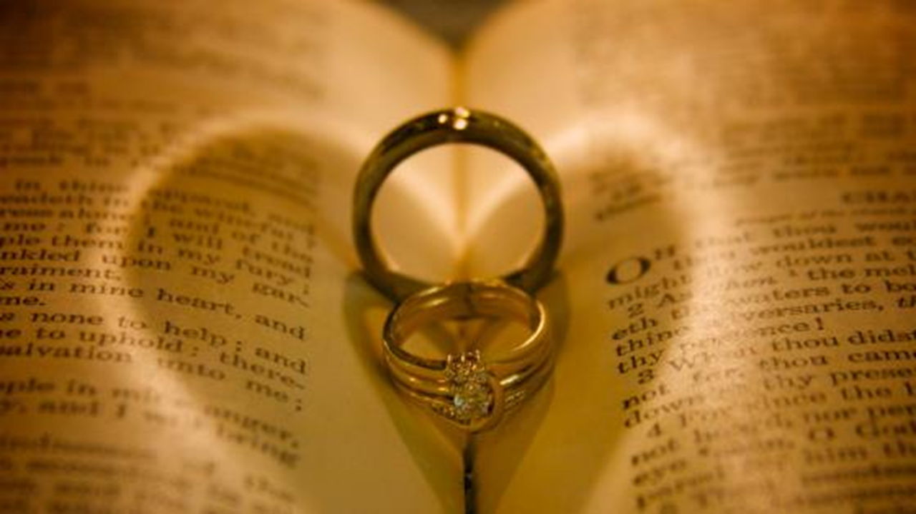
Part 2: Marriage is a Covenant Agreement
Covenant: (w) an agreement.

Slide 32
Noah: GENESIS 9:12
And God said, This is the token of the covenant which I make between me and you and every living creature that is with you, for perpetual generations: 13 I do set my bow in the cloud, and it shall be for a token of a covenant between me and the earth. 15 And I will remember my covenant, which is between me and you and every living creature of all flesh; and the waters shall no more become a flood to destroy all flesh. 16 And the bow shall be in the cloud; and I will look upon it, that I may remember the everlasting covenant between God and every living creature of all flesh that is upon the earth.

Slide 33
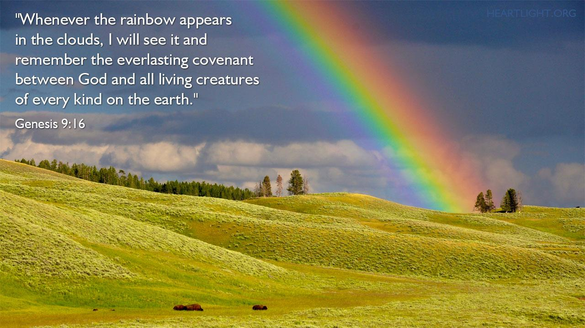

Slide 34
PSALM 89:1-4
I will sing of the mercies of the LORD for ever: with my mouth will I make known thy faithfulness to all generations. 2 For I have said, Mercy shall be built up for ever: thy faithfulness shalt thou establish in the very heavens. 3 I have made a covenant with my chosen, I have sworn unto David my servant, 4 Thy seed will I establish for ever, and build up thy throne to all generations.

Slide 35
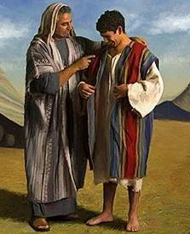
THE.CHILDREN.OF.ISRAEL
31 Joseph, the younger son, rejected of his brethren: Christ, rejected of His brethren. He wore a coat of seven colors, Joseph. And the seven colors, of course, represented seven colors in the rainbow, which was a covenant. And God always has His covenant people. 47-1123

Slide 36
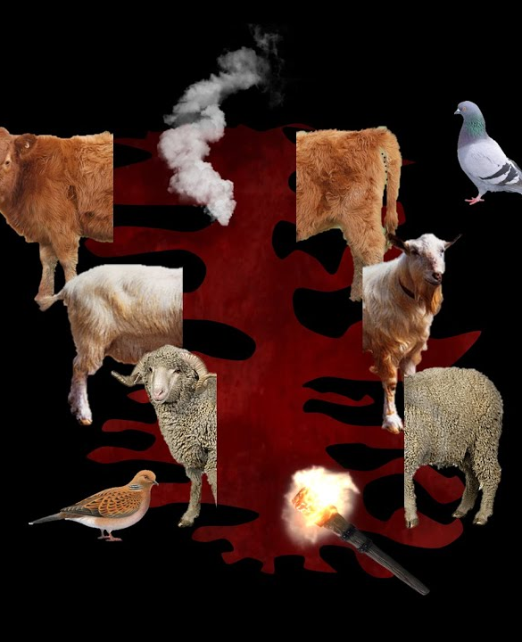
GENESIS 15:17-18
And it came to pass, that, when the sun went down, and it was dark, behold a smoking furnace, and a burning lamp that passed between those pieces. 18 In the same day the LORD made a covenant with Abram, saying, Unto thy seed have I given this land, from the river of Egypt unto the great river, the river Euphrates…

Slide 37

JEREMIAH 11:1-3
The word that came to Jeremiah from the LORD, saying, 2 Hear ye the words of this covenant, and speak unto the men of Judah, and to the inhabitants of Jerusalem; 3 And say thou unto them, Thus saith the LORD God of Israel; Cursed be the man that obeyeth not the words of this covenant…

Slide 38
JEREMIAH 29:10
For thus saith the LORD, That after seventy years be accomplished at Babylon I will visit you, and perform my good word toward you, in causing you to return to this place. 11 For I know the thoughts that I think toward you, saith the LORD, thoughts of peace, and not of evil, to give you an expected end.
Perform (HEB.) quwm
To arise, to fulfil, confirm, establish.

Slide 39
JOB 11:13-18
If thou prepare [establish] thine heart, and stretch out thine hands toward him; 14 If iniquity be in thine hand, put it far away, and let not wickedness dwell in thy tabernacles. 15 For then shalt thou lift up thy face without spot; yea, thou shalt be stedfast, and shalt not fear: 16 Because thou shalt forget thy misery, and remember it as waters that pass away: 17 And thine age shall be clearer than the noonday; thou shalt shine forth, thou shalt be as the morning. 18 And thou shalt be secure [confident], because there is hope; yea, thou shalt dig about thee, and thou shalt take thy rest in safety.

Slide 40
JEREMIAH 31:31-34*
Behold, the days come, saith the LORD, that I will make a new covenant with the house of Israel, and with the house of Judah: 32 Not according to the covenant that I made with their fathers in the day that I took them by the hand to bring them out of the land of Egypt; which my covenant they brake, although I was an husband unto them, saith the LORD: 33 But this shall be the covenant that I will make with the house of Israel;

Slide 41
After those days, saith the LORD, I will put my law in their inward parts, and write it in their hearts; and will be their God, and they shall be my people. 34 And they shall teach no more every man his neighbour, and every man his brother, saying, Know the LORD: for they shall all know me, from the least of them unto the greatest of them, saith the LORD: for I will forgive their iniquity, and I will remember their sin no more.

Slide 42
Abraham: GENESIS 17:2,4,7
And I will make my covenant between me and thee, and will multiply thee exceedingly. 4 As for me, behold, my covenant is with thee, and thou shalt be a father of many nations. 7 And I will establish my covenant between me and thee and thy seed after thee in their generations for an everlasting covenant, to be a God unto thee, and to thy seed after thee.

Slide 43
IT.IS.I
19 Let your wife know that you love her; she loves you. When you're young and you find favor with one another, it makes you join yourselves together for a lifetime journey: that's phileo love; human love. What will Agapao love do, when you can really get into a place that you can show God that you love Him and you got confidence in Him? How you'll join yourself to Him, not only for a life's journey, but for eternity. 60-0720

Slide 44
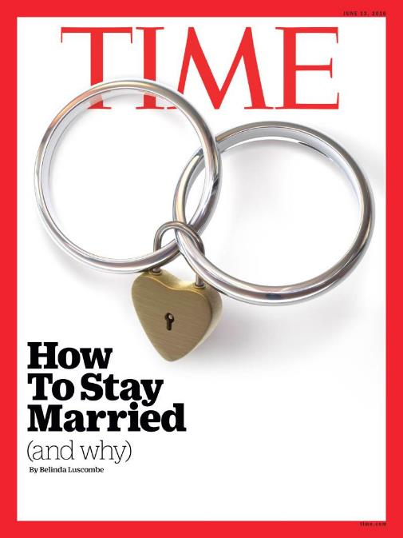
“Most Americans of every stripe still want to get married–even millennials, although they’re waiting until they’re older. To aid them in their search, businesses have devoted billions of dollars and thousands of gigabytes to mate seeking individuals.
Lawyers have spent countless hours arguing that people should be able to marry whomever they choose, of any gender.

Slide 45
Techies have refined recommendation engines so that people can more accurately find their perfect other half. In many ways, getting married is now easier than it has ever been.
But staying married, and doing so happily, is more difficult.
While divorce rates have been dropping among all ages since the 1980s, there’s one exception: older people. Divorce rates among this group are up. A report in 2014 found it has doubled among people 50 and older in the past two decades; more men over 65 are divorced than widowed.

Slide 46
How to avoid it? There are two main antidotes: The first, obvious as it sounds, is to figure out what specifically makes your partner feel loved. And the other is to learn to apologize–properly–and to forgive.
Disagreements are inevitable and healthy, so learning to fight fair is essential; resentment is one of contempt’s chief co-conspirators.

Slide 47
PSALM 16:11
Thou wilt shew me the path of life: in thy presence is fulness of joy; at thy right hand there are pleasures for evermore.

Slide 48
ECCLESIASTES 4:9-12
Two are better than one; because they have a good reward for their labour. 10 For if they fall, the one will lift up his fellow: but woe to him that is alone when he falleth; for he hath not another to help him up. 11 Again, if two lie together, then they have heat: but how can one be warm alone? 12 And if one prevail against him, two shall withstand him; and a threefold cord is not quickly broken.

Slide 49
"Commitment"
Unpopular in our culture which emphasizes individual rights, personal freedom, independence and mobility. The idea of giving these up because of dedication to another person or loyalty to a relationship makes people feel trapped.
But you can’t have it both ways. You can't build a divorce-proof marriage and remain unbending toward your personal rights. That doesn't mean you give up all your freedoms or choices, but it does mean your commitment to the relationship supersedes your individual rights.

Slide 50
EPHESIANS 5:21-24
Submitting yourselves one to another in the fear of God. 22 Wives, submit yourselves unto your own husbands, as unto the Lord. 23 For the husband is the head of the wife, even as Christ is the head of the church: and he is the saviour of the body. 24 Therefore as the church is subject unto Christ, so let the wives be to their own husbands in everything.

Slide 51
Accept that the Person You Chose Is Not Perfect.
You’re not perfect and neither is your partner. If there a red flags at the outset — say, a partner who lies or treats you with disrespect — you’re wise to think twice. But the ordinary challenging stuff — his car is like a dump, or she looses her keys — isn’t going to disappear once you say ‘I do.’ The key is to appreciate all the good things and to somehow find peace with what’s less than ideal.

Slide 52
Respond To Each Others’ Needs For Connection
Partners who catch the ways in which their partners turn toward them to try to connect on an emotional level do better in relationship.
This means that they connect in small ways when they spend time together. If one tells a joke, the other laughs. If one texts, the other texts back. If one is hurting and needs to talk, the other stops what they’re doing and listens.

Slide 53
This builds a strong sense of emotional connection over time. It also builds trust, which is fundamental in a good strong relationship.
A solid foundation for marriage doesn’t rest on the intensity of love but rather on whether the relationship is positive. Is there a sense of safety in the relationship? Can each person really listen to the other, and stay curious about their partner’s experience?
All of these things strengthen the foundation of your marriage.

Slide 54
Share How Much You Love Each Other.
Partners who are in the habit of telling one another what they appreciate about each other have a solid foundation. If they see something positive, they point it out.
When we appreciate the positives we avoid the very negative habit of scanning for the negatives, which results in contempt — one of the strongest predictors of divorce.

Slide 55
Old Testament: (Hebrew)
Emphasis in marriage was more upon a life-long commitment, than on an emotional feeling of “I am in Love!” Love was meant to blossom and mature as you spend years weaving the fabric of a life and family together.
Love is being able to love someone for who they are, who they were, and who they will be.

Slide 56
Engagement
Jewish (Biblical) Law (Kiddushin):
A contract between a man and a woman where they mutually promise to marry each other and the terms on which it should take place. They create a “Document of Conditions” and then the mothers break a plate to ratify the document.

Slide 57
Betrothal & Marriage
Betrothal: (erusin) This changes the couple’s interpersonal status. Involves the man giving the woman something of value: Document, or ring.
Marriage Ceremony (chupah) Establishes the legal consequences of the change in status.
Ceremonies normally were separated by one year.

Slide 58
Marriage
Marriage is viewed as a contractual bond commanded by God in which a man and a woman come together to create a relationship in which God is directly involved. (Gen. 1:28)
Marriage is understood to mean that the husband and wife are merging into a single soul which is why a man is considered “incomplete” if he is not married, as his soul is only one part of a larger whole that remains to be unified.

Slide 59
Once a couple was betrothed, the laws of adultery applied.
The “marriage” cannot be dissolved without a
Religious divorce.
Only after chuppah may the couple live together.

Slide 60
Shalom in the Home:
A man has to love his wife as he loves himself and honor her more than he honors himself. The Talmud forbid a husband from being overbearing to his household, and domestic abuse was unheard of. It was said of a wife that God counts her tears.

Slide 61
Minimum Provisions for the Wife
1. Enough bread for at least two meals a day;
2. Sufficient oil for cooking and lighting;
3. Sufficient wood for cooking;
4. Fruit and Vegetables;
5. Wine, if customary;
6. Three meals on the Sabbath (fish and meat);
7. An allowance of a silver coin each week;
8. One hat, one belt, three pairs of shoes annually.

Slide 62
“Marriage is just texting each other – “do we need anything from the grocery store?” – until one of you dies.”

Slide 63
SHALOM 64-0112
44 …I have constantly done my very best to try to in disagreeing with men in religious terms; but if I couldn't take his hand afterwards, no matter how sharp the thing might be, and take a hold of his hands, and say, "this is in the light of a better understanding between us, and still love the person (not just say it from my lips, but from my heart), then I'm no subject at all to go out there and to try to talk to people. Because we must do that, we must love the person. And going amongst the people in all kinds of classes, different cults, clans, and religions…

Slide 64
...Maybe sometime men get up real sharp; but if I got one thought that I didn't like that person, then I know one thing, the Spirit of Christ has departed from me. If I can feel that I don't like that person, there's something wrong with me. Because we must do that, we must love the person.
"Let's discuss it not from your creed or from your book of ethics, but from the Bible." ...Maybe sometime men get up real sharp; but if I got one thought that I didn't like that person, then I know one thing, the Spirit of Christ has departed from me. If I can feel that I don't like that person, there's something wrong with me.

