Slide 1
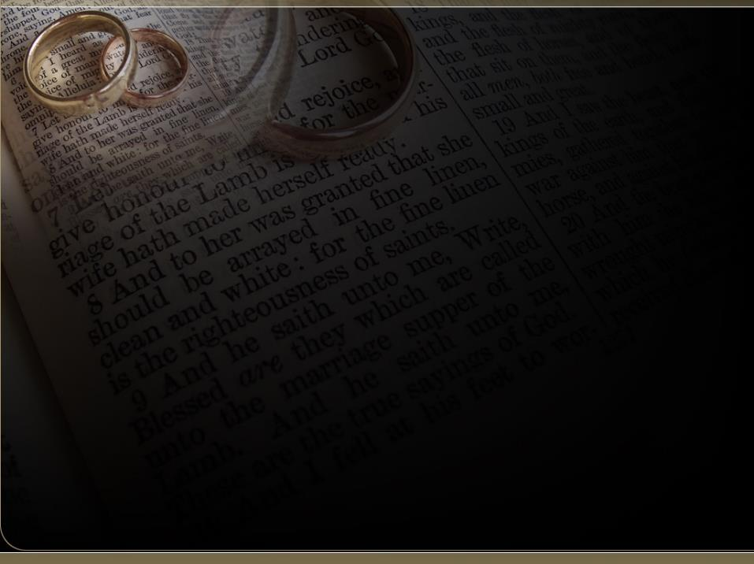

The Spirit Controlled Marriage 6
I JOHN 4:7-8
Beloved, let us love one another: for love is of God; and every one that loveth is born of God, and knoweth God. He that loveth not knoweth not God; for God is love.

Slide 2
Birthdays
Feb. 15th Arwen Cockman
Feb. 17th Annie Godwin, Jaron Brown

Slide 3


Mamvuradonha Zimbawe.

Slide 4
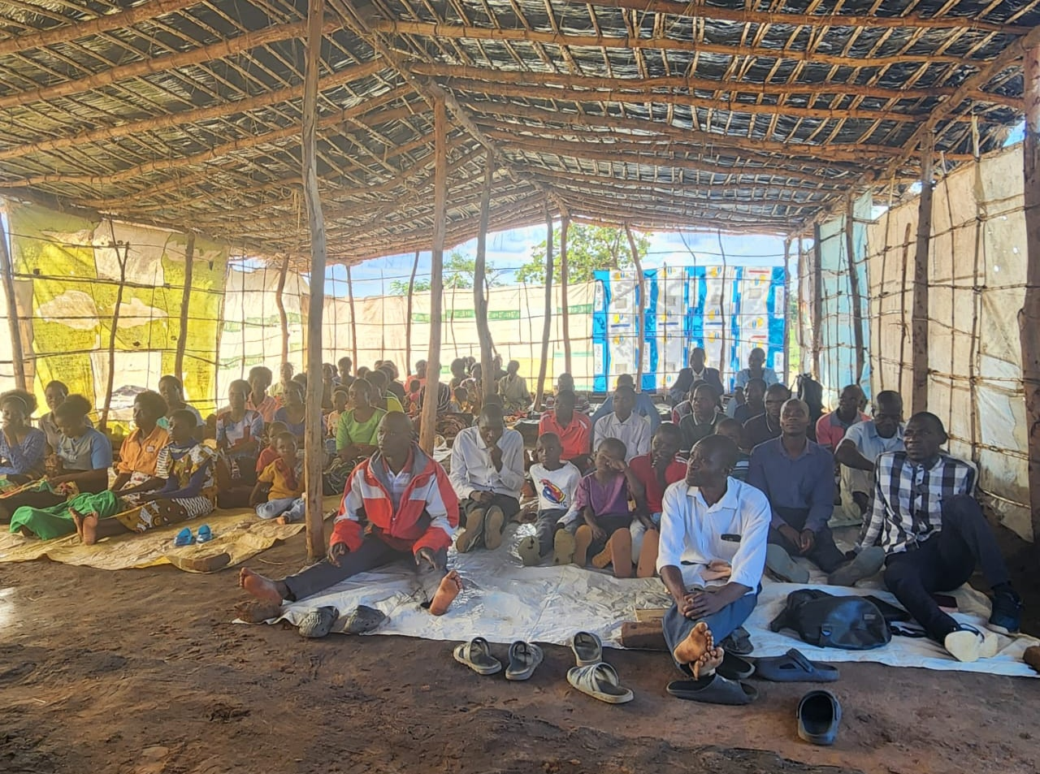
“Chairs for this flock in Malawi $1200.”

Slide 5
The Spirit Controlled Marriage 6
I JOHN 4:7-8
Beloved, let us love one another: for love is of God; and every one that loveth is born of God, and knoweth God. He that loveth not knoweth not God; for God is love.

Slide 6
UNBELIEF.DOES.NOT.HINDER.GOD 37 …In the last days what it's going to take to stand is a Scriptural-trained church, on the line…
62-0128

Slide 7
I CHRONICLES 29:17-19
17 I know also, my God, that thou triest the heart, and hast pleasure in uprightness. As for me, in the uprightness of mine heart I have willingly offered all these things: and now have I seen with joy thy people, which are present here, to offer willingly unto thee. 18 O LORD God of Abraham, Isaac, and of Israel, our fathers, keep this for ever in the imagination of the thoughts of the heart of thy people, and prepare their heart unto thee: 19 And give unto Solomon my son a perfect heart, to keep thy commandments, thy testimonies, and thy statutes, and to do all these things, and to build the palace, for the which I have made provision.

Slide 8
Can Love last a lifetime?
Hebrews, Chap. 7 #2
362 Marriage is honorable, but it should be entered prayerfully, reverently. And genuine love for that woman will bind you together forever. “What you bind on the earth...”

Slide 9
You may get stoop-shouldered, bald-headed, wrinkled-faced and everything else, but she’ll love you just like you did when you stood with wide shoulders and curly hair, if it’s really God.
For you’re looking to the time when you’ve crossed the river yonder, when you’ll spring back, again to young men and women, to live together forever. That’s God’s Eternal promise. 57-0922

Slide 10
Marriage Is Down. Living Together Is Up. But Who’s The Happiest?
Nov 6, 2019
SALT LAKE CITY — The share of Americans who cohabit has been rising and most adults say that’s acceptable, whether a cohabiting couple intends to marry or not. And married couples are more satisfied with their relationship and have more trust in their partner than do those who cohabit.

Slide 11
The Happy Marriage Is the ‘Me’ Marriage
By TARA PARKER-POPE Published: December 31, 2010
…After all, isn’t marriage supposed to be about putting the relationship first? Not anymore. For centuries, marriage was viewed as an economic and social institution, and the emotional and intellectual needs of the spouses were secondary to the survival of the marriage itself. But in modern relationships, people are looking for a partnership, and they want partners who make their lives more interesting.
https://archive.nytimes.com/www.nytimes.com/2011/01/02/weekinreview/02parkerpope.html

Slide 12
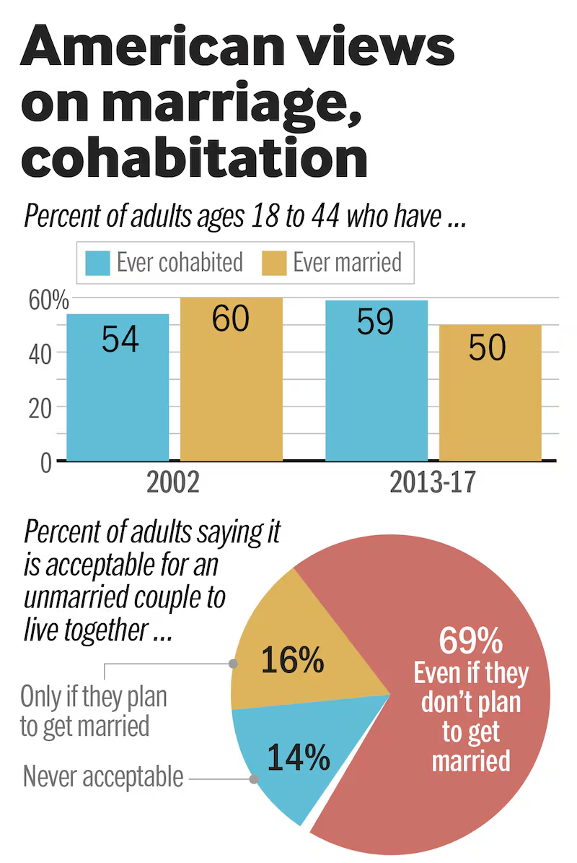
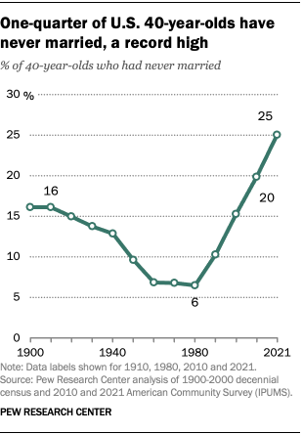

Slide 13
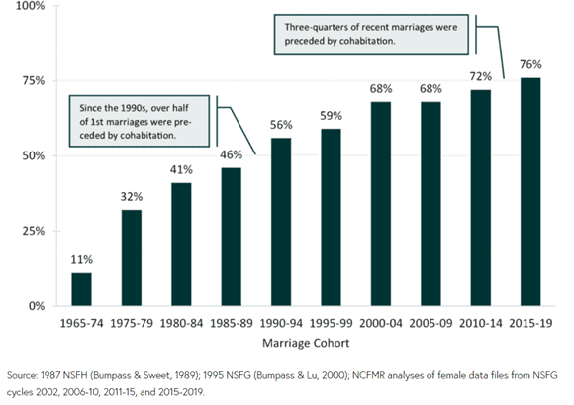

Slide 14
The playwright Thornton Wilder said it well:
“I didn’t marry you because you were perfect... I married you because you gave me a promise. That promise made up for your faults. And the promise I gave you made up for mine.
Two imperfect people got married and it was the promise that made the marriage. And when our children were growing up, it wasn’t a house that protected them; and it wasn’t our love that protected them—it was that promise.”

Slide 15
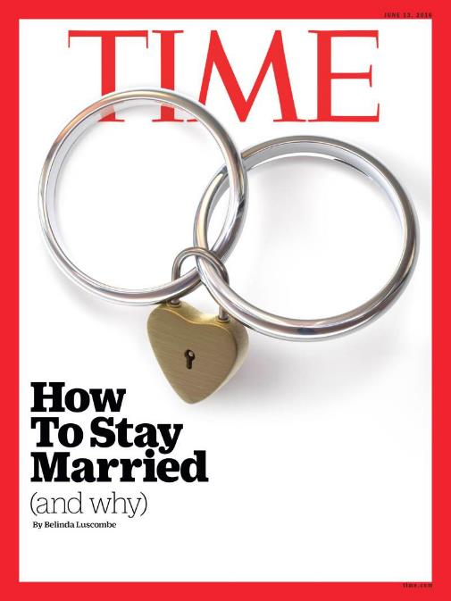
“Most Americans of every stripe still want to get married–even millennials, although they’re waiting until they’re older. To aid them in their search, businesses have devoted billions of dollars and thousands of gigabytes to mate seeking individuals.
Lawyers have spent countless hours arguing that people should be able to marry whomever they choose, of any gender.

Slide 16
Techies have refined recommendation engines so that people can more accurately find their perfect other half. In many ways, getting married is now easier than it has ever been.
But staying married, and doing so happily, is more difficult.
While divorce rates have been dropping among all ages since the 1980s, there’s one exception: older people. Divorce rates among this group are up. A report in 2014 found it has doubled among people 50 and older in the past two decades; more men over 65 are divorced than widowed.

Slide 17
In addition, their careers make it simpler for them to imagine a life without a spouse. They have their own income, a network of friends and associates and their own retirement savings.
And when people go home after work, their networks go with them. Social media has made it much easier to seek support and conversation elsewhere than in a spouse.

Slide 18
But what’s the trick once you’re hitched? One constant is to avoid contempt at all costs. By contempt, [we] mean more than making derogatory remarks about a partner’s desirability or earning power. It’s also communicated by constant interruption, dismissal of their concerns or withdrawal from conversation. Contempt sets off a lethal chain reaction. It kills vulnerability, among other things. Vulnerability is a prerequisite for intimacy. Without intimacy, commitment is a grind. And without commitment, there is no security in the marriage.

Slide 19
How to avoid it? There are two main antidotes: The first, obvious as it sounds, is to figure out what specifically makes your partner feel loved. And the other is to learn to apologize–properly–and to forgive.
Disagreements are inevitable and healthy, so learning to fight fair is essential; resentment is one of contempt’s chief co-conspirators.

Slide 20
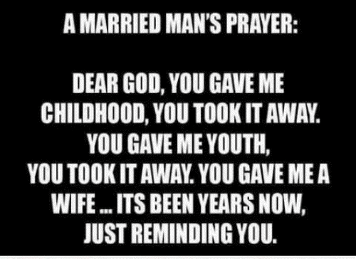

Slide 21
Dietrich Bonhoeffer (From a Nazi Prison Cell)
“Marriage is more than your love for each other. It has a higher dignity and power, for it is God's holy ordinance, through which He wills to perpetuate the human race till the end of time.
In your love you see only your two selves in the world, but in marriage you are a link in the chain of the generations, which God causes to come and to pass away to His glory, and calls into His kingdom.

Slide 22
In your love, you see only the heaven of your own happiness, but in marriage you are placed at a post of responsibility towards the world and mankind. Your love is your private possession, but marriage is more than something personal - it is a status, an office.
Just as it is the crown, and not merely the will to rule, that makes the king, so it is marriage, and not merely your love for each other, that joins you together in the sight of God and man.”

Slide 23
Old Testament:
Emphasis in marriage was more upon a lifelong commitment, (God’s love) than on an emotional feeling of “I am in Love!”
Love was meant to blossom and mature as you spend years weaving the fabric of a life and family together.

Slide 24
PSALM 16:11
Thou wilt shew me the path of life: in thy presence is fulness of joy; at thy right hand there are pleasures for evermore.

Slide 25
We Are Family
Gene Edward Veith 5-20-2000
“As children grow up to have children of their own, whereupon they grow up to have children, until both the earth and heaven are indeed filled with a particular couple's "large posterity.“ The family is God's invention.
He protects it in the Ten Commandments. Since our dependence on Him is like a helpless baby to a loving parent, we are told to address Him as "our Father." Since His relationship to us in Christ is as loving and intimate as that between a groom and his bride, the church is called "the Bride of Christ."

Slide 26
"Commitment"
Unpopular in our culture which emphasizes individual rights, personal freedom, independence and mobility. The idea of giving these up because of dedication to another person or loyalty to a relationship makes people feel trapped.
But you can’t have it both ways. You can't build a divorce-proof marriage and remain unbending toward your personal rights. That doesn't mean you give up all your freedoms or choices, but it does mean your commitment to the relationship supersedes your individual rights.

Slide 27
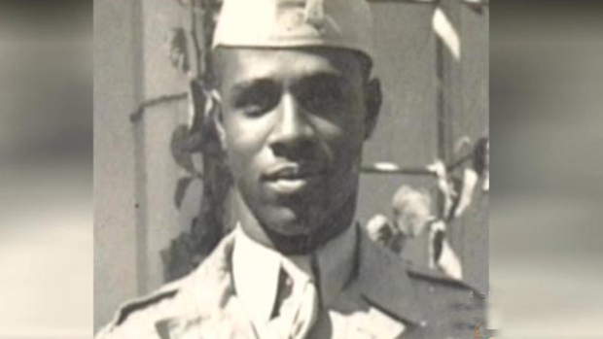
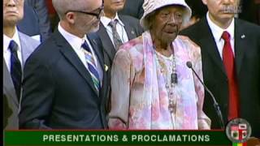
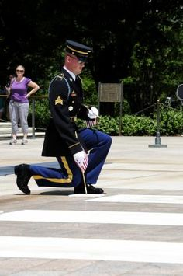
Sgt. First Class Joseph Gantt (Left)
Clara Gantt (Below)

Slide 28
TAKING.SIDES.WITH.JESUS
We got to think of young people. So we've got to think of the others that's coming on behind us, these young people, and a place for our children. Our daughters, we don't want them out in the world like that, we want them girls raised like their mothers. We've got to make arrangements for that.
62-0601

Slide 29

Age Integration Contributes to Maturity
Kingdom
Everyone is Reaching for Higher levels of Maturity
Elders
Parents
Young
Adults
The Power of Influence:
He that walketh with wise men shall be wise: but a companion of fools shall be destroyed.
PROVERBS 13:20
Children
Babies

Slide 30
Gregg Harris:
“Walking with the wise is a lifestyle, not a program. It includes working together, eating together, playing together, worshiping together, and studying together. This is where God placed the responsibility for child training and education, and it works very well in aiming children at God's highest and best targets in life.
That is what I want for my children - God's highest and best. I don't want my children to be merely counted among the Reformed. I want them to stand with the Reformers.”
http://greggharrisblog.blogspot.com/2005/11/priceless-treasure-why-i-choose-to.html

Slide 31
THE.MARRIAGE.OF.THE.LAMB
81 The earthly marriage here is a type of the heavenly marriage. The first thing in natural marriage, a decision has to be made. The young lady has to make her decision, whether she wants this young man; and the young man, whether he wants the young woman. She must be the only woman in the world that you love, and he must be the only man. And that's the same way it is by making the decision for Christ…
62-0121E

Slide 32
EPHESIANS 5:21-24
Submitting yourselves one to another in the fear of God. 22 Wives, submit yourselves unto your own husbands, as unto the Lord. 23 For the husband is the head of the wife, even as Christ is the head of the church: and he is the saviour of the body. 24 Therefore as the church is subject unto Christ, so let the wives be to their own husbands in everything.

Slide 33
The Story of Abigail:
I SAMUEL 25:2
And there was a man in Maon, whose possessions were in Carmel; and the man was very great, and he had three thousand sheep, and a thousand goats: and he was shearing his sheep in Carmel. 3 Now the name of the man was Nabal; and the name of his wife Abigail: and she was a woman of good understanding, and of a beautiful countenance: but the man was churlish and evil in his doings; and he was of the house of Caleb.

Slide 34
I SAMUEL 25:31
That this shall be no grief unto thee, nor offence of heart unto my lord, either that thou hast shed blood causeless, or that my lord hath avenged himself: but when the LORD shall have dealt well with my lord, then remember thine handmaid. 32 And David said to Abigail, Blessed be the LORD God of Israel, which sent thee this day to meet me: 33 And blessed be thy advice, and blessed be thou, which hast kept me this day from coming to shed blood, and from avenging myself with mine own hand.

Slide 35
Let the wife make the husband glad to come home and let him make her
sorry to see him leave.
Martin Luther
PROVERBS 12:4
A virtuous woman is a crown (wreath) to her husband: but she that maketh ashamed is as rottenness in his bones.

Slide 36
IT.IS.I
19 Let your wife know that you love her; she loves you. When you're young and you find favor with one another, it makes you join yourselves together for a lifetime journey: that's phileo love; human love. What will Agapao love do, when you can really get into a place that you can show God that you love Him and you got confidence in Him? How you'll join yourself to Him, not only for a life's journey, but for eternity. 60-0720

Slide 37
Conflict:
Stress characterized by incompatible desires, needs or environmental demands. The competition of two or more contradictory impulses. This is usually accompanied by emotional tension.
EPHESIANS 4:26
Be ye angry, and sin not: let not the sun go down upon your wrath:

Slide 38
You Accept That The Person You Chose Is Not Perfect.
You’re not perfect and neither is your partner. If there a red flags at the outset — say, a partner who lies or treats you with disrespect — you’re wise to think twice. But the ordinary challenging stuff — his car is like a dump, or she looses her keys — isn’t going to disappear once you say ‘I do.’ The key is to appreciate all the good things and to somehow find peace with what’s less than ideal.

Slide 39
Communication
The number one problem for couples. None of us are perfect at it, but when we can talk about difficult topics like money, kids, religion or politics, and do so respectfully, we’ve got a good foundation for a happy future together.

Slide 40
Respond To Each Others’ Needs For Connection
Partners who catch the ways in which their partners turn toward them to try to connect on an emotional level do better in relationship.
This means that they connect in small ways when they spend time together. If one tells a joke, the other laughs. If one texts, the other texts back. If one is hurting and needs to talk, the other stops what they’re doing and listens.

Slide 41
This builds a strong sense of emotional connection over time. It also builds trust, which is fundamental in a good strong relationship.
A solid foundation for marriage doesn’t rest on the intensity of love but rather on whether the relationship is positive. Is there a sense of safety in the relationship? Can each person really listen to the other, and stay curious about their partner’s experience?
All of these things strengthen the foundation of your marriage.

Slide 42
Share How Much You Love Each Other.
Partners who are in the habit of telling one another what they appreciate about each other have a solid foundation. If they see something positive, they point it out.
When we appreciate the positives we avoid the very negative habit of scanning for the negatives, which results in contempt — one of the strongest predictors of divorce.

Slide 43
Old Testament: (Hebrew)
Emphasis in marriage was more upon a life-long commitment, than on an emotional feeling of “I am in Love!” Love was meant to blossom and mature as you spend years weaving the fabric of a life and family together.
Love is being able to love someone for who they are, who they were, and who they will be.

Slide 44
Engagement
Jewish (Biblical) Law (Kiddushin):
A contract between a man and a woman where they mutually promise to marry each other and the terms on which it should take place. They create a “Document of Conditions” and then the mothers break a plate to ratify the document.

Slide 45
Betrothal & Marriage
Betrothal: (erusin) This changes the couple’s interpersonal status. Involves the man giving the woman something of value: Document, or ring.
Marriage Ceremony (chupah) Establishes the legal consequences of the change in status.
Ceremonies normally were separated by one year.

Slide 46
Marriage
Marriage is viewed as a contractual bond commanded by God in which a man and a woman come together to create a relationship in which God is directly involved. (Gen. 1:28)
Marriage is understood to mean that the husband and wife are merging into a single soul which is why a man is considered “incomplete” if he is not married, as his soul is only one part of a larger whole that remains to be unified.

Slide 47
Once a couple was betrothed, the laws of adultery applied.
The “marriage” cannot be dissolved without a
Religious divorce.
Only after chuppah may the couple live together.

Slide 48
Shalom in the Home:
A man has to love his wife as he loves himself and honor her more than he honors himself. The Talmud forbid a husband from being overbearing to his household, and domestic abuse was unheard of. It was said of a wife that God counts her tears.

Slide 49
Minimum Provisions for the Wife
1. Enough bread for at least two meals a day;
2. Sufficient oil for cooking and lighting;
3. Sufficient wood for cooking;
4. Fruit and Vegetables;
5. Wine, if customary;
6. Three meals on the Sabbath (fish and meat);
7. An allowance of a silver coin each week;
8. One hat, one belt, three pairs of shoes annually.

Slide 50
“Marriage is just texting each other – “do we need anything from the grocery store?” – until one of you dies.”

Slide 51
SHALOM 64-0112
44 …I have constantly done my very best to try to in disagreeing with men in religious terms; but if I couldn't take his hand afterwards, no matter how sharp the thing might be, and take a hold of his hands, and say, "this is in the light of a better understanding between us, and still love the person (not just say it from my lips, but from my heart), then I'm no subject at all to go out there and to try to talk to people. Because we must do that, we must love the person. And going amongst the people in all kinds of classes, different cults, clans, and religions…

Slide 52
...Maybe sometime men get up real sharp; but if I got one thought that I didn't like that person, then I know one thing, the Spirit of Christ has departed from me. If I can feel that I don't like that person, there's something wrong with me. Because we must do that, we must love the person.
"Let's discuss it not from your creed or from your book of ethics, but from the Bible." ...Maybe sometime men get up real sharp; but if I got one thought that I didn't like that person, then I know one thing, the Spirit of Christ has departed from me. If I can feel that I don't like that person, there's something wrong with me.

