Slide 1


Principles to Live by 9
Stewardship: Financial Responsibility According to the Bible
Pr. 21:20
In the house of the wise are stores of choice food and oil, but a foolish man devours all he has."
Notes:
MOVE YOUR MIC DOWN AN INCH

Slide 2
Life Cycle of Planning
Stage 1: The Early Years -- A Time of Wealth Accumulation
Stage 2: Approaching Retirement -- The Golden Years
Stage 3: The Retirement Years

Slide 3
“(We) have been blessed in retirement with our investment advisors at Fidelity. My pension has been a blessing as it covers insurance and a benefit to cover a major portion for insurance coverage for [husband].
IRAs started years ago were a smart investment. We believe the Lord nudged us early toward a path that made all of this possible.”

Slide 4

The Lesson:
Stewardship is an
internal conviction, not
just a response to supervision. A wise
person works diligently
even when no one is watching.

Slide 5
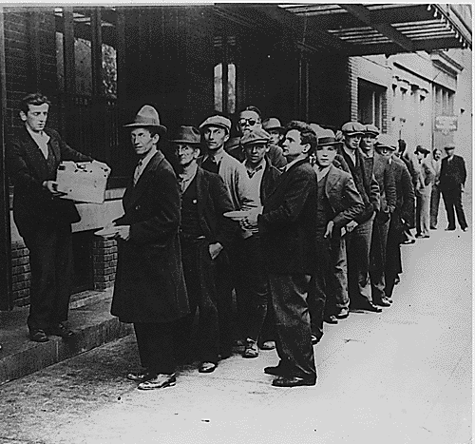


Circumstances are Subject to Change!

Slide 6
The Biblical Rules
Have Not Changed!
A prudent man foreseeth the evil, and hideth himself: but the simple pass on, and are punished.
PROVERBS 22:3

Slide 7
Put God First: Tithe Mal. 3:8-11
Develop an Emergency Fund: (Save)
3. Commit to a Budget (Luke 14:28-29)
4. Automate your Saving!
5. Study the Ant: Learning how to prepare for changing seasons of life.

Slide 8
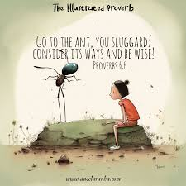
PROVERBS 6:1-11
My son, if thou be surety for thy friend, if thou hast stricken thy hand with a stranger, 2 Thou art snared with the words of thy mouth, thou art taken with the words of thy mouth. 3 Do this now, my son, and deliver thyself, when thou art come into the hand of thy friend; go, humble thyself, and make sure thy friend.

Slide 9
4 Give not sleep to thine eyes, nor slumber to thine eyelids. 5 Deliver thyself as a roe from the hand of the hunter, and as a bird from the hand of the fowler. 6 Go to the ant, thou sluggard; consider her ways, and be wise: 7 Which having no guide, overseer, or ruler, 8 Provideth her meat in the summer, and gathereth her food in the harvest. 9 How long wilt thou sleep, O sluggard? when wilt thou arise out of thy sleep? 10 Yet a little sleep, a little slumber, a little folding of the hands to sleep: 11 So shall thy poverty come as one that travelleth, and thy want as an armed man.

Slide 10
Proverbs 6:1-5
My child, if you have put up security for a friend’s debt or agreed to guarantee the debt of a stranger - if you have trapped yourself by your agreement and are caught by what you said - ³ follow my advice and save yourself, for you have placed yourself at your friend’s mercy. Now swallow your pride; go and beg to have your name erased. ⁴ Don’t put it off; do it now! Don’t rest until you do. ⁵ Save yourself like a gazelle escaping from a hunter, like a bird fleeing from a net.

Slide 11
A good man leaveth an inheritance to his children's children: and the wealth of the sinner is laid up for the just.
PROVERBS 13:22

Slide 12
1. Spiritual and Moral Legacy: In the Book of Proverbs, "wealth" is often synonymous with wisdom. A "good man" leaves behind a blueprint for living:
  Character: Teaching honesty, integrity, and work ethic.
  Faith: Passing down a spiritual foundation that helps future generations navigate life's storms.
  Reputation: Leaving a "good name," which Prov. 22:1 explicitly says is "rather to be chosen than great riches."

Slide 13

Why Do You Need a Plan?
1. For most people it is easier to spend than save.
2. To track expenses, so you don’t spend more than you think you’re spending.
3. To retire someday.

Slide 15
NUMBERS 8:23-26 (Retirement)
And the LORD spake unto Moses, saying, 24 This is it that belongeth unto the Levites: from twenty and five years old and upward they shall go in to wait upon the service of the tabernacle of the congregation: 25 And from the age of fifty years they shall cease waiting upon the service thereof, and shall serve no more: 26 But shall minister with their brethren in the tabernacle of the congregation, to keep the charge, and shall do no service. Thus shalt thou do unto the Levites touching their charge.

Slide 16
Christian financial planning diverges from conventional wisdom: Ps. 24:1 declares, "The earth is the Lord's, and everything in it.“ This truth transforms everything.
CORE PRINCIPLE: If God owns it all, then we're not owners building our own security. We're stewards managing His resources for His purposes.
"Is it biblical to save for retirement?" Yes. Scripture commends saving and planning (Proverbs 21:20, Genesis 41). The key is saving with wisdom and faith rather than fear and greed. Biblical retirement planning balances responsible preparation with trust in God's provision.

Slide 17
Scripture warns against two dangers:
Hoarding out of fear - This reveals a lack of trust in God's provision and can lead to the idolatry of wealth.
Presuming on God without planning - This isn't faith; it's foolishness. God gave us minds to plan and hands to work.

Slide 18
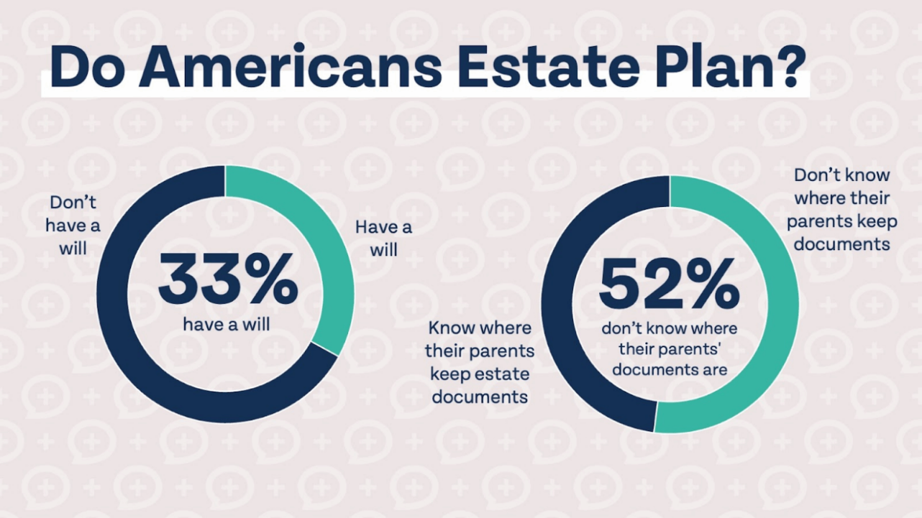

Slide 19
The Checklist
Estate: Wills, Trusts, Communicate with Heirs
Taxes: SS Surcharges, Financial Advisor
Investments: Turtle? Or Hare?
Risk Management: Health care, Supplementals, LTC
Cash Flow: 6-12 months of salary saved (Liquidity).

Slide 20
What Is Estate Planning?
Estate planning is much more than just writing a will. It encompasses planning for all of the decisions that will need to be made when you no longer have the ability. Estate planning can include establishing wills, trusts, power of attorneys, healthcare directives, and more.
Nobody really enjoys thinking about planning what happens after they’re gone, but even if you don’t care about what happens to your assets (which you probably do), your family will benefit tremendously from a sound estate plan. Many families are left to put the pieces together after a death or incapacityation, which adds more stress to an already stressful season of life.

Slide 21
Contrary to popular belief, estate planning isn’t just for rich people and it isn’t just for old people. Even if you don’t have any assets when you die, you still need to plan for medical decisions and post-death decisions (burial vs. cremation, how about my kids?).
Estate planning becomes more imperative the older you get, but it is not just for old people. Life is unpredictable, and while odds are you will live a long and happy life, it is always best to prepare for the unexpected.

Slide 22
Worst Case Scenario:
In North Carolina, if both parents pass away without a will or a legal directive (Intestate), the state's legal system takes over to manage two distinct areas:
1. The care of the children, and
2. The management of their inheritance.

Slide 23
1. Physical Care (Guardianship of the Person)
Without a will naming a guardian, any "interested party" (usually grandparents, aunts, uncles, or adult siblings) must petition the court for guardianship.
Best Interests Standard: The judge decides based on the "best interests of the child." They consider existing relation-ships, petitioner's ability to provide a home, and the child's current environment.
Child’s Input: In NC the wishes of a child over the age of 12 are typically given significant weight by the court.

Slide 24
Interim Care:
  If no family member is immediately available or if there is a dispute, the Department of Social Services (DSS) may take temporary custody, potentially placing the children in foster care until a permanent guardian is vetted and appointed.

Slide 25
Phase | Action
Immediate | Family or DSS steps in to ensure the children are safe.
Petition | A relative or friend files a Petition for Guardianship with the Clerk of Superior Court.
Investigation | The court often appoints a Guardian ad Litem—a neutral third party—to investigate the home and represent the child's best interests.
Hearing | A clerk holds a hearing to formally appoint a General Guardian (covers both the person and the estate).

Slide 26
THE.CHOOSING.OF.A.BRIDE
67 Now, we here see plainly the spiritual plan, of God's planning for His future Home with His future Bride, comes into view now.
65-0429

