Slide 1

The Spirit Controlled Church & It’s Members 5
GALATIANS 5:25
If we live in the Spirit, let us also walk in the Spirit.

Slide 2
Birthdays & Anniversaries
Feb. 2nd Troy Hughes, Shirley Lingle
Feb. 3rd Macy Stevens
Feb. 4th Tom & Kim Ward
Feb. 5th Jennifer Cockman
Lukas & Hailey Coffey
Feb. 7th Anwar & Sheba Javed
Feb. 10th Danny Florian

Slide 3
UNITY.ONE.GOD.ONE.CHURCH
71 That little compartment in a man's heart, God made that in there for Himself. That's His control room. He sets there to control you. That's His place. That's where He sends His messages from.
How can He work with you when the nature of the spirit of the Devil is there? And every man born on earth is borned in sin, shaped in iniquity, come to the world speaking lies. So, in that carnal Adamic nature, how can a man achieve anything, only through

Slide 4
his intellectuals? But when he comes to be a new creature, the old man has passed out, and the new Man, Christ, takes His throne in the human heart, then life looks different; he starts on a new road from his own selfish motives, till the big ideas to make himself something big, he starts right towards Calvary to recognize God.*
Then his objective, motive, achievement, and all that he is, lays in the glory of the cross, where Christ paid the price for human life. 58-1221

Slide 5
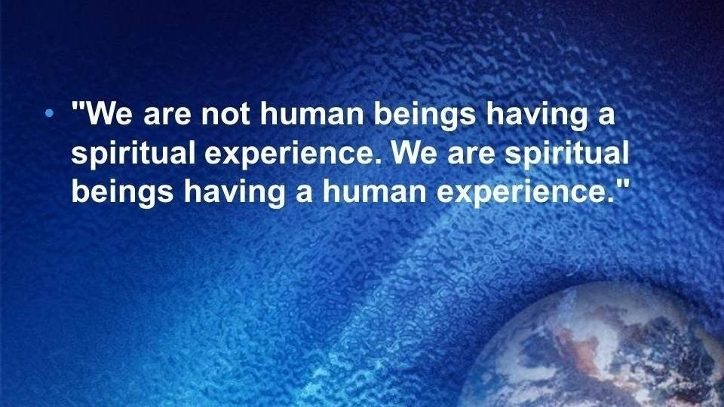

Slide 6
PERFECT.FAITH
112 Jesus lived in a world no one knowed about, He was an odd Person. He lived in a world of Perfect Faith in the Perfect God, in which He was... If we lived in a Perfect Faith of a Christian, we'd be a mystic to the world; people wouldn't understand you. You'd walk in the Spirit. What the Spirit said, you’d do. What It forbid, you would not do. Jesus lived in a world that nobody else could touch… They wasn't in the world that He lived in. Now you're getting into Bride material. 63-0825

Slide 7
ACTS 16:14
And a certain woman named Lydia, a seller of purple, of the city of Thyatira, which worshipped God, heard us: whose heart the Lord opened, that she attended unto the things which were spoken of Paul. 15 And when she was baptized, and her household, she besought us, saying, If ye have judged me to be faithful to the Lord, come into my house, and abide there. And she constrained us.
ACTS 16:25
And at midnight Paul and Silas prayed, and sang praises unto God: and the prisoners heard them. 26 And suddenly there was a great earthquake, so that the foundations of the prison were shaken: and immediately all the doors were opened, and every one's bands were loosed. 27 And the keeper of the prison…

Slide 8
ACTS 20:20-23
And how I kept back nothing that was profitable unto you, but have shewed you, and have taught you publickly, and from house to house, 21 Testifying both to the Jews, and also to the Greeks, repentance toward God, and faith toward our Lord Jesus Christ. 22 And now, behold, I go bound in the spirit unto Jerusalem, not knowing the things that shall befall me there: 23 Save that the Holy Ghost witnesseth in every city, saying that bonds and afflictions abide me.

Slide 9
JEHOVAH.JIREH.3
10 Every Word is true… Enoch had faith enough, one day to take an afternoon stroll with God, and just kept on walking, went up Home without dying.
Now, I think the Church has got to come to that, to a Rapturing faith. 64-0404

Slide 10

ADOPTION.1
54 And there's where the church is failing today: on that walk.
60-0515
JEHOVAH.OF.MIRACLES
22 Oh, it's too bad that the church today doesn't walk in the Spirit like that more than we do. For it's that kind of a time that when God comes to you. 59-1126

Slide 11
*THE.UNCERTAIN.SOUND
"Bruder Branham." And he pulled out of his little... had a little satchel, he was from Russia. And he had a handkerchief in there that he wanted me to pray over and tear it in six strips for a woman with her real bad arm, that had been hurt and wouldn't get well, and shrinking up. And she was the mother of five children, six strips, just perfect. I looked at his passport. He was from Russia, up in behind the iron curtain. I said, "How did you know I was down here?“
55-0731

Slide 12
THE.CALLING.OF.ABRAHAM
21 Abraham, soon as God called him, called him to separate himself. That's a strange thing. “You've never walked this way before, but I want you to separate yourself so you can walk with Me, among a strange people, speaking a strange language. And you're to be a pilgrim, a sojourner." Every man that's borned of Christ separates himself from sin immediately. The Holy Spirit just calls you right out, different nature… used to run to nightclubs, everywhere you should not have went. And when God called you, He calls you to separate from that kind of a life and walk a different life. 55-1116

Slide 13
GO.TELL
158 I'm afraid of defeat, afraid I'll bring a reproach. I'm always afraid, think I'll call the wrong thing. I've took warning of the Bible, how Moses was given great power, and smote the rock instead of speaking to it. I remember Elijah, he went baldheaded, them little children teasing him about being baldheaded; he put a curse on those children, and forty-two of them was killed by bears. Now, that wasn't the Holy Spirit, but it was that prophet angered. And there He stood, talking to me. And He said, "But you walk with too many. To walk with Me, you'll walk alone.“ 60-0417

Slide 14
HE.THAT.IS.IN.YOU
107 I stood still. My brethren wondering what was happen-ing. The sleet, rain stopped. A wind whirling down through the mountains, lifted up the clouds… Within a few minutes, the sun was shining nice and warm. I just stood there, just looking around; with my hat off, looking. I got numb, all over.
109 I thought, "The very God of Creation, it's all in His hands. What's He telling me?“ Picked up my gun, wiped off the scope, started to walk down the hill. Something said to me, "Why don't you stroll with Me through this wilderness, walk with Me…“ I said, "Yes, Lord, with all my heart; it would be one of the greatest things I could do, was walk with You." 63-1110

Slide 15
GALATIANS 5:16-18
This I say then, Walk in the Spirit, and ye shall not fulfil the lust of the flesh. 17 For the flesh lusteth against the Spirit, and the Spirit against the flesh: and these are contrary the one to the other: so that ye cannot do the things that ye would. 18 But if ye be led of the Spirit, ye are not under the law.
The Flesh: Your life apart from Christ.
Everything you are minus God

Slide 16
What is “the Flesh”?
1. The soft substance of the living body, which covers the bones, blood; the body of a man;
2. The natural or physical origin, genealogy;
3. The sensuous "animal nature" without any suggestion of depravity; the animal nature with cravings which incite to sin;
4. Human nature, the earthly nature of man apart from divine influence, therefore prone to sin and opposed to God.

Slide 17
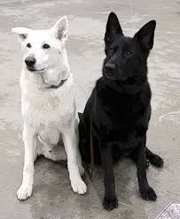
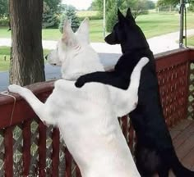
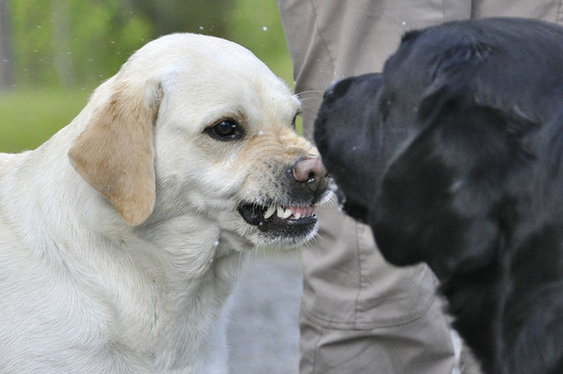
Two natures beat within my breast,
The one is foul; the one is blest.
The one I love; the one I hate,
The one I feed will dominate.
GALATIANS 5:17
For the flesh lusteth against the Spirit, and the Spirit against the flesh: and these are contrary the one to the other: so that ye cannot do the things that ye would.

Slide 18
Galatians 5: 16-18 (NLT)
So I say, let the Holy Spirit guide your lives. Then you won’t be doing what your sinful nature craves. ¹⁷ The sinful nature wants to do evil, which is just the opposite of what the Spirit wants. And the Spirit gives us desires that are the opposite of what the sinful nature desires. These two forces are constantly fighting each other, so you are not free to carry out your good intentions. ¹⁸ But when you are directed by the Spirit, you are not under obligation to the law of Moses.

Slide 19
HEBREWS.CHAPTER.FIVE.AND.SIX.1
118 God don't see you no more; He only sees Christ… He took our judgments, invited us in. And by faith, through grace, we walk in, accept our pardoning. And the Holy Spirit brings us into this fellowship with Him. "And we walk no more after the things of the world, but we walk in the Spirit."
All my desires is to serve Him. All my love is to Him. All my walks want to be in His Name. Wherever I go, whatever I do, I glorify Him. If I'm hunting, fishing, if I'm playing ball, and whatever, I must be, "Christ in me," in such a life, that will make men long to be that way; not tattling, backbiting, and fussing about your churches. 57-0908

Slide 20
Gal. 5:22-26
But the Holy Spirit produces this kind of fruit in our lives: love, joy, peace, patience, kindness, goodness, faithfulness, 23 gentleness, and self-control. There is no law against these things!
24 Those who belong to Christ Jesus have nailed the passions and desires of their sinful nature to his cross and crucified them there. 25 Since we are living by the Spirit, let us follow the Spirit’s leading in every part of our lives. 26 Let us not become conceited, or provoke one another, or be jealous of one another.

Slide 21
BLIND.BARTIMAEUS
27 Then he heard that priest…"Say, you Galilean so-called prophet, if you raise the dead like you said you did, raised Lazarus, we've got a whole graveyard up here on the hill. Let's see you come raise some of them." You know, that devil isn't dead yet either. He still lives. Jesus never even paid any attention to him. And if He didn't then, neither does His people today. Let him holler his head off; we don't care. We walk in the Spirit of the Lord. 59-1127

Slide 22
ROMANS 7:7-9
What shall we say then? Is the law sin? God forbid. Nay, I had not known sin, but by the law: for I had not known lust, except the law had said, Thou shalt not covet. 8 But sin, taking occasion by the commandment, wrought in me all manner of concupiscence. For without the law sin was dead. 9 For I was alive without the law once: but when the commandment came, sin revived, and I died.
⁷ Therefore, what are we to say? That the Torah is sinful? Heaven forbid! Rather, the function of the Torah was that without it, I would not have known what sin is. For example, I would not have become conscious of what greed is if the Torah had not said, “Thou shalt not covet.”
But sin, seizing the opportunity afforded by the commandment, worked in me all kinds of evil desires — for apart from Torah, sin is dead.

Slide 23
The Glorious Church
EPHESIANS 5:25-27
Husbands, love your wives, even as Christ also loved the church, and gave himself for it;
26 That he might sanctify and cleanse it with the washing of water by the word,
27 That he might present it to himself a glorious church, not having spot, or wrinkle, or any such thing; but that it should be holy and without blemish.

Slide 24
WHEN.DIVINE.LOVE.IS.PROJECTED
SOVEREIGN GRACE.TAKES.ITS.PLACE
7 Be merciful and heal the sick and afflicted. For in this Thou has atoned for at Calvary, and we feel that it is our personal property...
And now, Father, may the Holy Spirit take the Word, open the Book, loose the power of the Spirit in the Word, and may it find Its resting place in each heart. For we ask it in the Name of Thy beloved Child, the Lord Jesus. Amen. 57-0126

Slide 25
EXODUS 13:17-18
And it came to pass, when Pharaoh had let the people go, that God led them not through the way of the land of the Philistines, although that was near; for God said, Lest peradventure the people repent when they see war, and they return to Egypt: 18 But God led the people about, through the way of the wilderness of the Red sea: and the children of Israel went up harnessed out of the land of Egypt.

Slide 26
EXODUS 17:8
Then came Amalek, and fought with Israel in Rephidim. 9 And Moses said unto Joshua, Choose us out men, and go out, fight with Amalek: to morrow I will stand on the top of the hill with the rod of God in mine hand.

Slide 27
MATTHEW 24:24
For there shall arise false Christs, and false prophets, and shall shew great signs and wonders; insomuch that, if it were possible, they shall deceive the very elect.
COD 1005-56
...We do have today, by God's help, the perfect interpretation of the Word with Divine vindication. Then that which is in part is done away with.
64-0823

Slide 28
THE.BREACH 63-0317
106-4 The Lamb broke the Seals and revealed them to His church to collect His subjects for His Kingdom, His Bride. He wants to bring His subjects to Him now.
The.Uniting.Time & Sign 63-0818
Never before, since the early church age, was the pillar of fire ever among the people. Never before, since the early church age, did they ever see the things that we are seeing today. And this was only made possible when God sent the Seven Seals…

Slide 29
ISRAEL.AND.THE.CHURCH
43 God's now loosening up the church every-where, getting in order now… got to give it rapturing faith before it can go in the rapture.
53-0326

Slide 30
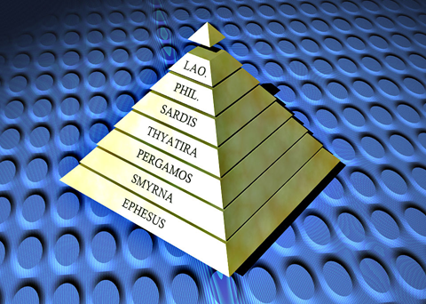
Gentile Dispensation: From Early Church
To the Bride Age
I CORINTHIANS 13:9-10
For we know in part, (missing) and we prophesy in part 10 But when that which is perfect is come, then that which is in part shall be done away.
INVISIBLE.UNION
324 The Word that fell on the Day of Pentecost will not work this day. That was for Pente-cost. This is for the Bride, going Home of the Bride. We got something different. The Pentecostals represented that, again. We're in the Bride age.
65-1125

Slide 31
THE.RESULTS.OF.DECISION
75 Joshua said, "Now, you're going to see the glory of God." For there hung the Pillar of Fire over them... “But don't let it get out of your sight, 'cause you've never passed this way before.“
I believe there's an experience for the Church “…you've never passed this way before.”
To you people tonight, let's move out towards Jordan. God's here leading you. That's what's talking to your heart and telling you to do it, is the Holy Spirit.

Slide 32
76 Now, I can see the people as they went marching on. The Angel of God took Jordan first. The Angel of God will lead you every step of the way. Sometimes you think that the trials are hard. God ain't in no hurry. You're the only one that's in a hurry.
God let the Hebrew children go right in the fiery furnace. He let Daniel get right in the lion's den, before He ever come. Just rise up and start walking by faith. "God, I believe you. I'm bound for the promised land. God, You promised it to me, and here I come…” 55-1008

Slide 33
EXODUS 4:1-3
And Moses answered and said, But, behold, they will not believe me, nor hearken unto my voice: for they will say, The LORD hath not appeared unto thee. 2 And the LORD said unto him, What is that in thine hand? And he said, A rod. 3 And he said, Cast it on the ground. And he cast it on the ground, and it became a serpent; and Moses fled from before it.
Faith in God’s Existence; and,
Faith in God’s Trustworthiness

Slide 34
RUTH 3:17-18
And she said, These six measures of barley gave he me; for he said to me, Go not empty unto thy mother in law. 18 Then said she, Sit still, my daughter, until thou know how the matter will fall: for the man will not be in rest, until he have finished the thing this day.

Slide 35
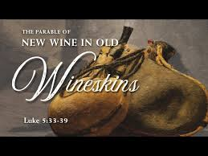
LUKE 5:37-38
And no man putteth new wine into old bottles; else the new wine will burst the bottles, and be spilled, and the bottles shall perish. 38 But new wine must be put into new bottles; and both are preserved.

Slide 36
New Wine = The Gospel Covenant:
Represents the new way of grace and spiritual freedom Jesus brought.
Old Wineskins = Old Traditions/Legalism:
Represents the rigid religious structures, rituals (like mandated fasting) legalistic mindset of the Pharisees.
The Lesson: You cannot simply "patch up" [squeeze] Jesus’ transformative message into old, inflexible religious habits. A new heart and mind (a new wineskin) are required to receive and hold the new life He offers.

Slide 37
WHAT.DOES.IT.TAKE.TO.MAKE.A.CHRISTIAN.LIFE
16 (New wine in old bottles.) Say, "Now, our school teaches different, (denomination)" That old dry cowhide... "Our teachers, our pastors said these things are finished.“ But if it's a new hide and got new life, it's flexible, it gives to the Word, and the Spirit supports the Word, and when they come into the new bottle and say, "Someone got healed of a cancer last evening," the old hide says, "Let’s see what the doctor says. Let’s see in a year from now. I just can't believe it."
But the new hide says, "Hallelujah to the Lamb," spreads out. Then both wine and bottle is kept. You can't put new wine in old bottles. 57-0113

Slide 38
DANIEL 3:16
Shadrach, Meshach, and Abednego, answered and said to the king, O Nebuchadnezzar, we are not careful to answer thee in this matter. 17 If it be so, our God whom we serve is able to deliver us from the burning fiery furnace, and he will deliver us out of thine hand, O king. 18 But if not, be it known unto thee, O king, that we will not serve thy gods, nor worship the golden image which thou hast set up.

Slide 39
DANIEL 3:28-29
Then Nebuchadnezzar spake, and said, Blessed be the God of Shadrach, Meshach, and Abednego, who hath sent his angel, and delivered his servants that trusted in him, and have changed the king's word, and yielded their bodies, that they might not serve nor worship any god, except their own God. 29 Therefore I make a decree, That every people, nation, and language, which speak any thing amiss against the God of Shadrach, Meshach, and Abednego, shall be cut in pieces, and their houses shall be made a dunghill: because there is no other God that can deliver after this sort.

Slide 40
I SAMUEL 14:12-13
And the men of the garrison answered Jonathan and his armourbearer, and said, Come up to us, and we will shew you a thing. And Jonathan said unto his armourbearer, Come up after me: for the LORD hath delivered them into the hand of Israel.
13 And Jonathan climbed up upon his hands and upon his feet, and his armourbearer after him: and they fell before Jonathan; and his armourbearer slew after him.

Slide 41
I SAMUEL 14:22-23
Likewise all the men of Israel which had hid themselves in mount Ephraim, when they heard that the Philistines fled, even they also followed hard after them in the battle. 23 So the LORD saved Israel that day: and the battle passed over unto Bethaven.

Slide 42
THE.PATRIARCH.ABRAHAM
2 What a promise, because of obedience! Obedience is what God wants. It was once said, "Obedience is better than sacrifice." To obey the Lord is better than any sacrifice that you could do.
64-0207

Slide 43
ESTHER 2:10
Esther had not shewed her people nor her kindred: for Mordecai had charged her that she should not shew it. 11 And Mordecai walked every day before the court of the women's house, to know how Esther did, and what should become of her. 12 Now when every maid's turn was come to go in to king Ahasuerus, after that she had been twelve months, according to the manner of the women, (for so were the days of their purifications accomplished, to wit, six months with oil of myrrh, and six months with sweet odours, and with other things for the purifying of the women;)

Slide 44
JUDGES 20:1-3
Then all the children of Israel went out, and the congregation was gathered together as one man, from Dan even to Beersheba, with the land of Gilead, unto the LORD in Mizpeh. 2 And the chief of all the people, even of all the tribes of Israel, presented themselves in the assembly of the people of God, four hundred thousand footmen that drew sword. 3 (Now the children of Benjamin heard that the children of Israel were gone up to Mizpeh.) Then said the children of Israel, Tell us, how was this wickedness?

Slide 45
JUDGES 20:15 (Men of Benjamin)
And the children of Benjamin were numbered at that time out of the cities twenty and six thousand men that drew sword, beside the inhabitants of Gibeah, which were numbered seven hundred chosen men.
JUDGES 20:17 (Men of Israel)
And the men of Israel, beside Benjamin, were numbered four hundred thousand men that drew sword: all these were men of war.

Slide 46
JUDGES 20:18 (1st Day – 22,000)
And the children of Israel arose, and went up to the house of God, and asked counsel of God, and said, Which of us shall go up first to the battle against the children of Benjamin? And the LORD said, Judah shall go up first.

Slide 47
JUDGES 20:22-23 (2nd Day – 18,000)
And the people the men of Israel encouraged themselves, and set their battle again in array in the place where they put themselves in array the first day. 23 (And the children of Israel went up and wept before the LORD until even, and asked counsel of the LORD, saying, Shall I go up again to battle against the children of Benjamin my brother? And the LORD said, Go up against him.)

Slide 48
JUDGES 20:26-28 (3rd Day)
Then all the children of Israel, and all the people, went up, and came unto the house of God, and wept, and sat there before the LORD, and fasted that day until even, and offered burnt offerings and peace offerings before the LORD. 27 And the children of Israel enquired of the LORD, (for the ark of the covenant of God was there in those days, 28 And Phinehas, the son of Eleazar, the son of Aaron, stood before it in those days,) saying, Shall I yet again go out to battle against the children of Benjamin my brother, or shall I cease?

Slide 49
Judges 20:29
And the LORD said, Go up; for to morrow I will deliver them into thine hand.
THE.PATRIARCH.ABRAHAM
2 What a promise, because of obedience! Obedience is what God wants. It was once said, "Obedience is better than sacrifice." To obey the Lord is better than any sacrifice that you could do. 64-0207

Slide 50
THREE.KINDS.OF.BELIEVERS
89 And Abraham believed it. That's a believer. "How you going to do it, Lord?" he never asked the question.
God said He would do it, and that settled it.
63-1124

Slide 51
PERFECT.FAITH
184 This is coming into that Third Pull! And watch a perfect God, with a perfect heart, keep a perfect promise, by His Perfect Word...
We're coming now to the perfection, because the people has to come to this in order for the Rapture. That's what's holding it away right now, is waiting for that Church to come into that Perfect Raptured Faith. Looking for it. It means a lot of shaving down for me, for you, but together we'll make it by the grace of God. 63-0825

Slide 52
GENESIS 22:17-19
That in blessing I will bless thee, and in multiplying I will multiply thy seed as the stars of the heaven, and as the sand which is upon the sea shore; and thy seed shall possess the gate of his enemies; 18 And in thy seed shall all the nations of the earth be blessed; because thou hast obeyed my voice. 19 So Abraham returned unto his young men, and they rose up and went together to Beersheba; and Abraham dwelt at Beersheba.

Slide 53
THE.PATRIARCH.ABRAHAM
2 What a promise, because of obedience! Obedience is what God wants. It was once said, "Obedience is better than sacrifice." To obey the Lord is better than any sacrifice that you could do.
64-0207

Slide 54
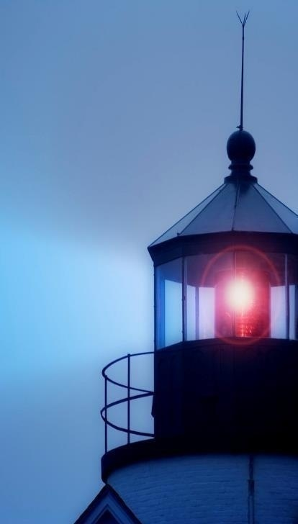
“…at evening time it shall be light.”
I JOHN 1:7
But if we walk in the light, as he is in the light, we have fellowship one with another, and the blood of Jesus Christ his Son cleanseth us from all sin.

