Slide 1


Principles to Live by 8
Stewardship: Financial Responsibility According to the Bible
PROVERBS 6:6-11
Go to the ant, thou sluggard; consider her ways, and be wise:
Notes:
MOVE YOUR MIC DOWN AN INCH

Slide 2
“Trump” Accounts
New, tax-advantaged investment accounts for children under 18, established by the Working Families Tax Cuts Act, which provide a $1,000 government-seeded, invested contribution for U.S. citizens born between 2025 and 2028. Parents or guardians can open these accounts via IRS Form 4547 to help children accumulate wealth, allowing up to $5,000 in annual contribution.
https://www.fidelity.com/learning-center/personal-finance/trump-accounts

Slide 3
The average American worker will earn about $2,000,000 in an average working lifetime.
None of us plan to fail, but we often fail to plan!

Slide 4

The direction of our lives should not be determined by our finances.
Rather we should learn about our position in order to create a plan that supports the direction we take in our lives.
And helps us in times of adversity.

Slide 5
Life Cycle of Planning
Stage 1: The Early Years -- A Time of Wealth Accumulation
Stage 2: Approaching Retirement -- The Golden Years
Stage 3: The Retirement Years

Slide 6
No Virtue in Poverty!
LEVITICUS 25:35-38
And if thy brother be waxen poor, and fallen in decay with thee; then thou shalt relieve him: yea, though he be a stranger, or a sojourner; that he may live with thee. 36 Take thou no usury of him, or increase: but fear thy God; that thy brother may live with thee. 37 Thou shalt not give him thy money upon usury, nor lend him thy victuals for increase. 38 I am the LORD your God, which brought you forth out of the land of Egypt, to give you the land of Canaan, and to be your God.

Slide 7
INVESTMENTS
47 Good businessman, know better than gamble. Don't gamble; you're going to lose. You can't win, gambling. You're a pauper one time, a rich man the next, then back a pauper again. Gambling is a disease. It's just an evil spirit. And it gets onto people, sometime, in mild form. There's a pattern laid down, a definite thing, it doesn't belong in any certain group of people. It's God's Word. Don't gamble on That. Don't take chances.

Slide 8
And another thing I notice… A man get a hold of a little money, and then he'll try to invest it in some kind of a get-rich-overnight, some unidentified business. You'll lose the shirt off your back... Don't you try that. It never pays off.
63-0126

Slide 9

The Lesson:
Stewardship is an
internal conviction, not
just a response to supervision. A wise
person works diligently
even when no one is watching.

Slide 10

The Analogy: Ants are known for carrying loads much larger than themselves, one grain at a time, to build massive, secure mounds.

Slide 11
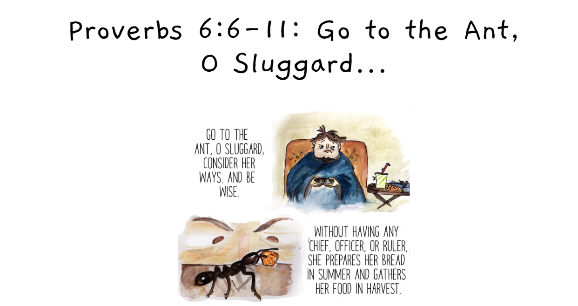

Slide 12
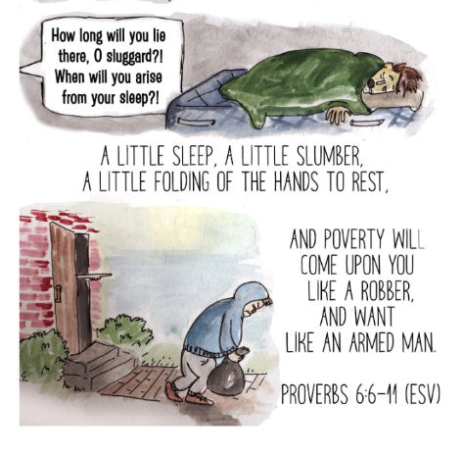
PROVERBS 6:9
How long wilt thou sleep, O sluggard? when wilt thou arise out of thy sleep? 10 Yet a little sleep, a little slumber, a little folding of the hands to sleep:11 So shall thy poverty come as one that travelleth, and thy want as an armed man.

Slide 13
There’s nothing wrong with…
Working hard!
Wealth gotten by vanity shall be diminished: but he that gathereth by labour shall increase. PROVERBS 13:11
Refusing to give your children all they ask for.

Slide 14

Why do We Need
to Be Concerned?

Slide 15
Why Don’t We React?
Not Angry Enough
We are Fooled by Marketers, Influencers and Media
We Make Decisions Based on Image/Envy
JAMES 1:22
But be ye doers of the word, and not hearers only, deceiving your own selves. 23 For if any be a hearer of the word, and not a doer, he is like unto a man beholding his natural face in a glass…

Slide 16

Sign in a Loan Office:
“We will loan you
enough money to
get completely
out of debt!”

Slide 17
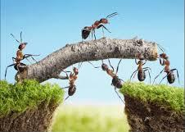
Stay the Course!
Stay with Proven Biblical Principles.
Money Verses
16 out of 38 of Christ’s parables dealt with money. More is said NT about money than Heaven and hell combined; 5x more is said about money than prayer; and there are over 500 verses on both prayer and faith, there are over 2000 verses dealing with money and possessions.

Slide 18
PRESUMING
37 When you come to the end of the road, you'll say, "Praise God. I'm glad I took that old rugged way. Here I stand washed in the Blood of the Lamb." Don't palaver around them old creeds and things out there. Come on, get in the Way.
God has a Way, a plan. It’s wrote here in the Bible. Let's stay with that.
62-0408

Slide 19

“I never would have been able to tithe the first million dollars I ever made if I had not tithed my first salary, which was $1.50 per week.”
John D. Rockefeller

Slide 20
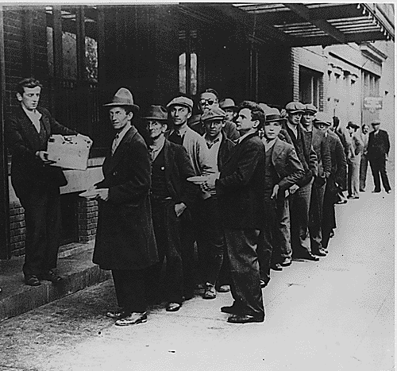
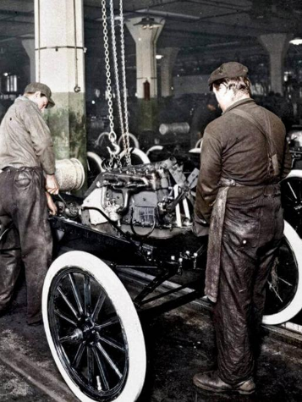

Circumstances are Subject to Change!

Slide 21
The average job now lasts about 3.2 years.
The average worker will therefore have 14-16 different jobs in a working lifetime.
Benefits will also decline, and they will be given based on need, rather than as an entitlement.
Social Security Official Changes in 2026
For anyone born in 1960 or later, the full retirement age is now officially 67.
Impact on Benefits: While you can still claim benefits at 62, doing so now results in a permanent reduction of approximately 30% compared to waiting until age 67.

Slide 22
“Bro. Barry, Should I make financial decisions based on envy or the influence of Social Media? I just want to be like everyone else.”
The "Curated Reality" Trap:
Social media often showcases only the "highlight reels" of others' lives, such as expensive vacations and luxury items. These depictions rarely include the associated debt, envy or external financial help (like family support) that make such lifestyles possible.

Slide 23
Lifestyle Inflation and Envy: Constant upward social comparison can make individuals feel financially behind even when they are stable. This envy often triggers "conspicuous consumption"—spending on luxury items primarily to display wealth or status to others.
FOMO & Impulsive Spending: The "fear of missing out" (FOMO) is amplified on social media, leading to impulsive purchases of trendy items or "must-have" products promoted by influencers. These influencers are often paid to promote these items.

Slide 24
Unreliable Financial Advice: Many "influencers" lack professional qualifications, certifications, or Biblical knowledge. Their advice is often generic, self-serving (gaining commissions), or may even promote high-risk scams and volatile investments like certain stocks or crypto.
Neglect of Personal Goals: Basing decisions on external feedback shifts focus away from personal values and long-term financial health (emergency funds, retirement). Research suggests those who spend over 3 hrs/day on social media are more prone to making irrational financial decisions.

Slide 25
The Biblical Rules
Have Not Changed!
A prudent man foreseeth the evil, and hideth himself: but the simple pass on, and are punished.
PROVERBS 22:3

Slide 26
Put God First: Tithe Mal. 3:8-11
Develop an Emergency Fund: (Save)
3. Commit to a Budget (Luke 14:28-29)
www.everydollar.com
4. Automate your Saving!

Slide 27

Why Do You Need a Plan?
1. For most people it is easier to spend than save.
2. To track expenses, so you don’t spend more than you think you’re spending.
3. To retire someday.

Slide 28
Markets: [Gov’t] Says U.S. To Ban Large Investors From Buying Homes
Published Wed, Jan 7 20261:00 PM ESTUpdated Wed, Jan 7 20267:04 PM EST
“Private equity giants, real estate investment trusts and other large institutional investors have amassed sizable portfolios of single-family rental homes over the past decade. Many have argued that these investments have reduced housing supply for would-be homeowners and helped drive up prices.”

Slide 29
“Institutional investors target geographic areas with strong rental price growth and young adult population growth.
As a result, the buy-to-rent homes they own are concentrated in cities in the South and Southwest like Atlanta, Charlotte, and Phoenix. Outside a small handful of cities, institutional ownership is less than 1% of SFHs.”
https://insights.som.yale.edu/insights/will-banning-corporate-homebuyers-make-housing-more-affordable

Slide 30
“Any form of down payment assistance [Eg. 401’s] will subsidize purchases for current buyers at the cost of higher house prices in the near future. An additional concern with allowing prospective homebuyers to withdraw early from their 401(k) without penalty is that borrowers may be left with reduced resources in retirement if the appreciation in their housing wealth is lower than that of the stock market over the same investment horizon, which depends on people’s ability to hold onto their home in the event of a market crash. In contrast to having a diversified portfolio, owning a home ties your fortunes to those of a local economy.”

Slide 31
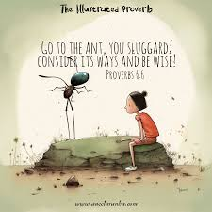
PROVERBS 6:1-11
My son, if thou be surety for thy friend, if thou hast stricken thy hand with a stranger, 2 Thou art snared with the words of thy mouth, thou art taken with the words of thy mouth. 3 Do this now, my son, and deliver thyself, when thou art come into the hand of thy friend; go, humble thyself, and make sure thy friend.

Slide 32
4 Give not sleep to thine eyes, nor slumber to thine eyelids. 5 Deliver thyself as a roe from the hand of the hunter, and as a bird from the hand of the fowler. 6 Go to the ant, thou sluggard; consider her ways, and be wise: 7 Which having no guide, overseer, or ruler, 8 Provideth her meat in the summer, and gathereth her food in the harvest. 9 How long wilt thou sleep, O sluggard? when wilt thou arise out of thy sleep? 10 Yet a little sleep, a little slumber, a little folding of the hands to sleep: 11 So shall thy poverty come as one that travelleth, and thy want as an armed man.

Slide 33
Proverbs 6:1-5
My child, if you have put up security for a friend’s debt or agreed to guarantee the debt of a stranger - if you have trapped yourself by your agreement and are caught by what you said - ³ follow my advice and save yourself, for you have placed yourself at your friend’s mercy. Now swallow your pride; go and beg to have your name erased. ⁴ Don’t put it off; do it now! Don’t rest until you do. ⁵ Save yourself like a gazelle escaping from a hunter, like a bird fleeing from a net.

Slide 34
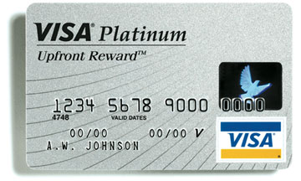
Laptops for Balances
Universal Savings Bank is offering
brand new laptop computers in ex-
change for transferring a balance of at least $5,000 from
other credit cards. The "Upfront Rewards VISA Platinum“
also requires cardholders to maintain a balance of at least
$3,500 on the card for at least 18 months. Those who do not have
$5,000 to transfer can request a cash advance up to $2,500 to
bring their initial balance up to $5,000. (Current APR is 9.99%).

Slide 35
Laptop for Balances!
$5000 x 9.9% x $100.00 per month
64.74 months
$6,474.00
(provided there are no further purchases!)
Remember the Laptop’s original cost
is approximately $800 to $900

Slide 36
Laptop for Balances!
$5000 x 9.9% x $50.00 per month
212 months
$10,600.00
(provided there are no further purchases!)
Remember the Laptop’s original cost
is approximately $800 to $900

Slide 37
A good man leaveth an inheritance to his children's children: and the wealth of the sinner is laid up for the just. PROVERBS 13:22

