Slide 1

Principles to Live by 7
Stewardship: Financial Responsibility According to the Bible.
PROVERBS 3:9-10 & PROVERBS 6:6-11
Honour the LORD with thy substance, and with the firstfruits of all thine increase: 10 So shall thy barns be filled with plenty, and thy presses shall burst out with new wine.
Notes:
MOVE YOUR MIC DOWN AN INCH

Slide 2
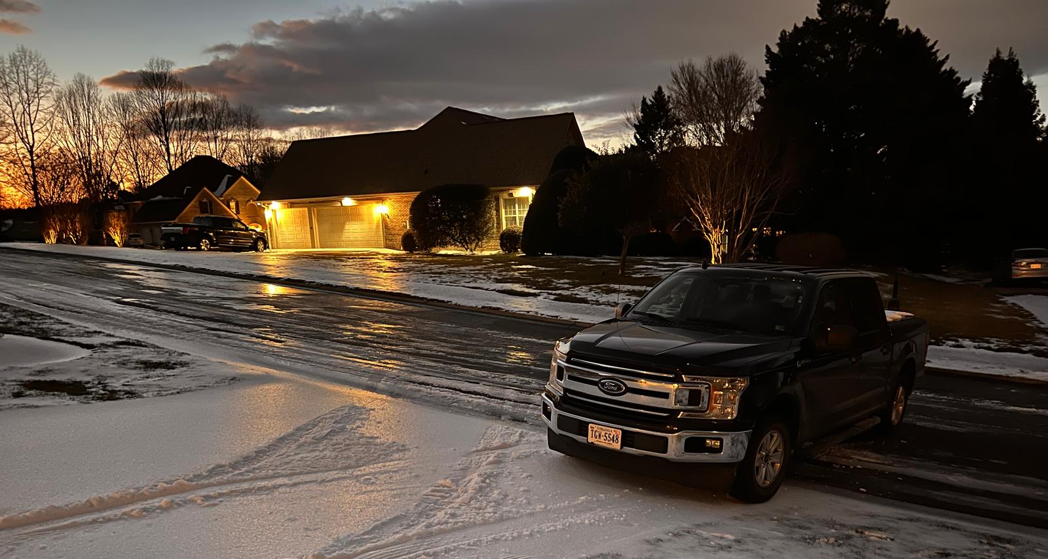

Slide 3
ROMANS 14:12
So then every one of us shall give account of himself to God.
STEWARD: (Gr.) oikonomos
The manager of household or of household affairs; manager whom the proprietor has entrusted the management of his affairs…
An overseer; the treasurer of a city.

Slide 4
Time, Talents and Gifts
Ministries & Mysteries of God
Resources(Finances, Investments, etc.)
THE.BEGINNING.OF.JESUS.FAME
The church ought to get in God's program… Like suppers and dinners to appropriate money, that's not God's way of doing it. Pay your tithes; that's what God wants you to do. Just keep in God's program, and He'll bless the giver. He promised it. 53-0605

Slide 5
Is This Your
“Normal”?
Income
Retirement
Debt

Slide 6

Why do We Need
to Be Concerned?

Slide 7
Why Don’t We React?
Not Angry Enough
We are Fooled by Marketers, Influencers and Media
We Make Decisions Based on Image/Envy
JAMES 1:22
But be ye doers of the word, and not hearers only, deceiving your own selves. 23 For if any be a hearer of the word, and not a doer, he is like unto a man beholding his natural face in a glass…

Slide 8
Cell Phone Technology:
1. New Phone Every Year:
$1200/yr. x 40 years = $48,000 spent.
2. New Phone Every 3 Years:
$1200 x 13 times = $15,600 (Saving $32,200)
The Real Cost: $32,200 @10% x 40 years = $1,462,898.38

Slide 9
Mortgage rate history:
(1970s to 2025)
Looking at the past four decades, the average rate on a 30-year fixed mortgage peaked in 1981, rising just above 16%.
https://www.bankrate.com/mortgages/historical-mortgage-rates/

Slide 10
What Is a Good Interest Rate on a Credit Card?
A good credit card interest rate is one that's below the national average, which currently hovers at 21.98%.
Consumers with excellent credit may qualify for rates in the mid-teens or lower, while those with fair or poor credit often see rates in the 20% to 30% range.

Slide 11
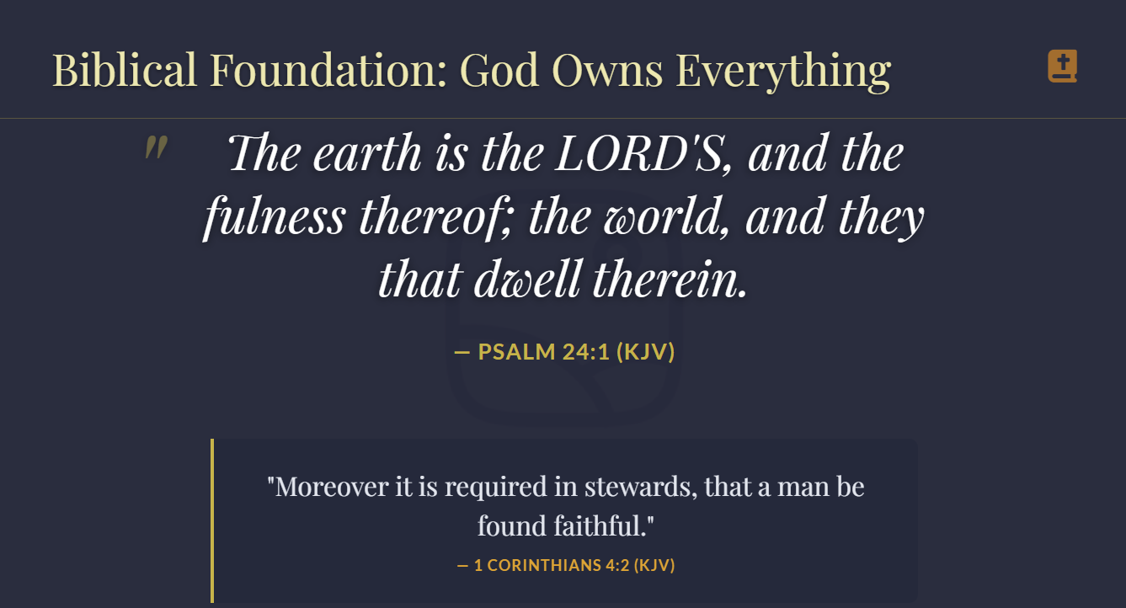
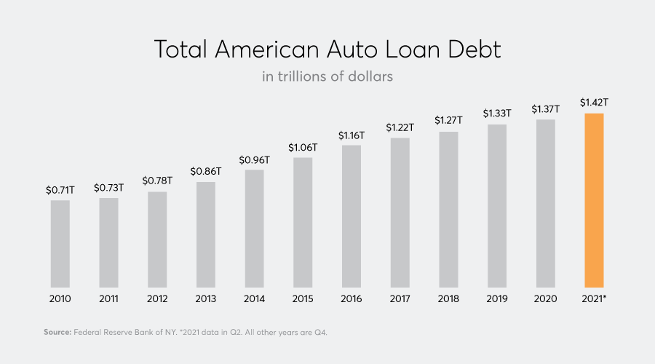

Slide 12
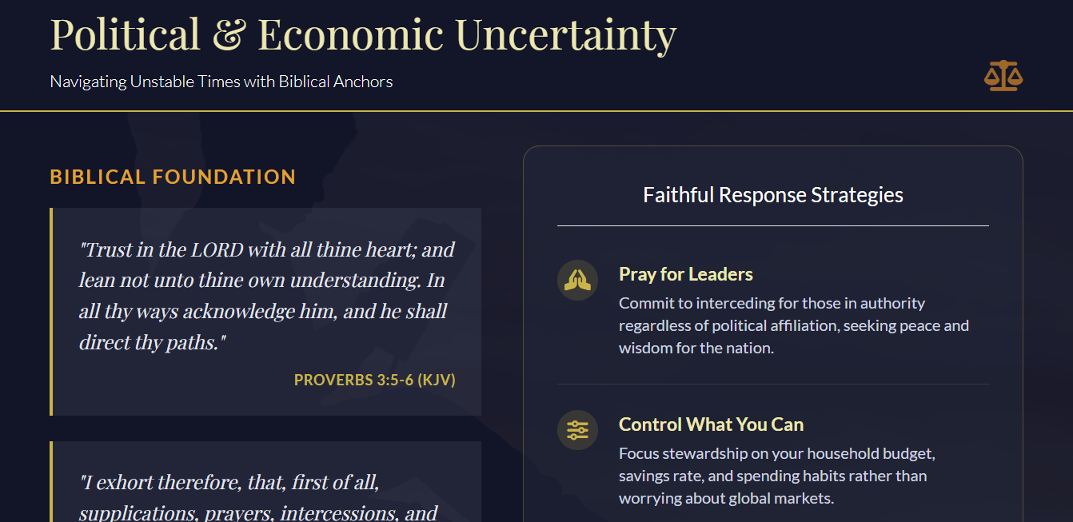

Slide 13
US National Debt: $37.64 Trillion.
Interest on Debt: Approx. 20% of Fed. Spending.
Stay the Course!
Stay with Proven Biblical Principles.

Slide 14
Tithe. Mal. 3:8-11
Develop an Emergency Fund to avoid further debt.
3. Commit to a Budget
Luke 14:28-29
www.everydollar.com

Slide 15

“I never would have been able to tithe the first million dollars I ever made if I had not tithed my first salary, which was $1.50 per week.”
John D. Rockefeller

Slide 16
The Tithe
NUMBERS 18:1-2,6-7, 20-26,32
And the LORD said unto Aaron, Thou and thy sons and thy father's house with thee shall bear the iniquity of the sanctuary: and thou and thy sons with thee shall bear the iniquity of your priesthood. 2 And thy brethren also of the tribe of Levi, the tribe of thy father, bring thou with thee, that they may be joined unto thee, and minister unto thee: but thou and thy sons with thee shall minister before the tabernacle of witness.

Slide 17
DEUTERONOMY 7:12-14
Wherefore it shall come to pass, if ye hearken to these judgments, and keep, and do them, that the LORD thy God shall keep unto thee the covenant and the mercy which he sware unto thy fathers: 13 And he will love thee, and bless thee, and multiply thee: he will also bless the fruit of thy womb, and the fruit of thy land, thy corn, and thy wine, and thine oil, the increase of thy kine, and the flocks of thy sheep, in the land which he sware unto thy fathers to give thee.
14 Thou shalt be blessed above all people: there shall not be male or female barren among you, or among your cattle.

Slide 18
DEUTERONOMY 14:22-23
Thou shalt truly tithe all the increase [gain] of thy seed, that the field bringeth forth year by year. 23 And thou shalt eat before the LORD thy God, in the place which he shall choose to place his name there, the tithe of thy corn, of thy wine, and of thine oil, and the firstlings of thy herds and of thy flocks; that thou mayest learn to fear the LORD thy God always…
29 And the Levite, (because he hath no part nor inheri-tance with thee,) and the stranger, and the fatherless, and the widow, which are within thy gates, shall come, and shall eat and be satisfied; that the LORD thy God may bless thee in all the work of thine hand which thou doest.

Slide 19
Israel at Gilgal: JOSHUA 5:10-12
And the children of Israel encamped in Gilgal, and kept the passover on the fourteenth day of the month at even in the plains of Jericho. 11 And they did eat of the old corn of the land on the morrow after the passover, unleavened cakes, and parched corn in the selfsame day. 12 And the manna ceased on the morrow after they had eaten of the old corn of the land; neither had the children of Israel manna any more; but they did eat of the fruit [increase, gain] of the land of Canaan that year.

Slide 20
II CHRONICLES 31:1,5
Now when all this was finished, all Israel that were present went out to the cities of Judah, and brake the images in pieces, and cut down the groves, and threw down the high places and the altars out of all Judah and Benjamin, in Ephraim also and Manasseh, until they had utterly destroyed them all. Then all the children of Israel returned, every man to his possession, into their own cities…
5 And as soon as the commandment came abroad, the children of Israel brought in abundance the firstfruits of corn, wine, and oil, and honey, and of all the increase of the field; and the tithe of all things brought they in abundantly.

Slide 21
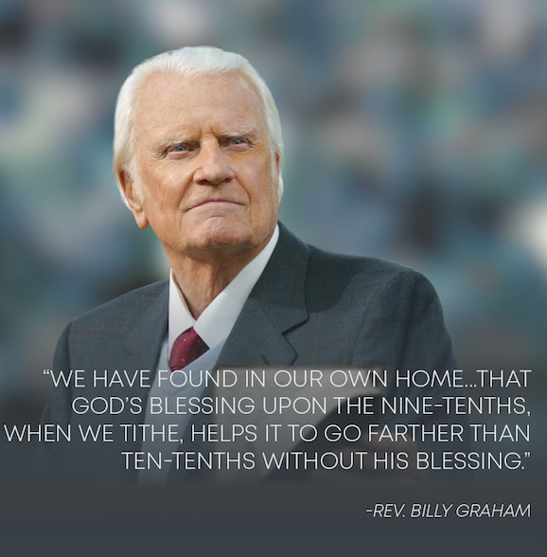
Matt. 23:23, Luke 11:42 Jesus referred to tithing as something that should not be neglected…
“Woe to you, teachers of the law and Pharisees, you hypocrites! You give a tenth of your spices–mint, dill and cummin. But you have neglected the more important matters of the law–justice, mercy and faithfulness. You should have practiced the latter, without neglecting the former.”

Slide 22
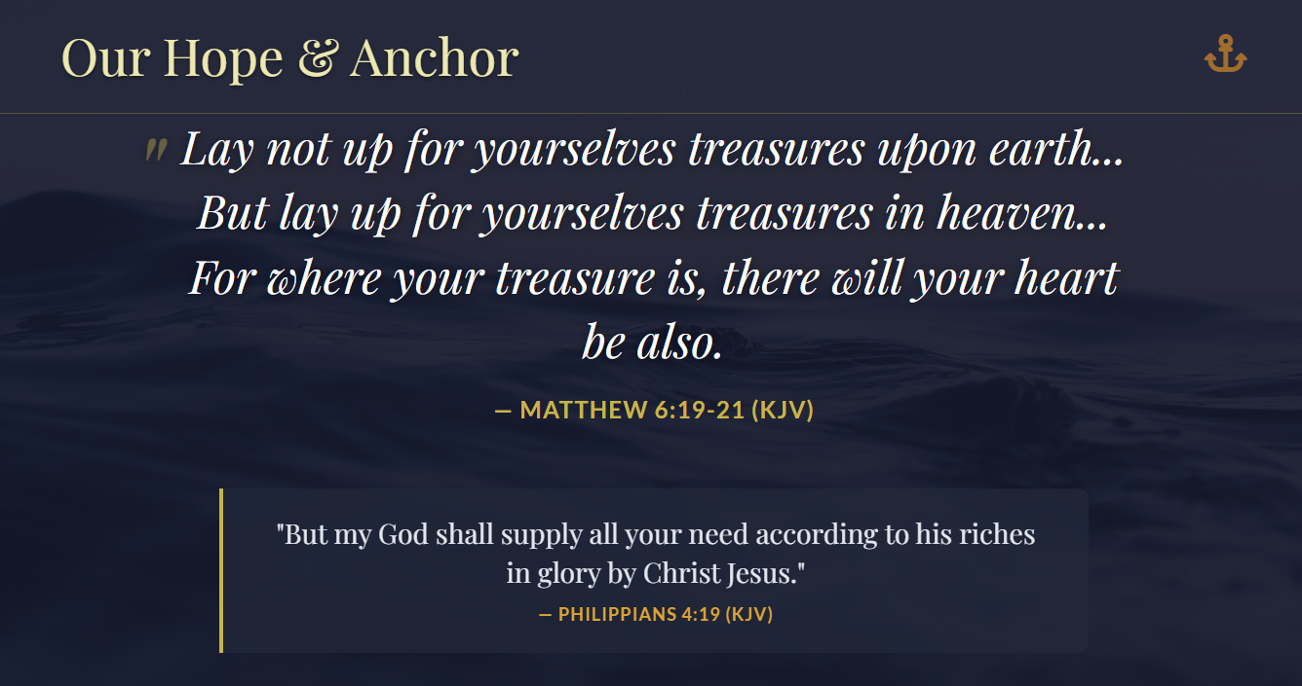

Slide 23
Matthew 6:19-21
Your ultimate focus and devotion should be on eternal, spiritual values rather than temporary material possessions ("treasures on earth"), because only the former will last. It does not prohibit saving for retirement but warns against greed, materialism, and putting your hope and security in wealth instead of God.
The passage advises storing up treasures in heaven, because where one's treasure is, there their heart will be also. The verses do not condemn saving for future needs

Slide 24
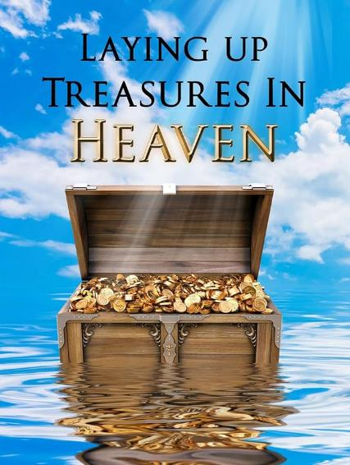
like retirement, which is consistent with the Bible's encouragement of planning and diligence. Instead, the warning is against making wealth an idol, trusting in it more than in God's provision.
Responsible saving for retire-ment is seen as good stewardship, with the understanding that possessions should be held loosely and used to honor God.

Slide 25
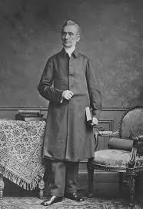
George Mueller
Evangelist, 1805–1898
“As the outward man is not fit for work for any length of time, except we take food, one of the first things we do in the morning, so it should be with the inner man. We should take food for that. Now what is the food for the inner man; not prayer, but the Word of God; and here again not the simple reading of the Word of God, so that it only passes through our minds, just as water runs through a pipe, but considering what we read, pondering over it, and applying it to our hearts....”

Slide 26
Funding the Orphanages: Mueller cared for over 10,000 orphans, built 5 orphanages, raising millions of dollars solely through prayer, without ever making a public appeal for funds.
Personal Finances: Early in his ministry, he gave up a guaranteed church salary, choosing to rely on anonymous donations placed in a box at the chapel.
Death and Estate: Despite receiving and dispensing vast sums of money throughout his life (over £1.5 million GBP, or $7.3 million USD in today), his personal estate at the time of his death was only a few hundred pounds, showing his lack of personal attachment to wealth.

Slide 27
“Money is really worth no more than as it can be used to accomplish the Lord's work. Life is worth as much as it is spent for the Lord's service.”
Daily Provisions: Famously, one morning when there was no food in the orphanage for breakfast, Mueller gathered them to pray and give thanks for the meal they were about to receive. Almost immediately, a baker arrived with enough bread to feed everyone, and a milkman whose cart had broken down outside the orphanage door donated his spoiling milk.

Slide 28
GOD'S.WAY.THAT'S.BEEN.MADE.FOR.US
109 And she goes in: she takes these two sticks and break them. Brought the hoecake out and give it to the preacher; he stood there and eat. Said, "Now, go back and get one for yourself and your son. For, THUS SAITH THE LORD, the barrel is not going to run empty, or the cruse dry, until the day that God sends rain on the earth." Hallelujah. Because she sought the Kingdom of God first, she walked in God's provided way; God rewarded her. 52-0900

Slide 29
WITNESSES
190 "Seek ye first the Kingdom of God." Have you ever witnessed that to be the truth?
Put God first. Pay your tithes first. Pay everything first. Pay God. Pray first at morning. Pray all through the day. Give God the first place in everything. You'll be a witness.
53-0405

Slide 30
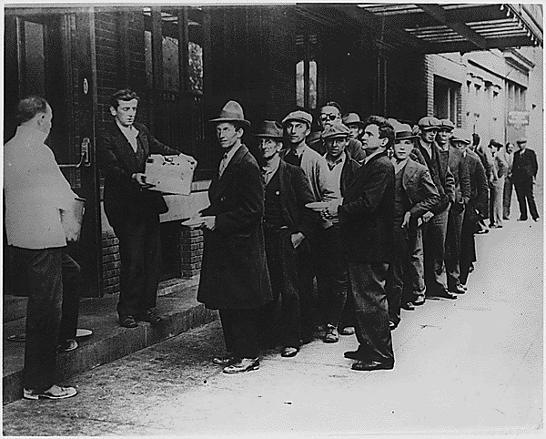
All the Rules have Changed

Slide 31
Manufacturing Revolution:
The shift from craft-based production to a moving assembly line enabled rapid, high-volume production, transforming the automotive industry. The Economic Impact meant drastic reductions in production time allowed Ford to lower the price of the Model T significantly, making automobiles affordable for the average American consumer.
Circumstances are Subject to Change!

Slide 32
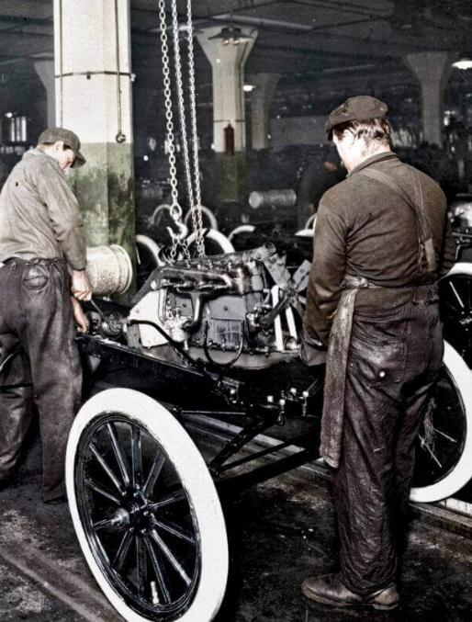
The labor became highly repetitive and monotonous, leading to worker dissatisfaction and high turnover. To combat this, Ford introduced the $5 workday, which more than doubled wages, created a stable middle-class workforce, and spurred industrial growth in Detroit.
The assembly line approach became a cornerstone of 20th-century mass production, impacting everything from consumer goods to electronics.

Slide 33
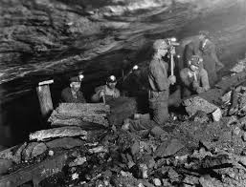
Mass Layoffs: The industry continues
to see significant closures. Recent permanent layoffs at various opera-
tions in McDowell County have left hundreds of workers without employ-ment. West Virginia has the lowest labor force participation
rate in the nation. Young miners face a mismatch between
their specialized skills and requirements of emerging sectors.
Household incomes are failing to keep pace with post-pandemic inflation and rising housing costs, squeezing
families that once relied on high-paying mining wages.

Slide 34

The net effect of the AI approach to work is a profound, productivity-driven transformation that enhances efficiency, boosts worker performance particularly for less-experienced staff—while shifting job roles rather than causing immediate mass displacement. While it drives significant economic growth and job creation at firms using AI, it also risks polarizing the workforce, favoring highly educated, technical workers over those with lower education levels.

Slide 35
The average job now lasts about 3.2 years.
The average worker will therefore have 14-16 different jobs in a working lifetime.
Benefits will also decline, and they will be given based on need, rather than as an entitlement.
Official Changes in 2026
For anyone born in 1960 or later, the full retirement age is now officially 67.
Impact on Benefits: While you can still claim benefits at 62, doing so now results in a permanent reduction of approximately 30% compared to waiting until age 67.

Slide 36
“Bro. Barry, Should I make financial decisions based on envy or the influence of Social Media?
I just want to be like everyone else.”
The "Curated Reality" Trap:
Social media often showcases only the "highlight reels" of others' lives, such as expensive vacations and luxury items. These depictions rarely include the associated debt, struggles, or external financial help (like family support) that make such lifestyles possible.

Slide 37
Lifestyle Inflation and Envy: Constant upward social comparison can make individuals feel financially behind even when they are stable. This envy often triggers "conspicuous consumption"—spending on luxury items primarily to display wealth or status to others.
FOMO and Impulsive Spending: The "fear of missing out" (FOMO) is amplified on social media, leading to impulsive purchases of trendy items or "must-have" products promoted by influencers. These influencers are often paid to promote these items.

Slide 38
Unreliable Financial Advice: Many "influencers" lack professional qualifications, certifications, or Biblical knowledge. Their advice is often generic, self-serving (aimed at gaining commissions), or may even promote high-risk scams and volatile investments like certain stocks or crypto.
Neglect of Personal Goals: Basing decisions on external feedback shifts focus away from personal values and long-term financial health, such as emergency funds and retirement. Research suggests those who spend over three hours a day on social media are more prone to making irrational financial decisions.

Slide 39
The Biblical Rules
Have Not Changed!
A prudent man foreseeth the evil, and hideth himself: but the simple pass on, and are punished.
PROVERBS 22:3

Slide 40
Tithe. Mal. 3:8-11
Develop an Emergency Fund to avoid further debt.
3. Commit to a Budget
Luke 14:28-29
www.everydollar.com

Slide 41
Markets: Trump Says U.S. To Ban Large Investors From Buying Homes
Published Wed, Jan 7 20261:00 PM ESTUpdated Wed, Jan 7 20267:04 PM EST
“Private equity giants, real estate investment trusts and other large institutional investors have amassed sizable portfolios of single-family rental homes over the past decade. Many have argued that these investments have reduced housing supply for would-be homeowners and helped drive up prices.”

Slide 42
“Institutional investors target geographic areas with strong rental price growth and young adult population growth.
As a result, the buy-to-rent homes they own are concentrated in cities in the South and Southwest like Atlanta, Charlotte, and Phoenix. Outside a small handful of cities, institutional ownership is less than 1% of SFHs.”
https://insights.som.yale.edu/insights/will-banning-corporate-homebuyers-make-housing-more-affordable

Slide 43
“Any form of down payment assistance [Eg. 401’s] will subsidize purchases for current buyers at the cost of higher house prices in the near future. An additional concern with allowing prospective homebuyers to withdraw early from their 401(k) without penalty is that borrowers may be left with reduced resources in retirement if the appreciation in their housing wealth is lower than that of the stock market over the same investment horizon, which depends on people’s ability to hold onto their home in the event of a market crash. In contrast to having a diversified portfolio, owning a home ties your fortunes to those of a local economy.”

Slide 44
The value of the IRA after 40 years, with a monthly investment of $500 at 6% interest compounded monthly, would be approximately $995,745.37.
Should I Save?
The value of the IRA after 40 years, with a monthly investment of $500 at 6% interest compounded monthly, would be approximately $995,745.37.
Automate your Saving!

Slide 45
The value of the IRA after 40 years, with a monthly investment of $500 at 6% interest compounded monthly, would be approximately $995,745.37.
The value of the IRA after 40 years, with a monthly investment of $600 at 7% interest compounded monthly, would be approximately $1,574,888.04.
In 2023, mutual funds averaged an annual return of 13.17%, well above the average annual return over the 15 years before that.

Slide 46
A good man leaveth an inheritance to his children's children: and the wealth of the sinner is laid up for the just. PROVERBS 13:22

Slide 47
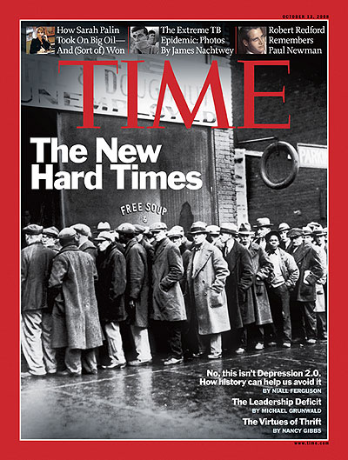
Welcome to the New Reality

Slide 48
THE.UNPARDONABLE.SIN 54-1024
102 I've been through depression, been through prosperity. But I wouldn't turn loose the hand of Jesus Christ for all the money and wealth on the face of this earth. He's my Friend when I'm broke. He's my Friend when I got plenty. I love Him when I'm hungry. I love Him when I'm filled. I love Him when I'm in sorrow. I love Him when I'm happy. I love Him because He first loved me.

Slide 49

Sign in a Loan Office:
“We will loan you
enough money to
get completely
out of debt!”

