Slide 1

Principles to Live by 6
Stewardship: Financial Responsibility According to the Bible.
PROVERBS 15:22 Without counsel purposes are disappointed: but in the multitude of counsellors they are established.
Notes:
MOVE YOUR MIC DOWN AN INCH

Slide 2
ROMANS 14:12
So then every one of us shall give account of himself to God.
STEWARD: (Gr.) oikonomos
The manager of household or of household affairs; manager whom the proprietor has entrusted the management of his affairs…
An overseer; the treasurer of a city.

Slide 3
Time, Talents and Gifts
Ministries & Mysteries of God
Resources(Finances, Investments, etc.)
QUEEN.OF.THE.SOUTH 58-0620
18 God gives gifts; He never takes gifts. Your gift remains, but if you be honest with what you got, God will take other talents and just keep pouring them on, if you just keep climbing on.

Slide 4
Why do We Need to
Be Concerned?

Slide 5
A very high percentage of U.S. population carries some form of debt;
Approx. 80% of adults have debt;
Up to 90% of households hold debt like mortgages, auto loans, credit cards, making it nearly universal for living a typical American lifestyle, with credit cards, student loans, auto loans being major components.

Slide 6
A “Successful” man is one who makes more money than his wife can spend.
A “Successful” woman is one who can find such a man.
A man has 6 items in his bathroom: toothpaste, toothbrush, shaving cream, razor, bar of soap, towel.
A woman has (ave.) 337 items. A man would not be able to identify more than 20 of the items.

Slide 7
Social Security payments still provide about 90% of income for more than 25% of older adults, according to SSA. But the Social Security trust fund is facing a 75-year deficit, and without intervention it will be depleted by the mid-2030s, meaning that only a portion of retirees’ expected benefits will be paid out. Lawmakers have faced a decades-long political stalemate on how to fix it.

Slide 8
“Normal”
Or Typical
Income
Retirement
Debt

Slide 9
On average, today's consumer has a total of 13 credit obligations on record.
These include credit cards (department store charge cards, gas cards, bank cards) and installment loans (auto loans, mortgages, student loans, etc.).
Of these 13 credit obligations, nine are likely to be credit cards and four are likely to be installment loans. (Source: myfico.com)
Not included are savings and checking accounts. Typically not reported to a credit bureau.

Slide 10
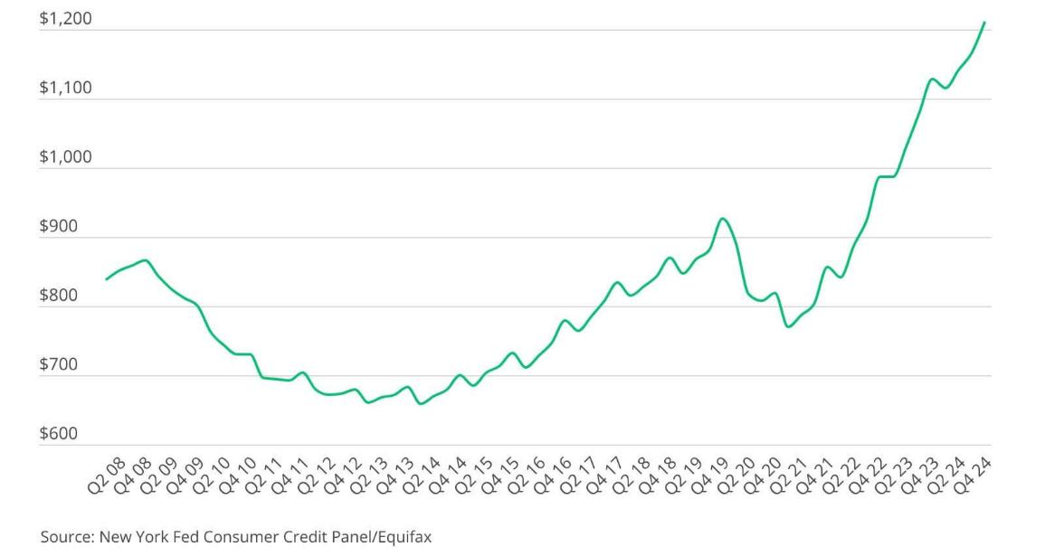
“Americans have an absolute mountain of credit card debt — $1.233 trillion.” ($7,369 per card)

Slide 11
Current Population of the United States:
347,300,906
The “Debt Squeeze”
Total Household Debt has surged to $18.59 trillion

Slide 12
Income
Retirement
Debt

Slide 13
Income
Retirement
Debt

Slide 14
49% of Families could cover less than one month’s expense if they lost their income.
61% for GenZ Familes

Slide 15

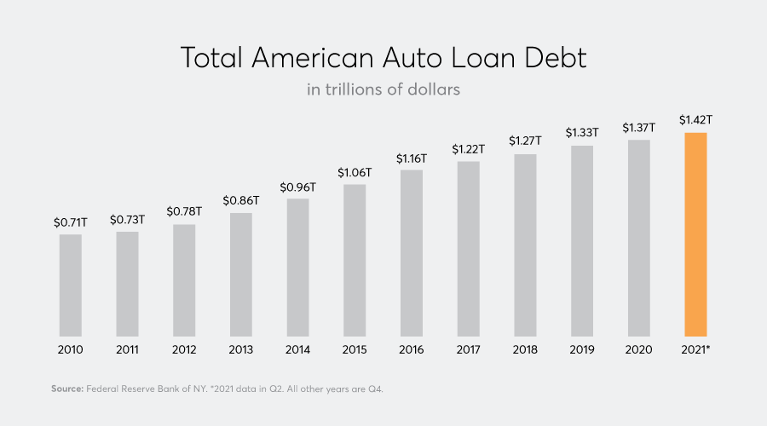

Slide 16


Slide 17
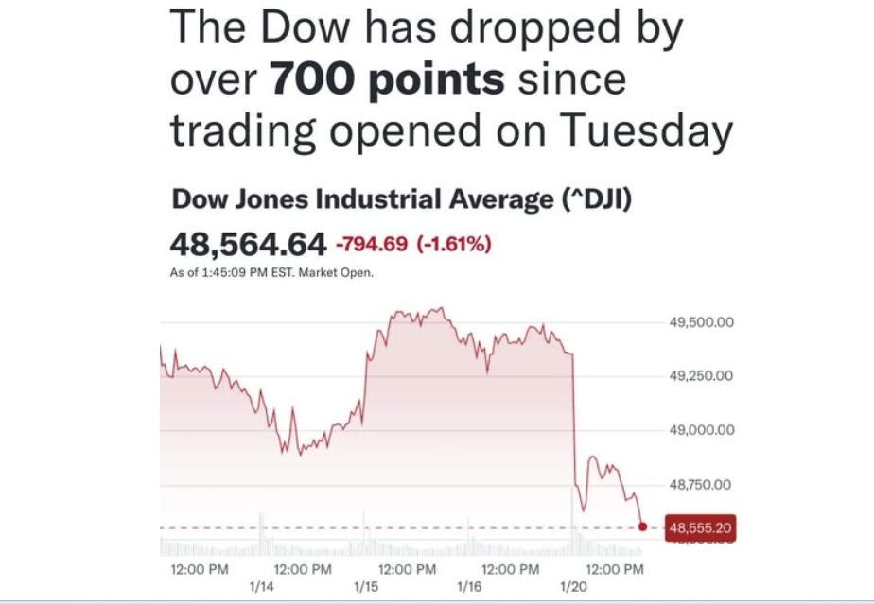

Slide 18


Slide 19


Slide 20
US National Debt: $37.64 Trillion.
Interest on Debt: Approx. 20% of Fed. Spending.
Stay the Course!

Slide 21
How do we deal with an
Overload of Debt?

Slide 22
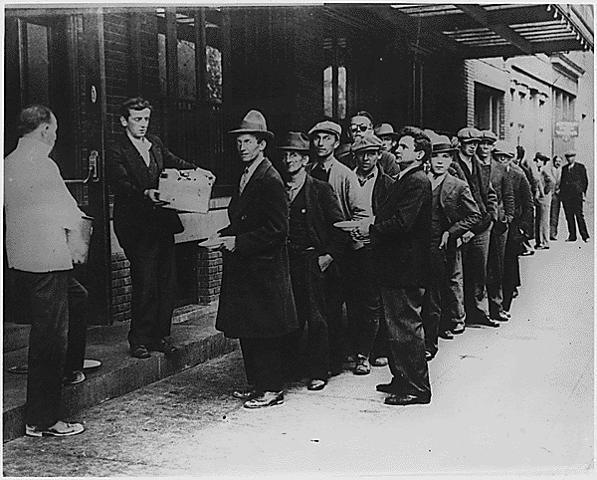
All the Rules have Changed

Slide 23
The Biblical Rules
Have Not!
A prudent man foreseeth the evil, and hideth himself: but the simple pass on, and are punished.
PROVERBS 22:3

Slide 24
Sputnik Launch (October 1957): The Soviet Union's launch of the first man-made satellite caused U.S. stocks to decline.
1973 OPEC Oil Embargo: OPEC members imposed an oil embargo on U.S., leading to severe inflation and contributing to a significant stock market decline that took more than nine years to recover from.
Watergate Scandal (1970s): Political uncertainty surrounding the scandal and President Nixon's resignation added to market turmoil already reeling from the Vietnam War and inflation.

Slide 25
Dot-Com Bubble Burst (03-10-2000): After a rapid rise fueled by investment in IT startups, NASDAQ peaked and crashed, wiping out trillions, many companies became worthless.
9/11 Attacks: The terrorist attacks caused the stock market to close for several days, led to market drops upon reopening.
Enron Scandal (2001): This major corporate scandal led to increased scrutiny and regulatory changes in the market.
Subprime Mortgage Crisis (2007-08): Decline of U.S. housing market, caused by lax lending standards and risky mortgages, exposed widespread financial instability.

Slide 26
Bear Stearns Collapse/Sale; Lehman Brothers (03/08): The New York Fed facilitated a deal for JPMorgan to acquire Bear Stearns to prevent a systemic collapse, causing a freeze in the inter-bank loan market and a rapid spread of the global economic shock.
Black Monday (October 19, 1987): The largest single-day percentage decline in U.S. stock market history occurred, with the S&P 500 falling by 20.5% and the Dow Jones by 22.6%.
Russian Ruble Devaluation and LTCM Collapse

Slide 27
Oct. 1962: Cuban Missile Crisis
2000: Y2K?
What if I was 20 years old in 1957 and agreed to invest $250 per month into a retirement fund at a modest 7% interest?
Would it have been wise to pull out the funds because of market volatility?

Slide 28
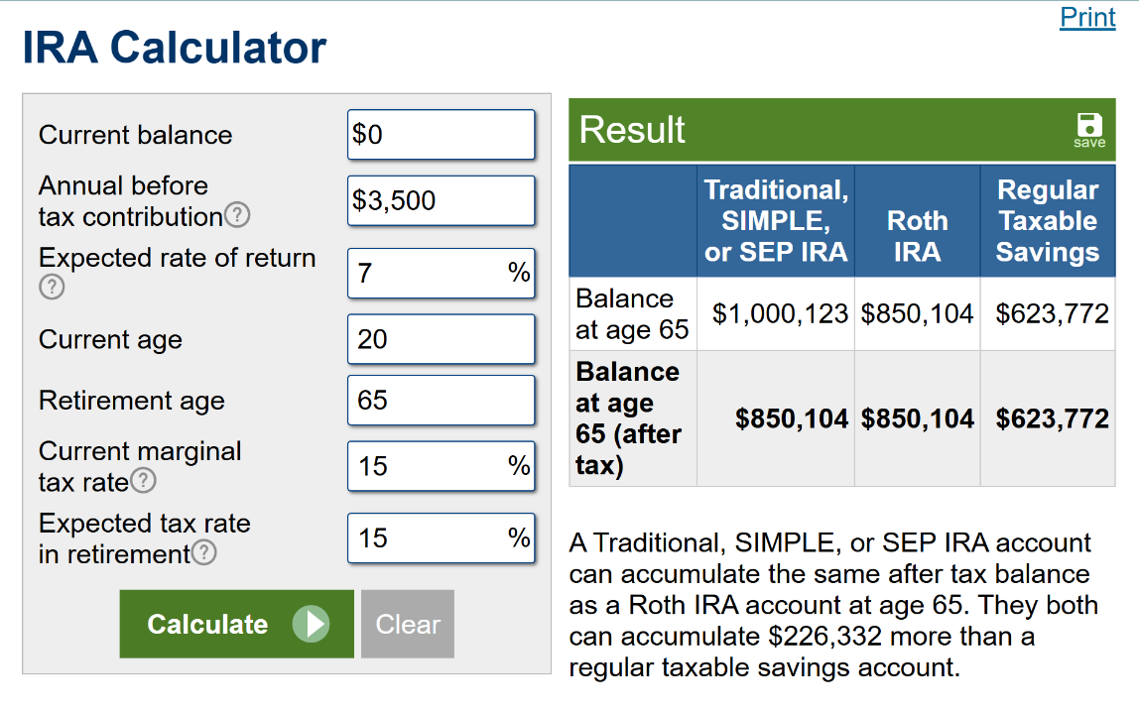

Slide 29



Slide 30


Slide 31
1. Keep God First!
Will a man rob God? Yet ye have robbed me. But ye say, Wherein have we robbed thee? In tithes and offerings. Ye are cursed with a curse: for ye have robbed me, even this whole nation.
MALACHI 3:8-11

Slide 32
Bring ye all the tithes into the storehouse, that there may be meat in mine house, and prove me now herewith, saith the LORD of hosts, if I will not open you the windows of heaven, and pour you out a blessing, that there shall not be room enough to receive it.
MALACHI 3:8-11
Notes:
And I will rebuke the devourer for your sakes, and he shall not destroy the fruits of your ground; neither shall your vine cast her fruit before the time in the field, saith the LORD of hosts.

Slide 33
2. Develop an Emergency Fund
to avoid further debt.
Save $1000
(Single: $500)

Slide 34
MATTHEW 25:14-30
For the kingdom of heaven is as a man travelling into a far country, who called his own servants, and delivered unto them his goods. 15 And unto one he gave five talents, to another two, and to another one; to every man according to his several ability; and straightway took his journey. 16 Then he that had received the five talents went and traded with the same, and made them other five talents.

Slide 35
Markets: Trump Says U.S. To Ban Large Investors From Buying Homes
Published Wed, Jan 7 20261:00 PM ESTUpdated Wed, Jan 7 20267:04 PM EST
“Private equity giants, real estate investment trusts and other large institutional investors have amassed sizable portfolios of single-family rental homes over the past decade. Many have argued that these investments have reduced housing supply for would-be homeowners and helped drive up prices.”

Slide 36

2025: Average car payment is around $748 for new cars and $532 for used cars, (figures vary significantly by credit score, loan terms, vehicle price), with rising costs driven by higher vehicle prices and interest rates, leading to longer loans and more consumers paying over $1,000 monthly.

Slide 37
3. Commit to a Budget
LUKE 14:28-29
For which of you, intending to build a tower, sitteth not down first, and counteth the cost, whether he have sufficient to finish it? Lest haply, after he hath laid the foundation, and is not able to finish it, all that behold it begin to mock him.
www.everydollar.com

Slide 38
The value of the IRA after 40 years, with a monthly investment of $500 at 6% interest compounded monthly, would be approximately $995,745.37.
Should I Save?
The value of the IRA after 40 years, with a monthly investment of $500 at 6% interest compounded monthly, would be approximately $995,745.37.
Automate your Saving!

Slide 39
The value of the IRA after 40 years, with a monthly investment of $500 at 6% interest compounded monthly, would be approximately $995,745.37.
The value of the IRA after 40 years, with a monthly investment of $600 at 7% interest compounded monthly, would be approximately $1,574,888.04.
In 2023, mutual funds averaged an annual return of 13.17%, well above the average annual return over the 15 years before that.

Slide 40
The average job now lasts about 3.2 years.
The average worker will therefore have 14-16 different jobs in a working lifetime.
In 2001, there were over 1,000,000 layoffs and terminations. This is an all-time historical record.
By 2010, we expect the retirement age to be delayed well into the 70s. Benefits will also decline, and they will be given based on need, rather than as an entitlement.

Slide 41
A good man leaveth an inheritance to his children's children: and the wealth of the sinner is laid up for the just.
PROVERBS 13:22

Slide 42
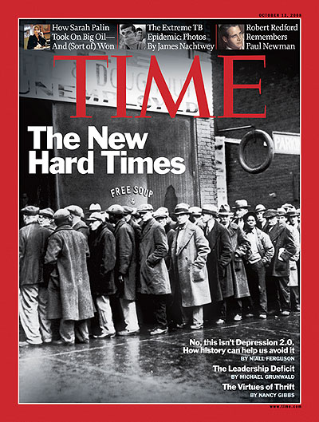
Welcome to the New Reality

Slide 43
THE.UNPARDONABLE.SIN 54-1024
102 I've been through depression, been through prosperity. But I wouldn't turn loose the hand of Jesus Christ for all the money and wealth on the face of this earth. He's my Friend when I'm broke. He's my Friend when I got plenty. I love Him when I'm hungry. I love Him when I'm filled. I love Him when I'm in sorrow. I love Him when I'm happy. I love Him because He first loved me.

Slide 44

Sign in a Loan Office:
“We will loan you
enough money to
get completely
out of debt!”

