Slide 1

The Spirit Controlled Church & It’s Members 4
ACTS 20:20 (17-24)
And how I kept back nothing that was profitable unto you, but have shewed you, and have taught you publickly, and from house to house, 21 Testifying both to the Jews, and also to the Greeks, repentance toward God, and faith toward our Lord Jesus Christ. 22 And now, behold, I go bound in the spirit unto Jerusalem, not knowing the things that shall befall me there:

Slide 2

Birthdays
Jan. 18th Lily Harwell, Rebekah Ivy
Jan. 20th Laura Harwell
Jan. 21st Katie Quinn
Jan. 22nd Grace Johnson, Rowan and Elowen Cockman
Jan. 24th Lydia Clayville
Jan. 25th Jonathan Mayl

Slide 3
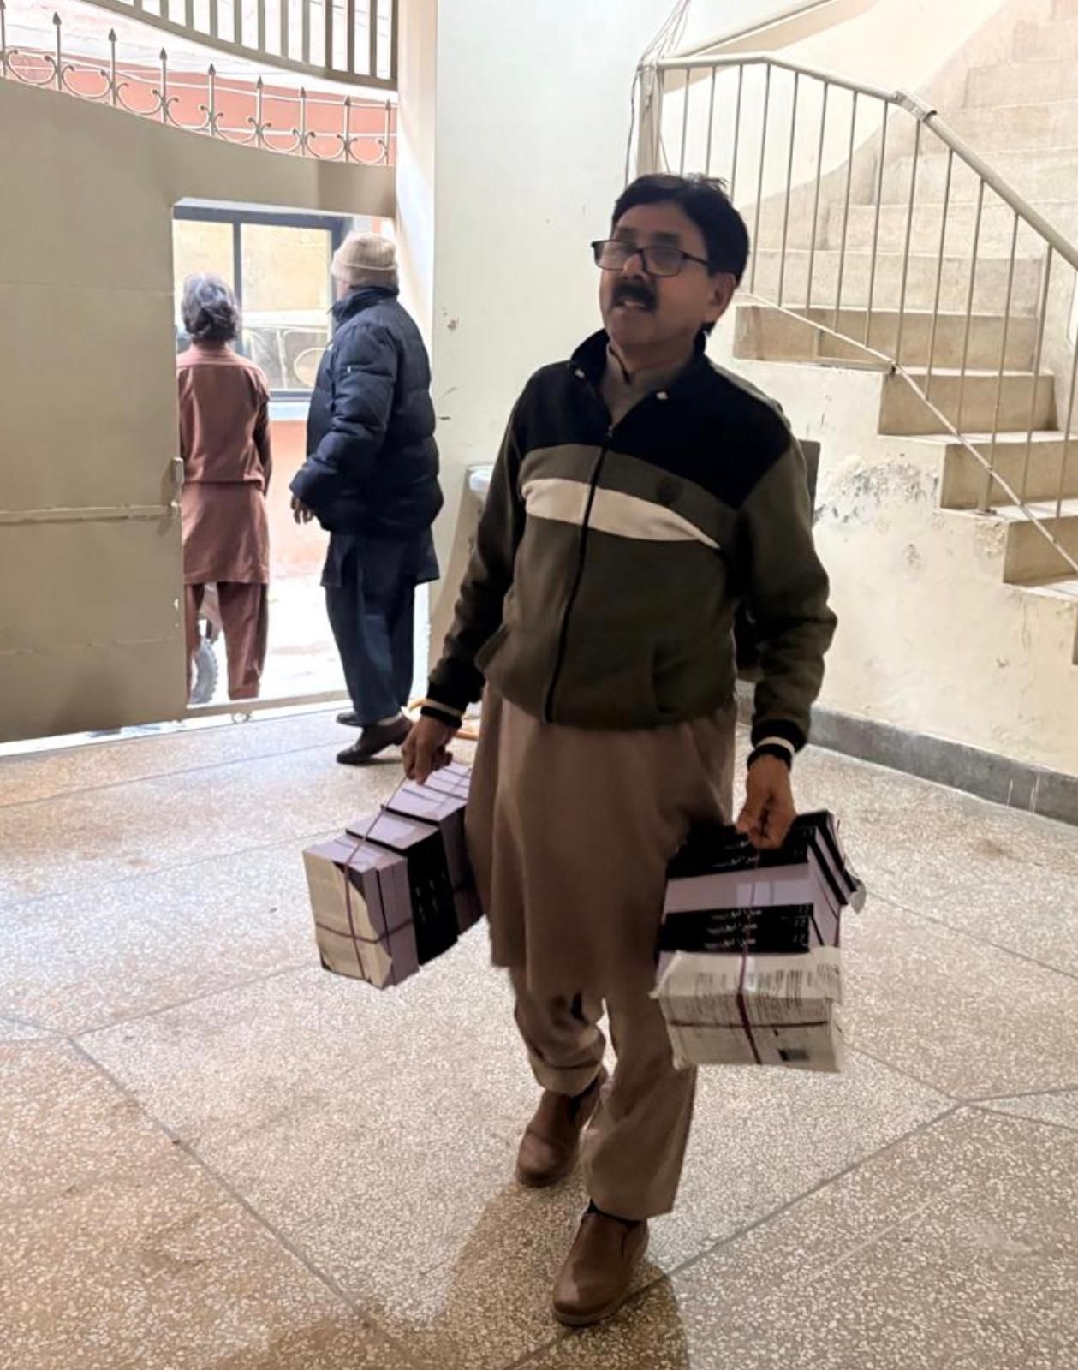
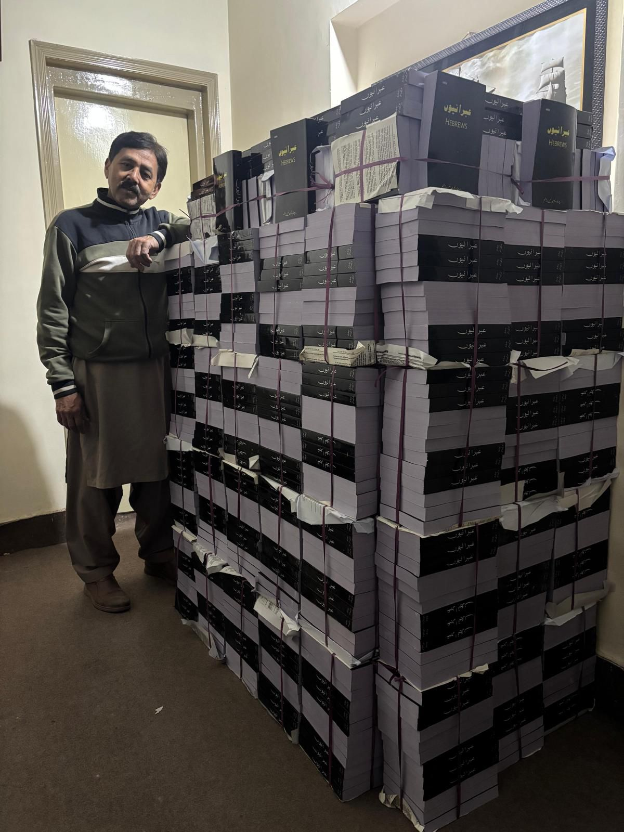
Pakistan

Slide 4

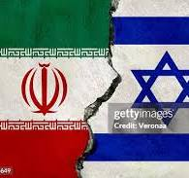

Slide 5
The Spirit Controlled Church & It’s Members 4
ACTS 20:20 (17-24)
And how I kept back nothing that was profitable unto you, but have shewed you, and have taught you publickly, and from house to house, 21 Testifying both to the Jews, and also to the Greeks, repentance toward God, and faith toward our Lord Jesus Christ. 22 And now, behold, I go bound in the spirit unto Jerusalem, not knowing the things that shall befall me there:

Slide 6
UNITY.ONE.GOD.ONE.CHURCH
71 That little compartment in a man's heart, God made that in there for Himself. That's His control room. He sets there to control you. That's His place. That's where He sends His messages from.
How can He work with you when the nature of the spirit of the Devil is there? And every man born on earth is borned in sin, shaped in iniquity, come to the world speaking lies. So, in that carnal Adamic nature, how can a man achieve anything, only through

Slide 7
his intellectuals? But when he comes to be a new creature, the old man has passed out, and the new Man, Christ, takes His throne in the human heart, then life looks different; he starts on a new road from his own selfish motives, till the big ideas to make himself something big, he starts right towards Calvary to recognize God.*
Then his objective, motive, achievement, and all that he is, lays in the glory of the cross, where Christ paid the price for human life. 58-1221

Slide 8
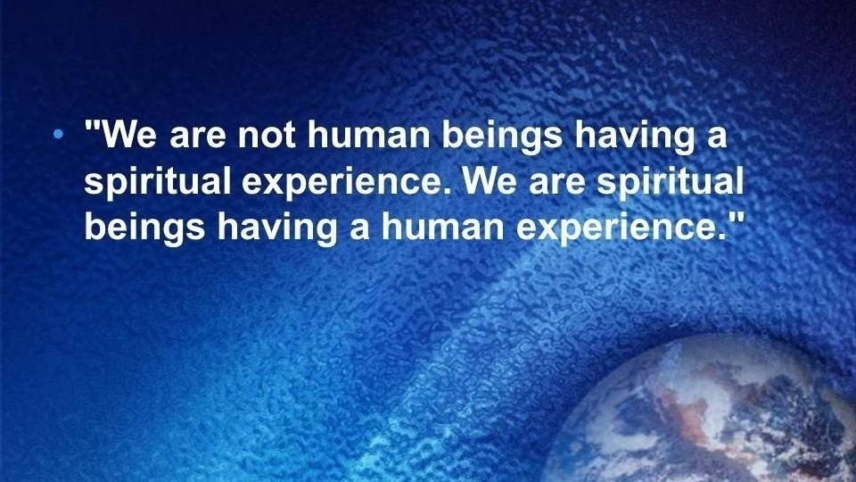

Slide 9
MANIFESTED.SONS.OF.GOD
And Christ brought the church up to the place to where their possession was given to them, just the Jordan to cross, but the Holy Spirit is the One Who sets the church in order, the Joshua of today puts the church in its order, giving to each one, gifts, places, position. And He is the Voice of God speaking to the inner man that Christ has saved: the Holy Spirit. 60-0518

Slide 10
THE.FALLING.APART.OF.THE.WORLD
143 National strife. And now where you ought to think that they ought to be trying to hold together, they're so separated. That's the way it was in the coming two thousand years ago when the world was falling apart. It's falling apart today under the same conditions. And then the church corruption!
62-1216

Slide 11

JOHN 20:22
And when he had said this, he breathed on them, and saith unto them, Receive ye the Holy Ghost:
LUKE 24:49
And, behold, I send the promise of my Father upon you: but tarry ye in the city of Jerusalem, until ye be endued with power from on high.

Slide 12
QUESTIONS.AND.ANSWERS.4
383. Bro. Branham, what is the difference when Jesus breathed on the disciples and said, "Receive ye the Holy Ghost," and when they had to go to the upper room to tarry?
It was a promise He gave them, breathed upon them His promise, said, "Receive ye the Holy Ghost." It was a promise. They went to the upper room to wait for the promise to be fulfilled. The same thing is when we lay hands upon you to be healed, then you go on about your business waiting for the promise to be fulfilled.
64-0830

Slide 13
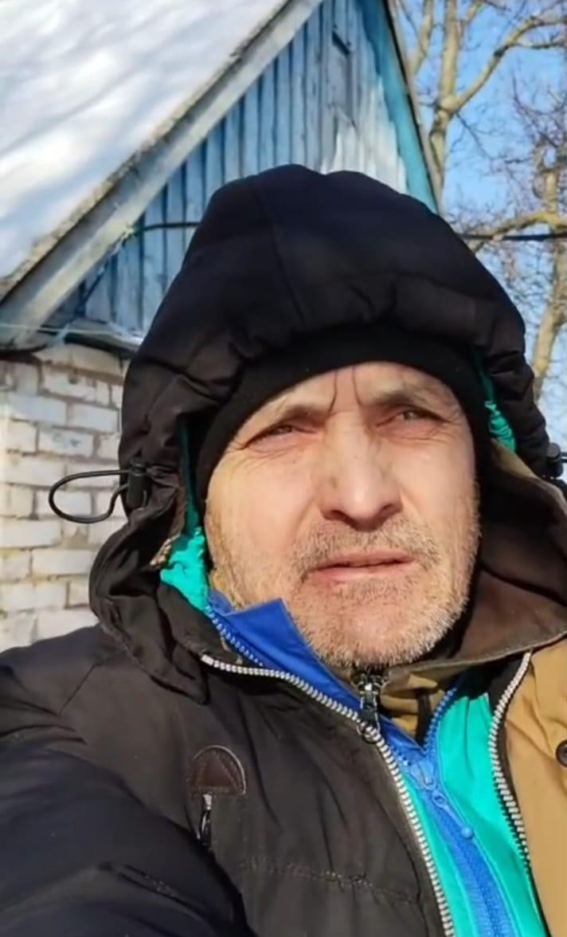
Greetings, brothers and sisters. My name is Ivan. I currently live in a small village near the front line. I cannot leave because I am liable for military service. They could take me away as soon as they see me and send me straight into battle. As a Christian, I do not want to take up arms to kill anyone. Every day, the front line is getting closer and there is frequent shelling.

Slide 14
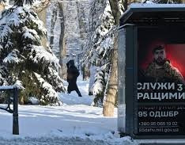
As a result, almost all the houses
are destroyed and the windows are
broken by the shock wave. It is
very difficult to leave the shelter.
I am hiding from the explosions
and from the military, who are
grabbing people and sending them
straight to the front. Almost all the residents have left the village. There is no work and no electricity. Please remember me in your prayers. I believe that the Lord is powerful enough to protect and guide us through the valley of death. I trust in His grace and mercy. He is worthy of glory and honour. Amen.

Slide 15
God is Here
YOU ARE HERE
What shall we then say to these things? If God be for us, who can be against us?
Romans 8:31

Slide 16
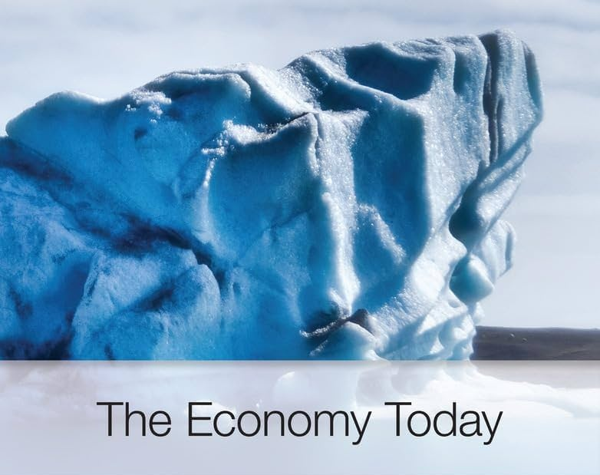
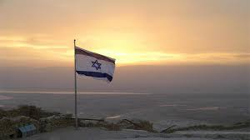
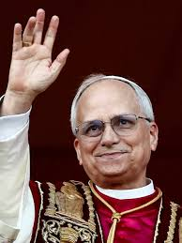
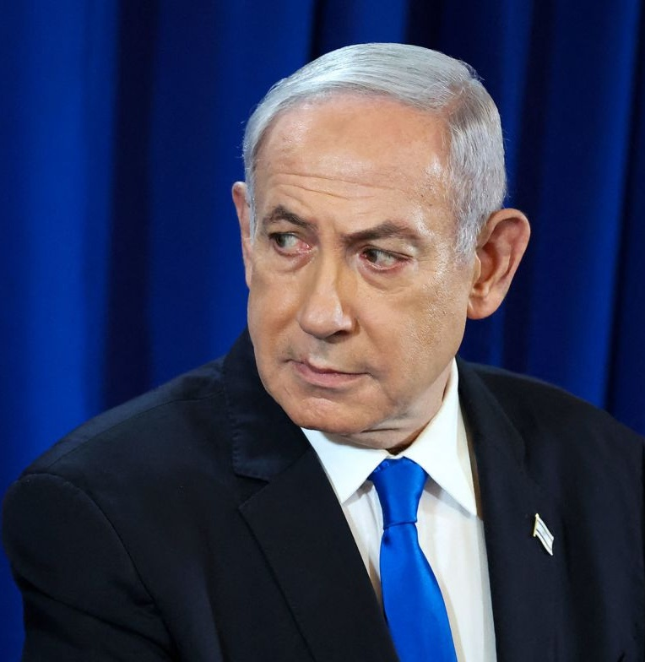
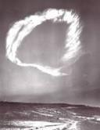
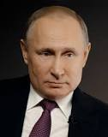
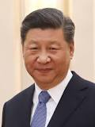
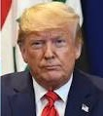
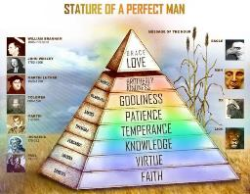
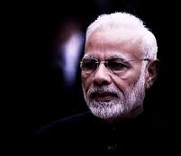
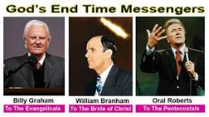
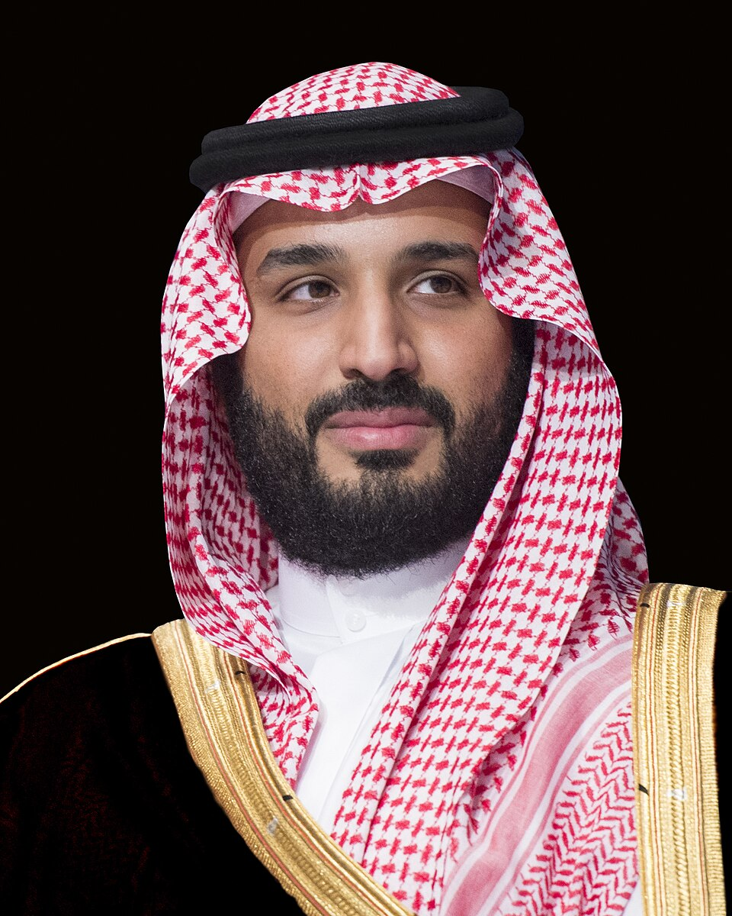
Shout Voice Trumpet I Thes. 4
Perilous Times
Sword
in the Hand
Pestilences
Matt. 24:7
1st Exodus 2nd Exodus
3rd Exodus
Elijah Elisha
John the Baptist Bro Branham
Rev. 11 to Israel
Day of the Lord
Great Falling Away
II Thes. 2
YOU ARE HERE
Fourth Seal Anointing
Malachi 4/Rev. 10:1-7
Bride Age
Days of Lot Days of Noah
II PETER 3:10

Slide 17
THE.REJECTED.KING
36 Our nation used to be governed by real true politics, Christians who'd go together and pray and come out anointed and try to govern our nation. Now, it's just as crooked... They tell me that communist is all over the country, free-thinkers, and all them organizations rising up. And it's just in such a state, there's no stop to it. And it only shows that the true King, the Son of God, is coming to take over and reign… 60-0610

Slide 18
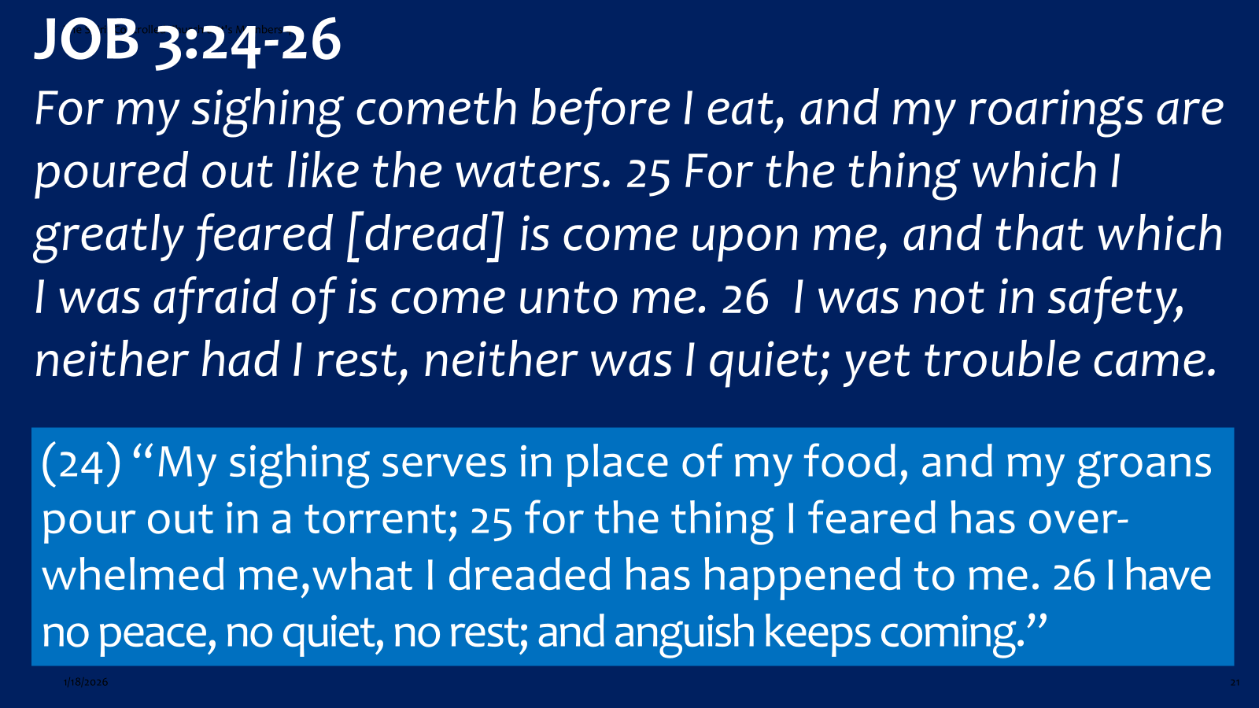

Slide 19

THE.RESULTS.OF.DECISION
38 I said, "The Sabbath is the Holy Ghost. It was at one time limited to a certain people, but today the Sabbath is the baptism of the Holy Ghost.” He said, "Oh, it can't be. God gave the day and sealed it with a memorial that it was a day keeping."
I said, "For a people, but today Eph. 4:30 said, 'Grieve not the Holy Spirit of God whereby you're sealed till the day of your redemption.’ 55-1008

Slide 20
THE.TOKEN
153 When God has give you the true baptism of the Holy Spirit, then the Life of Jesus Christ is within you… It's the new Birth. And because God has did this, you know you're no good in yourself, you accept what God has did, then He seals you into His Kingdom, by the Holy Spirit. Everything that Jesus purchased and promised you, in the Bible, is yours. It's your property because it's paid for. Life is mine; Life is

Slide 21
yours; Healing is mine; He paid for it. Freedom is mine; Heaven is mine… Everything He purchased belongs to the man that holds the Token. Amen. “On that Day of the Judgment I'll pass over you." Holding your confession in the Word, that Jesus Christ has died for you. And when He does it, He displays Himself through you. 63-1128

Slide 22
Example: THE.ANGEL.OF.GOD
5 My little brother brought into the line this boy. He was the most hideous crippled person that I've seen in many years. His arms was drawn down to his legs. But all of a sudden my hand, the vibrations, got real hot. The little child was nine years old… And I laid it upon her little thigh, and something just moved downward. And friends, the four inches lacking on the child's leg was perfect. She put this Bible on her head and walked up-and-down before the audience just as

Slide 23
perfect as anyone could walk. She was healed, over a hour of prayer for her.
6 The next was this crippled boy. After he'd been prayed for for some 35-40 minutes, I could not feel that there was any difference. And after awhile the liberty came. The power that had him bound was gone… The next morning the boy shaved himself. His hands was drawing down; he couldn't even feed or shave himself, walked into the building, pushed his wheelcart up-and-down across the floor for the first time for thirty some odd years.

Slide 24
10 Jesus, our heavenly Father, we're asking you from the very hearts, to come again into Phoenix, in the Name of Thy beloved Son, Christ Jesus, that they will, beyond any shadow of doubt, see the glory of Almighty God manifested, where the deaf and dumb spirits leave the people, the blind to leave, the cripples set at liberty, when the power of Christ comes down to liberate those who are captured and bound by the powers of Satan.
47-1102

Slide 25
Example: AS.THE.EAGLE.STIRRETH.UP.HER.NEST
8 Take a young woman; maybe be married and scared she isn't going to have a baby. She’s so scared she won't have it, she won’t. Just like Job said, "The things that I've feared the most come upon me." You take that same woman and let her adopt a baby, then she'll have one herself. It quietens her. Now, if you haven't got enough faith, to receive it right now as a miracle, take the adopted baby attitude. "Lord, it's mine because You promised it...” And if you can feel just a least little speck of faith that tells you that you'll be all right, you believe it. 59-0815

Slide 26

WHAT.HEAREST.THOU.ELIJAH
47 If there's something in your life condemns you, better make that thing right. You just can't operate right. The Holy Spirit can't deal with you. When you got prejudice, selfishness, the Holy Spirit can never bless you. You might get some intellectual emotions, some work-up.
For instance, a women gets married, and she's afraid that she's not going to have a baby. Job said, "The things that I feared worse is come upon me." You want to be above everything, where there's no condemnation… You got to live like real Christians. Live in the Presence of God. Live daily, hourly, momently…Let me tell you, God wants separators... 59-0609

Slide 27
WHAT.HEAREST.THOU.ELIJAH
49 Let me show you something. What if Joseph here, wanted to defend a friend of his. And so he tried to say that he was in Philadelphia on Tuesday night 'cause he has to defend that friend. See, he can say that intellectually. But way down in his soul, he knows it's wrong. So they bring him to trial. "Mr. Boze, do you solemnly swear that you was at Philadelphia at a certain-certain place on Tuesday night, June 9th, 1959?"

Slide 28
"I solemnly swear I was right here with my friend, at a certain-certain place."
"Go get the lie detector, fasten it across his wrists." He say, "Now, I've got to make it out to look right." He can put a big face on. "Yes, sir, my most precious friend…” That lie detector's saying, "He's telling a lie." Why? Intellectually, he's trying to make it look right; he's speaking it right. But his heart says "No." That's his soul. That's where God lives. Man wasn't made to tell a lie. Man was made to tell truth. 59-0609

Slide 29
Example 1: LUKE 13:14-16
And the ruler of the synagogue answered with indignation, because that Jesus had healed on the sabbath day, and said unto the people, There are six days in which men ought to work: in them therefore come and be healed, and not on the sabbath day. 15 The Lord then answered him, and said, Thou hypocrite, doth not each one of you on the sabbath loose his ox or his ass from the stall, and lead him away to watering? 16 And ought not this woman, being a daughter of Abraham, whom Satan hath bound, lo, these eighteen years, be loosed from this bond on the sabbath day?

Slide 30
Example 2: LUKE 8:28-29
When he saw Jesus, he cried out, and fell down before him, and with a loud voice said, What have I to do with thee, Jesus, thou Son of God most high? I beseech thee, torment me not. 29 (For he had commanded the unclean spirit to come out of the man. For oftentimes it had caught him: and he was kept bound with chains and in fetters; and he brake the bands, and was driven of the devil into the wilderness.)

Slide 31
Example 3: ACTS 20:20
And how I kept back nothing that was profitable unto you, but have shewed you, and have taught you publickly, and from house to house, 21 Testifying both to the Jews, and also to the Greeks, repentance toward God, and faith toward our Lord Jesus Christ. 22 And now, behold, I go bound in the spirit unto Jerusalem, not knowing the things that shall befall me there: 23 Save that the Holy Ghost witnesseth in every city, saying that bonds and afflictions abide me.

Slide 32
“Faith is deliberate confidence in the character of God whose ways you may not understand at the time.” Oswald Chambers
“Faith is what you do not see; it's what you believe, you do not see it, but there's something inside of you sees it. And that's God that's inside sees His own Word being made manifest.
56-1002 FATHER.THE.HOUR.HAS.COME

Slide 33
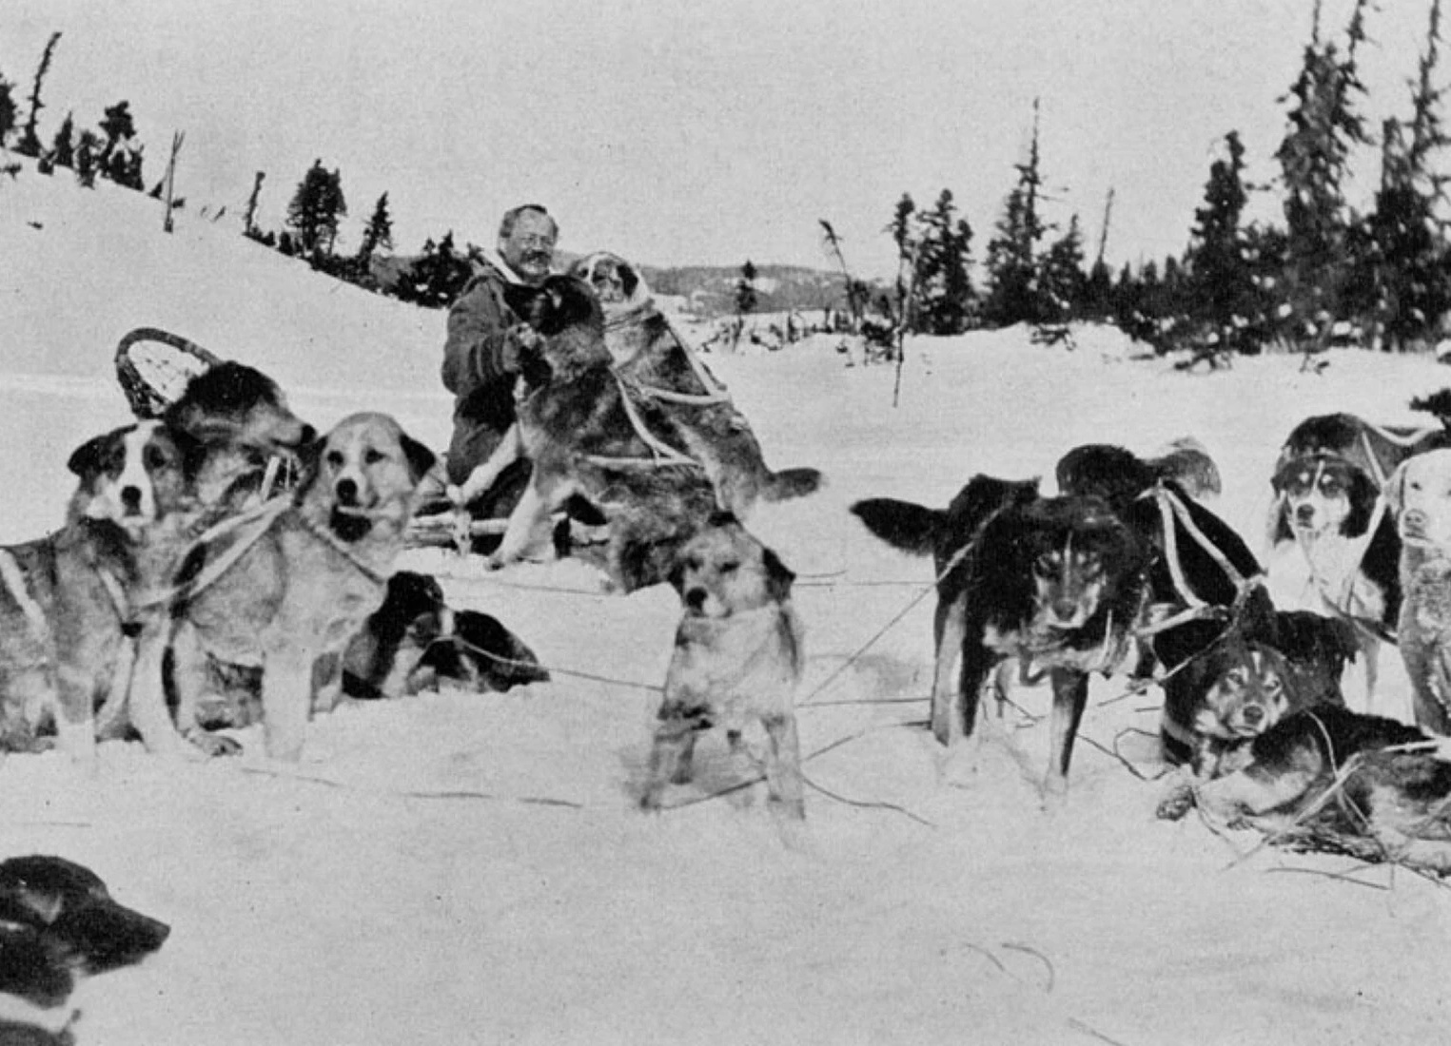
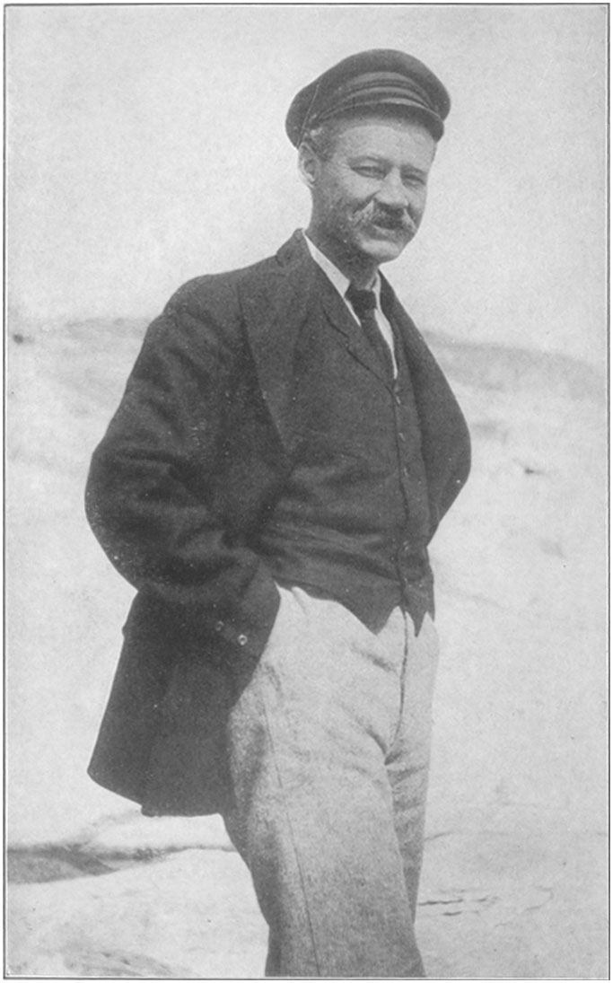
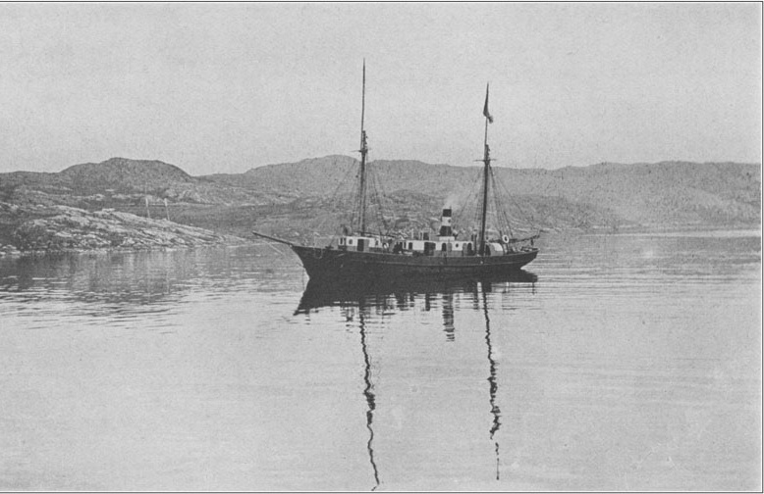
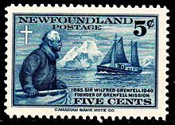
Sir Wilfred Grenfell (1865-1940)

Slide 34
Sir Wilfred Grenfell, medical missionary in Labrador, found himself adrift on an ice flow, headed out to sea.
He mercifully killed his dogs, made a coat out of their hides, put up a distress flag, and lay down and slept. Later he said, "There was nothing to fear. I had done all I could, the rest lay in God's hands."

Slide 35
JEHOVAH.JIREH.3
10 Every Word is true. I may not have faith enough to make every Word of It act, but I certainly wouldn't stand way of anybody that did. Enoch had faith enough, one day to take an afternoon stroll with God, and just kept on walking, went up Home without dying.
Now, I think the Church has got to come to that, to a Rapturing faith. 64-0404

Slide 36
THE.SIGNS.OF.HIS.COMING
19 God will always give a sign of warning, before something happens.
62-0407
GOD.HATH.A.PROVIDED.WAY
Before these great disasters happen, God always gives a warning and makes a way of escape. He prepares it.
56-0108

Slide 37
WORLD.IS.AGAIN.FALLING.APART
13 The last name's redeemed, put on that Book that settles it, He comes to claim what He redeemed. And it might be a strange time: people will go right on preaching, the church will go right on even thinking they're getting people saved. It's too late then, it's all over and the Message will go to the totally lost… And we don't know what time these things might happen. 63-1127

Slide 38
ISAIAH 60:1-3
Arise, shine; for thy light is come, and the glory of the LORD is risen upon thee. 2 For, behold, the darkness shall cover the earth, and gross darkness the people: but the LORD shall arise upon thee, and his glory shall be seen upon thee. 3 And the Gentiles shall come to thy light, and kings to the brightness of thy rising.

Slide 39
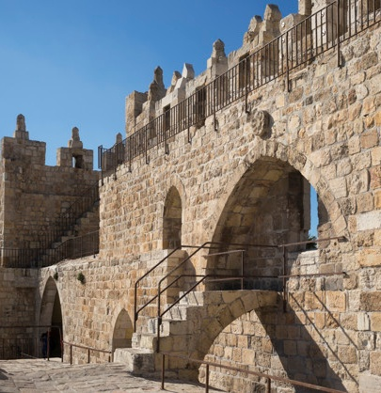
Is. 62:10-12
Go out through the gates! Prepare the highway for my people to return! Smooth out the road; pull out the boulders; raise a flag for all the nations to see. 11 The Lord has sent this message to every land: Tell the people of Israel, ‘Look, your Savior is coming. See, he brings his reward with him as he comes.’”
(NLT)
Salvation
Praise

Slide 40
THE.LAMB'S.BOOK.OF.LIFE
69 Anything that you have need of, no matter what it is. If it's sickness, healing; if it's a trouble, and you have need of relief; if you're wearied and bothered, need of peace, come now, won't you?
You see, it's a work of the Holy Spirit. He does this. Not emotional, solid, deep, not fanatically, it's not formal. 56-0603

Slide 41
PREPARATION
51 There's more than a jawbone of a mule laying next to you tonight. Let's get up and do something about it. Let's forsake thee old cots, stretchers, wheelchairs, crutches, and say, "It belongs to the devil. I have no more to do with it."
I claim Jesus Christ's Word's right. Claim your God given privileges, and the devil hasn't got any privilege, one legal power over any believer. He was stripped and robbed at Calvary.

Slide 42
WHY.SO.MANY.CHRISTIANS. FIND. IT. SO HARD TO.LIVE. THE. CHRISTIAN .LIFE
55 Intellectual will never do it. Mental conception will never do it. It's the work of the Holy Spirit that brings the human being to his place.
57-0303

Slide 43
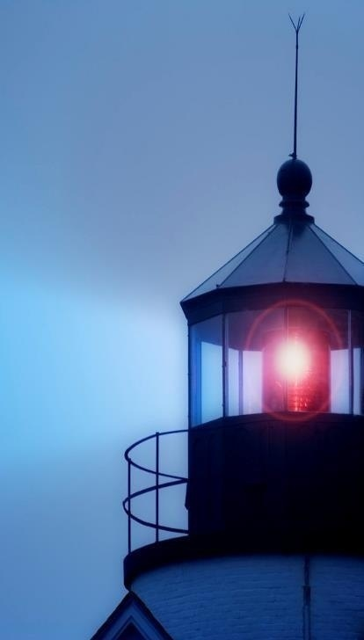
“…at evening time it shall be light.”
I JOHN 1:7
But if we walk in the light, as he is in the light, we have fellowship one with another, and the blood of Jesus Christ his Son cleanseth us from all sin.

Slide 44
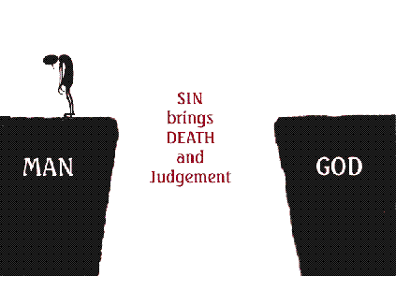

Slide 45
